Slide 1
Global Precipitation Measurement
Walt Petersen
GPM Deputy Project Scientist for Ground Validation
Chief, Earth Sciences Office of Field Support
NASA’s Goddard
Space Flight Center
CoCoRaHS Webinar
February 18, 2015
Notes:
Title slide

Slide 2
Notes:
Rain affects everyone on Earth
-- rain, snow and ice are one of the primary sources of freshwater for people around the world

Slide 3
Notes:
Four applications of GPM data (snowstorm in Ontario, Canada; storm track of Hurricane Katrina; landslide vulnerability map from TRMM data; Cedar Rapids, Iowa, flooded in 2008)
GPM applications include
-- predicting storms and getting an accurate measurement of snowfall
-- providing new data to better understand how hurricanes move and intensify
-- providing information about what areas are vulnerable to landslides
-- predicting floods

Slide 4
Notes:
Four more Applications of GPM data (water faucet for drinking water, Famine Early Warning System, World’s Freshwater Supplies, life cycle of Schistosomiasis correlated to flood events)
-- snowpack and rainwater replenish aquifers and reservoirs used for drinking water and water for agriculture
-- rain data aids projections of freshwater availability around the world
-- in turn, this helps with agriculture projections and famine early warning systems, especially in Africa where rainfall is scarse in many regions
-- knowing where and when it rains also helps with world health in the cases of diseases that flourish when rainwater is high. In the example above, snails that are carriers of Shistosomiasis reproduce rapidly in wet conditions. Their presence, and the spread of Schistosomiasis, is correlated with high rainfall.

Slide 5
Notes:
Water cycle
-- water endlessly moves through the water cycle
-- precipitation is the part that we can see and touch the most easily
-- the water cycle is part of the wider Earth and climate system
-- understanding the processes of how storms form, and how rain and snow behave in the atmosphere improves our understanding of our planet

Slide 6
Notes:
GPM Core Observatory
-- GPM Core Observatory provided by NASA and Japan Aerospace Exploration Agency (JAXA)
-- The GPM Core Observatory was built at NASA’s Goddard Space Flight Center and is the largest satellite ever built and assembled at Goddard
-- has two advanced instruments, a Dual-frequency Precipitation Radar (DPR) and a GPM Microwave Imager (GMI)
-- the data collected onboard the GPM Core Observatory will serve as the reference standard for the data collected by the constellation satellites, so it can all be combined into a consistent precipitation product available globally every 3 hours

Slide 7
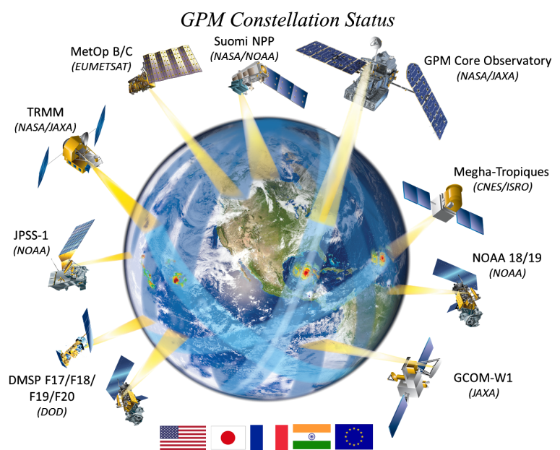
Notes:
GPM Constellation
-- Satellites can get the view from above and see the whole world
-- The GPM mission is an international satellite mission led by NASA and the Japan Aerospace Exploration Agency (JAXA)
-- It is a multi-country partnership that collects rain data from multiple satellites to get a global map of rain data every three hours
-- The GPM Core Observatory is the satellite that unifies the measurements into a global data set
--The other satellites that contribute data to the GPM mission each have their own scientific or operational goals

Slide 8
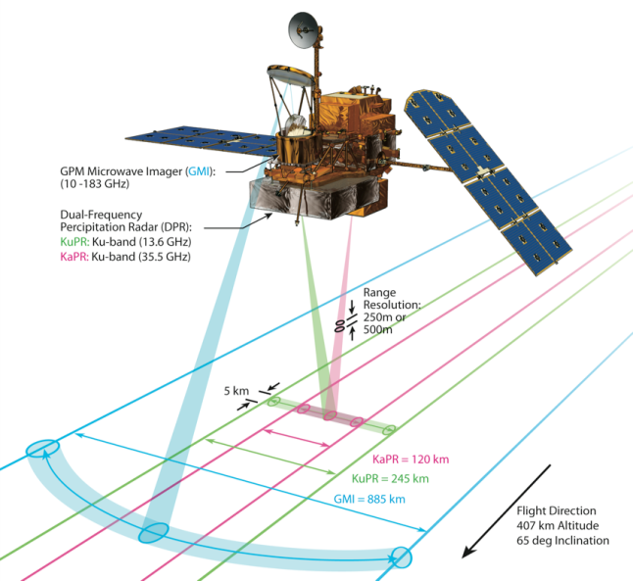
GPM Core Satellite Key Instruments
GPM Microwave Imager (GMI)
Dual Frequency Precipitation Radar (DPR)

Slide 9
How the Instruments Work
http://svs.gsfc.nasa.gov/goto?11253
Notes:
Video: What the instruments measure inside clouds
URL: http://svs.gsfc.nasa.gov/goto?11253
-- animation begins with GMI. Purple upward pulse indicates naturally emitting energy from the ground and precipitation
-- each channel on the instrument is sensitive to different types of precipitation
-- lower frequency (10 to 37 GHz) channels are more sensitive to raindrops, middle frequency channels (37 to 166 GHz) to both liquid and ice particles, higher frequency channels (166 to 183 GHz) to snow and ice
-- the DPR sends down two pulses. The Ka-band is more sensitive to ice in the upper part of the cloud and the Ku-band is more sensitive to liquid rain lower in the cloud

Slide 10
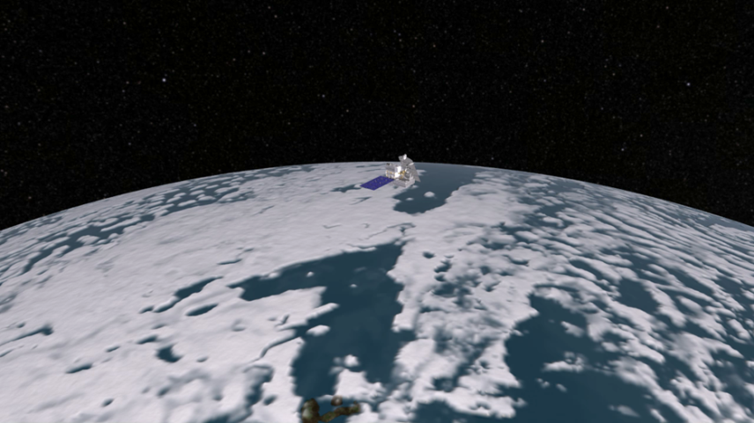
How the Instruments Scan
http://svs.gsfc.nasa.gov/goto?4016
Notes:
Video: The GPM Core Observatory’s instruments collecting data
URL: http://svs.gsfc.nasa.gov/goto?4016
-- this video shows how the DPR and the GMI collect precipitation data
-- first it shows the Ka-band radar, whose ground swath (75 miles or 120 km) is nested inside the Ku-band radar’s swath (152 miles or 245 km). They make 3D observations of precipitation
-- next, the GMI data covers a wider swath (562 miles or 904 km)

Slide 11
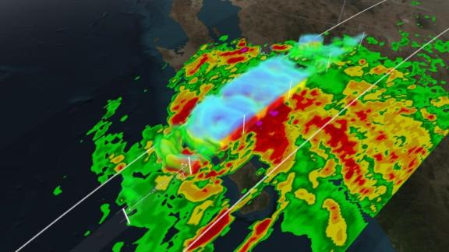
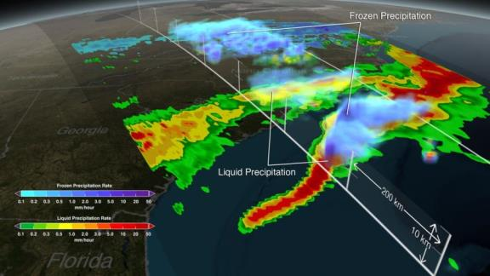
Hurricane Odile & March Snow Storm
Click here for movie
Hurricane Odile
Category 3, near Baja California
Sept. 15, 2014
after it made landfall
Mid-Atlantic States
Snow event,
March 17, 2014
(DC- 18 cm snow)
Transition to deep thunderstorms over the Gulf Stream
Click here for movie

Slide 12
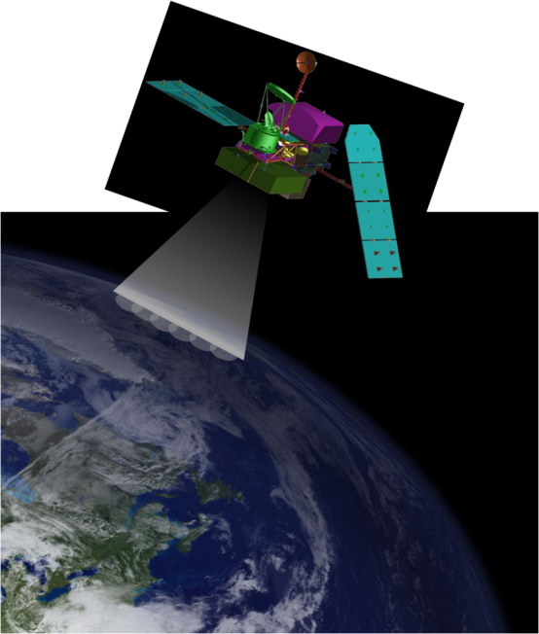
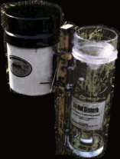
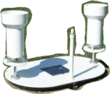
GPM Satellites estimate precipitation but are not rain gauges
Remote Sensing
Area measurement
Diameter of “Best” area measurement resolution for GPM is ~3.2 miles/ 5 km
Typical Gauge diameter
4 – 12 inches/ 10 – 30.5 cm
(~2.5 billion to 270 million x smaller than a GPM pixel area!!)

Slide 13
Connecting the ground to space
GROUND VALIDATION (GV)
Three Basic Approaches
Direct Comparison (surface):
Satellite estimates compared to rain gauge and radar products
Physical Process: (surface and airborne)
Improving our understanding of precipitation physical characteristics and how they relate to remote sensing
Integrated Hydrometeorology: (surface)
End to end evaluation of satellite and ground-based products in hydrologic/weather/climate applications
Notes:
An end to end tracing of GPM products, algorithm physics and product errors to water resources applications at different scales

Slide 14
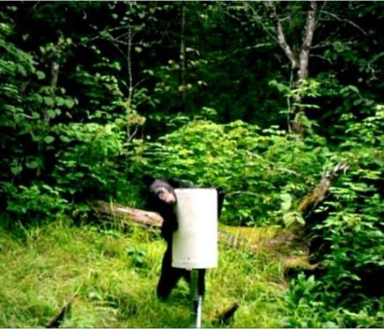
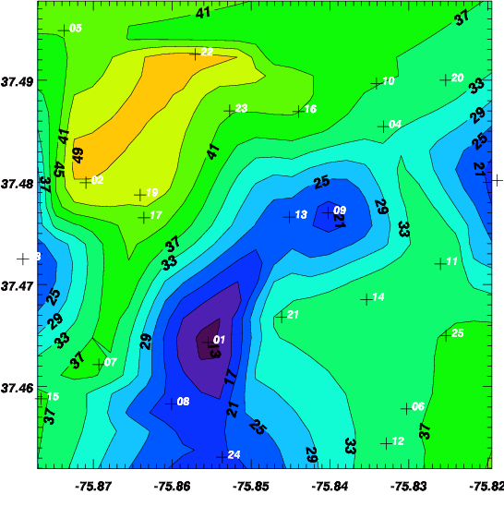
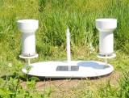
Why not just use rain gauges for GV?
Rain gauges are important, but only measure at a point
Gauges are weather, site, and “nature” sensitive- all affect measurement quality.
“Where’s the honey?
GPM Dense Raingauge Network
(25 dual-platforms in 5 x 5 km² area)
5/30/2013: Daily rain accumulation
>250% difference!
Rain is HIGHLY variable in space and time. Measuring it accurately over areas the size of satellite footprints can be challenging.
Need as few as 4 but as many as 15 gauges in a single GPM footprint to get accurate area measurement! (depends on accumulation time)
Large networks of recording gauges are required and these can be difficult/costly to maintain.
3 miles

Slide 15
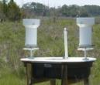
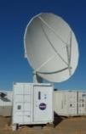
GV Measurements required at a multitude of scales
Radars function as the “BRIDGE”
Gauge Network
(100 m – 10000 m)
Radar
(volume)
Satellite
Gauge (point)
(pixel, column)
100 m to 4 km
4 km - 50 km
Scanning radiometer/radar
ΔX
Scanning Precipitation Radar
We focus on complementary use of radars and ground networks
Radar rain mapping over a larger area (> 10,000 km²)
Radar Ability to “probe” clouds in 3-D at high space-time resolution
Reference to reliable ground measurements (gauge networks)

Slide 16
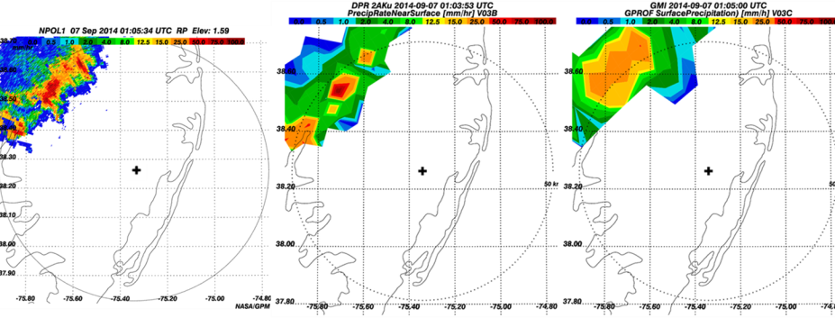
GPM vs. Ground Radar: Resolution matters!
GPM Overpass of NPOL Radar near NASA Wallops Flight Facility Site
NPOL RADAR
150 m x 750 m
GPM Radar
5000m x 5000 m
GPM Radiometer
5000 m x 5000 m
Ground radars can map precipitation similar to a “dense” rain gauge network, but over a much larger area: Good for satellite comparisons
High-resolution radar data are used to study how precipitation “fills” GPM footprints and how footprints can be further “downscaled”

Slide 17
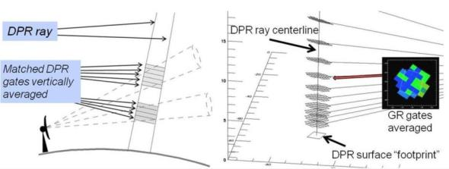
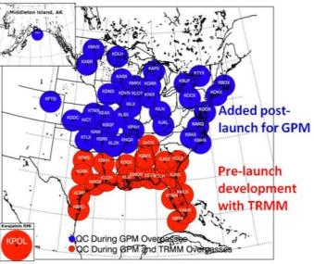
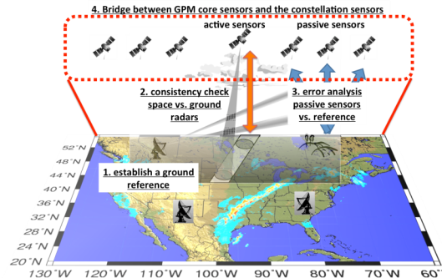
Direct GV: “Operational” Radar and Rainfall Measurements
1) Ground radar matching to GPM instruments (rain rates, precipitation types, sizes…..)
2) NOAA “Multi-Radar Multi-Sensor” http://nmq.ou.edu / 1-km²/2 min resolution
Blend of radar and rain-gauge data
We then compare highest quality data, or a ground reference, to GPM products

Slide 18
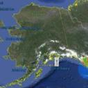
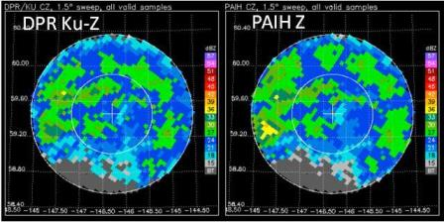
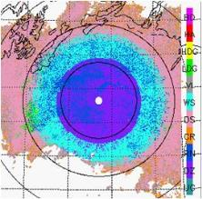
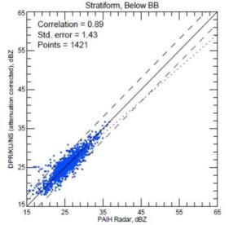
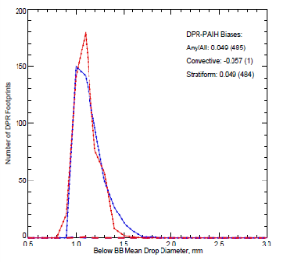
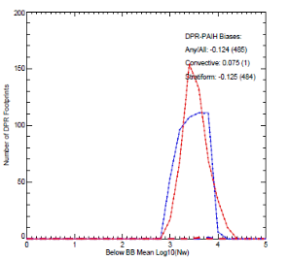
GV vs. GPM DPR radar measurements: Rain Drops
Middleton Island, Alaska (PAIH) NEXRAD Radar August 14, 2014
Light to moderate rain over Pacific Ocean
PAIH Precipitation Types
Rain and Drizzle
Melting Snow
Snow
Ground vs. GPM comparisons of reflectivity, rain drop sizes, and numbers- Looks good!
Radar Reflectivity
Rain Drop sizes
Rain Drop Numbers
(RAIN)
DPR
PAIH
PAIH
DPR
DPR
PAIH

Slide 19
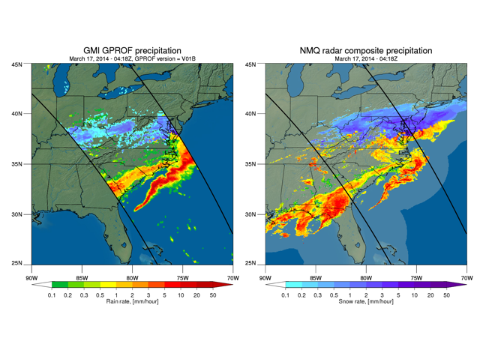
GV vs. GPM GMI Radiometer Measurements: Rain and Snow
Post-Launch
GPM Radiometer (GMI) Precipitation Compared to GV
Snow
Rain
Snow
Rain
Generally good first results in snow and rain!!
However, also some “misses” ……(see circle)- why?

Slide 20
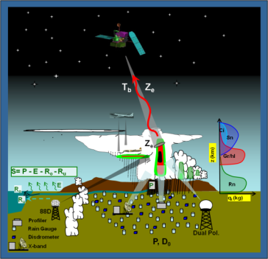
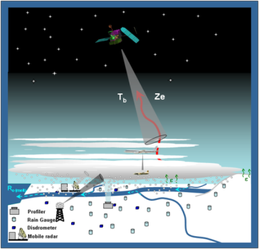
GPM Ground Validation
Getting the Physics Right: GPM Field Campaigns
Warm season
Rain
Cold season Snow/ice
GPM must produce accurate precipitation estimates using remote sensing over a broad range of rain and snow conditions- difficult proposition!
Ground and airborne field measurements of precipitation physics to improve satellite-based remote sensing methods for estimating precipitation

Slide 21
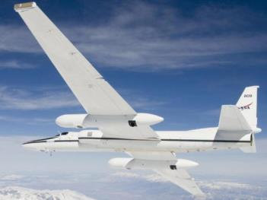
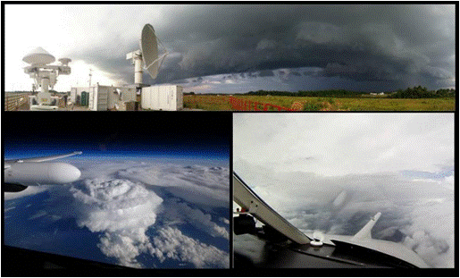
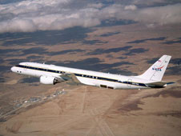
Research Aircraft
Connecting satellite, cloud and ground measurements
High Altitude “Satellite Simulators”
Cloud-Penetrating Aircraft
NASA ER-2
Gust probe
Cloud probes
UND Citation
Views from ground radars, ER-2, and Citation
NASA DC-8

Slide 22
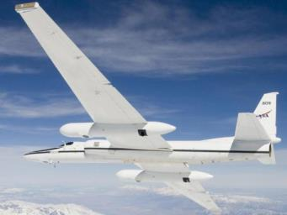
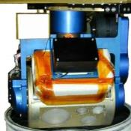
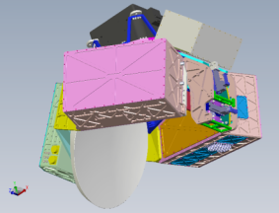
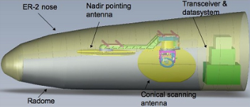
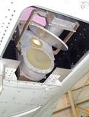
Radars and Radiometers on The ER-2
CoSMIR Radiometer
Pod
EXRAD Radar
Nose
AMPR Radiometer
Q-Bay
HIWRAP
Pod

Slide 23
Example of Working Airplanes in a Strong Thunderstorm
(IPHEx Field Experiment 2014)
ER-2
Citation
Citation stays out of the strongest thunderstorm core (areas in red shown on the radar); We loop the ER-2 over the top of the severe portion of storm and then over the Citation on his return leg (sampling both heavy and lighter precipitation).
Ground-based “dual-polarimetric” radars provide us a “look” into the strongest part of the thunderstorm where the Citation cannot penetrate but the ER-2 can fly over.

Slide 24
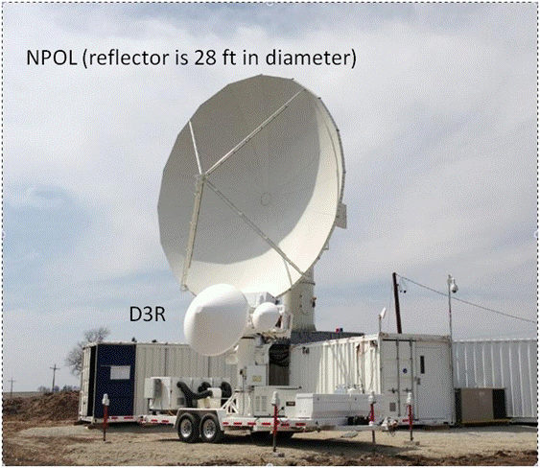
NASA NPOL and D3R Dual-Polarimetric Radars
NASA’s Research GV Radars
NPOL- S-band (10 cm wavelength)
D3R – Ka/Ku Band (0.86 and 2 cm wavelength; matches GPM DPR)
Scan storms in 3-D, more accurately measure precipitation characteristics (types, numbers, sizes, rainfall rate) from the ground to tops of clouds. This provides a science reference for measurements the satellites make as they look down from space

Slide 25
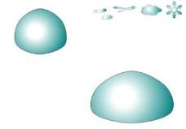
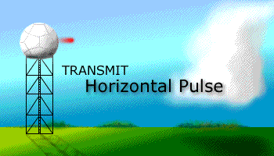
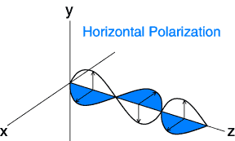
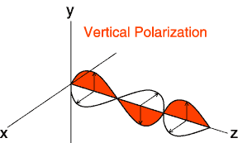
Ground-Based Polarimetric radars?
Better detect sizes, type, numbers of precipitation
Conventional
Radar (NEXRAD)
Polarimetric
Radar (ARMOR)
Courtesy T. Schuur, NOAA CIMMS

Slide 26
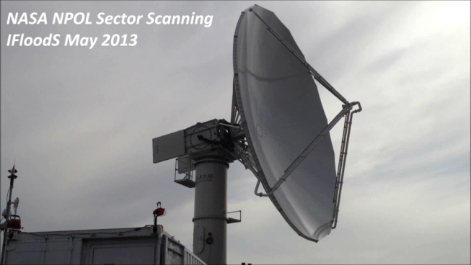
How do we scan with radars? (I)
Horizontal Plan Position (PPI) scanning
Send out 1100 pulses/second over a sector or full 360º scan at 1 - 20 elevation angles
Used for mapping precipitation and its variability

Slide 27
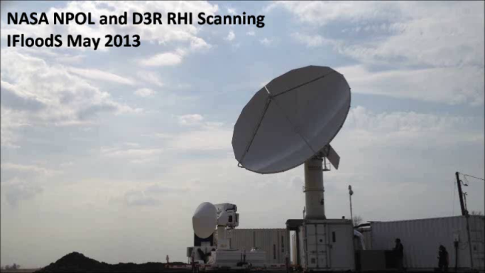
How do we scan with radars? (II)
Radar Range-Height Scanning (RHI’s) modes
NASA NPOL and D3R Radars
Vertical cross sections or “Slices” of the atmosphere
Studying the precipitation physics a satellite “sees”

Slide 28
Rainfall: Dual-Rain Gauge Networks
Ground State: Soil Moisture and Temperature
Dual-gauges ensure measurement consistency
Networks provide a reference for radars
Soil probes connect precipitation to ground hydrology and energy balance

Slide 29
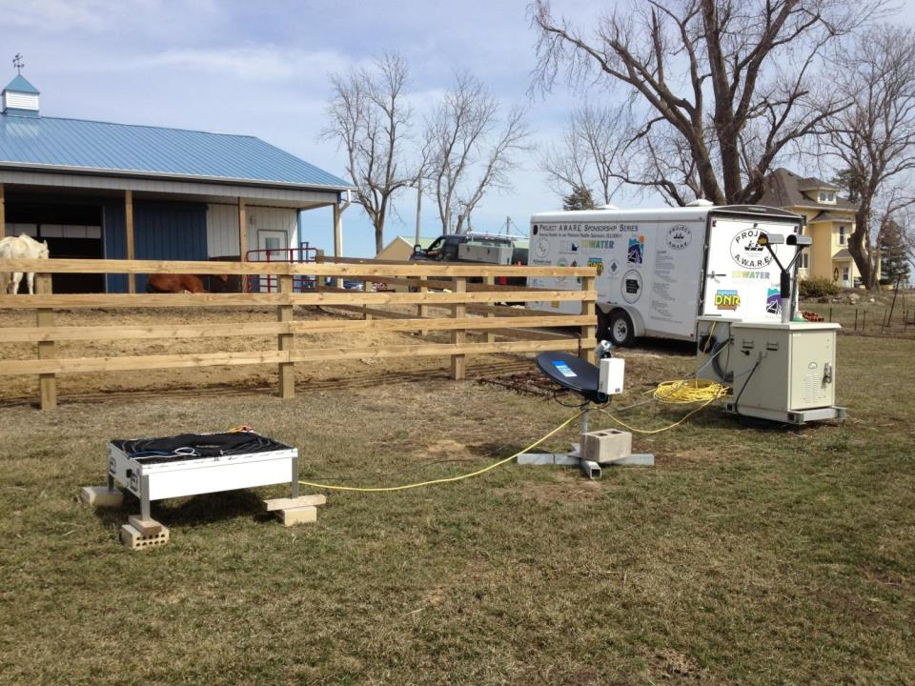
Precipitation Particle Measurements
2D Video Disdrometer
Drop sizes, numbers ,shapes, type fallspeed
Parsivel Laser Disdrometer
Drop sizes, number, type fallspeed
Micro Rain Radar
Vertical profile of precipitation properties
Reference for polarimetric radar estimates

Slide 30
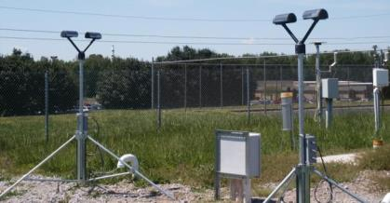
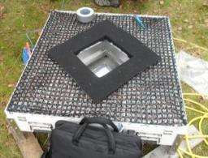
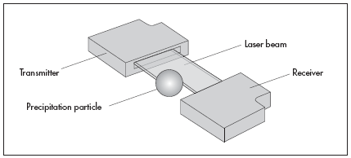
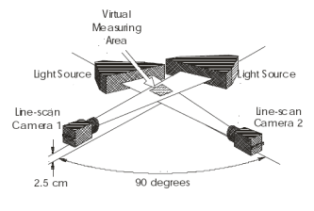
Parsivel Laser Disdrometer
2D Video Disdrometer
Operation:
Laser signal blocked when particle passes through beam
Measurement:
Particle diameters and size distribution fall speeds, types (rain, snow), precipitation rate
Operation:
Two perpendicular light sheets project onto line-scan cameras. Falling hydrometeors cast a shadow recorded by cameras
Measurement:
Particle diameters (2-D) and shapes, numbers, fall speeds, type (rain, snow, hail), precipitation rate

Slide 31
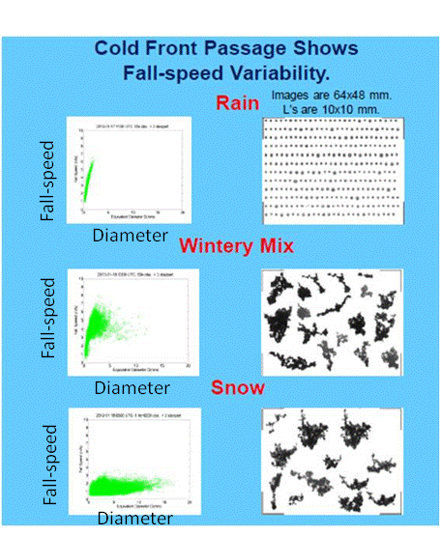
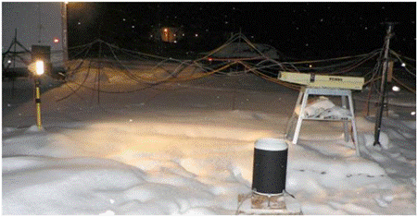
Snow: Precipitation Imaging Package
Size, shape, and fall speeds of snow
Image, track, size, count, each snow crystal/flake
Systems in Virginia, Michigan, Washington, Canada, Finland

Slide 32
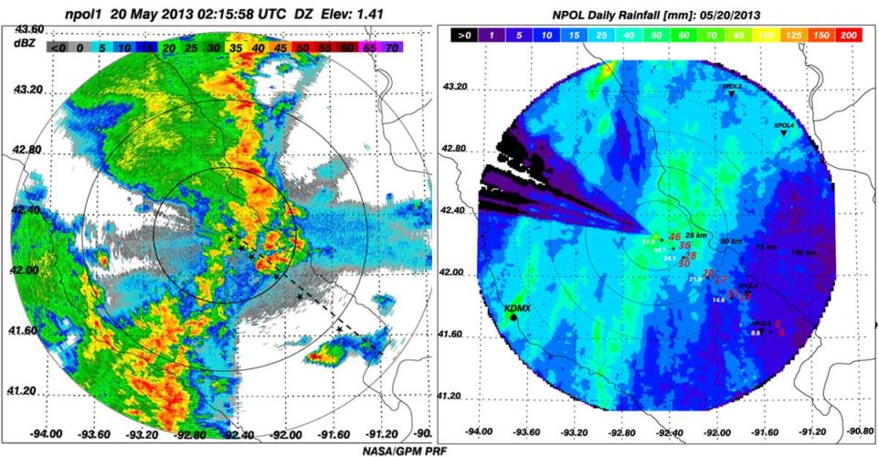
Putting it all together: Radar Map of Rain
“Standard” PPI of Radar Reflectivity
Radar-Derived Map of 24-Hour Rainfall
Combine ground and radar measurements for “reference” rainfall maps
Use reference maps for satellite comparisons and flood modeling studies.
Use what we learn about rainfall process to improve satellite estimations methods

Slide 33
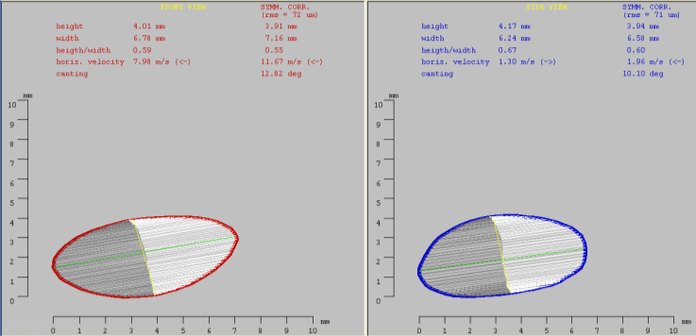
Disdrometers: What did the precipitation “look” like?
Characterize rain size, shape and numbers as it falls.
“Oblate” large rain drops
~ 1/3 inch
“Spherical” Small Hail
Reference for radar identification of precipitation type and size

Slide 34
Define the Physical Process: What satellites are “seeing”
NPOL Radar also “slices” the storm with RHI scans
The “process” : Ice to Rain
Graupel becomes hail and/or rain freezes and rimes to become hail
Rain drops
(melting snow, hail, graupel)
Snow rimes
Graupel is formed

Slide 35
Sampling a Deep Storm Top to Bottom
5/23/2014 Northern S. Carolina
View from ER-2 at 65,000 feet
Advanced Microwave Passive Radiometer “sees” ice
NPOL Radar: slices the storm from bottom to top
Picture: D.S. Broce, AFRC
50,000 foot echo top, hail core 39,000 feet, golf ball to tennis ball-sized Hail
walt.petersen@nasa.gov
Notes:
ER-2 sampling from IPHEX showing the data collection vantage point from the ER-2, with AMPR brightness temperatures and then the coinciding view from the ground via NPOL (theme here again is the “complete” picture of the physics from top to bottom). Airborne and ground-based instruments provide a complementary view.

Slide 36
Snow from Top to Bottom 1/30-31, 2012
DC-8 Airborne (satellite)
Stacked Legs (DC-8/Citation)
Citation Airborne (cloud)
Snow microphysics profiles
Grnd. Instruments (surface)
Regional to Particle Scale
King City
C-band Radar
Ku
D3R Radar Ku-Band
DC-8 APR-2 Radar
DC-8 CoSMIR Radiometer
Ku
Ka
U. Manitoba Imaging Camera
Ka
PIP Size Distributions
And images
Left: Snow event as viewed from the air by DC-8 above, Citation Aircraft in cloud;
Right: Ground observations via radar, particle sizing instruments, and imaging

Slide 37
Walt.petersen@nasa.gov

Slide 38
GV is a Global Effort!
International cooperation to connect what is observed at the ground and in the clouds (e.g., rain, snow, ice), to what is observed from space
GPM GV: Map- we are everywhere….and when we are not there we are here
National Network
collaboration
Instruments deployed (current)
Field campaigns since 2007
OLYMPEX Field Campaign (2015/16)

