Slide 1
GLOBE International Virtual Science Symposium K-4 (Lower Primary) Research Reports 2017 www.globe.gov
http://www.globe.gov/science-symposium
Notes:
Introduce Julie and Matt

Slide 2
Presenters
Lynne Hehr
lhehr@uark.edu
Director
GLOBE Implementation Office
UA Center for Math and Science Education
Arkansas NASA Educator Resource Center
Julie Malmberg, PhD
malmberg@ucar.edu
Education, Outreach, and Technology Specialist
GLOBE Implementation Office

Slide 3
GLOBE International Virtual Science Symposium
http://globe.gov/science-symposium
Online space for students to share and discuss GLOBE research with other students, scientists, GLOBE community
Open to all GLOBE students K-16
Rubrics by grade level
Notes:
Ask who is in audience – teachers? Scientists?

Slide 4
Timeline
http://globe.gov/science-symposium
Entries accepted starting in early 2017 (look for announcements)
Projects Due: 03 April 2017
Scoring & Comment Period: 23-29 April 2017
Badges Announced: 15 May 2017
Live Drawing: 15 May 2017
GLOBE Annual Meeting: July/August 2017

Slide 5
Rubrics
http://globe.gov/science-symposium

Slide 6
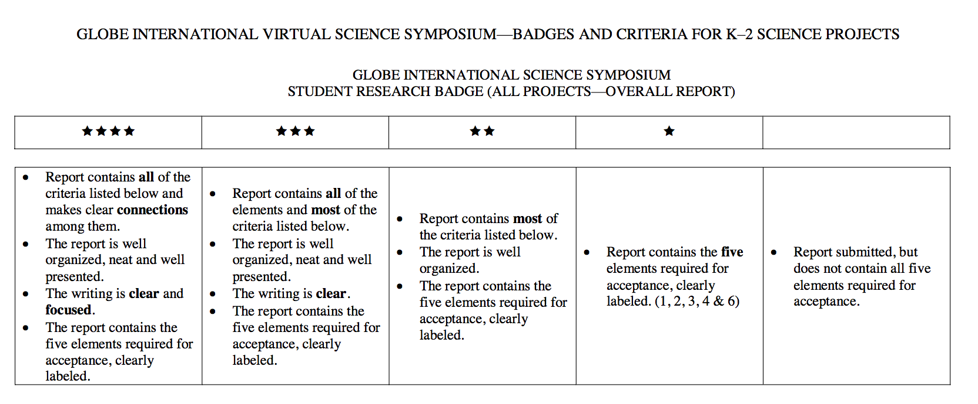
http://globe.gov/science-symposium

Slide 7
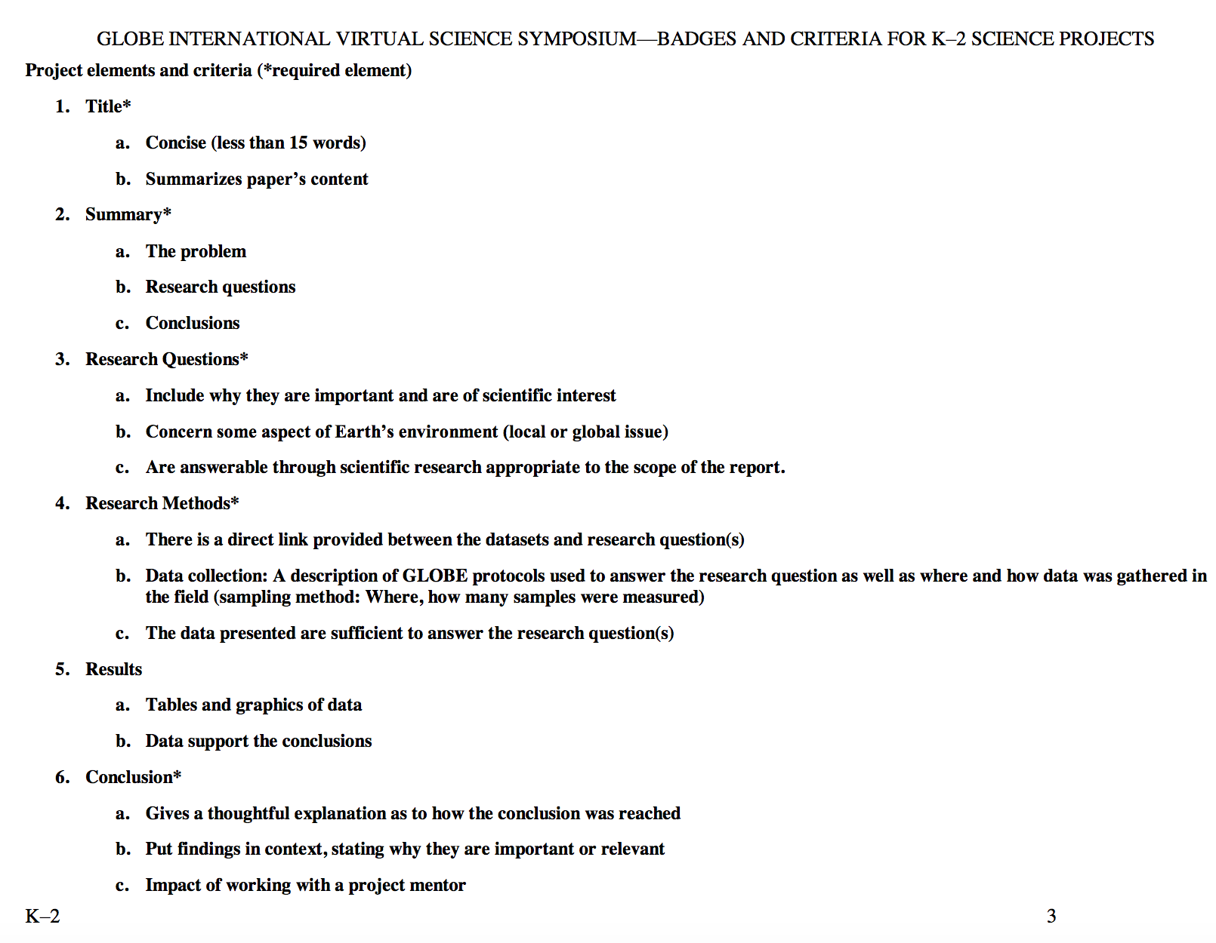
http://globe.gov/science-symposium

Slide 8
http://globe.gov/science-symposium

Slide 10
http://globe.gov/science-symposium
Examples of Research

Slide 11
http://globe.gov/science-symposium
Examples of Research

Slide 12
Find info Online
http://www.globe.gov/science-symposium
GLOBE.gov →News & Events → Meetings & Symposia→ Virtual Science Symposia

Slide 13
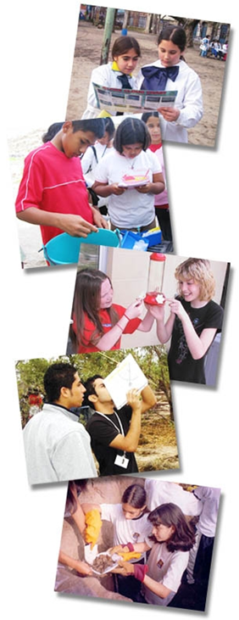
Questions? Comments? malmberg@ucar.edu

