Slide 1
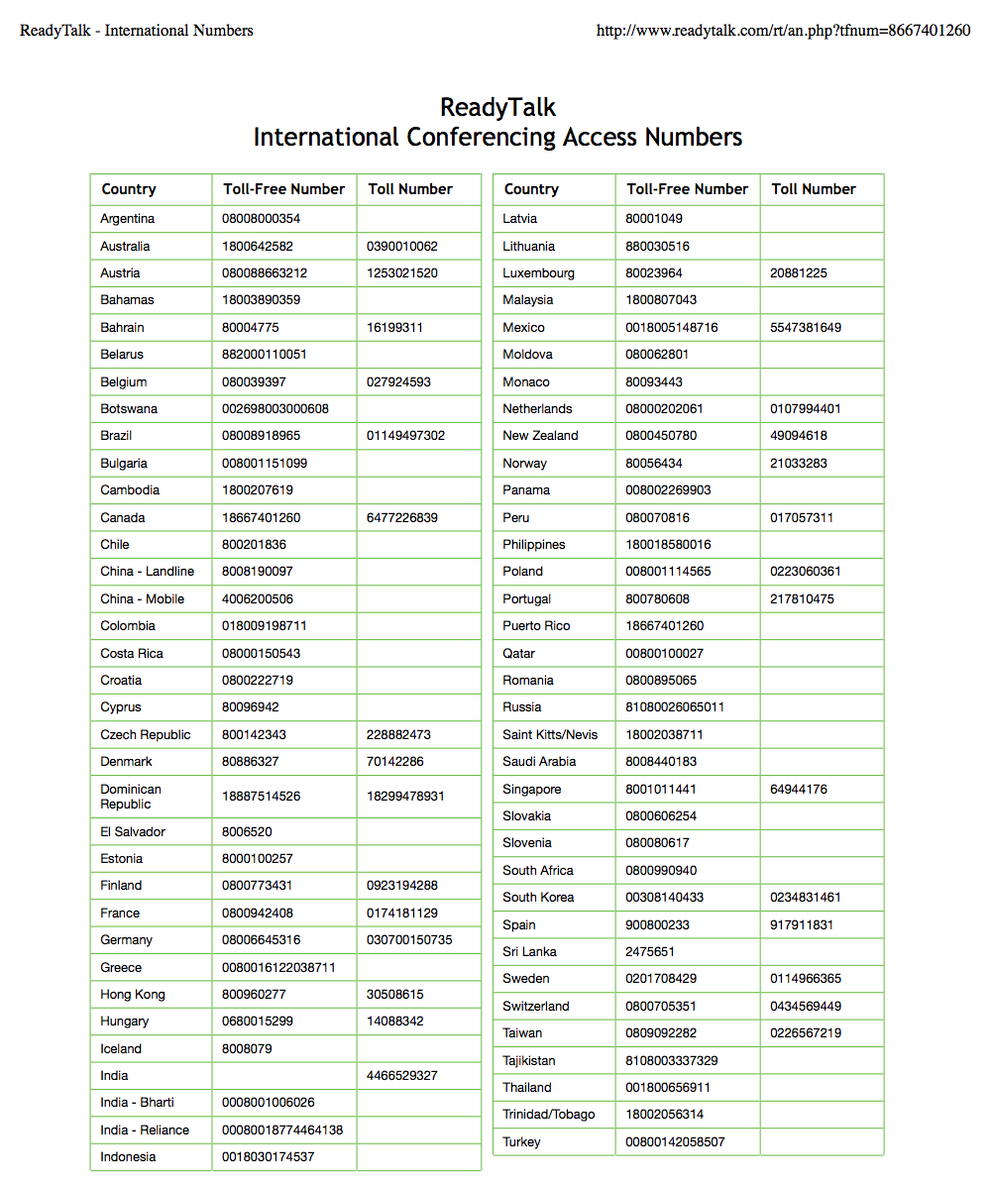
Webinar Logistics
Please type in the chat window if you need assistance finding your access phone number!

Slide 2
Webinar Logistics
Raise your hand if you have any technology problems
Type questions and comments in the chat space here

Slide 3
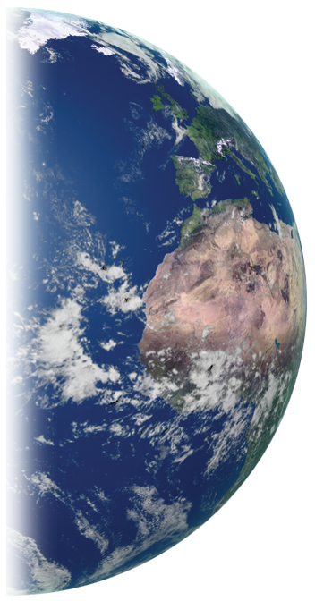
Webinar #5: How to do Outreach
GLOBE International Scientist Network (GISN)
2015 Webinar Series
Thursday, 28 May 2015
Notes:
Welcome to the first webinar in the 2015 GISN Webinar Series! Today’s GISN webinar is called

Slide 4
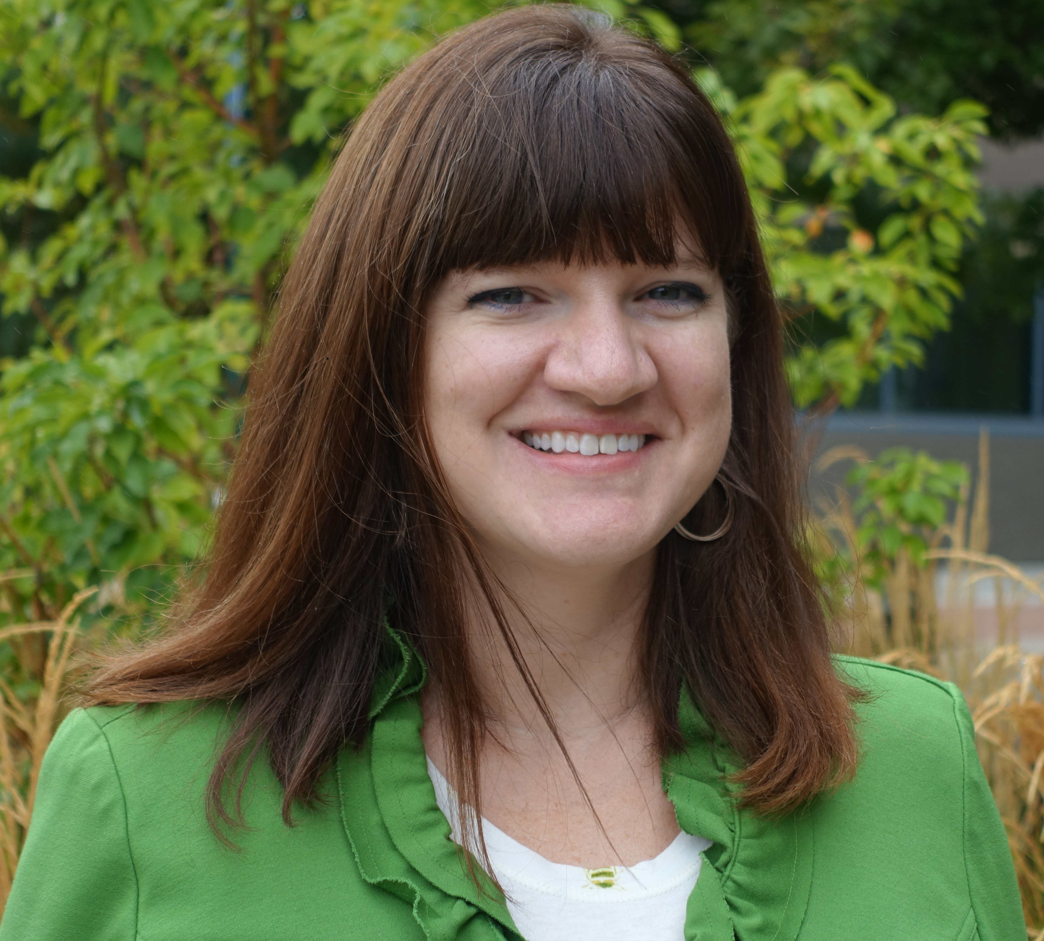
Presenter
Dr. Julie Malmberg
GLOBE Implementation Office
Science Education and Outreach

Slide 5
Who are you?
Who are you? Let us know in the chat window. (I’ll read answers aloud).
Name
Location
Organization

Slide 6
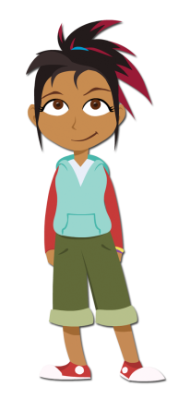
Agenda
Overview of SciGirls
SciGirls Seven
SciGirls and GLOBE

Slide 7
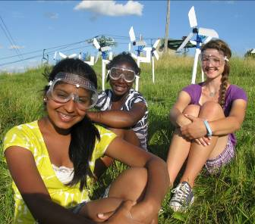
The Big Idea
To change how millions of girls (ages 8-13) think about STEM
Notes:
1. The mission of SciGirls is bold. We want to change how millions of girls ages 8-13 think about STEM – OR- Science, Technology, Engineering and Math.
2. We focus on upper elementary and middle school girls b/c that is where the research shows girls begin to lose interest and confidence in STEM subjects.

Slide 8
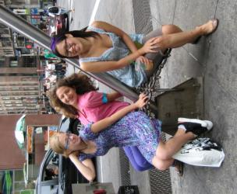
Our Approach
On TV
– national PBS Kids series
Online
– safe, social networking website
On the Ground
– activities and professional development
Notes:
8
We have a 3-pronged approach. SciGirls offers:
a 30-min. long national PBS Kids series
a safe, social networking site for kids on PBS
research-based activities, professional development and support for educators nationwide

Slide 9
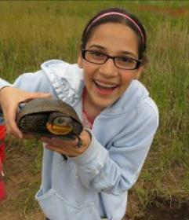
On TV
check your local PBS listings –OR- watch full episodes online at pbskidsgo.org/scigirls -OR- download from iTunes -OR- watch on YouTube
Features real girls doing investigations they’re passionate about
Highlights the process of science
Notes:
SciGirls is a 30 min. television program aired nationally. It airs at different times all over the country, so you must check your local listings for the air time in your area. We are carried on approximately 86% of PBS stations nationwide. You can always stream episodes online from our website or download them for FREE from iTunes.
The show features “real” girls, meaning that we do not have actors. We go around the country and select a different group of girls for each episode.
We are QUALITY, reality TV! The girls are not scripted. We connect the girls with a scientist or engineer as a mentor, give them a STEM challenge and let them go. The reason we do this is so that we show the PROCESS of science, not just the end result. We wanted to show girls that it is ok to struggle, make mistakes and disagree. This is all part of science!

Slide 10
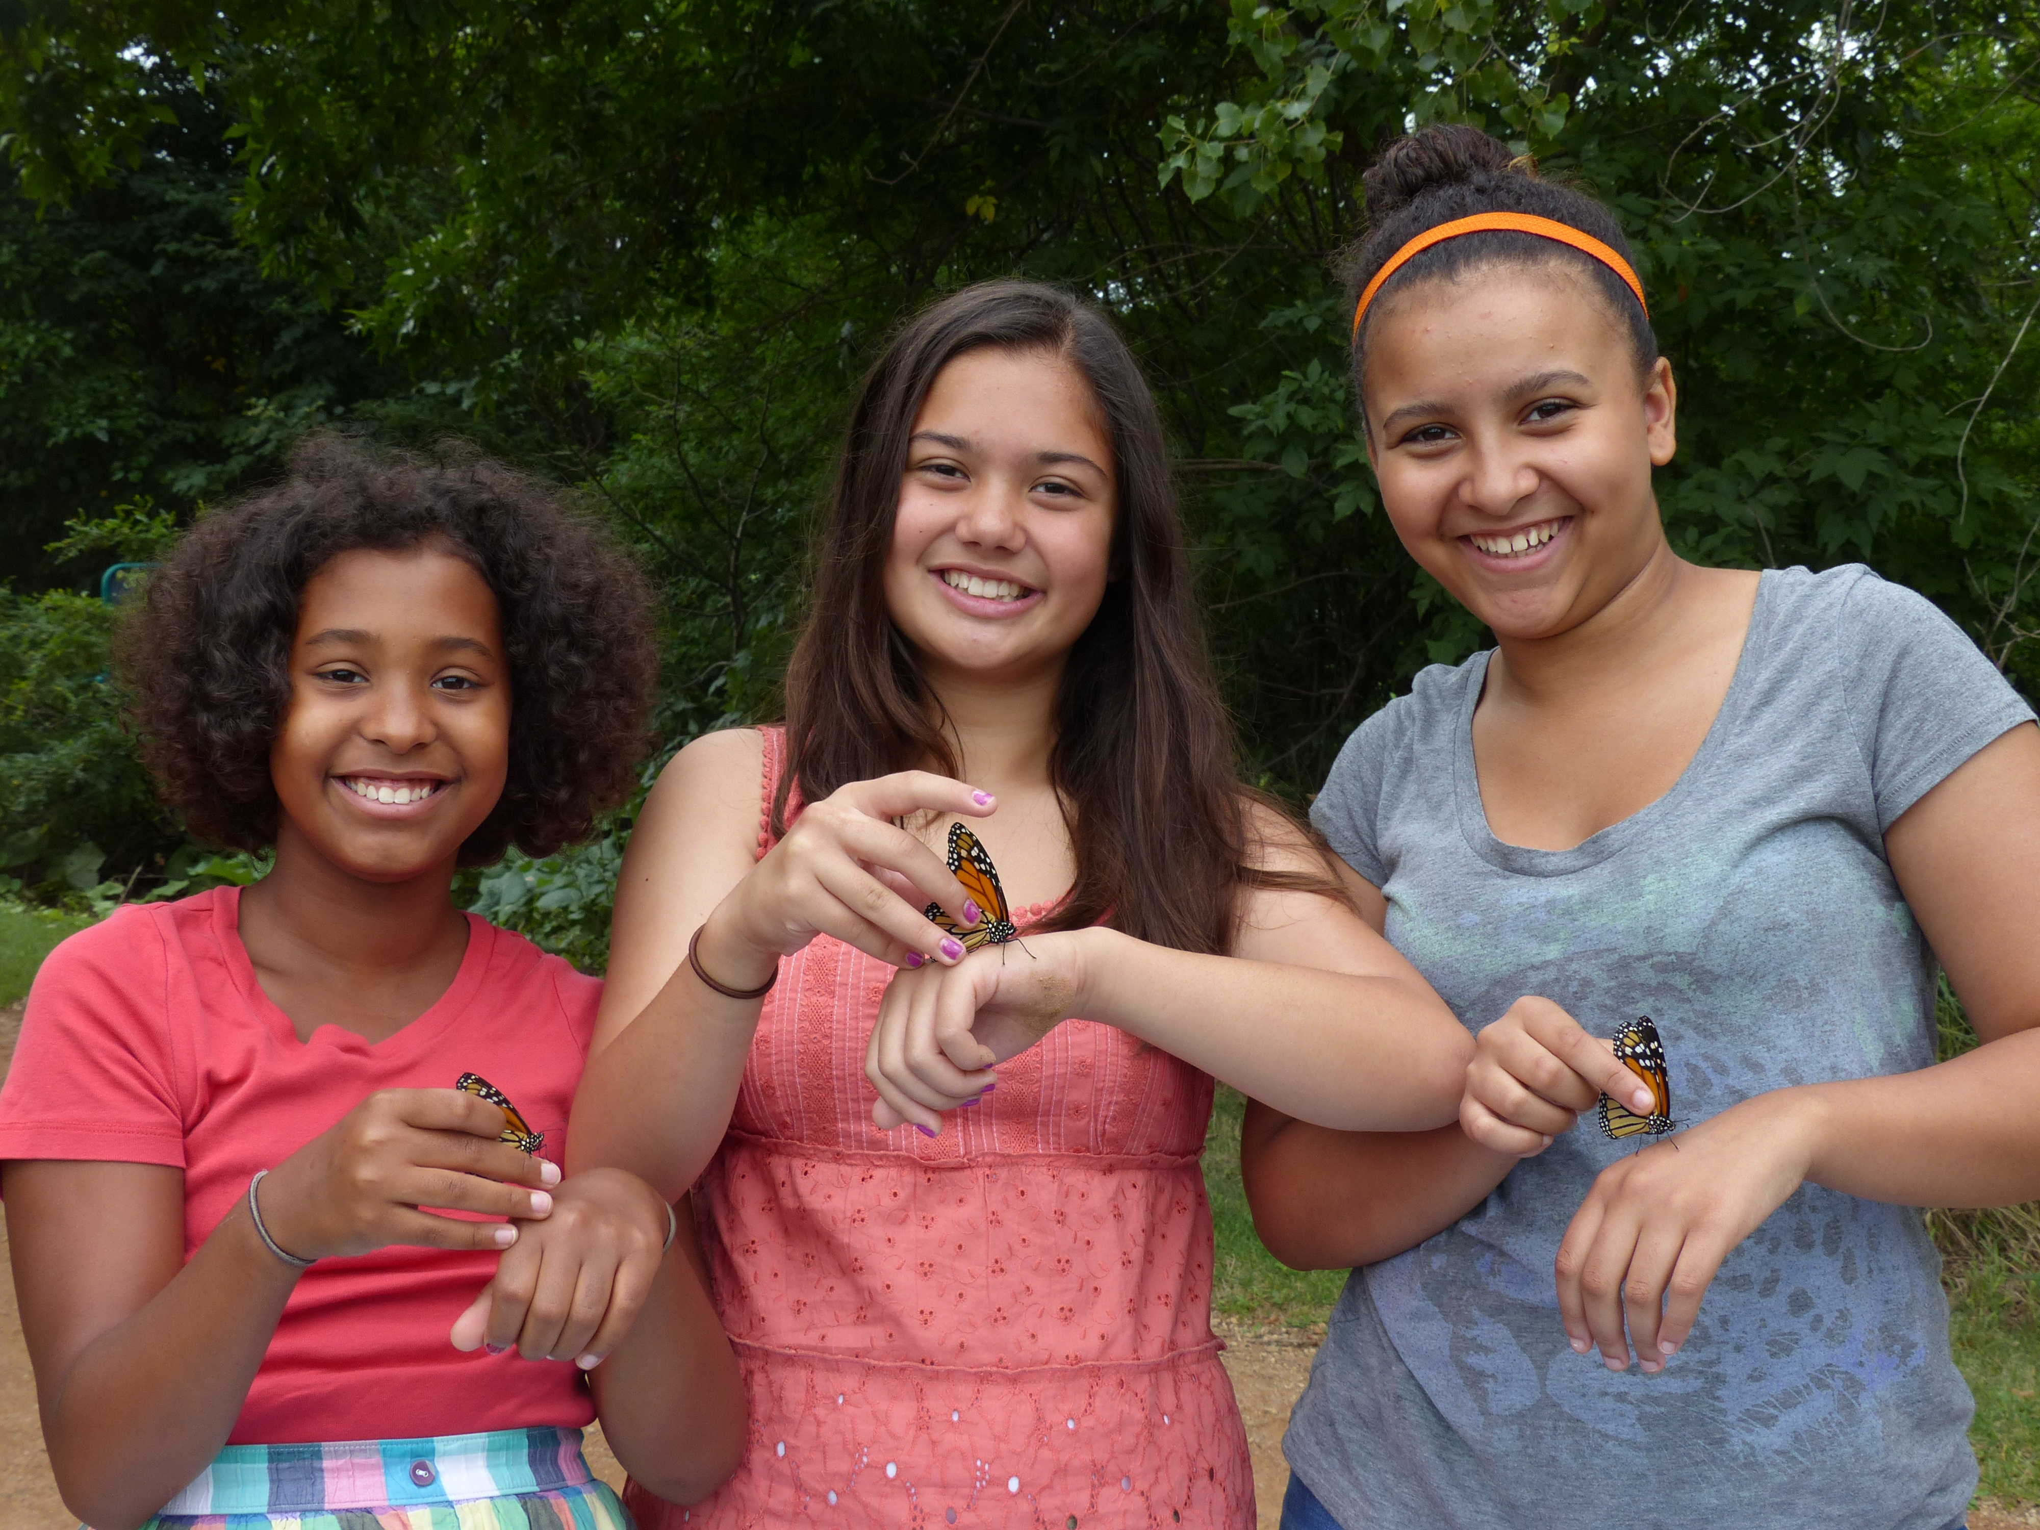
On TV
Six new episodes available as of April 2015!
Notes:
Thanks to the NSF, Season Two of SciGirls aired nationwide in the Fall of 2012 and is now available online, and through iTunes.
We also feature an animated character name Izzie. Izzie and her best friend Jake start every episode with a problem that only the SciGirls can help solve. Izzie goes onto our website and finds a group of SciGirls to help out. She LEARNS from the SciGirls and uses that information to help solve her problem.
The show contains about 2-3 min total of animation. The majority is live-action with the girls.

Slide 11
On TV
Season One Episodes:
Turtle Mania
Puppet Power
Dolphin Dive
Digging Archaeology
Horsing Around
Blowin’ in the Wind
High-Tech Fashion
Science Cooks!
Underwater Eco-Adventure
Robots to the Rescue!
Star Power
Going Green
Season Two Episodes:
Aquabots
Mother Nature’s Shoes
Habitat Havoc
The Awesome App Race
Multitasking Mania
Insulation Station
Workin’ It Out
Bee Haven
Pedal Power
Super Sleuths
Season Three Episode
Topics:
Frog Whisperers
Flower Power
SkyGirls
Butterfly Diaries
Feathered Friends
Terrific Pacific
Notes:
Season One Episodes:
We cover a large variety of science and engineering episodes as seen from our list from Season 1.
We also like to show that science and engineering exists in places you may not expect as in our Puppet Power episode, for example, where the girls team up with an engineer to design and build a giant pig puppet with 3 movable parts for a local parade.
Season Two Episodes:
Ten new episodes showcase bright, curious, real girls using science, technology, engineering and math in their everyday lives. They design an underwater robot, engineer a “chill” ice-cream-making bike, apply real forensic methods to solving a mysterious crime, and more!

Slide 12
Insert “Sizzle Reel”
video clip here
Notes:
12
Here is a clip that will give a sample of all 12 episodes.

Slide 13
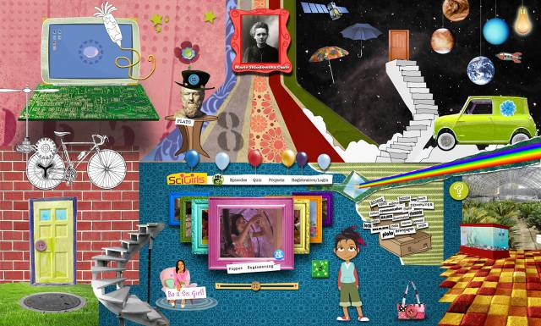
Online
New mobile friendly SciGirls website in April!
pbskids.org/scigirls
Notes:
Our website features a large canvas that girls can explore.
Click on the umbrella and type in your zip code to get the weather in your area.
Click on the Green Van to find clubs in your state. This uses the database from the NGCP (National Girls Collaborative Project). So, please register your camp or club on their Program Directory so millions of girls can find you from our site!
Click on the picture frame to see an All-Star card featuring a different female scientist or engineer each week.
Girls can create a profile. We are a COPPA-compliant site (Children Online Privacy and Protection Act). This means that we cannot collect ANY personal information about our users for their safety. Girls create an avator, can decorate their room and tell us about themselves from pull-down menus and cloud tags. They can then “friend” other users with the same interests.
For the latest web stats, please download the file entitled, “SciGirls information sheet.” It’s in the Trainers Group on the Ning site under “Training Resources”.

Slide 14
On the Ground
SciGirls Seven: Strategies to engage girls in STEM
Tips for using the SciGirls Seven
Applying the SciGirls Seven
Notes:
14
The cornerstone of our work is this piece, the SciGirls Seven. The booklet contains the following pieces.

Slide 15
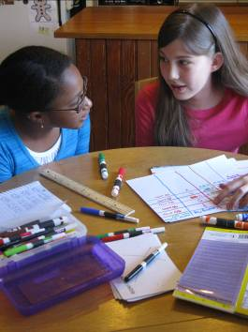
SciGirls Seven
1. Girls benefit from collaboration, especially when they can participate and communicate fairly. (Parker & Rennie, 2002; Fancsali, 2002)
2. Girls are motivated by projects they find personally relevant and meaningful. (Eisenhart & Finkel, 1998; Thompson & Windschitl, 2005; Liston, Peterson, & Ragan, 2008)
Notes:
Ask the participants that had Strategy 2 to share what they discussed.
Feel free to chime in with any of the SciGirls tips from the booklet or from your own experience!
Look for ways to connect the material to the girls’ lives. If you are teaching an environmental studies lesson, for instance, ask the girls to identify examples of
environmental issues in the area where they live and bring information to share from articles in local magazines, newspapers, videos, etc.
Demonstrate and talk about your own enthusiasm for the scientific material, and how it affects you personally.
Create a “need to know.” As you are preparing your activities, ask yourself—why would kids need to know this? Ask girls to prepare a table of their thoughts, including: what they know, want to know, have learned, and how they can learn more. Use this in groups or individually as a tool for tapping into prior knowledge and encouraging personal reflection.
Use case studies. Kids generally relate to characters who face decisions or dilemmas; they often make connections from the story to their own lives. Using SciGirls videos, as suggested throughout our activity guides, provides one avenue to accomplish this. Ask girls if they have ever felt like the girls in the video, or ask what similarities they may
have seen between themselves and the SciGirls.
Use follow-up questions that focus kids’ attention on ideas or assumptions embedded in their first answers. These questions can help girls explore and express what they know even when they aren’t sure they know it. For example: T ell me more. Then what? Could you give me an example?

Slide 16
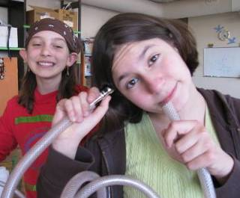
SciGirls Seven
3. Girls enjoy hands-on, open-ended projects and investigations. (Chatman, Nielsen, Strauss, & Tanner, 2008; Burkam, Lee, & Smerdon,1997; Fanscali, 2002)
4. Girls are motivated when they can approach projects in their own way, applying their creativity, unique talents and preferred learning styles. (Eisenhart & Finkel,1998; Calabrese Barton, Tan, & Rivet, 2008)
Notes:
Ask the participants that had Strategy 4 to share what they discussed.
Feel free to chime in with any of the SciGirls tips from the booklet or from your own experience!
Allow girls to design their own experiments and tests. Groups can share their plans with you; but your role is as a facilitator rather than as a leader or expert.
Emphasize that everyone is learning and discovering together.
Let girls communicate their findings using a variety of techniques relevant to their lives: poetry, music, posters, plays, slideshows, 2D- and 3D-models, drawings, etc.
Have your girls create their own project pages at pbskidsgo.org/scigirls.
Use your girls’ language to reiterate their points. Use a board or large sheet of paper to document each person’s participation. Write the idea as you hear it—don’t reword unless you have permission from the speaker. When meanings are unclear, restate what the girls said in their own words first, and then ask them to expand on their thinking with, “Tell me more” or, “What makes you think that?”
Ask girls to write personal narratives relating to a particular time or place and share these in small or large groups. A journal or blog (for older girls) provides an avenue for reflection on learning.

Slide 17
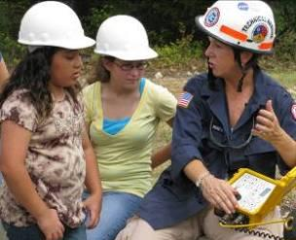
SciGirls Seven
5. Girls’ confidence and performance improves in response to specific, positive feedback on things they can control – such as effort, strategies and behaviors. (Halpern, et al., 2007; Zeldin & Pajares, 2000; Blackwell, Trzesniewski, & Sorich Dweck, 2007; Mueller & Dweck, 1998)
6. Girls gain confidence and trust in their own reasoning when encouraged to think critically. (Chatman, et al., 2008; Eisenhart & Finkel,1998)
7. Girls benefit from relationships with role models and mentors. (Liston, et al., 2008; Evans, Whigham, & Wang, 1995)
Notes:
Ask the participants that had Strategy 7 to share what they discussed.
Feel free to chime in with any of the SciGirls tips from the booklet or from your own experience!
Invite guest speakers from all levels, including high school, undergraduate, and graduate students, along with professional scientists. Probe visitors to describe what their work looks like along with how they identify and ask questions, answer them, and share information with others. Remind them to talk about their hobbies, interests, family and life outside of the lab.
Invite guest scientists to help lead an activity. If you are unsure of their comfort level working with children, pair them with other educators or leaders. The experience will be valuable for both the students and the scientists!
Spotlight women who work on the subjects you are studying.
If you can’t get someone live, show videos of female scientists. (Use SciGirls videos or DragonflyTV’s scientist profiles at scigirlsconnect.org).
Use SciGirls videos to showcase peers as mentors. The girls in each episode can act as role models for projects.
Encourage mentor pairings.

Slide 18
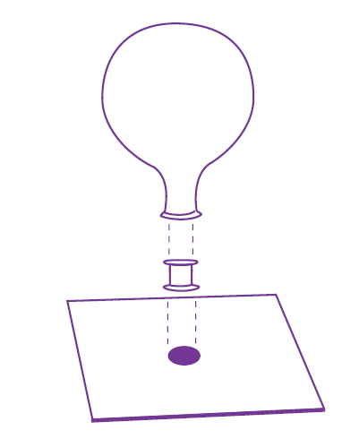
The SciGirls Seven in Practice
Hovercraft Activity
You’ll need (for each group):
an empty thread spool
a 4-inch square of cardboard
white glue, or a hot-glue gun
a sharpened pencil
a balloon (12 inch, when inflated)
Notes:
Ask the participants that had Strategy 7 to share what they discussed.
Feel free to chime in with any of the SciGirls tips from the booklet or from your own experience!
Invite guest speakers from all levels, including high school, undergraduate, and graduate students, along with professional scientists. Probe visitors to describe what their work looks like along with how they identify and ask questions, answer them, and share information with others. Remind them to talk about their hobbies, interests, family and life outside of the lab.
Invite guest scientists to help lead an activity. If you are unsure of their comfort level working with children, pair them with other educators or leaders. The experience will be valuable for both the students and the scientists!
Spotlight women who work on the subjects you are studying.
If you can’t get someone live, show videos of female scientists. (Use SciGirls videos or DragonflyTV’s scientist profiles at scigirlsconnect.org).
Use SciGirls videos to showcase peers as mentors. The girls in each episode can act as role models for projects.
Encourage mentor pairings.

Slide 19
The SciGirls Seven in Practice
Hovercraft Activity
You’ll need (for each group):
an empty thread spool
a 4-inch square of cardboard
white glue, or a hot-glue gun
a sharpened pencil
a balloon (12 inch, when inflated)
Have a table full of additional supplies to promote creativity:
old CDs, water bottle caps of various shapes & sizes, tape, scissors, push pins, old cereal boxes, etc….
Notes:
Ask the participants that had Strategy 7 to share what they discussed.
Feel free to chime in with any of the SciGirls tips from the booklet or from your own experience!
Invite guest speakers from all levels, including high school, undergraduate, and graduate students, along with professional scientists. Probe visitors to describe what their work looks like along with how they identify and ask questions, answer them, and share information with others. Remind them to talk about their hobbies, interests, family and life outside of the lab.
Invite guest scientists to help lead an activity. If you are unsure of their comfort level working with children, pair them with other educators or leaders. The experience will be valuable for both the students and the scientists!
Spotlight women who work on the subjects you are studying.
If you can’t get someone live, show videos of female scientists. (Use SciGirls videos or DragonflyTV’s scientist profiles at scigirlsconnect.org).
Use SciGirls videos to showcase peers as mentors. The girls in each episode can act as role models for projects.
Encourage mentor pairings.

Slide 20
The SciGirls Seven in Practice
Guide your kids as they:
Glue the bottom of the empty spool to the center of the cardboard square.
Use the sharpened pencil to punch a hole in the cardboard that lines up with the center of the spool.
Blow up the balloon. Hold the bottom without tying it.
Get your partner to hold the spool for you. While pinching the neck of the balloon, stretch the bottom over the top of the spool, release the neck, and lift off!
Experiment with different sizes and shapes of cardboard to get the best hover out of your balloon hovercraft. Give your hovercraft a shove along a smooth tabletop, and see how far it goes.
Notes:
Ask the participants that had Strategy 7 to share what they discussed.
Feel free to chime in with any of the SciGirls tips from the booklet or from your own experience!
Invite guest speakers from all levels, including high school, undergraduate, and graduate students, along with professional scientists. Probe visitors to describe what their work looks like along with how they identify and ask questions, answer them, and share information with others. Remind them to talk about their hobbies, interests, family and life outside of the lab.
Invite guest scientists to help lead an activity. If you are unsure of their comfort level working with children, pair them with other educators or leaders. The experience will be valuable for both the students and the scientists!
Spotlight women who work on the subjects you are studying.
If you can’t get someone live, show videos of female scientists. (Use SciGirls videos or DragonflyTV’s scientist profiles at scigirlsconnect.org).
Use SciGirls videos to showcase peers as mentors. The girls in each episode can act as role models for projects.
Encourage mentor pairings.

Slide 21
The SciGirls Seven in Practice
Guide your kids as they:
Glue the bottom of the empty spool to the center of the cardboard square.
Use the sharpened pencil to punch a hole in the cardboard that lines up with the center of the spool.
Blow up the balloon. Hold the bottom without tying it.
Get your partner to hold the spool for you. While pinching the neck of the balloon, stretch the bottom over the top of the spool, release the neck, and lift off!
Experiment with different sizes and shapes of cardboard to get the best hover out of your balloon hovercraft. Give your hovercraft a shove along a smooth tabletop, and see how far it goes.
Ask girls to write a narrative describing how hovercrafts could be used
to rescue families or animals in flooded coastal areas or along rivers.
Notes:
Ask the participants that had Strategy 7 to share what they discussed.
Feel free to chime in with any of the SciGirls tips from the booklet or from your own experience!
Invite guest speakers from all levels, including high school, undergraduate, and graduate students, along with professional scientists. Probe visitors to describe what their work looks like along with how they identify and ask questions, answer them, and share information with others. Remind them to talk about their hobbies, interests, family and life outside of the lab.
Invite guest scientists to help lead an activity. If you are unsure of their comfort level working with children, pair them with other educators or leaders. The experience will be valuable for both the students and the scientists!
Spotlight women who work on the subjects you are studying.
If you can’t get someone live, show videos of female scientists. (Use SciGirls videos or DragonflyTV’s scientist profiles at scigirlsconnect.org).
Use SciGirls videos to showcase peers as mentors. The girls in each episode can act as role models for projects.
Encourage mentor pairings.

Slide 22
The SciGirls Seven in Practice
Guide your kids as they:
Glue the bottom of the empty spool to the center of the cardboard square.
Use the sharpened pencil to punch a hole in the cardboard that lines up with the center of the spool.
Blow up the balloon. Hold the bottom without tying it.
Get your partner to hold the spool for you. While pinching the neck of the balloon, stretch the bottom over the top of the spool, release the neck, and lift off!
Experiment with different sizes and shapes of cardboard to get the best hover out of your balloon hovercraft. Give your hovercraft a shove along a smooth tabletop, and see how far it goes.
Once hovercrafts have been constructed and tested, change the focus from “best hover” to fastest craft, farthest hover or
maneuverability/steering through a course. Ask girls to redesign to meet the new challenge.
Notes:
Ask the participants that had Strategy 7 to share what they discussed.
Feel free to chime in with any of the SciGirls tips from the booklet or from your own experience!
Invite guest speakers from all levels, including high school, undergraduate, and graduate students, along with professional scientists. Probe visitors to describe what their work looks like along with how they identify and ask questions, answer them, and share information with others. Remind them to talk about their hobbies, interests, family and life outside of the lab.
Invite guest scientists to help lead an activity. If you are unsure of their comfort level working with children, pair them with other educators or leaders. The experience will be valuable for both the students and the scientists!
Spotlight women who work on the subjects you are studying.
If you can’t get someone live, show videos of female scientists. (Use SciGirls videos or DragonflyTV’s scientist profiles at scigirlsconnect.org).
Use SciGirls videos to showcase peers as mentors. The girls in each episode can act as role models for projects.
Encourage mentor pairings.

Slide 23
The SciGirls Seven in Practice
Guide your kids as they:
Glue the bottom of the empty spool to the center of the cardboard square.
Use the sharpened pencil to punch a hole in the cardboard that lines up with the center of the spool.
Blow up the balloon. Hold the bottom without tying it.
Get your partner to hold the spool for you. While pinching the neck of the balloon, stretch the bottom over the top of the spool, release the neck, and lift off!
Experiment with different sizes and shapes of cardboard to get the best hover out of your balloon hovercraft. Give your hovercraft a shove along a smooth tabletop, and see how far it goes.
Invite a rescue worker who may use hovercrafts or an engineer who designs them.
Notes:
Ask the participants that had Strategy 7 to share what they discussed.
Feel free to chime in with any of the SciGirls tips from the booklet or from your own experience!
Invite guest speakers from all levels, including high school, undergraduate, and graduate students, along with professional scientists. Probe visitors to describe what their work looks like along with how they identify and ask questions, answer them, and share information with others. Remind them to talk about their hobbies, interests, family and life outside of the lab.
Invite guest scientists to help lead an activity. If you are unsure of their comfort level working with children, pair them with other educators or leaders. The experience will be valuable for both the students and the scientists!
Spotlight women who work on the subjects you are studying.
If you can’t get someone live, show videos of female scientists. (Use SciGirls videos or DragonflyTV’s scientist profiles at scigirlsconnect.org).
Use SciGirls videos to showcase peers as mentors. The girls in each episode can act as role models for projects.
Encourage mentor pairings.

Slide 24
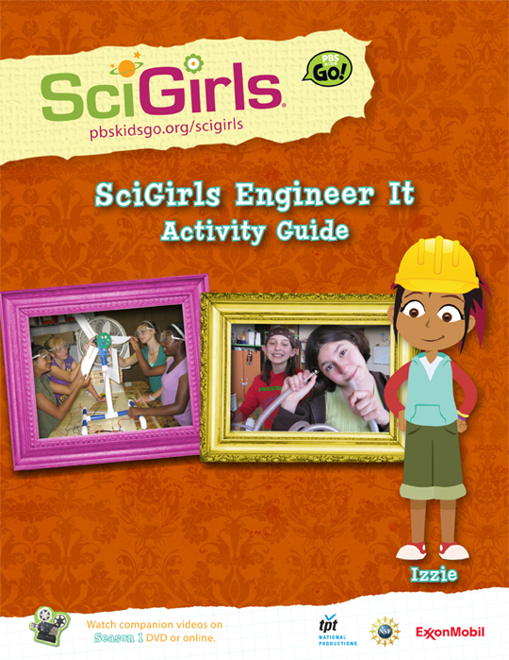
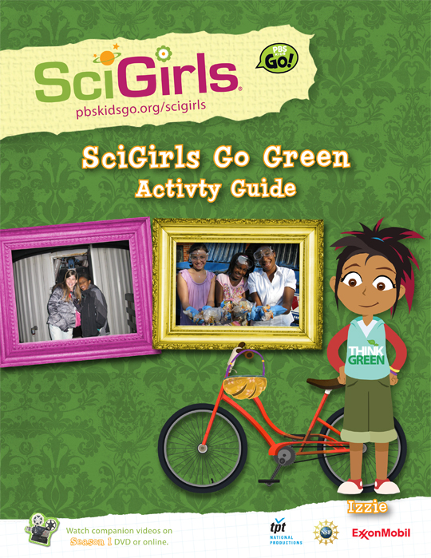
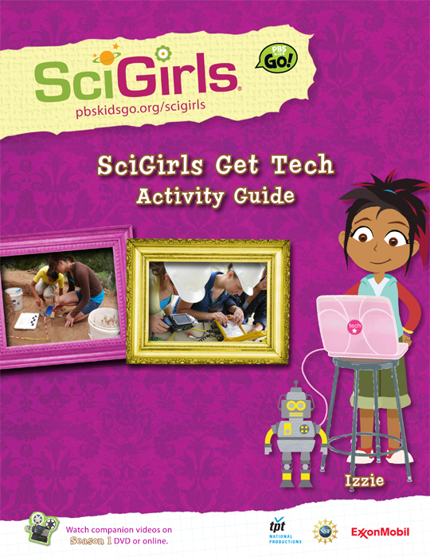
Activity Guides
scigirlsconnect.org
Notes:
SciGirls has 7 activity guides that are aligned to our Seasons 1&2 episodes and National Science Standards. All of these and many other resources can be found on the SciGirls CONNECT site. Please visit the site, log on, create a profile and join an affinity group. You will have access to all of SciGirls video (in both English and Spanish), scientist profile videos, how to videos for some of our activities, webinars, handouts and more!

Slide 25
Activity
Breaking Point
Each Group Needs:
Materials to test
Tissue paper
Coffee filter
Plastic Wrap
Paper
Plastic bag
Wax paper
Paper Plates
Folder
Paper cup
Beans
Paper clips
Single hole punch

Slide 26
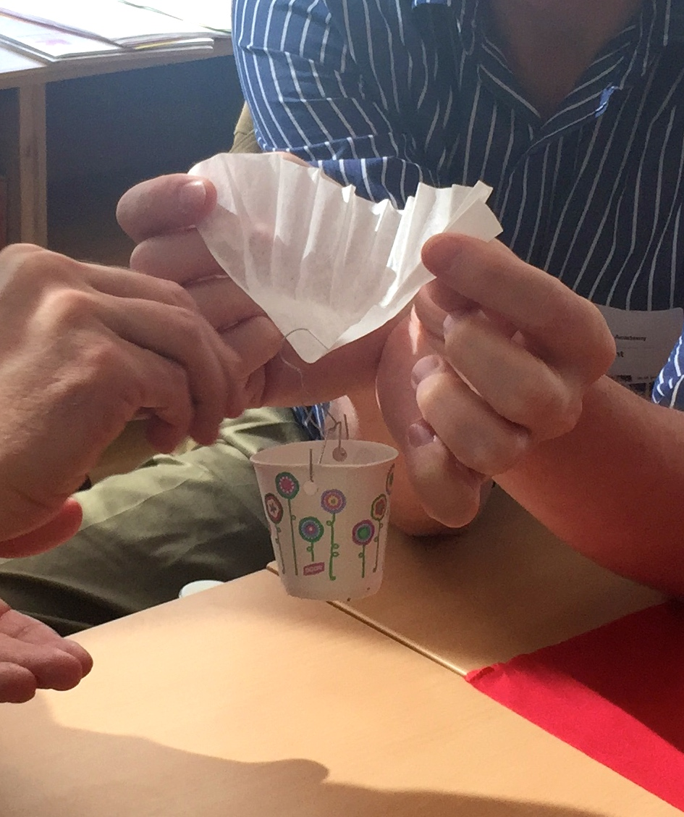
Activity
Breaking Point
Procedure:
Introduce leaf toughness - herbivore diet
Build penetrometer and test various materials
Discuss how results might influence use as a food source

Slide 27
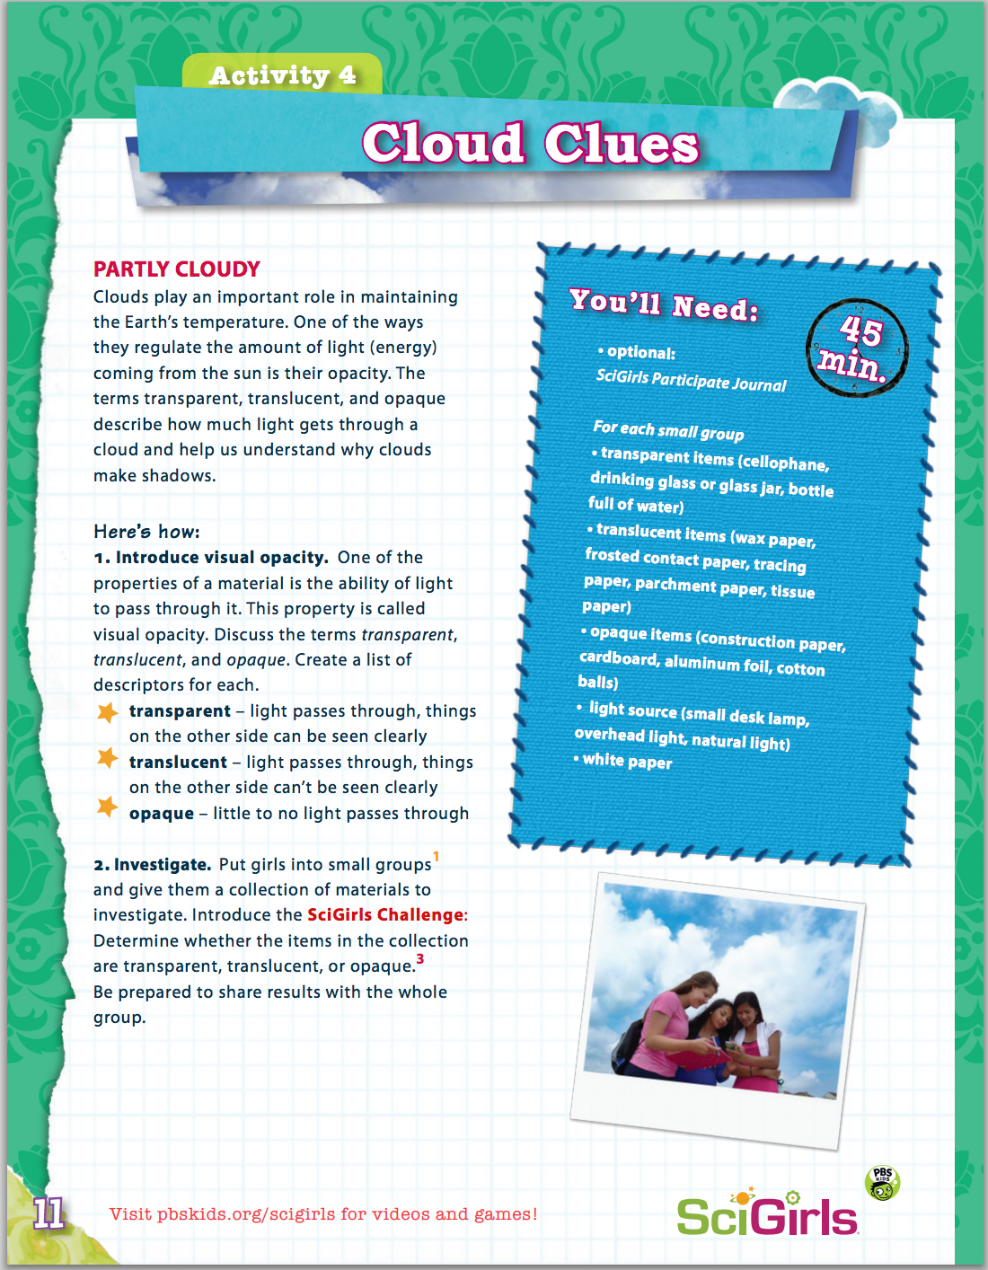
Activity
Cloud Clues
Each Group Needs:
Materials to test
Plastic wrap
Tissue paper
Wax paper
Parchment paper
Construction paper
Aluminum Foil
Flashlight
White Paper

Slide 28
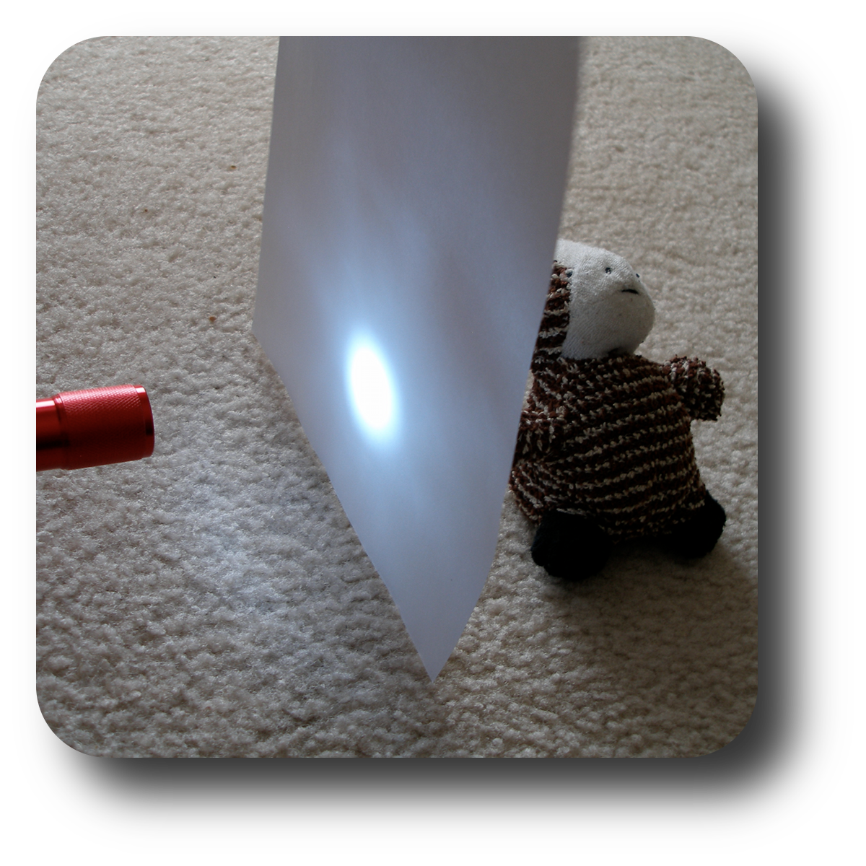
Activity
Cloud Clues
Procedure:
Test materials to see if they are transparent, translucent, or opaque
Go outside to see if clouds are transparent, translucent, opaque
Extension: Make model of clouds with materials from the first step

Slide 29
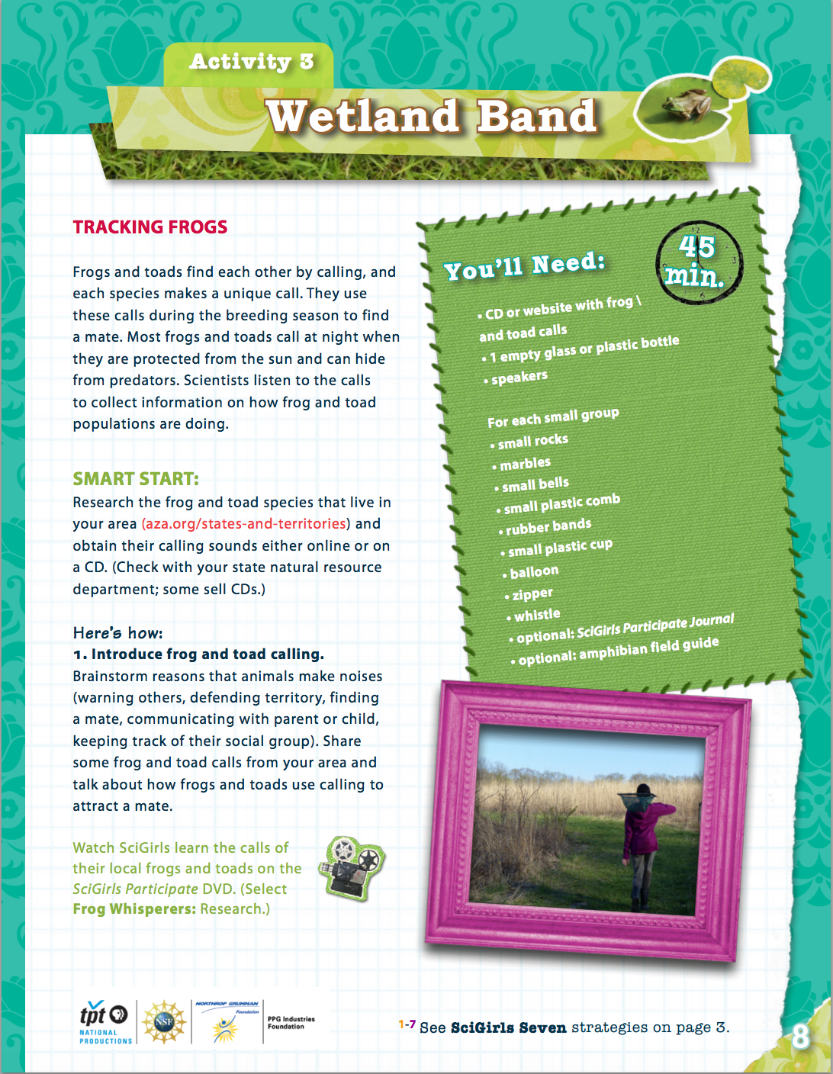
Activity
Wetland Band
Your Group Needs:
Small rocks
Marbles
Bells
Comb
Balloons
….

Slide 30
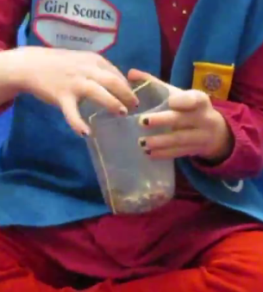
Activity
Wetland Band
Procedure:
Introduce frog and toad calls
Use materials to imitate frog and toad calls
Create wetland band
Extension: Be citizen scientists and try to identify calls

Slide 31
GLOBE Activity
Water Detectives
Each Group Needs:
Plastic cups
Water
Pollutants to vary appearance, smell, sound, touch of water

Slide 32
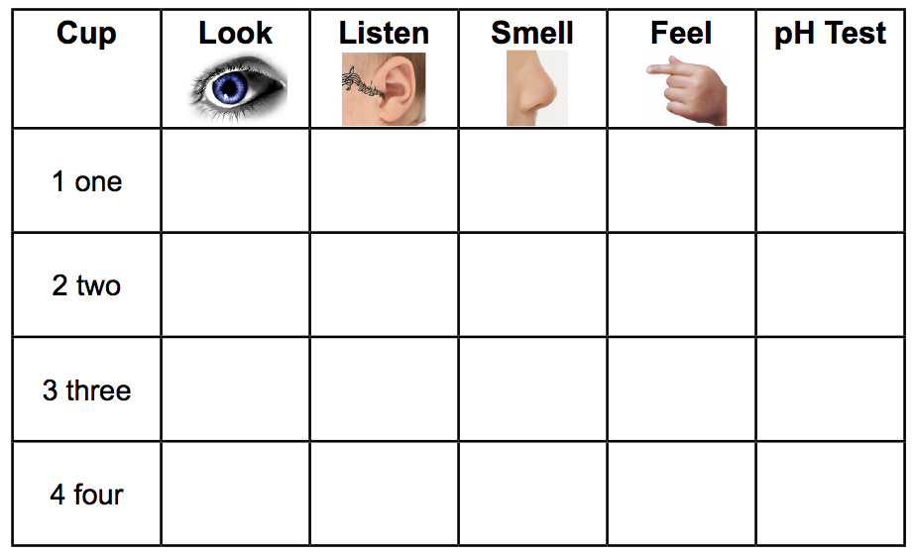
GLOBE Activity
Water Detectives
Procedure:
Students use their senses to identify the cup that is just water
Discuss why it is important to know about pollutants
Discuss methods to test water quality

Slide 33
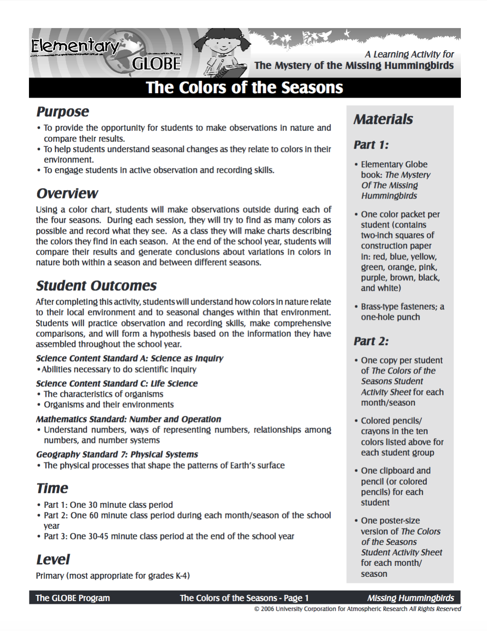
GLOBE Activity
The Colors of the Seasons
Each Group Needs:
Color packet

Slide 34
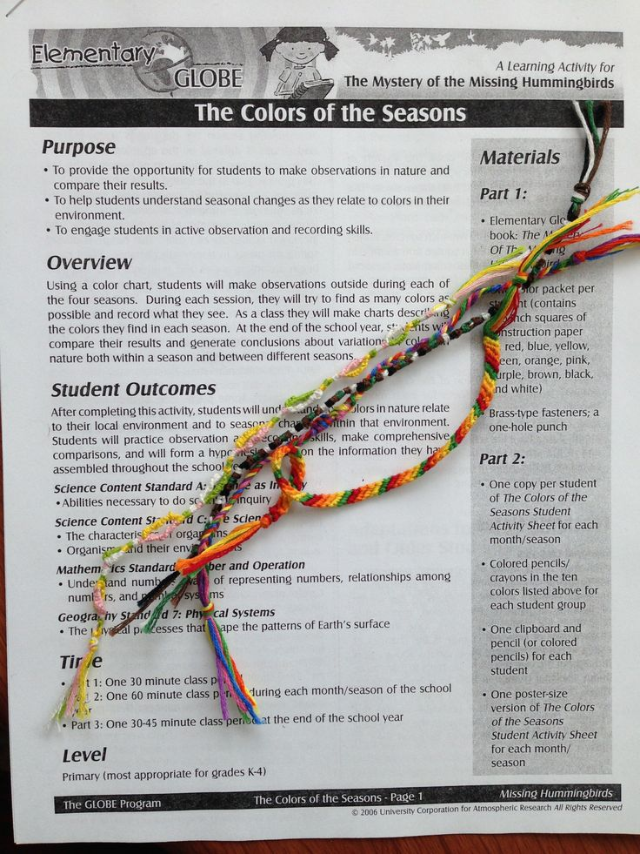
GLOBE Activity
The Colors of the Seasons
Procedure:
Students use color packets to identify colors found outside in different seasons
Discuss why colors vary by season
Extensions: Have students create art to show seasons

Slide 35
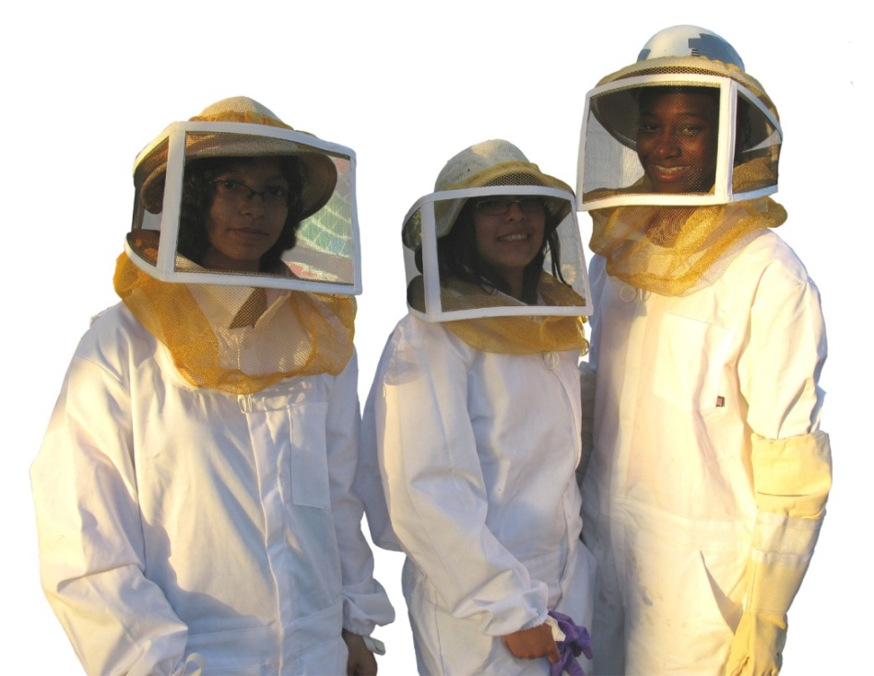
Looking for more?
For Kids: pbskidsgo.org/scigirls
For Parents: pbs.org/parents/scigirls
For Educators/Outreach: scigirlsconnect.org
scigirlstv @SciGirls

Slide 36
Thank you for attending!
GLOBE activities in investigation areas:
http://www.globe.gov/do-globe/globe-teachers-guide
GLOBE International Scientist Network:
http://www.globe.gov/web/globe-international-scientist-network
Elementary GLOBE:
http://www.globe.gov/web/elementary-globe

Slide 37
Thank you for attending!
Contact information:
Julie Malmberg: malmberg@ucar.edu
Questions: help@globe.gov

