Slide 1
ŠTO TO TAMO LEBDI?
WHAT IS AEROSOLING THERE ?
Mentori/Teachers:
Marina Pavlić
Irena Sabo
Učenici/Students:
Sarah Butigan
Dino Bešić
Marin Morić
Prirodoslovna i grafička škola Rijeka, Croatia
Notes:
This is a free translation ,in croatian aerosols are called suspended particles or floating(lebdi) particles

Slide 2
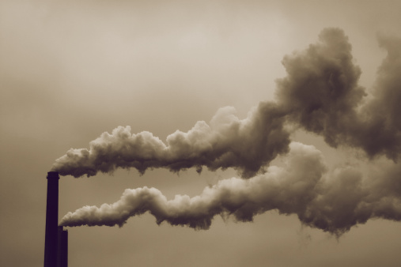
What are the suspended particles and why are they significant?
All solid and liquid particles suspended in the air with a diameter of 0.002 -100μm
One of the most important indicators of air pollution

Slide 3
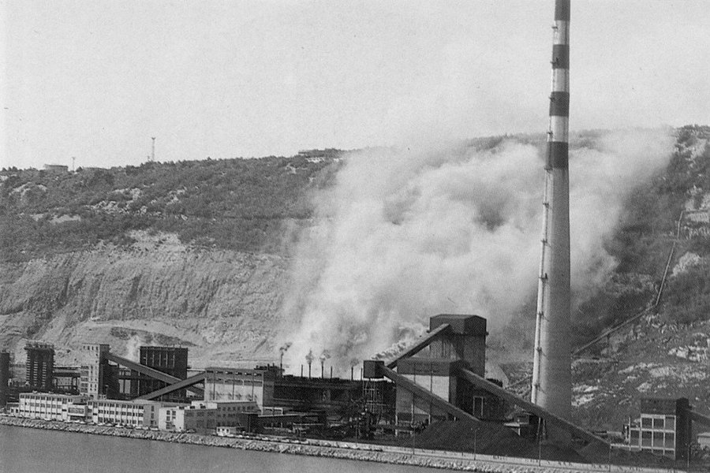
The amount of suspended particles in the air depends on:
Direction and intensity of the wind
Air temperature
Moisture
Rainfall
Cloud cover
Insolation
Stability of the troposphere

Slide 4
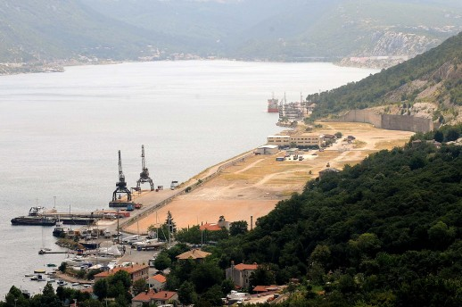
Why Bakar?
Bakar is a small marine town 16 km from Rijeka, where our school is located
The citizens of Bakar invited us to see the big black blot in the middle of the Bakar bay and black particles in their homes.
Notes:
Why did we choose Bakar(small marine town 16 km from Rijeka)
The citizens of Bakar invited us to see the big black blot in the middle of the Bakar bay and black particles in their homes.
We investigated the quality o the sea,seabed and soil in our previous projects and knew that the pollution we found had to come from the air.
Near Bakar there are:oil refinery,ex coke plant, scattered cargo port, crude oil power plant and a waste water drain.

Slide 5
Why Bakar?
We investigated the quality of the sea, seabed and soil in our previous projects and knew that the pollution we found had to come from the air.
Oil refinery,ex coke plant, scattered cargo port, crude oil power plant and waste water drain are located near Bakar town
Notes:
Why did we choose Bakar(small marine town 16 km from Rijeka)
The citizens of Bakar invited us to see the big black blot in the middle of the Bakar bay and black particles in their homes.
We investigated the quality o the sea,seabed and soil in our previous projects and knew that the pollution we found had to come from the air.
Near Bakar there are:oil refinery,ex coke plant, scattered cargo port, crude oil power plant and a waste water drain.

Slide 6
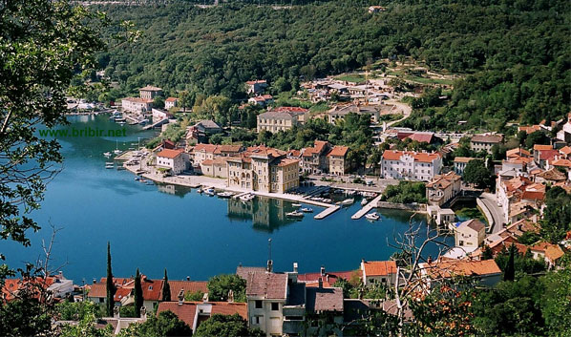
Our questions
What is the intensity of aerosol pollution in Bakar area?
What is the composition of the suspended particles?

Slide 7
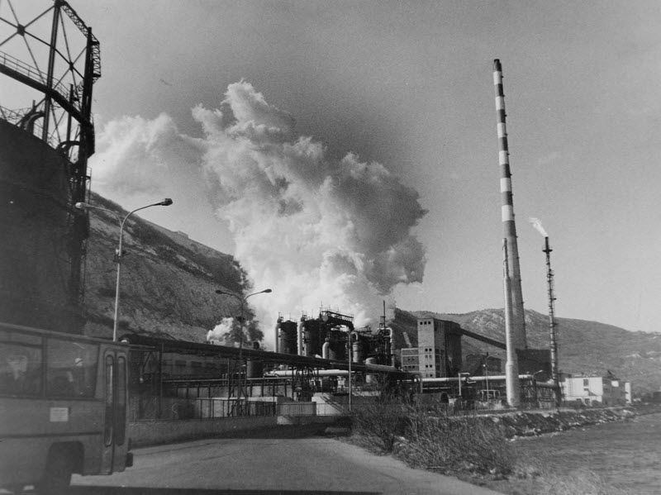
What are the health effects of aerosols ?
Can we do something to prevent generating the particles?

Slide 8
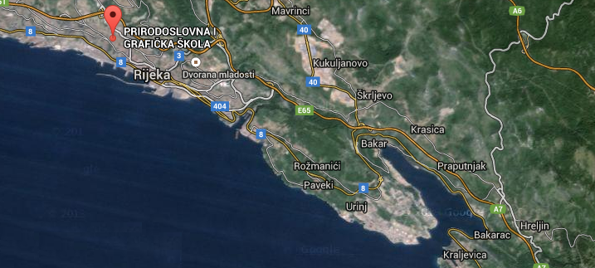
Sites locations
8
We used the jar method based on wet sedimentation on 8 sites:
(1) RN Urinj
(2) Klanac
(3) Stara cesta
(4) Nova cesta
(5) Hotel(parkiralište)
(6) Luka za rasute terete
(7) Hreljin
(8) Prirodoslovna i grafička škola Rijeka
4
3
TE Urinj
2
5
6
1
7
Notes:
We collected the jars after 1 month and took them in our lab.Our students filtrated,dryed and weighted the samples and detrmined total mass of aerosol particles and masses of anorganic and organic parts.

Slide 9
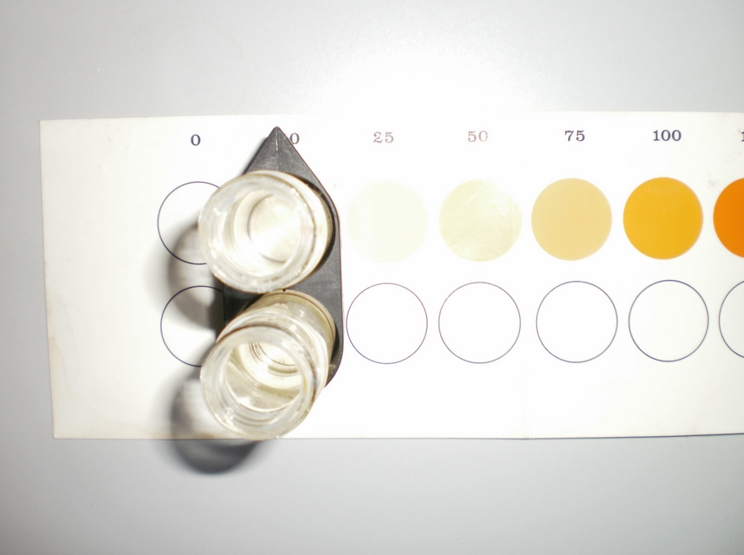
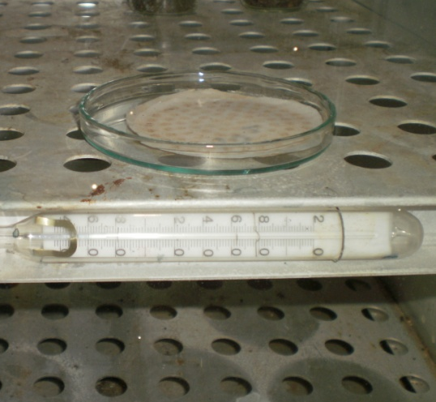
Research methods
We collected the jars after 1 month
Our students filtrated,dryed and weighted the samples and determined total mass of aerosol particles and masses of anorganic and organic parts.
GLOBE protocols
temperature
cloud cover
conductivity
moisture
rainfall
pH

Slide 10
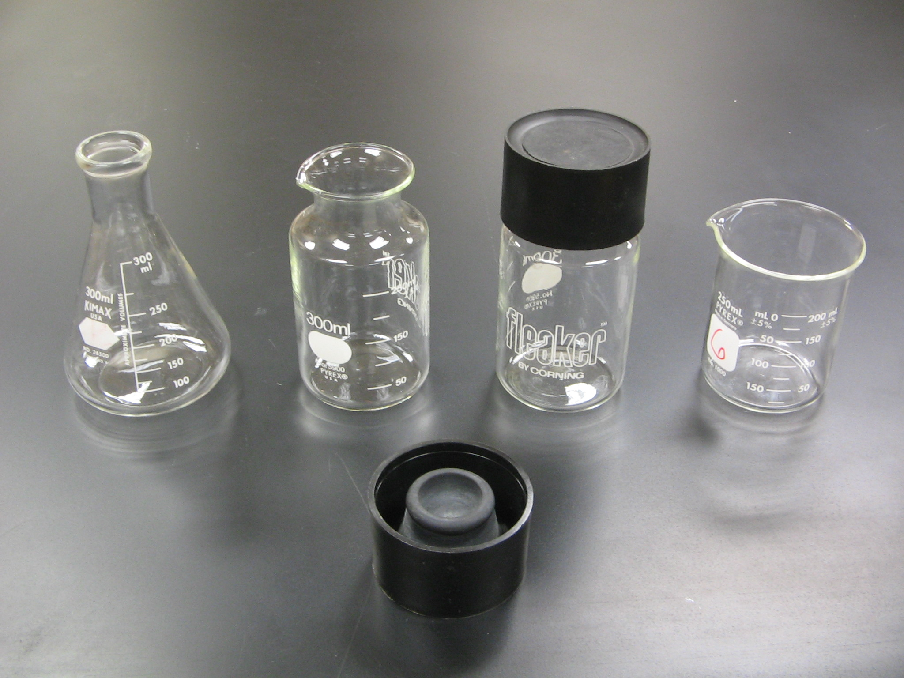
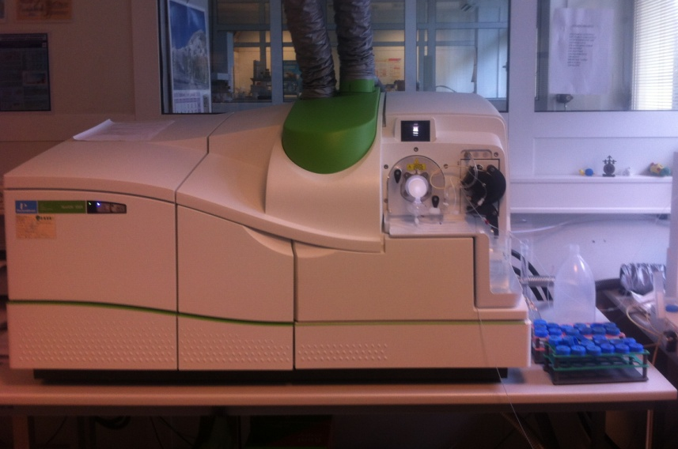
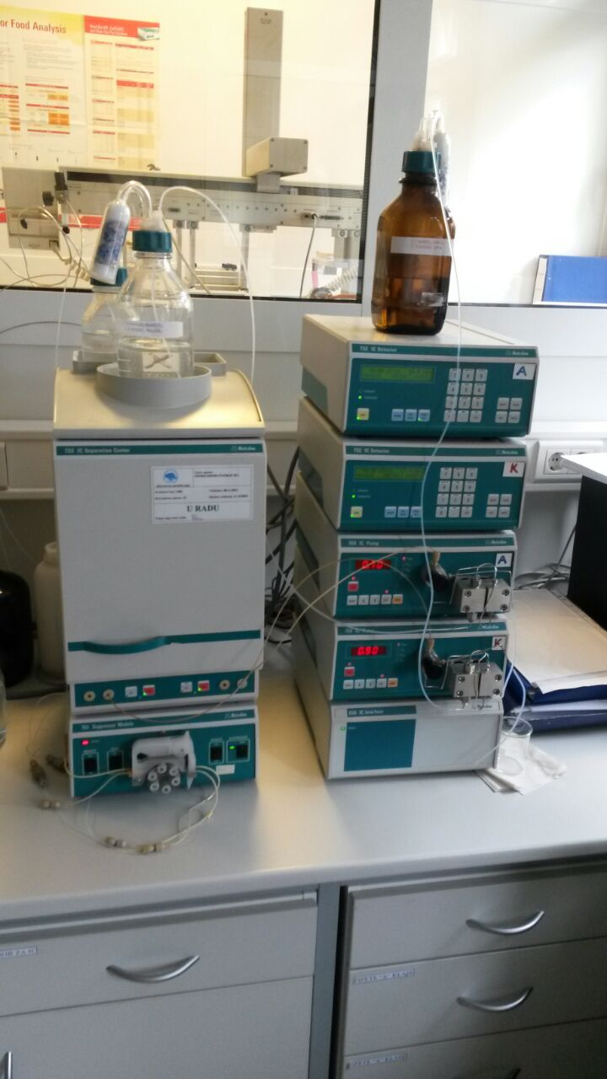
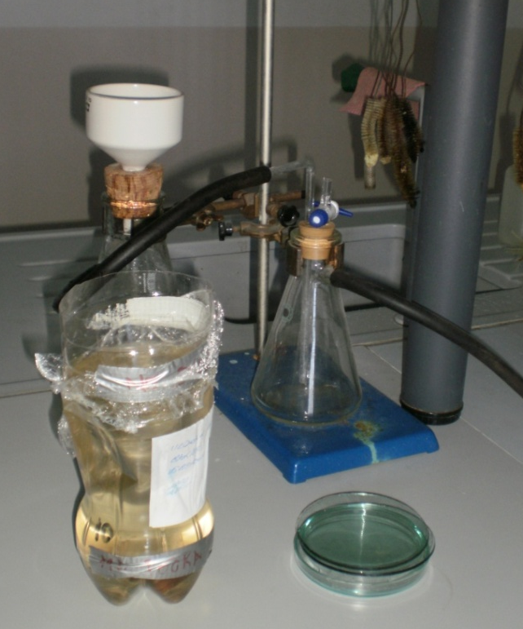
Other measurments
The strength and direction of
the wind
Chemical analysis

Slide 11
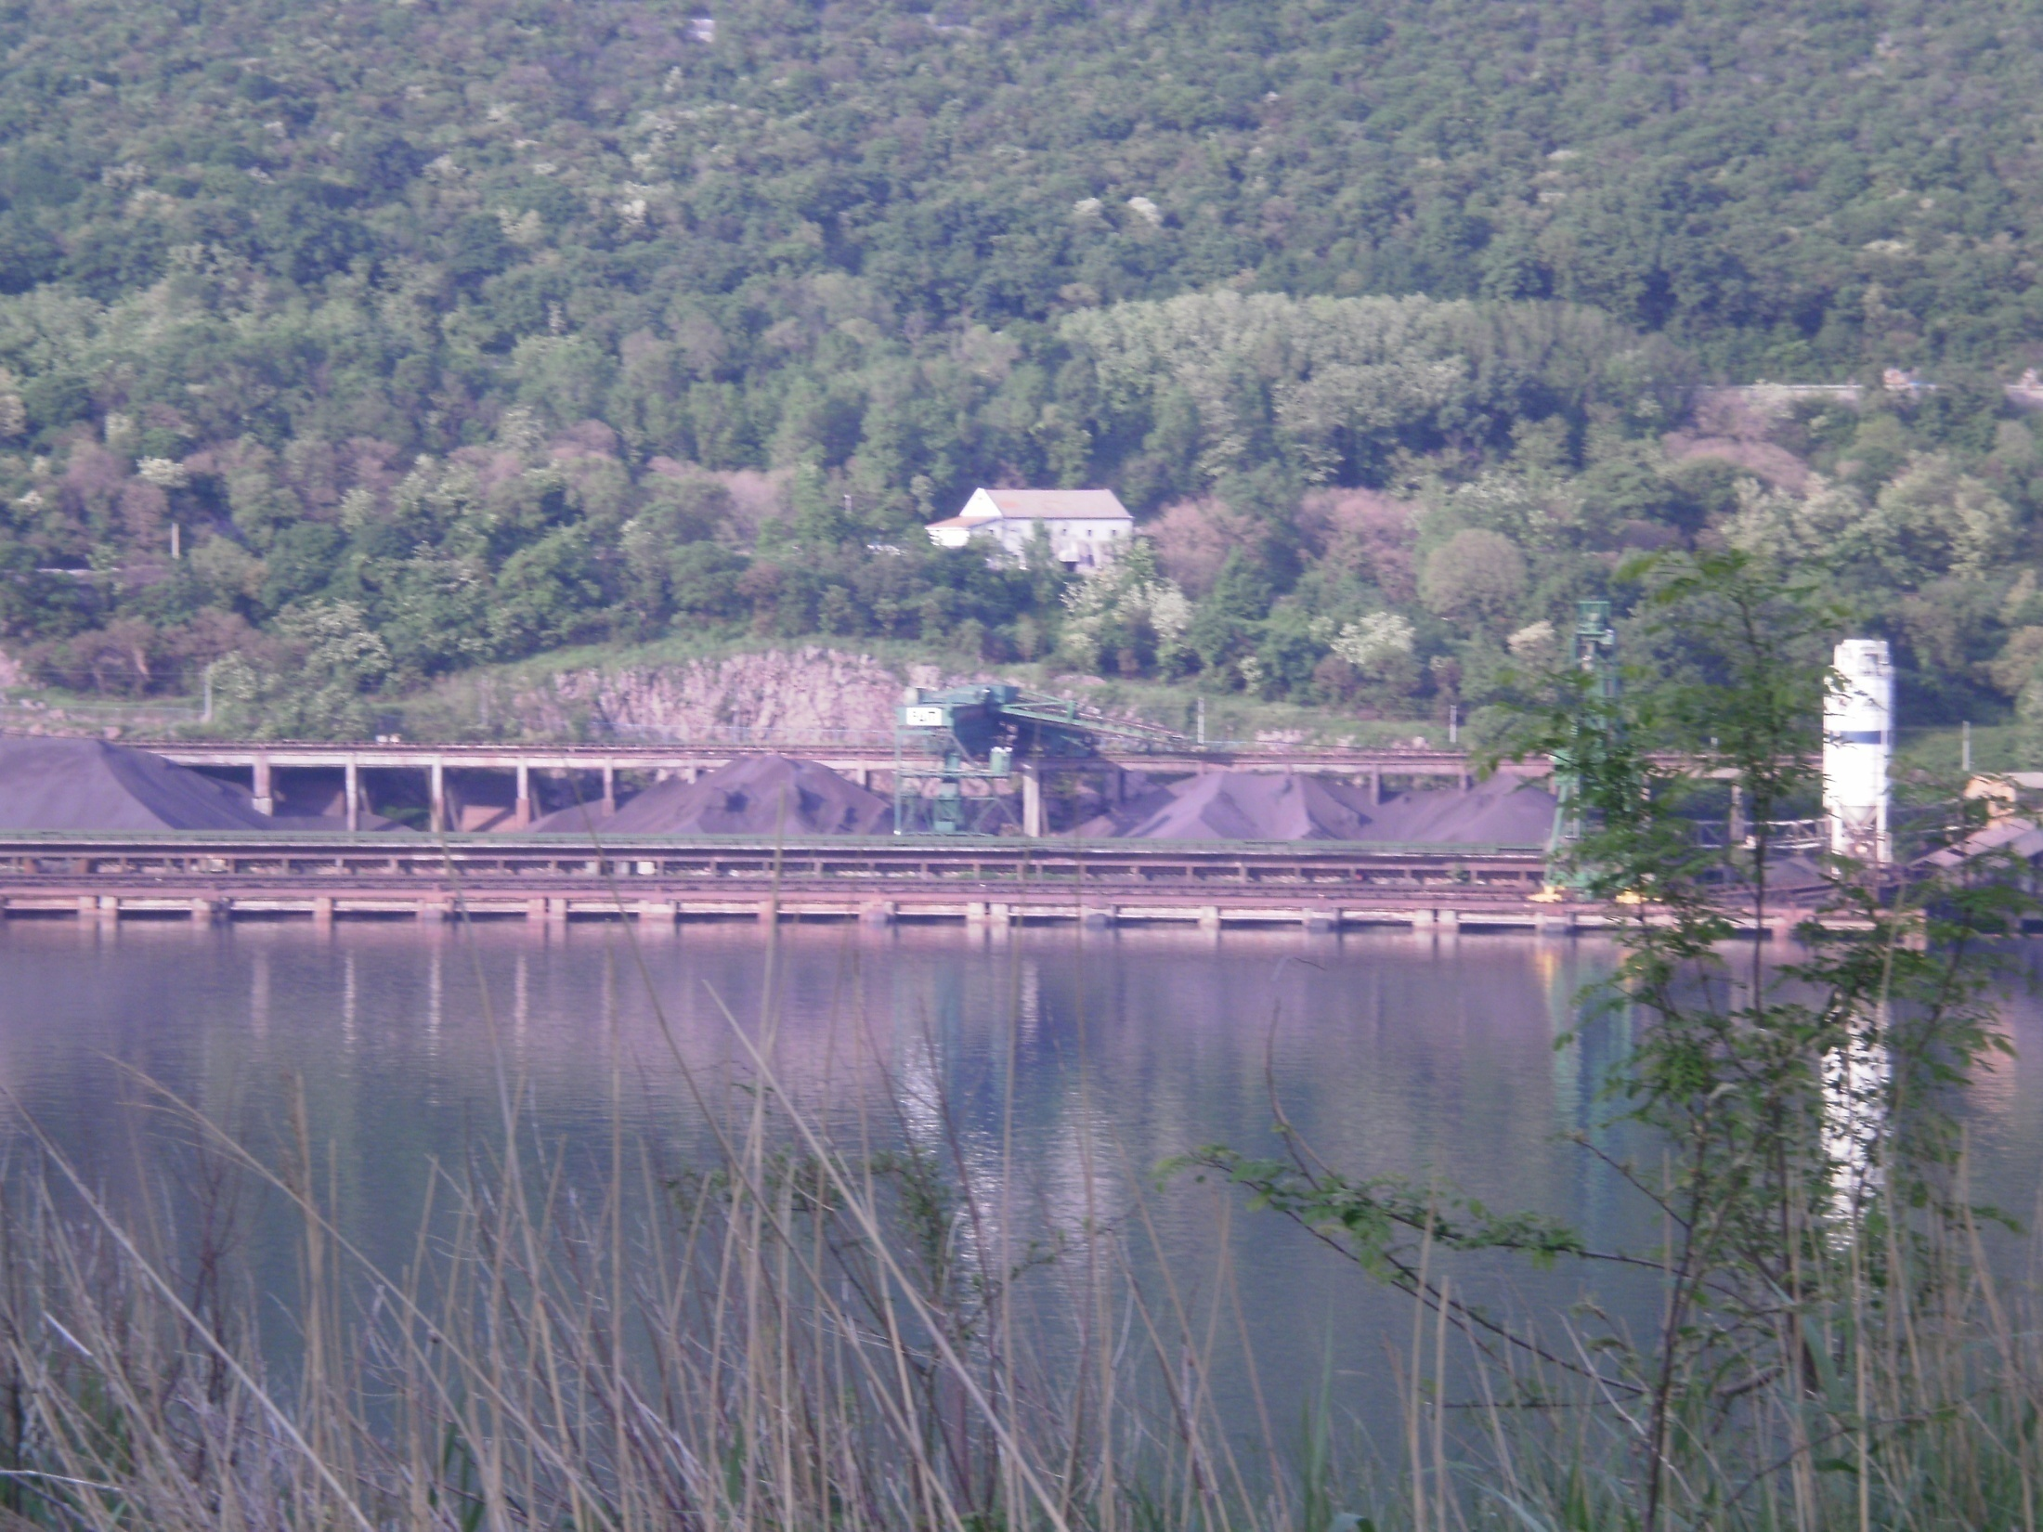
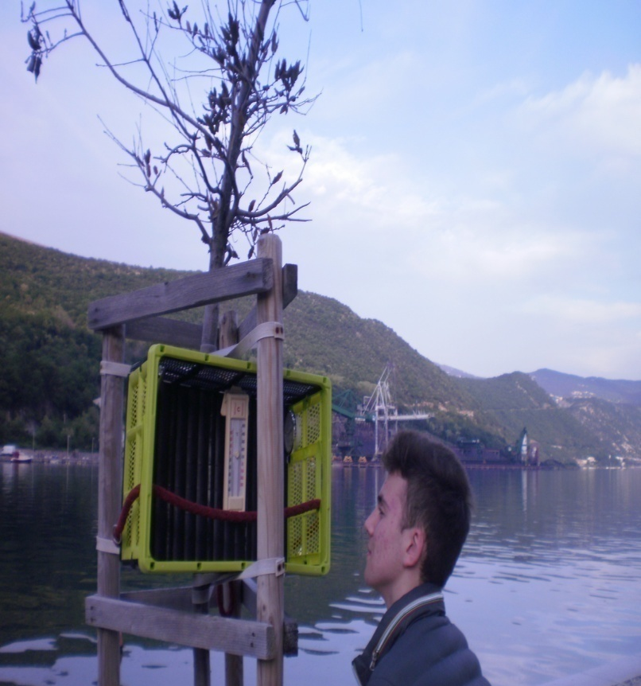
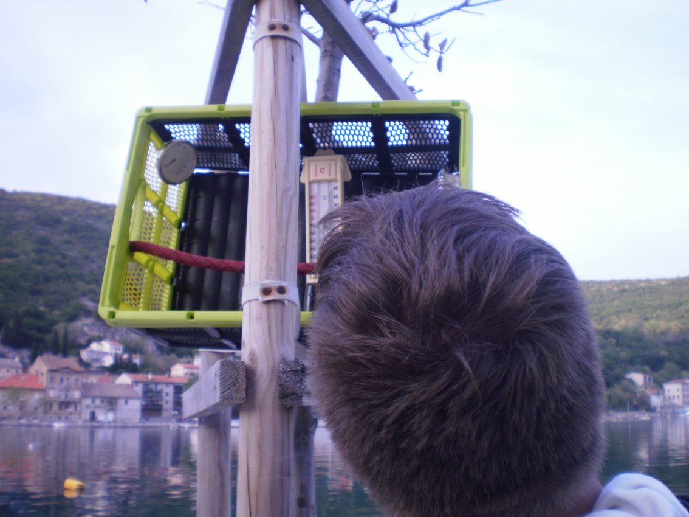
N 45 21 5; E 14 32 10; visina 2m
Notes:
Our station

Slide 12
Research data
(1) RN Urinj
(2) Klanac
(3) Stara cesta
(4) Nova cesta
(5) Hotel(parkiralište)
(6) Luka za rasute terete
(7) Hreljin
(8) Prirodoslovna i grafička škola Rijeka
Postaja | 1 | 2 | 3 | 4 | 5 | 6 | 7 | 8
pH | 7.5 | 6.7 | 6,5 | 6,9 | 6,7 | 6,9 | 7,4 | 7,1
Vodljivost µS/cm | 42.7 | 74.8 | 12,83 | 257 | 19,6 | 29,5 | 89,2 | 10,1
Notes:
We measured pH after 1 month so it does not indicate the real acidity of the rain
We measured conductivity too (in our previous projects we proved that the conductivity is proportional to the quantity of heavy metals, ions and sulphur dioxide in the soil-by quantitative analysis)

Slide 13
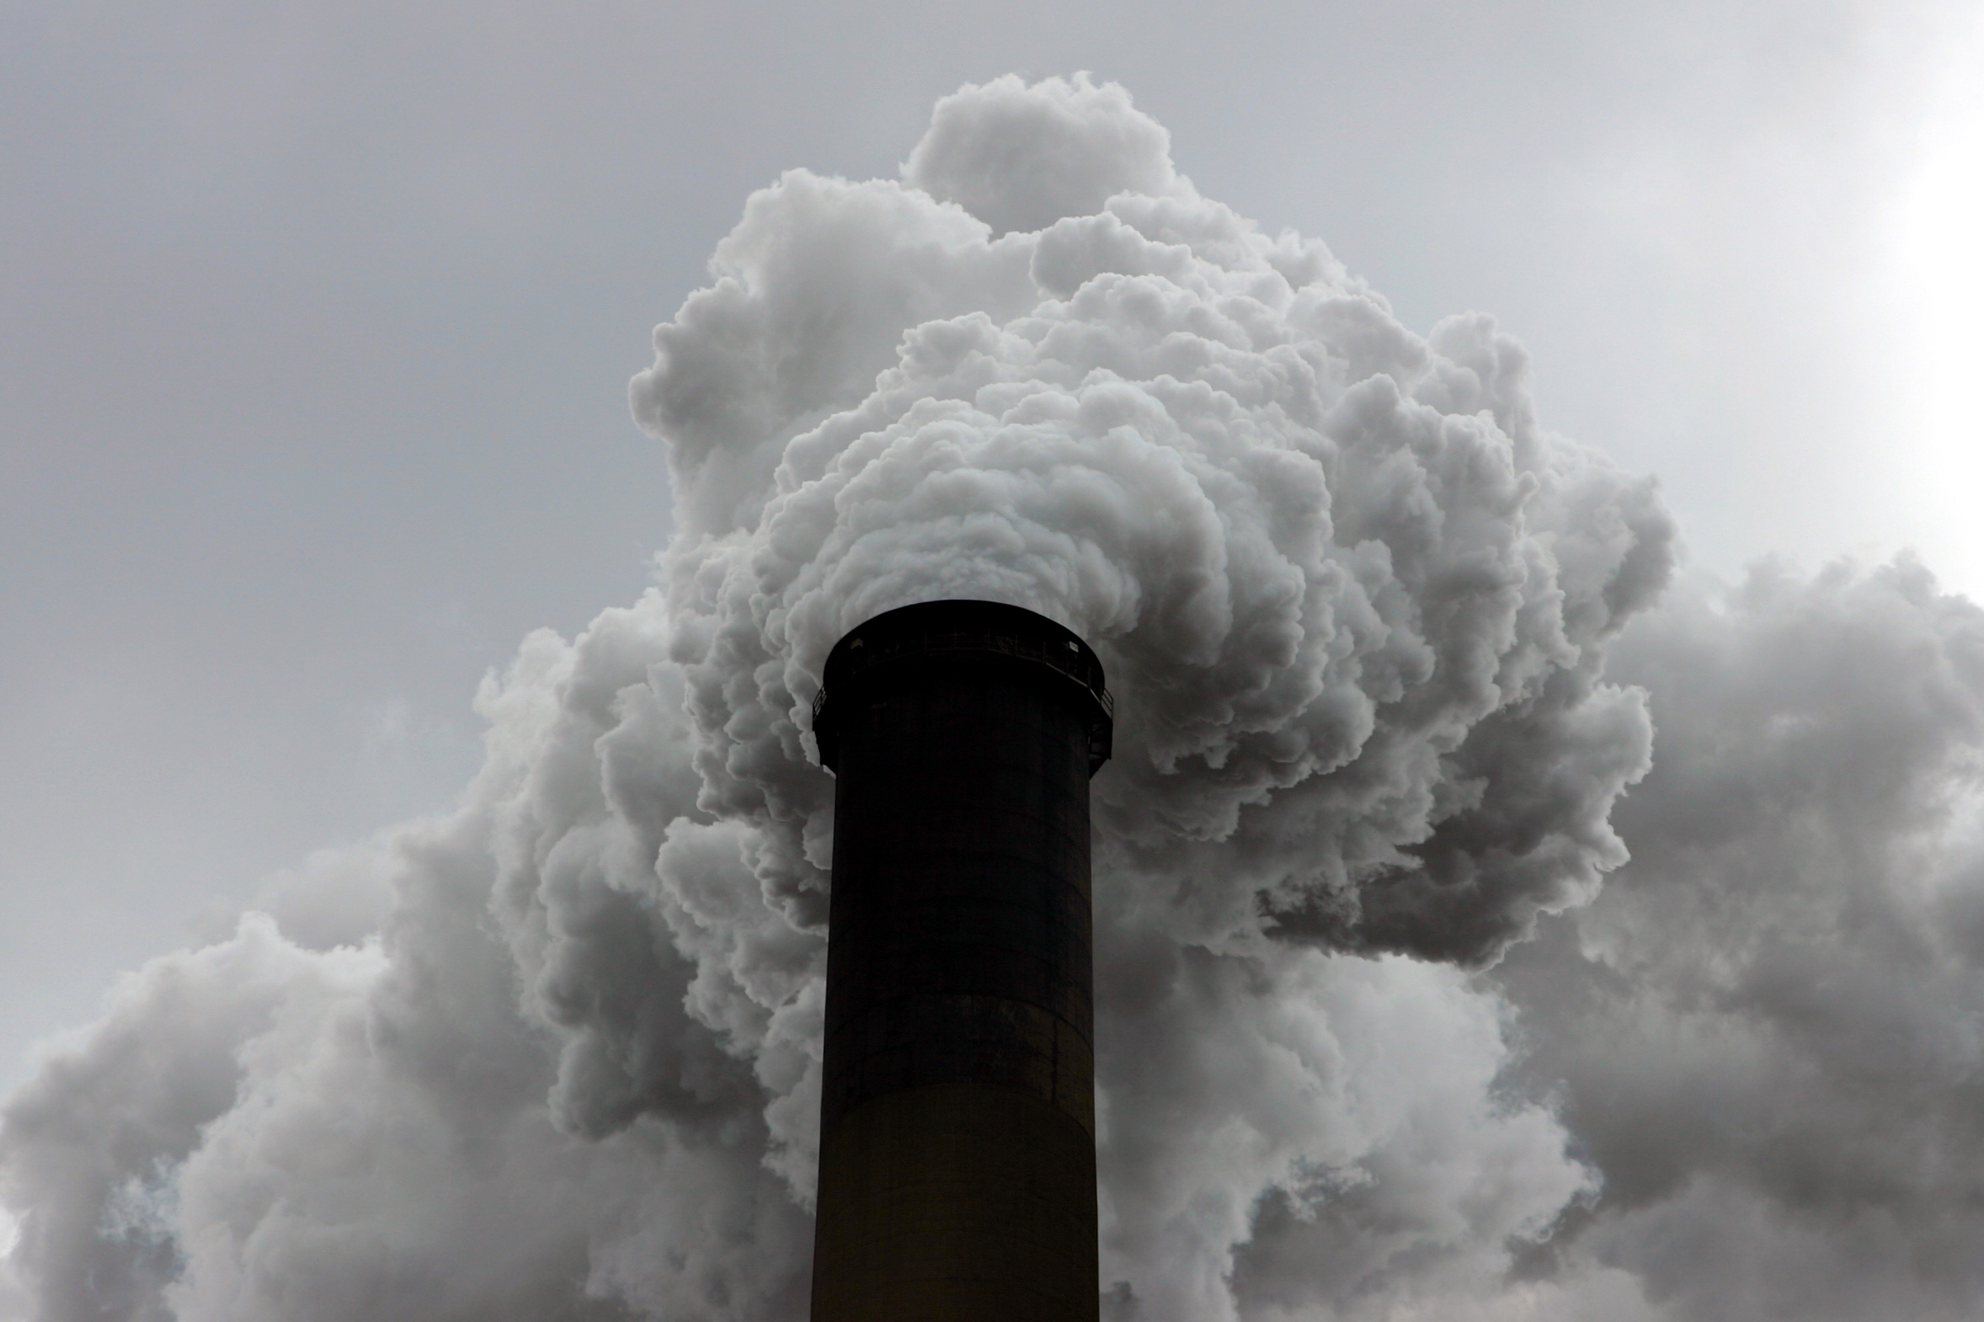
Temperature
Temperature was lower than the average
Notes:
The temperatures were lower then the averages

Slide 14
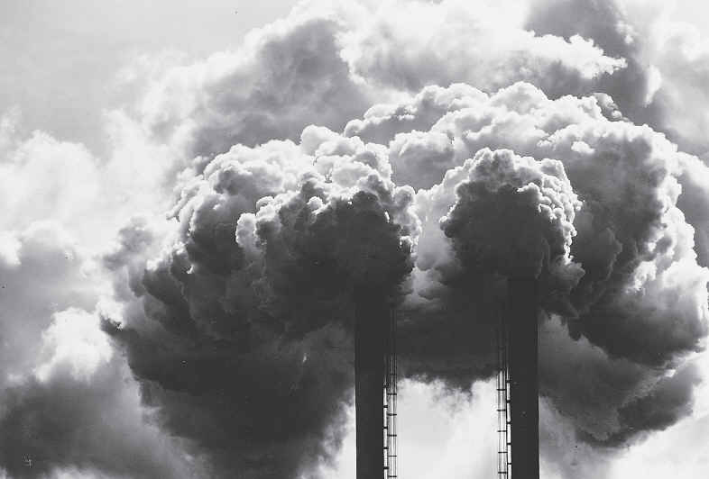
The moisture was higher than the average
Notes:
The moisture was higher than averges

Slide 15
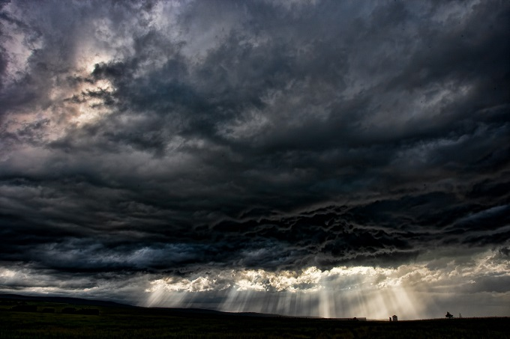
We measured cloud cover in %
Notes:
We measured cloud coverage in %

Slide 16
Rainfall
The month was extremely wet (143 mm of rain)
Notes:
The month was extremely wet(143 mm of rain)

Slide 17
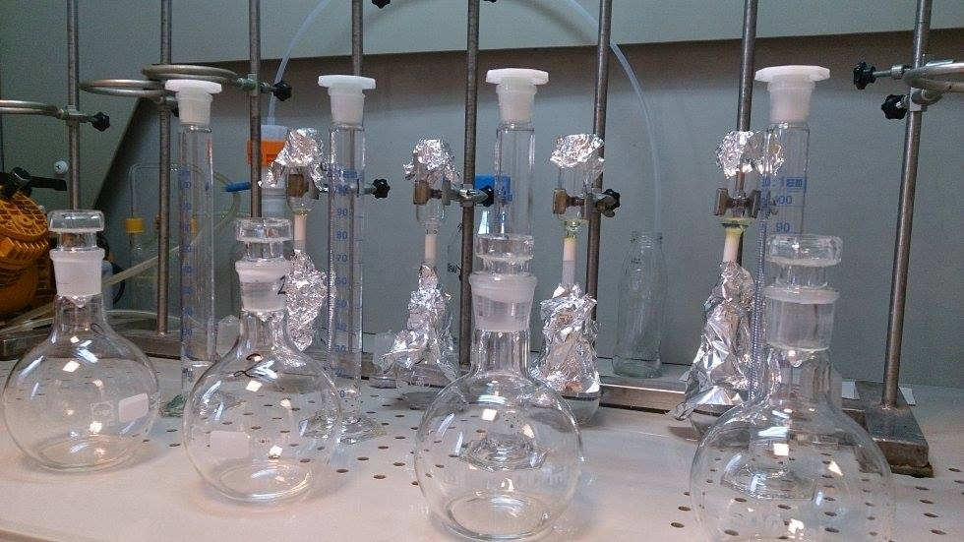
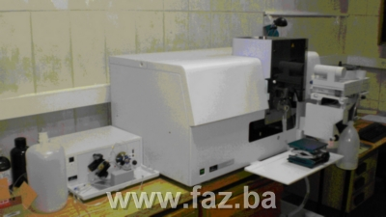
Heavy metals and organic substances
Determinating heavy metals by ICP-MS spectrometry and PAHs by gas chromatography
Notes:
Measuring heavy metals and PAHs in NZZJZ PGŽ Rijeka(and we thank them)

Slide 18
TOTAL MASS OF COLLECTED PARTICLES
UZORAK | 1 | 2 | 3 | 4 | 5 | 6 | 7 | 8
mg/l | 72,98 | 45,48 | 249,15 | 98,57 | 20,68 | 585,10 | 37,92 | 16,95
GVmg/l NN 80/13 | 29,16 (we divided the annual allowed amount by twelve-29,16- because we wanted to show the whole amount of collected particles)
The total mass of collected particles is high according to standards
Mass of anorganic particles
UZORAK | 1 | 2 | 3 | 4 | 5 | 6 | 7 | 8
mg/l | 58,83 | 28,24 | 221,65 | 76,53 | 16,10 | 553,90 | 16,70 | 16,95
Mass of organic particles
UZORAK | 1 | 2 | 3 | 4 | 5 | 6 | 7 | 8
mg/l | 14,15 | 17,24 | 27,50 | 22,04 | 4,58 | 31,20 | 21,22 | 0
Notes:
The total mass of collected particles is high according to standards(we divided the annual allowed amount by twelve-29,16- because we wanted to show the whole amount of collected particles)

Slide 19
Polycyclic aromatic hydrocarbons-PAHs
POSTAJA | NAFTEN | ACENAFTEN | FENANTREN | FLUORANTEN | PIREN | KRIZEN | BENZO FLUORANTEN | BENZO PIREN
BAKAR- STARA CESTA μg/dm³ | 870,13 | 114,36 | 0,8764 | 0,11152 | 7,412 | 3,783 | 9,22966 | 8,8006
BAKAR- CENTAR μg/dm³ | 0 | 116,08 | 0,57779 | 0,19542 | 13,34 | 8,6825 | 0 | 0
GV(zrak) μg/dm³ | 0,1 | nije propisano | nije propisano | 0,003 | nije propisano | nije propisano | nije propisano | 2
GV(voda) μg/l | 10 | 0,1 | 0,1 | 10 | nije propisano | nije propisano | 3 | 5
Notes:
In or samples we found PAHs: naphtene,phenantrene,fluorantene,pyrene ,chrysene,benzofluorantene and benzopyrene
The data is not veryfied because of our method of collection and the methods of recalculating the data
To show the pollution we used national air quality standards and national water quality standards
We found out that many PAHs and their effects on humans have not been investigated but accoding to U.S. Department of
Health and Human Services (HHS) benzofluoranthene and benzo pyrene are known animal carcinogens and according to International Agency for Research on
Cancer (IARC) benzopyrene, chrysene and benzofluoranthene are probably carcinogenic to humans.
We found the same PAHs in our earlyer research „Diving into the depths of Bakar Bay.”

Slide 20
Polycyclic aromatic hydrocarbons -PAHs
In or samples we found PAHs: naphtene,phenantrene,fluorantene,pyrene, chrysene,benzofluorantene and benzopyrene
The data is not verified because of our method of collection and the methods of recalculating the data
To show the pollution we used national air quality standards and national water quality standards
We found out that many PAHs and their effects on humans have not been investigated but accoding to U.S. Department of Health and Human Services (HHS) benzofluoranthene and benzo pyrene are known animal carcinogens and according to International Agency for Research on Cancer (IARC) benzopyrene, chrysene and benzofluoranthene are probably carcinogenic to humans.
We found the same PAHs in our earlyer research „Diving into the depths of Bakar Bay.”
Notes:
In or samples we found PAHs: naphtene,phenantrene,fluorantene,pyrene ,chrysene,benzofluorantene and benzopyrene
The data is not veryfied because of our method of collection and the methods of recalculating the data
To show the pollution we used national air quality standards and national water quality standards
We found out that many PAHs and their effects on humans have not been investigated but accoding to U.S. Department of
Health and Human Services (HHS) benzofluoranthene and benzo pyrene are known animal carcinogens and according to International Agency for Research on
Cancer (IARC) benzopyrene, chrysene and benzofluoranthene are probably carcinogenic to humans.
We found the same PAHs in our earlyer research „Diving into the depths of Bakar Bay.”

Slide 21
Metals
HEAVY METALS | Pb µg/L | Cd µg/L | Ni µg/L | Cu µg/L | Zn µg/L | Fe µg/L
Bakar-Luka(3) | 0,1486 | 0,006972 | 0,1231 | 0,6236 | 3,756 | 6,9
Bakar-Stara cesta(6) | 0,3159 | 0,007812 | 0,40476 | 1,2488 | 5,4888 | 39,09
Prirodoslovna i grafička škola Rijeka | 0 | 0 | 0 | 0 | 0 | 0
GV(air) μg/dm³ godišnje NN 117/12. | 0,1 | 0,005 | 0,020 |  |  | 20
Notes:
The same as for PAHs

Slide 22
Ions
IONI* | Cl⁻ mg/L | NO₃⁻ mg/L | SO₄²⁻ mg/L | Na⁺ mg/L | NH₄⁺ mg/L | K⁺ mg/L | Ca²⁺ mg/L | Mg²⁺ mg/L
Bakar-Luka(3) | 16,32 | 1,56 | 27,12 | 20.88 | 8,52 | 5,54 | 53,28 | 5,88
Bakar-Stara cesta(6) | 23,16 | 83,4 | 25,20 | 14,64 | 0,48 | 12,72 | 17,0 | 8,89
Prirodoslovna i grafička škola Rijeka | u tragovima | 0 | 0 | u tragovima | 0 | 0 | 0 | 0
GV(voda) |  |  | 25 |  | 10

Slide 23
CONCLUSION
Heightened concentration of heavy metals and PAHs!
Notes:
According to our data the concentration o heavy metals and PAHs the air pollution in Bakar is very high.
We think that living in Bakar is very dangerous: in our past projects we investigated the soil,sea and the bottom of the Bakar bay and found dangerous quantity of heavy metals in soil, PAHs and heavy metals in the sediments at the bottom of the sea, coliform bacteria in the sea.
But after this project we are most concerned about the amount of the PAHs in the air.The PAHs are carcinogenic and there are uncertainties associated with the toxicities of PAH mixtures.
We will inform the inhabitants of Bakarof our findings and together try to influence the cargo port to cover their cargo(mostly ore and charcoal in small particles).

Slide 24
CONCLUSION
We think that living in Bakar is very dangerous: in our past projects we investigated the soil,sea and the bottom of the Bakar bay and found dangerous quantity of heavy metals in soil, PAHs and heavy metals in the sediments at the bottom of the sea, coliform bacteria in the sea.
But after this project we are most concerned about the amount of the PAHs in the air. The PAHs are carcinogenic and there are uncertainties associated with the toxicities of PAH mixtures.
We will inform the inhabitants of Bakar about our findings and together try to influence the cargo port to cover their cargo (mostly ore and charcoal in small particles).
Notes:
According to our data the concentration o heavy metals and PAHs the air pollution in Bakar is very high.
We think that living in Bakar is very dangerous: in our past projects we investigated the soil,sea and the bottom of the Bakar bay and found dangerous quantity of heavy metals in soil, PAHs and heavy metals in the sediments at the bottom of the sea, coliform bacteria in the sea.
But after this project we are most concerned about the amount of the PAHs in the air.The PAHs are carcinogenic and there are uncertainties associated with the toxicities of PAH mixtures.
We will inform the inhabitants of Bakarof our findings and together try to influence the cargo port to cover their cargo(mostly ore and charcoal in small particles).

Slide 25
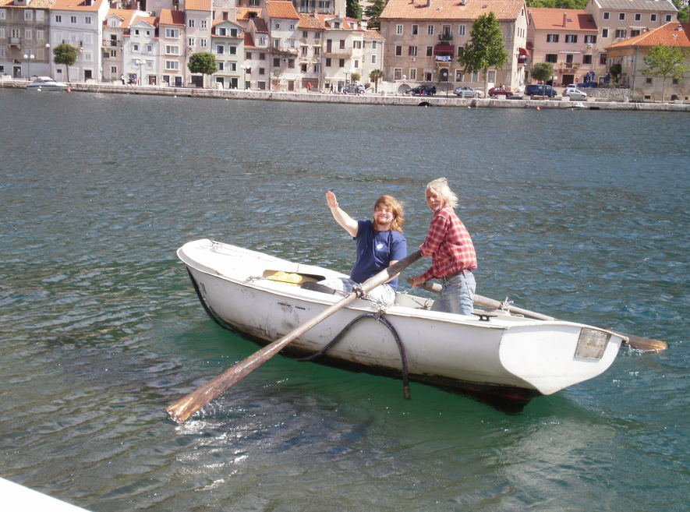
THANK YOU FOR YOUR ATTENTION !
ANY QUESTIONS?
Notes:
If you have any questions here is my mail:
mapav18@gmail.com

