Slide 1
The effects of color and size on the attractiveness of mosquito traps
By Eitan Benzaquen, Dominic Lampo, Andrew Quintana, Karim Elyoussef, and Ethan Arroyo
Notes:
Say hello: Dominic, Eitan, Karim, Ethan, (Andrew)
Hello I’m Dominic and I’m here today with Eitan, Karim, Ethan, and Andrew who is currently under the weather and will not be speaking today. We are here to present our research on the effects of...

Slide 2
Do the color and surface area of mosquito traps have an effect on their ability to attract mosquitoes?
Our Research Question
Notes:
Eitan
Our research question is: Do color and surface area of the traps have an effect on their ability to attract mosquitoes?

Slide 3
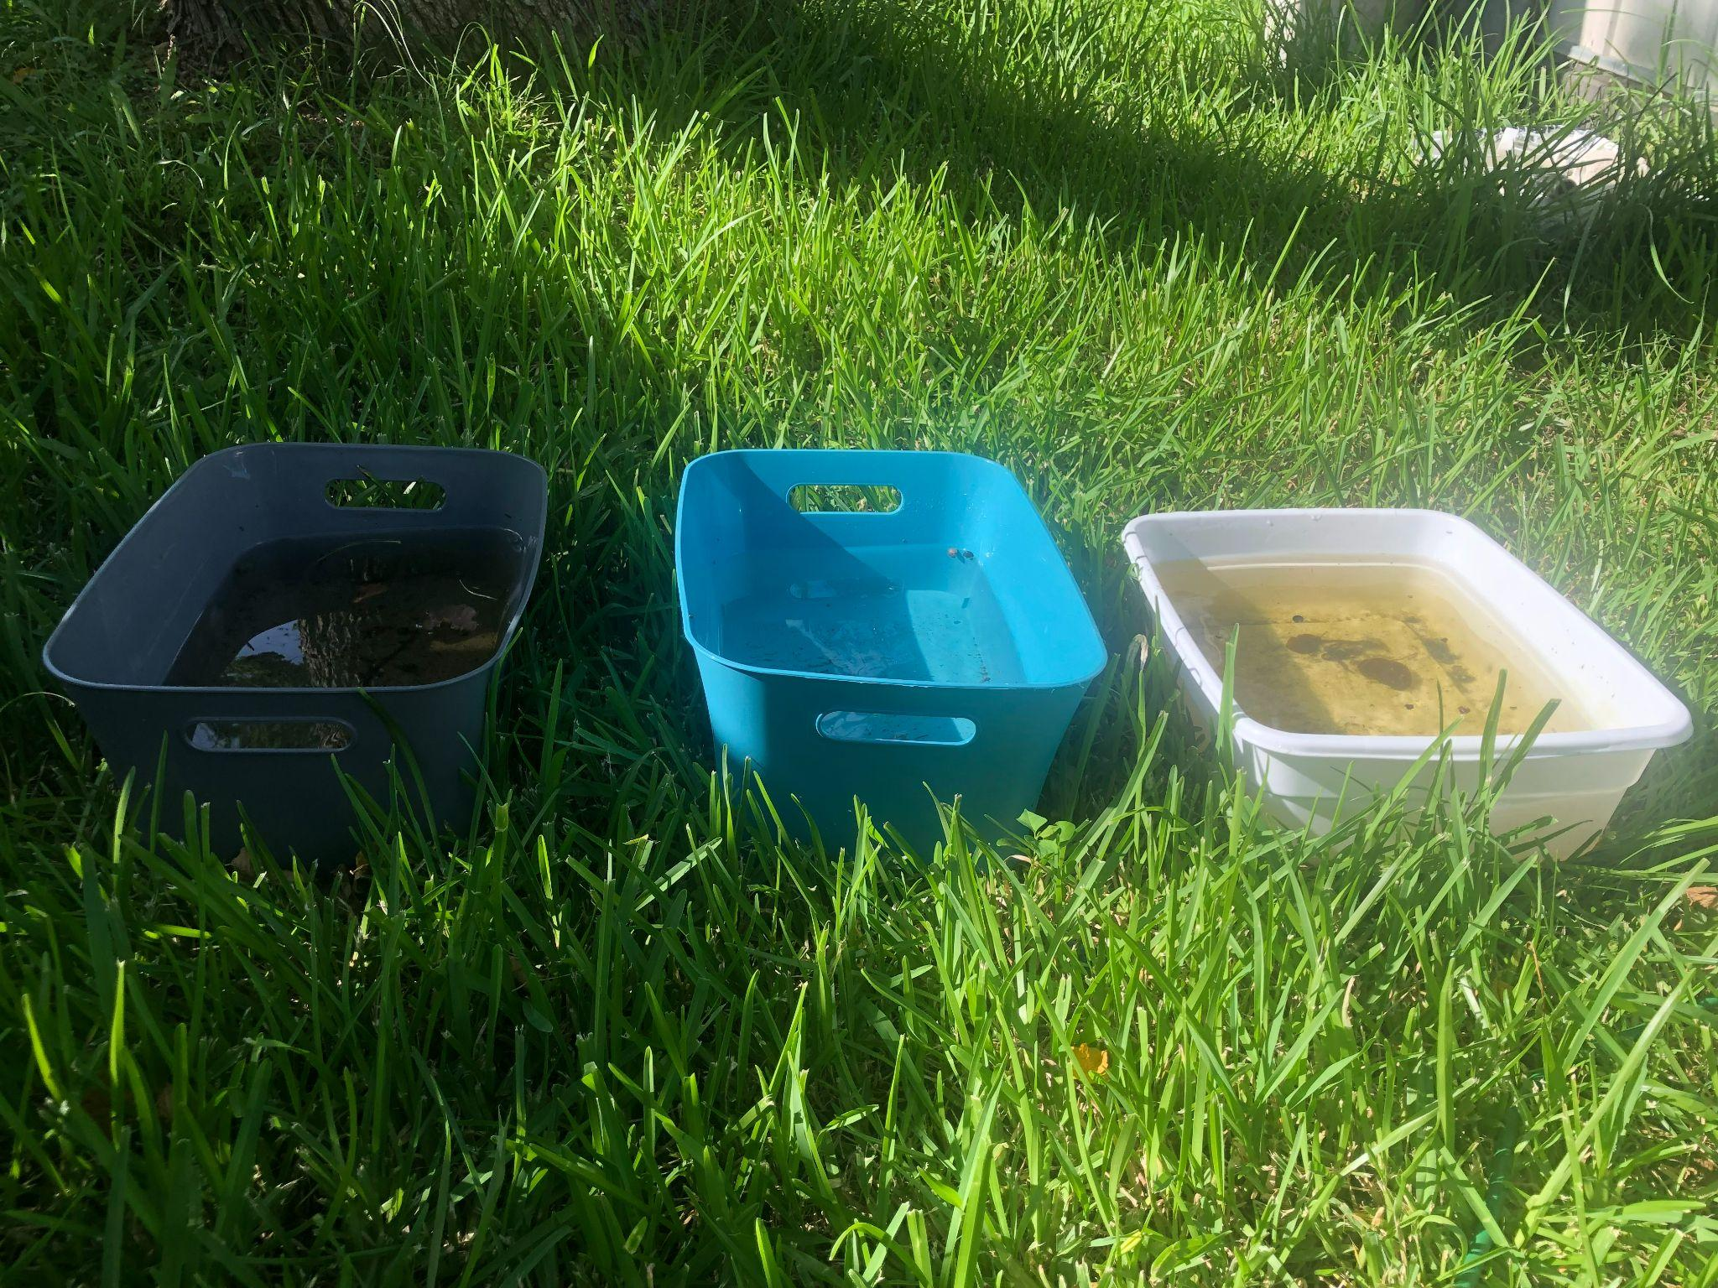
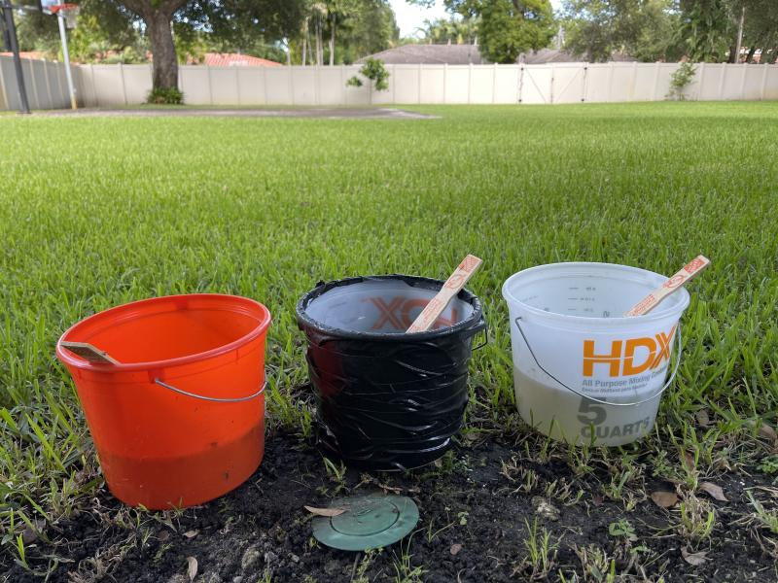
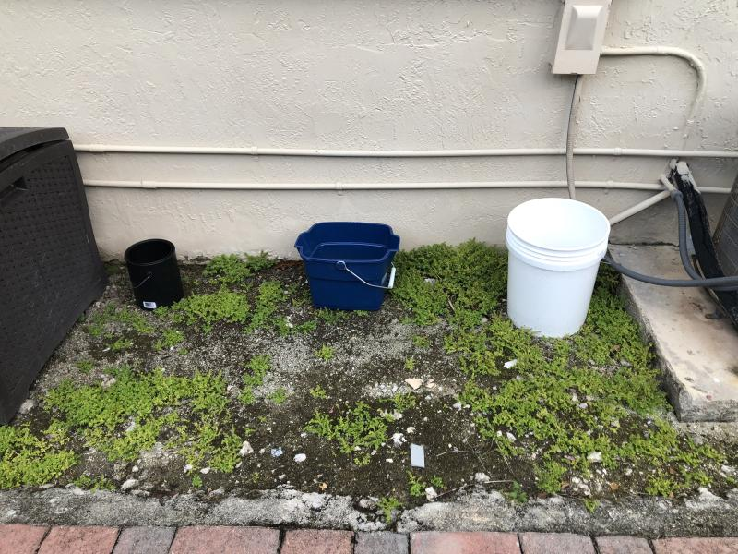
To answer our question Eitan, Andrew, and Karim...
Notes:
Eitan
Here you can see the traps set up by Karim (on the right), Andrew (in the middle), and I (on the left). We each set up our traps in similar outdoor environments with shade and different color buckets. We all used a white bucket and a black bucket as controls and added a colored bucket as our independent variable to test in comparison to the control buckets.

Slide 4
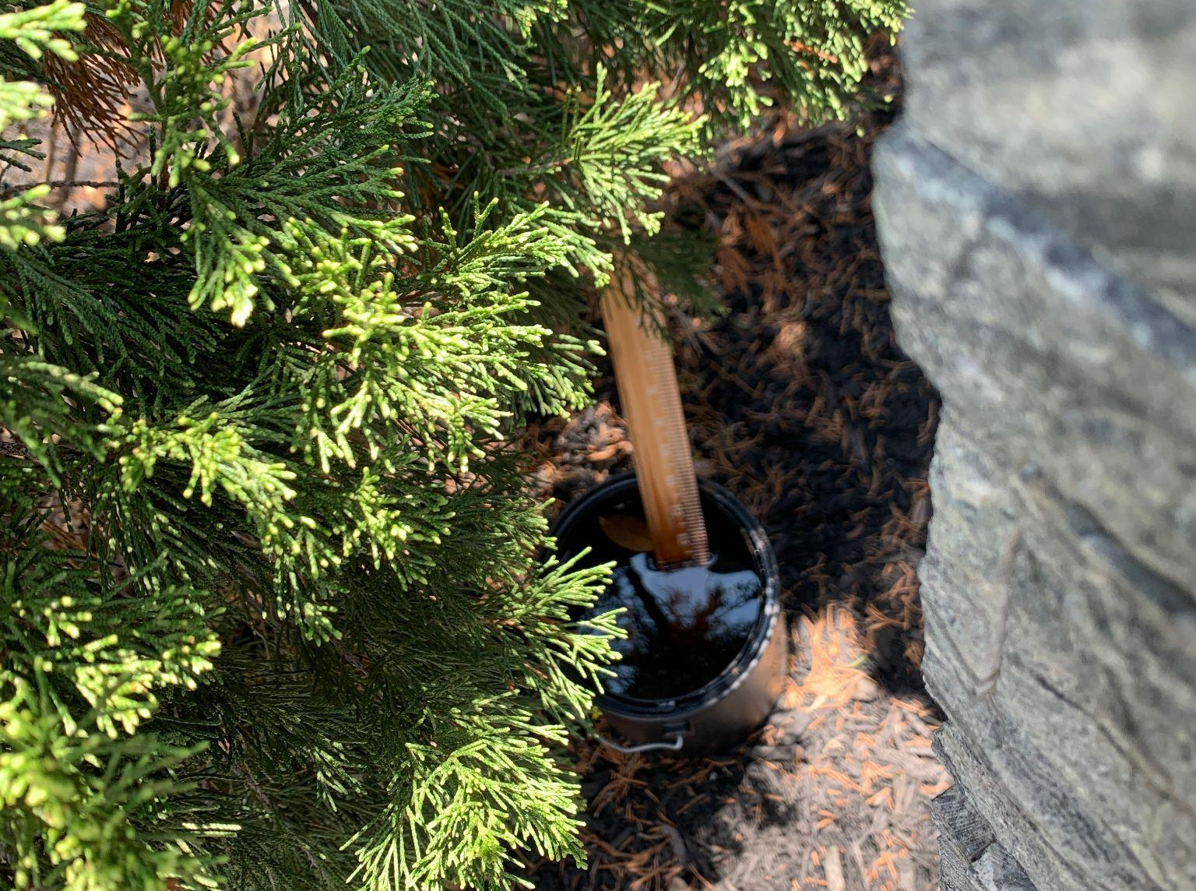
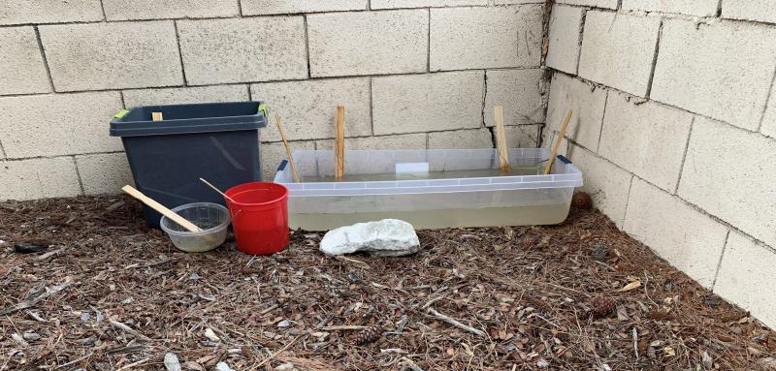
… and Dominic and Ethan
Large bucket Surface Area ~600in ^2
Small paint can Surface Area ~28in²
Medium bucket Surface Area ~100in ^2
Medium bucket Surface Area ~100in ^2
Large bucket Surface Area ~600in ^2
Small paint can Surface Area ~28in²
Notes:
Dominic
Here you can see the traps set up by me and Ethan. We each set up our traps in similar outdoor environments with shade and different sized buckets. Two of my traps were set up near my house and the largest one was set about 20 minutes away at my school.

Slide 5
If you have a big surface area and a dark color, then the trap will attract more mosquitoes.
Our hypothesis
Notes:
For our hypothesis we expect that darker colors and larger surface areas will attract more mosquitos. Dominic next slide
Karim

Slide 6
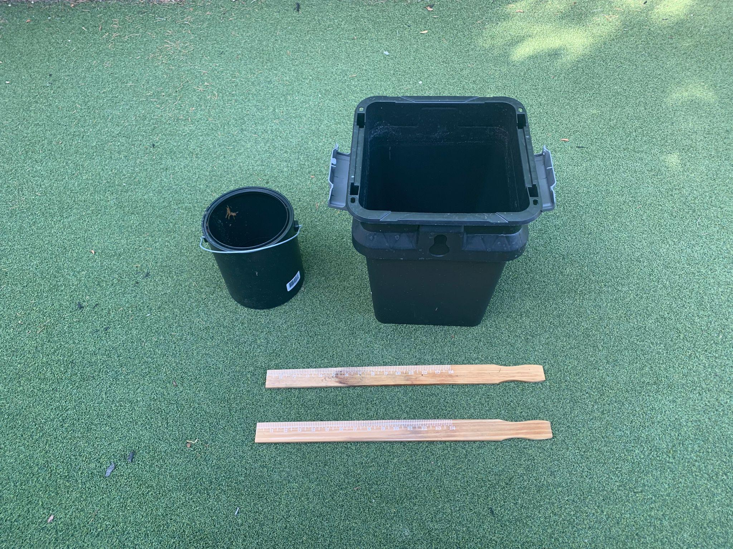
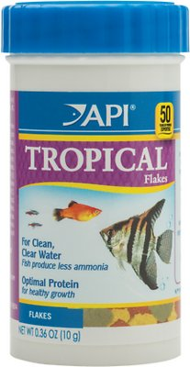
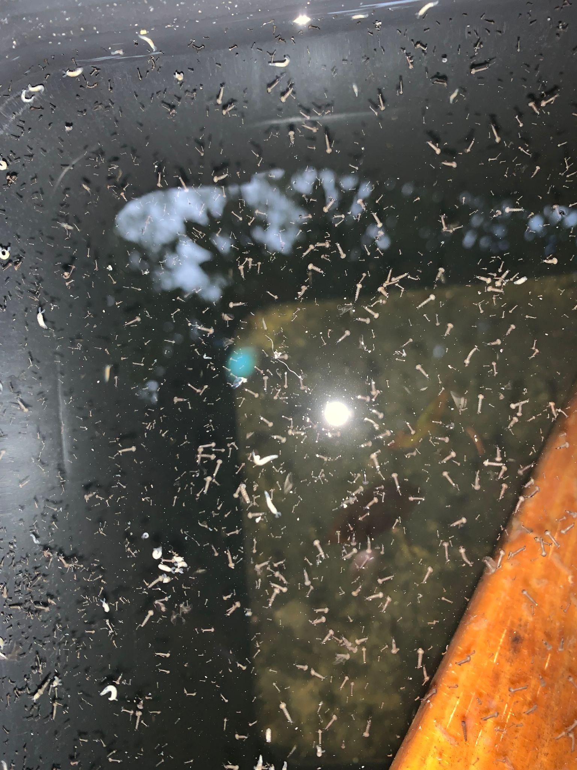
How was the experiment set up?
TIME: 1 week
IVs: Surface Area, Color
DV: Number of Mosquito larvae
Controlled Variables: Bait (fish flakes) and Land Cover
Notes:
ethan
For the experiment we had a one week time frame to set and gather data for the traps with the independent variables being surface area and color with the dependent variable being the number of mosquito larvae in the traps. The controlled variables are the bait and land cover.

Slide 7
Collected Data (Colors)
 | Day 2 | Day 4 | Day 6
White | 4 | 20 | 2
Blue | 0 | 2 | 0
Black | 0 | 5 | 0
Notes:
For our colored buckets we consistently noticed at least a couple larva in the white bucket, which larva were only found in the blue and black bucket on day 4. From day 2 to 4 we saw an increase in larva in all colors but once day 6 was reached we found less larva than on day 2.
Karim

Slide 8
Analysis of data (Colors)
White
The white trap showed to be most effective when attracting mosquitos as it consistently had larva. Larva were also found on day 6 were the previous day it had rained washing out the traps.
Blue
The blue trap showed to be the least effective when attracting mosquitos as only two larva were found across all 6 days.
Black
The black trap showed to be slightly more efficient than the blue trap as five larva were found across all 6 days
Notes:
The blue trap showed to be the least effective when attracting mosquitos with the black trap showing to be slightly more efficient. On the other hand the white trap did show to be the most effective for attracting mosquitoes as it was the only that consistently had larva, even after the buckets were rained out on day 5.
Karim

Slide 9
Collected Data (Surface Area)
 | Day 2 | Day 4 | Day 6
Small Bucket 28 in² | 0 | 603 | 416
Medium Bucket 100 in² | 243 | 1941 | 676
Large Bucket 600in² | 204 | 2743 | 1834
Notes:
So here we have data collected for the surface area and in this I checked the traps every two days over the span of a week. Now as you can see with the small in medium buckets in days two in 4 there is a strong increase in mosquito larvae. By dividing these resulting to their respective area you get roughly 20 larvae per square inch

Slide 10
Analysis of data (Surface Area)
From the data I am able to conclude that a larger surface area attracts more mosquitoes sooner.
But as the week went on I confirmed that the density of mosquito was similar between the small and medium buckets averaging around 20 mosquitos per square inch.
Notes:
Dominic
But It is important to note that by day four traps had similar densities proving the theory that larger bodies of water attract mosquitoes faster but in the end all hold a similar amount of larvae.

Slide 11
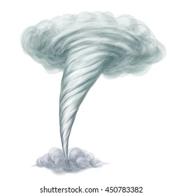
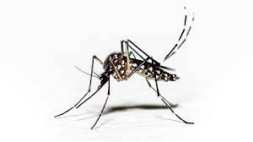
Possible Errors in data:
Eitan’s and Andrew’s Traps :
Intense weather made the possible environment for mosquitoes very unlikely resulting in little to no data being collected.
Karim’s Traps
Traps were placed in uneven shading which changed throughout the day
White: was under almost constant shade under a tree
Blue: partial shade throughout the day with full shade in the evening
Black: was shaded during the afternoon
Dominic’s Traps:
There was severe rain during the first two days of data collection in the area my large bucket was located resulting in a lower number of mosquito larvae
Ethan’s Traps:
Due to the lack of time and an unsuitable climate for mosquitoes not much data could be collected by my traps.
Notes:
Eitan:
Andrew and I both live in Miami and experienced similar weather throughout our research. Severe weather left us with little to no data. Andrew’s traps were often knocked over by storms, while my traps would get filled with debris and excess water, giving me very little, unreliable data about the few mosquito larvae I had caught.
Karim:
The white trap was shaded on average a lot longer than the black and blue traps. Over the course of the summer we have concluded that mosquitoes are attracted to more shaded areas. We have reason to believe that this could be behind the white traps performance. If we look solely at the data from the blue and black traps, which had roughly equal amounts of shade, our hypothesis does stand, but because of small amounts of data no conclusions can be made.
Dominic:
Ethan:
Due to the short time span and unsuitable climate for mosquitoes I only collected an insufficient amount of data for this study.

Slide 12
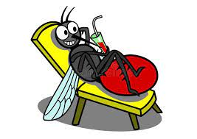
Conclusion
According to our data we can conclude that a larger surface area attracts more mosquitoes. But we found out that it is not necessarily the color of the buckets, but proper shading of traps that plays a key role in a good mosquito habitat.
Notes:
When talking about the weather mention that it included lighting and thunderstorms and rain with very little visibility, which in turn made conditions unsafe to go check/ repair traps.
So this can be applied to big lakes or ponds or storage containers left out
Dominic

Slide 13
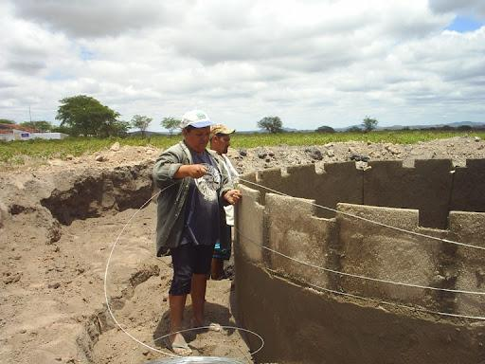
Why does it matter?
The goal of our traps showing the effectiveness of size and color on attracting mosquitoes is to help with preventing outbreaks of mosquito-transmitted disease in poverty-stricken countries, where it may be necessary to collect and store water in outdoor vats.
Notes:
Eitan
Why Does it Matter:
In poverty-stricken countries, rain collectors are often the only source for clean water. Although necessary for people in these areas, rain collectors can act as larger versions of our traps. Our goal with our research was to see if changing the surface area or the color of our traps could help keep mosquitoes to a minimum and avoid severe outbreaks of mosquito-transmitted diseases, like Malaria, in countries where rain collectors are common.

Slide 14
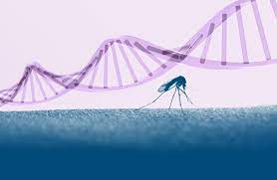
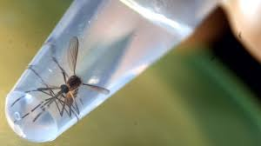
Future Research
We found a study that conducted research on changing the color of the water as a variable for attractiveness of mosquitoes. As a continuation of our research, combined with that study, we would like to conduct a study where we test the variable of trap color and water color together.
: Ortiz-Perea N, Gander R, Abbey O, Callaghan A (2018) The effect of pond dyes on oviposition and survival in wild UK Culex mosquitoes. PLoS ONE 13(3): e0193847. https://doi.org/10.1371/journal.pone.0193847
Notes:
We came across an experiment that studied the effects of dyes in water which can be found in many amusements parks and tourist attractions which could be a hazard for people in the area. The study found no significant differences in the number larva between the dyes used, indicating that they are not attractants. In the future we would like to pair our experiments as it could provided interesting information.
Karim

Slide 15
Thank you
If you have you questions, please ask!
Notes:
Eitan
Thank you for giving us your time and your ears. We would like to give our thanks to NASA, SEES, and the Texas Space Grant Consortium, along with Rusty, Cassie, Peder, and the peer mentors for the opportunity to present our research. At this time, feel free to ask any questions that you may have.

