Slide 1
Biosensing with Waveguides & Land Cover
Anna Ager, Justin Lan, Nicole Schmidt, Benito Esposti, Michelle Eno, Andrew Kim, Corbin Adkins, and Felipe Solorzano

Slide 2
Comparing Current Biosensing Methods
Biosensing Method | Advantages | Disadvantages
Reverse transcription polymerase chain reaction (RT-PCR) | Specific, sensitive, and rapid RT-PCR diagnosis test kits | Positivity is often limited to the acute stage of disease (2–7 days) Flavivirus infection can cause a weak or no viremia
Virus isolation | Direct pathogen detection can confirm flavivirus presence | Biosafety Laboratory considerations (BSL levels 2 to 4) Requirement of cultured cell lines for viral growth Requires expensive equipment Time consuming
Viral Antigen Capture | Rapid diagnosis test kits | Only available for dengue False positivity is possible
Serology | Specific and sensitive test kits | Complex Virus neutralization assays require BSL levels 2 to 4 Time consuming May have false positives between flavivirus
Notes:
Justin
First, it’s best to compare current biosensing methods, the first being reverse transcription polymerase chain reaction. RT-PCR utilizes DNA and RNA polymerase to identify changes in gene expression in order to diagnose disease. It’s highly sensitive and specific, but is limited to a disease’s acute stage. Virus isolation, where a virus is separated from a serum sample, offers direct pathogen detection, but is expensive, time-consuming, and laborious. Next, viral antigen capture is a method of virus capture in samples using a specific antibody and offers simple and rapid detection, but lacks versatility as it is only viable for dengue and introduces the risk of false positive detection. Lastly, serology involves the complex study of blood serum and is similar to viral antigen capture in terms of vulnerability to false positives.

Slide 3
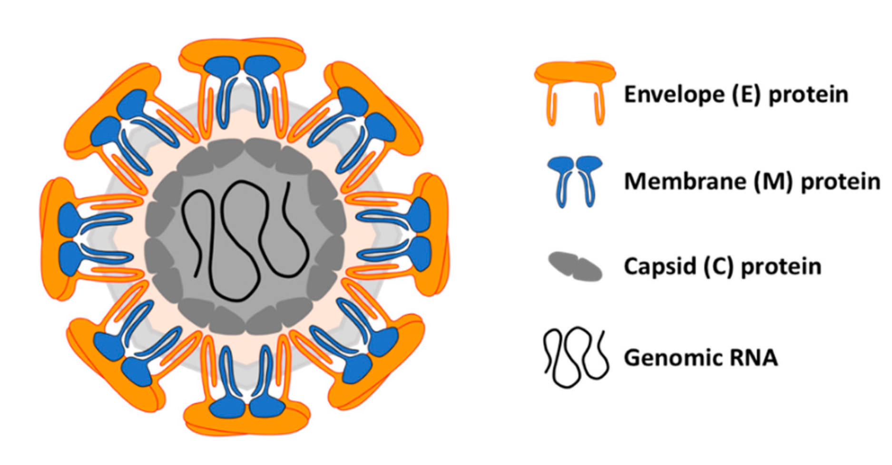
Flaviviridae
Flaviviridae are a family of single-stranded RNA enveloped viruses that share conserved structural and genomic features.
Dengue | West Nile | Yellow Fever | Zika
Aedes species mosquitoes | Culex species mosquitoes | Aedes or Haemagogus species mosquitoes | Aedes species mosquitoes
In areas where multiple flaviviruses co-exist, cross-reactivity between them may occur, in which different antigens appear similar in detection. This can make accurate diagnosis a challenging task.
This highlights the need for the joint operation of waveguides and accompanying contrast methods such as fluorescence and surface plasmon resonance.
Notes:
Justin

Slide 4
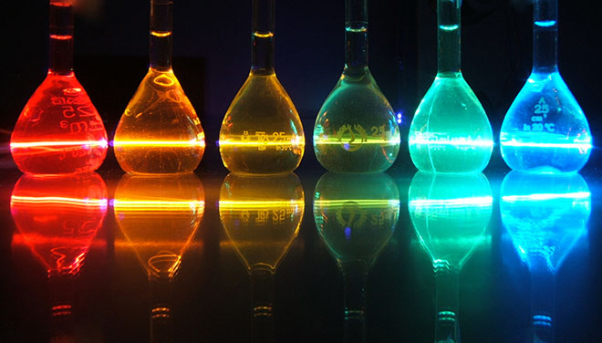
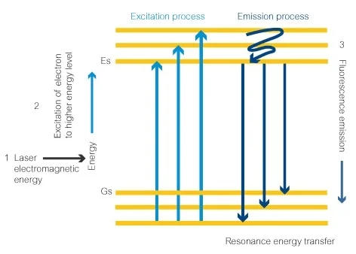
Comparing Contrast Methods
Fluorescence
Proteins known as fluorophores emit light of a specific wavelength when impacted by light of a different specific wavelength
These fluorophores can bind to specific biomolecules, making the target biomolecules stand out from the others in a sample
There are specific types of dyes that are used alongside individual viruses, ie: zika or dengue
Pros: lots of potential for use alongside waveguides, better than contrast dyes, generally more accurate than SPR
Cons: requires impact from light of a specific wavelength, single use, typically less portable
Notes:
Nicole

Slide 5
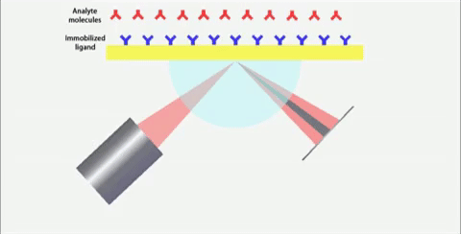
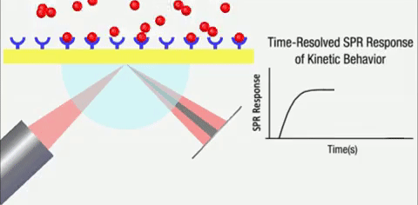
Comparing Contrast Methods
Surface Plasmon Resonance
A polarized light is fired at a metal film with glass on the side the light is being fired and a solution containing biomolecules on the other side (see the image to the right)
There are ligands on the metal, and as the biomolecules bind or don’t to the ligands, it affects the surface plasmons in the metal in a way that creates a dark band in the center of the resulting beam. That beam shifts depending on how many ligands bind or don’t.
Pros: doesn’t require light of a specific wavelength like fluorescence, generally cheaper and faster than fluorescence
Cons: Very specific applicative properties, not as accurate as fluorescence
Notes:
Nicole

Slide 6
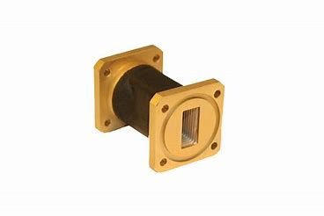
Understanding Optical Biosensor Waveguide Function
Electromagnetic device
Observable phase change
Used in conjunction with contrast method
Notes:
Waveguides are relatively simple electromagnetic biosensing devices. Light enters one side of the waveguide and undergoes a phase change in the waveguide due to its internal structure. When a waveguide is paired with a contrast method, such as fluorescence or spr, specific diseases can be tested for. The light in the waveguide passes directly through a contrast method and by determining the exact phase change, or fluorescence, the presence of a disease in a sample can be confirm or denied.

Slide 7
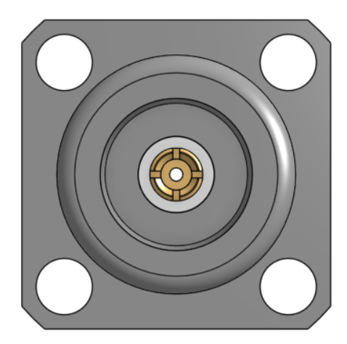
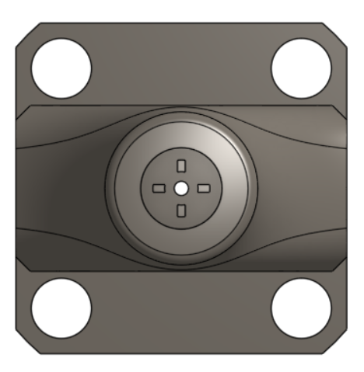
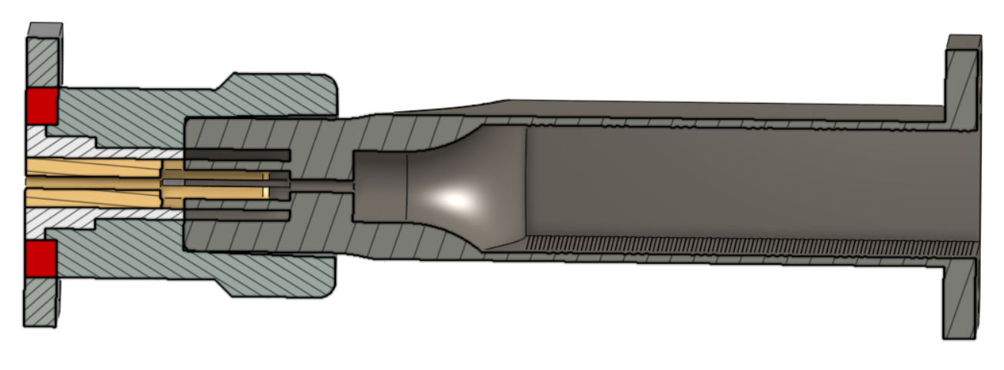
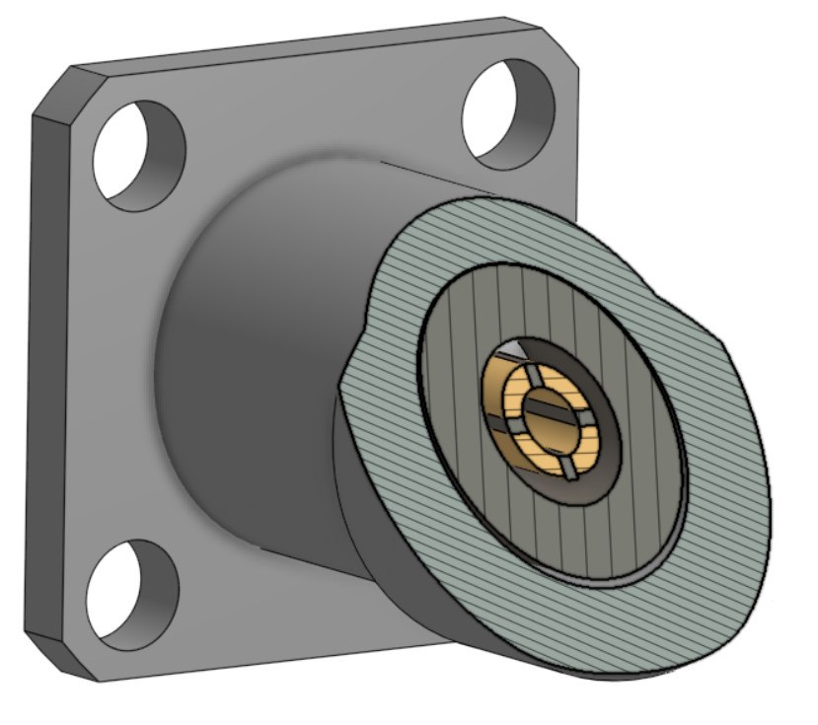
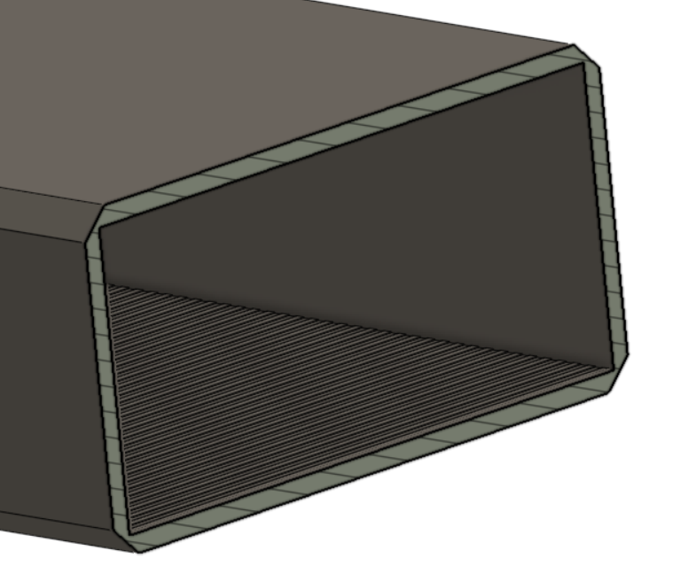
Our Design
Notes:
Here is our design for the waveguide. The light enters from the open rectangular end of the waveguide body and undergoes the phase change. The light then goes through the connector and into the vial chamber; where the light then shines through a glass vial containing a sample with the contrast method, and comes out the other end. How the disease is detected depends on whether fluorescence or spr is being used.

Slide 8
Implications for Waveguide Study
Current optochemical sensor limitations
Sensitivity
Reproducibility
Current optochemical sensor appeal
Cost
Design flexibility
The future
Connection of sensors into an optical network
Notes:
Michelle Optochemical sensors
These are disadvantages present in most other types of chemical sensors, however there are promising niche areas and successful applications in biosensing that are of growing interest. The low cost and design flexibility adds to the appeal of the design, and future developments include possibly connecting the sensors into an optical network that will lead to the direct coupling of sensing systems to optical systems.

Slide 9
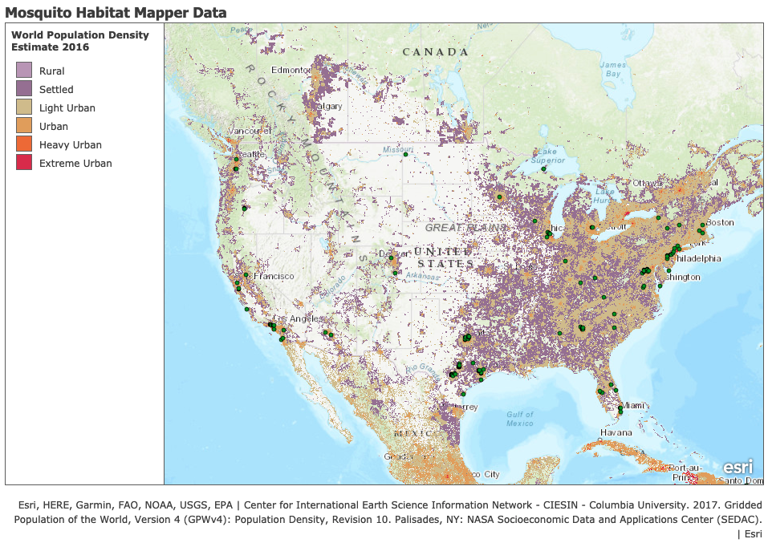
Mosquito Habitat Data
Dataset Used
2019-2021 Globe SEES Data
Concentration
Mosquito counts concentrated in coastal, urban regions
Data Limitations
Entirely reliant on where the interns lived
Entire spans of the country may be unrepresented
2019-2021 Mosquito Habitat Observations with at least 1 Larve Sighting, dots are individual observations and population measured in persons per kilometer squared
Notes:
*topic sentence for the transition from waveguide slide* - probably something like:
The contrast method for the waveguide was determined by observing the 2019 to 2021 Globe SEES Mosquito Habitat Mapper Data with a Esri Population Density Map that estimates people per square kilometer. It was determined the Habitat Mapper points were generally concentrated in coastal urban regions, suggesting a relationship between human and mosquito populations. However, it is important to consider the habitat observations were dependent in the residence of the SEES interns and may under represent certain areas around the US.

Slide 10
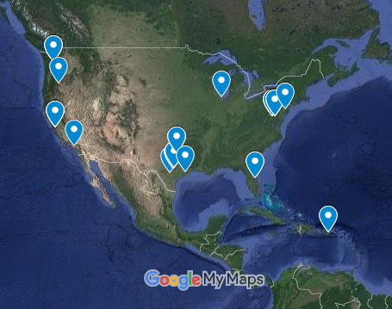
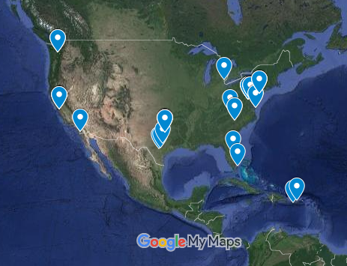
Vector Mosquito Data
GLOBE Data
Isolated observations of Aedes and Culex mosquitoes
Concentration
Primarily suburban areas
Generally coastal areas
Accessibility
Almost all of the observations were easily accessible by road or were in open areas
Aedes Observations
Map Data ©2021 INEGI Imagery ©2021 NASA, Terrametrics
Culex Observations
Notes:
Andrew
-what we talked about in andrew’s absence
Briefly cover method used for map making
Mention patterns of mosquito ovipositioning near cost- specifically dense, urban areas,

Slide 11
Target Audience for Waveguide
CDC
Mosquito habitat data gives knowledge of mosquito location
Devices can be chosen based on the needs of locations
Hospitals
Knowledge of diseases in their area will assist in preparation for outbreaks
The general public
Gives knowledge which can be used in preventive measures
Communities can use the fluorescence waveguide
About $825
Notes:
Michelle
$1.64 per fluorescence test
The mosquito habitat data used in our project can assist the CDC in making decisions about which device will be most beneficial by looking at where specific species of mosquitoes are prevalent. Hospitals and communities could use the data collected from the devices to have up to date information regarding diseases in their area which would allow them to be better prepared for any outbreaks.

Slide 12
Biosensing with Waveguides & Land cover Project Conclusion
Answers:
How do we detect the presence of certain mosquito-borne disease using waveguides?
By using fluorescence and SPR contrast methods to detect the presence of flaviviridae
Does the land cover data correlate with the potential effectiveness of the device? Yes, we believe that a fluorescence-based biosensor is most efficient for areas with dense human and mosquito population
Notes:
Anna

Slide 13
Thank you!
Any questions?

