Slide 1
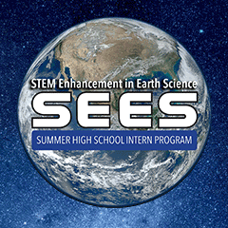
Identifying Anopheles/ Non-Anopheles Larvae with AI Implications
By Peer Mentor Vishnu Rajasekhar, Jocelyn Browning, Ashley Hume, Kellen Meymarian, Robyn Ogombe, and Hannah Slocum

Slide 2
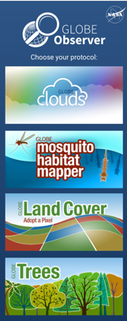
Research Goals
To explore the benefits and downfalls of Citizen Science and how it can be improved
To identify the malaria-spreading Anopheles mosquito’s larvae and verify if their classifications are correct in the GLOBE Observer database
To propose manual and technological solutions to correct inaccuracies in Citizen Science
Ultimately, to make Citizen Science a more credible resource and to refine the current GLOBE Observer database to be more reputable for use in future research

Slide 3
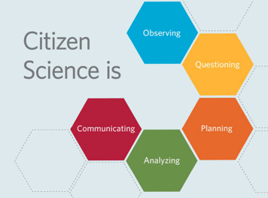
Benefits and Constraints of Citizen Science
Allows scientists to access data from different people in locations across the globe, resulting in lower research costs and simpler methods of gathering data
Involves common citizens in research, providing enriched public education in STEM fields
Involves requesting both trained and untrained individuals to gather data, which some see as a threat as untrained individuals can contribute to the collection of statistically biased data
Can be difficult to train citizens to gather correct data
Despite its constraints, Citizen Science is an extremely useful technique of gathering data for scientific research
GLOBE Observer is one of the more popular Citizen Science databases

Slide 4
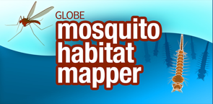
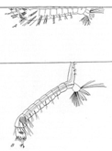
Why we are identifying Anopheles vs. Non-Anopheles Larvae
The purpose of this study was to manually identify Anopheles larvae vs. other species of mosquito larva.
The goal of this data analysis study was to analyze multiple citizen science submissions from the GLOBE Observer app and verify Anopheles and Non-Anopheles mosquito larvae observations.
The manual verification data will be used by an artificial intelligence (AI) team to create an AI algorithm for computerized larvae identification.
This study serves to identify larvae of the malaria-spreading Anopheles genus of mosquitoes in North America while fueling methods to refine the NASA GLOBE Observer data set and promoting Citizen Science.
Anopheles
Non-Anopheles

Slide 5
Methods
After deciding on our research goals and establishing our purpose, we obtained a sample of 155 larvae observations from the GLOBE Observer database, ranging across all of North America
We set up a separate spreadsheet for each of our seven larvae classifiers and each of us classified all 155 samples into four categories: Anopheles, not Anopheles, indistinguishable, and not mosquito:
For specimen where a classifier was not sure of their classification, a confidence interval could be left as a comment to be factored into the mastersheet.
A master sheet consolidated the votes for each specimen and made a final classification based on a majority vote:
The votes were weighted towards experts, whose vote counted as two points, while everyone else’s votes counted as one point
For specimen with greater than six votes in a category, a final classification was assigned automatically to this category
For specimen with fewer than six votes in every category, a final classification was made manually after additional analysis of the specimen and reviewing classifiers’ comments

Slide 6
Larvae Classification Categories
Question | Tags | Meanings | Comments
Is the organism in the photo an Anopheles larva? | “y” | Yes this specimen is an Anopheles larva | This is where classifiers can write the reason why they tagged a specimen as “ind” or “non” and give their confidence score on a specimen
 | “n” | No this specimen is not an Anopheles larva
 | “ind” | It can not be determined whether or not this specimen is an Anopheles larvae
 | “non” | This specimen has been determined to not be a mosquito larva

Slide 7
Classification sheet
Example of a data entry from the GLOBE Observer database, to be classified by a classifier

Slide 8
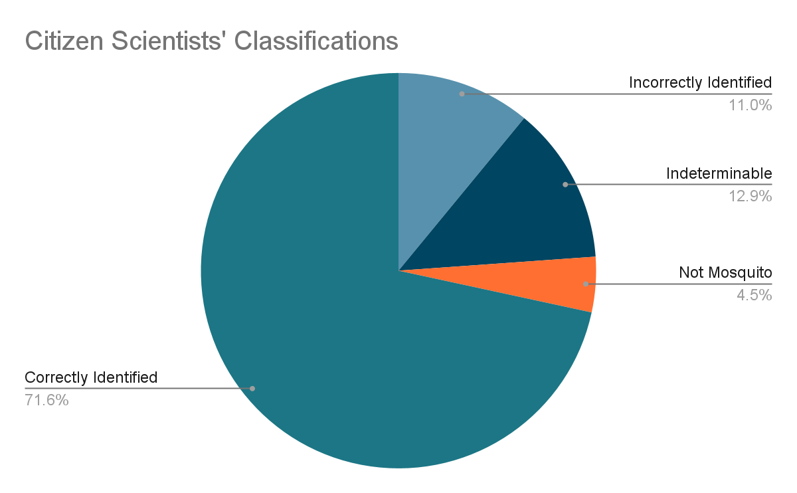
Results
155 Entries

Slide 9
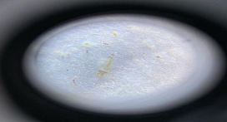
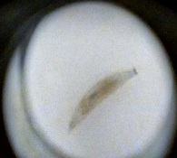
Classification Examples
Indistinguishable
Non-Mosquito

Slide 10
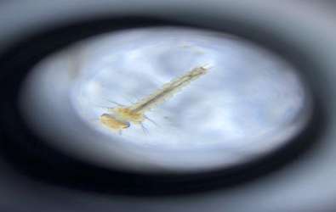
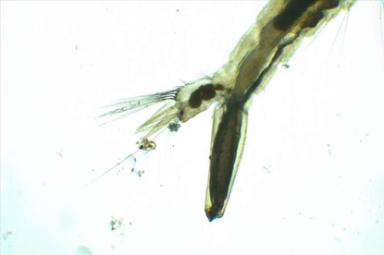
Classification Examples
Anopheles
Not Anopheles

Slide 11
Results
155 Entries

Slide 12
Conclusion & Further Discussion
Cross validating larvae identification (Anopheles/Not Anopheles)
AI based identification eliminates human error in mosquito identification
Easier to identify Anopheles mosquitoes due to reduction in manual work
Tracking Anopheles to prevent malaria spreading
Making citizen science more reliable and credible:
Introduce training section within the GLOBE Observer app to allow users to improve their knowledge on the types of observations they will be making and how to make them as accurately as possible
Introduce the concept of user verification or “super-users” who will have a special tag within the app and database to note their status; these users are verified manually and are recognized for having high accuracy rates due to completion of training and through experience by making more observations

Slide 13
Thank you for listening!
More information regarding our project can be found here:
Anopheles/Non-Anopheles Classification - Google Sheet - https://tinyurl.com/NAAnophelesSheet
Anopheles/Non-Anopheles Final Report - Google Docs - https://tinyurl.com/NAAnophelesReport

Slide 14
Citations
Murindahabi, M. M., Asingizwe, D., Poortvliet, M., van Vliet, A. J.H., Hakizimana, E., Mutesa, L., Takken, W., & Koenraadt, C. J.M. (2018, August 18). A citizen science approach for malaria mosquito surveillance and control in Rwanda. ScienceDirect. Retrieved July 26, 2021, from https://www.sciencedirect.com/science/article/pii/S1573521418301507
Rios, L., & Roxanne, C. (2018). Common malaria mosquito - anopheles quadrimaculatus say. https://entnemdept.ufl.edu/creatures/aquatic/Anopheles_quadrimaculatus.htm.
New Mexico Department of Health. (n.d.). CLASSIFICATION AND IDENTIFICATION OF MOSQUITOES OF NEW MEXICO. New Mexico Department of Health. https://www.nmhealth.org/publication/view/guide/986/.
Burkett-Cadena, N. (n.d.). Morphology of Adult and Larval Mosquitoes. University of Florida: Florida Medical Entomological Laboratory. https://fmel.ifas.ufl.edu/media/fmelifasufledu/workshop/Mosquito_Morphology.pdf.
King, W. V., Bradley, G. H., & McNeel, T. E. (1939, June). USDA Miscellaneous Publication No. 336: The mosquitoes of the southeastern States. USDA National Agriculture Library. https://naldc-legacy.nal.usda.gov/naldc/download.xhtml?id=CAT10307175&content=PDF.
Low, R., Boger, B., Nelson, P. and Kimura, M. (2021). GLOBE Observer Mosquito Habitat Mapper Citizen Science Data 2017-2020, v1.0. https://observer.globe.gov/get-data/mosquito-habitat-data

Slide 15
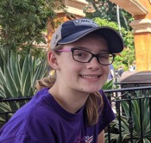
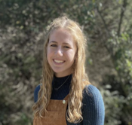
Reflections
Hannah Slocum
This program showed me how I could use my skills as part of something bigger. I learned how to read a research paper and a lot about mosquitoes. I was able to contribute my insight and problem solving skills to the group project. I now have a better idea of how NASA works and how I can be a part of it.
Ashley Hume
This program made me feel like a true scientist. I was able to trap and examine mosquitoes in my backyard and go around my community to collect Land Cover data with my official field investigator badge. Finishing up the internship with our research project was so interesting because I got to meet people from all over the country who have an interest in Earth Science and NASA just like I do.

Slide 16
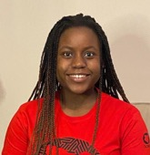
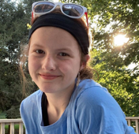
Reflections
Robyn Ogombe
This program has allowed me to dip my toes into the world of being an Earth Scientist, and I have a newfound appreciation for Earth Sciences. I was able to meet and work with likeminded people from across the U.S., and I was able to learn a ton about mosquitoes and different kinds of mosquito larvae.
Jocelyn Browning
The SEES program has allowed me to develop a deeper understanding on the research process, allowing me to develop my skills in science and grow as a researcher. I have learned important collaboration skills, and have met so many people with the same interests as me. I was able to learn so much outside of a classroom environment, and it felt so special to be able to interact with professionals and learn from them.

Slide 17
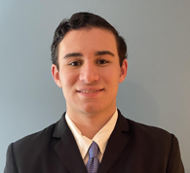
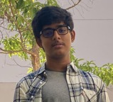
Reflections
Kellen Meymarian
This program gave me a new understanding of what NASA does and where it is making an impact in our daily lives. It has taught me so much about mosquitoes and their larvae. I honestly never found mosquitoes interesting before joining this program, and have gained a new respect for this type of research.
Vishnu Rajasekhar
Once part of the SEES program in 2019 and now as a peer mentor, SEES has allowed to become the “real scientist” every student wants to be. Throughout this project, I have learned more about the world of Citizen Science and how it can be beneficial to the scientific community when used correctly and properly refined. I have also learned project management skills which are bound to be useful in the future.

