Slide 1
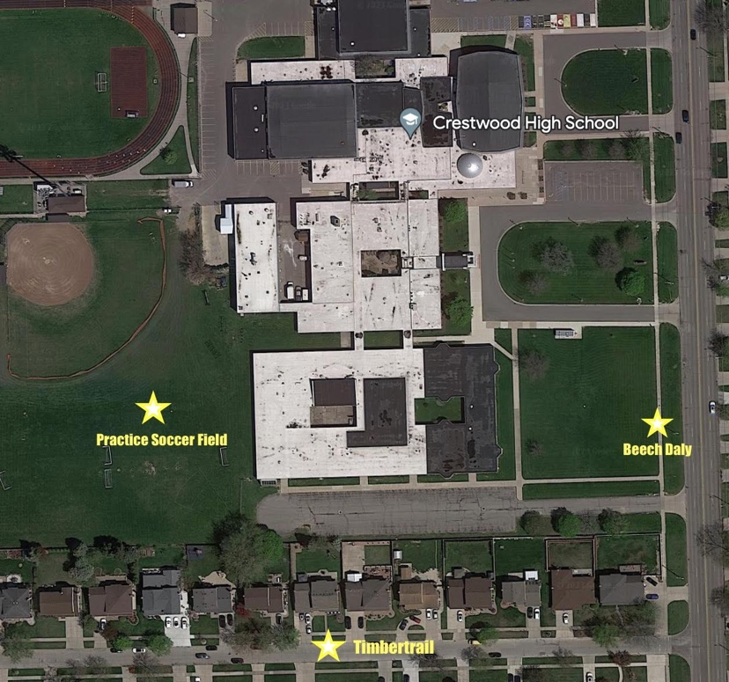
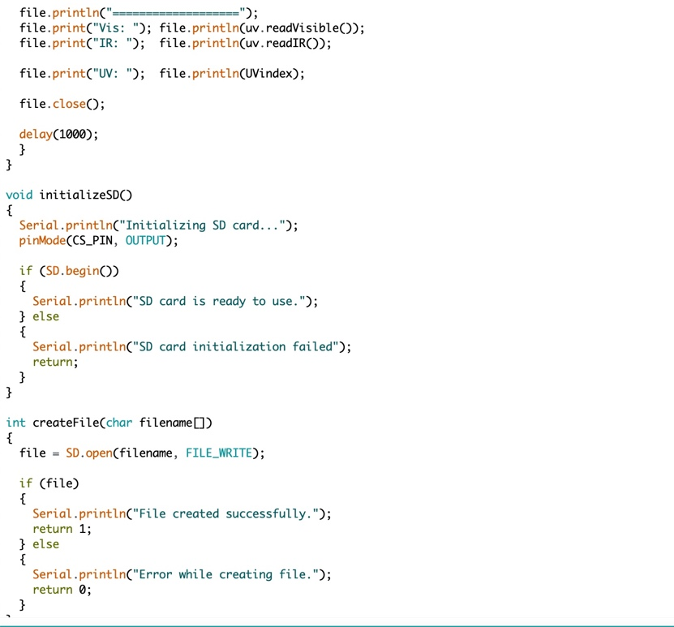
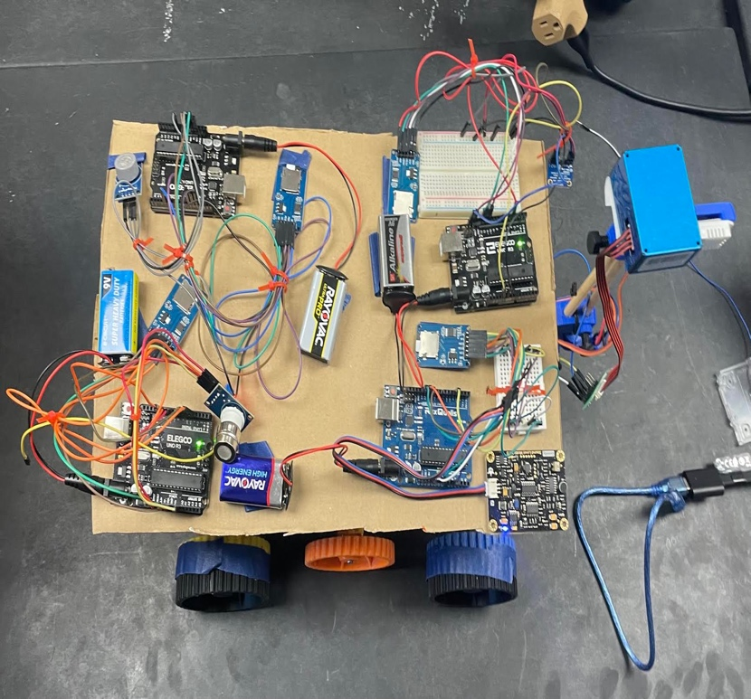
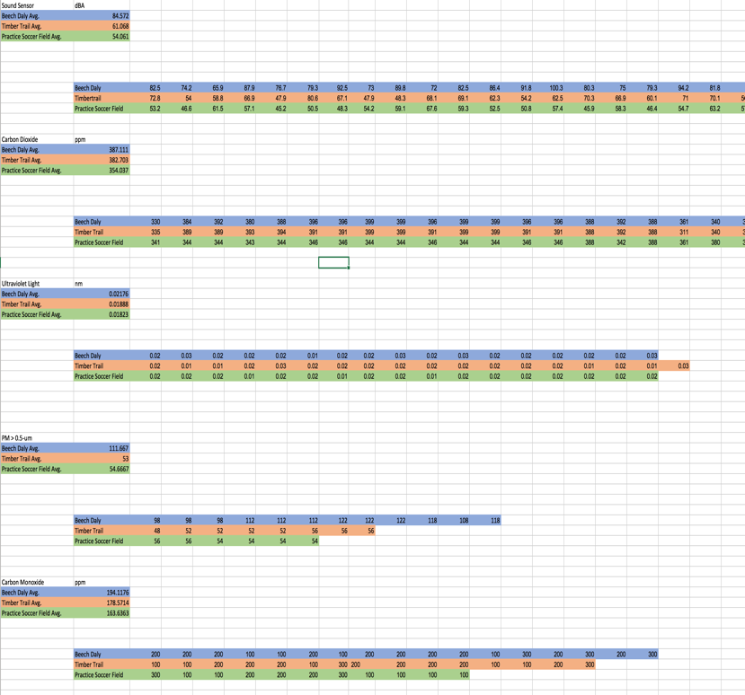
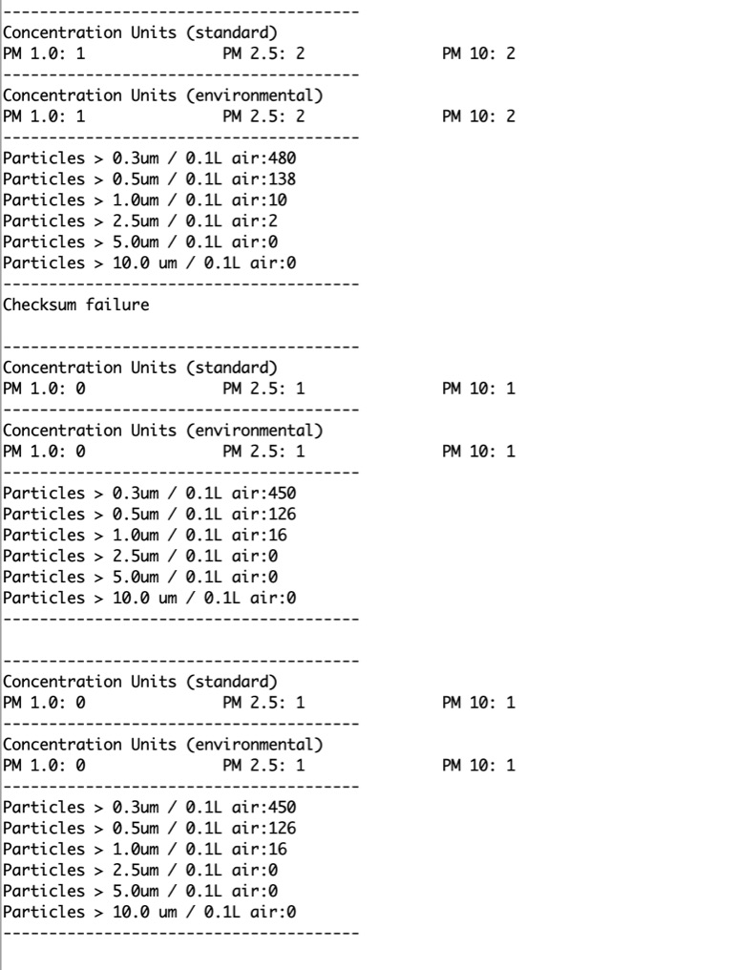
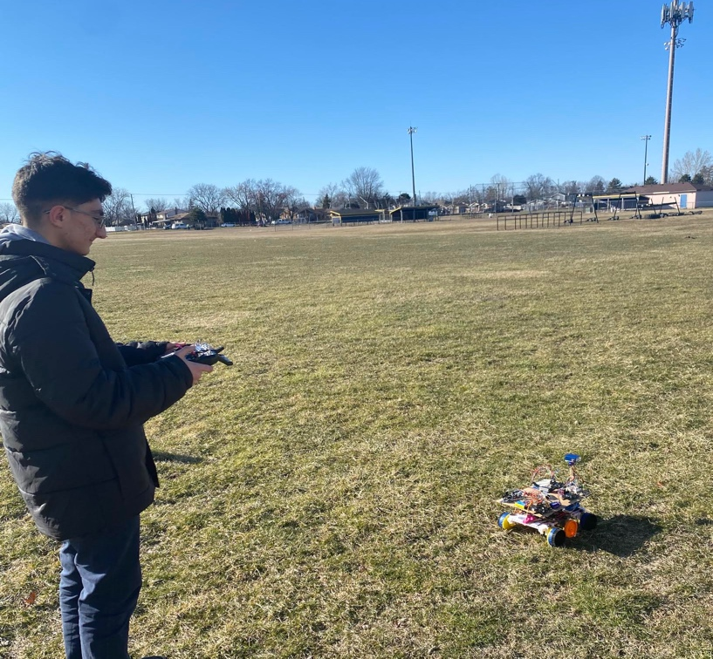
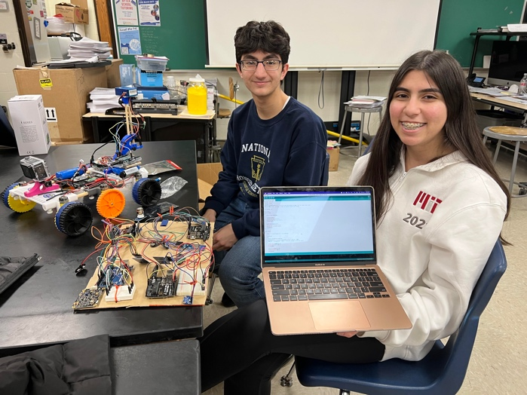
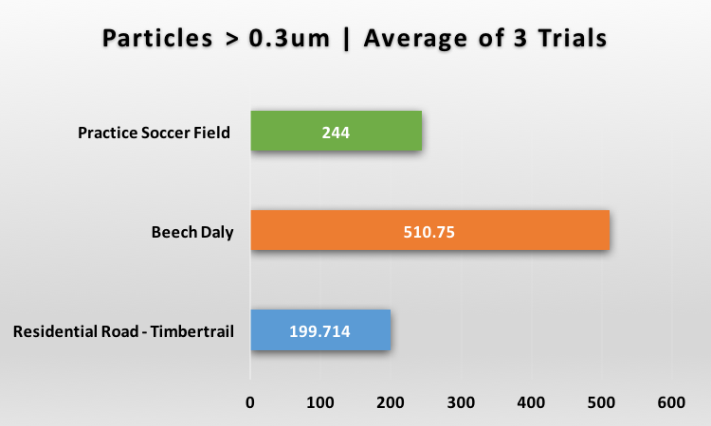
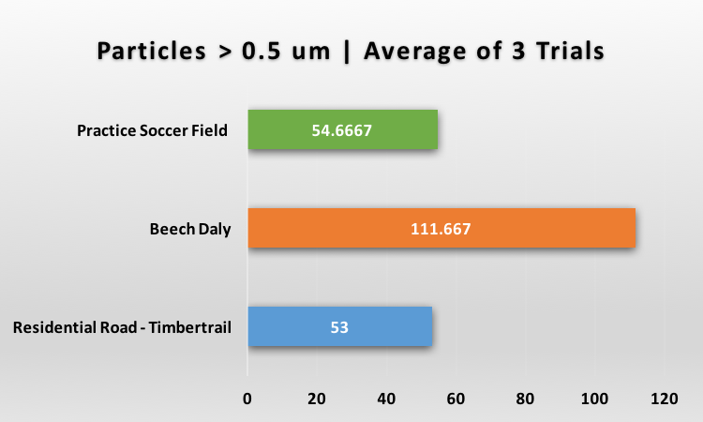
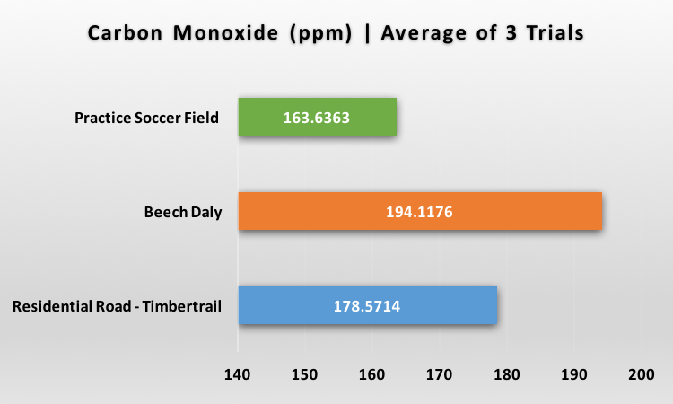
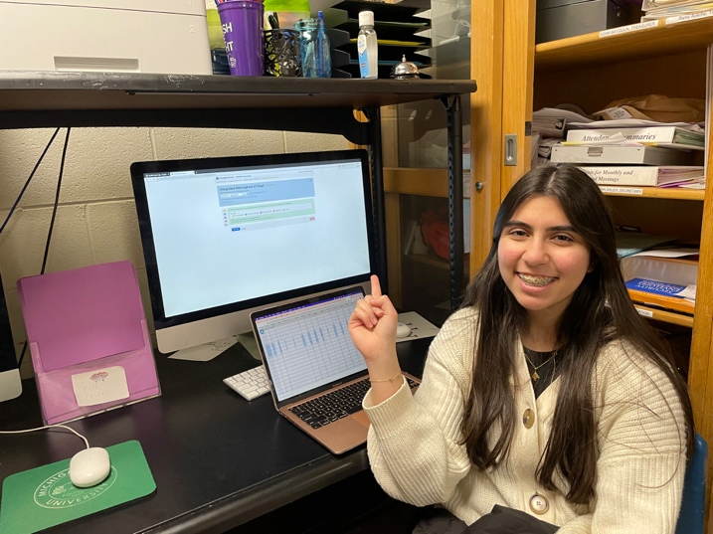
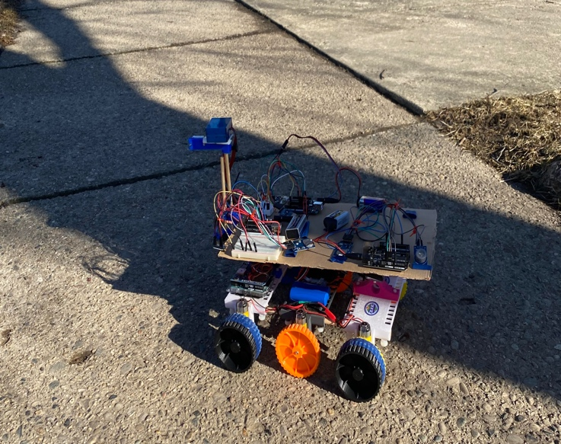
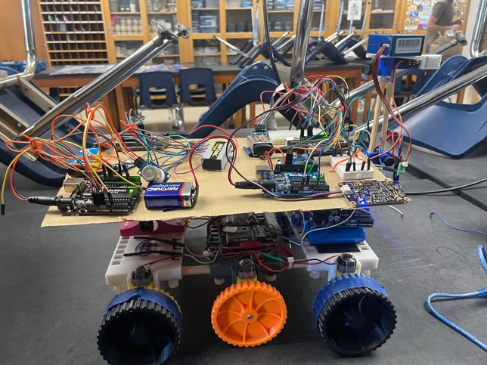
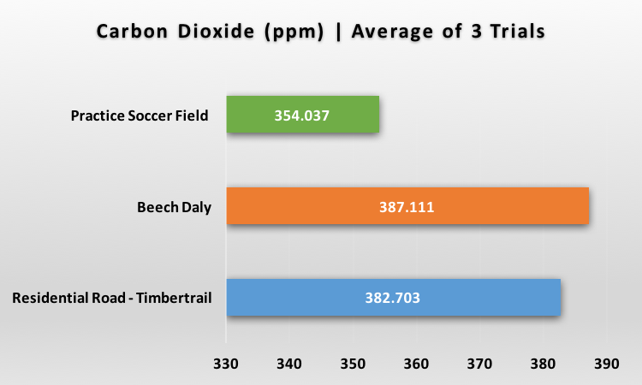
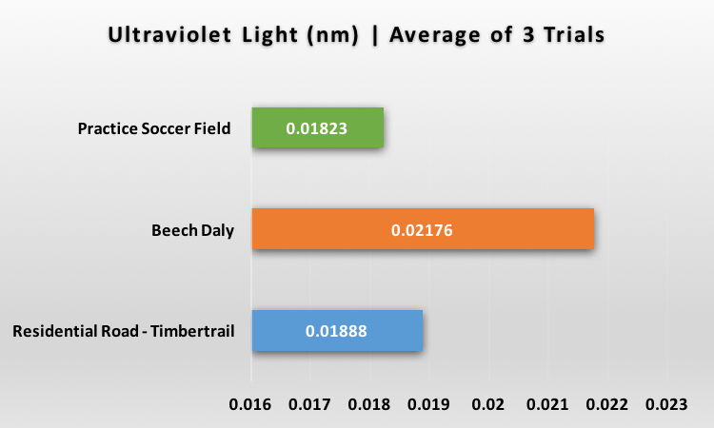
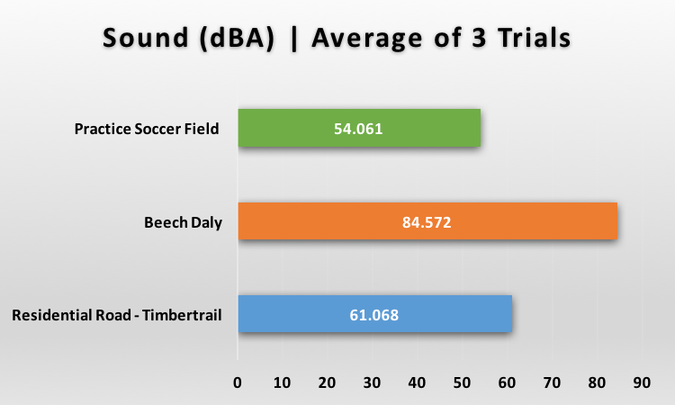
TerraRover 2 Augmented to Detect a Suite of Atmospheric Parameters Using Arduino Related Technology
Maher Harp and Hala Komaiha
Crestwood High School, Dearborn Heights, MI
Abstract
Methodology
Conclusion
In this research, a NASA TerraRover 2 was modified to detect and record data for fine particulate matter, carbon dioxide (CO₂), carbon monoxide (CO), ultraviolet light (UV), and sound. All sensors were independently programmed using the Arduino programming language and wired onto Arduino Uno Boards. Due to the limited space, the researchers prototyped an elevated, lightweight platform. This platform supported the CO₂, CO, UV, and sound sensors. The researchers used CAD modeling to design and 3D-print new wheels for the TerraRover 2 in an effort to increase the thickness of the wheels for better traction. Multiple trial runs were made with particle size concentrations ranging from 0.3 to 0.5 microns, carbon dioxide (ppm), carbon monoxide (ppm), ultraviolet light (nm), and sound (decibels) at three different sites around our school. All atmospheric sensors were remotely mobilized using the TerraRover 2, a robot using 3D-printed components and a controller. Micro SD cards were used to remotely save data for each sensor. The goal of this research was to use the data collected to compare with select atmospheric data (using GLOBE protocols) from several different areas around Crestwood High School. The data we collected and analyzed is significant over time as overall health and wellbeing may be compromised. Knowing levels of select atmospheric gases may help alert school personnel of unsafe outdoor air conditions. Data analysis demonstrated some differences between PM, carbon monoxide, carbon dioxide, ultraviolet light, and sound at various different locations. However, the difference was less than expected. In the future, the use of the TerraRover 2 can expand to different protocols other than air quality, allowing it to be used for various purposes. The microsensors on the TerraRover 2 can be a significant and novel way to monitor potentially toxic air remotely.
The Beech Daly research site held the highest concentration of PM, CO, CO₂, UV, and sound. This may have been due to the presence of car exhaust and low vegetation. The Residential Road – Timber Trail research site held the second-highest concentration of PM, CO, CO₂, UV, and sound. This may have been the presence of trees and houses acting as covers and shade for airborne particulate matter, carbon monoxide, carbon dioxide, ultraviolet light, and sound. The Practice Soccer Field research site held the lowest concentration of PM, CO, CO₂, UV, and sound. This may have been the presence of open space and vegetation assisting the particulate matter, carbon monoxide, carbon dioxide, ultraviolet light, and sound. This interaction of vegetation with concentrations sensed shows a great example of two of Earth’s spheres interacting to result a large impact. This impact is the increase and large concentration of air pollutants being contact with humans. Throughout the data, there lies a higher concentration of the parameters collected in the Beech Daly and Residential Road – Timber Trail. As previously stated, both sites have similar geographic characteristics with low vegetation and cement. This shared characteristic was amplified with the contrasting result of the carbon dioxide concentrations. Unlike Beech Daly and Residential Road – Timber Trail, the research site of the Practice Soccer Field has a high vegetation, which may explain the carbon dioxide concentrations being lowest at the Practice Soccer Field. This correlation of high vegetation and lower concentrations of atmospheric parameters, such as carbon dioxide, is seen through the graphical difference of the Practice Soccer Field and, both, the Beech Daly Road and Residential Road – Timber Trail research sites. By measuring local levels of particulate matter, carbon monoxide, carbon dioxide, ultraviolet light, and sound, students involved in school outdoor activities can be warned on days that they might be exposed to high levels. Teaching staff and coaches can make informed decisions about whether or not to allow outdoor play, labs, etc. Lungs damaged by inhaling fine particulate matter, carbon monoxide, or carbon dioxide can lead to increased pulmonary and heart issues if COVID-19 or other respiratory diseases are contracted. In the future, the researchers would like to compare concentrations of particulate matter, carbon monoxide, carbon dioxide, ultraviolet, and sound on warmer weather days to see if weather has a positive correlation. The researchers also hope to build a new robot using metal and other tough materials. With this new build, there will be a more intact platform for the sensors. The drive will also be much smoother and faster because of the improved mechanism of the wheels. Another advancement that the researchers would like to include is multiple air quality sensors that would simultaneously run to display other pollutants in the air such as Nitrogen Oxides, Sulfuric Oxides, Lead, Ozone, and other criteria air pollutants.
Satellite image of data collection site, Crestwood High School
Using the Arduino IDE to code each sensor and their corresponding SD card
All Arduinos, sensors, and SD cards mounted onto TerraRover 2
Discussion
PM, CO, CO₂, UV, and sound levels varied slightly between each of the 3 research sites. While most of the data did not differ as much between each sensed parameter, the data taken near the Beech Daly site had higher levels of particulate matter > 0.3-um, particulate matter > 0.5-um, carbon monoxide, carbon dioxide, ultraviolet light, and sound. This location is directly near a major road
making car exhaust and low vegetation the most
probable cause for the shift in concentrations of
particulate matter, carbon monoxide, and carbon
dioxide. At the Residential Road – Timber Trail
site, levels carried the second-highest
concentrations. The levels of particulate matter,
ultraviolet light, and sound may have been
affected by the close houses and abundant
vegetation at elevated levels. The trees overhead and nearby shrubs may have collected airborne particles, provided shade, and blocked sound from human activity. At the Practice Soccer Field site, the levels were generally the least. The levels of PM, CO, CO₂, UV, and sound may have been affected by the open space and high amounts of vegetation at low levels. Possible sources of error include the limited data collected and accuracy of each sensor. To verify the sensors’
results, the researchers could compare data with
a professional grade sensor. Unfortunately, this is
outside the researchers’ budget. In the future, the
researchers can verify the data points by visiting an
outside lab. As the research develops, the
researchers are going to monitor the differences of
particulate matter, carbon monoxide, carbon dioxide
, ultraviolet light, and sound levels compared to weather conditions including pressure, relative humidity, and temperature. The researchers had to reject their first null hypothesis as there was great differences of particulate matter, carbon monoxide, carbon dioxide, ultraviolet light, and sound levels in different locations. The researchers rejected their second null hypothesis, as there were greater levels of particulate matter, carbon monoxide, carbon dioxide, ultraviolet light, and sound levels near heavy traffic. The researchers also rejected their third null hypothesis, as the TerraRover 2’s was successfully able to drive while collecting particulate matter, carbon monoxide, carbon dioxide, ultraviolet light, and sound data outdoors.
Data collected gets exported into a spreadsheet and averaged out
Sensor values get printed onto an SD card
Driving the TerraRover 2 in the Practice Soccer Field
Results
Acknowledgements
Working with Mr. David Bydlowski and Mr. Andy Henry of the NASA AREN program was very educational and inspiring for the researchers. They worked with and advised them on how to improve the CAD models for the new TerraRover 2 wheels and the different methods to approach connection of a data logging and collecting SD card module. The researchers also worked with their former AP Environmental Science teacher, GLOBE Advisor, and Science Club Advisor – Mrs. Diana Johns. Inside and outside the classroom, Mrs. Johns has informed both researchers about the dangers of air pollution and its effects on other Earth spheres. Through working with all their mentors, the researchers were able to truly understand the importance and impact of their research. Studying the relationships between the different Earth spheres through collecting data on air quality in general is as significant as ever as a result of the COVID-19 pandemic and the rising use of fossil fuels.
Citations
World Health Organization. (2021). Air pollution. In Compendium of WHO and other UN guidance on health and environment (pp. 9–32). World Health Organization. http://www.jstor.org/stable/resrep35857.8
Schwarze PE;Ovrevik J;Låg M;Refsnes M;Nafstad P;Hetland RB;Dybing E; (n.d.). Particulate matter properties and health effects: Consistency of epidemiological and toxicological studies. Human & experimental toxicology. Retrieved March 9, 2023, from https://pubmed.ncbi.nlm.nih.gov/17165623/
Klaassen, G., Berglund, C., & Wagner, F. (2005). Carbon dioxide. In The GAINS Model for Greenhouse Gases — Version 1.0: Carbon Dioxide (CO₂) (pp. 19–22). International Institute for Applied Systems Analysis (IIASA). http://www.jstor.org/stable/resrep15745.5
Yasuda, T., Yonemura, S., & Tani, A. (2012). Comparison of the Characteristics of Small Commercial NDIR CO2 Sensor Models and Development of a Portable CO2 Measurement Device. Sensors, 12(3), 3641–3655. https://doi.org/10.3390/s120303641
World Health Organization. (2021). Radiation. In Compendium of WHO and other UN guidance on health and environment (pp. 81–93). World Health Organization. http://www.jstor.org/stable/resrep35857.12

