Slide 1
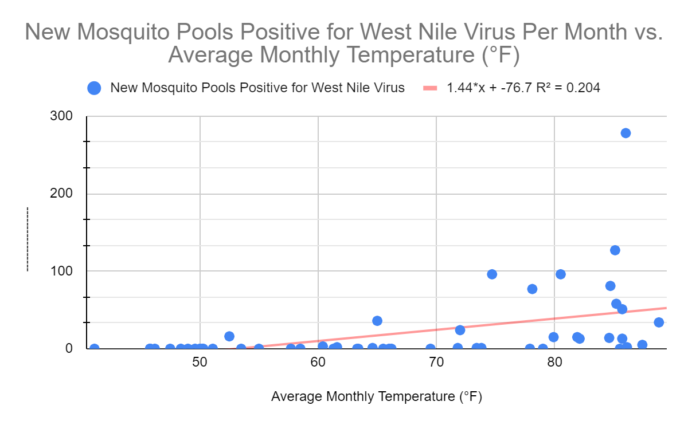
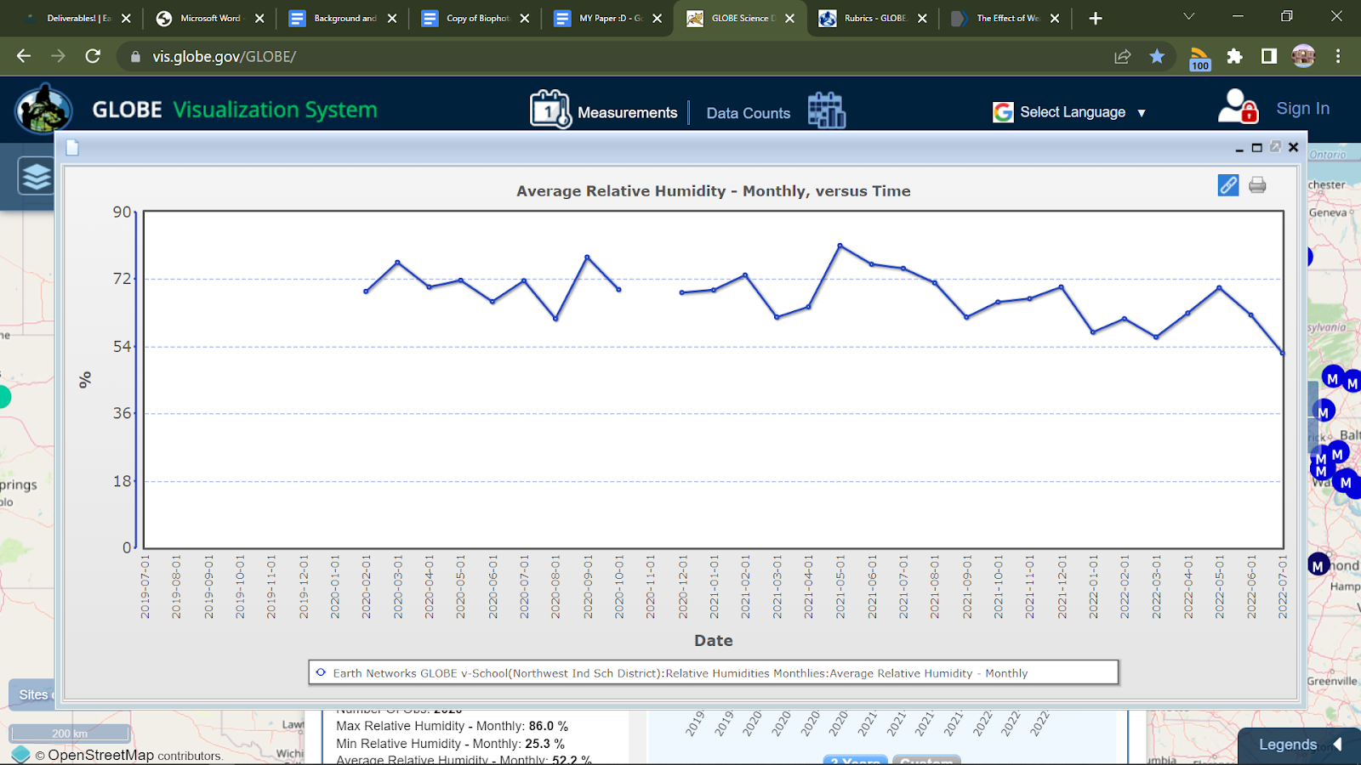
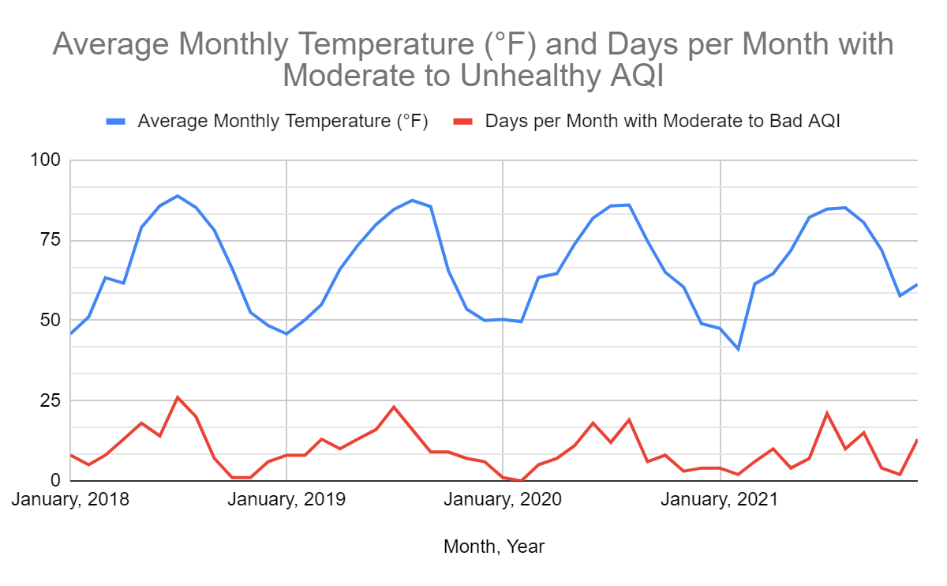
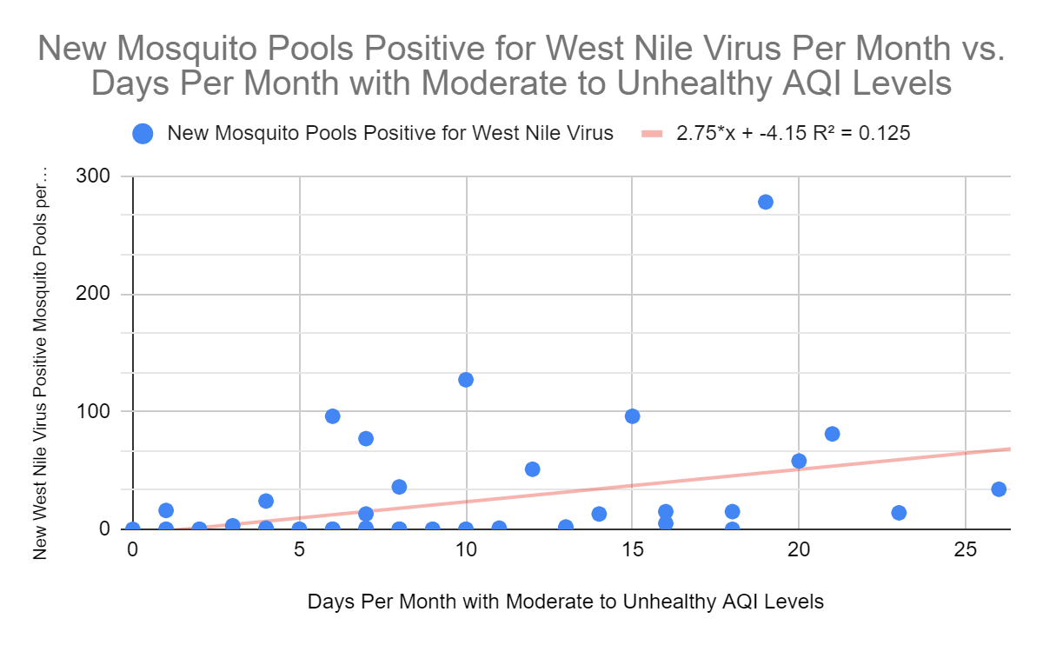
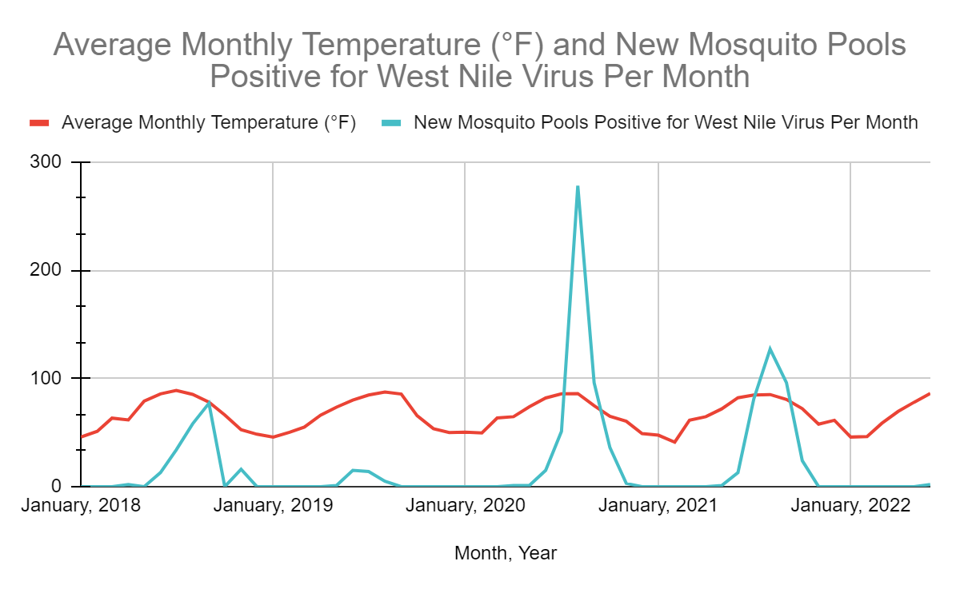
Prediction of West Nile Positive Mosquito Pools with Pollution Incorporation
Sarah Jano, Ayla Sumer, Gabrielle Longman
Mentors: Rusty Low, Cassie Soeffing, Peder Nelson, Erika Podest, and Andrew Clark
Partner
Abstract
Methodology
Air Temperature
Conclusions + Discussion
West Nile Virus is a significant issue in much of the world and is primarily transmitted through Culex Mosquitoes. The density of Culex mosquito populations is dependent on numerous environmental factors. In our project, we aim to evaluate the correlation between Culex mosquito density and certain environmental factors that are forecasted to change due to human-produced pollution. Specifically, we investigate the effect of air pollution and air temperature on mosquito vector density. Furthermore, we also consider how these various environmental factors will change over time, particularly due to climate change, and develop a predictive model to forecast these changes in mosquito populations based on our research. We focus our research on Dallas County, Texas and utilize Air Quality Index Data from the Environmental Protection Agency, average monthly temperature reports from the National Weather Service, and Arbovirus Weekly Activity Reports From Texas Department of State Health Services. We also utilize GLOBE data for other environmental factors, including humidity and precipitation. Our findings reveal a strong correlation between the environmental factors of air temperature and air pollution and new mosquito pools positive for West Nile Virus in Dallas County.
Study Site
West Nile Virus is now a common occurrence in temperate and tropical climates of the United States. In our study, we focus our research in the county of Dallas, Texas. West Nile Virus emerged in Texas in 2002 and since then has been detected yearly in the state. The largest case of West Nile Virus outbreak occurred in Texas in 2012 and this disease remains a significant public health concern for the region (Martinez et al., 2017).
Data Sets
To investigate our research question, we used data on mosquitoes in Dallas, Texas that test positive for West Nile Virus from Texas’s Department of State Health Services Arbovirus Weekly Report. We specifically used data on the number of new mosquito pools that tested positive for West Nile Virus in Dallas County per month. We used this particular data set as proxy data for the overall Culex mosquito density in Dallas county
We compared this mosquito data to data for our two environmental factors (air quality and air temperature). For our air quality data, we used Air Quality Index Data from Dallas County, Texas from the United States Environmental Protection Agency’s (EPA) Air Quality Index Report. We specifically looked at the days per month with Moderate to Unhealthy AQI levels (51-500 AQI). For our air temperature data, we used average monthly temperature reports from the National Weather Service.
We compared the data sets for each month from January 2018 to June 2022.
Data Analysis
For both environmental factors, we used linear regression to fit our data and create a predictive equation to estimate the amount of West Nile Positive Mosquito Pools in Dallas County, Texas based on the average monthly temperature and monthly Air Quality Index data sets.
Other Environmental Factors with GLOBE data
Using GLOBE data from the Northwest Independent School District in Dallas County we were able to look at other climate factors in our area of interest. Although for our prediction model we only focused on temperature and air quality, this GLOBE data was extremely helpful for understanding the precipitation, humidity, and other environmental factors in the Dallas area.
Overall, our research suggests a significant correlation between temperature, air quality levels, and the abundance of West Nile positive mosquito pools in Dallas County, Texas. Recent outbreaks in Texas have caused West Nile Virus to be of great concern to the general public. Understanding the environmental factors, including air quality and air temperatures, that positively correlate with West Nile Positive Mosquito Pools, allows for more accurate prediction of future exposures to West Nile Virus. However, as mosquito density depends on numerous interacting factors, predicting future mosquito densities is complex. In the future, we hope to increase the accuracy of our predictions, specifically by expanding our research to study sites beyond Dallas, and analyzing the correlation between air pollution, temperature, and West Nile Positive Mosquito Pools in these areas. We also hope to look at other environmental factors related to climate change and pollution, including water pollution, to more accurately forecast future Culex mosquito populations.
New Mosquito Pools Positive for West Nile Virus Per Month
Source: Google Sheets
We calculated our correlation coefficient (R) to be about .451664. This indicates a moderate positive correlation between the average monthly temperature in Dallas County, Texas and the number of new mosquito pools that tested positive for West Nile Virus in Dallas County.
Using our data inputs, we are able to predict the number of new positive mosquito pools with West Nile Virus using average monthly temperature. The following equation represents our linear regression model and can be used for prediction of the amount of positive West Nile Virus mosquito pools in Dallas County based on average monthly temperature.
Research Question
Culex Mosquitos are the primary vectors of West Nile Virus. Air pollution and air temperature are two environmental factors that are forecasted to change with continued human-produced pollution. What is the relationship between these environmental factors (air pollution, air temperature) and Culex mosquito density? How can these environmental factors be used to predict future West Nile-carrying mosquito population densities?
We also plotted Average Monthly Temperature and West Nile Virus Positive Mosquito pools in Dallas County over time and were able to clearly see peak mosquito season in Dallas County, Texas and how temperature cycles correlate with positive West Nile Virus mosquito pools.
Introduction
Pollutants produced by human activity have significantly altered the ecosystems and environmental conditions that mosquitoes live, develop, and reproduce in. These changing environmental factors due to pollution (especially air temperature and air pollution) not only pose a serious threat to humans, but they can potentially have profound effects on the transmission of disease via mosquitos. When deciding on which environmental factors to evaluate in relation to mosquito populations, we selected air quality and air temperature as our factors of interest.
Air Pollution
Air pollution can originate from a variety of sources, including industrial production and human activity. The U.S Air Quality Index (AQI) is an index used by the EPA to quantify this air pollution. Measured on a scale from 0 to 500, a larger AQI represents increased air pollution. Generally, an AQI level of 51-151 is considered moderate, and an AQI level above 151 is considered unhealthy. Between 1960 and 2009, concentrations of air pollutants globally increased by 38%. With continued human activity and industrial production, air pollution is forecasted to continue to increase on this trajectory. (Shaddick et al., 2020). Furthermore, prior studies have suggested a positive correlation between pollutants and mosquito density. For example, researchers in Sri Lanka found that disease-carrying mosquito populations developed resistance to insecticides and increased in density when exposed to groundwater pollution (Surendran et al., 2020). Even though this study primarily looked at water pollution, the general principle of mosquito vectors adapting to pollutants and environmental changes is directly applicable to air pollution. For this reason, evaluating the relationship between Culex mosquito density and air pollution is critical for forecasting future West Nile-carrying mosquito density.
Air Temperature
Climate change, defined as the long-term shift in temperatures and weather patterns, is most commonly measured using the average surface temperature of specific regions on the planet. Emission of pollutants directly contributes to climate change by affecting the absorption of heat in the atmosphere. For this reason, we selected air temperature change over time as an additional environmental factor and measure of human-induced pollution. Furthermore, prior studies have suggested a relationship between increased temperatures and the survival and reproduction rates of the vectors, their habitat distribution and abundance (Paz 2015). For this reason, understanding the correlation between air temperature and Culex mosquito density is crucial for predicting future West Nile-carrying mosquito density.
GLOBE Visualization Page depicting average relative humidity over time
References
Beck-Johnson LM, Nelson WA, Paaijmans KP, Read AF, Thomas MB, Bjørnstad ON (2013) The Effect of Temperature on Anopheles Mosquito Population Dynamics and the Potential for Malaria Transmission. PLoS ONE 8(11): e79276. https://doi.org/10.1371/journal.pone.0079276.
Bellone R and Failloux A-B (2020) The Role of Temperature in Shaping Mosquito-Borne Viruses Transmission. Front. Microbiol. 11:584846. doi: 10.3389/fmicb.2020.584846. Drakou K, Nikolaou T, Vasquez M, Petric D, Michaelakis A, Kapranas A, Papatheodoulou A, Koliou M. The Effect of Weather Variables on Mosquito Activity: A Snapshot of the Main Point of Entry of Cyprus. Int J Environ Res Public Health. 2020 Feb 21;17(4):1403. doi: 10.3390/ijerph17041403. PMID: 32098137; PMCID: PMC7068582.
Gabriel L. Hamer, Uriel D. Kitron, Jeffrey D. Brawn, Scott R. Loss, Marilyn O. Ruiz, Tony L. Goldberg, Edward D. Walker, Culex pipiens (Diptera: Culicidae): A Bridge Vector of West Nile Virus to Humans , Journal of Medical Entomology, Volume 45, Issue 1, 1 January 2008, Pages 125–128, https://doi.org/10.1093/jmedent/45.1.125.
Kent RJ, Crabtree MB, Miller BR (2010) Transmission of West Nile Virus by Culex quinquefasciatus Say Infected with Culex Flavivirus Izabal. PLOS Neglected Tropical Diseases 4(5): e671. https://doi.org/10.1371/journal.pntd.0000671.
Martinez D, Murray KO, Reyna M, Arafat RR, Gorena R, Shah UA, Debboun M. West Nile Virus Outbreak in Houston and Harris County, Texas, USA, 2014. Emerg Infect Dis. 2017 Aug;23(8):1372-1376. doi: 10.3201/eid2308.170384. PMID: 28726615; PMCID: PMC5547786.
Michael J. Turell "Members of the Culex pipiens Complex as Vectors of Viruses," Journal of the American Mosquito Control Association, 28(4s), 123-126, (1 December 2012).
Murray KO, Ruktanonchai D, Hesalroad D, Fonken E, Nolan MS. West Nile virus, Texas, USA, 2012. Emerg Infect Dis. 2013 Nov;19(11):1836-8. doi: 10.3201/eid1911.130768. PMID: 24210089; PMCID: PMC3837649.
Paz, S. (2015, April 5). Climate change impacts on West Nile virus transmission in a global context. Philosophical transactions of the Royal Society of London. Series B, Biological sciences. Retrieved July 28, 2022, from https://www.ncbi.nlm.nih.gov/pmc/articles/PMC4342965/.
Petersen LR, Hayes EB. West Nile virus in the Americas. Med Clin North Am. 2008 Nov;92(6):1307-22, ix. doi: 10.1016/j.mcna.2008.07.004. PMID: 19145778. Petersen LR, Marfin AA, Gubler DJ. West Nile Virus. JAMA. 2003;290(4):524–528. doi:10.1001/jama.290.4.524. Reiter P. Climate change and mosquito-borne disease. Environ Health Perspect. 2001 Mar;109 Suppl 1(Suppl 1):141-61. doi: 10.1289/ehp.01109s1141. PMID: 11250812; PMCID: PMC1240549.
Ruiz, M.O., Chaves, L.F., Hamer, G.L. et al. Local impact of temperature and precipitation on West Nile virus infection in Culex species mosquitoes in northeast Illinois, USA. Parasites Vectors 3, 19 (2010). https://doi.org/10.1186/1756-3305-3-19.
Shaddick, G., Thomas, M. L., Mudu, P., Ruggeri, G., & Gumy, S. (2020, June 17). Half the world's population are exposed to increasing air pollution. Nature News. Retrieved July 28, 2022, from https://www.nature.com/articles/s41612-020-0124-2. Theodore G. Andreadis "The Contribution of Culex pipiens Complex Mosquitoes to Transmission and Persistence of West Nile Virus in North America," Journal of the American Mosquito Control Association, 28(4s), 137-151, (1 December 2012). William K. Reisen, Ying Fang, Vincent M. Martinez, Effects of Temperature on the Transmission of West Nile Virus by Culex tarsalis (Diptera: Culicidae) , Journal of Medical Entomology, Volume 43, Issue 2, 1 March 2006, Pages 309–317, https://doi.org/10.1093/jmedent/43.2.309.
Results
Air Pollution
Source: Google Sheets
Air Pollution and Air Temperature
We plotted the average monthly temperature in Dallas County, Texas and the days per month with moderate to unhealthy AQI Levels. Average monthly temperature and days per month with moderate to unhealthy AQI levels follow roughly the same pattern which could be a possible reason both factors have a positive correlation with the amount of West Nile positive mosquito pools in the Dallas County Region.
New Mosquito Pools Positive for West Nile Virus Per Month
Acknowledgements
Source: Google Sheets
This project was completed with the aid, guidance, and support of Dr. Rusanne Low, Ms. Cassie Soeffing, Mr. Peder Nelson, Dr. Erika Podest, and Mr. Andrew Clark. We also want to thank the STEM Enhancement in Earth Science (SEES) program for providing us with the necessary tools and information to carry out our research.
The material contained in this poster is based upon work supported by the National Aeronautics and Space Administration (NASA) cooperative agreements NNX16AE28A to the Institute for Global Environmental Strategies (IGES) for the NASA Earth Science Education Collaborative (NESEC) and NNX16AB89A to the University of Texas Austin for the STEM Enhancement in Earth Science (SEES). Any opinions, findings, conclusions, or recommendations expressed in this material are those of the authors and do not necessarily reflect the views of NASA.
We fit our data for air quality using a linear regression model and calculated our correlation coefficient (r) to be .3536 indicating a moderate positive correlation between days per month with moderate to unhealthy AQI levels and the amount of West Nile Virus positive mosquito pools in Dallas County.
Using our linear regression model, we created a predictive equation. The following equation represents our linear regression model and can be used for prediction of the amount of positive West Nile Virus mosquito pools in Dallas County based on days per month with moderate or below AQI levels.
Source: Google Sheets
Notes:
Format for abstract
Change google sheets graphs to have consistent titles
Remake graphs
Which model to use for temp?
Consistent titles for graphs
References
Citation format
Is this required

