Slide 1
UNIVERSITY BASIC SCHOOL,LEGON RESEARCH PAPER TO GLOBE 2024

Slide 2
THE RELATIONSHIP BETWEEN LAND COVER AND MICROCLIMATIC INDEX - A CASE STUDY OF UNIVERSITY OF GHANA MAIN CAMPUS.
Organization: University of Ghana Basic School, Legon
Country : Ghana
Students: Jeremiah Okyere Amponsah, Kendra Adobea Asare, Victoria Antock, Paapa Wiredu, Nhyira Addison, Jayden Asare, Samaaha Abukari
Grade Level: Junior High School(grades 6-8, 11-14)
GLOBE Teacher(s): Enoch Lamptey, Eva Sakyi & Sylvester Bako
Contributors: Christina A. Armah-Head of School, Eric Sifa -Deputy Head
Other Contributors: Mr. Leslie Darko, Grace Fredua –Agyeman, Richard Obeng
Protocol: Precipitation
Language: English

Slide 3
ABSTRACT
University of Ghana has it as a culture of planting trees regularly. In recent times tree planting activities have picked up again on the University campus under the operation “Green Project”.
The very recent tree planting exercise on the University of Ghana Campus was embarked upon by the University Basic School pupils in October,2022 and the Green Ghana Project which was launched on the University of Ghana Campus under the auspices of His Excellency Nana Addo Danquah Akuffo Addo on Friday, 9th June,2023.
The Security Department of the University of Ghana estimated that about 2,500 vehicles move in and out of the university's campus every day.
This implies that about 17,500 vehicles ply the campus every week. This figure multiplied by a month and a year gives a staggering figure and it is anticipated that the figure will increase.
The high vehicular movements within the university campus and the surrounding highways produce high carbon emissions.
This could affect carbon concentration in the atmosphere leading to precipitated water having pH lower than 5.0. Such a situation poses a risk to the university community.

Slide 4
The President of the Republic of Ghana, His Excellency Nana Addo Dankwa Akuffo Addo planting the first tree of the day

Slide 5
The Vice Chancellor of the University of Ghana, Prof. Nana Aba Appiah Amfo also taking her turn to plant the second tree of the day.

Slide 6
The University of Ghana Basic School Pupils in Tree Planting Exercise.

Slide 7
INTRODUCTION & REVIEW OF LITERATURE
Microclimate is a small section within a larger macroclimate that differs in temperature, precipitation, humidity, and other climatic factors.
It can also be referred to as the atmospheric conditions that are different in one area from those in surrounding areas. It can mean areas as small as a few square feet (meters) or larger areas of many square miles (kilometers). (Oke, 1987).
The US Environmental Protection Agency defines land cover as the surface components of land that are physically present and visible.
It further provides a means to examine landscape patterns and characteristics, which are significant in understanding: the extent, availability, and condition of land.
The study was conducted based on data collected by University Basic School pupils using the Globe Observer app. The data revealed that the pH of the rainwater collected had a lower acidic level with pH between 5.0 -5.5.
This pH test prompted pupils to do a comparative test with rainwater from different location closer to the university. Faith Community Baptist Senior High School located near the Madina Market area was chosen.
Samples of rainwater collected using a rain gauge were sent to the University of Ghana's chemistry department for further testing. This was to authenticate the Globe observer app data.

Slide 8
Aerial View of Faith Community Baptist Senior High School

Slide 9
Aerial View of University of Ghana Campus

Slide 10
Research Questions
This research work is to find out.
Whether there is any relationship between Land Cover and acidity level of rainwater.
2. Whether the university land cover has an impact on microclimatic conditions particularly the pH of the rainwater

Slide 11
Research Hypothesis
The carbon emissions from the large number of cars moving in and out of the University campus coupled with the long vehicular traffic on the highways surrounding the University`s main campus could lead to precipitated water with low pH level and being deep red when tested with litmus paper.
The large coverage of trees on the land cover could balance carbon emissions from vehicles and carbon absorption. This could lead to a higher pH value.
However, more vehicular activity and fewer trees on Faith Community Baptist Senior High School (Madina) may have resulted in precipitated water with a lower pH value and deep blue litmus paper.

Slide 12
RESEARCH METHOD
Pupils with the help of their Globe teachers mounted the rain gauge on the University Basic School premises to collect data on rainfall. They also cleaned the rain gauge after each rainfall collection to ensure the best possible reading. We also measured the rainwater collected shortly after it rains. An improvised rain gauge was used to collect data at Faith Community Baptist Senior High School.
After each rain event, the pH of rainwater was measured using the GLOBE Protocol. The rainwater pH was also submitted to the GLOBE website and recorded in our own spreadsheet.
Rainfall data was also obtained from the Ghana Metrological Agency to support rainfall data collected by pupils with the rain gauge.
Some soil samples from around the research sites were also gathered and analyzed.
The data on rainwater pH, and the amount of rainfall for each rain event and soil pH, were placed into graphs and spreadsheets to be compared and analyzed.

Slide 13
Pupils determining the amount of rainfall using the Rain gauge

Slide 14
Pupils determining the pH of rainwater collected

Slide 15
pH meter reading pH of soil sample collected at University of Ghana Campus, Legon

Slide 16
COMPARATIVE ANALYSIS OF THE TOTAL AMOUNT RAINWATER COLLECTED FOR THE SELECTED MONTHS IN 2023. GRAPH 1

Slide 17
Data summary
GRAPH 1
Displays the rainfall pattern both at the University of Ghana campus, Legon and at the Faith Community Baptist Senior High School in Madina Zongo Junction.
The graph shows a higher amount of monthly rainfall at the University of Ghana campus, Legon than at the Faith Community Baptist Senior High School, Madina Zongo Junction.
This is an indication that the more trees found in an area the higher the amount of rainfall with lower acidity levels in the area.

Slide 18
The pH levels of the schools in the selected months in 2023. GRAPH 2

Slide 19
Data summary
GRAPH 2
Displays the average pH of rainwater collected from the University of Ghana campus, Legon and Faith Community Baptist Senior High School respectively.
The graph or data shows a mean average of 5.2 for the four (4) months (March – June) for the University of Ghana campus, Legon.
In contrast, a mean average of 4.2 for the same period, from March to June, for Faith Community Baptist Senior High School, Madina Zongo Junction.

Slide 20
Data analysis
The data gathered from the rainfall pattern shows that the University of Ghana campus, Legon recorded higher rainfall amounts during the period of data collection.
This is compared to the data collected from Faith Community Baptist Senior High School.
This answers the second research question as vegetational cover affects the rate of water transpiration, humidity, and surface temperature.
This culminated in high rainfall.
The land cover of trees on the University of Ghana campus increased carbon absorption by trees for photosynthesis.
This brought about a balance between carbon emissions and carbon absorption affecting precipitated water pH. This was not the case at Faith Community Baptist Senior High School.
This also answers the second research question.

Slide 21
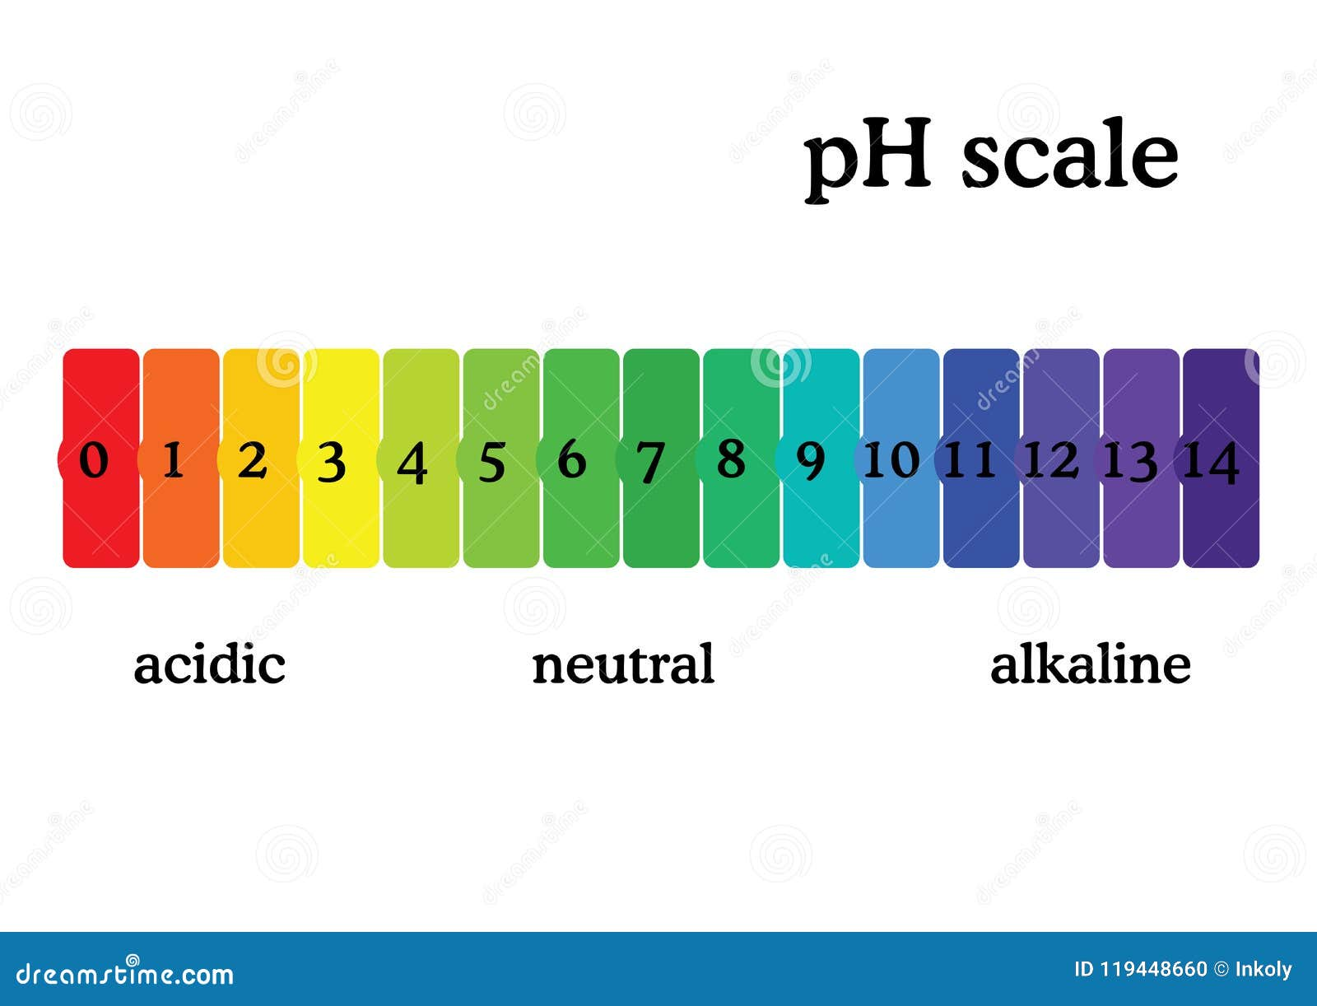
A pH scale adopted from Dreamstime.com
The pH scale operates on the following basic principles:
The lower the pH value the higher the level of acidity.
The higher the pH value the lower the level of acidity.

Slide 22
Conclusion
After a careful analysis of the research and data collected from both research sites, it can be concluded that land cover influences the microclimatic conditions of the area such as surface temperature, humidity, rainfall, pH of rainwater.
The more trees found in an area, the higher the amount of rainfall.
This explains why more rainwater was collected on University of Ghana Campus than Faith Community Baptist Senior High School Campus.
The number of trees found in an area influences the level of acidity of rainwater in the area. The more trees found in an area, the lower the level of acidity of rainwater in the area.
This explains why the acidity level of rainwater of University of Ghana Campus was higher compared to Faith Community Baptist Senior High School’s rainwater.

Slide 23
Recommendation(s)
This research recommends the following;
That Faith Community Senior should embark upon a massive tree-planting campaign to get more trees planted on the School compound and its environs.
University of Ghana community should be encouraged to intensify their effort of planting more trees on its campus.

Slide 24
Reference(s)
Oke, T. R. (1987) Boundary Layer Climate. Routeledge
https://www.epa.gov/report-environment/land-cover
E Mueller - AGU Fall Meeting Abstracts, 2018 - ui.adsabs.harvard.edu
https://www.air-quality.org.uk/16.php
https://www3.epa.gov/acidrain/education/site_students/phscale.html.
Dreamstime.com

