Slide 1
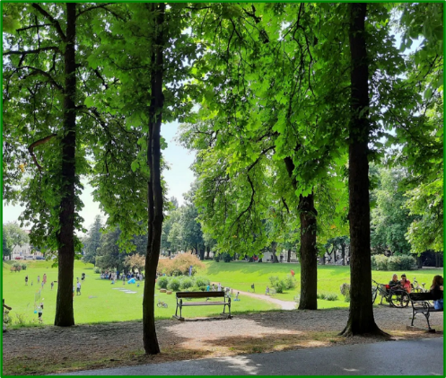
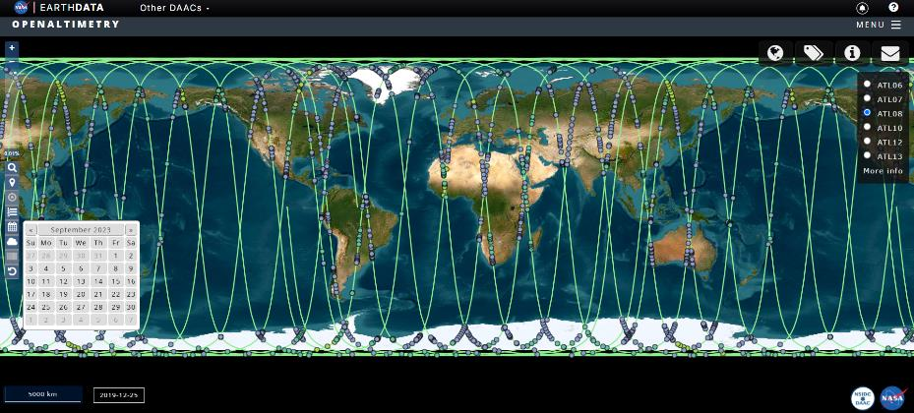
Analysis of biometry measurements in Karlovac Promenade
Students:
Zoea Benković
Esma Šabanović
Lana Blažan
Mentors to students:
Snježana Marković – Zoraja, Kristina Fratrović
Dubovac Primary school, Karlovac, Croatia

Slide 2
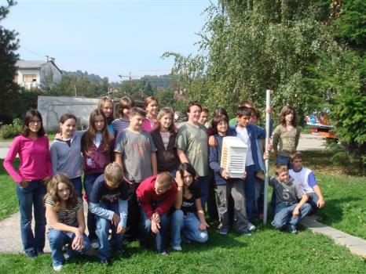
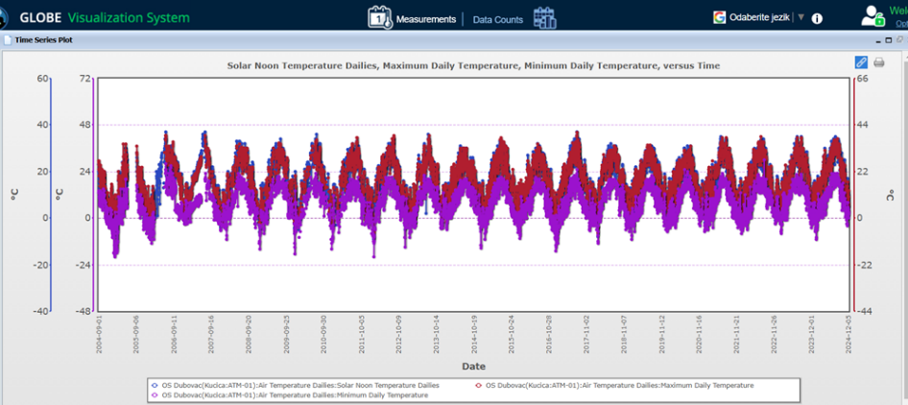
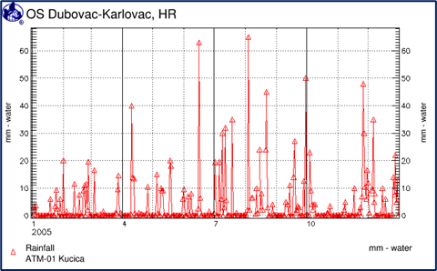
We joined GLOBE in 2004
First GLOBE generation 2004.
atmospheric measurements
hydrological measurements

Slide 3
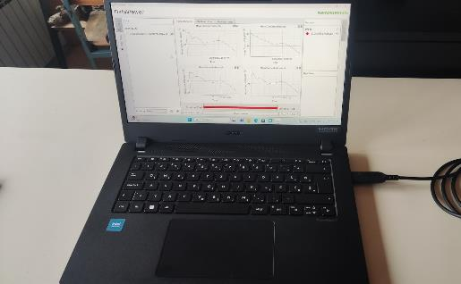
Last generation, 2024 – research projects in the alleys of the city of Karlovac
The beginning of measuring air quality with devices and Arduino systems
IVSS 2024.

Slide 4
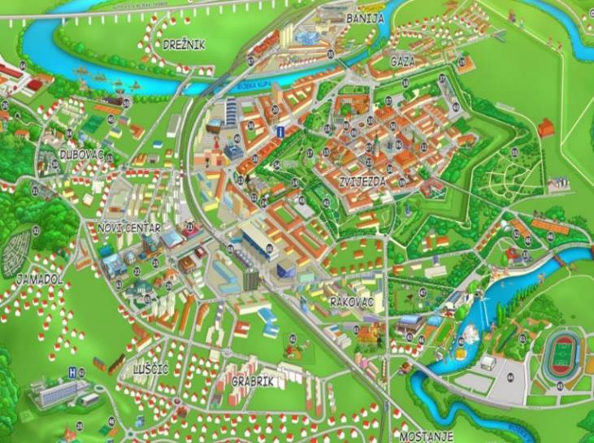
Introduction in research project 2024
Karlovac Promenade – the alley located on the west side of Karlovac Star
treeline consisting of wild chestnut trees (Aesculus hippocastanum L.)
and a few linden trees (Tilia sp.)
place of city manifestations
place of citizen gathering who enjoy the city greenery

Slide 5
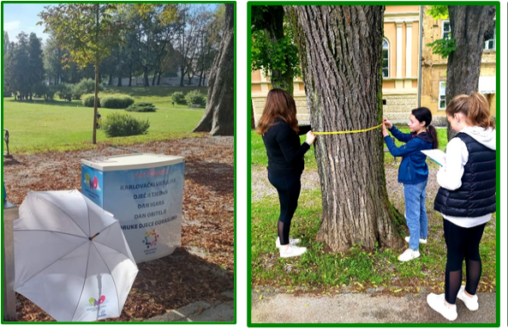
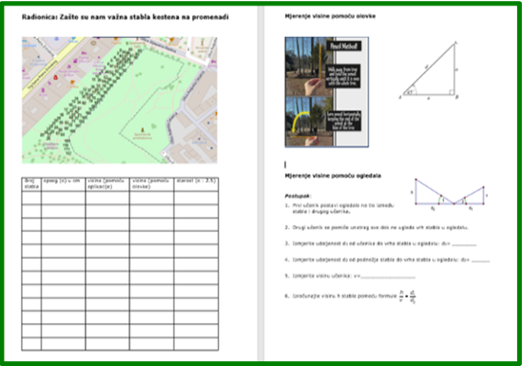
on the manifestation „Karlovac carousel”, our GLOBE students with teachers have a biometry workshops on the Promenade ewery year
because of student interest, the workshop became a research project of biometry for all 190 trees on the Promenade
we worked on the project from March to May 2024 and it was presented at the National competition

Slide 6
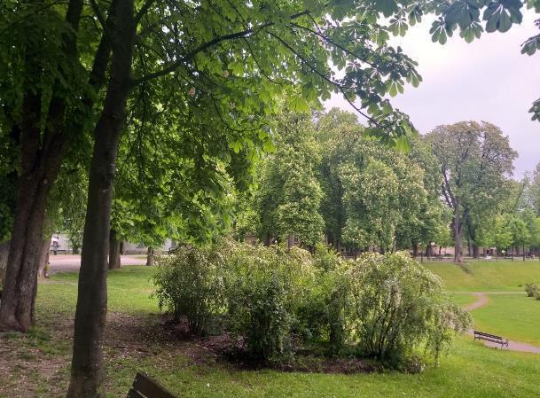
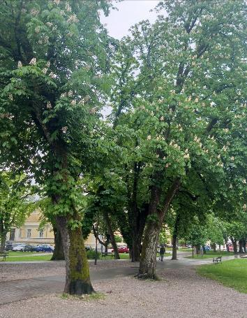
Research questions
Can we read the height of the trees in the satellite measurement databases?
How old are the trees in the Karlovac Promenade and when were they planted?
How much carbon did the trees in the Karlovac Promenade store?
How much CO₂ did the trees in Karlovac Promenade absorb?

Slide 7
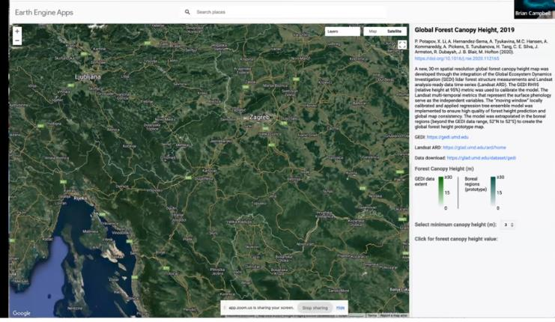
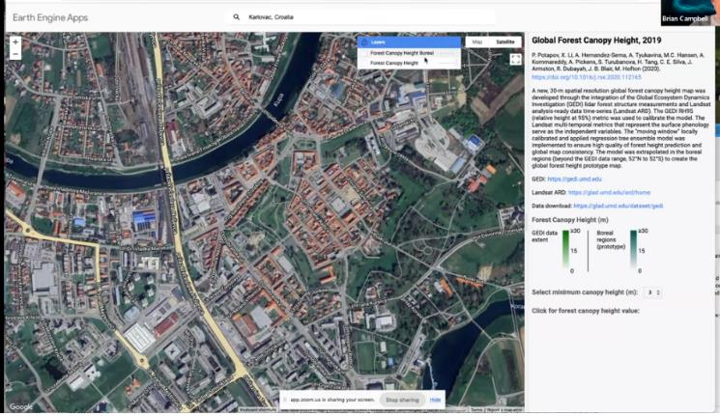
Research methods – working on databases
The students explore the database on platform:
Earth Engine apps
(GEDI satellite - Global Ecosystem Dynamics Investigation, measures canopy height)
https://glad.earthengine.app/view/global-forest-canopy-height-2019

Slide 8
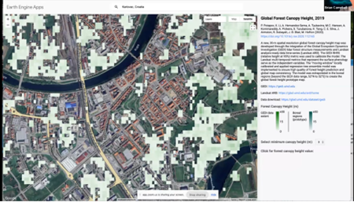
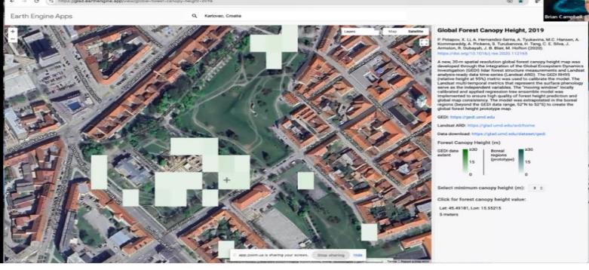
By zooming in on the map, pixels in varying shades of green appear, representing canopy height
By selecting and marking a pixel, only the average height of the entire pixel is obtained, not that of specific tree

Slide 9
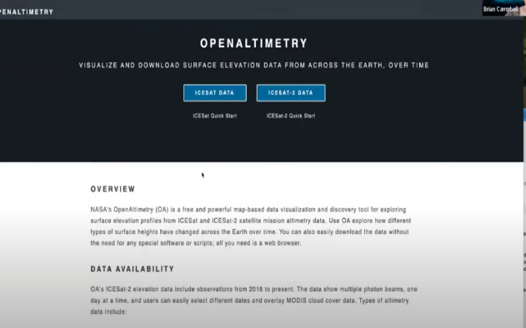
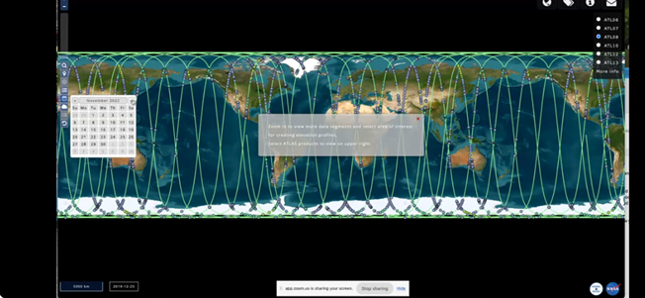
The students explore the database on platform:
OPENALTIMETRY
(ICE Sat 2 )

Slide 10
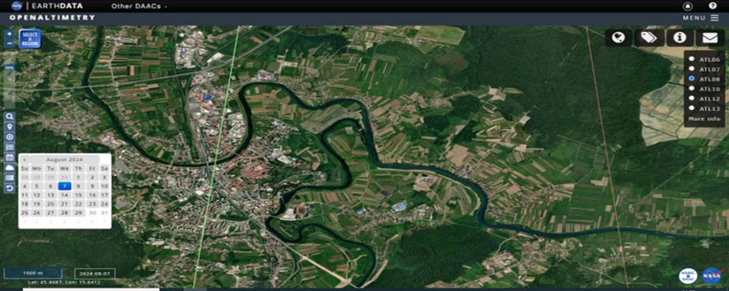
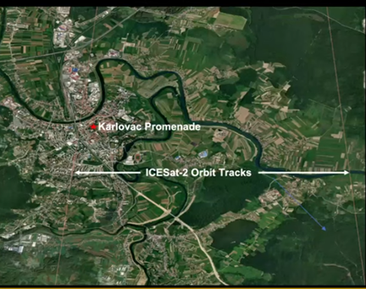
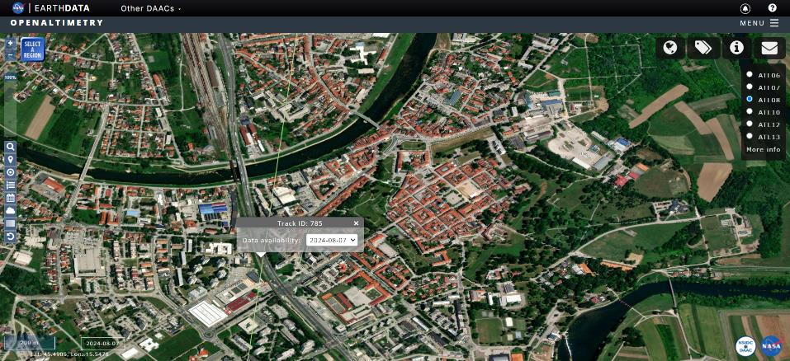
The satellite paths did not capture the canopy over the area of the Karlovac Promenade

Slide 11
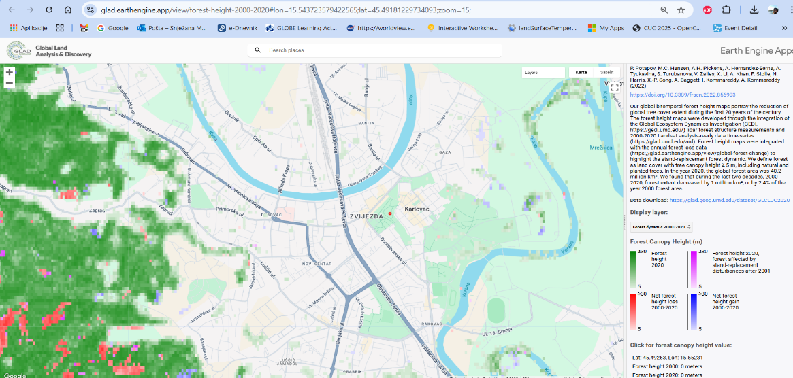
The students explore the database on platform: Earth Engine apps
the dynamics of the global tree cover 2000.- 2020
No data
https://glad.earthengine.app/view/forest-height-2000-2020#lon=15.543723579422565;lat=45.49181229734093;zoom=15;

Slide 12
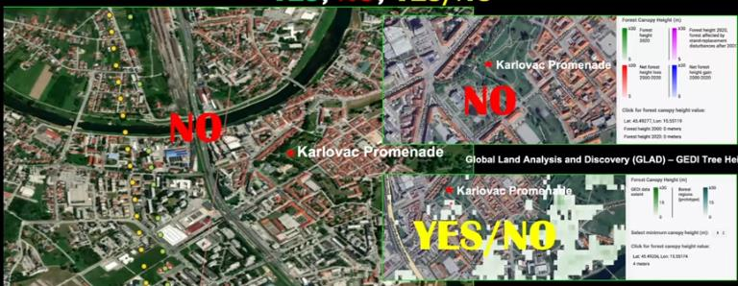
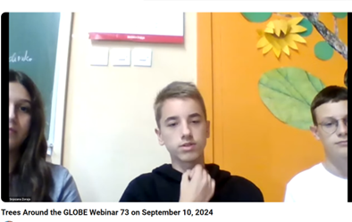
Did satellites capture and measure the height of trees n the Karlovac Promenade?
Talking with Brian Campbell (NASA scientist) on webinar how satellites record the Earth surface
ICE Sat 2 : NO, as the recording lines were not on the location.
GEDI: PARTIALLY, measuring the average canopy height per pixel.

Slide 13
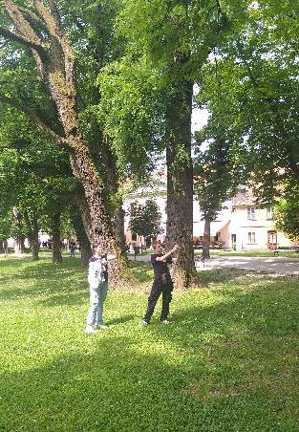
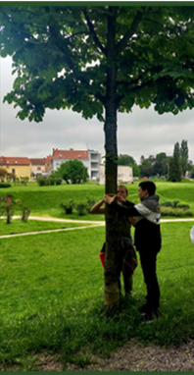
Research methods on the field
Biometry measurements were conducted on all 120 trees on the Promenade
GLOBE protocols:
tree circumference
tree age
GLOBE Observer
tree height and location

Slide 14
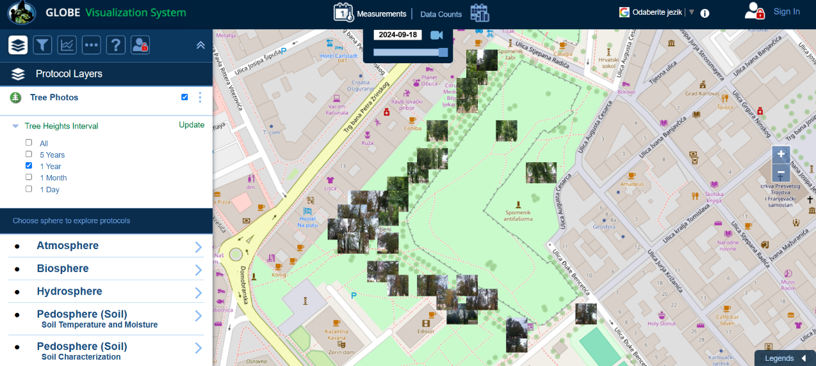
The measured values can be accessed in the GLOBE database

Slide 15
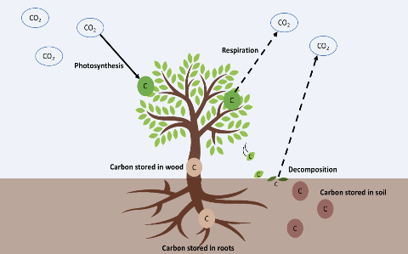
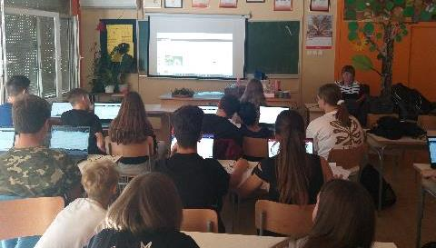
The following values were calculated in the classroom
diameter/cm = $\frac{circumference of tree}{π}$
green weight - GW/ kg
$GW=0.0346∙d^{2}∙$ $h$ (if the $d>28 cm$)
$GW=0.0577∙d^{2}∙h$ (if the $d<28 cm$)
dry weight - DW/kg = $\frac{GW}{2}$
carbon storage - CC/kg = $\frac{DW}{2}$
absorbed CO₂ /kg
Carbon storage $∙3.67$ jer je $\frac{{Mr(CO}_{2})}{Ar(C)}=3.67$

Slide 16
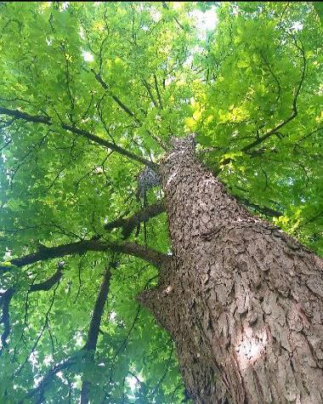
Results
The stored carbon and absorbed CO₂ in the Promenade are presented in intervals based on tree diameter
interval of tree diameter /cm | interval of tree age /years | number of trees | stored carbon /kg | absorbed CO₂ /kg
1 - 50 | 1 - 62.5 | 120 | 12 896 | 47 328
51 - 100 | 63 - 125 | 66 | 54 571 | 200 575
101 - 150 | > 125 | 4 | 8 966 | 32 906
 | 190 |  | 76 433 | 280 809

Slide 17
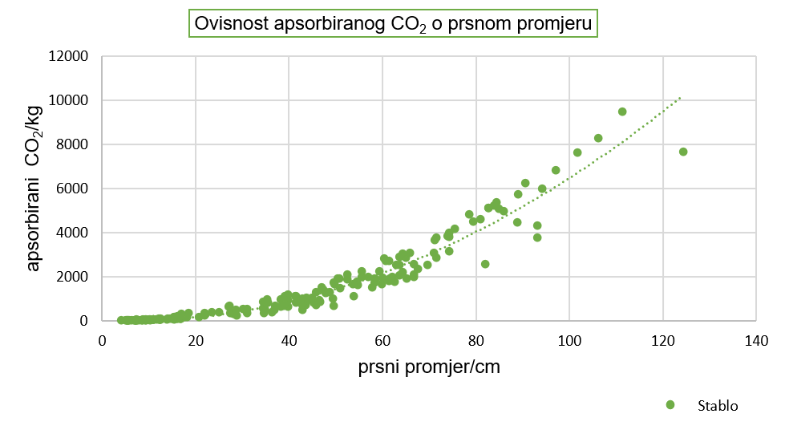
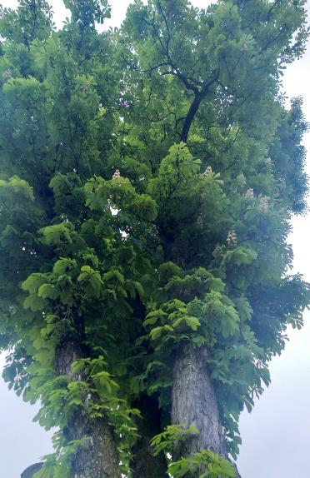
190 trees on the Karlovac Promenade)
Dependence of absorbed CO₂ on chest diameter
absorbed CO₂/ kg
diameter
tree

Slide 18
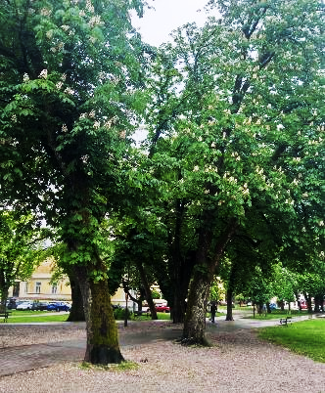
Discussion and conclusion
Trees in the Promenade absorbed more then 280 t of CO₂ and contain over 76 t of stored carbon
2% of the trees are over 125 years
Field measurements are crucial because satellites
cannot capture all surfaces on Earth,
especially in urban areas
age | Promenade (190 trees)
to 62.5 years | 64%
63 - 125 years | 34%
more then 125 years | 2%

Slide 19
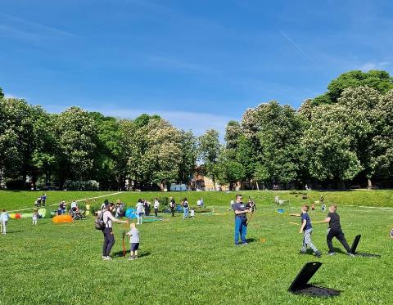
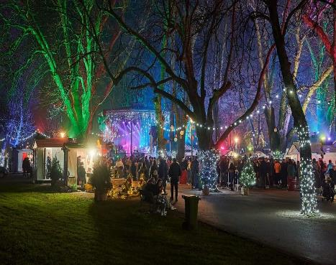
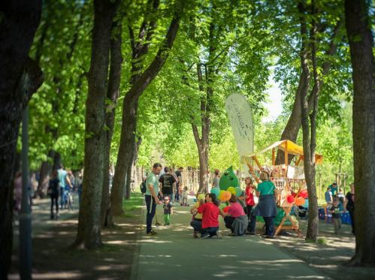
Karlovac promenade is a place for urban gatherings and events
maintaining and caring for avenues is of great importance for the city

Slide 20
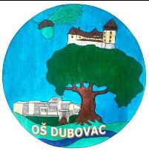
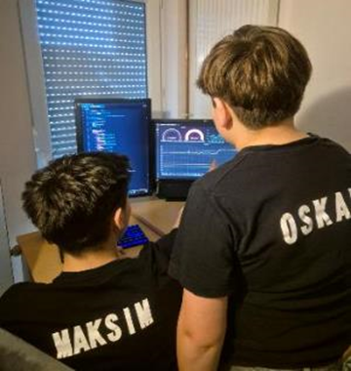
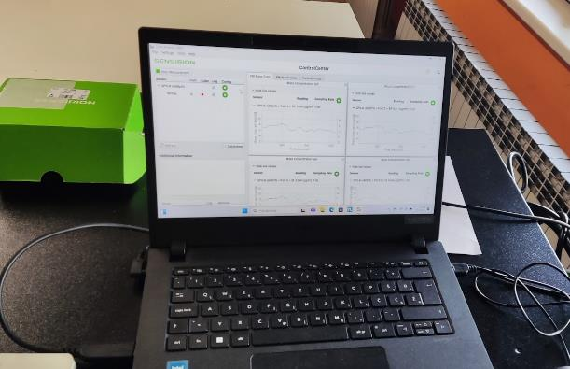
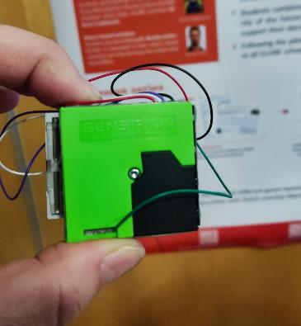
Generation of students 2024/2025
GLOBE atmospheric measurements and tree monitoring
monitors the amount of the main air pollutants in the city of Karlovac
compares biometric measurements in the field and compares them with satellite measurement data

