Slide 1
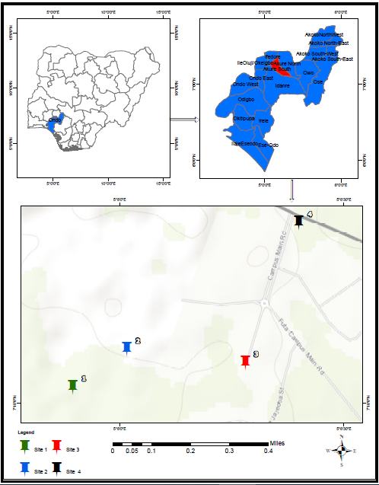
SPATIAL VARIABILITY OF CO₂, CARBON MONOXIDE, AIR TEMPERATURE AND RELATIVE HUMIDITY IN AKURE CITY, NIGERIA
Teacher: Mr. Olawunmi Fasakin. Students: Ayomiposi Ojumu, Adedemeji Odunjo and Titilayo Olatunji
ST. PETER’S UNITY SECONDARY SCHOOL, AKURE, ONDO STATE, NIGERIA
Abstract
Research Methods
Results
Discussion
Planning Investigations
The HANNA (AQ-9901SD) instrument was used for measuring the emissions of CO and CO₂, while relative humidity and air temperature values were also obtained at the area of investigation using the same device. Figures 2 and 3 display the HANNA instrument while one of the probes is shown in Figure 3.
ArcGIS was used for generating the map of the study area (Figure 4). Four atmospheric sites at FUTA in Akure metropolis which is within Akure South local government, Ondo State, Nigeria (Figure 4).
Safety Precautions
All larval habitats sampled as specimens for the research work were immediately discarded and destroyed. We sampled the larvae at or near solar moon.
Geographical Location of Akure City
Akure metropolitan city is in south-western Nigeria, and is the capital of Ondo State. It lies about 7°25’ north of the equator and 5°19’ east of the Meridian (Figure 1). Figure 2 is the Print screen of GLOBE.
GLOBE Protocols in this research work: Atmosphere protocols – air temperature and relative humidity; Carbon protocols – carbon dioxide (CO₂) emissions; Air quality protocol – carbon monoxide (CO).
The fluctuations in CO levels could indicate varying levels of human activity or natural events that influence CO emissions.
CO₂ levels also vary, with some sites showing more pronounced fluctuations than others. This could be related to localized sources of CO₂, such as traffic or industrial activities.
The interplay between CO levels, temperature, and humidity can have complex effects on local and global climates. Persistent high levels of CO can lead to deteriorating air quality and health issues, as well as contribute to the warming of the a weak negative correlation between CO emissions and time at this atmosphere..
Overall, the data suggests a weak negative correlation between CO emissions and time at this location, but this finding is not statistically significant. There is a moderate positive correlation between relative humidity and air temperature, which is statistically significant.
The spatial variability of atmospheric carbon dioxide (CO₂), carbon monoxide (CO), air temperature and relative humidity in Akure metropolitan city, Ondo State, Nigeria was carried out with the aim to determine how the earth systems are impacted by climatic changes. The objectives are to evaluate the relationships between the climate parameters. Four observational sites (A, B, C and D) were chosen within the area of investigation, which is the Federal University of Technology Akure (FUTA), Nigeria. The HANNA instrument was used to measure CO₂ and CO emissions with the corresponding air temperature and relative humidity from the four locations. The interplay between CO levels, temperature, and humidity can have complex effects on local and regional climates. Persistent high levels of CO can lead to deteriorating air quality and health issues, as well as contribute to the warming of the atmosphere. There is a weak negative correlation between CO emissions and time (days) (correlation coefficient of -0.139). This suggests CO emissions may be slightly lower over time. There is a very weak positive correlation between CO₂ emissions and time (days) (correlation coefficient of 0.005), which is close to zero and suggests no relationship. There is a moderate positive correlation between air temperature and relative humidity (correlation coefficient of 0.779). This means that as relative humidity increases, air temperature also tends to increase. There is a weak positive correlation between CO emissions and CO2 emissions (correlation coefficient of 0.204) and a weak negative correlation between CO emissions and air temperature (correlation coefficient of -0.111). It is therefore recommended to incorporate sustainable transportation system, adopt sustainable agriculture and forest management, and building sustainable infrastructure to reduce the CO₂ emissions from buildings and building new low energy physical structures. Also, adopting renewable energies such as solar, wind, biomass and geothermal, that is, moving away from fossil fuels.
Keywords: Carbon dioxide, Carbon monoxide, Air temperature, Humidity, Climate change.
Analyzing Data
Research Questions
Do human activities influence the climate change?
2) Does carbon dioxide, air temperature, relative humidity and carbon monoxide play significant roles in climate change?
3) What is the relationship between the physicochemical factors and climate change?
Conclusions
The combined analysis of these graphs can provide insights into the environmental conditions at each site and how they might be interrelated. For instance, higher CO and CO2 levels could be indicative of increased fossil fuel combustion, which is a significant contributor to climate change. The relative humidity and air temperature data can help in understanding the local climate dynamics and how they might be influenced by or contribute to broader climatic trends.
The interplay between CO levels, temperature, and humidity can have complex effects on local and global climates. Persistent high levels of CO can lead to deteriorating air quality and health issues, as well as contribute to the warming of the atmosphere.
Recommendation
How to prevent global warming include the following:
Adoption of renewable energies such as solar, wind, biomass and geothermal, that is, moving away from fossil fuels.
Reducing our consumption of energy and water by using more efficient devices such as Light Emitting Devices (LED) light bulbs, innovative shower systems.
Introduction
Both natural and human actions have contributed to high greenhouse gas emission and increased concentration of carbon dioxide in the atmosphere in the last four decades. This has led to global warming and subsequently to climate change (Amuka et al., 2018).
Effects of rapid climate change include global temperature rise and warming ocean. The large increase in industrial activity during the present century is discharging so much carbon dioxide into the atmosphere that the average temperature is rising at the rate of 1.5 degrees per century. Human activities have raised the atmosphere's carbon dioxide content by 50% in less than 200 years (Lindsey, 2023).
Time (days) | Site A | Site B | Site C | Site D
1 | -0.390 | -0.325 | -0.075 | 0.132
-0.390 | 1 | 0.749 | 0.268 | -0.121
-0.325 | 0.749 | 1 | 0.574 | 0.245
-0.075 | 0.268 | 0.574 | 1 | 0.863
0.132 | -0.121 | 0.245 | 0.863 | 1
Figure 3. A sample of a probe attached with the device.
Figure 4. (a) Map of Nigeria, (b) 18 local government areas of Ondo State and (c) four observation sites at FUTA campus.
Source | Value | Table 3. Model parameters (CO₂ emissions) Standard error | t | Pr > |t| | Lower bound (95%) | Upper bound (95%)
Intercept | 564.071 | 5.318 | 106.071 | < 0.0001 | 553.571 | 574.572
DATE-Site A | -67.048 | 7.521 | -8.915 | < 0.0001 | -81.897 | -52.198
DATE-Site B | -36.048 | 7.521 | -4.793 | < 0.0001 | -50.897 | -21.198
DATE-Site C | -41.190 | 7.521 | -5.477 | < 0.0001 | -56.040 | -26.341
DATE-Site D | 0.000 | 0.000
Table 3. Model parameters (CO₂ emissions)
Bibliography/References
Afolabi, O.J., & Aladesanmi, C.O. (2018). Seasonal variation in distribution and
abundance of mosquitoes (Diptera: Culidae) in Akure North local government area, Ondo State, Nigeria, Uttar Pradesh Journal of Zoology, 38, 149–159.
Amuka, J.I., Asogwa, F.O., Ugwuanyi, R.O., Omeje, A.N., and Onyechi, T. (2018).
Climate change and life expectancy in a developing country: Evidence from
greenhouse gas (CO2) emission in Nigeria. Ecojournals, 8(4)
Lindsey, R. (2023). Climate change: Atmospheric carbon dioxide

