Slide 1
UNIVERSITY BASIC SCHOOL,LEGON RESEARCH PAPER GLOBE 2025

Slide 2
THE RELATIONSHIP BETWEEN LAND COVER AND AIR TEMPERATURE - A CASE STUDY OF UNIVERSITY OF GHANA MAIN CAMPUS.
Organization: University of Ghana Basic School, Legon
Country : Ghana
Students: Kendra Adobea Asare, Jeremiah Okyere Amponsah, Victoria Antock, Nhyira Addison Offei, Samaham Abubakari,
Grade Level: Junior High School(grades 6-8, 12-14)
GLOBE Teacher(s): Enoch Lamptey, Ms. Eva Sakyi
Contributors: Eric Sifa - Head of School,
Other Contributors: Richmond Obeng
Protocol: Air Temperature
Language: English

Slide 3
ABSTRACT
Recent observation shows an increase in the number of cars moving in and out of the campus of the University, Legon. This is coupled with the long vehicular traffic on the main highways that surround it. The Adenta – Madina – Accra highway, the Atomic – Haatso highway, and the GIMPA – Agbobga highway. These highways are close to the main campus of the University of Ghana, Legon.
From the university’s security department, it is estimated that about 2,500 or more cars move in and out of the university's campus every day. This gives us about 17,500 cars or vehicles per week. This figure multiplied by a month and a year gives a staggering figure. This figure is anticipated to increase soon.
Tree planting activities have picked up lately on the University campus under the operation “Green Project”. The recent ones have been the tree planting exercise embarked upon by the University Basic School pupils in October,2022 and the Green Ghana project under the auspices of His Excellency Nana Addo Danquah Akuffo Addo which saw him and other notable dignitaries’ part of the exercise on Friday, 9th June,2023.

Slide 4
ABSTRACT
Research indicates that areas with dense vehicle traffic experiences higher average air temperatures. This temperature increase is more pronounced during sunny weather and rush hours, where traffic congestion can elevate urban heat island (UHI) effects.
The rise in temperature is directly proportional to internal exhaust emissions, including gases like carbon monoxide (CO), nitrogen oxides (NO), hydrocarbons (HC), carbon dioxide (CO₂), sulfur oxides (SO₂), and particulate matter (PM₁₀). These emissions increase environmental entropy, leading to warmer and less fresh air
This paper explores the relationship between tree cover and Air Temperature at the University of Ghana, Legon Campus comparative with the Faith Baptist Community School with less tree cover, providing insights into how urban planning can incorporate green infrastructure to combat climate challenges

Slide 5
The Immediate Former President of the Republic of Ghana, His Excellency Nana Addo Dankwa Akuffo Addo planting the first tree of the day

Slide 6
The Vice Chancellor of the University of Ghana, Prof. Nana Aba Appiah Amfo also taking her turn to plant the second tree of the day.

Slide 7
The University of Ghana Basic School Pupils in Tree Planting Exercise.

Slide 8
INTRODUCTION & REVIEW OF LITERATURE
According to Stull, R. (2011), Air temperature is a key atmospheric variable, indicating the degree of warmth or coldness of the air. It can also be said to be the temperature indicated by a thermometer exposed to the air but shielded from direct solar radiation. American Meteorological Society (2020). Rapid urbanization and the proliferation of vehicular traffic have intensified urban heat islands (UHIs) and elevated Air Temperatures in cities worldwide.
Vehicular emissions contribute not only to air pollution but also to the warming of urban areas. The type and extent of land cover, particularly tree cover, significantly influences Air Temperature.
This study was conducted based on the examination of data on Air Temperature collected by Pupils of the University of Ghana Basic School situated within the University of Ghana, Legon Campus using the GLOBE Observers App and data from the Ghana Meteorological Service Agency.
The data collected prompted pupils to conduct comparative research on the effects of the dense tree cover in the University of Ghana, Legon campus and the sparse tree cover of the Faith Community Baptist Senior High School located near the Madina Market on Air Temperatures with substantial vehicular traffic.

Slide 9
REVIEW OF LITERATURE
Studies have established the cooling effects of trees in urban areas. Akbari et al. (2001) found that urban tree planting can reduce local temperatures by up to 3°C, depending on canopy density and species.
Additionally, Bowler et al. (2010) highlighted those urban green spaces, including tree cover, significantly reducing surface and air temperatures, particularly during peak heat periods.
However, the effectiveness of trees in cooling varies with factors such as species, age, and spatial arrangement (Rahman et al., 2020).
Areas with limited tree cover often experience higher Air temperatures due to increased heat absorption by exposed surfaces and a lack of natural cooling mechanisms (Santamouris, 2020).
This effect is exacerbated in areas with high vehicular traffic, where exhaust heat adds to the thermal load.

Slide 10
Aerial View of Faith Community Baptist Senior High School

Slide 11
Aerial View of University of Ghana Campus

Slide 12
Research Questions
This research work is to find out.
Whether there is any relationship between Land Cover and Air Temperature in areas with high vehicular traffic.
Whether the University of Ghana land cover has an impact on Air Temperature.

Slide 13
Research Hypothesis
The carbon emissions from the large number of cars moving in and out of the University campus coupled with the long vehicular traffic on the highways surrounding the University`s main campus could lead to high Air Temperatures.
The large coverage of trees on the landcover could balance carbon emissions from vehicles and carbon absorption. This could lead to lower Air temperatures.
However, more vehicular activity and fewer trees on Faith Community Baptist Senior High School (Madina) may have resulted in high Air Temperatures

Slide 14
RESEARCH METHOD
This study focuses on two areas, The University of Ghana Campus (University Basic School) and the Faith Community Baptist Senior High School (Madina), having different landcovers.
Data Collection on Air Temperature by Pupils of the University of Ghana Basic School were obtained from The Automated Weather Satellite mounted on the campus of the University of Ghana Basic School and from the Ghana Meteorological Agency. Pupils also obtained tree cover data from both the University of Ghana Campus and the Faith Community Baptist Senior High School using the GLOBE Observer’s App.
Statistical analyses were performed by Pupils on the data collected from both sources to examine the relationship between tree cover percentage and Air Temperatures. The data collected were used to visualize temperature distributions relative to tree cover density.

Slide 15
Pupils Taking Air Temperature from Automated weather station

Slide 16
Pupils taking data on Landcover at the University of Ghana Campus

Slide 17
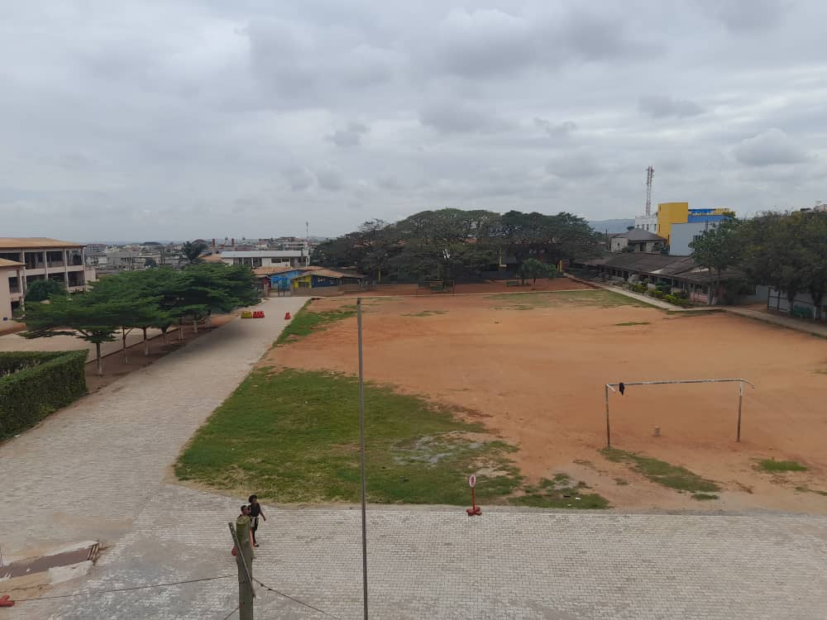
Pupils taking data on Landcover at the Faith Community Baptist Senior High School

Slide 18
AVERAGE AIR TEMPERATURES FROM JANUARY 1ST ,2023 – AUGUST27TH 2023 UNIVERSITY OF GHANA, LEGON CAMPUS
 | MONTHS
 | JANUARY | FEBRUARY | MARCH | APRIL | MAY | JUNE | JULY | AUGUST
Temperature AVG (Degrees Celsius) | 27.9 | 28.5 | 28.0 | 28.3 | 28.0 | 25.9 | 25.8 | 25.1
Temperature MAX (Degrees Celsius) | 33.6 | 33.3 | 32.3 | 32.8 | 31.6 | 29.4 | 29 | 28.0
Temperature MIN (Degrees Celsius) | 24.1 | 25.1 | 24.6 | 24.8 | 24.8 | 23.4 | 23.9 | 23.4

Slide 19
AVERAGE AIR TEMPERATURES FROM JANUARY 1ST ,2023 – AUGUST 27TH 2023 FAITH BAPTIST COMMUNITY SENIOR HIGH SCHOOL - MADINA
 | MONTHS
 | JANUARY | FEBRUARY | MARCH | APRIL | MAY | JUNE | JULY | AUGUST
Temperature AVG (Degrees Celsius) | 28.6 | 29 | 28.6 | 28.9 | 28.6 | 26.4 | 26.2 | 25.3
Temperature MAX (Degrees Celsius) | 34 | 34.1 | 33.3 | 33.7 | 32.6 | 29.9 | 29.5 | 28.2
Temperature MIN (Degrees Celsius) | 25.4 | 25.8 | 25.3 | 25.4 | 25.5 | 23.9 | 24.3 | 23.8

Slide 23
Results and Discussions
Areas with more than 30% tree cover showed an average Air Temperature reduction of 1.5°C compared to areas with less than 10% tree cover.
Broadleaf species exhibited greater cooling effects compared to conifers. Clusters of trees provided more significant cooling effects than isolated trees, emphasizing the importance of contiguous green spaces.
The findings corroborate existing research on the cooling benefits of trees in urban environments with high vehicular traffic.
The observed Air Temperature reductions align with the hypothesis that shade, and evapotranspiration are primary mechanisms driving cooling. Moreover, variations among species suggest that urban planning should prioritize contiguous green spaces of broadleaf species with high transpiration rates.
The findings also highlight the need for integrated green infrastructure planning to maximize cooling benefits.

Slide 24
Conclusion
After a careful analysis of the research and data collected from both research sites, it can be concluded Tree cover plays a pivotal role in mitigating urban heat by lowering Surface and Air Temperatures.
The more trees found in an area, the lower the surface and air temperatures.
This explains the lower surface and air temperatures experienced at the University of Ghana Campus than Faith Community Baptist Senior High School Campus.
This study demonstrates the potential of intensifying urban greening initiatives to address the challenges posed by climate change and urbanization. Future research should explore long-term effects of tree cover changes and investigate socio-economic implications of urban forestry programs

Slide 25
Recommendation(s)
This research recommends the following;
That Faith Community Senior should embark upon a massive tree-planting campaign to get more trees planted on the School compound and its environs.
University of Ghana community should be encouraged to intensify their effort of planting more trees on its campus.

Slide 26
Reference(s)
Akbari, H., Pomerantz, M., & Taha, H. (2001). Cool surfaces and shade trees to reduce energy use and improve air quality in urban areas. Solar Energy, 70(3), 295-310.
Bowler, D. E., Buyung-Ali, L., Knight, T. M., & Pullin, A. S. (2010). Urban greening to cool towns and cities: A systematic review of empirical evidence. Landscape and Urban Planning, 97(3), 147-155.
Oke, T. R. (1982). The energetic basis of the urban heat island. Quarterly Journal of the Royal Meteorological Society, 108(455), 1-24.
Rahman, M. A., Stratopoulos, L. M. F., & Moser-Reischl, A. (2020). Evaluating the cooling effects of urban trees: A novel approach. Urban Forestry & Urban Greening, 55, 126-132.

