Slide 1
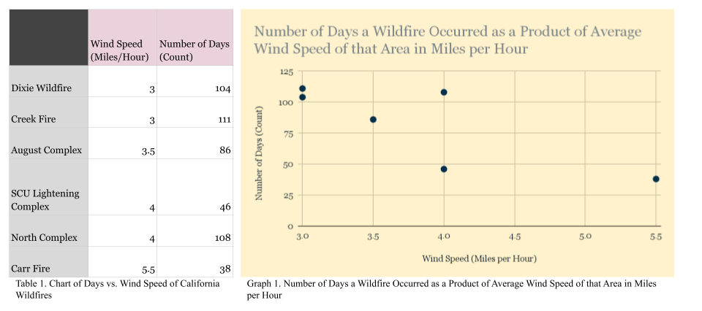
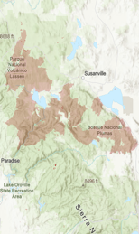
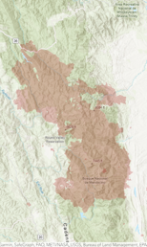
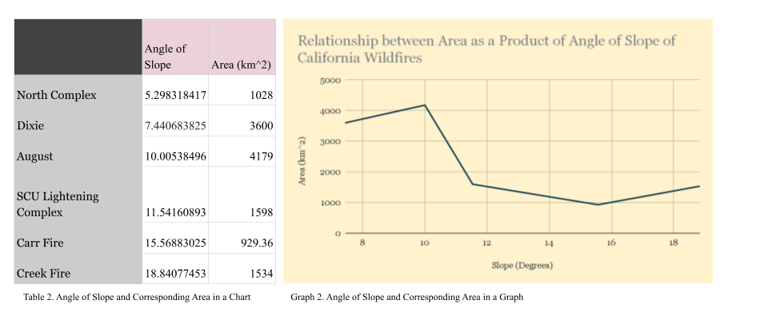
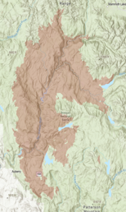
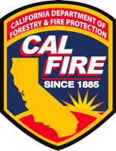
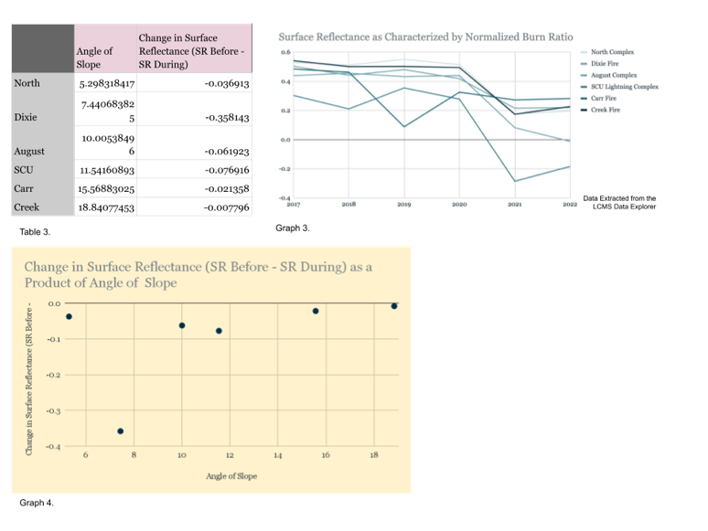
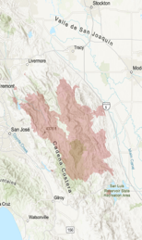
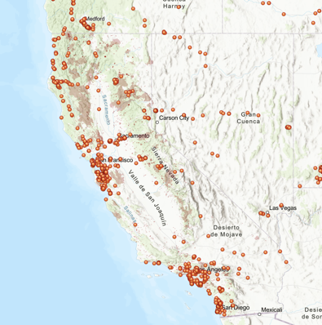
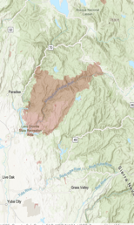
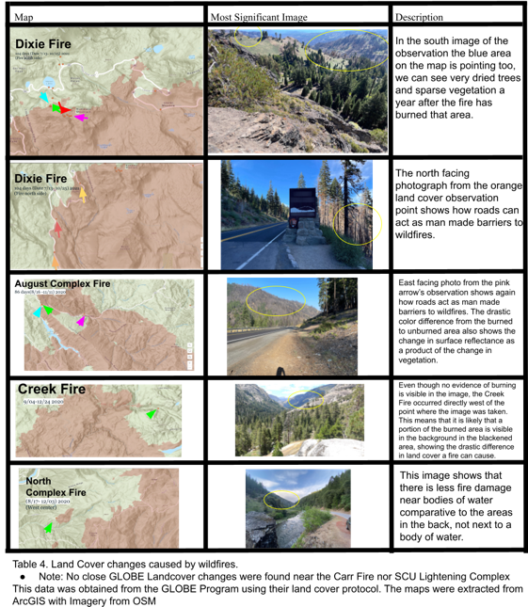
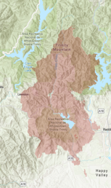
Analyzing the Correlation between Terrain and the Characteristics of Wildfires.
Trisha Gorusu, Kate Bittle, Renee Easterbrook, and Dafne Rodriguez
Mentors: Russanne Low PhD, Cassie Soeffing PhD, Peder Nelson, Andrew Clark, Erika Podest PhD
The material contained in this poster is based upon work supported by the National Aeronautics and Space Administration (NASA) cooperative agreements NNX16AE28A to the Institute for Global Environmental Strategies (IGES) for the NASA Earth Science Education Collaborative (NESEC) and NNX16AB89A to the University of Texas Austin for the STEM Enhancement in Earth Science (SEES). Any opinions, findings, conclusions, or recommendations expressed in this material are those of the authors and do not necessarily reflect the views of NASA.
Abstract
Data
Data Collection Resources & Methodology
Wildfires, also known as bush or forest fires, pose significant threats to land cover, wildlife, humans, and property due to their rapid spread and difficulty in containment. This study explores the correlation between terrain and wildfire characteristics in respective areas. It analyzes terrain based on average elevation, and average slope, while also considering variables like wind speed and temperature. It then studies the terrain’s effects on wildfires by first characterising wildfires in terms of surface reflectance, spread, and landcover changes, and then using that data to find underlying correlations. The research can be used identify patterns that can aid in developing improved wildfire prevention methods. Data sets from LCMS, ArcGIS, Google Earth Engine, Earth Explorer by USGS, NOAA Climate.gov, NCEI NOAA, GLOBE Observer and Cal Fire were used for the study. The most significant correlation found in this study was between surface reflectance and terrain. Future studies should include additional variables like humidity and human activities to better assess the effects of terrain on wildfires.
Wildfire Information
Terrain Information
Wildfire Characteristics
Data sets from LCMS, ArcGIS, Google Earth Engine, Earth Explorer by USGS, NOAA Climate.gov, NCEI NOAA, and Cal Fire were used for the study. The USGS Earth Explorer visually identified wildfire-induced terrain changes. The Google Earth Engine measured slope and elevation. For the surface reflectance assessment, the LCMS dataset was used. Overlapping GLOBE Observer Land Cover Observations from the past three years with ArcGIS software helped identify relevant GLOBE Landcover observations for characterizing wildfire effects. Temperature measurements from NOAA Climate.gov and average wind speeds from NCEI NOAA were incorporated. Comprehensive wildfire details, including coordinates, area, and impact, were sourced from the CalFire database.
Dixie
Slope: 7.440683825°
Average elevation: 612.682941 m
Avg Wind Speed: 4 m/s
Avg Temperature: 67.5°F
Area (km^2): 963,309 acres
Change in Surface Reflectance: -35.81%
GLOBE Landcover Observations: Large areas of burned trees. We were able to see in detail the limits of the fire.
Starting Coordinates:
[39.871306,-121.389439]
Timespan:
104 days
Location:
Northern California, US.
August Complex
r = -0.78 r^2 = .6909
Starting Coordinates:
[39.765, -122.673]
Timespan:
86 days
Location:
Northern California, US.
Slope: 10.00538496°
Average elevation: 496.8550615 m
Avg Wind Speed: 3.5 m/s
Avg Temperature: 70°F
Area (km^2): 1,032,648 acres
Change in Surface Reflectance: -6.19%
GLOBE Landcover Observations: Visible difference between dried trees and burned trees.
Introduction
In 2022, the US experienced a particularly devastating wildfire season, with 66,255 wildfires reported. These fires scorched a staggering 7,534,403 acres of land, leading to widespread destruction of natural habitats and critical ecosystems. The destruction of critical ecosystems disrupted natural processes, impacting the balance of plant and animal species and hindering ecological recovery. The flames not only endangered wildlife but also forced thousands of residents to evacuate their homes, highlighting the direct threat wildfires pose to human lives and property. The sheer scale of the wildfires made containment efforts incredibly difficult for firefighting teams, who bravely worked day and night to mitigate the impact and protect communities at risk. Not all wildfires are created equal, however. Based on location, wind speed, and terrain, the effects caused by wildfires can vary considerably. California is one of the most wildfire prone states in the US causing, but the spread of wildfires in this state can vary from one to over 100,000 acres due to a variety of factors including terrain. Our study aims to determine the specific effects terrain causes as it can affect the speed and direction of a wildfire heavily. We primarily focus of California due to the state's unique
Creek
Area (km^2): 379,895 acres
Change in Surface Reflectance:
-0.77%
GLOBE Landcover Observations: We were able to see the fire zone in the background of the picture and identify the terrain of the fire area.
Starting Coordinates:
[37.439437,-121.30435]
Timespan:
111 days
Location:
Northern California, US.
Slope: 18.84077453°
Average elevation: 2264.116594 m
Avg Wind Speed: 3.5 m/s
Avg Temperature: 70°F
r= -0.32 r^2 =.1069
SCU Lightning Complex
Conclusion
Starting Coordinates:
[37.19147,-119.261175]
Timespan:
46 days
Location:
San Francisco Bay Area (East Bay), Central Valley.
Slope: 11.54160893°
Average elevation: 374.5688823 m
Avg Wind Speed: 2.67 m/s
Avg Temperature: 78.34°F
Area (km^2): 396,624 acres
Change in Surface Reflectance:
-7.69%
GLOBE Landcover Observations: We were able to identify the type of terrain of the surroundings of the fire.
r^2 = .2303
r = .4799
There are four main conclusions that can be made from this study. First off, the greater the wind speed the fewer days a wildfire will occur. Second, the greater the average angle of slope of an area the less the area it spreads is. Third, as the angle of slope increases the change in surface reflectance decreases (meaning there is less of a discoloration of the land in that area). The last conclusion that can be made is from the GLOBE Observer data points; it is that roads act as barriers for fires and that water can reduce the effects of a wildfire.
The conclusions above can be generalized to all of California as all of our wildfires were extracted from across the state of California. These conclusions are relevant because they show that if the terrain is more monotonous then there will be less discoloration of land in that area and a smaller amount of distance it spreads. This is relevant because this conclusion could be used as a basis for understanding a fire better and modeling its pathway.
A key improvement that could be made in our methodology could be to use additional methods of statistical analysis to check for errors in our data and to reaffirm results.
topography, with its varying elevations, canyons, and slopes, which plays a significant role in influencing fire behavior. Steep terrain can act as channels for fire propagation, accelerating its spread and making firefighting efforts even more difficult. In contrast, flat terrains may offer ease controlling fires, allowing firefighting teams to establish strategic containment lines.
North Complex
Starting Coordinates:
[ 39.85], -120.96]
Timespan:
108 days
Location:
Between Quincy and Oroville, California.
Slope: 5.298318417°
Average elevation: 1028.324672 m
Avg Wind Speed: 3.4 m/s
Avg Temperature: 55°F
Area (km^2): 318,935 acres
Change in Surface Reflectance: -3.69%
GLOBE Landcover Observations: Less damage of fire near water bodies. After 5 months of the fire there is no visible damage.
Carr
Starting Coordinates:
[40.6543, -122.6236]
Timespan:
38 days
Location:
Whiskeytown–Shasta–Trinity National Recreation Area, California.
Further Research
The Globe Observer and Open Street Maps Data sets were used in the above maps.
Slope: 15.56883025°
Average elevation: 929.5891018 m
Avg Wind Speed: 4.5 m/s
Avg Temperature: 85°F
Area (km^2): 229, 651 acres
Change in Surface Reflectance: -2.13%
GLOBE Landcover Observations: No nearby data recorded.
Aspect is another main variable we hope to include in this study as it is a major indicator of terrain. Further research on this study should also focus on studying additional confounding variables to lower the chances of error in research and better analyze data values. In addition, using a higher sample population would ensure more precise results.
Research Question
How does terrain affect California wildfires in terms of wildfire’s intensity in terms of surface reflectance, land cover change, and their spread?
The California Fire Perimeters Dataset published byjuliah_esri was used to create the above maps.
Acknowledgements
Analysis of Results
References
Thank you to our SME mentors, the CSR SEES Staff, and our partners.
SME Mentors: Russanne Low PhD, Cassie Soeffing PhD, Peder Nelson, Andrew Clark, Erika Podest PhD
CSR SEES Staff: Celina Miller, Margaret Baguio
Partners: Texas Space Grant Consortium, Center of Space Research (University of Texas Austin), National Aeronautics and Space Administration, NASA Earth Science Education Collaborative
Wind speeds accelerate wildfire extinction by extinguishing flames and reducing temperatures, thus lowering wildfire occurrence rates. Greater wind availability shortens wildfire duration, evident in correlated graph 1.
Collected data establishes direct slope-angle correlation with wildfire spread, amplified by wind speed and climate factors. Mountainous woodlands, with dense tree spacing and steeper slopes, are prone to extensive wildfires. Heat-driven upward flames scorch nearby vegetation, sharply dropping the Raw NBR index. Wind intensification during burns aids spread. Surface reflectance and slope angle show equivalent ratios, with increased slope angles decreasing reflectance. Recent years saw most large-scale fires in high-elevation California areas, possibly due to dense forests and dry air facilitating rapid vegetation ignition.
GLOBE Observer's table 4 data confirms significant post-fire land cover changes, validating altered reflectance and terrain effects. Observations highlight road barriers and water bodies' efficient wildfire spread prevention and vegetation change reduction.
Bishop, L. (2023). Wildfire Statistics: Damage, Fatalities and Insurance Rates. Valuepenguin. Wildfire Statistics: Damage, Fatalities and Insurance Rates
Bishop, L. (2023, July 7). Wildfire Damage & Home Insurance claims by state . ValuePenguin. https://www.valuepenguin.com/homeowners-insurance/wildfire-statistics
https://igestrategies.maps.arcgis.com/home/item.html?id=6fd0d8d6f47d414da7bcb1dcd0539999
California: Let’s stop making wildfire history. The Nature Conservancy. (2018, September 15). https://www.nature.org/en-us/about-us/where-we-work/united-states/california/stories-in-california/californias-wildfire-future/
Holtzclaw, J. (2020). California Fire Perimeters 1878-2021 [Map]. ArcGIS.
Pelletier, J. D., & Orem, C. A. (2014). How do sediment yields from post-wildfire debris-laden flows depend on terrain slope, soil burn severity class, and drainage basin area? Insights from airborne-LiDAR change detection. Earth Surface Processes and Landforms, 39(13), 1822–1832. https://doi.org/10.1002/esp.3570
Scan QR Code for the data used in this study:

