Slide 1
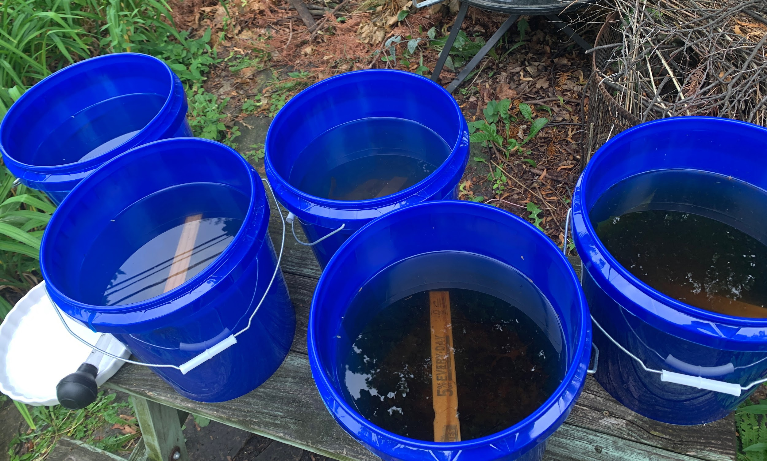
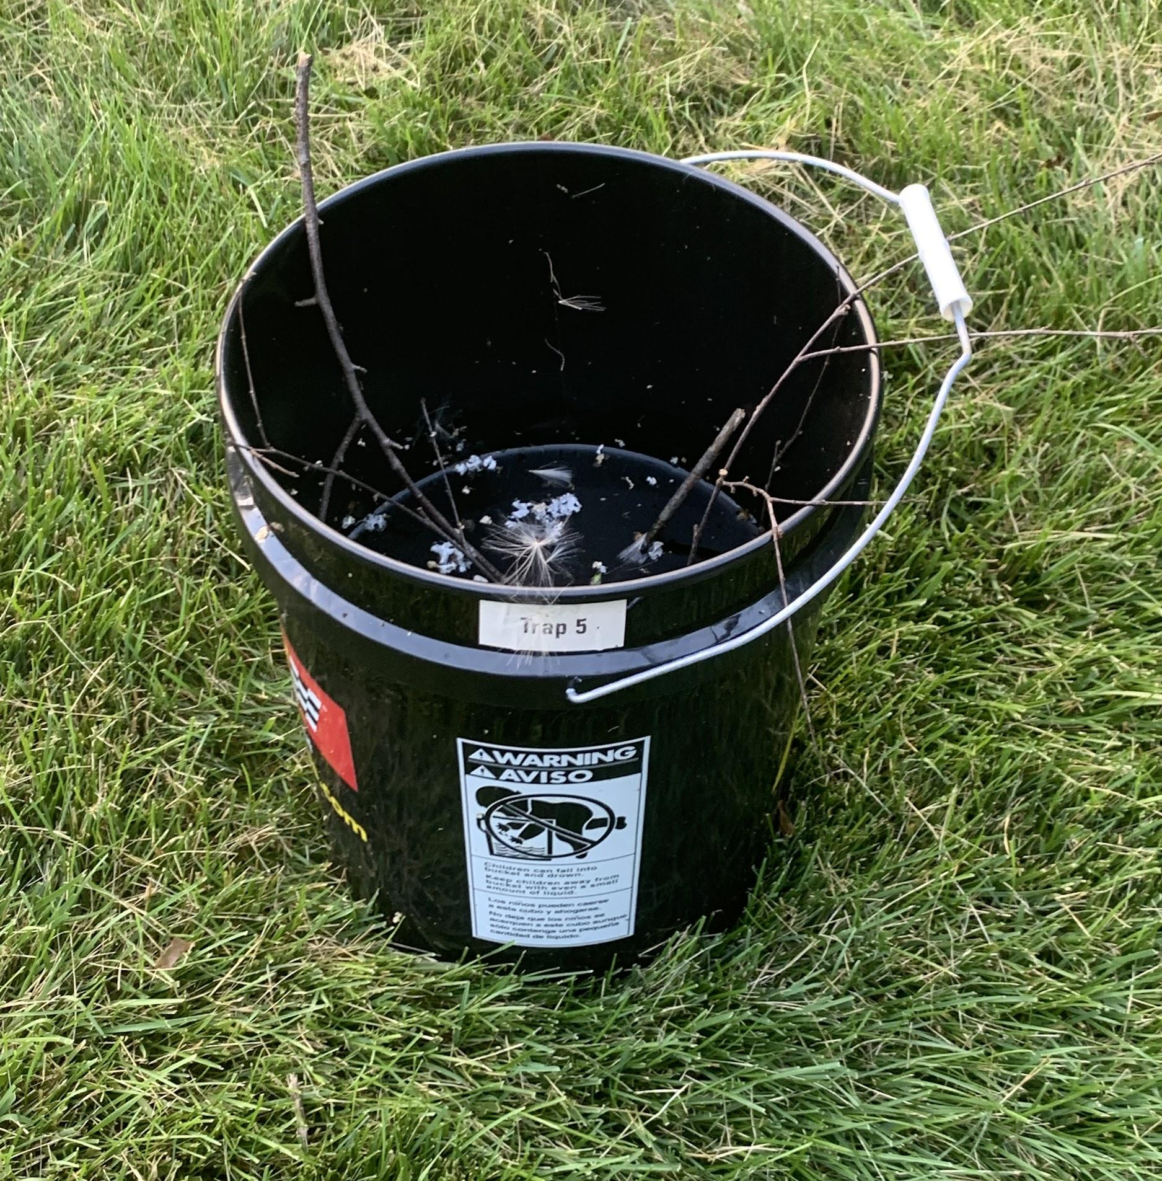
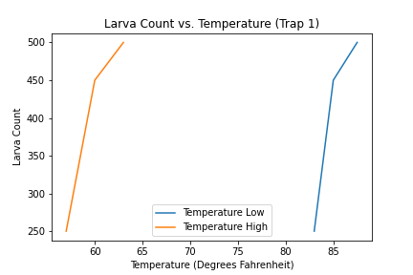
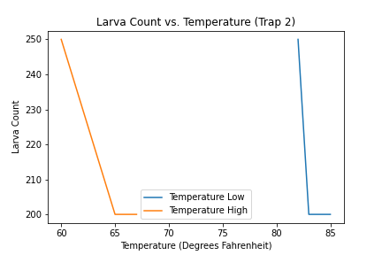
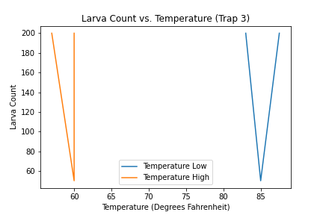
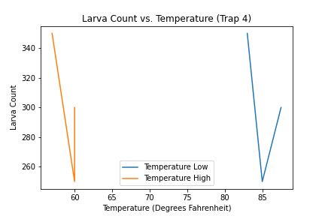
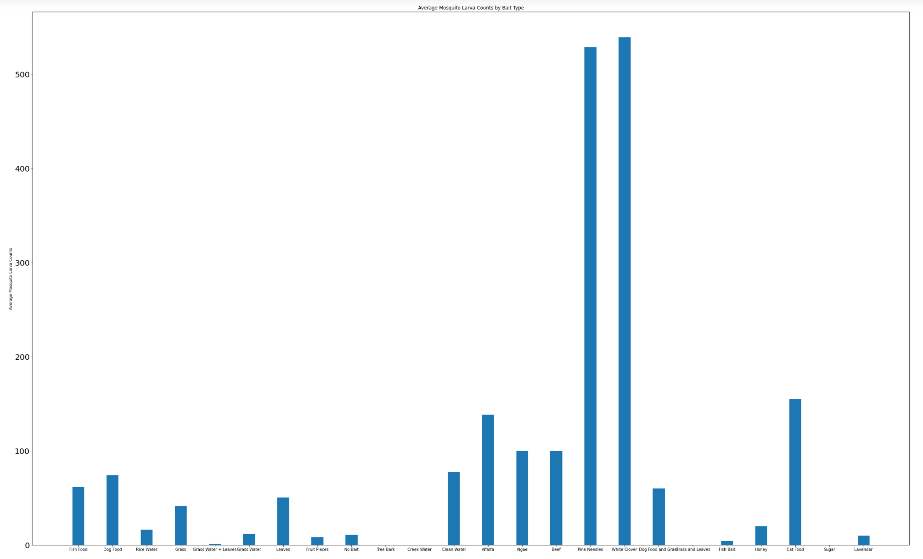
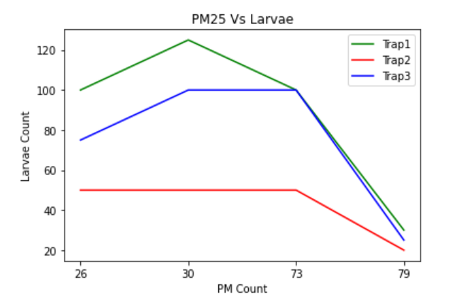
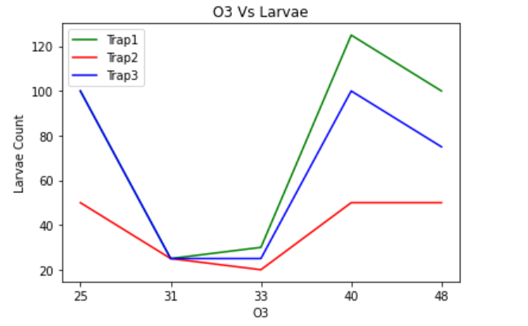
Exploring Various Environmental Aspects and Determining Their Impact on Mosquito Populations for Eco-friendly Solutions
Avery Abramson, Sanjana Anand, Paige Bowman, Isabela Erfort, Aksh Iyer, Vishruth Konakanchi, Virginia Ogburn, and Haran Tekle
Global Learning and Observations to Benefit the Environment (GLOBE) Observer, National Aeronautics and Space Administration (NASA), NASA Johnson Space Center, NASA STEM Enhancement in Earth Science (NASA SEES), Texas Space Grant Consortium, The University of Texas at Austin
Abstract
Research Methods: Planning and Carrying Out Investigations
Discussion
Acknowledgements
Using GLOBE Observer data, water turbidity and container dimensions, nutritional density, temperature, and air pollutants on mosquito habitats were analyzed. Observed trends were organized with Anaconda and MatLab. It was established that low turbidity and smaller water containers would deter mosquitoes; creek water, sugar, and tree bark dissuade mosquitoes from laying eggs; higher temperatures increased mosquito egg mortality rates and accelerated larval growth; and heavily polluted areas correlated with an increase in mosquito populations. While there was limited time to determine results, this data is anticipated for use in future studies to discover eco-friendly methods for regulating mosquito populations.
To explore water properties, different containers of water with water from different areas were set up. To assess the relationship between mosquito larvae count with water properties and type of bait, data compiled from the GLOBE Observer application under the Mosquito Habitat Mapper tool by interns from multiple locations was analyzed. The interns set up multiple mosquito larvae traps using various bait and water types, while keeping the container, collection methods, and location of the traps constant. Mosquito larvae in the traps were counted and assessed, taking note of bait and water types that coincided with mosquito larvae counts. Throughout this study, it was important to use external sources along with conducting localized research. Because of the difficulties collecting temperature data in such a short time frame, the majority of that data was collected online by reading other scientific articles and journals. The association between air pollution parameters on mosquito larvae count was observed. PM25 values changed between the samples, as well as the Ozone levels, making the graphs inconclusive. However, further research allowed us to predict the future trends.
Mosquito populations are affected by specific water properties such as turbidity and water container size. This was supported by an experiment and a study. Mosquito larvae thrive off of baits containing equal amounts of carbohydrates and protein. Mosquitoes also seem to prefer to lay their eggs in an environment secluded from other organisms regardless of bait attractiveness. It has been shown that in higher temperatures, mosquito embryonation and development is faster; however, they live shorter and develop smaller bodies. In cooler climates, mosquito embryonation and development is slower, yet they live longer and grow larger bodies. Air quality findings can help predict dengue outbreaks, forecasting models using air pollution. For further prevention, an ozone-producing air purifier should be utilized concurrently with other vector control methods.
Thank you to the Earth System Explorers, Mosquito Mappers, and NASA SEES mentors (Margaret Baguio, Dr. Russanne Low, Celena Miller, Peder Nelson, and Cassie Soeffing) and peer mentors (Matteo Kimura and Aseel Rawashdeh).
Research Questions
Research Methods: Map of Study Sites
Conclusions
What is the impact of water properties on mosquito populations? Water properties, such as turbidity and water container size, impact the attractiveness of possible mosquito breeding sites, which in turn impacts mosquito populations in certain areas. What is the impact of type of bait on mosquito populations? Nutritional density is the ratio of nutrients to energy. Understanding this provides context for determining how different baits affect mosquito populations. What is the impact of temperature on mosquito populations? As the global climate warms, it is vital to discover how mosquitoes react as temperatures rise. Mosquitoes are ectothermic, so temperature is known to affect them as they gain heat from external sources. What is the impact of air quality on mosquito populations? The role of air pollution parameters on mosquito vector density has not been well addressed in the scientific literature. However, some studies have indicated that the presence of air pollutants interferes with mosquito life cycles, especially the Aedes aegypti mosquito.
Research on water properties was not complete, however relationships found showed that water properties do impact mosquito populations. Due to a limited time frame, this study is inconclusive. It is assumed mosquitoes prefer to lay their eggs in isolated mosquito habitats with baits that are not only abundant in nutritional density, but contain an equal amount of protein and carbohydrates. On the contrary, it could be assumed that mosquito larvae are able to thrive better in this environment, and it could have no relations on how mosquitoes determine where to lay their eggs. It is hoped that by using this data in the future, we can modify highly effective baits to be used in mosquito habitats without leaving an impact on ecosystems to stunt mosquito growth. It can also be concluded through this research that temperatures influence mosquito embryonation cycles and the length of mosquito life cycles, as well as their survival and maximum longevity. This will be important as the rising of global temperature continues at record rates because there will be a rise in the number of mosquitoes and the area that mosquitoes can survive will expand. Ozone air-purifiers are not deemed to be safe for the human population. Further studies may reveal important instruments for environmental monitoring and the control of endemic vectors.
Introduction
Results
Bibliography
Water quality influences mosquito populations greatly. Water contaminated with organic matter allows for mosquito populations to grow extensively as it provides excellent sources of larval food. It was favored to provide developments of attractive, eco-friendly mosquito larvicides through data collected in this study not only to reduce mosquito populations, but do so in a way that would not interfere with other affairs such as farming, improving convenience. Temperatures affect mosquito development, reproduction, and survival. They are cold-blooded, meaning their body temperature varies with the environment. Air pollutants diffused through soil, air and water affect mosquito populations. Smoke from domestic fuel could endanger areas free from disease as mosquitoes would be able to expand their range of travel there.
Please scan the QR code for access to this project’s bibliography.

