Slide 1
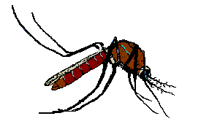
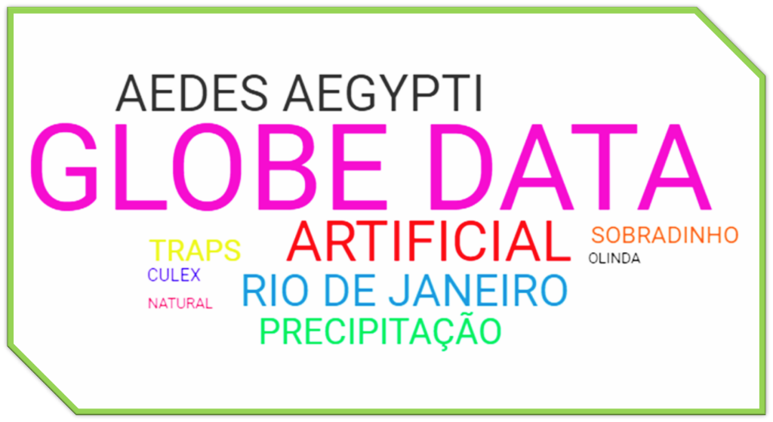
GYP
A
ICIA
1
TRAPS A
CUL

Slide 2
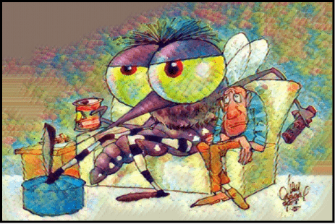
1. TITLE
Is the mosquito Aedes aegypti human’ "new pet"?
Figure 1.: Is the mosquito Aedes Aegypti our new pet?
Minas Gerais Science Club: Juliana Karina Villela, Andrea Silva, Camille Santos, Luís Eduardo Cordeiro de Freitas.
Teacher: Mrs. Inês Mauad Rio de janeiro, Brazil

Slide 3
The goal of this study is to evaluate whether, in a competition
2. ABSTRACT:
of breeding sites, the mosquito, predominantly Aedes aegypti, prefers to spawn in domestic water deposits, which are found in human residences and surroundings, due to its opportunistic, adaptive and anthropophilic behavior and the expressive ecological capacity to adapt to various types of containers or water reservoirs.The study analyzed the GLOBE data collected in three schools in Brazil: Rio de Janeiro, Olinda, and the Federal District.

Slide 4
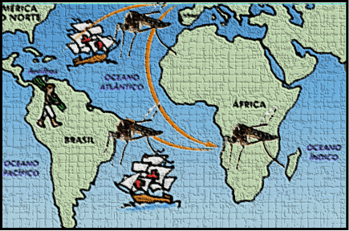
3. Introdução
Arboviruses are diseases caused by viruses transmitted mainly by mosquitoes, being the female of the species Aedes aegypti the great villain. Arboviruses include urban yellow fever, dengue, Chikungunya, and Zika virus.
Aedes aegypti was introduced in Brazil during the colonial period, probably during the slave trade, by sea (PAHO 1992, Consoli & de-Oliveira, 1994).
Figure 2.: Aedes aegypti was introduced in Brazil in the colonial period, probably during slave trade.
In recent years, the incidence of diseases caused by arboviruses has shown a relevant global increase due to the intensive growth of global transportation systems, adaptation of vectors to increasing urbanization, inability to contain the mosquito population, and changes in environmental factors. In addition to the elements that favor the spread of diseases, Brazil represents a country with optimal environmental conditions for the permanence and dissemination of vector mosquitoes, such as Aedes aegypti (Gregianini et al., 2017).

Slide 5
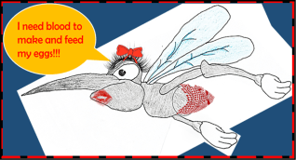
QUESTION
3. RESEARCH QUESTION AND HYPOTHESIS
In a breeding competition, the behavior of the mosquito determines the type of container chosen for ovoposition, especially for the Aedes aegypti species?
Figure 3.: Aedes aegypti female needs blood to make their eggs.
HYPOTHESIS
Because it has opportunistic, domestic and urban behavior (IOC/Fiocruz), in a competition of containers for breeding sites, the Aedes aegypti, prefers to spawn in water deposits that are in its surroundings, such as: pots of plants, clogged gutters, bottles, open waste, air conditioning trays, capture traps, among others.

Slide 6
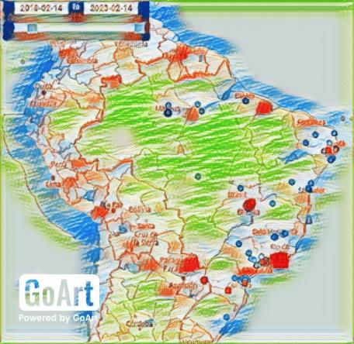
4. MATERIALS AND METHODS
DATA COLLECTION
The mosquito larvae survey was carried out based on GLOBE data collected in schools in three Brazilian cities: Rio de Janeiro, Olinda and Sobradinho, located in the respective geographic coordinates 22°57' S, 43°11' W; 8°073' S; 34°88' W; 15°63' S, 47°82' W , in the period from February 2018 to November 2022.
The schools were chosen because they presented the three types of breeding areas intended in the research (Figure 1a,b,c). A total of 116 data collections from data stored in the GLOBE platform.
ENTOMOLOGICAL STUDIES
Figure 4:.GLOBE map of the study with the mosquito data collected in the three cities analyzed.
Data analysis was performed on mosquito larvae from free artificial breeding sites (Vessels / jars with water, dish, bottles, drip pan, defrosting containers in refrigerators, discarded garbage), artificial capture sites (traps / mosquitoes) and natural breeding sites, to monitor the opportunistic behavior through oviposition of the female mosquito, in particular, Aedes aegypti, the main transmitter of Arboviroses: Dengue, Chikungunya, Urban Yellow Fever and Zika.

Slide 7
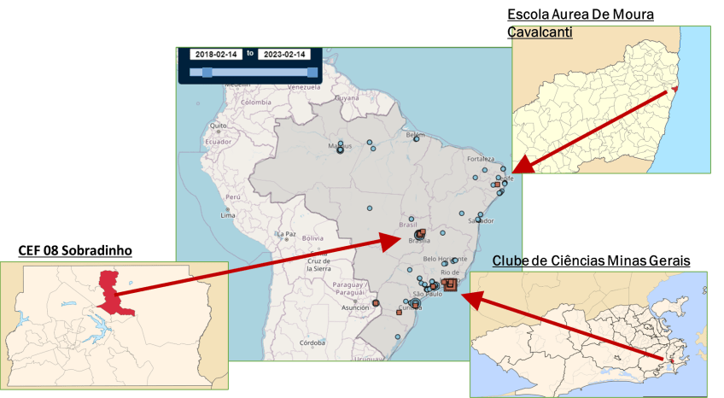
4. MATERIALS AND METHODS
STUDY SITES
Table 1. GLOBE map of the study with the mosquito data collected in the three cities analyzed.

Slide 8
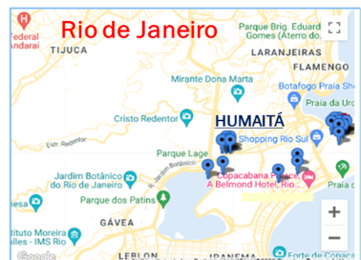
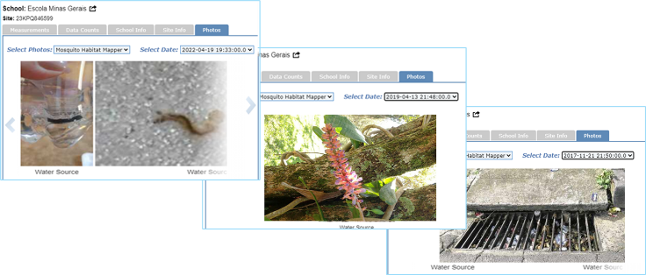
Study site 1
Minas Gerais Science Club, Rio de Janeiro.
97 data collections – 77 larvae
10 free artificial containers with 7 larvae
85 artificial capture containers with 69 larvae
2 natural container - 1 larvae
Figure 13:. Aurea de Moura Cavalcanti School GLOBE map .
Figure 9:. Minas Gerais Science Club' mosquito data free artificial containers using MHM (2018-2022).
Figure 10:. Minas Gerais Science Club' mosquito data from capture containers using MHM (2018-2022).
Figure 11:. Minas Gerais Science Club' mosquito data from natural containers using MHM (2018-2022).

Slide 9
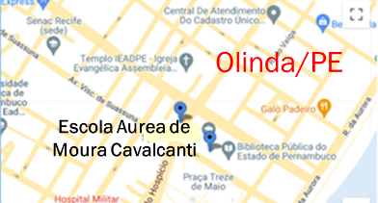
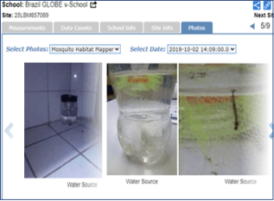
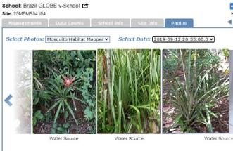
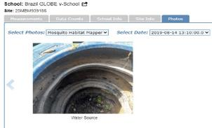
Study site 2
Escola Aurea de Moura Cavalcanti, Olinda/PE.
5 data collections –
4 larvae
4 free artificial containers with 2 larvae
3 artificial capture containers with 2 larvae
1 natural container - 0 larvae
Figure 18:. Aurea de Moura Cavalcanti School GLOBE map.
Figure 7:. Aurea de Moura Cavalcanti School ' mosquito data from three kinds of containers using MHM (2018-2022).

Slide 10
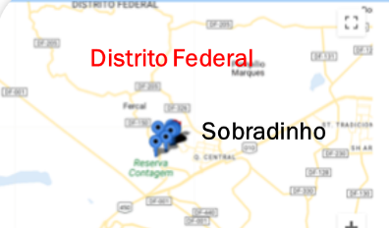
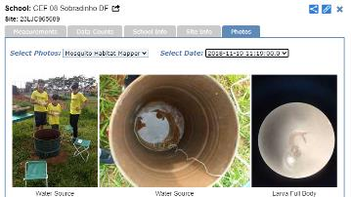
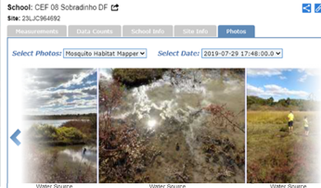
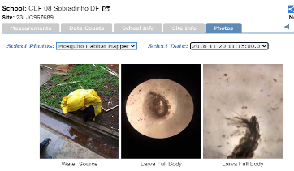
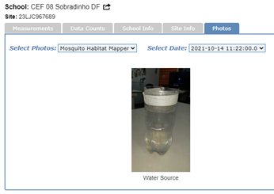
Study site 3
CEF 08 Sobradinho, Cidade de Sobradinho/ DF
14 data collections – 17 larvae
10 free artificial containers with 14 larvae
2 artificial capture containers with 1 larvae
2 natural container - 2 larvae
Figure 23:. CEF 08 Sobradinho GLOBE map.
Figure 19. CEF 08 Sobradinho’ mosquito data from three kinds of containers using MHM (2018-2022).

Slide 11
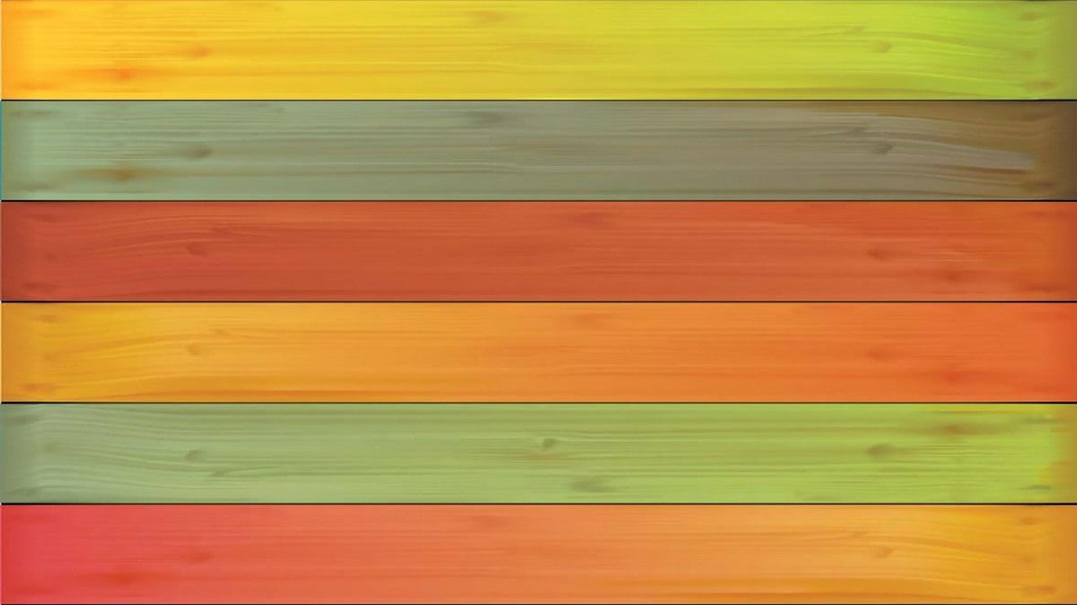
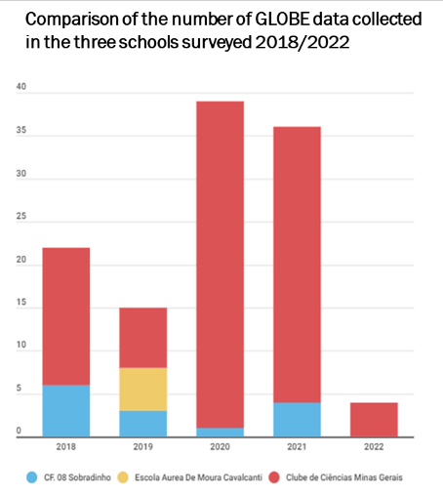
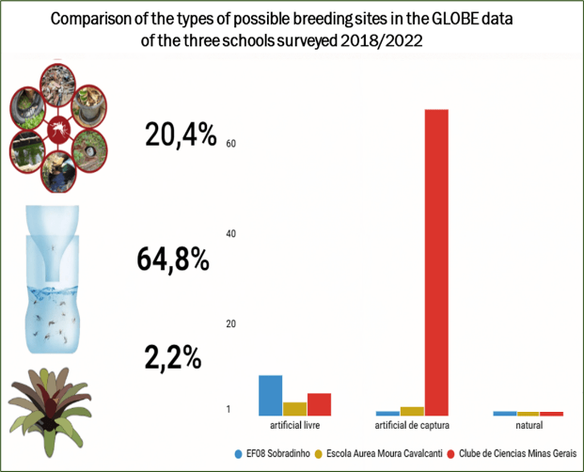
DATA ANALYSIS
Table 2. Data collected from GLOBE Platform using MHM – mosquito habitat from 2018
- 2022. SOURCE: globe.gov
Table 3. Data collected from GLOBE Platform using MHM – mosquito habitat from 2018 - 2022. SOURCE: globe.gov

Slide 12
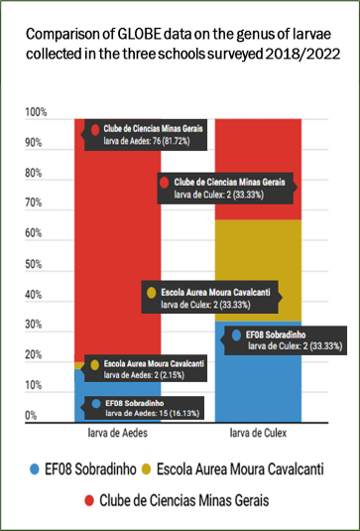
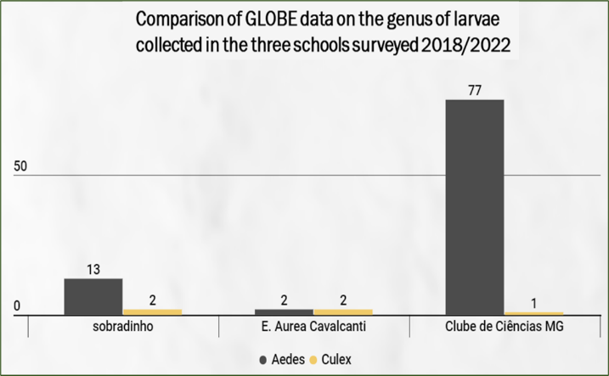
Table 5. Data collected from GLOBE Platform using MHM – mosquito habitat from 2018 - 2022. SOURCE: globe.gov
Table 6. Data collected from GLOBE Platform using MHM – mosquito habitat from 2018 - 2022. SOURCE: globe.gov

Slide 13
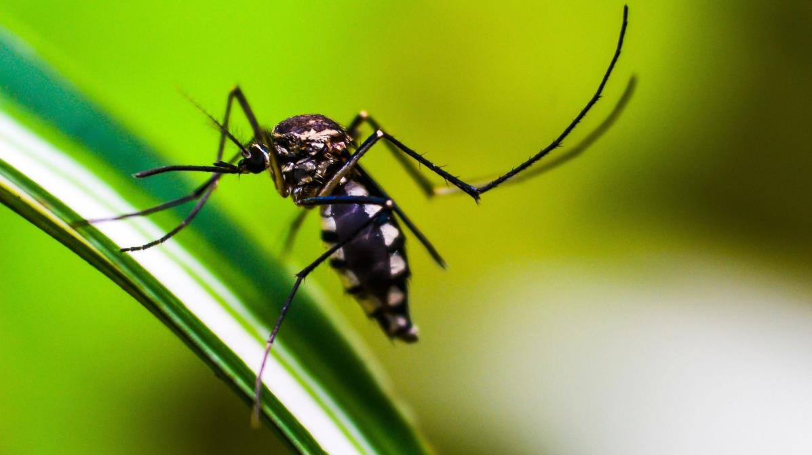
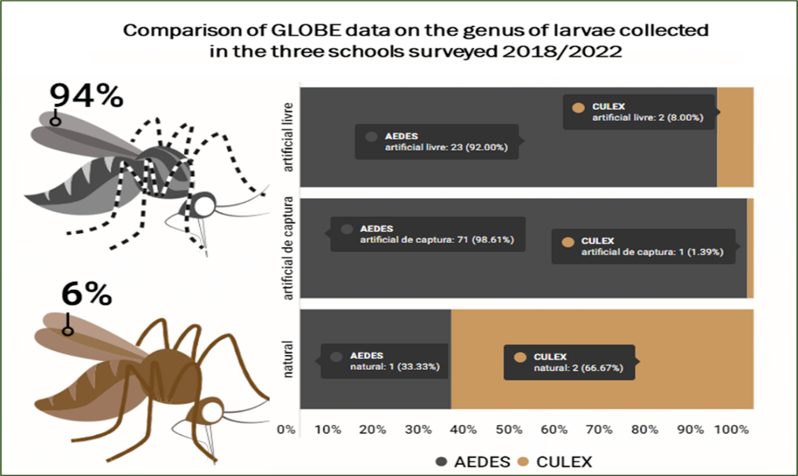
Table 7 Data collected from GLOBE Platform using MHM – mosquito habitat from 2018 - 2022. SOURCE: globe.gov

Slide 14
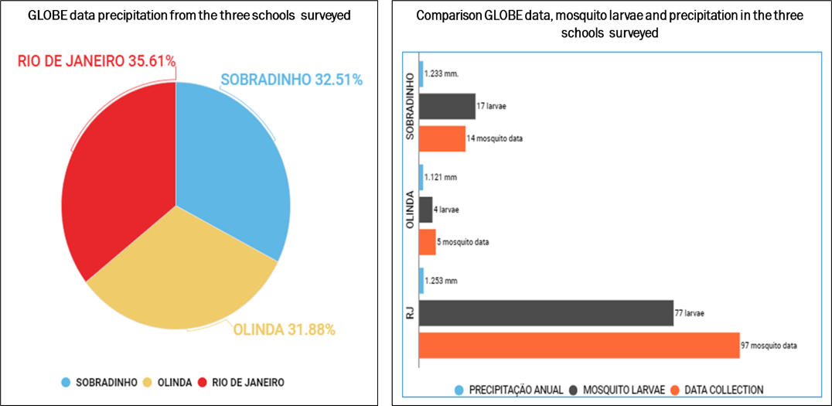

Slide 15
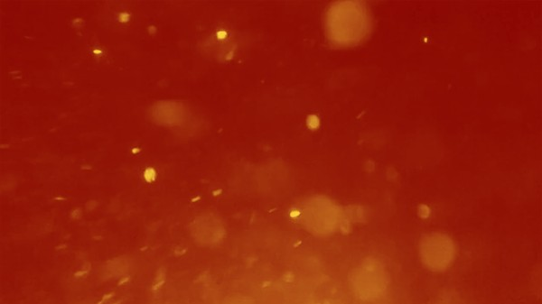
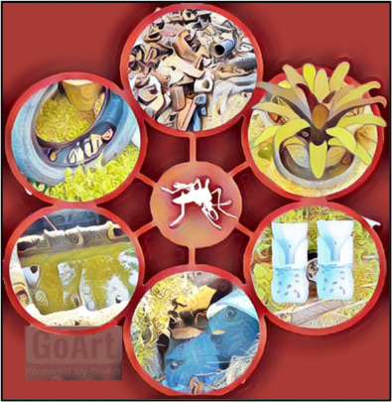
5. RESULTS
Our results showed that the number of mosquito larvae increases with the increase in the number of containers in all collected sites and that in a competition of containers there is a positive correlation of mosquito larvae around houses, schools, villages, and churches, in free artificial breeding sites, followed by artificial breeding sites of capture and natural breeding sites, proportionally. The precipitation influences the amount of water stored in each container and determined the possibility of a new breeding site. The Aedes aegypti mosquito, had the highest incidence of most larvae collected in the three investigated sites, especially in artificial breeding sites, due to its opportunistic, adaptive and anthropophilic behavior and the expressive ecological capacity to adapt to various types of containers or water reservoirs.
Figure 9. brrding sites containers

Slide 16
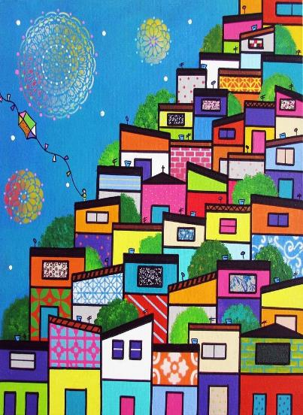
8. DISCUSSION
The analysis of data collection of the three schools in the cities of Sobradinho, in the Federal District, Midwest Region; Olinda, Northeast Region; Rio de Janeiro, Southeast Region, it was observed that the number and types of containers varied in the three sites. In addition, we observed that the number of mosquito larvae increased with the increase in the number of water containers offered in all collected sites, suggesting that where there is free supply of water reservoirs, mosquitoes reproduce more.
This study showed that Aedes aegypti has a higher incidence in urban areas, in artificial capture reservoirs and free (94%) confirming its anthropophilic character. This analysis corroborates with Natal (2002), stating that the invasion and permanence of
Aedes aegypti in the urban environment is due to the decharacterization of the natural habitat of this mosquito, caused by human pressures when deforestation caused a genetic variety of this mosquito to be selected by the altered environment.
Figure 10: Global urbanization

Slide 17
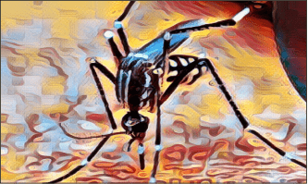
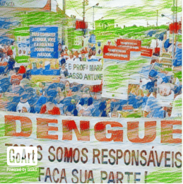
The prevention is the solution to mosquito to avoid
7. CONCLUSION
outbreaks!!
In our project analysis of the data collection from the three schools in the cities of Sobradinho, Olinda, and Rio de Janeiro, it was observed that the number and types of containers varied in the three sites. Furthermore, we observed that the number of mosquito larvae increased with the increase in the number of containers in all the sites collected and that the Aedes aegypti mosquito appears in greater numbers in the three breeding sites analyzed.
Knowledge of mosquito behavior contributes to the development of educational campaigns in the elimination of breeding sites found with water in buildings, discarded waste and natural environments, which could become potential foci, preventing, and controlling vectors.

Slide 18
8. ACKNOWLEDGEMENTS

