Slide 1
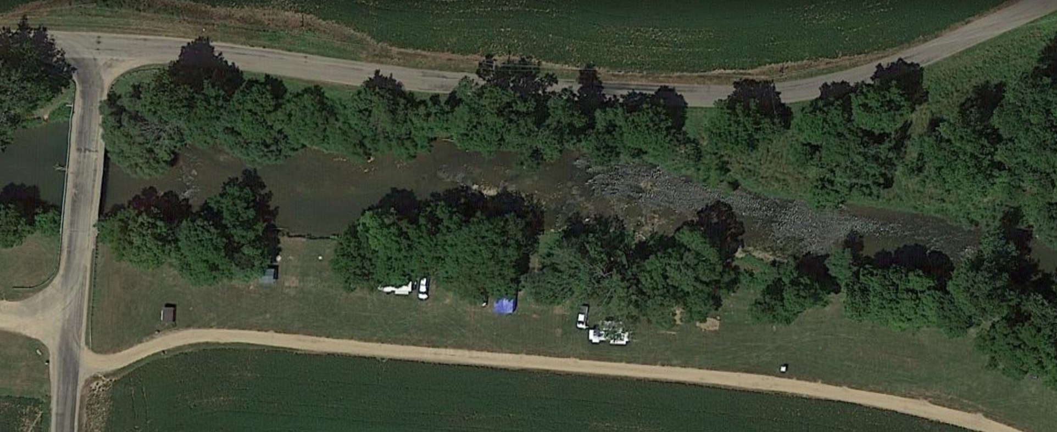
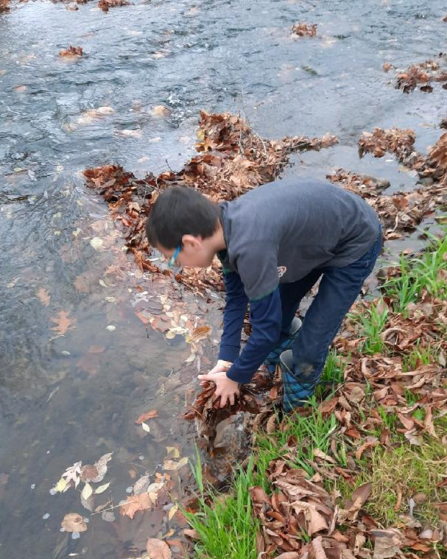
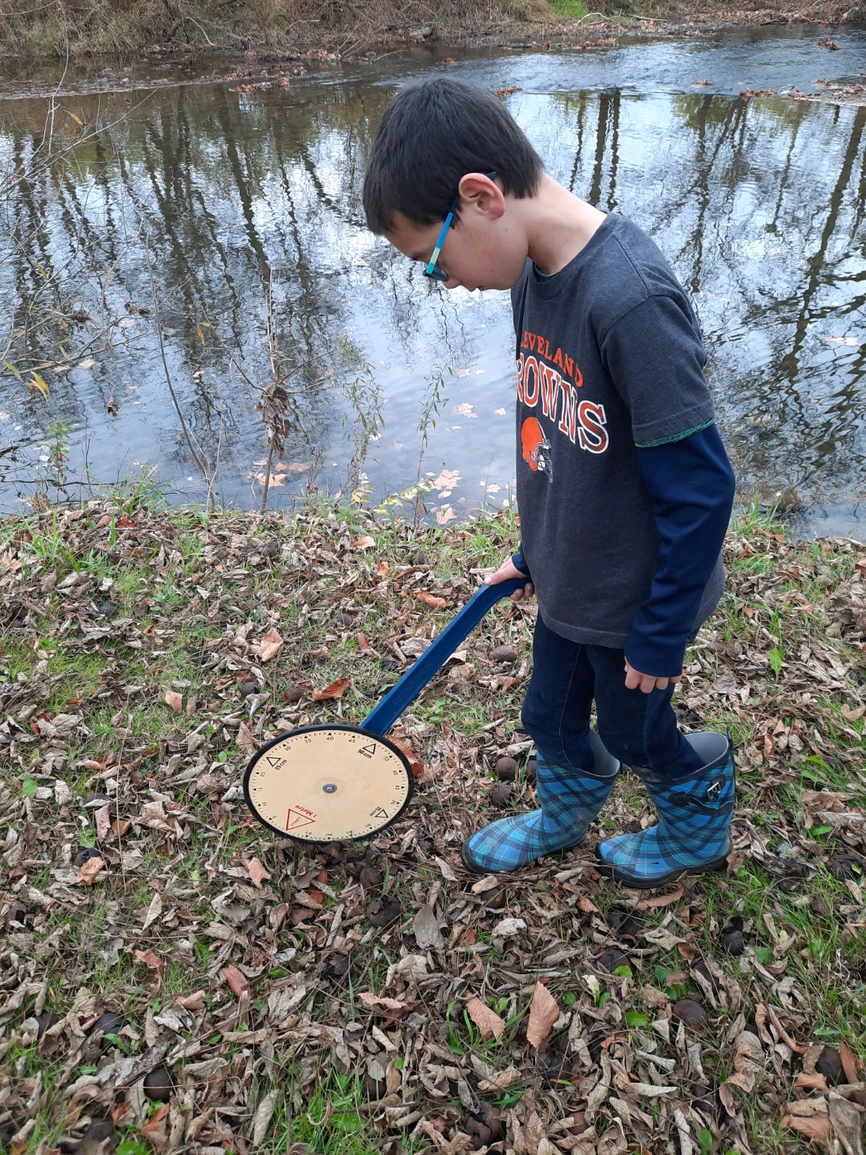
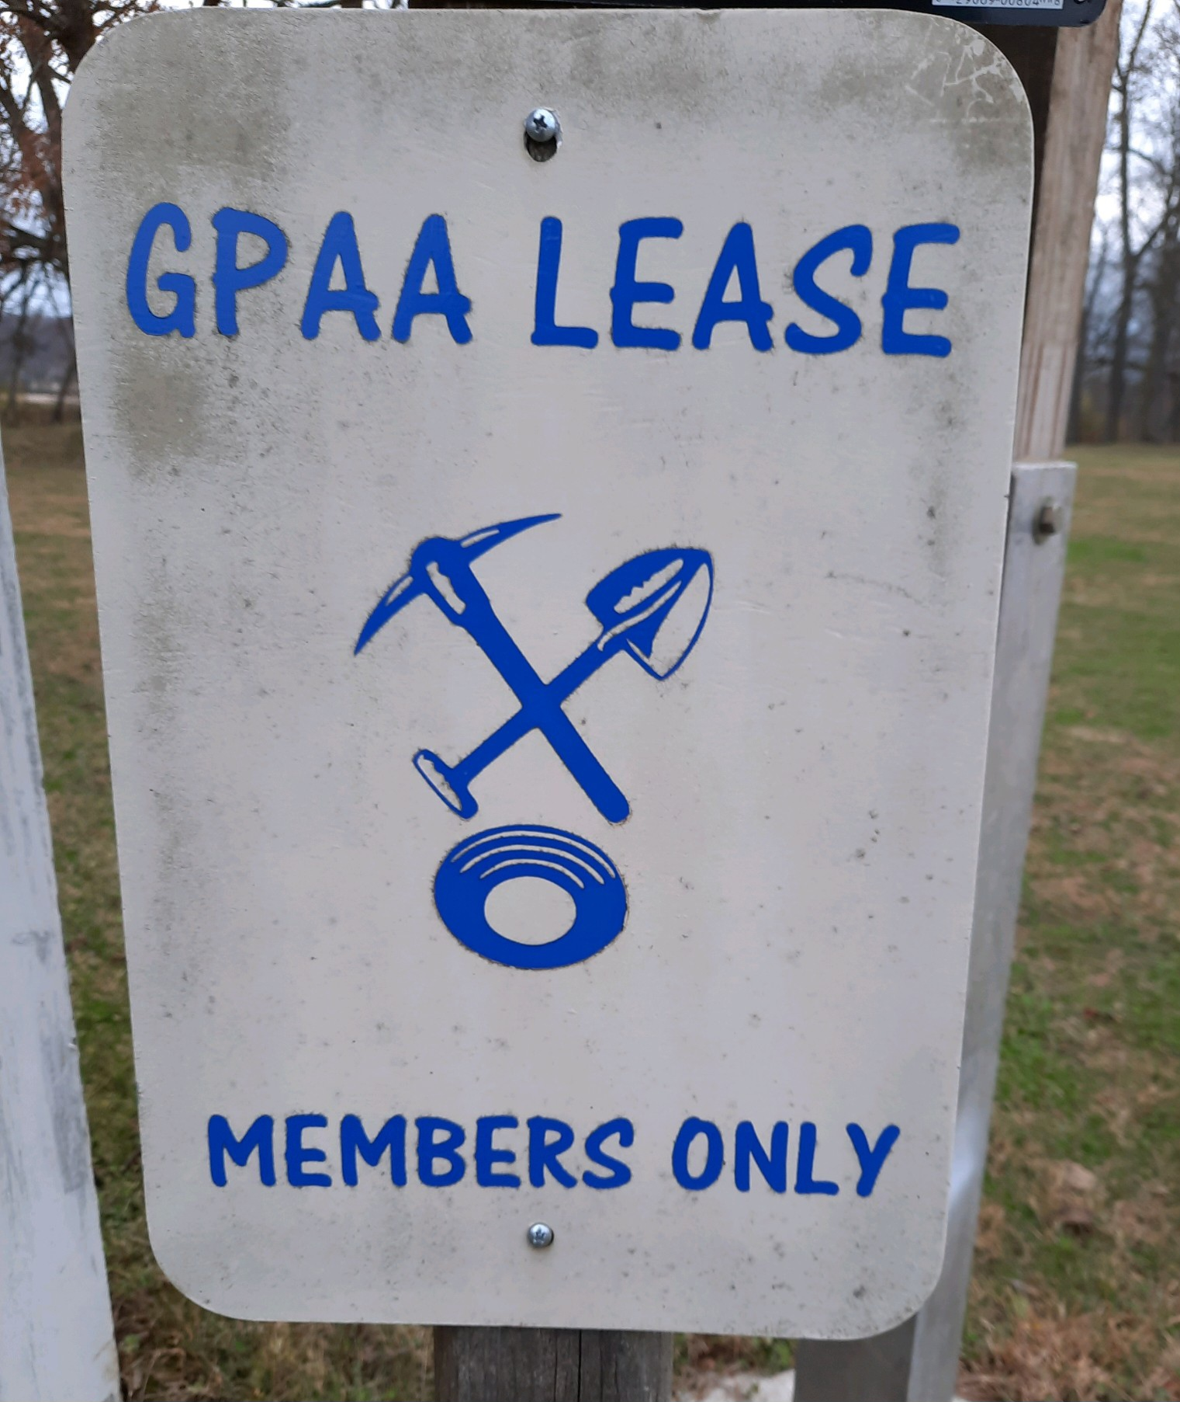
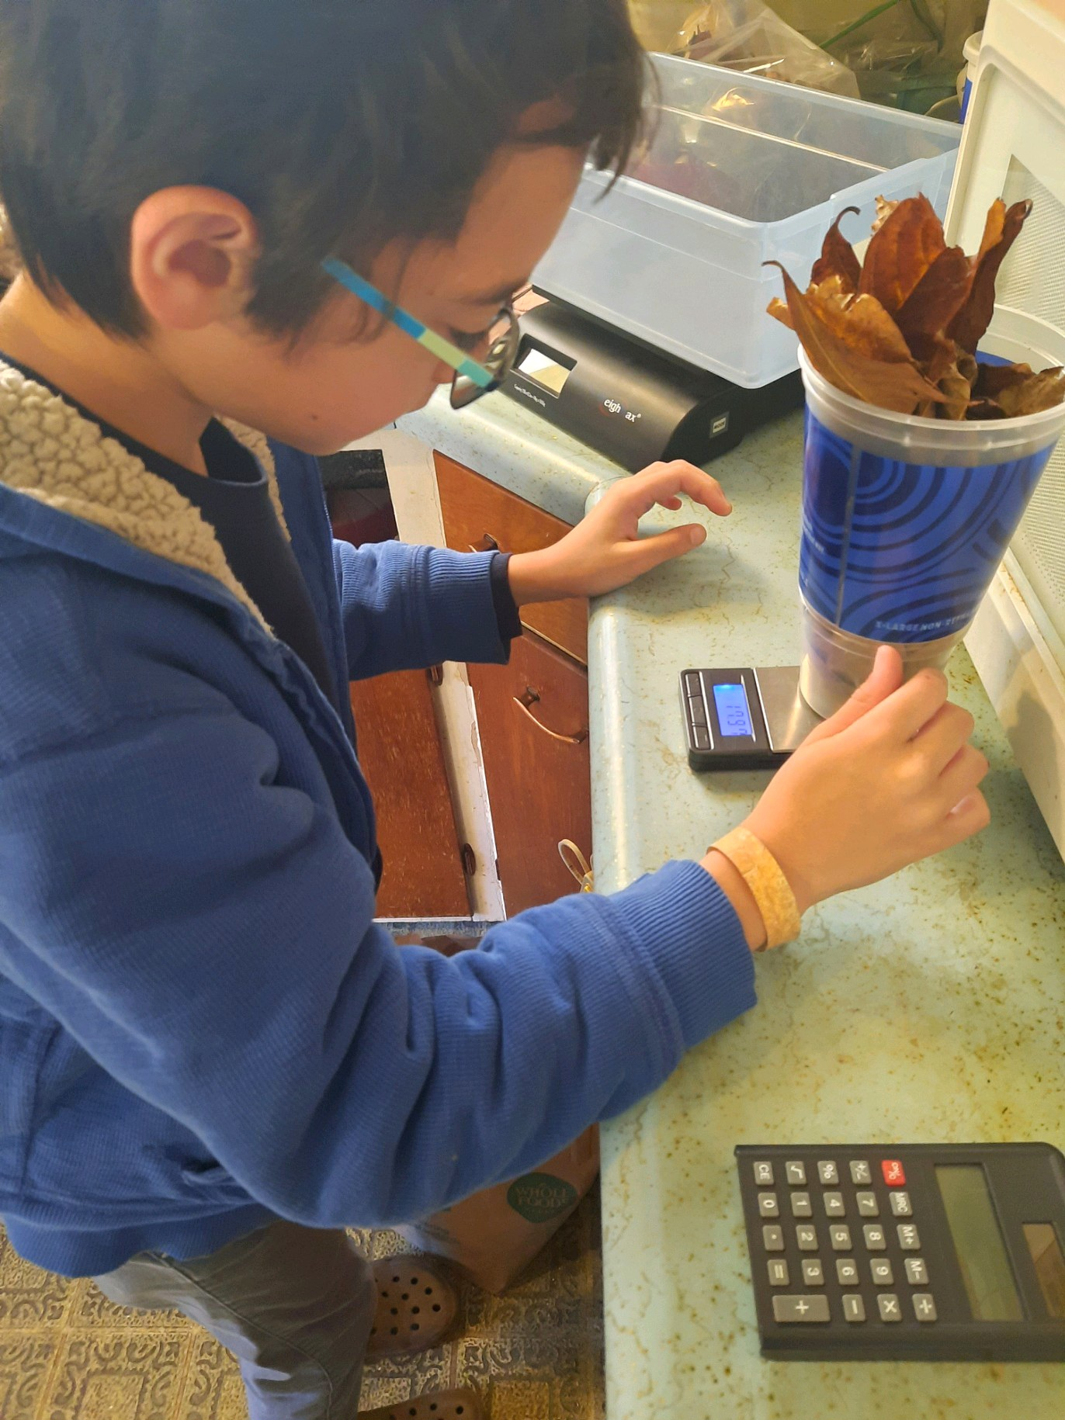
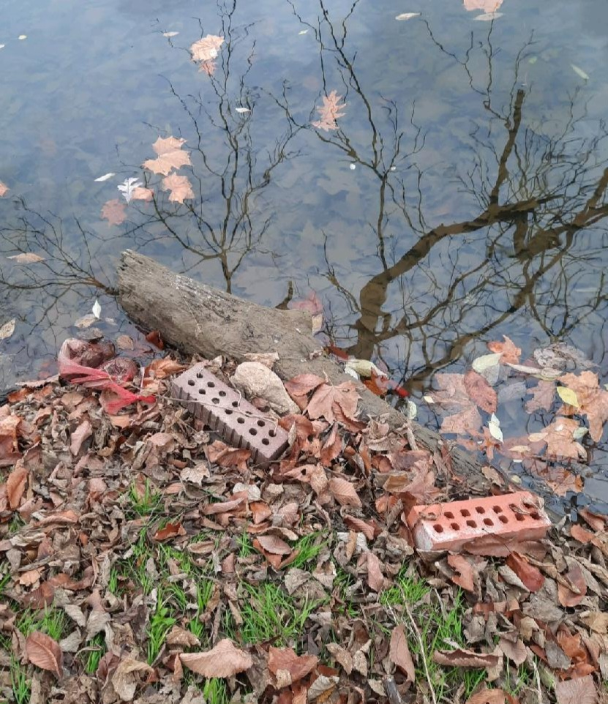
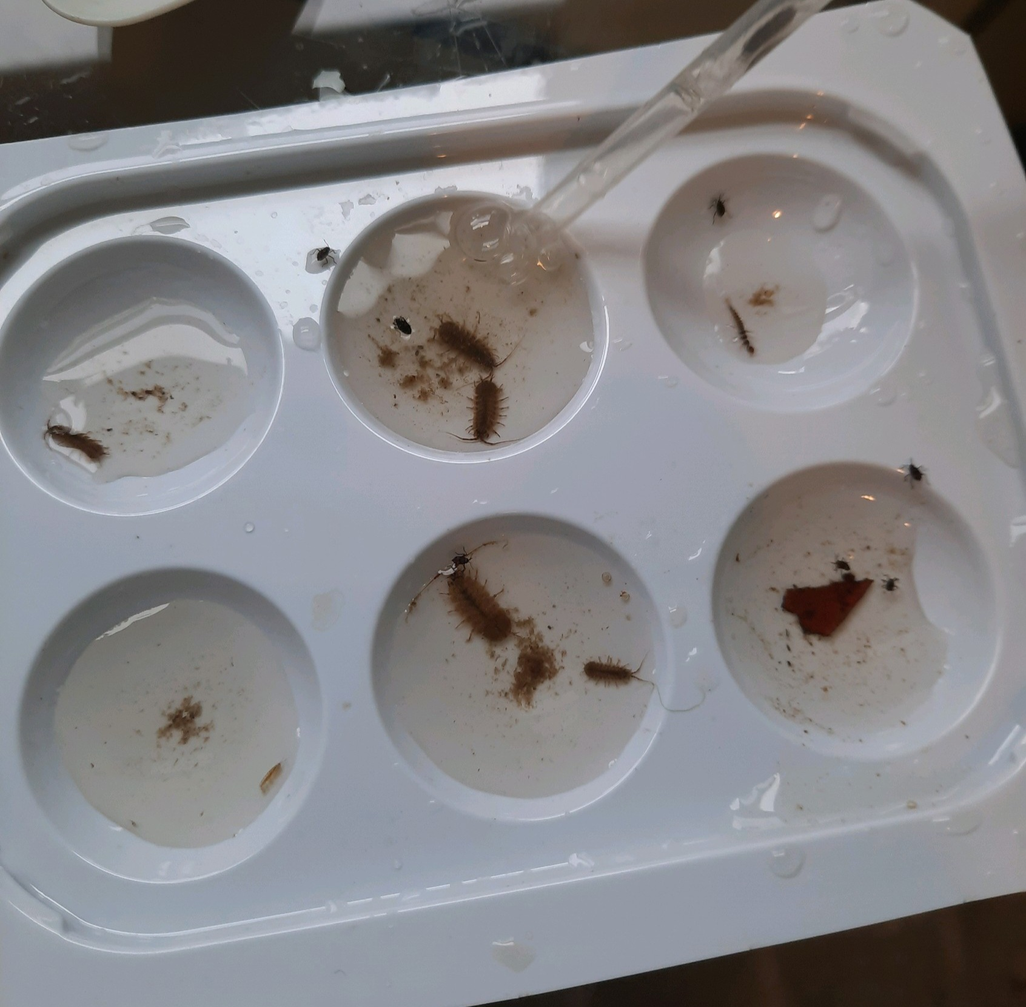
MACROINVERTEBRATES: A LEAF PACK EXPERIMENT
Stevie Frantz
Wooster City Schools
Abstract
Research Methods
Results
Discussion
The purpose of this project was when I was raking leaves around my house, I kept seeing all sorts of bugs hiding amongst them. Then I started to wonder, “What kinds of bugs live in leaves?”. When I was done raking leaves, I got on the GLOBE Program website to see if there were any studies to be done with insects. I discovered there were! I decided to base my project around the GLOBE Program macroinvertebrate protocol. This combines not one, but two things I enjoy: insects and fishing.
My question is what leaves do macroinvertebrates prefer?
In conclusion, I learned macroinvertebrates prefer native tree species more than non- native tree species. My data did not entirely support my hypothesis.
My research methods are as follow (as developed by the Stroud Water Research Center):
1. Collect 4 different kinds of leaves species.
2. Measure out 20 grams of each leaf species.
3. Put 20 grams of each leaf species into mesh bags.
4. Have an identification tag in each bag with the type of leaf and leaf pack group.
The leaf packs will be tied on to bricks and carried to the shore of the creek.
Record where I put the leaf packs.
Retrieve the leaf packs in 2 weeks.
Identify and count the bugs in the leaf packs.
Carrying Out Investigations
Description of the Study Site: I found out there were 68 trees along the bank of the Clear Fork River, where I put the leaf packs. (1 box elder, 48 American elms, 9 walnuts, 8 cherry trees, 1 sugar maple, 1 weeping willow.) There were a lot of black walnuts lying around and I rolled my ankle and there were a lot of little divots in the ground. I asked a camper about the little divots in the ground and it turns out that what caused those tracks was a bear. As I looked closer, some of the trees had scratches on the bark. The whole creek was owned by the GPAA (gold prospecting site) and close to the creek was a stair case leading down to the river so the gold prospectors could easily get down to the river. The climate in the study site area is cool in the fall. When I was doing the project, it was during the fall so the overall temperature was in the mid 50s-60s degrees Fahrenheit and was not too windy. Overall, it was pleasant to be out in the creek doing my project, soaking up the sun in the fall.
Analyzing Data
My question is what leaves do macroinvertebrates prefer?
The hypothesis was the leaf packs containing native trees bordering the Clear Fork River would have more macroinvertebrates than leaf packs containing non-native leaves.
The following results are for the three study sites for each of four tree species in this study: Black Walnut, Juglans nigra; American Elm, Ulmus americana; Persimmon, Diospyros virginiana; and Paw-Paw, Asimina triloba. The following macroinvertebrates were found: Aquatic Sow Bug, Asellidae sp.; Scud, Malacostraca sp.; Flatworm, Turbellaria sp.; Snail, Gastropoda sp.; Mayfly, Ephemeroptera sp.; Caddisfly, Trichoptera sp.; Midge, Dixidae sp.; Black Fly, Simuliidae sp.; Water Beetle, Coleoptera; Mosquito, Culicidae; and Damselflies, Zygoptera.
Common names will be used throughout these results.
My experimental procedures are as follow (per Stroud Water Research Center protocol):
Collect the leaves
Let them dry
Weigh the leaves out
Put the leaves in mesh bags (leaf pack)
Place the leaf packs in the creek
Wait two weeks
Take the leaf packs out
Sort macroinvertebrates by species from leaves
Count macroinvertebrates
Release macroinvertebrates when finished
In the end I discovered macroinvertebrates preferred native tree species more than non-native tree species, however this is not entirely true when I looked at each individual tree species. American elm had more macroinvertebrates than the other three tree species combined. Macroinvertebrates are changing and adapting all the time (and so are the tree). For example, when I did the experiment, the macroinvertebrates must have been adapting to the black walnut trees because I got the least amount of macroinvertebrates and found two dead macroinvertebrate bodies.
My research is important when identifying places to go fishing. Fish eat macroinvertebrates. Fishing underneath black walnut trees might not be the most productive area as this might not provide enough macroinvertebrates for fish to eat. The opposite is also true. Fishing under American elm trees might prove to be a good place to fish. I can’t wait to test this theory this summer.
Macroinvertebrates are also an indicator or water quality. Even though this was not a direct part of my research, the recent accident in East Palestine, Ohio has shed the national spotlight on water quality and how fragile this resource is. I have seen many reports of hundreds of dead fish in the creeks around East Palestine. I think it would be interesting (although very unsafe) to do a macroinvertebrate study. I believe this area will have ample opportunities for all kinds of water quality research for many years to come.
Research Question
GLOBE Data Used
I decided to base my project around the GLOBE Program macroinvertebrate protocol. Besides, Three leaf packs were used for each of four species of trees: Asimina triloba, Diospyros virginiana, Ulmus americana, Juglans nigra, at three different locations along the bank of the Clear Fork River following Stroud Run leaf pack protocol.
My question is what leaves do macroinvertebrates prefer?
My research is important when identifying places to go fishing. Fish eat macroinvertebrates. Fishing underneath black walnut trees might not be the most productive area as this might not provide enough macroinvertebrates for fish to eat. The opposite is also true. Fishing under American elm trees might prove to be a good place to fish. I can’t wait to test this theory this summer.
Macroinvertebrates are also an indicator or water quality. Even though this was not a direct part of my research, the recent accident in East Palestine, Ohio has shed the national spotlight on water quality and how fragile this resource is. I have seen many reports of hundreds of dead fish in the creeks around East Palestine. I think it would be interesting (although very unsafe) to do a macroinvertebrate study. I believe this area will have ample opportunities for all kinds of water quality research for many years to come.
Conclusions
In conclusion, I learned macroinvertebrates prefer non-native tree species more than native tree species. My data did not agree with my hypothesis. I was confused, so I began asking around to why this might be. My first conversation was with Dr. Lee, Director of the Bug Museum at the Ohio State University, Wooster Campus. He told me there is a constant battle between and I found out Black Walnut trees have toxins which macroinvertebrates switch from offense and defense from over the years. Mr. Jones, a family friend and tree expert, told me Black Walnut trees have a toxin and plants will not grow around them. Because of what I’ve been told, perhaps the non-native tree had never developed any defense against the macroinvertebrates in the Clear Fork River. Finally, I’d like to say thanks to my mom for helping me make the graphs and my dad for introducing me to GLOBE science fair and my older sister who did science fair before me and guided me.
NEXT STEPS:
I had so much fun doing this experiment I keep thinking I might want to do it again. I keep thinking about doing something with the fish living in these areas. I am thinking if there are not enough macroinvertebrates, there might not be enough food to keep the fish fed. My study can help fishermen determine where to fish. The Clear Fork River is a spring fed river and is one of a very few trout rivers in Ohio. People spend a lot of money buying special flyfishing rods, waders, and clothing to go trout fishing. They also spend a lot of time tying flies to lure the trout to bite. After all the money and preparation, it would be a shame to fish in a spot under beautiful black walnut trees only to go home empty handed. Knowing how to identify trees and how they impact fishing seems important to me.
Introduction
Graph
The goal of this project was to find out what kinds of leaves macroinvertebrates prefer the most. The hypothesis was the leaf packs containing native trees bordering the Clear Fork River would have more macroinvertebrates than leaf packs containing non-native leaves. Three leaf packs were used for each of four species of trees: Asimina triloba, Diospyros virginiana, Ulmus americana, Juglans nigra, at three different locations along the bank of the Clear Fork River following Stroud Run leaf pack protocol. The results did not support my hypothesis. Black walnut, by far, had the least number of macroinvertebrates. There was a difference of opinion when talking to several scientists, leading me to want to continue further study into the black walnut tree specifically. I believe this study can help in a number of ways, most importantly to me is where not to fish. If there is a lack of macroinvertebrates around black walnut trees, it leads me to believe there would also be a lack of fish. Only time will tell if this is true as I continue my research. What a great excuse to go fishing!
Bibliography
Fauld, A. Macroinvertebrate Identification Flashcards. Stroud Water Research Center of the Academy of Natural Sciences of Philadelphia. LaMotte Company.
Fillour, J. Post Doctor Scholar. Ohio Agricultural Research and Development Center. Personal Conversation November 2022.
GLOBE Program. Data retrieved from www.globe.gov. November 2022 to January 2023.
GOOGLE Earth. Data retrieved from https://earth.app.goo.gl/? apn=com.google.earth
&isi=293622097&ius=googleearth&link=https%3a%2f%2fearth.google.com%2fweb
% 2f%4040.5979016,-82.45954451,331.11511498a,265.5446897d,35y,0h,0t,0r.
November 2022.
Kautz, A. (2016). International Congress of Entomology (ICE) Reflections. Retrieved from
https://seetolearn.weebly.com/project-blog/archives/10-2016. November 2022.
Lee, T. PhD. Director of the Insect Zoo, Ohio Agricultural Research and Development Center. Personal Conversations November to December 2022.
Voshell, R. (2002). A Guide to Common Freshwater Invertebrates of North America. The
McDonald and Woodward Publishing Company. Granville, OH.
Watt, M. T. (1998). Tree Finder: A Manual for the Identification of Trees by Their Leaves.
Nature Study Guild Publishers. Rochester, NY.

