Slide 1
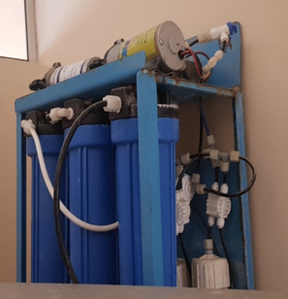
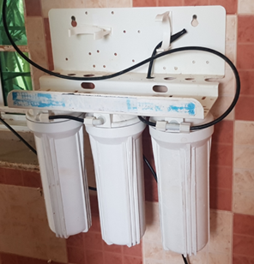
Impact of the use of filtration systems
On the suitability of water for consumption.
Done by:
Rayan Awad Rashid Al Farsi
Jana Said Salim Al Farsi

Slide 2
Abstract :
The effect of using filtration systems on water suitability
Done by :
1- Rayan Awad Rashid Al Farsi
2- Jana Said Salim Al Farsi
Supervisor:
Hedaya Sulaiman Al farsi
Asma bint Omais for basic education (1- 8) school:
Our research aims to study the effect of filtration systems on water suitability, and we have asked the following two questions:
1- What is the effect of water filtration on its properties (acidity, salinity, conductivity, transparency and dissolved oxygen)?
2- How does filtration affect the suitability of water?
In order to answer these two questions, we decided to study the properties of water before and after using filters (normal filter and electric filter), and we applied the water protocol and the dissolved oxygen protocol to study the properties of each sample of water in terms of acidity, salinity, conductivity, transparency, and dissolved oxygen.
We have concluded, after research, experimentation and interviewing specialists, that the properties of water are not affected by the use of the first type of filters (the normal filter), but the use of the second type of filters (the electric filter) leads to the removal of most of the salts from the water. We also concluded that the water remains suitable for drinking if its salinity ranges between (120-1000ppm) / liter of water, but it becomes unfit for drinking if the percentage of salts in it is less than (120ppm), as it will negatively affect human health due to the lack of minerals useful to the body such as calcium and magnesium.
Based on the results, we recommend the need for specialists to direct and educate people about the specifications of potable water and urge them to examine the water before installing filters, so that if its salinity is within the normal range or conforms to the standards, there is no need to install filters. If the water salinity is very high and does not conform to the specifications, then filters must be installed. Electric filter for water filtration with the need to add a part to the filter to add the necessary minerals to the water so that its deficiency does not affect human health.

Slide 3
Research question:
1- What is the effect of water filtration on its properties (acidity, salinity, conductivity, transparency and dissolved oxygen)?
2- How does filtration affect the suitability of water?

Slide 4
Research methodology:
Collecting information on the subject of the research from the books available at the Learning Resource Center and from the information network.
Develop a search plan.
Setting a timetable for the implementation of the research plan.
Determine the protocols necessary to carry out the research.
Determine the devices and tools necessary to carry out the work (a pH meter, a device for measuring salinity and conductivity, a tube for measuring transparency, and a Dissolved oxygen kit).
Data collection and organization in tables.
Enter the data on the program website.
Data analysis and graphic representation.
Reaching conclusions and recommendations.

Slide 5
Visiting the Ibri municipality and having an interview with Ms. Layla Al-Muqbaliya, head of the food and water laboratory in the municipality of Ibri, to collect information about the specifications of potable water according to Omani standards.
2. Collect 3 samples of water (the main water source, from the normal filter, from the electric filter).
6. Compare and analyze the results.
5. Visit the headquarters of the Omani Water Company and discuss the results of the samples with a. Aisha Al-Wahshiyya, Head of the Water Laboratory Department in Ibri.
3. Use globe software devices to study the properties of water in all samples (transparency - acidity - salinity - conductivity - dissolved oxygen).
Methods of data collection
4. Collecting samples of water by Deem Water Company to study the properties of water and the elements in it.

Slide 6
Results:
First: Water properties data before and after filtration using GLOBE devices:
Electric Filter | Normal Filter | Before filtering | characteristics
8.4 | 8.3 | 8.2 | Acidity (pH)
317 | 1372 | 1372 | Salinity (ppm)
460 | 1959 | 1953 | Conductivity (µS/cm)
120 | 120 | 120 | Transparency
8 | 8 | 8 | Dissolved oxygen

Slide 7
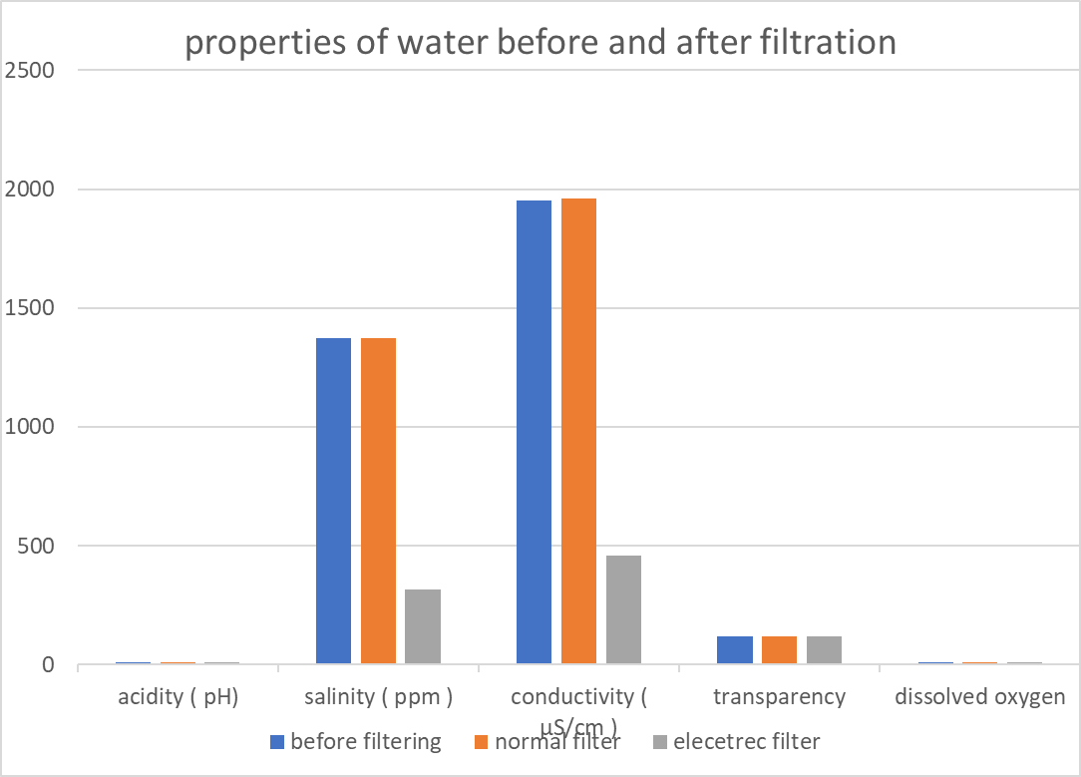

Slide 8
Second: Comparison of the results of water properties before and after filtration using GLOBE devices and Oman Water Company (Haya - Deem)
1- Before filtering:
Before filtering |  | characteristics
Oman Water Services Company (Haya & Deem) | GLOBE devices
8.2 | 8.2 | Acidity (pH)
1322 | 1372 | Salinity (ppm)
2035 | 1953 | Conductivity (µS/cm)
- | 120 | Transparency
- | 8 | Dissolved oxygen

Slide 9
2- After filtering:
After filtering |  |  |  | characteristics
Electric Filter Oman Water Company | Electric Filter Globe devices | Normal Filter Oman Water Company | Normal Filter Globe devices
7.24 | 8.4 | 8.39 | 8.3 | Acidity (pH)
279.5 | 317 | 1101 | 1372 | Salinity (ppm)
430 | 460 | 2003 | 1959 | Conductivity (µS/cm)
- | 120 | - | 120 | Transparency
- | 8 | - | 8 | Dissolved oxygen

Slide 10
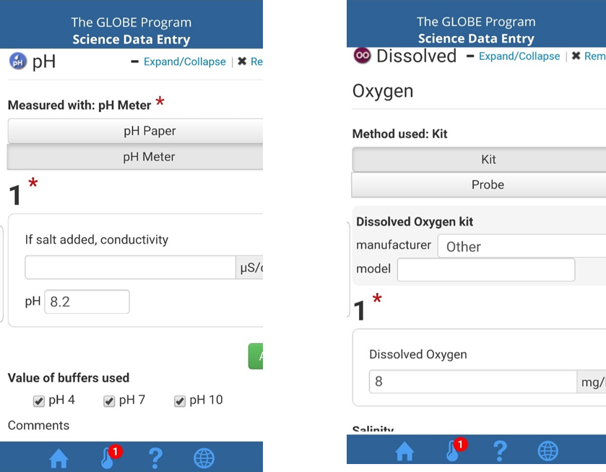
The data have been inserted and sent to the program website (www.globe.gov) through the application (DATA ENTRY).

Slide 11
Conclusion:
We thank God Almighty for the completion of this research, in which we used GLOBE protocols (Water Protocol and Dissolved Oxygen Protocol) to compare the properties of water before and after the use of two filtration systems and the extent of their impact on the validity of water and we have reached after research, experimentation and interview specialists that the properties of water are not affected by the use of the first type of filters (normal filter), but the use of the second type of filters (electric filter) leads to the removal of most salts from the water. We also found that water remains drinkable if its salinity ranges between (120-1000ppm) / liter of water, but becomes undrinkable if the percentage of salts in it is less than (120 ppm), as it will negatively affect human health due to the lack of minerals beneficial to the body such as calcium and magnesium.
Therefore, we recommend the following:
1- The need for specialists to guide and educate people about the specifications of drinking water and urge them to check the water before installing filters so that if its salinity is within the normal range or conforms to the standards, there is no need to install filters.
2- If the salinity of the water is very high and does not conform to specifications, electric filters must be installed to filter the water, with the need to add a part to the filter to add the necessary minerals to the water so that its deficiency does not affect human health.
3- Using natural sources of drinking such as falaj or river water, where the salts are balanced, and staying away from bottled water.

Slide 12
References:
1- Technical Office of the GLOBE Program. (2014) Water Protocol Note for the GLOBE Teacher Training Program.
2- Technical Office of the GLOBE Program. Dissolved Oxygen Protocol Memorandum for the GLOBE Program Teacher Training Program.
3- Ministry of Education (2013) Science book for the eighth grade.
4- Factualy Of Science (2012, April 29). Drinking water specifications according to the World Health Organization, retrieved on 8/2, 2015 from
https://ar-ar.facebook.com/faculty.science.aleppo/.../396398910383527
5- Atka Al-Borini (2018, November 9). Standards of potable water. Retrieved on October 2, 2022 from
https://mawdoo3.io

