Slide 1

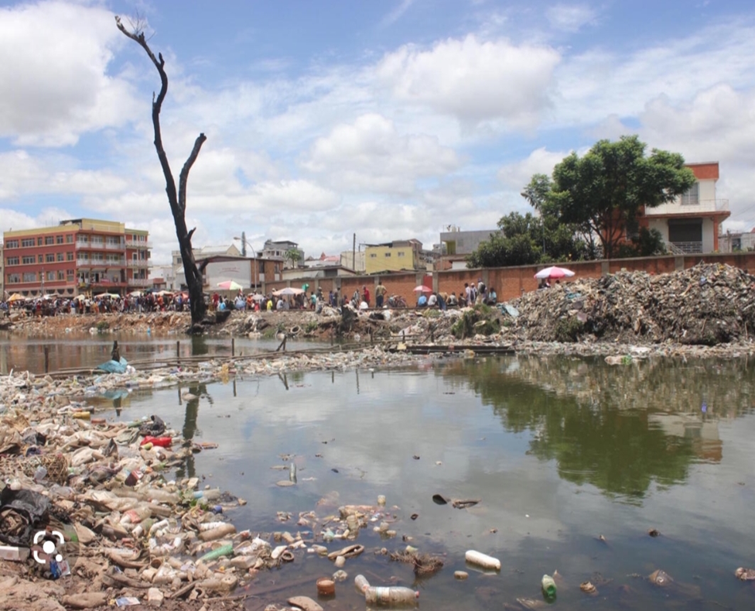
ALTERATION OF WATER QUALITY CAUSED BY POLLUTING PRODUCTS
Water quality bundle

Slide 2
RESEARCH TEAM
GLOBE STUDENTS: - RASAMIMANANA Lovasoa Christian
- ANDRIANTSARABORY Voavinantenaina Xaris Siloh
- ANDRIAMAMINIAINA Lovasoa
GLOBE TEACHERS: - RABENANDRASANA Doris
ORGANIZATION : LYCEE ANDOHALO High School -District Antananarivo ville -Commune 1er Arrondissement– Antananarivo Madagascar

Slide 3
For Madagascar, the water treated by JIRAMA (Water and Electricity Company) is one of the main sources of drinking water for the population. For the water to be clean for consumption, according to the coordinator of the JIRAMA water project, the pH at the factory outlet must be around 8 and arrive at consumer level around 7.5 8 depending on the path traveled by the treated water. This drinking water is physically and chemically treated according to international standards. Unfortunately, only 54.4% of the capital's population benefits from it. It is for this reason that we are undertaking this research with the aim of answering questions
Thus, we assume that the water taken at the source or throughout the IKOPA river, the main watercourse with its many tributaries used by JIRAMA and the rest of the population of the capital can only be of good quality ( neutral or basic pH) and suitable for consumption. Otherwise the water company will not use it.
So to verify this hypothesis, as a Globe student we will carry out sampling and pH tests in different areas of the IKOPA river which run through almost the entire capital (see the map of Antananarivo the capital).
After the tests, - almost all the water samples have an acid pH, even those intended for JIRAMA filtration. But the water company rectifies them by efficient physical-chemical tests
ABSTRACT

Slide 4
- the water intended for JIRAMA filtration still has a less acidic pH (5.5 to 6) than that of unfiltered water (3 to 5.5) which is heavily polluted by excrement, household waste and others (picture A )
Let's conclude that the acid water from the treated JIRAMA does not pose any problem, but that used by the rest of the population is dangerous or even fatal. Raising student and community awareness (especially local residents) is imperative. And we have already carried out 2 recently to inform and help the population in terms of hygiene and health

Slide 5
RESEARCH QUESTIONS
Is the water consumed by the rest of the population of the capital, especially for disadvantaged people, drinkable?
If not, what are the causes and consequences?

Slide 6
MATERIALS
As we are Globe students we use materials from the hydrology protocol (www.globe.gov) such as
*pH paper that allows us to assess the pH value of each water sample in a given area
*water sampling tube
*Data collection sheet that allows us to record pH values ​​in all sampling areas.
But we also use other materials such as
*Red cabbage solution which is a colored indicator studied in class that we will want to test in comparison with ph paper by developing our scientific curiosity
*Recycled plastic bag as latex gloves
*Geographic map of Antananarivo Madagascar for the delimitation of water withdrawal areas
MATERIALS

Slide 7
1. Surveys of the national water and electricity distribution company and the Ministry of Water (Water Component service)
2. pH sampling
a) Delineation of representative water withdrawal zones in the capital of Madagascar using the geographical map
b) Establishment of the sampling schedule according to our availability
c) Descent to the field to take water samples using labeled tubes showing the name of the sampling area, the date and time of sampling
d) Analysis of the ph of the samples at the laboratory of our school by adding the pH value on the labels
3. Processing of the results of the pH analysis of the water sampled
a) Establishment of the table and graphs representative of the pH values ​​of all the sampling areas
b) Analysis of pH values ​​obtained in the field and interpretation in relation to the hypothesis put forward
4. Issuance of a conclusion taking into account field observations and interpretations of the pH values ​​obtained
5. Establishment of a community and student awareness timetable
METHODS USED DURING THE RESEARCH

Slide 8
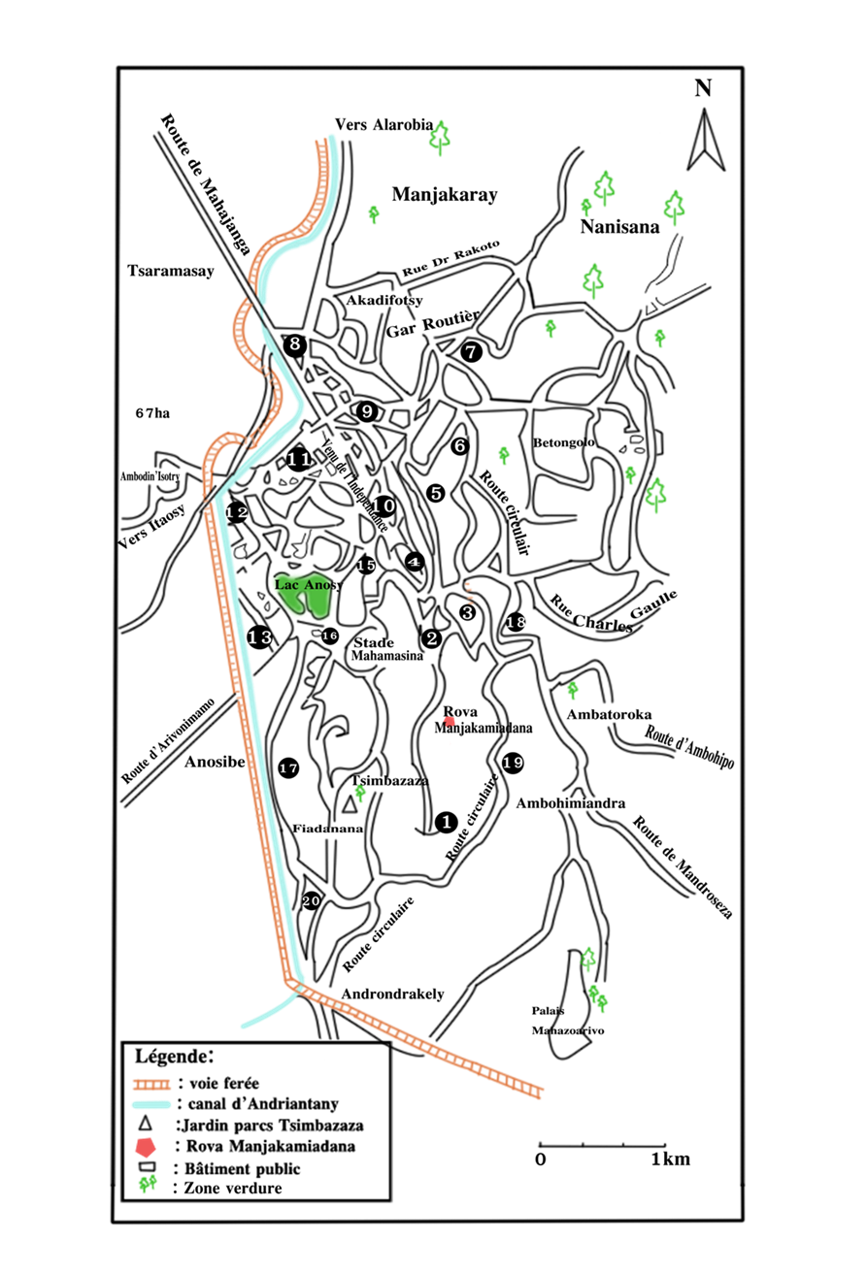
MAPS OF WATER SAMPLING AREAS

Slide 9
RESULTS OF THE pH SAMPLING OF THE IKOPA RIVER AND ITS DIFFERENT TRIBUTARIES
All as in the Ikopa River, the tributaries without exception display a pH value lower than 7, which indicates the nature of ACID pH.
Note *Filtered water represents water treated by JIRAMA.
*Unfiltered water represents water used directly by local residents
*Red cabbage is a biological indicator prepared and studied in class that we students want to test during this research project

Slide 10
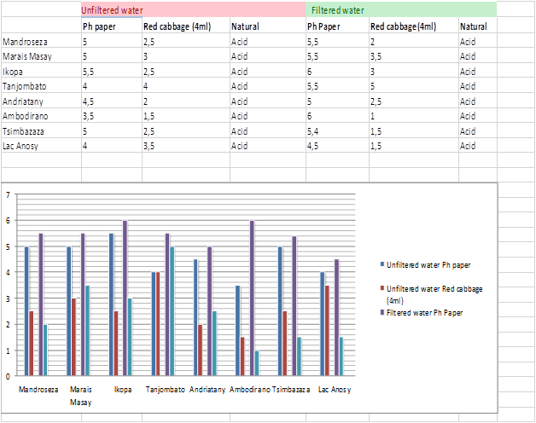
Fig. 1 -2 Table and graph showing the pH variation of the Ikopa River and its tributaries

Slide 11
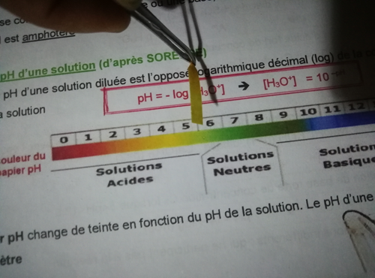
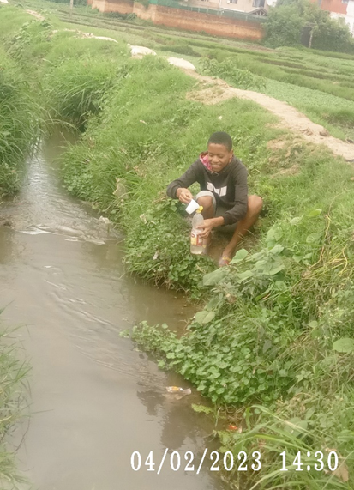
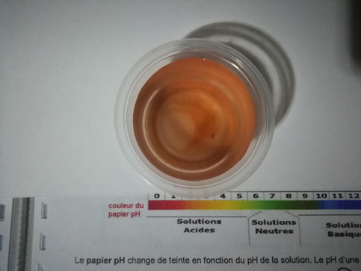
Fig. 4 pH analysis using pH paper
4
3
Fig. 3 Water sampling (Ikopa –Tanjombato
Fig.5 pH analysis using red cabbage solution
5

Slide 12
D
I
S
C
U
S
I
O
N
After the analysis of the results of the waters sampled in the different areas, the interpretations of this analysis we can see that;
* the nature of the pH is not what is assumed in the hypothesis (neutral or basic) to be suitable for consumption.
However, the results may already be significant because we tried to cover the areas of the capital during the sampling.
*the choice of the 2 qualities of water (unfiltered and filtered) is also a strategy that allows us to make a comparison with that distributed by the national water and electricity company
*the use of the red cabbage solution prepared in class is a real discovery and evidence on the nature of the water analyzed

Slide 13
CONCLUSIONS
CONCLUSIONS
We can conclude that all water sources in the capital of Madagascar are acidic in nature,
however JIRAMA will ensure its potability through efficient physical-chemical treatment,
but those that are used directly by local residents or the rest of the population will not having no access to drinking water are very acidic caused by a wide variety of polluting substances and all the more dangerous (excrement, toxic industrial waste, household waste,)
which requires immediate, continuous and lasting handling to save human lives

Slide 14
We could also have carried out an analysis of polluting substances using nitrate and phosphate kits from around the world when we note the main causes of water pollution or carry out bacteriological analyses,
but this is not the objective of the research and it is very expensive.
We will be able to do this soon in another scientific research project and in collaboration with NGOs or departments of the Ministries concerned (health, water environment, University, etc.).
Water sampling for physical or chemical testing can be done by several methods, depending on the precision required and the characteristics of the contaminant. Many contamination events are highly time-limited. For this reason, “grab” samples are often insufficient to fully quantify contaminant levels.

Slide 15
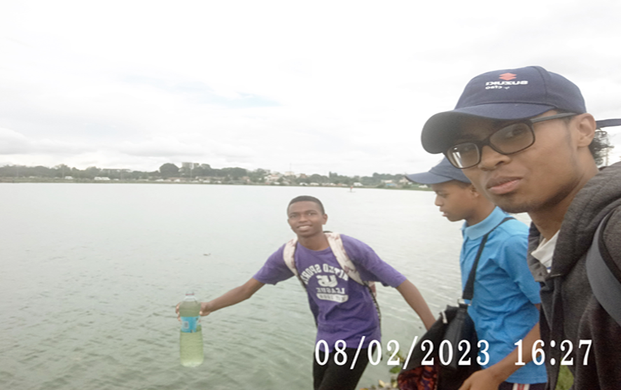
THANK YOU

