Slide 1
GLOBE Introduction to Data Entry and Setting up Your Data Entry Site
Why Enter Data?
What do I need to begin?
How to Create a Data Entry Site

Slide 2
Introduction
This package will help you setup your data entry site so you can begin entering data into the GLOBE database
This presentation is available online as well as a video which walks you through the steps.
http://www.globe.gov/get-trained/using-the-globe-website
There is a section for you to try things for yourself after the demonstration and a section to test your knowledge at the end.
Questions – contact help@globe.gov

Slide 3
Why Enter Data?
As a GLOBE teacher, doing the protocols is only one part of “Doing GLOBE”. Reporting and analyzing the data is just as important. The GLOBE website provides tools to input, report and analyze your data.

Slide 4
Why Enter Data?
Data is kept permanently. Your school data is available for you and others to analyze now and in the future.
Tools will help you plot and export data
You will be able to analyze data from year to year and by comparing data from other schools and countries
Your school will have an opportunity to be recognized as a GLOBE science honor roll school
Your students will get to see their data on the site
Your students will be able to share their data with the worldwide community
Scientists will be able to view and use your data in their studies
Often funding for support is based on activity. If there is no activity, this will impact funding

Slide 5
How to Start – what do I need?
A GLOBE teacher account
You must be trained
Your account *should* be setup if you’ve completed your training. If not, contact your trainer or help@globe.gov
A GLOBE school
Your account should already be connected with your school
A Data site for your school
enter the characteristics of the site in the GLOBE Data Entry area

Slide 6
Accessing the Data Entry System
Click the Login button on the the top right of the GLOBE website
Enter your email for the username and your password
You can select Forgot Password and a link will be sent to your email address to allow you to reset your password
If there is no account, contact your trainer or help@globe.gov
If you haven’t been trained, you will not be able to enter data
Select “Enter Data” from the Goto dropdown
Or under GLOBE Data select Enter Data
Or http://data.globe.gov

Slide 7
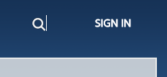
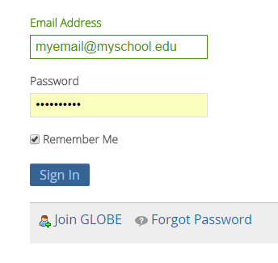
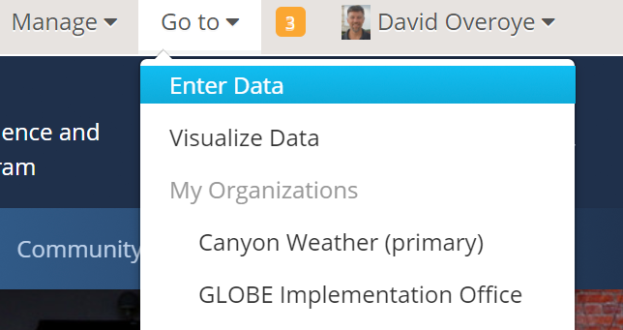

Slide 8
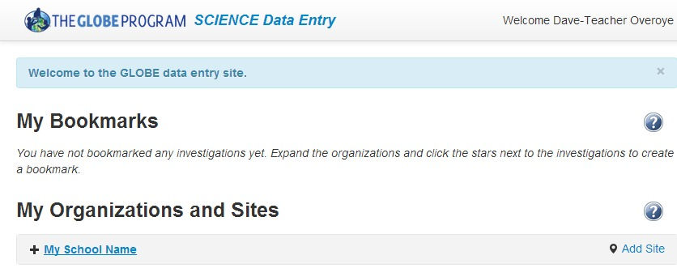
Data Entry – Starting Page
Initially your screen will look like the one below. Your school is listed, but nothing else is there.
If no school is listed, or an error exists, contact your trainer or help@globe.gov
With a school setup, you will create a site by clicking “Add Site”

Slide 9
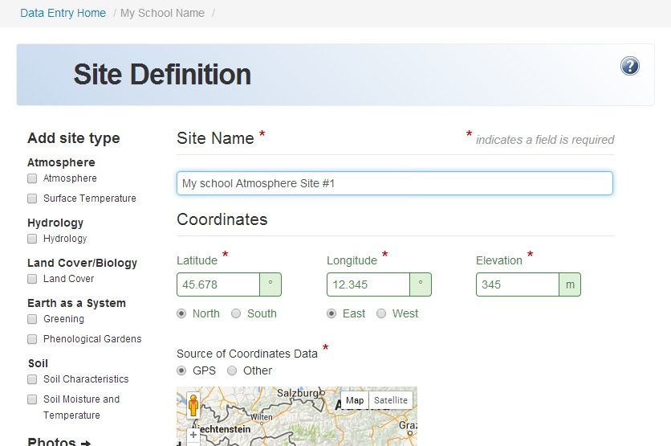
Creating a Site – Part 1 – Site Information
Start by entering the site information – name, location, and any comments. Required fields have a red asterisk*

Slide 10
Creating a Site – Part 2 – Details for Site Type
Select the type of site you are creating from the left menu. For this example, we’ll use an atmosphere site
Input the required fields to describe your site.
For Atmosphere, the only required field is the type of thermometer
If you try to submit a form without the required field, it will show an error and ask you to try again
Some fields must be within a certain range – for example, the height of the gauges can not be too low
If all is entered correctly, you will see the green smiley face!

Slide 11
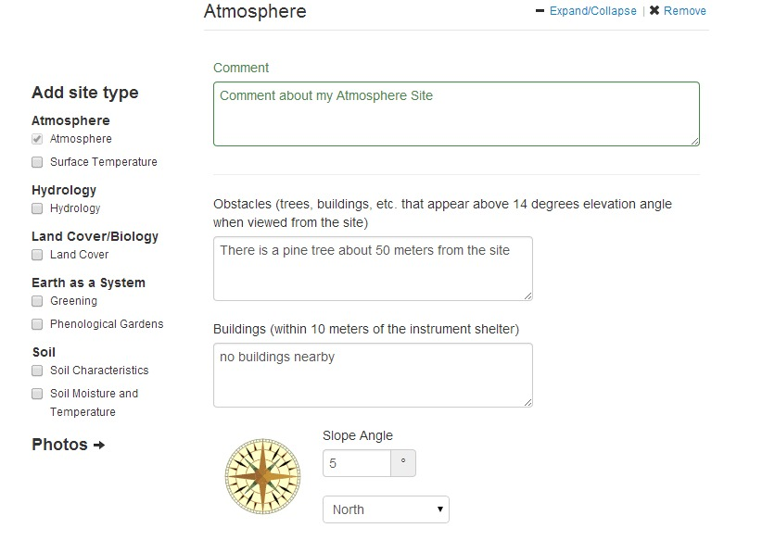
Example – Setting up an Atmosphere Site

Slide 12
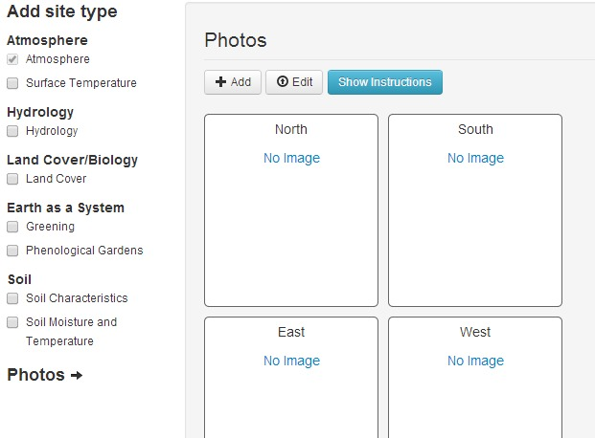
Adding Photos to your site definition
You can also add photos to capture what your site looks like and let others see what it looks like
Select Photos from the left and select +Add to add photos
Choose a direction
And “save” to place
your photo

Slide 13
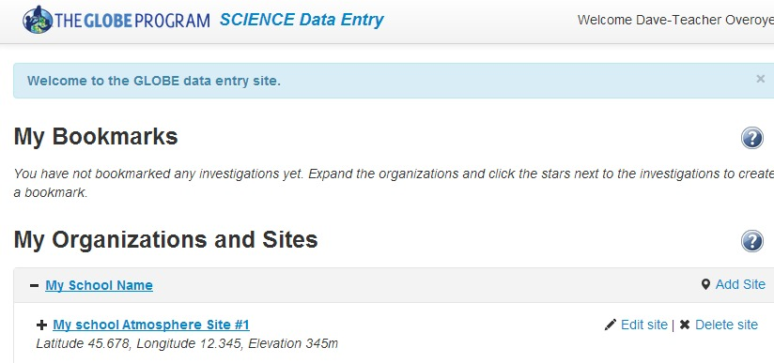
Check Your Site
Return to the Data Entry Home Page by clicking “Data Entry Home” on the top of the page.
Click on your school name to expand it and see your site. You can edit the site information if desired

Slide 14
Your Turn – Create a Site
Login and select Enter Data from the “go to” menu
Or to practice – choose - Training Data Entry from the Data Entry Page
Create an atmosphere site – this is all test data, so don’t worry about being accurate (you can make up lat/long)
Submit your atmosphere site and return to Data Entry Home
Edit your site and change the site name
Save the site and return to the Data Entry Home

Slide 15
Test – what do you do if this happens to you?
I can’t login it says “No Account”
I can’t login it says “Incorrect Password”
I can login, but when I click on the Data Entry link, it says I’m not authorized, or I’m not associated with a school
I want to change the name of my site
When I look at the site location in the visualization system, it shows my site in the wrong place.

Slide 16
Test - Answers
I can’t login it says “No Account”
If this is a workshop that is on the GLOBE website, go to the workshop page and signup for the workshop. Ask your trainer to approve your account.
http://www.globe.gov/events/workshops
Ask your trainer if they can setup your account for you.
Send an email to the helpdesk and tell them information about the workshop you attended and your school information and they can help you help@globe.gov
I can’t login - it says “Incorrect Password”
Select the “Forgot Password” link to receive a new password
I can login, but when I click on the Data Entry link, it says I’m not authorized, or I’m not associated with a school
Ask your trainer to make sure your school is added to GLOBE.gov and you are a teacher in that school, or send the information to help@globe.gov
Ask your trainer if they marked you as having completed your training. You will not be able to enter real data until they mark your training as complete

Slide 17
Test - Answers
4) I want to change the name of my site
Select “Enter Live Data”, click on your school name.
Click on “Edit” next to the site whose name you want to change
Save your changes
5) My site is in the wrong location?
Select “Enter Live Data”, click on your school name.
Click on “Edit” next to the site whose location you want to change
Input the correct latitude and longitude for your site
Save the site
Use the visualization system to be sure it is in the right place

Slide 18
Next Steps
Congratulations – you should have
A GLOBE Account
A GLOBE School
Setup a Site in training
You can now
Continue to Part 2 – Entering Measurement Data
Consider setting up your site in the Production environment
Questions – contact the GLOBE Helpdesk – help@globe.gov

