Slide 1
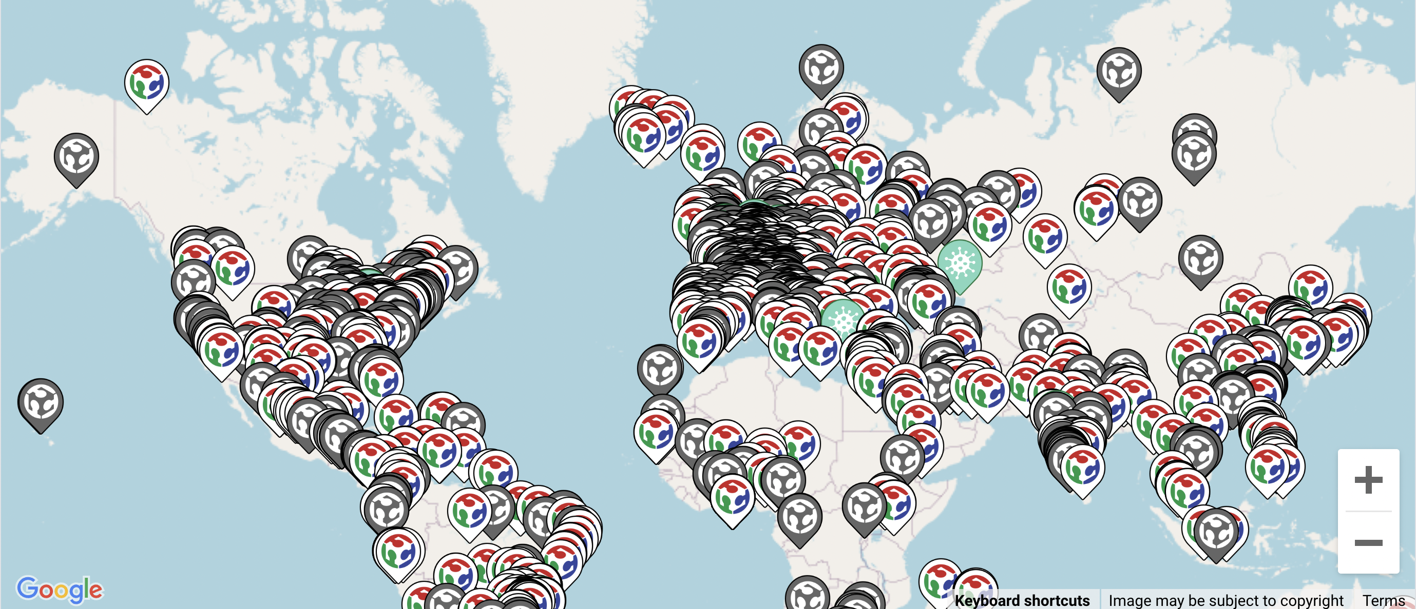
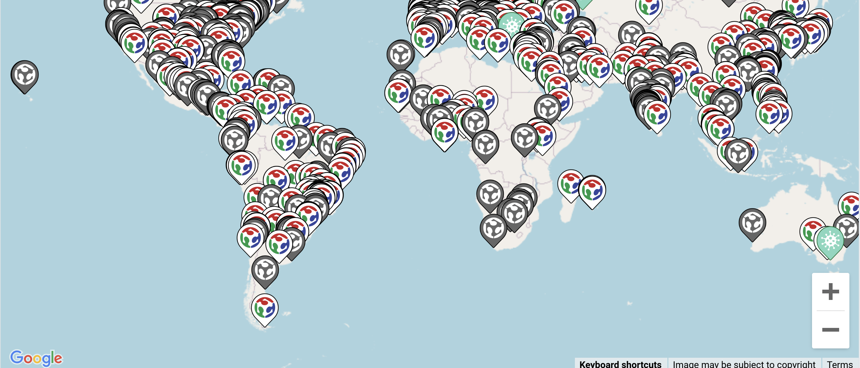
*GLOBE Opportunity: locate a “Fab Lab” somewhere near you --- learn more, share your work, and then team up on making sensors with students!
co-create‘GeoFab’
FabLab Network (welcome!)
https://www.fablabs.io/labs/map <--
https://academany.org/fab-all-in/

Slide 3
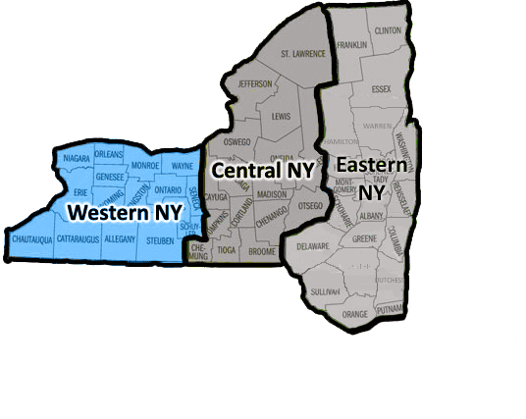
Sankofa
The farther backward you can look…
…. the farther forward you will see.
-- Winston Churchill

Slide 4
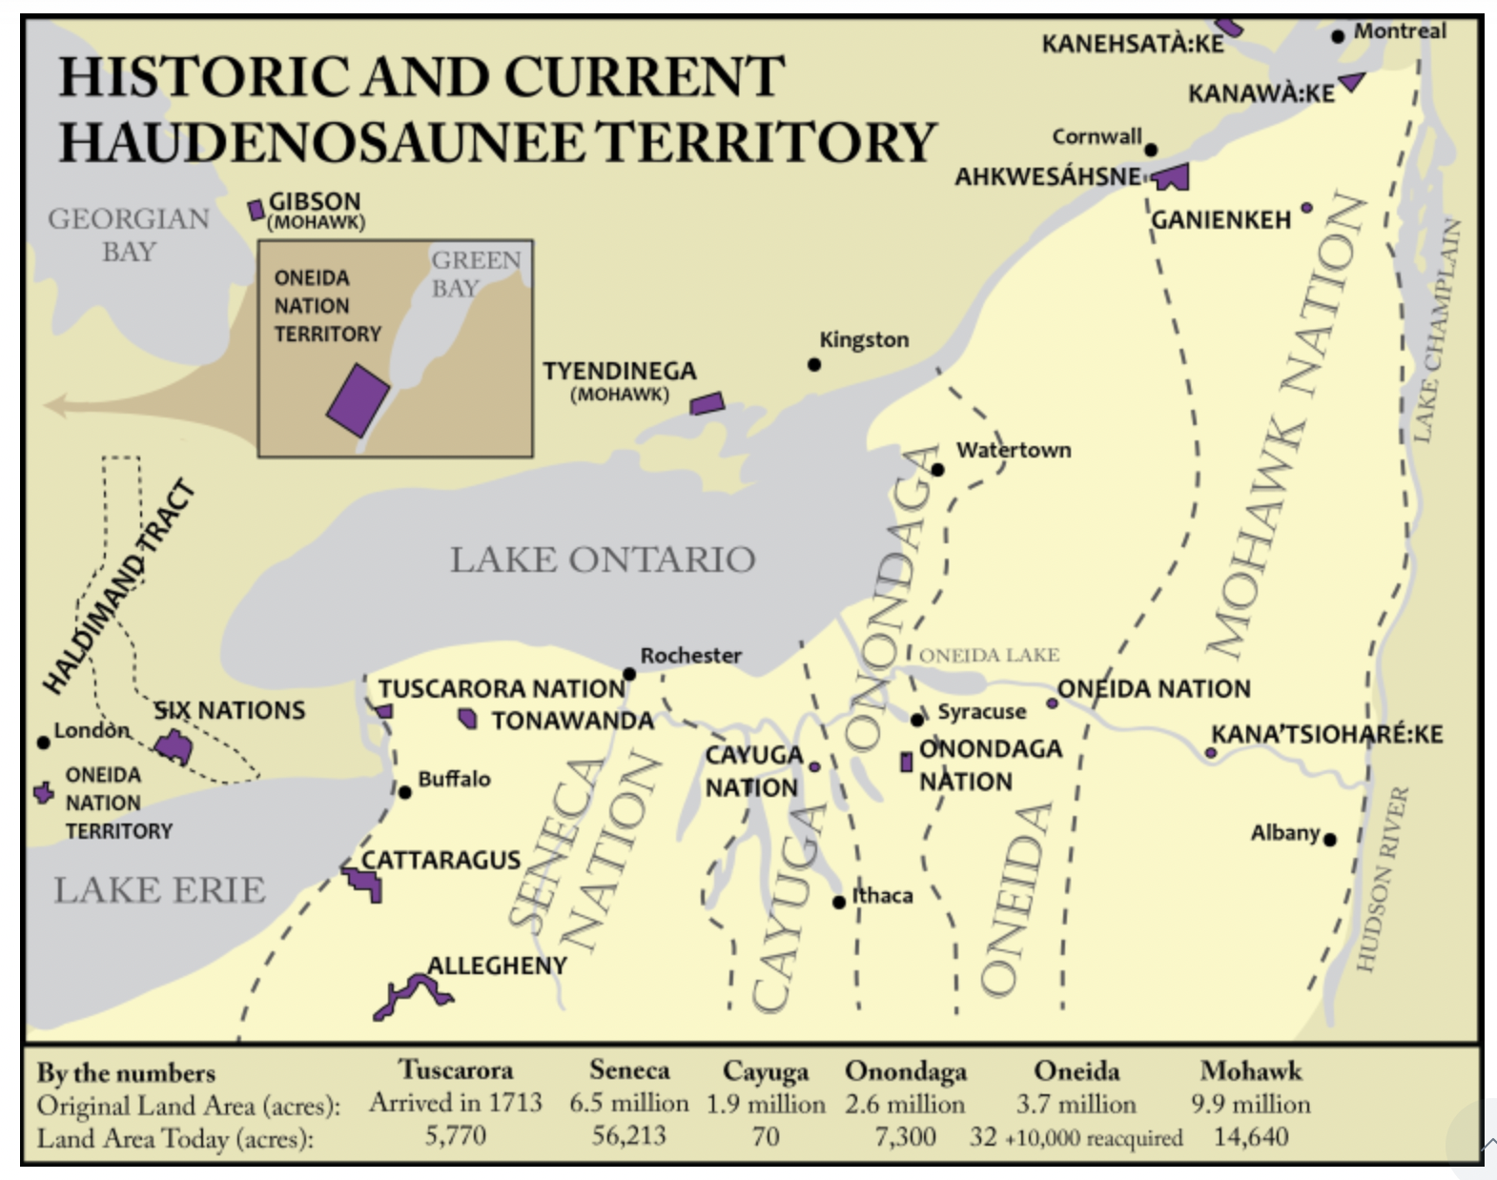
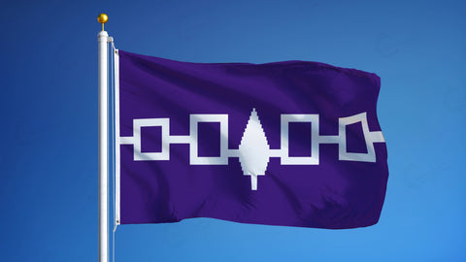

Slide 5
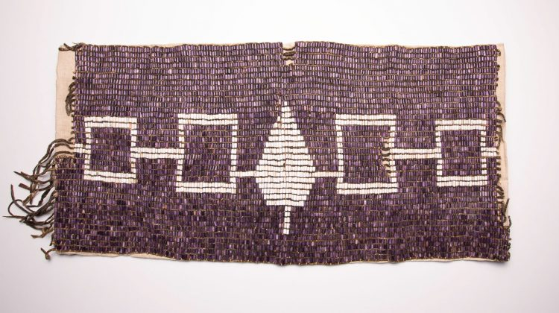
Haudenosaunee - Seneca, Cayuga, Onondaga, Oneida, Mohawk, Tuscarora
Iroquois Confederacy, founded by the Great Peacemaker (Hiawatha) in 1142, is the oldest living participatory democracy on earth.
In 1988, the U.S. Senate paid tribute with a resolution that said, "The confederation of the original 13 colonies into one republic was inﬂuenced by the political system developed by the Iroquois Confederacy, as were many of the democratic principles which were incorporated into the constitution itself."

Slide 6
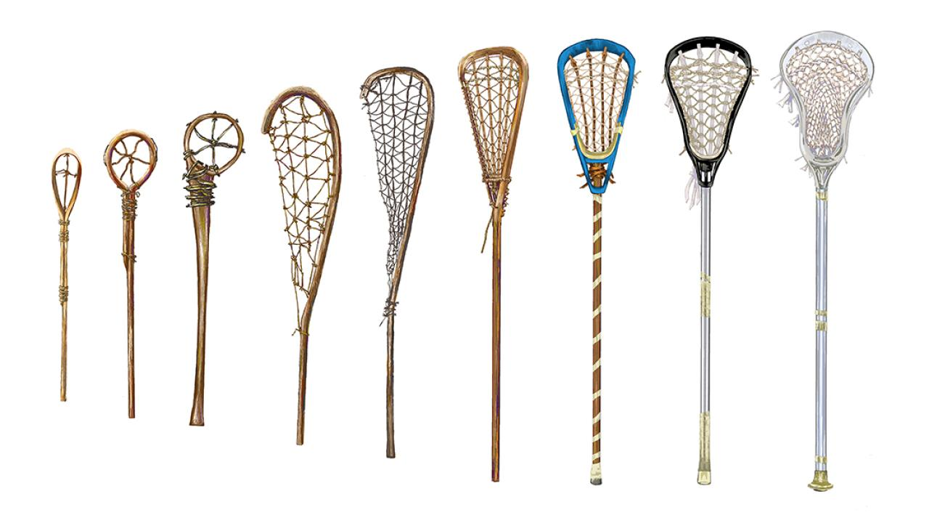
Los Angeles 2028

Slide 7
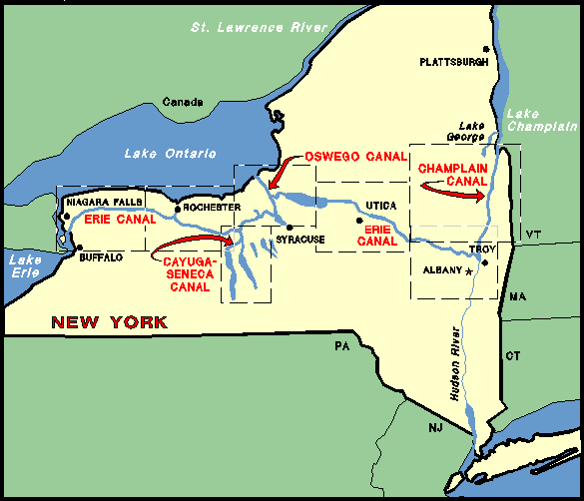
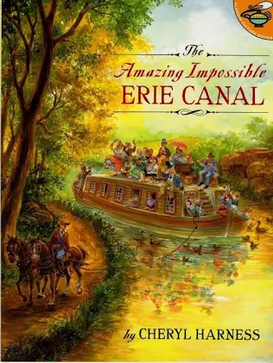

Slide 8
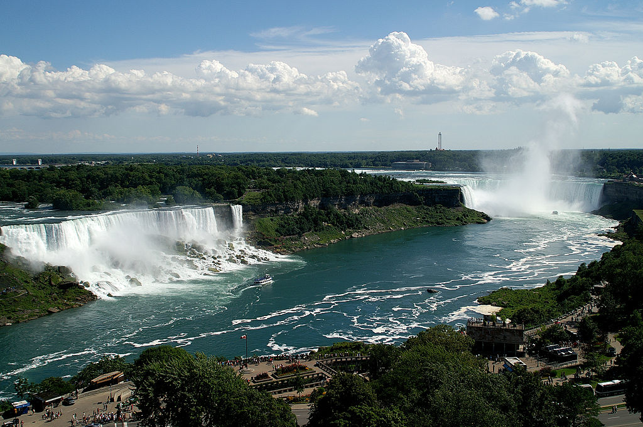
source: wikipedia

Slide 9
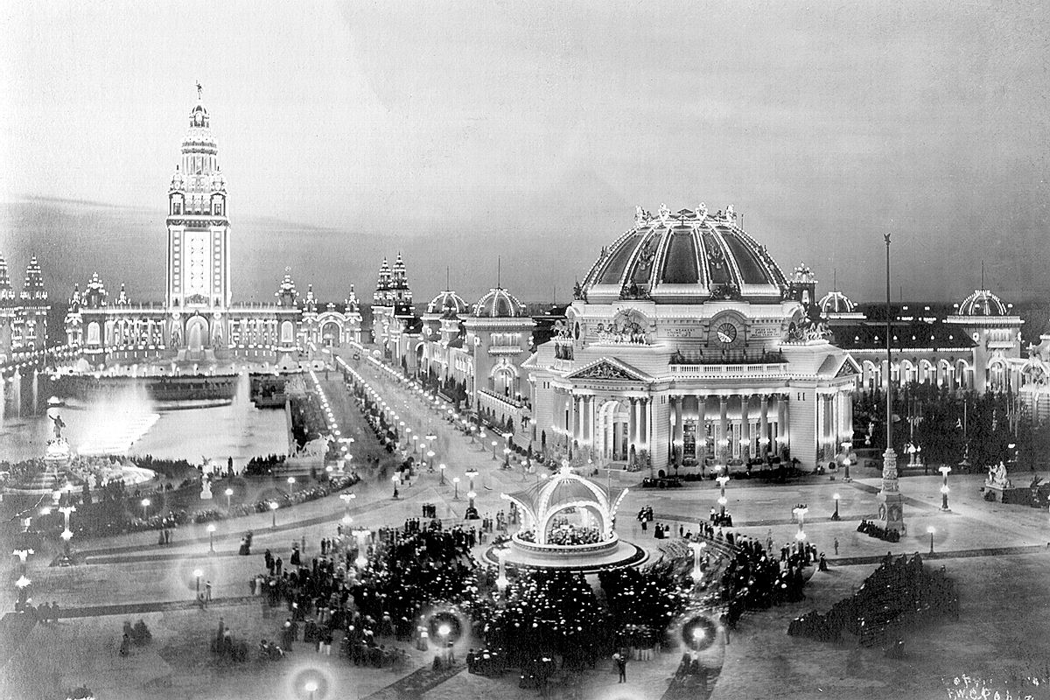
source: wikipedia

Slide 10
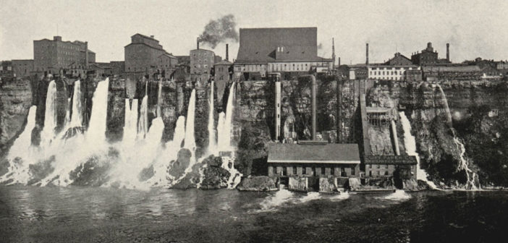
source: wikipedia

Slide 11
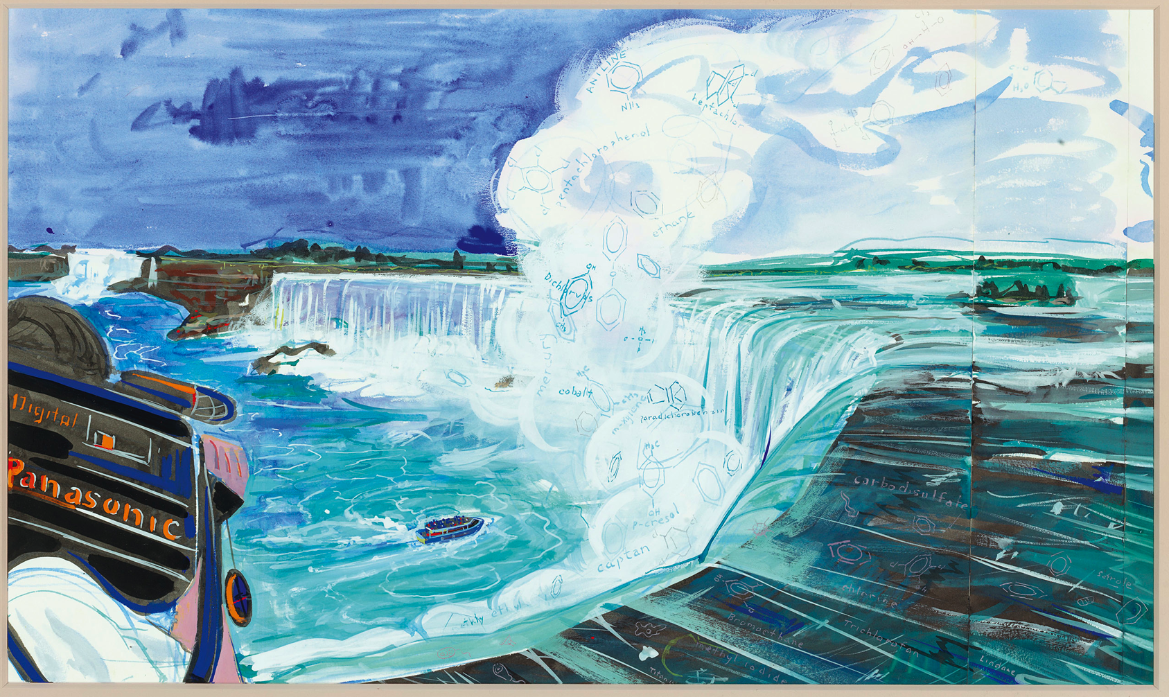
Frank Moore “Niagara”

Slide 12
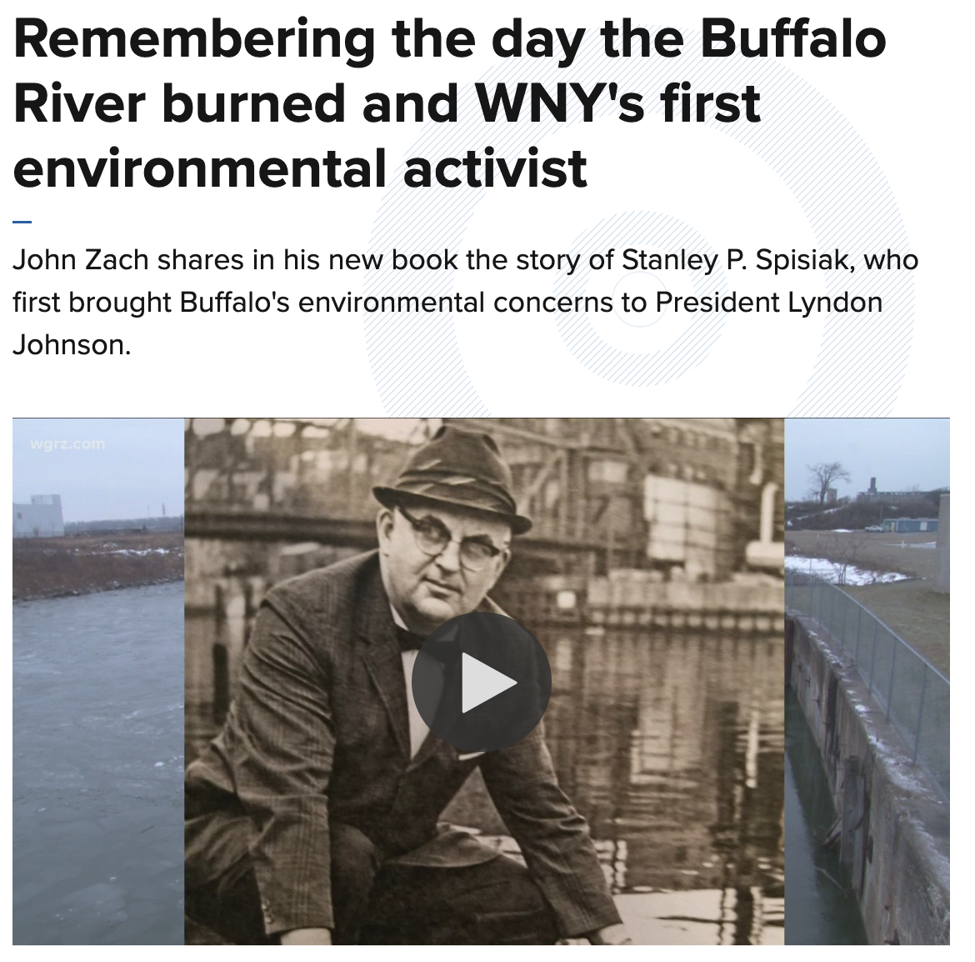
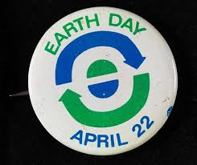
For the first Earth Day in 1970, Joan Smith organized a community-wide bicycle parade down Buffalo’s Main Street for hundreds of riders — complete with a commuter race between a bike, a car, a bus, and a walker racing from the city line to downtown, and she always shared when recounting these events, that the bicycle won the race. Founded Niagara Frontier Bicycle Club that day.

Slide 13
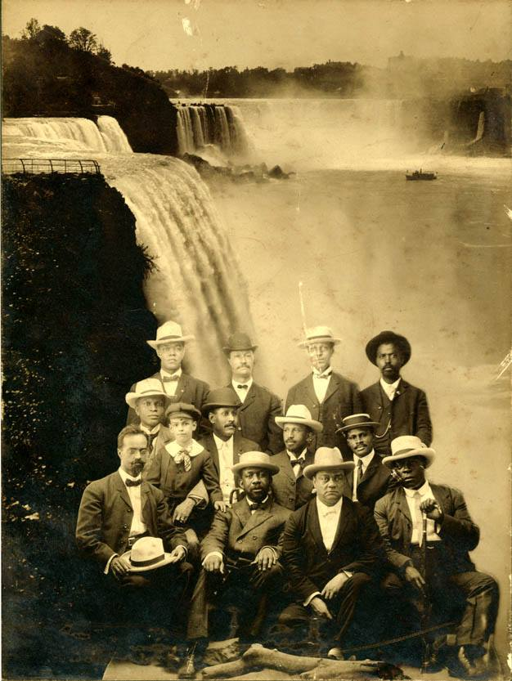
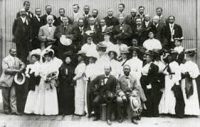
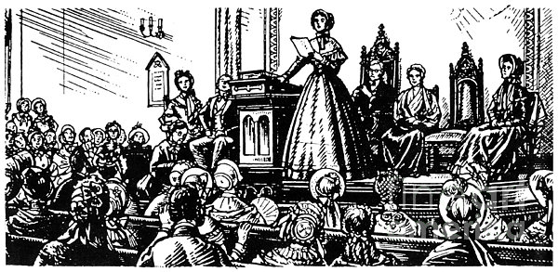
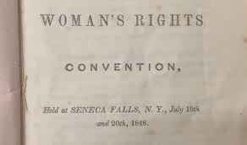
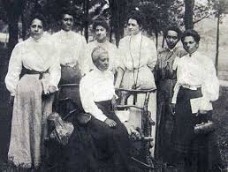
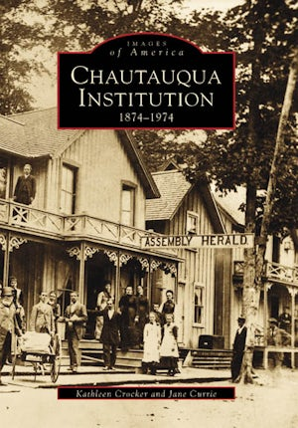
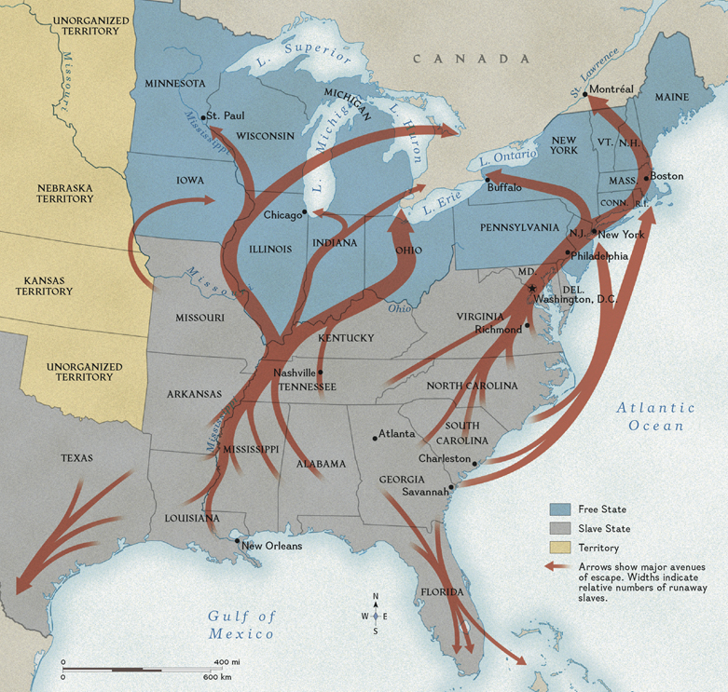
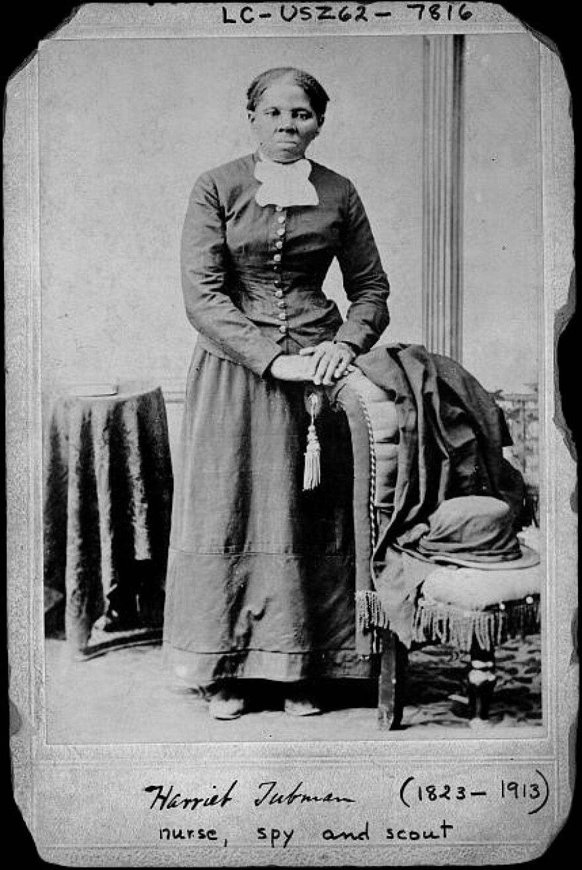
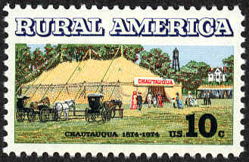

Slide 14
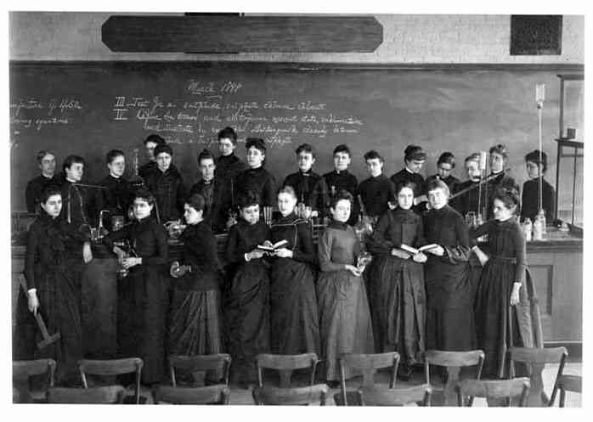
Images Matter

Slide 15
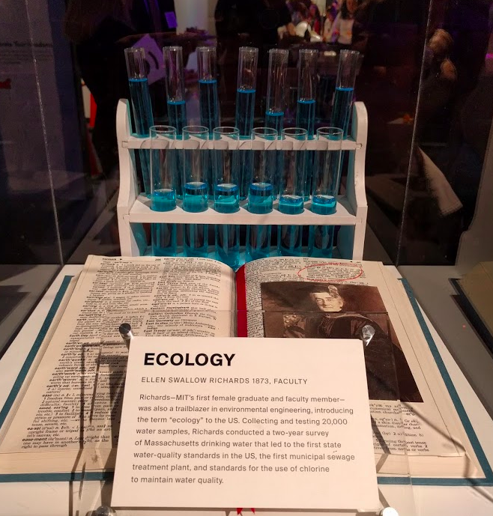
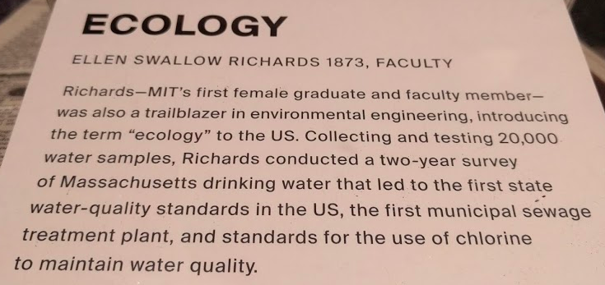
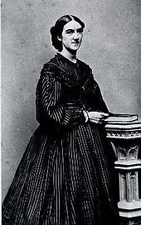

Slide 16
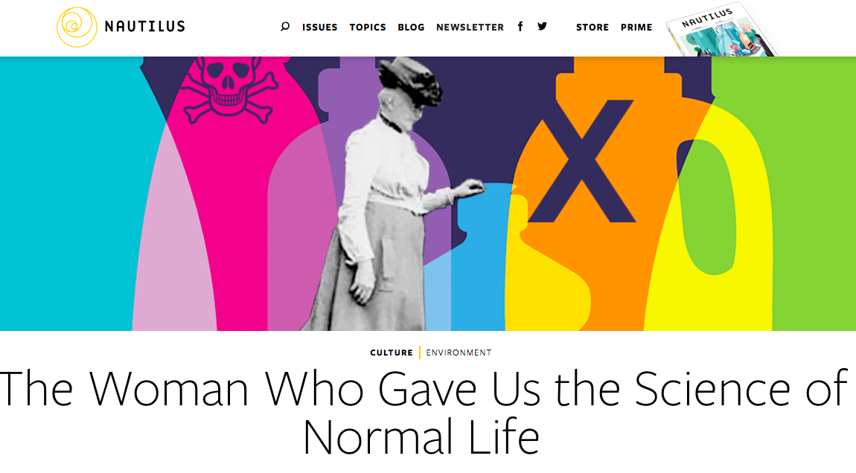
Ellen Swallow Richards: The conference, held annually, grew in size and influence under the leadership of Mrs. Richards until, meeting at Chautauqua in 1908, the participants agreed to gather again in Washington later that year to form the American Home Economics Association. Mrs. Richards was elected president and served until 1910, when she insisted on retiring. ← GLOBE Related (water, earth, air, food quality)

Slide 17
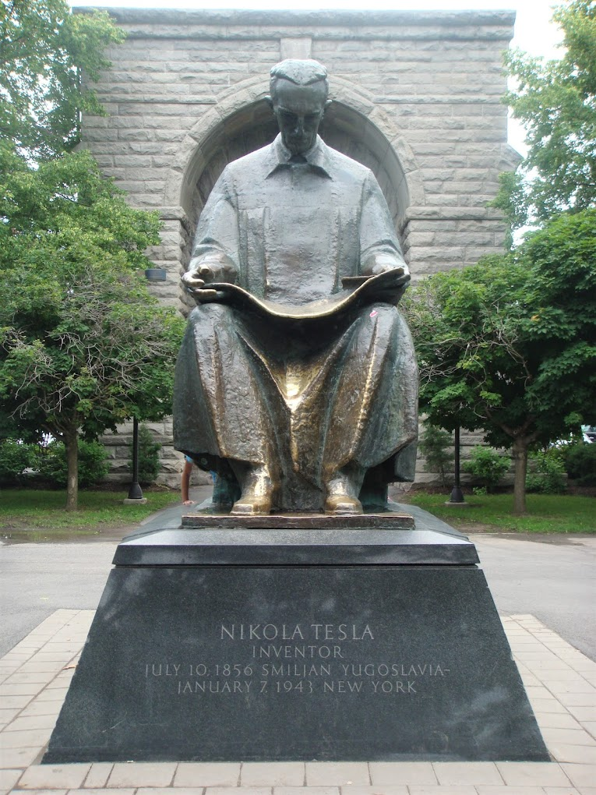
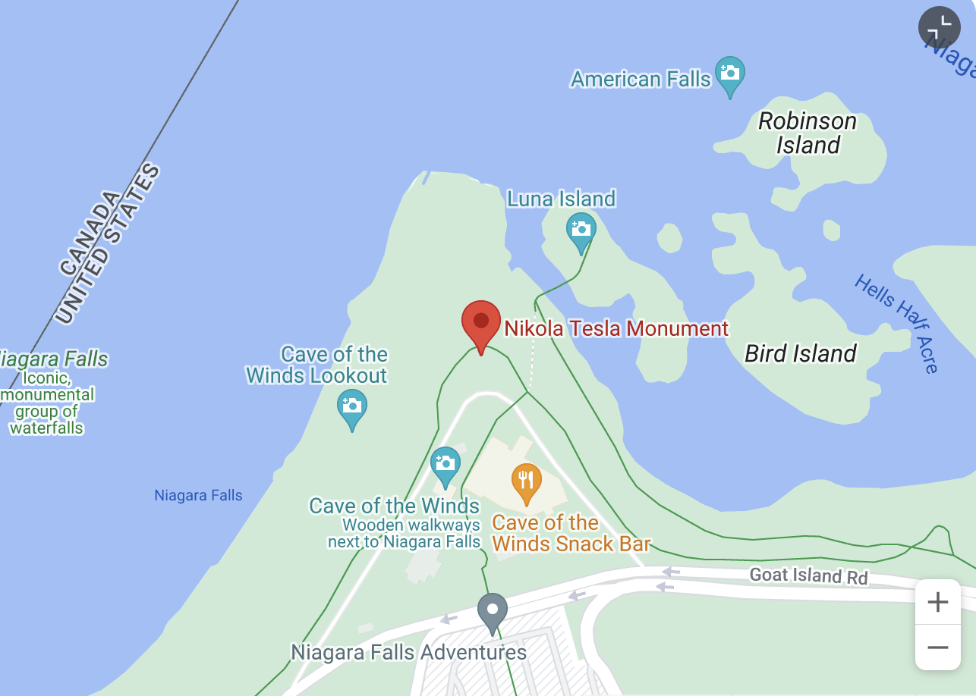
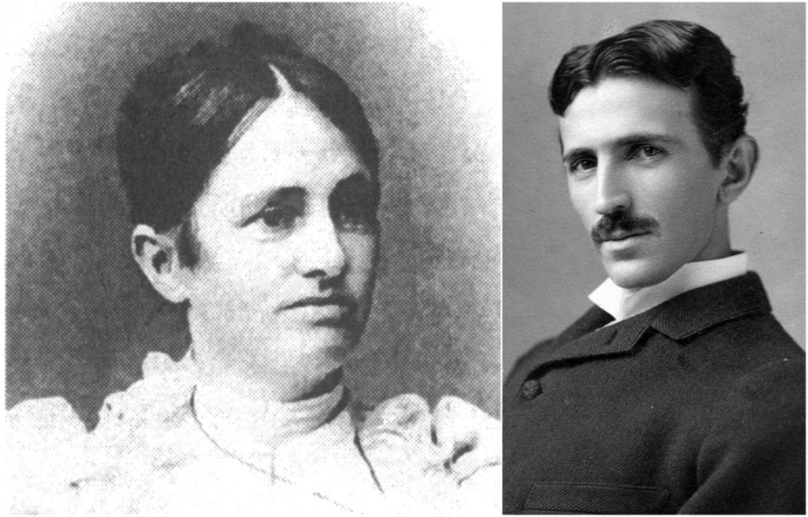
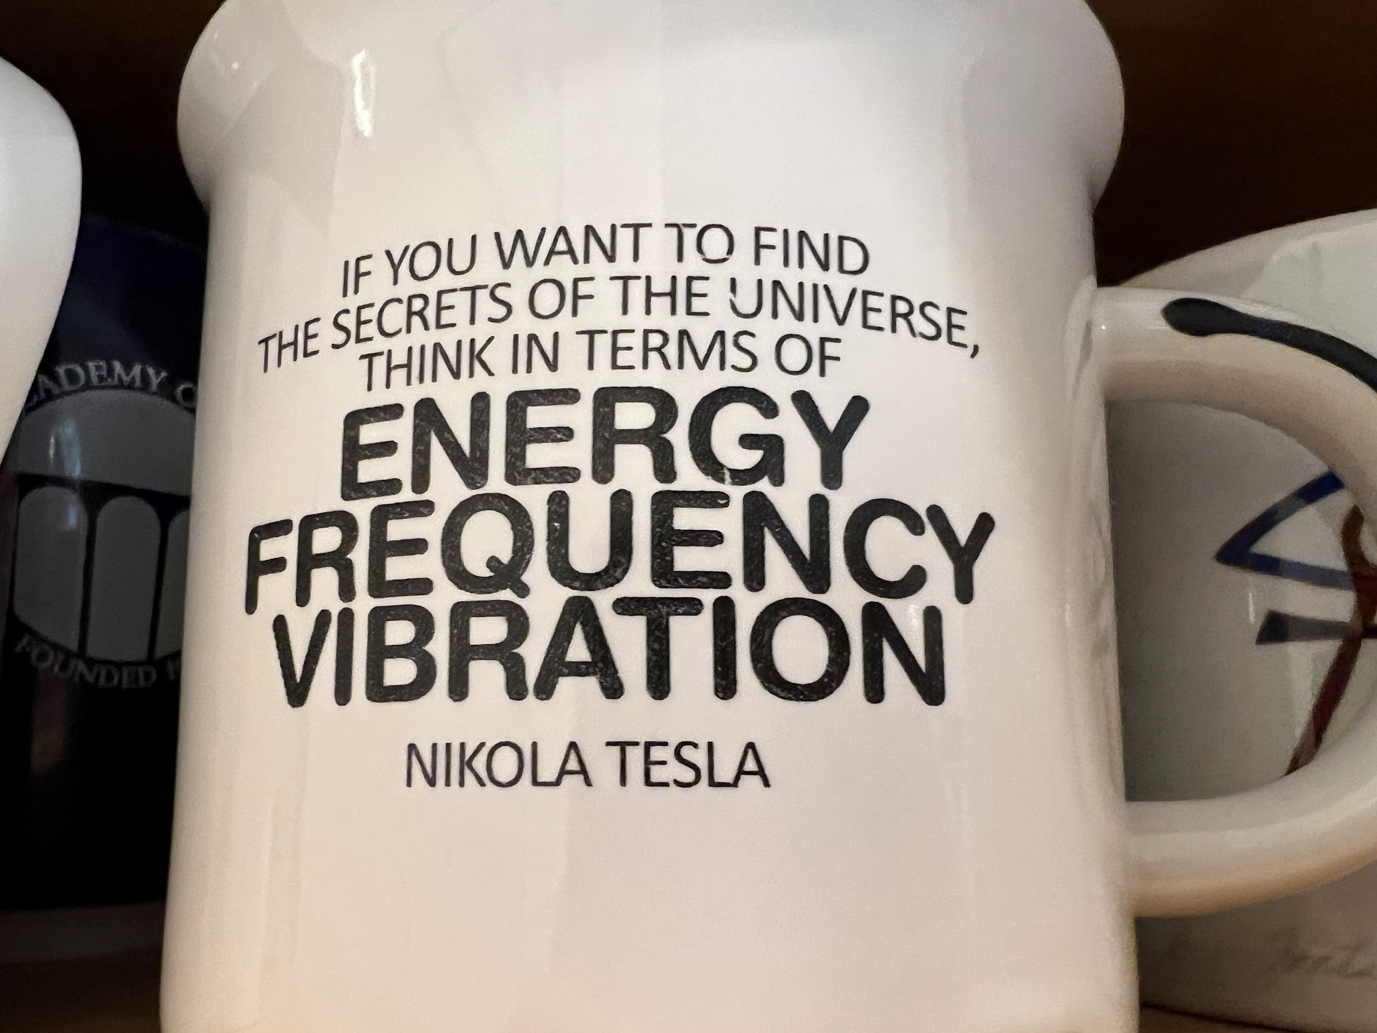
Tesla pioneered the generation, transmission, and use of alternating current (AC) electricity,
Duka Tesla: (…) My mother was an inventor of the first order and would, I believe, have achieved great things had she not been so remote from modern life and its multifold opportunities. She invented and constructed all kinds of tools and devices and wove the finest designs from thread which was spun by her. (…) -- Nikola Tesla

Slide 20
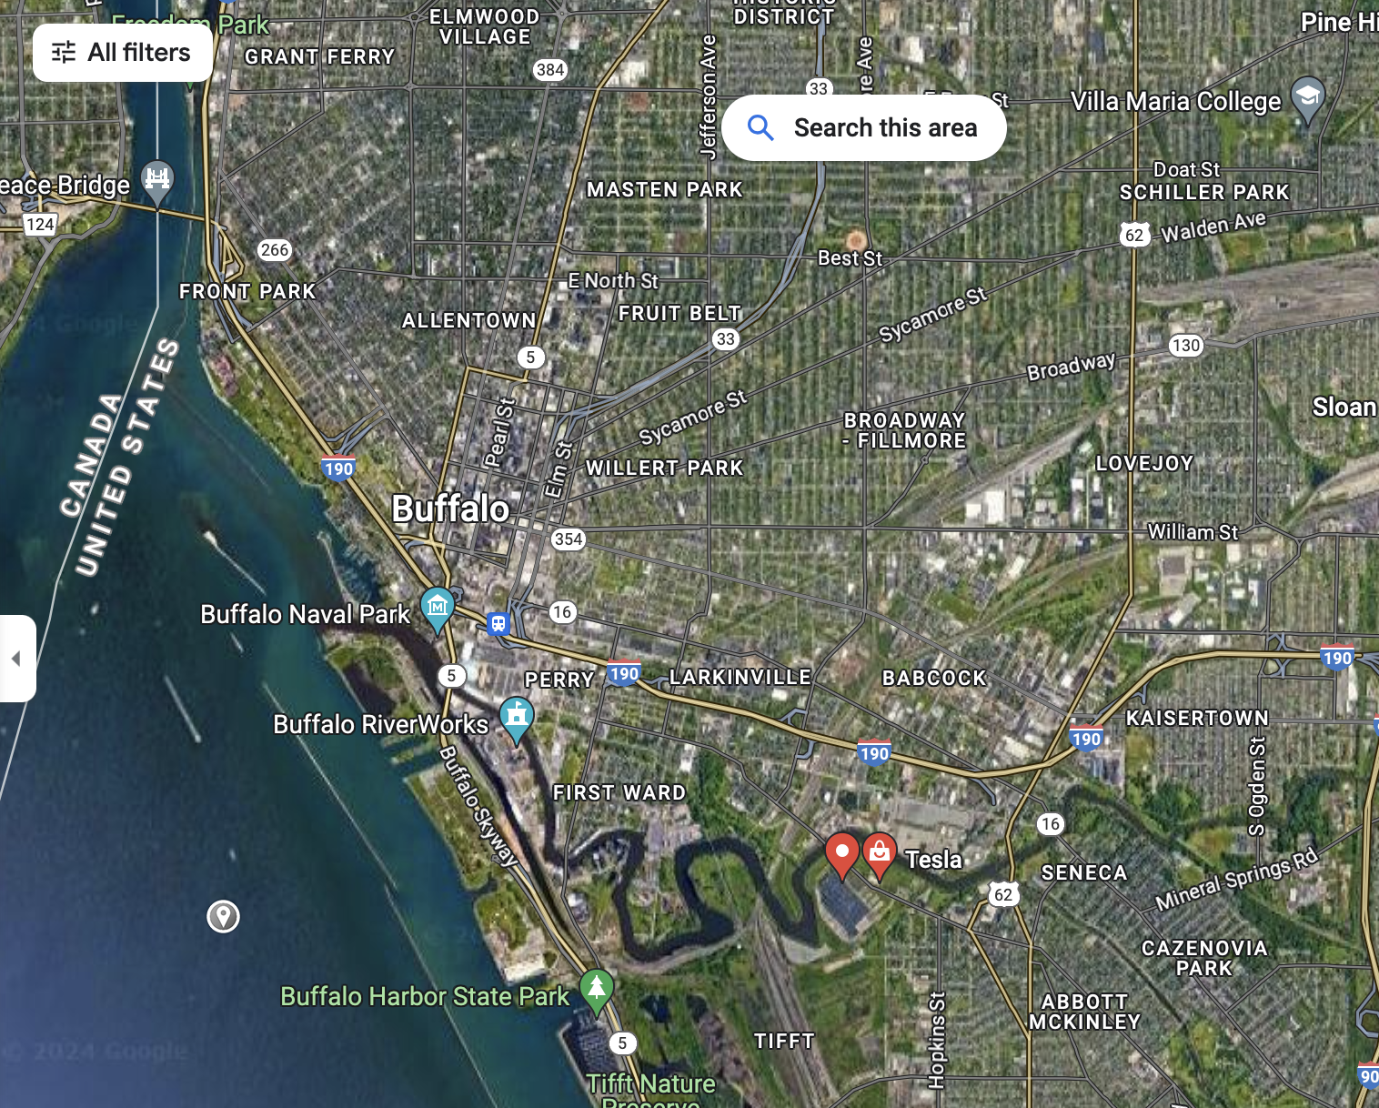
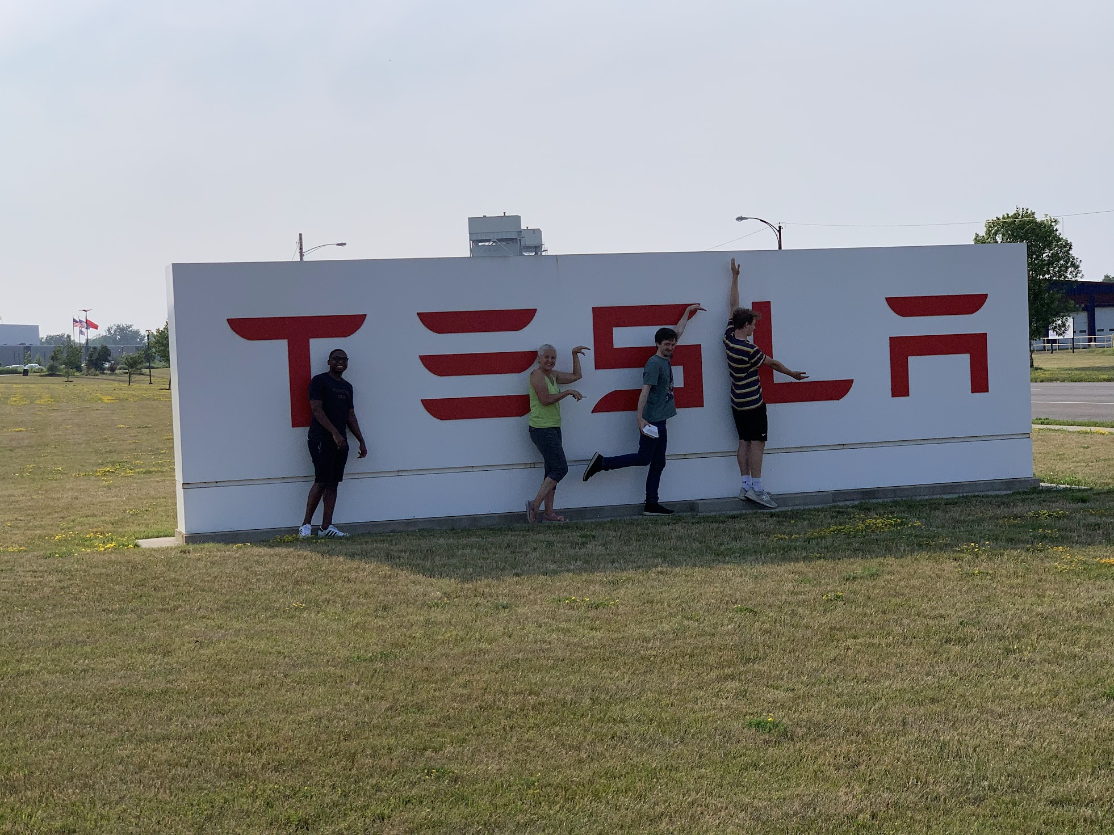
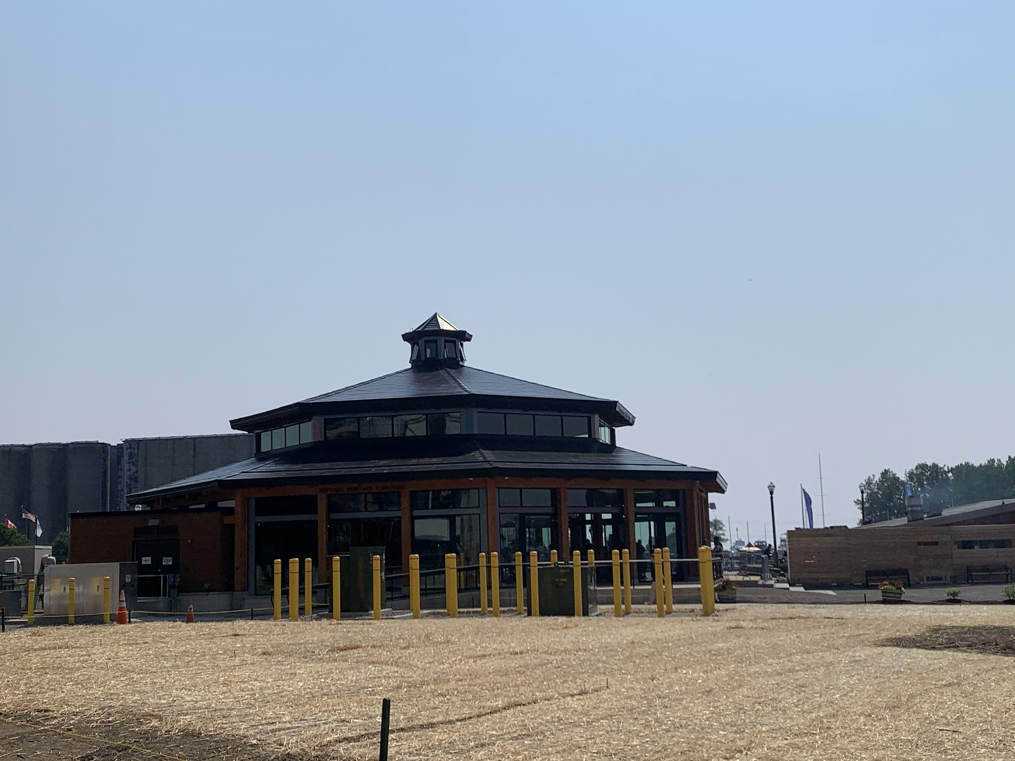
Buffalo NY – Canal Sides (start of Erie Canal)
…has a Solar Power Carousel with solar roof from nearby Tesla plant at the old Republic steel mill site

Slide 21
Notes:
MapMaker time lapse in Pakistan

Slide 22
Community Mapping Activity
None of these maps would exist without the extraordinary goodwill of people everywhere who share their knowledge with all of us to better their own lives, that of their their family and their communities.
Notes:
https://docs.google.com/a/google.com/Doc?docid=0AU81ep_FymLLZDl2Z3N0OV8yODBjbXR4ZnFmcA&hl=en

Slide 24
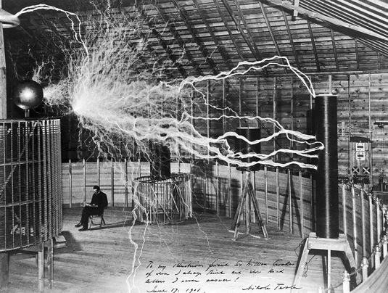
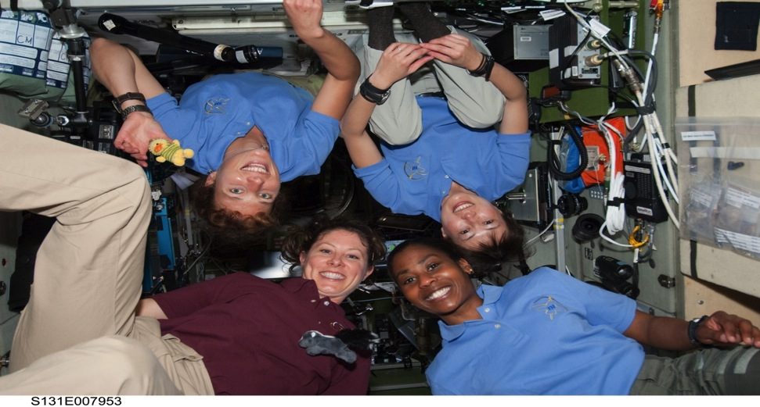
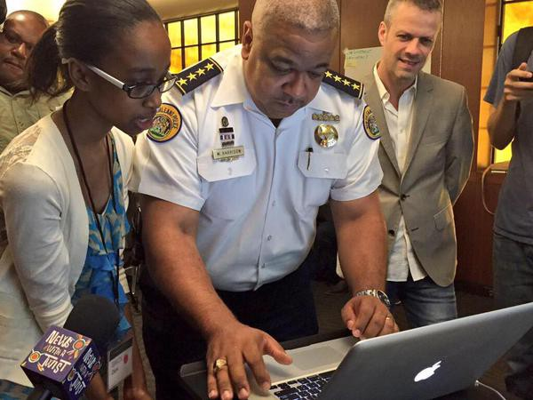
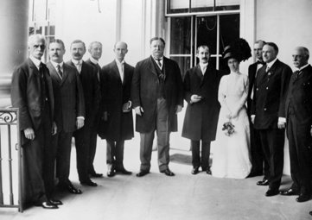
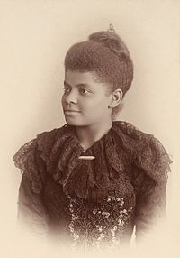
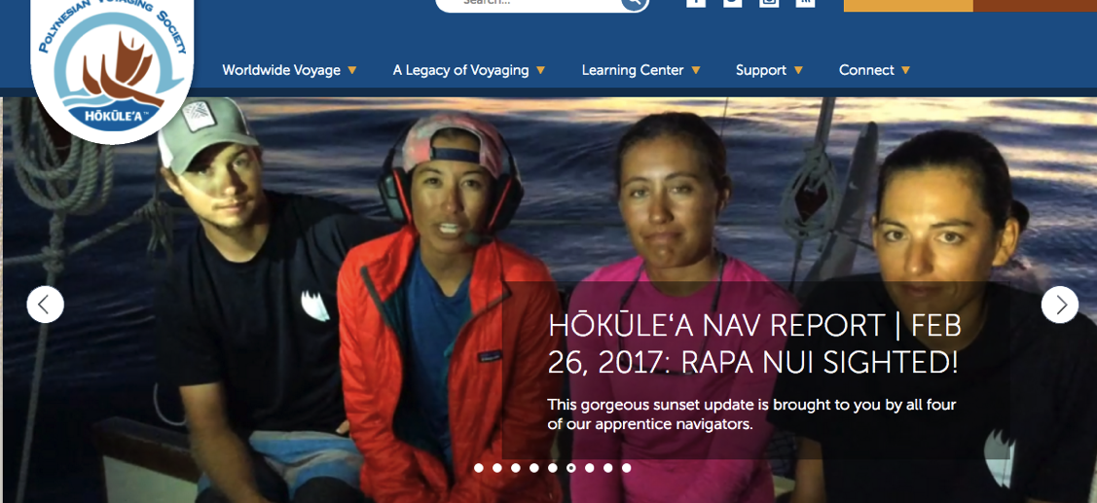
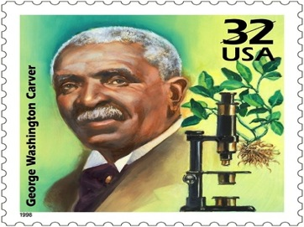
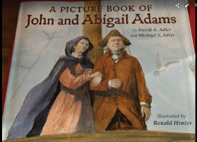
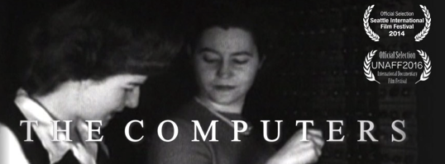
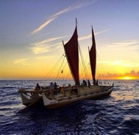

Slide 25
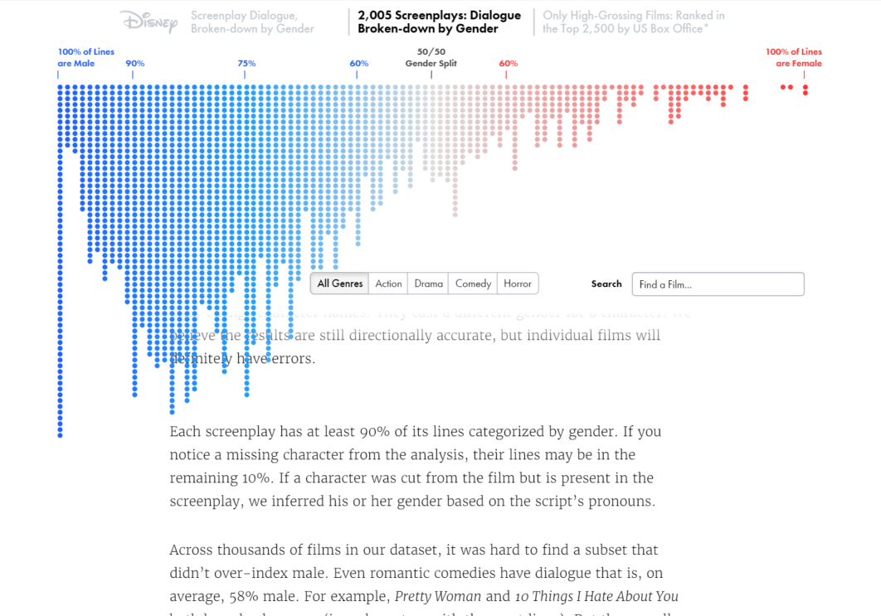
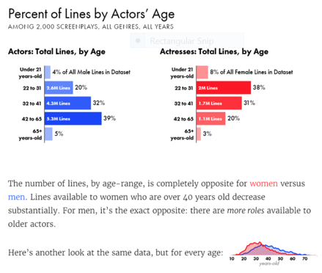
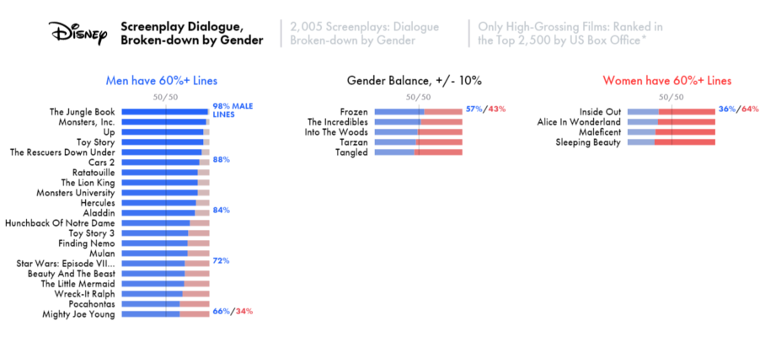
Data: Unconscious and Institutional Bias in Media example
SOURCE: http://polygraph.cool/films/

Slide 26
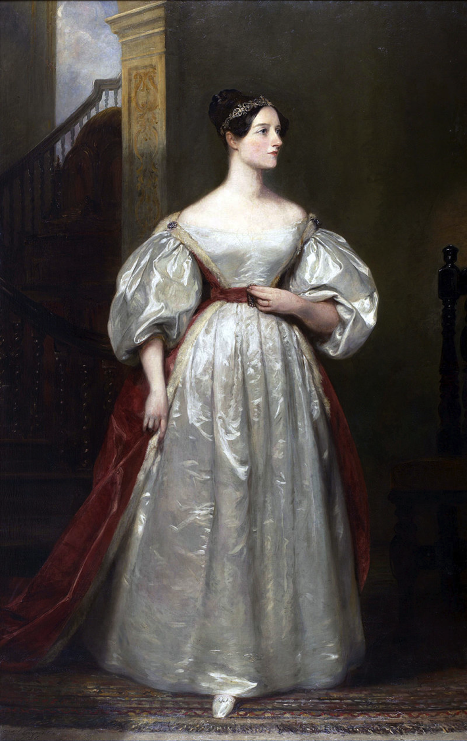
https://www.fourmilab.ch/babbage/sketch.html

