Slide 1
GLOBE International STEM Network
Monthly Networking Session
Leveraging GLOBE into Fulbright Award Opportunities
Russanne Low PhD
Deputy Director
GLOBE Implementation Office, STEPE
December 19, 2024
Grace Crain-Wright
GLOBE Implementation Office, STEPE
Larisa Schelkin
GIO-STEPE and Global STEM Education Center

Slide 2
Next Month’s GISN Meeting
Welcome to GISN in 2025
Onboard and welcome new GISN members
We will talk about opportunities coming up for GISN members
Please bring a single slide for the networking event for speed networking event!
Prospective GISN members are invited to attend- share this opportunity with your STEM colleagues: we are actively recruiting to balance the representation of regions in the GISN

Slide 4
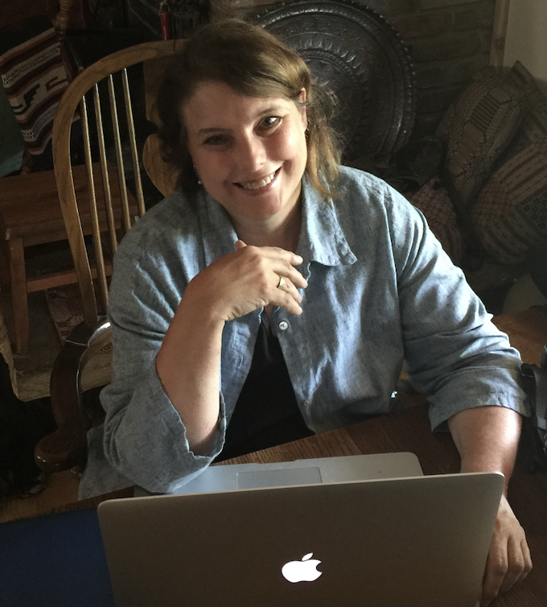
Make your GISN intro networking slide
Works at: The GLOBE Implementation Office, STEPE
Training: climate and environmental change on long timescales
Current interest: community science, Citizen science tools mosquito surveillance and monitoring land cover change
GLOBE Projects I want to work on as part of GISN:
Scientific review and update of GLOBE Teacher’s Guide (Biosphere)
Science mentor visiting GLOBE classes via zoom
Develop research project with other GISN members
I’d like to meet others who:
Have experience in mosquitoes, air quality monitoring, deep experience in citizen science and GLOBE data collection
Who have worked with UN initiatives in their country
I’d like to build skills in:
Global Science Diplomacy
Contact me at: rusty_low@strategies.org Whats app +1 720-839-2351
Website: https://www.globe.gov/web/mission-mosquito

Slide 5
GLOBE is one of the largest and most impactful worldwide science research and education program that engages students and the public in Earth system observations and research.
Key Features of the GLOBE Program:
Global Reach: Active in 127 countries, involving students, teachers, scientists, citizens, and communities
Longevity: celebrating its 30th Anniversary in 2025
Diverse Focus Areas: support many of the UN SDGs
Participants: Millions of participants have contributed data and learned through the program over the years.
US Department of State
Fulbright Program
Global reach: 135 countries involving teachers, university educators researchers
Longevity: 79 years in 2025
Diverse Focus Areas
Participants: over 400,000
US Department of State

Slide 6
The GLOBE Program
and the
The Fulbright Association: Synergies

Slide 7
International STEM Professionals: Fulbright Scholar-in-Residence Program
institutions host a scholar from outside of the United States for a semester or full academic year to teach courses and build international connections to with the host institution. https://fulbrightscholars.org/sir
Fulbright Visiting Scholars Program university teaching/research focus
https://fulbrightscholars.org/non-us-scholars/fulbright-visiting-scholar-program
All webinars will take place at 7pm UTC
January 21, 2025: Fulbright S-I-R Program Overview and Application Walkthrough
February 26, 2025: S-I-R Host Impact Panel - How can an S-I-R Exchange Contribute to your Institution's Internationalization Efforts and Benefit your Campus Community?
March 20, 2025: S-I-R Host Impact Panel - S-I-R Opportunities for Community Colleges and Minority Serving Institutions
May 2, 2025: Scholar-in-Residence 2026-2027 Application Q&A – Last Call
View our S-I-R webinar archive from past years' competitions.

Slide 8
Fulbright U.S. Scholars Program:
he Fulbright U.S. Scholar Program offers over 400 awards in more than 135 countries for U.S. citizens to teach, conduct research and carry out professional projects around the world.
https://fulbrightscholars.org/us-scholar-awards
Fulbright Global Scholar Award
multi-country, trans-regional projects. As a truly worldwide award, U.S. scholars will be able to propose research or combined teaching/research activity in two to three countries
https://fulbrightscholars.org/us-scholar-awards/global

Slide 9
Global Teachers: The Fulbright Teaching Excellence and Achievement (TEA) Program brings international secondary-level teachers to the United States for a six-week professional development opportunity. https://www.fulbrightteacherexchanges.org/
U.S. Teachers: Fulbright Distinguished Awards in Teaching
https://www.fulbrightteacherexchanges.org/programs/dast

