Slide 1
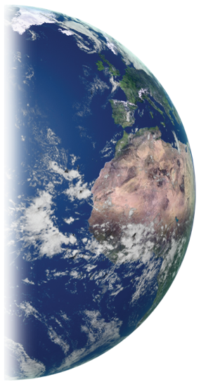
Introduction to GLOBE
A Worldwide Science and Education Program
eTraining Module

Slide 2
Welcome to GLOBE:
Global Learning and Observations to Benefit the Environment
GLOBE is a science and education program that connects a network of students, teachers, volunteers (citizen scientists), and scientists from around the world to better understand, sustain and improve Earth’s environment at local, regional and global scales.
To date, more than 130 million measurements have been contributed to the GLOBE database, creating meaningful, standardized, global research-quality data sets that can be used in support of student and professional scientific research.
It’s easy to get started! You’ll find out how in this module!

Slide 3
Overview and Objectives
This module:
Introduces the GLOBE Program
Describes the GLOBE Investigation areas
Identifies teacher resources and community science opportunities
After completing this module, you will be able to:
Describe why GLOBE protocols are used when collecting data
Identify the 4 GLOBE investigation areas as parts of the Earth system
View GLOBE data using the GLOBE Visualization System
Know how to become a volunteer citizen scientist or a GLOBE teacher and start using GLOBE in your classroom.
To become a GLOBE volunteer or teacher you will need to:
Take the quiz associated with this module
Complete quizzes covering the content of an introductory module for one of the GLOBE investigation areas, as well as a module that presents a GLOBE protocol within that area. This training includes a section for educators so that you can become certified as a GLOBE teacher and able to conduct investigations with students/learners.
Ready? Let’s get started!

Slide 4
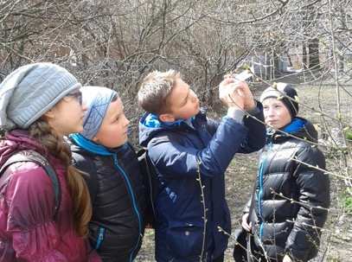
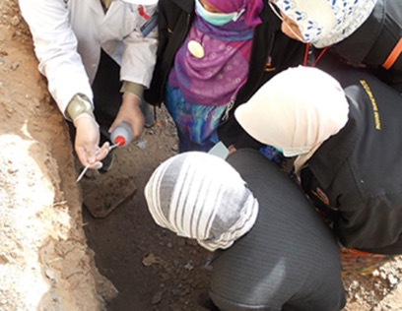
GLOBE participants build understanding by making environmental observations and asking questions

Slide 5
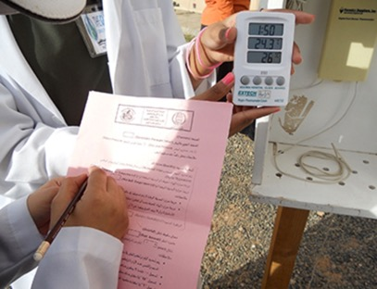
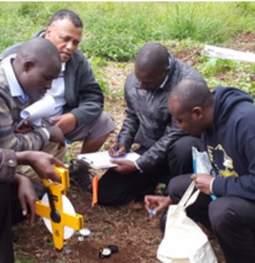
Participants collect data…

Slide 6
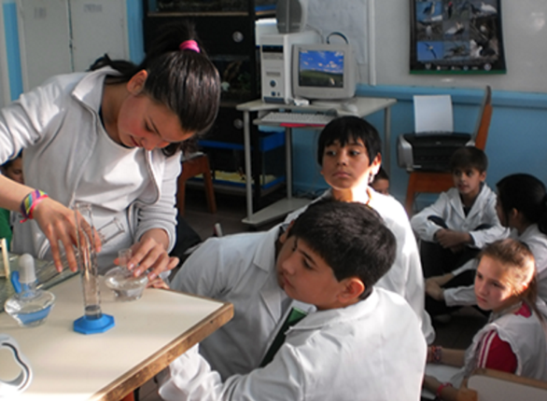
Conduct laboratory analyses…

Slide 7
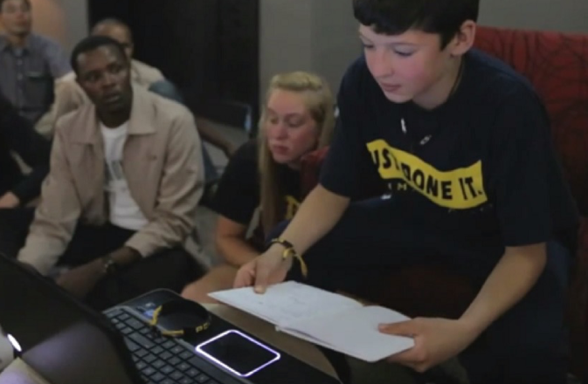
Upload their data to the GLOBE database…

Slide 8
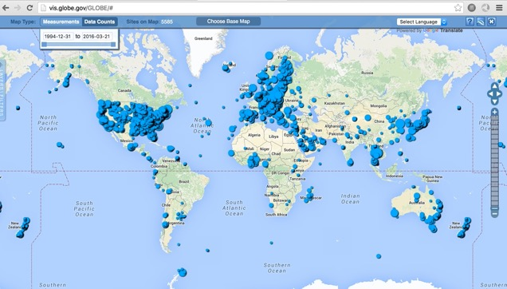
And share their data with students as well as research scientists around the world.
GLOBE’s Data Visualization System shows where participants have uploaded water temperature data. The GLOBE database contains more than 25 years of data collected by students at more than 37,000 schools around the world.

Slide 9
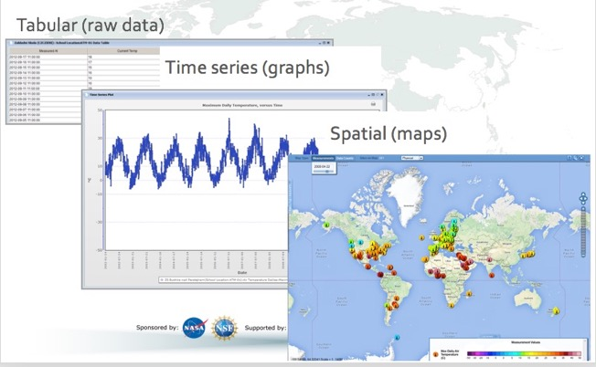
Students, volunteers, and scientists can download data from GLOBE’s database in different formats and conduct scientific analyses on data they have collected as well as global data sets provided by other participants.

Slide 10
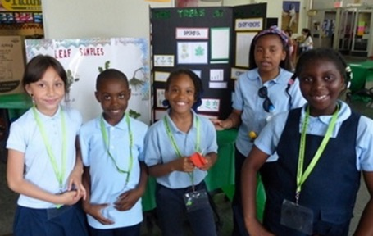
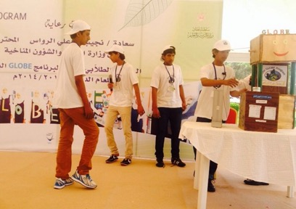
When research is completed, students can report on the outcomes of their investigations at science fairs, including GLOBE’s annual Virtual Science Symposia.

Slide 11
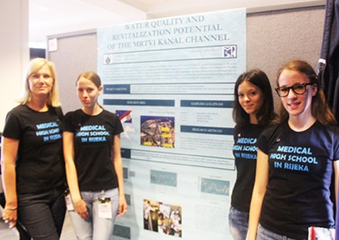
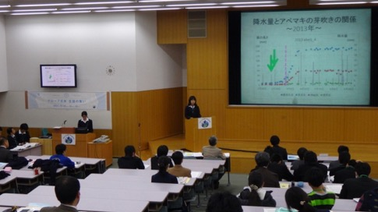
Students, scientists, and volunteers can all report their findings at scientific meetings and publish reports
Student Research Reports

Slide 12
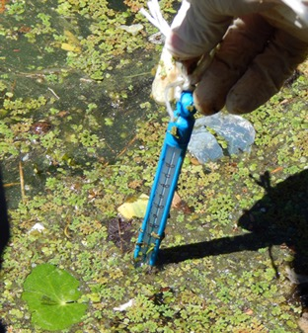
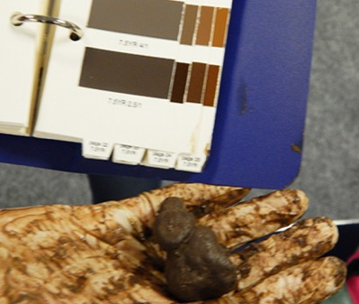
No matter where in the world, all participants collect their data the same way, using procedures developed by research scientists. These are called GLOBE Protocols.

Slide 13
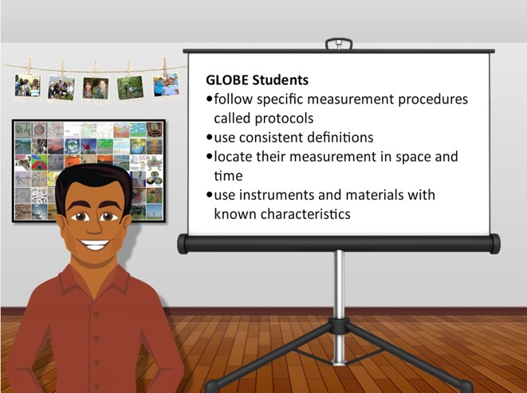
GLOBE Protocols, instrumentation standards and reporting conventions make sure that GLOBE data are sufficiently accurate and precise to be used in scientific research:
GLOBE Participants:
Follow specific measurement procedures
Use consistent definitions
Locate their measurement in space and time
Use instruments and materials with known characteristics

Slide 14
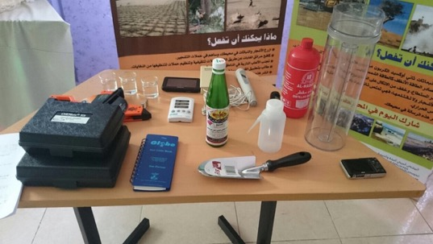
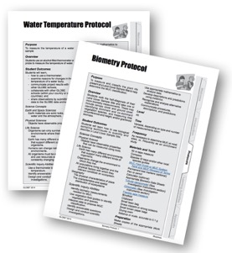
Because GLOBE participants use standardized scientific procedures and equipment, the data they collect are research quality and can be used not only in student or community investigations but also by professional research scientists.
All GLOBE educational materials, including the GLOBE Teacher’s Guide, are available at no-cost
From the GLOBE website. Some of the data protocols require no specialized instruments or can be completed using instruments you can make. Other investigations may require purchasing equipment. You can decide which investigations are most suitable for your students or community and your budget.

Slide 15
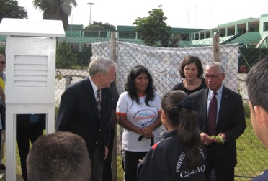
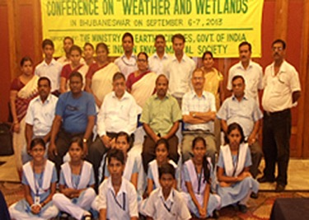
Scientists are interested in many of the the same environmental questions as students and volunteers. They serve as mentors, collaborate on research projects, and even use GLOBE data in their own work. Find out more about the GLOBE International STEM Network (GISN).

Slide 16
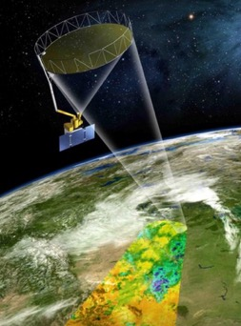
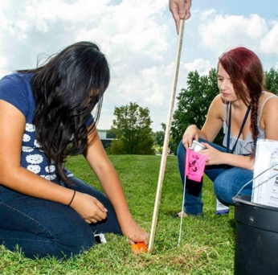
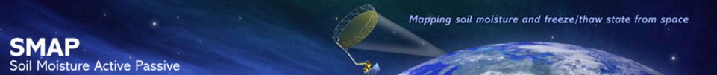
GLOBE’s unique partnership with NASA creates opportunities for students and volunteers to participate in exciting field campaigns and satellite missions.

Slide 17

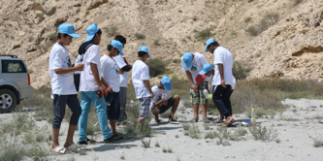
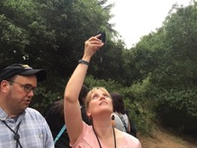
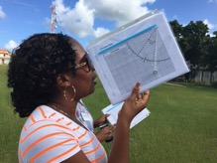
NASA’s Earth science mission monitors changes in the Earth system, both remotely from space and through ground observations.
Orbiting satellites collect a lot of data about our planet, but taking measurements on the ground is just as important. By taking accurate measurements and sharing your data through the Internet, you’re helping scientists validate remotely-sensed data from space. In addition, you develop detailed datasets that could never be created otherwise. GLOBE is one of NASA’s ground Earth observation programs.

Slide 18
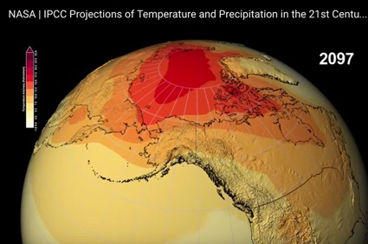
The Earth is a system, and processes that create change take place on many spatial scales
Some processes, such as those that contribute to climate are closely connected to changes in the atmosphere and ocean that take place on a global scale. For this reason, GLOBE’s coverage of whole regions, countries and continents enhances the value of the GLOBE database to understand the critical environmental issues such as contemporary climate change.
This NASA global data set combines historical measurements with data from climate simulations using the best available computer models to project how global temperature (shown here) might change up to 2100 under different greenhouse gas emissions scenarios. Darker red indicates where warming is projected to be greatest: dark red in the image shows a projected 15-17. 5 degrees Fahrenheit temperature anomaly in year 2097. Credits: NASA.

Slide 19
Some Earth processes and changes in the Earth system can be studied on a global scale, other interesting research questions may concern processes that take place on a scale of a meter or less.
The properties of our environment vary over different spatial scales, so it is essential that we collect data that can be examined as local, regional and global datasets. Changes can take place slowly or very quickly, so its important to take measurements around the world on a continuous basis.

Slide 20
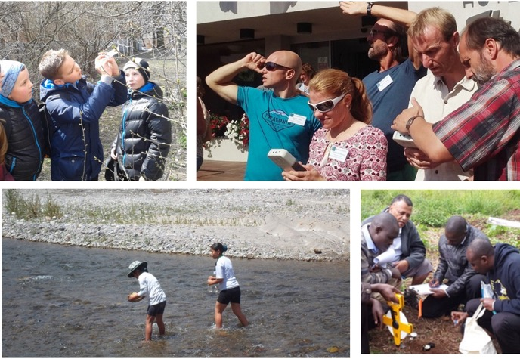
II. The International GLOBE Community

Slide 21
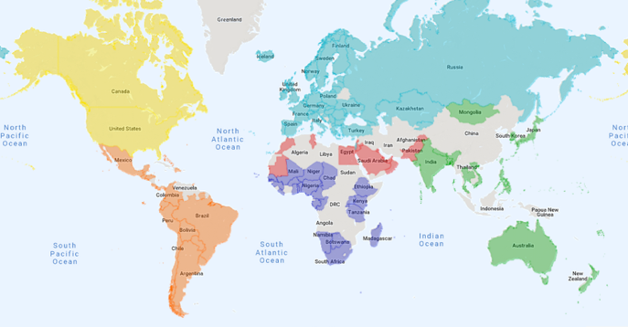
GLOBE is an International Science and Education Program
Over 185 million research quality measurements have been collected since the program began in 1995.
More than 50K teachers from over 35K schools and 178K volunteers in over 120 countries have participated in the program since it began.
GLOBE Countries

Slide 22
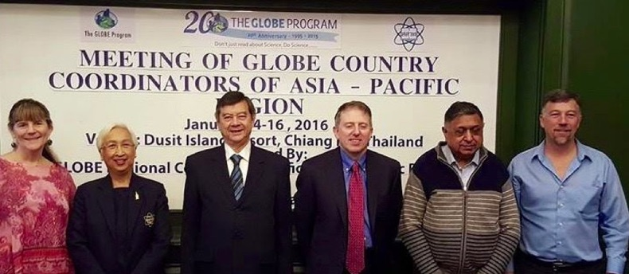
GLOBE Regions
Each GLOBE region has regular meetings and training events as well as an elected representative who serves on the GLOBE International Advisory Committee. Each region also has a Regional Office that provides the main support services for that region, including GLOBE resources in international languages.

Slide 23
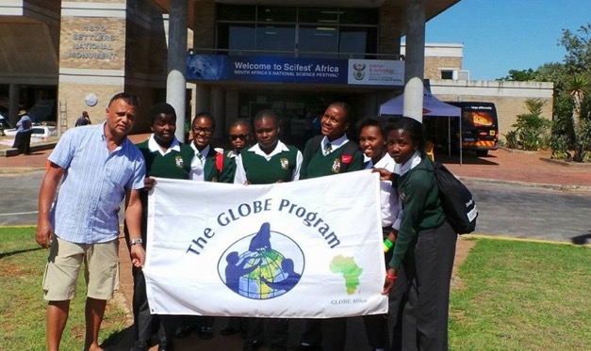
Web-based resources foster community connections
The GLOBE website highlights community activities through community profiles, GLOBE Stars reports, e-newsletters, and connects with other social media platforms.

Slide 24
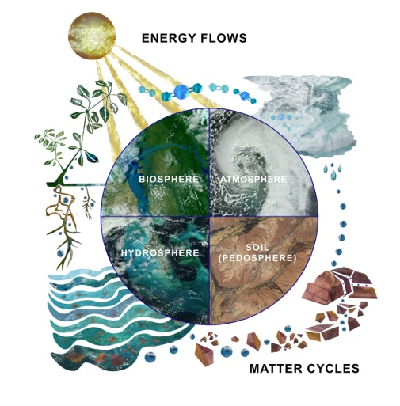
GLOBE Science Investigation Areas
The focus of GLOBE research is to understand the interaction of the different parts of the Earth system. GLOBE examines all the parts of the Earth system:
Atmosphere- Air
Hydrosphere- Water
Biosphere- Life
Pedosphere- Soil
GLOBE protocols provide the tools participants need to investigate and monitor the changes that are taking place on our dynamic planet.

Slide 25
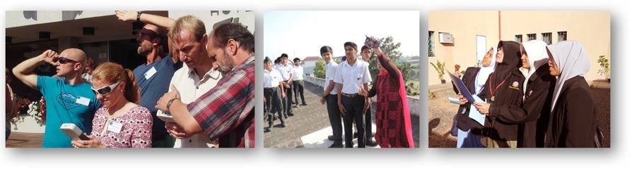
Atmosphere

Slide 26
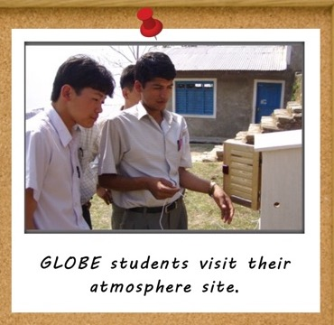
Atmosphere Investigation
The atmosphere investigation examines aspects of weather and climate, including protocols for air and surface temperature, clouds, precipitation, relative humidity, atmospheric pressure, aerosols, water vapor, and surface ozone.
By establishing local GLOBE weather stations, GLOBE participants help collect additional weather data to help understand more about microclimates, urban effects, weather around the world, and climate patterns.
GLOBE students visit their atmosphere site.

Slide 27
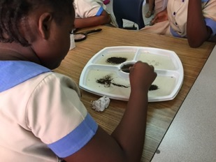
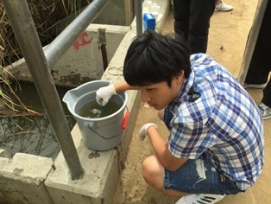
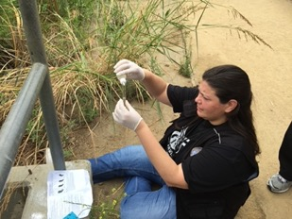
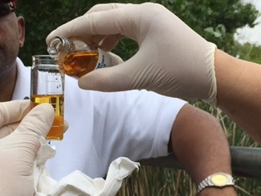
Hydrosphere

Slide 28
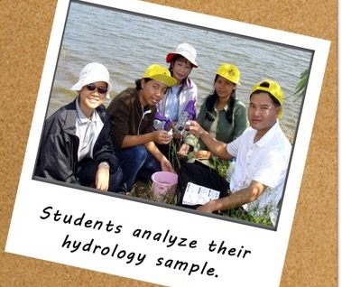
Hydrosphere Investigation
The hydrology investigation area focuses on water and water bodies. The hydrology protocols include water temperature, transparency, pH, dissolved oxygen, either conductivity or salinity, alkalinity, nitrates, as well as a documentation of the macro-invertebrates found in fresh water.
Since many scientific studies focus mainly on larger water bodies, the data GLOBE participants collect on local creeks, streams, and marshes provide data that might otherwise never be collected about these smaller tributaries.
Students analyze their hydrology sample.

Slide 29

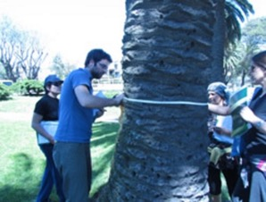

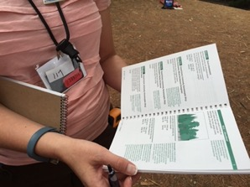
Biosphere

Slide 30
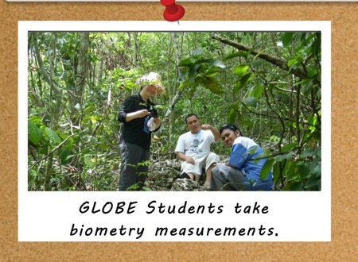
Biosphere Investigation
In the land cover investigation area, GLOBE participants classify the land cover type using the Modified UNESCO Classification (MUC) system and take photographs of their land cover sites to help interpret satellite images of land cover and provide more specific data on land cover change over time. Other protocols include measuring the amount of biomass found on individual grassland, woodland, and forest sites.
GLOBE students take biometry measurements.

Slide 31
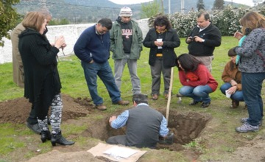



Soil (Pedosphere)

Slide 32
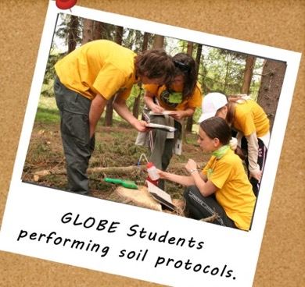
Soil Investigation
GLOBE participants can collect data on soil temperature and moisture, and on soil characteristics, including its structure, color, bulk density, particle density, particle size distribution, pH, and fertility. There is also a protocol for measuring how fast water infiltrates the soil including the saturated water content.
The data GLOBE participants collect about soil conditions relate to the growing season of plants (phenology), to what is growing on the land surface (land cover), to the quality of adjacent water bodies (hydrology), and to air and surface temperature, precipitation, and humidity (atmosphere) making it relevant to all the other GLOBE investigation areas.
GLOBE students performing soil protocols.

Slide 33
Who takes part in GLOBE Investigations?
Students (ages 5-18-years old) conduct scientifically meaningful environmental measurements, enter their data to the GLOBE science database, visualize their data and collaborate with scientists and other GLOBE students and communities worldwide.
Undergraduate students also participate in GLOBE as a way to gain practical field experience in the Earth sciences in conjunction with their college curriculum.
Adults and afterschool programs are welcome to participate in GLOBE’s citizen science program, GLOBE Observer.

Slide 34
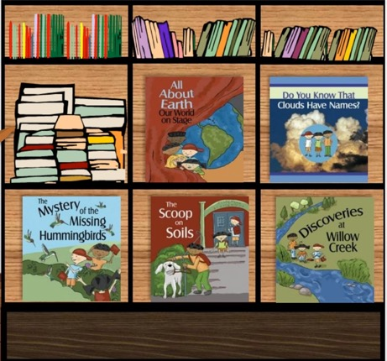
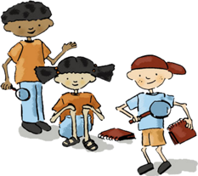
Elementary GLOBE
The youngest students can also participate in GLOBE. Elementary GLOBE is a series of science based storybooks and associated classroom learning activities designed to introduce young students to Earth system science.
Elementary GLOBE

Slide 35
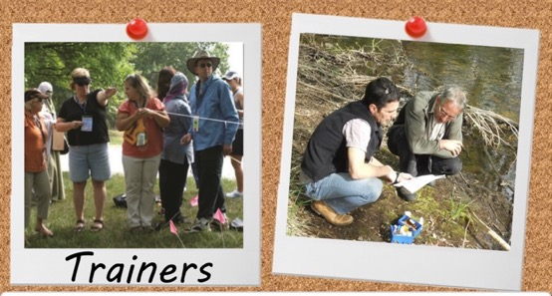
GLOBE Trainers and Mentor Trainers Support Teachers
“After 12 years with GLOBE I can say that this program provides great support for the promotion of science and environmental education, not only for secondary levels but for concerning students in all educational systems. In general, the majority of young people in Madagascar choose literary courses of study. GLOBE helps to make science more appealing, as there are real environmental questions that need to be answered and problems that need to be solved.”
-- Country Coordinator and Trainer Mr. Paul Randrianarisoa, Madicascar
Trainers
Experienced GLOBE Trainers and Mentor Trainers conduct in-person training in collaboration with country coordinators and U.S. partners. These training events instruct teachers so they can ensure that the data their students collect have fidelity and are research quality, so students and professional scientists can use them in their investigations. Most Trainers and Mentor Trainers began as Teachers in the GLOBE program.

Slide 36
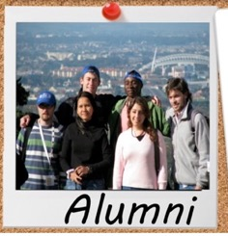
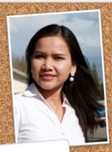
Former GLOBE students give back to the community
“The great part of my success in the Air Force, I attribute to knowledge gained from The GLOBE Program. With GLOBE I want to do more than learn and teach, I want to understand the entire world environment as a system and I encourage all the young people who are as enthusiastc as I am to follow me that exciting program called GLOBE.”
-- Tamsu Marcelin, GLOBE Alumni, Camaroon
Alumni
” I hope I can support the program even more after I graduate with my degree. GLOBE inspires me to learn, like, and love the real sciences.”
-- Watcharee Ruariuen, Thailand, currently a PhD student at School of Natural Resources and Agricultural Sciences, University of Alaska Fairbanks, USA
The GLOBE Alumni Organization is a network of individuals who participated in GLOBE as a student and have continued their involvement after graduation. GLOBE Alumni was started by students in Europe who worked with their country coordinators to stay connected to GLOBE as volunteers. There are now GLOBE alumni all over the world!

Slide 37
Getting started as a GLOBE Educator
This section will provide a summary of resources for GLOBE educators and students.
If you are a volunteer, you can skip to slide 46 to complete the training.

Slide 38
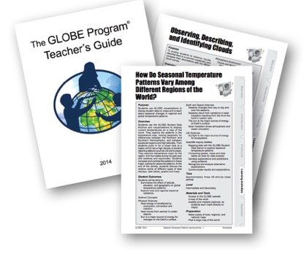

III. Using GLOBE in the Classroom
GLOBE includes a variety of grade level-appropriate, interdisciplinary activities and investigations aligned with national and state educational standards, which integrate easily into any school curriculum. The projects are designed to help students develop a wide range of skills such as critical thinking, scientific research methodologies, data analysis, independent learning and big picture thinking (taking local information and seeing global implications). Most importantly, the activities get students excited about science and show them how to think globally, while acting locally.

Slide 39


GLOBE supports teacher professional development
Teachers acquire expertise and confidence, through workshops and online training. GLOBE has developed a Teacher’s Guide which is used to train teachers in the protocols and learning activities. The Guide is available in several languages.
Teachers are provided with an opportunity to share innovative ideas and challenges, to attend protocol and related professional development sessions, and to build connections for research efforts between schools.

Slide 40



Teacher Support
GLOBE’s training program prepares teachers to conduct fieldwork activities and apply those lessons inside the classroom. Teachers learn how to mentor students in collecting, reporting and using high-quality data to perform and analyze scientific investigations. GLOBE connects you with other teachers and classrooms, giving you and your students the opportunity to collaborate with others across the world on scientific investigations and data analysis.

Slide 41
GLOBE Teacher’s Guide
Beyond training, the GLOBE Teacher’s Guide offers all the information you need to incorporate the GLOBE program into your classroom. Each investigation area includes:
Introduction: an overview of the investigation area and important science concepts
Protocols: background science and classroom connections associated with GLOBE measurement procedures
Field and Lab Guides: a step-by-step description of the protocol procedure
Data Sheets: allow the organized recording of data by students, and ensures that no data have been overlooked
Learning Activities: example lessons created by scientists and teachers to support understanding of scientific procedures and concepts
Looking at the Data: examples of how GLOBE datasets can be used by students in their own investigations

Slide 42
Other Teacher Resources to get you started:
GLOBE Implementation Guide:
Provides an introduction to the GLOBE program and what you and your students will do as part of the GLOBE program
Assists in planning the use of GLOBE with your students
Provides sample atmosphere, soil, Earth system, and biosphere unit plans to give you ideas about how to incorporate GLOBE activities and data into the classroom.
Appendix:
Discusses inquiry and other pedagogic strategies, provides a guide to where and how often individual protocols should be conducted, and presents rubrics you can use in assessing student learning
Toolkit:
Introduction to Remote Sensing and how GLOBE data support NASA satellite missions
Press kit for communicating your GLOBE activities with your community
Identifies protocols by complexity and appropriateness for different grade bands
Describes specifications of instruments used in GLOBE investigations

Slide 43

Shared Activities Connect Teachers and Students Worldwide
There are annual events where teacher workshops, student investigations and meetings take place. Here are Thai Students at the GLOBE Annual Meeting, Los Angeles, CA, USA, presenting their research project (2015)

Slide 44

GLOBE Learning Expeditions (GLEs)
GLEs are international meetings where students conduct investigations and share their research. The 5th GLOBE Learning Expedition (GLE) took place from 4-8 August 2014 in New Delhi, India. More than 300 participants from 29 countries took part in a range of educational activities including research and poster presentations, field studies and dialogue with keynote speakers and scientists.

Slide 45

GLOBE Research Campaigns
Scientists help organize scientific campaigns, mentor students conducting research projects and provide motivation and rationale for students to collect GLOBE data.

Slide 46

Frequently Asked Questions:
What is the time commitment?
Do you have time to do GLOBE? Yes, because you decide your level of participation. Through GLOBE, you can contribute data about the air, water, soil and vegetation around you. Some observations are needed only once while others should be taken every day. Many of these data are collected routinely only by GLOBE students. The datasets you help build will continue to be useful for years, decades and even centuries. It can be challenging work, but the excitement that comes with discovery and impact makes it worthwhile.
Any little bit helps. At GLOBE, the priority is collecting today’s data so we can better understand our changing world tomorrow.

Slide 47

Frequently Asked Questions:
What is the cost?
The scientific procedures used by GLOBE have been designed by scientists to be both accurate and affordable to conduct. Some require equipment you may already have, such as a meter stick or a thermometer. Some of the equipment can be easily built. Other protocols, such as the Cloud Protocol require no special equipment. You can find out what instruments are needed in the Toolkit in the GLOBE Teacher’s Guide. The Toolkit is also useful because it lists the GLOBE protocols by student skill level.
All that is needed to conduct the Cloud Protocol is either a copy of the GLOBE Cloud Chart, or a free download of the GLOBE Cloud Protocol Mobile App.

Slide 48
Frequently Asked Questions:
Who Can Participate?
GLOBE Teachers and Students
The GLOBE Program originated as a K-12 science and education program, but over the years its implementation has expanded to include undergraduate students and faculty as well as pre-service teachers. Anyone who is affiliated with a school or informal educational institution can participate in GLOBE. You will need to register as a GLOBE teacher affiliated with your school.
The Public Face of GLOBE: GLOBE Observer
In 2016, GLOBE expanded its citizen science program to include opportunities for learners of all ages. This is called GLOBE Observer. This public citizen science program is self contained within a mobile app available for both Android and Apple devices. Volunteer participants are also welcome to take eTraining to participate in GLOBE beyond the GLOBE Observer app protocols.
The GLOBE Program is established in each country with a bilateral agreement between the its government and the U.S. Department of State.
If your country is not part of GLOBE, you can still use the materials but you are not able to upload data. Contact the GLOBE Program for more information.

Slide 49

We need you!
GLOBE’s coverage of whole regions, countries and continents enhances the value of the GLOBE database to understand the dynamics of the Earth system
The more people who participate in data collection, the more extensive the data coverage and the more valuable the GLOBE database becomes- for everyone- students, communities, and research scientists alike.

Slide 50

Bringing Science to Life
GLOBE has already collected more than 185 million measurements from more than 120 countries around the world. By collecting GLOBE data, you are expanding science’s understanding of Earth’s dynamic environment and our changing climate.
Never has there been more environmental challenges for science to address than those posed by our dynamic Earth system today- and we need your help!
(Example of data from June 2020)

Slide 51

How do you get started?
You have started! Take the short quiz on this eTraining module. Then, select an investigation area and complete the eTraining introduction module. Once you have completed a GLOBE Protocol eTraining module and passed the quiz, you are ready to report data on your own or with your students.
Get engaged in your regional community. Contact your GLOBE Country Coordinator, or if you are in the United States, your GLOBE partner. Link to GLOBE Country Coordinator/Partner Contact Information

Slide 52

Please provide us with feedback about this module. This is a community project and we welcome your comments, suggestions and edits! Comment here: eTraining Feedback
For more information:
The GLOBE Program
NASA Earth Science
NASA Global Climate Change: Vital Signs of the Planet
The GLOBE Program is sponsored by these organizations:
Version: 6/24/2020

Slide 53

Welcome to the GLOBE Community!

