Slide 1
Judging the 2019 GLOBE International Virtual Science Symposium
25 April 2019

Slide 2
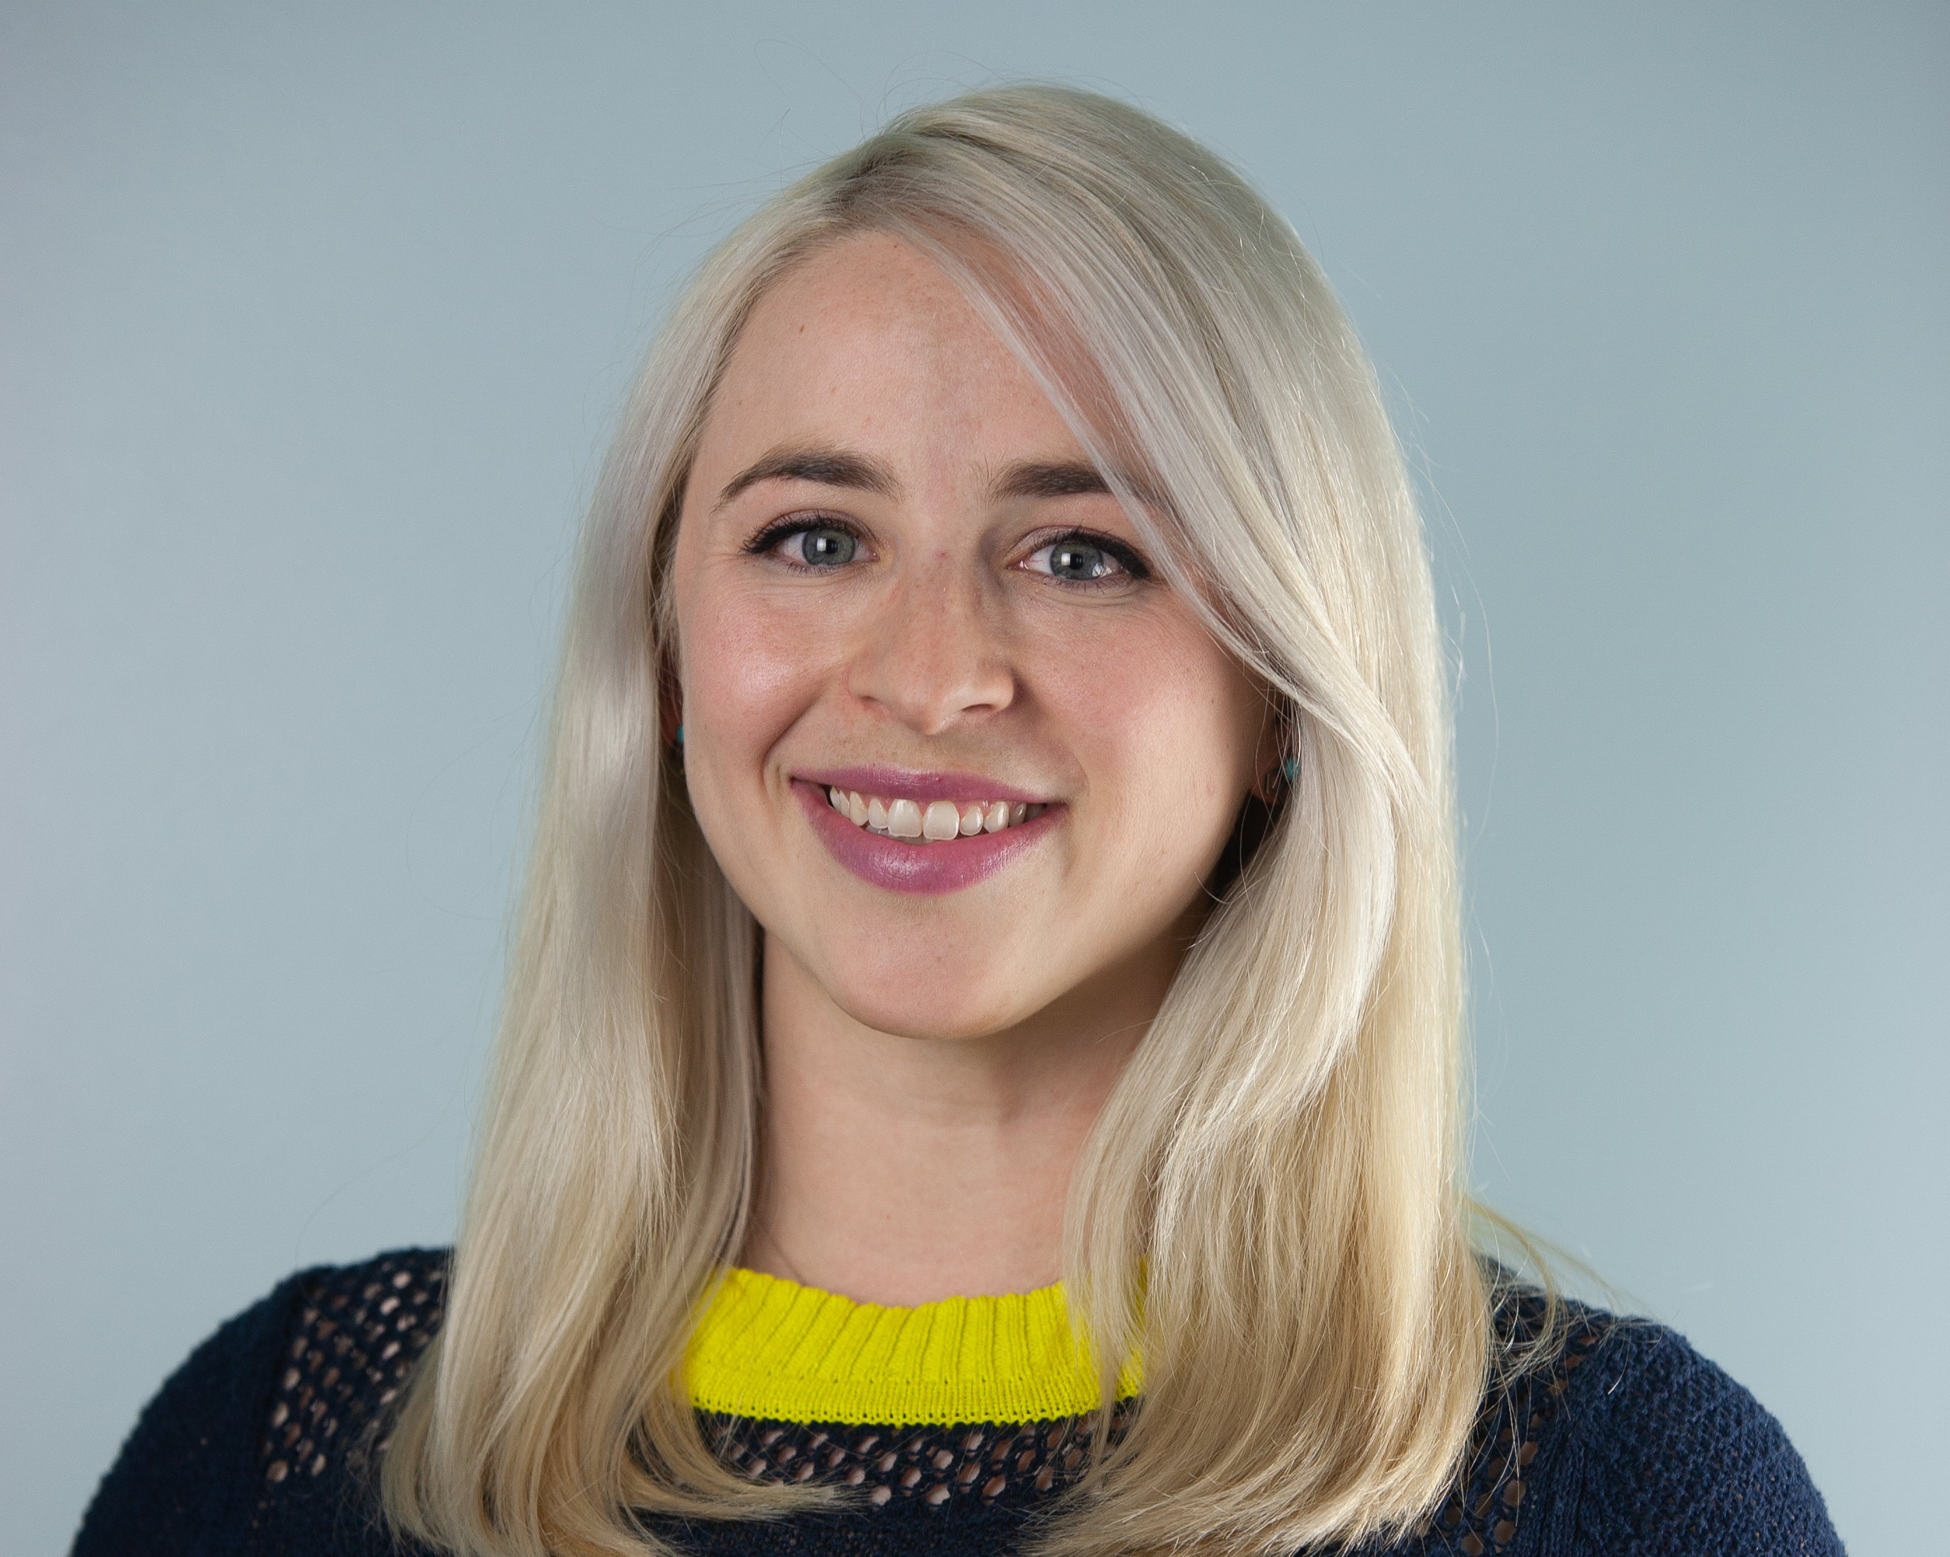
Presenter
Amy Barfield
GLOBE Implementation Office

Slide 3
Summary of Science Symposium
210 Entries – Goal: 3 judges per project
Entries include:
Research Report
Presentation
Optional badges
Student Research Badge

Slide 4
Timeline of Judging
25-26 April: Projects + scoring information emailed to judges.
26 April- 05 May: Review projects, ask students questions.
05 May: All scores due. (Sarah or Amy may email you before then!)
17 May: Scores and feedback sent to teachers. Badges posted.
17 May: Drawing for stipends.

Slide 5
Information Needed for Judging
Project title
Correct grade band rubric
Google scoring form – all should be entered by 05 May!
GLOBE.gov login – check this now! Need help accessing? help@globe.gov
If you do not have a GLOBE.gov login, you will receive information to login via “GLOBE Scientist”
You will be emailed these items 25-26 April.
Notes:
Scoring template – will not be discussed further, but it is just a tool for your own use to make keeping track of the scores easier. You can take notes on the form and then copy and paste the comments into the Google form once students have responded to the comments and you can submit your final scores.

Slide 6
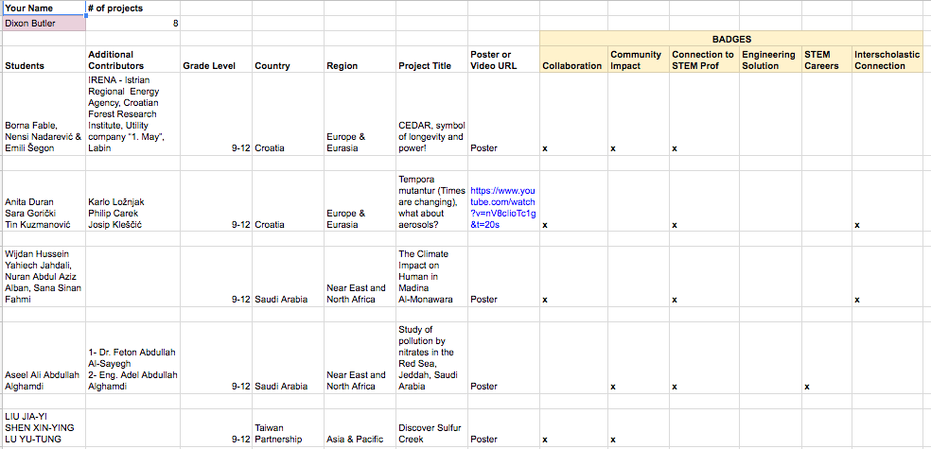
Project Sheet

Slide 8
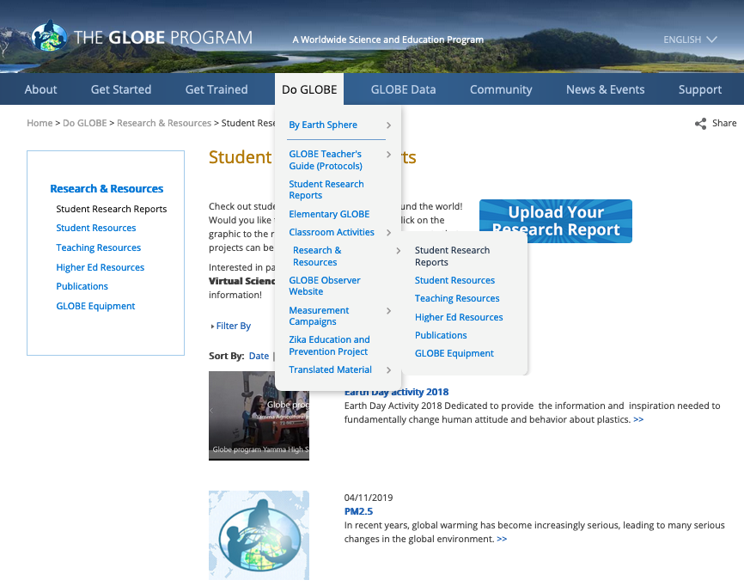
Finding Reports
Find student reports here
(both go to same place)

Slide 9
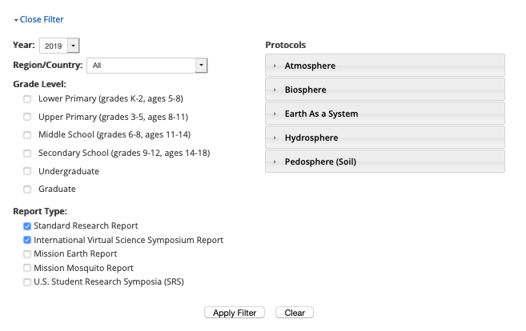
Filter to Find Project
Filter to 2019
Find projects based on country and grade level (information provided on your judge sheets)
Make sure to select BOTH Standard and IVSS Reports!!

Slide 10
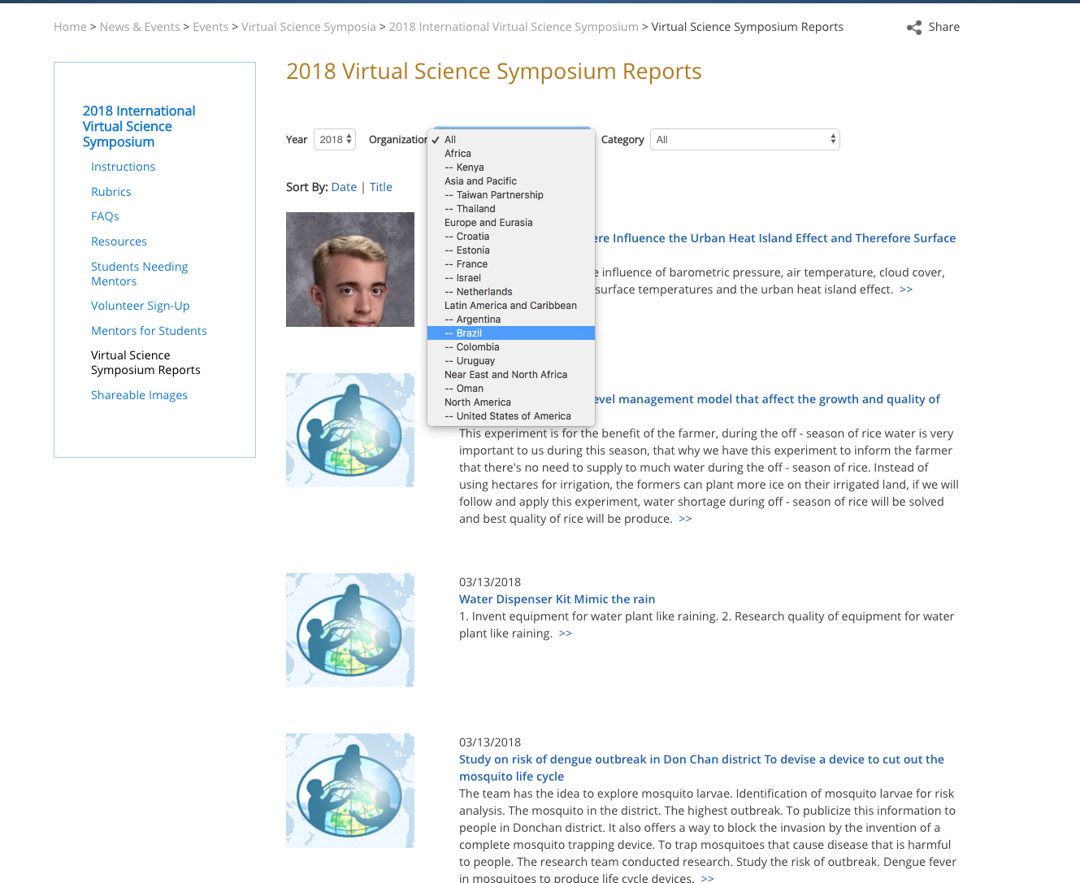
http://globe.gov/science-symposium
You can also search from the IVSS page, but not all projects will appear here.

Slide 11
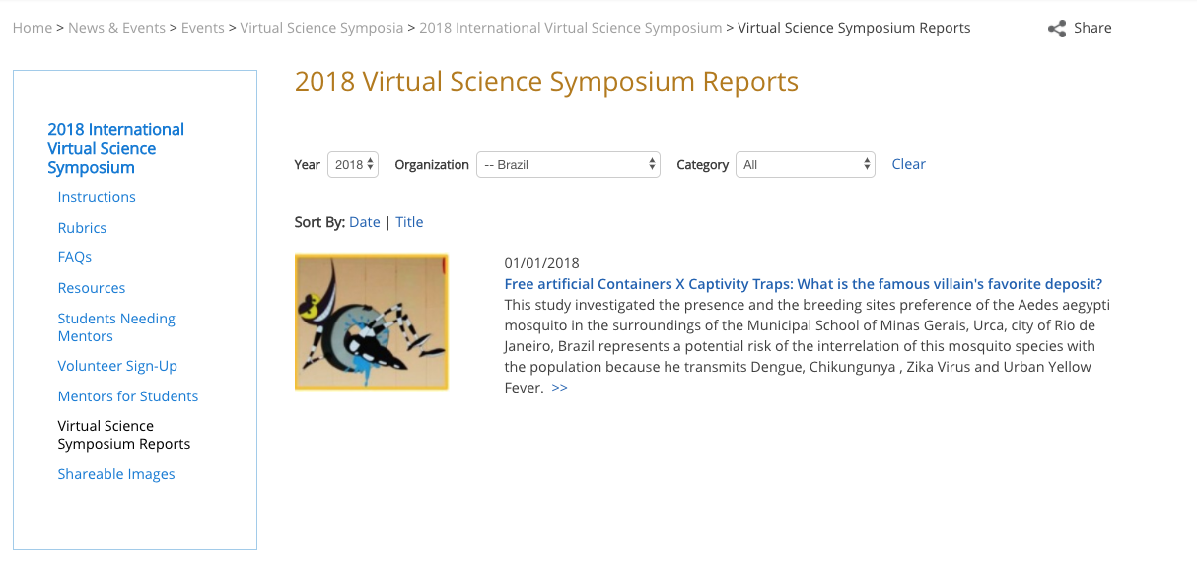
http://globe.gov/science-symposium

Slide 12
http://globe.gov/science-symposium
Notes:
Point out all the components of the slides, comments area (must be logged in) and “subscribe to comments”

Slide 13
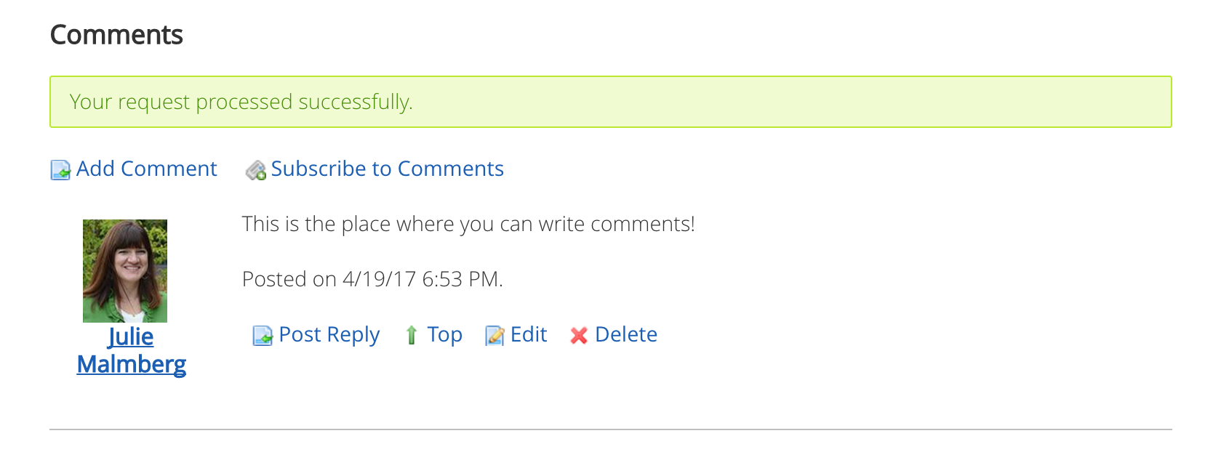
http://globe.gov/science-symposium
If you are using the “GLOBE Scientist” account, make sure to sign your name.

Slide 14
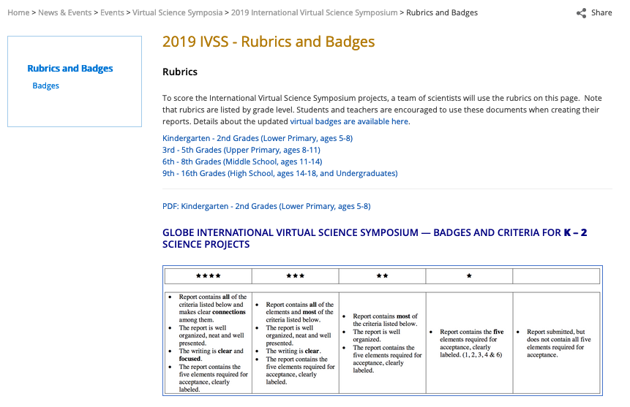
Grade Band Rubrics
Rubrics available at http://globe.gov/science-symposium, click on “Rubrics and Badges”
1
2

Slide 15
Google Form
Google form for entering scores – link will be sent via email
Should be filled out once you are completely done reviewing a project
Fill out one time for each project

Slide 16
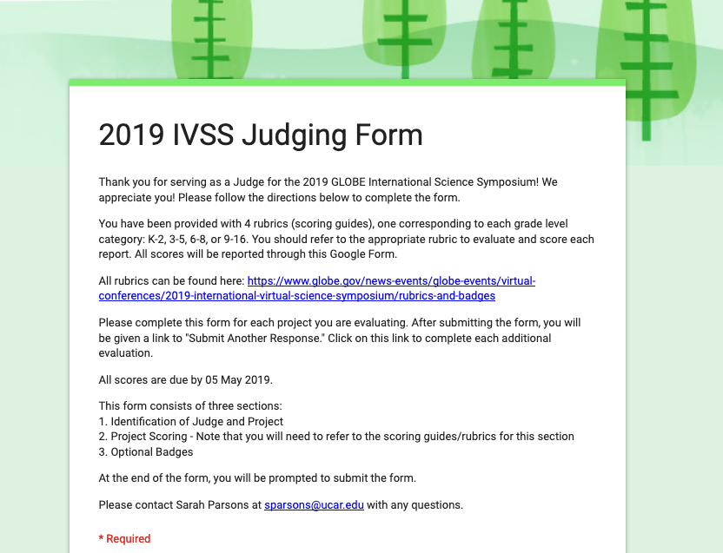

Slide 17
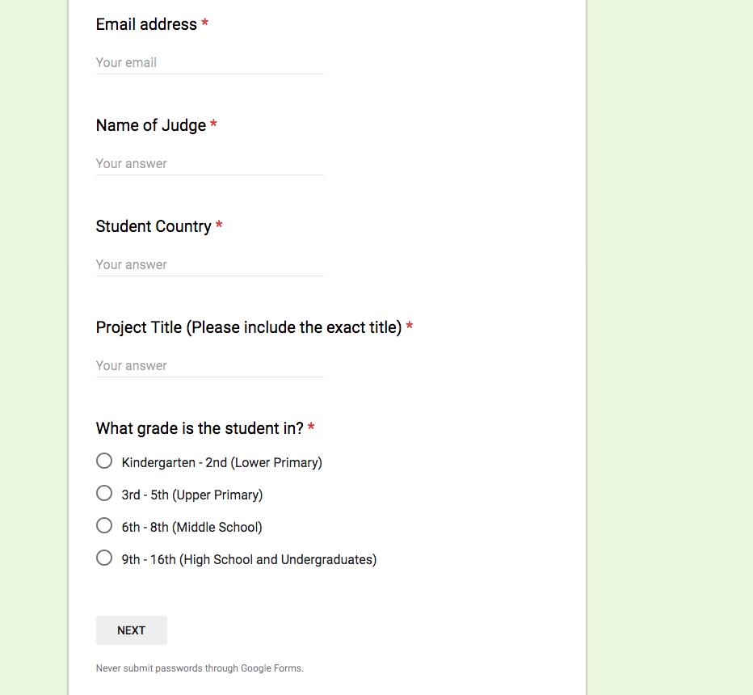

Slide 18
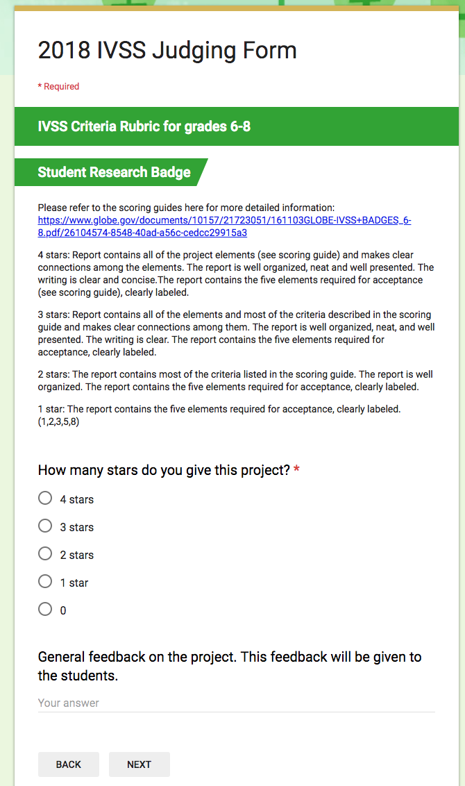
2019

Slide 19
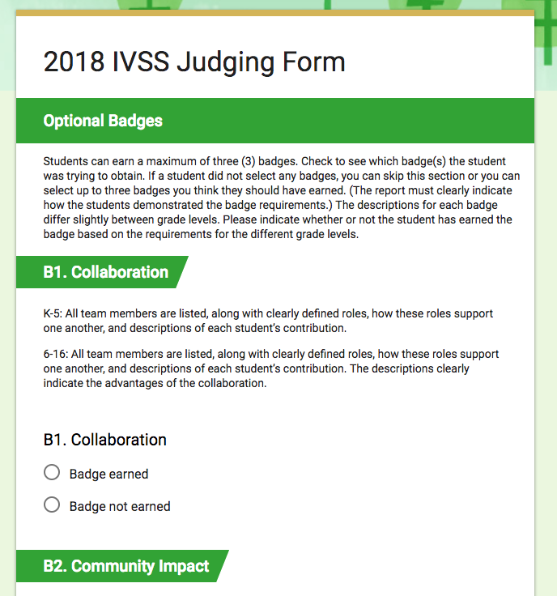
2019

Slide 20
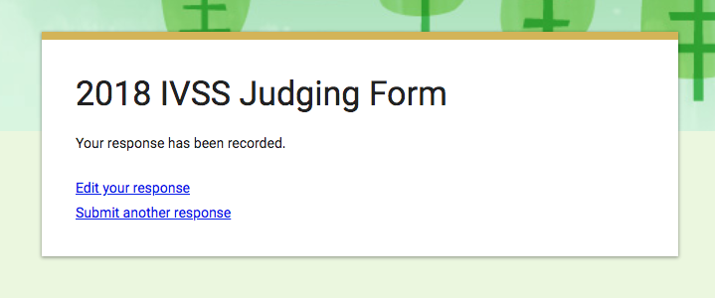
2019

Slide 21
Judging Tips
If you are not able to complete the judging for your projects, please let Sarah (sparsons@ucar.edu) know as soon as possible.
These are students ☺ - consider grade level too
Be positive – provide constructive feedback
Feedback (without your name) will be sent to students
Not all speak English as a first language – score on content rather than grammar
Check for content in the presentation too (note that some of the projects don’t have a presentation)
If you can’t find a project or think something is not correct, let Sarah know right away

Slide 22
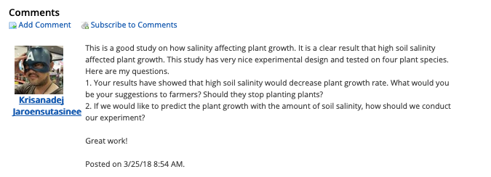
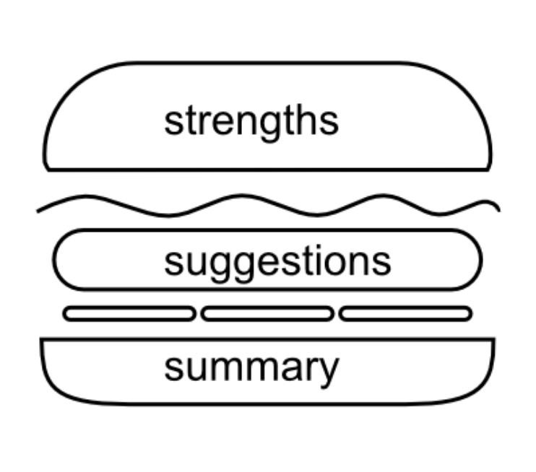
Example Comments
“Your research topic is a very important one. It focuses on the dangers that pesticides may have on the much needed agriculture in your area. With that said, it was interesting to find out that some of the treated plants even changed color due to the pesticides, which is very disconcerting. I love that you integrated the expertise of local farmers, as they get a first-hand look at how their crops react to what is in the soil and in the water within their growing fields. As you mentioned, it is truly important that you have addressed the need for those involved to seek out other, alternates to the pesticides, including DELTARIN. I hope that you will take this to your local environmental leaders and show them this data. One thing that I would like to have seen is better organization of the poster you have presented. I noticed different fonts and sizes and no real order to the text boxes. Thank you for a good project and am looking forward to seeing more research in the future.”

Slide 23
Timeline of Judging
25-26 April: Projects + scoring information emailed to judges.
26 April- 05 May: Review projects, ask students questions.
05 May: All scores due. (Sarah or Amy may email you before then!)
17 May: Scores and feedback sent to teachers. Badges posted.
17 May: Drawing for stipends.

Slide 24
Thank you!
Certificates emailed out by the end of May
Any questions or concerns, contact Sarah at sparsons@ucar.edu

