Slide 1
GLOBE Education Working Group Report Out

Slide 2
Education Working Group Members
Emma Hagen: GLOBE Implementation Office Liaison
Marta Kingsland: Latin America and Caribbean Region (Chair)
Lynne Hehr: At-Large Representative (Vice-Chair)
Rod Allan A. de Lara: Asia and Pacific Region
Manal Alsaleh: Near East and North Africa Region
Francis Wasswa N. Nsubuga: Africa Region
Dorian Janney: North America Region
Ülle Kikas: Europe and Eurasia Region
Notes:
Marta
All discuss themselves - 3 sentences, no more
Name, how long you have served on the Working Group, which region and country you are from

Slide 3
Education Working Group Focus
Ensure the quality and innovation of GLOBE educational materials and resources
Assist in maintaining the quality and number of GLOBE Trainers in all regions
Facilitate the use of GLOBE educational materials and resources by the formal and informal education community
Notes:
Rod

Slide 4
Activity
Learning Product Review
Assist the GIO with:
Submission guidelines
Online Submission form
Submission review
Encourage GLOBE community to submit activities, lessons, and other educational resources
Feedback
Sent to GIO
Notes:
Marta
Briefly explain what learning products are
The GLOBE community has activities/lessons that they would like to include for others to use and there needed to be some guidelines and a formalized process for people to use for creating and submitting lessons. GIO is currently working on this review process.

Slide 5
Trainer / Mentor Trainer Certification Process
GLOBE Home Page > Community > People > Trainers
GLOBE Trainer Information
Managing Workshops
Training Materials
Trainer Search
Useful Links
Discussions & Shared Documents
FAQ
Online Forms for Certification
GLOBE Trainer and Mentor Trainer Qualifications and Certification Process
Candidate Trainer Application
Candidate Trainer Workshop Observation Form
Current Trainer Active Status Form
Candidate Mentor Trainer Application
Candidate Mentor Trainer Workshop Observation Form
Current Mentor Trainer Active Status Form
View List of Trainers on our World Map
Notes:
Lynne:
Trainer / Mentor Trainer Information is found through this trail: GLOBE Home Page > Community > People > Trainers
Trainer Workshop Information, as well as Certification Information, is found on the same page.
The original certification process was detailed in a 14 page document and was used with minor modifications as the basis for the current process.
The current certification process
took several years to finalize
used input from partners, teachers, CCs/RCOs, trainers, GIO, etc.
Several regional workshops were held in the fall of 2020 to discuss the documents and explain the process.

Slide 6
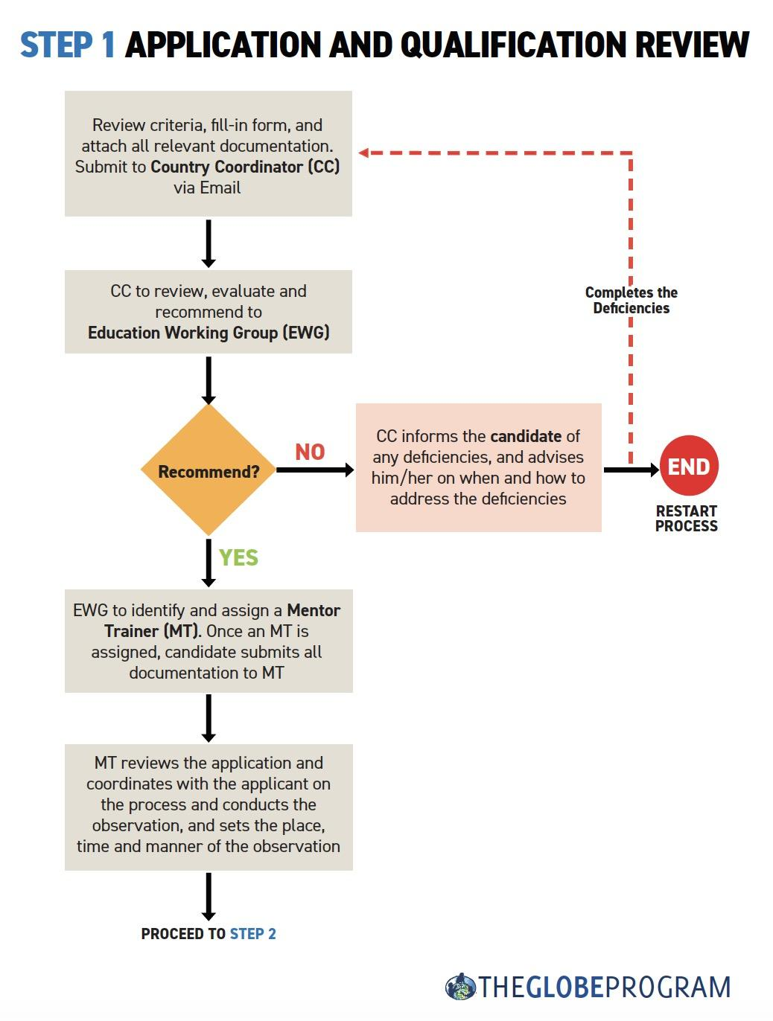
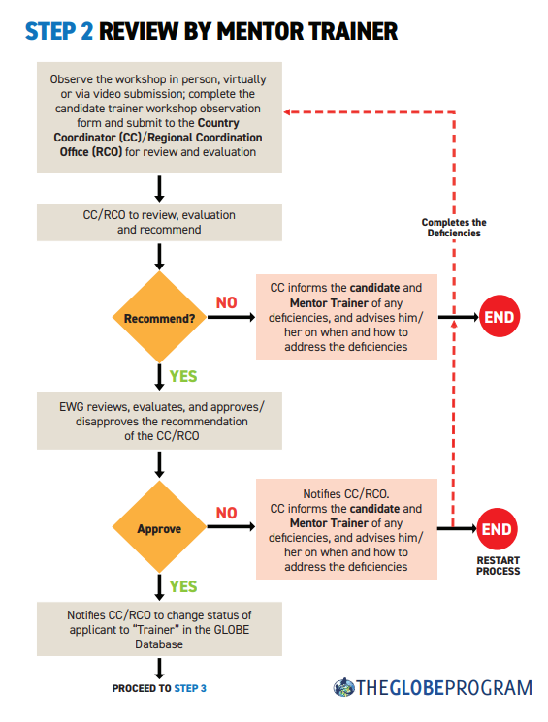
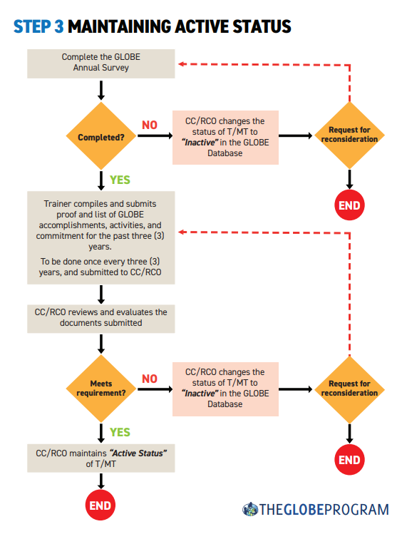
Notes:
Lynne:
These 3 flowcharts are online to assist the process.
Online submission is being finalized by GIO and will be in place TBD.

Slide 7
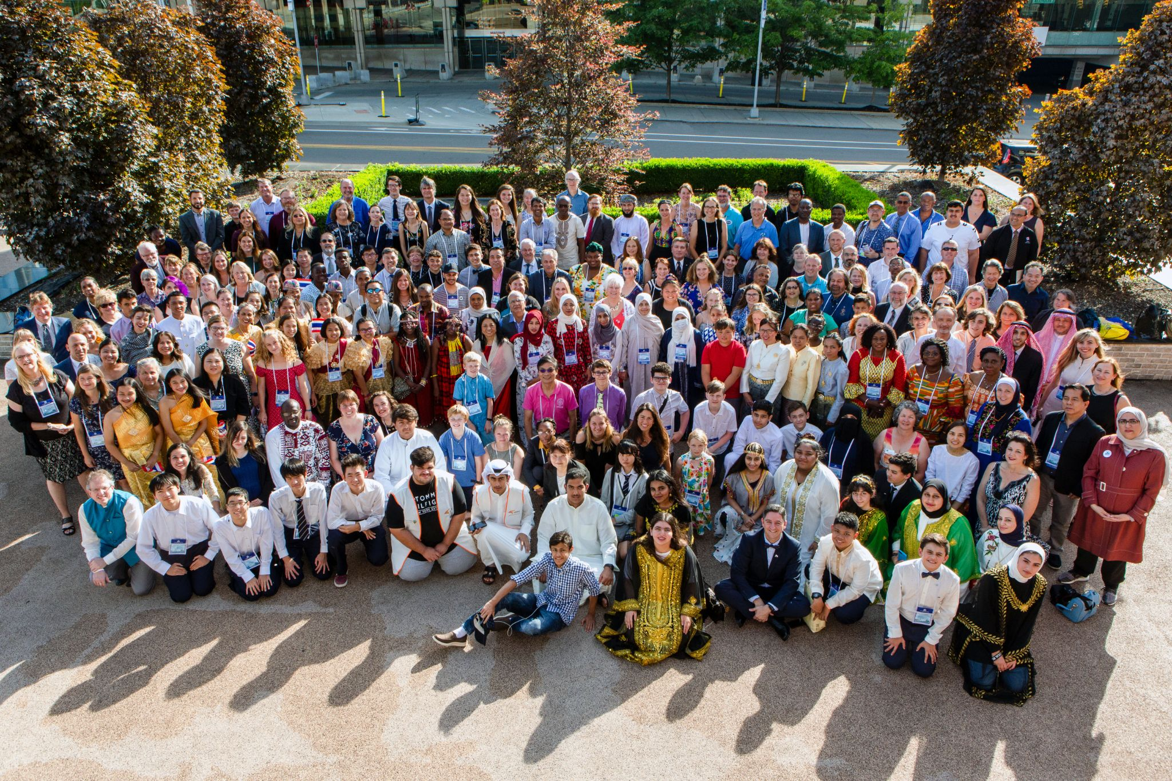
Networking Across Working Groups
Developed and submitted GLOBE Recognition for Educators to all GLOBE Working Groups for input
Rated protocols at request of Science Working Group to determine protocols to “sunset”
Assisted Evaluation Working Group with GLOBE teacher survey
Notes:
Dorian

Slide 8
Thank you!
For any questions, contact your regional representative.

