Slide 1
GLOBE Advanced Data Access Tool
“ADAT”

Slide 2
Retrieving Data
Using the Advanced Data Access Tool (ADAT)
Tool allows you to download GLOBE data from multiple protocols, schools, regions or dates without using the map
  Used for downloading large quantities of data – multiple protocols and multiple sites
Select GLOBE Data -> Retrieve GLOBE Data or http://datasearch.globe.gov/
Three Steps –
  Select the Protocols you’re interested in
  Select Filters
    Date Range, Country, School or Teacher etc.
  Select “Download Measurement Data” (may take a little while!)

Slide 3
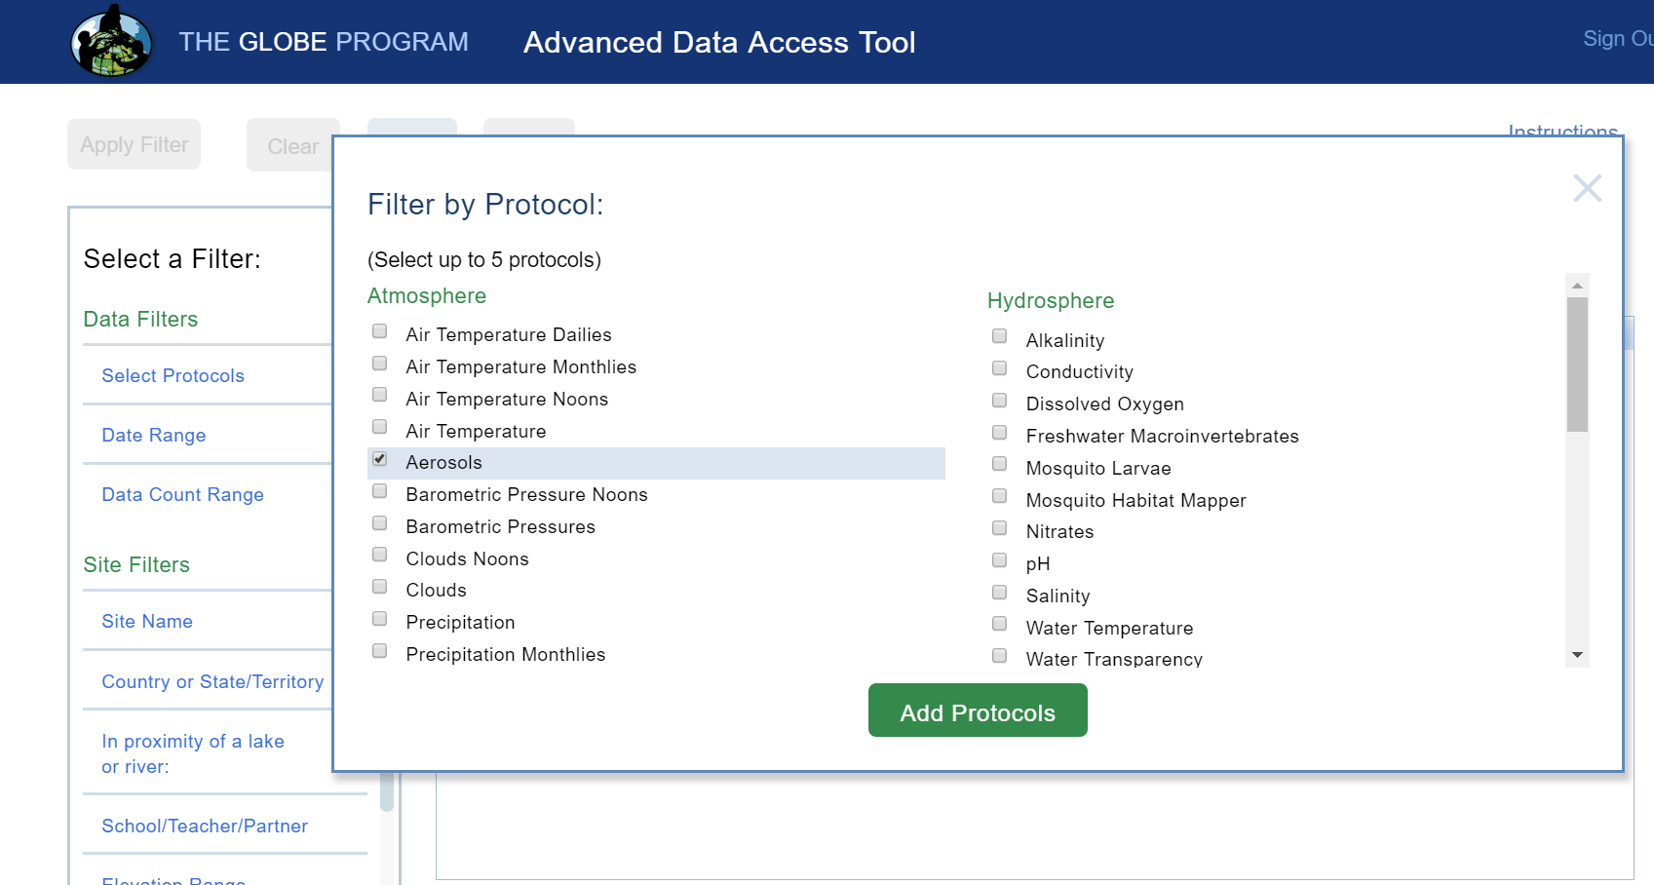
Select your protocols
Select Protocols
Up to 5 protocols can be selected

Slide 4
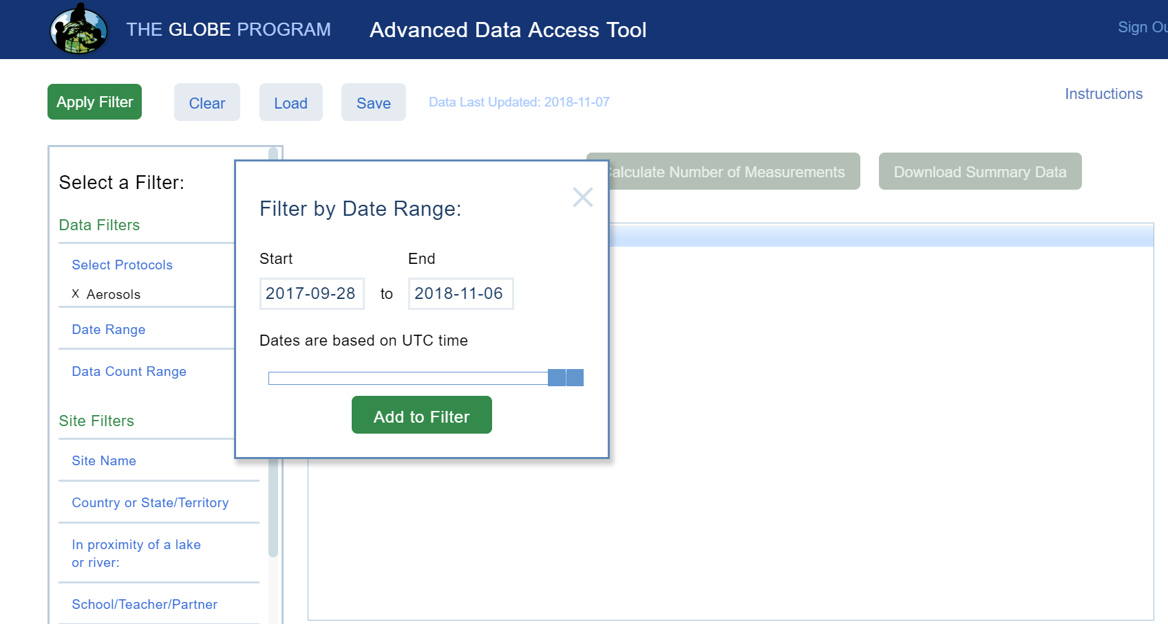
Select the date range
Select Date Range
Use sliders or enter a date range

Slide 5
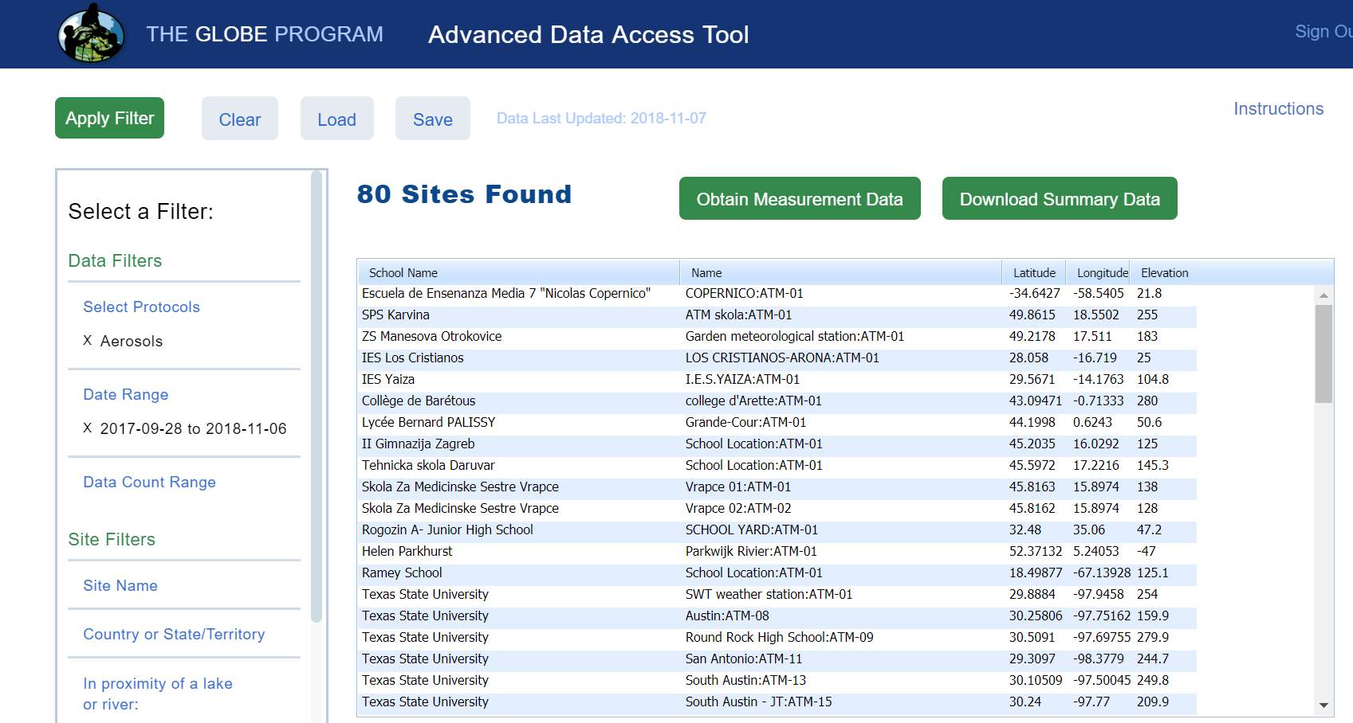
Add other filters if needed then “Apply Filter”
Apply Filters
Select any additional filtering, then click “Apply Filter” to see how much data is available for download

Slide 6
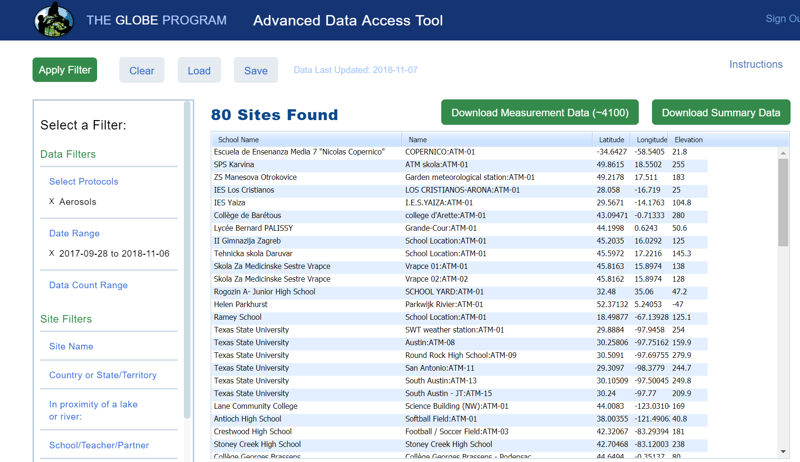
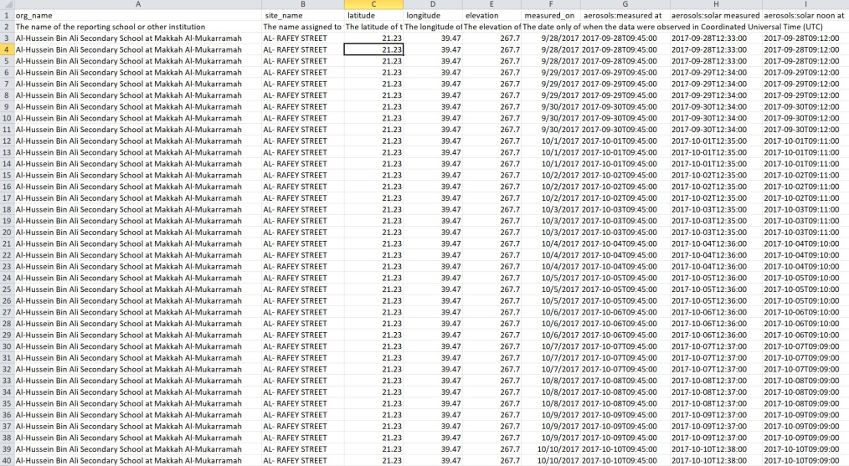
Download the Measurement Data
Download Data
Select Obtain Measurement data and download the data

Slide 7
ADAT – Your Turn – Storm Tracker
A storm just came through – how do air temperature, humidity and precipitation align during the storm?
Go to https://datasearch.globe.gov
Protocols – select Air Temperature Noons, Relative Humidities Noons and Precipitation
Date Range – select 2019-06-14 to 2019-06-28
School – select Tehnicka skola Daruvar
[Apply Filter] – 1 Sites Found
[Obtain Measurement Data]
[Download Measurement Data] ~90 records..Click Download
Upload to google drive and open in google sheets (or excel)
Create a new sheet called “Filtered”. Select 3 columns from the original sheet and paste them into the new “Filtered” sheet
  measured_on
  air temp noons:current temp (deg C)
  precipitations:liquid accumulation
  humidity noons:relative humidity (%)
Delete the second row of descriptive text

Slide 8
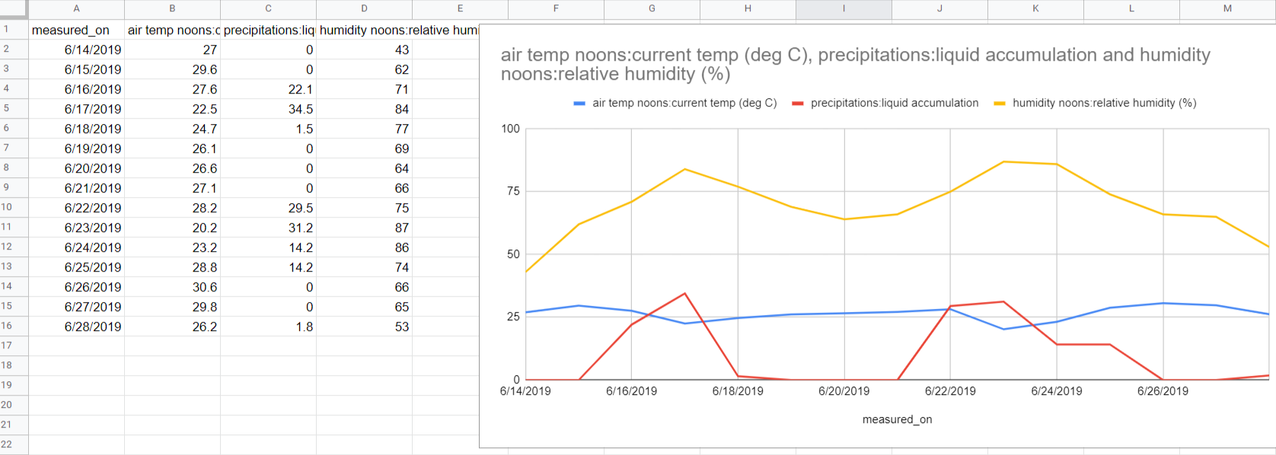
ADAT – Your Turn – Storm Tracker (2)
Select all 4 columns of data in your “Filtered” sheet and Insert->Chart
  The default line chart will work fine
Examine the chart and report how air temp, precipitation and relative humidity correlate during this storm
Sheet here: https://bit.ly/3TiqRWY

Slide 9
ADAT – Your Turn - Advanced
What does Air temperature data recorded by GLOBE students in Croatia tell us about global warming?
  Is it possible that all the temperature data collected in Croatia from 2000-2021 would provide any indication of global warming?

Slide 10
Retrieve data from GLOBE
Go to https://datasearch.globe.gov/
Steps:
  Protocol: Air temperature monthlies
  Date Range: 1/1/2000 through 12/31/2021
  Country or State/Territory: Croatia
  [Apply Filter] – 208 sites found
  [Obtain Measurement Data] ~9900 records
  [Download Measurement Data] – Save the file and extract the .csv from the .zip file

Slide 11
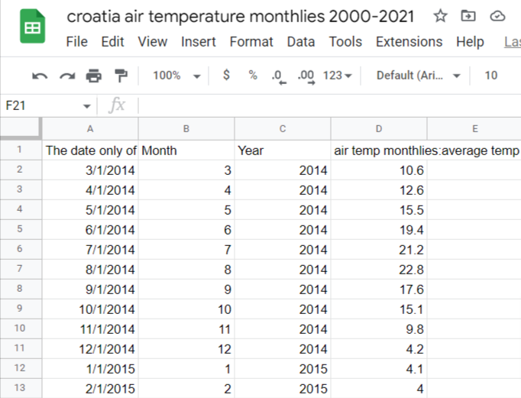
Setup data in Google Sheets/Excel
Upload the .csv file to Google drive and open it with Google Sheets
Extract the two columns – Measured On and air temp monthlies: average temp (deg C) and paste them into a new sheet (I called my sheet “Filtered”). Delete the second row (descriptive text).
Open two blank columns between the date and air temp values
Use google/Excel’s Month(xx) and Year(xx) function to extract the month and year for the Measured On values (date field). Put the titles “Month” and “Year” above as the column headers for each row.
Final sheet for this presentation is available here:
https://bit.ly/3Tp1Ut2

Slide 12
Setup a Pivot Table
Select the Year column and the air temp monthlies column values and click “Insert Pivot Table” to New Sheet (Excel create blank pivot table)
    Note: Data Range - Filtered!C1:D9895 where Filtered is the name of the tab the data is coming from
    For some reason sheets keeps selecting two extra rows when I click the columns, so I manually selected the values to get the range above before creating the pivot table. Make sure you have only rows with data in them selected.
A new sheet should be created with the “Pivot Table Editor” open on the right side.
Select “Add” next to Rows, and choose “Year”
Select “Add” next to Values, and choose “air temp monthlies”
  The sheet default is to “Summarize by” Sum. Change it to Average.
    (Excel select the value and select “Value Field Settings” to change to average)
    Note: If there’s an extra row on row 2 with a #DIV/0 that means when you selected the data in step 1 above, there were some extra rows selected. Try creating your pivot table again ensuring there are no extra rows selected

Slide 13
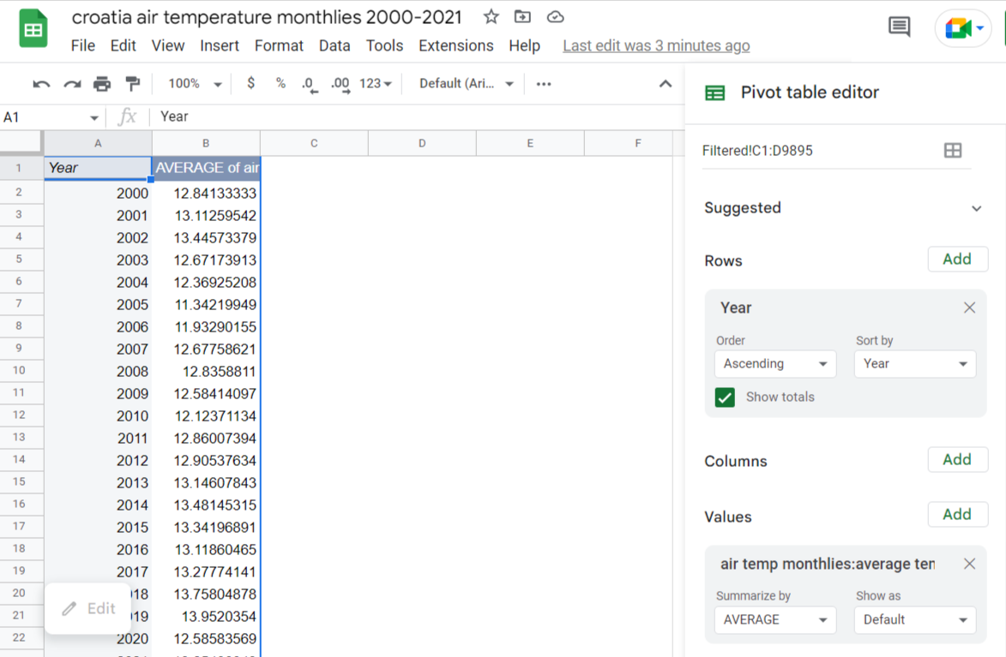
Pivot Table after selecting Rows and Values

Slide 14
Create a chart and trendline
Select the values for Year and AVERAGE of air temp
Select Insert->Chart. Default should be Line Chart, or select Line chart from options
Double click on the chart line to open the Chart Editor on the right panel.
Open the “Series” option and click the “Trend line” box option
What do you see? What are the strengths and weaknesses of this data and the results you see? How much do you trust this chart?

Slide 15
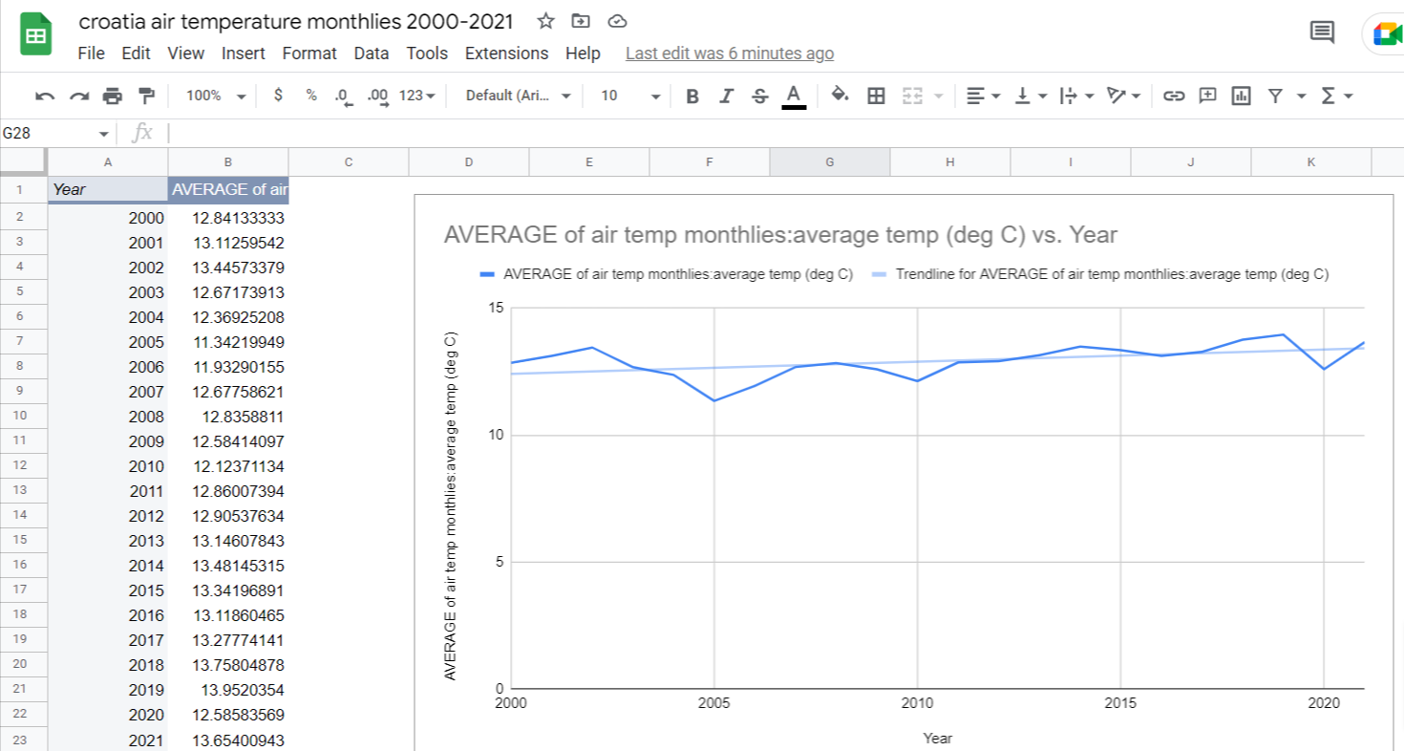
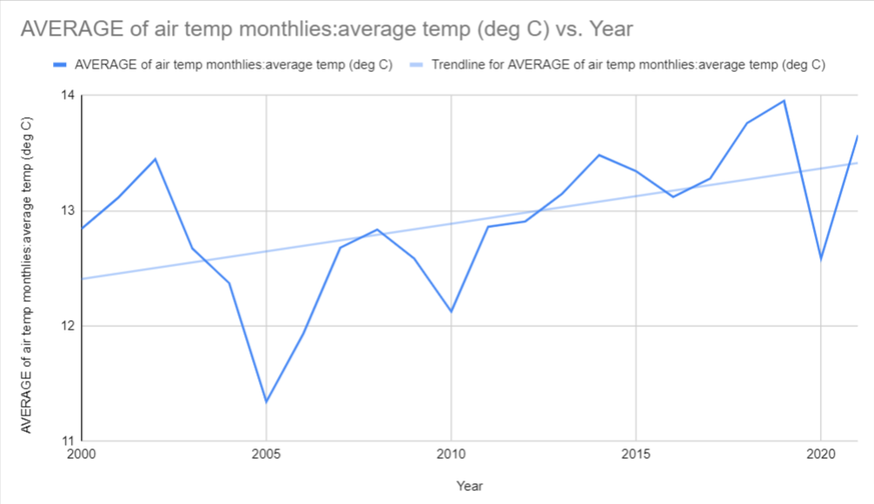
Trend line with Croatian average temperatures

Slide 16
Bonus – Compare to NASA Data
Make a new Sheet in your notebook and call it NASA Comparison
Copy and paste the values from your pivot table into this new sheet (Paste Special->Values Only)
This link: https://bit.ly/3EMqgca contains the worldwide average temperature variation as reported on NASA’s Climate site (https://climate.nasa.gov/vital-signs/global-temperature/) from 1880 – 2021
Select the data from 2000 to 2021 from the sheet, and paste it so it is adjacent to your Pivot Table data. Make sure the years align with your Pivot Table
Shift both the NASA and Croatia data down so that the Year 2000 data equals 0 (subtract the 2000 value from all values for each column. In mine that’s .39 for NASA and 12.841 for Croatia)
Make a line plot for both, add trend lines for both…How do they compare?

Slide 17
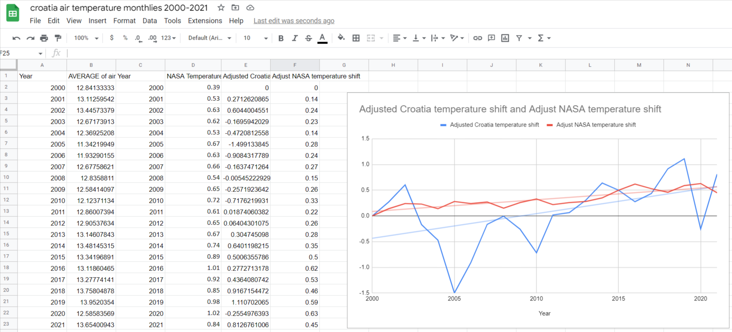
Comparison NASA and Croatian Data
Access this sheet: https://bit.ly/3Tp1Ut2

Slide 18
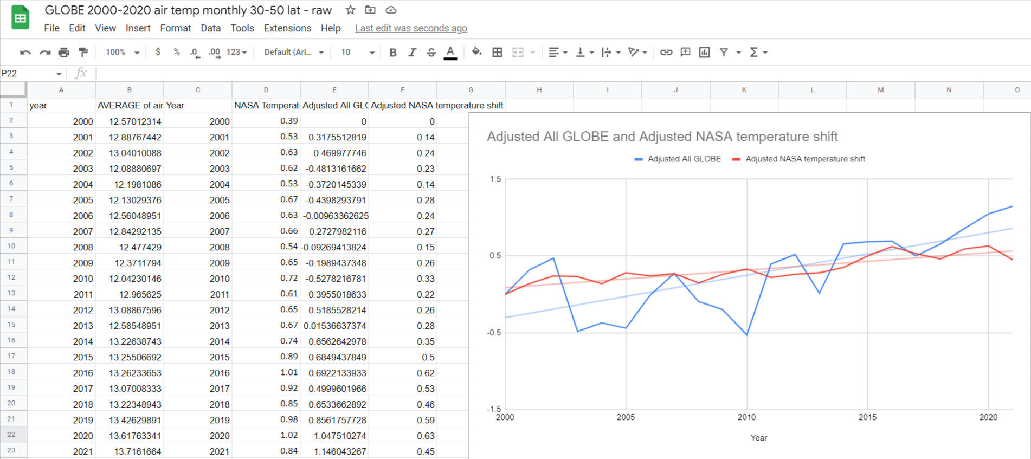
Super Bonus
Do the analysis again using all of GLOBE Air temp monthlies values in the latitude range of 30 to 50 degrees, longitude 180 to -180.
My Sheet: https://bit.ly/3rXh7WA

Slide 19
Questions?

