Slide 2
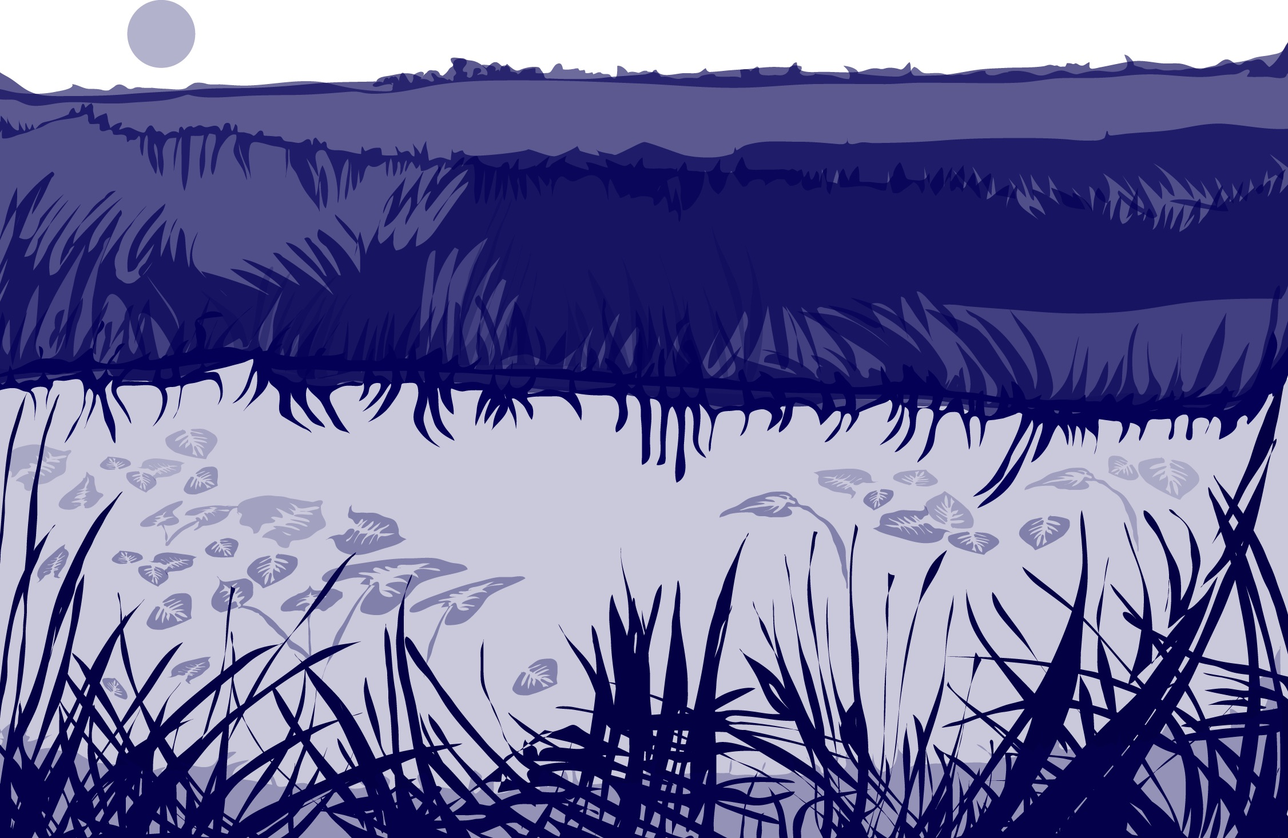
Overview
This module:
Reviews the selection of a GLOBE hydrology site
Reviews the water sampling technique used in GLOBE hydrology protocols
Provides a step by step introduction of the protocol method
Learning Objectives
After completing this module, you will be able to:
Define water salinity and explain how environmental variables can result in different measurements
Describe the importance of quality control steps in the the collection of accurate data
Conduct water salinity measurements using a hydrometer
Upload data to the GLOBE portal
Visualize data using GLOBE’s Visualization System

Slide 3
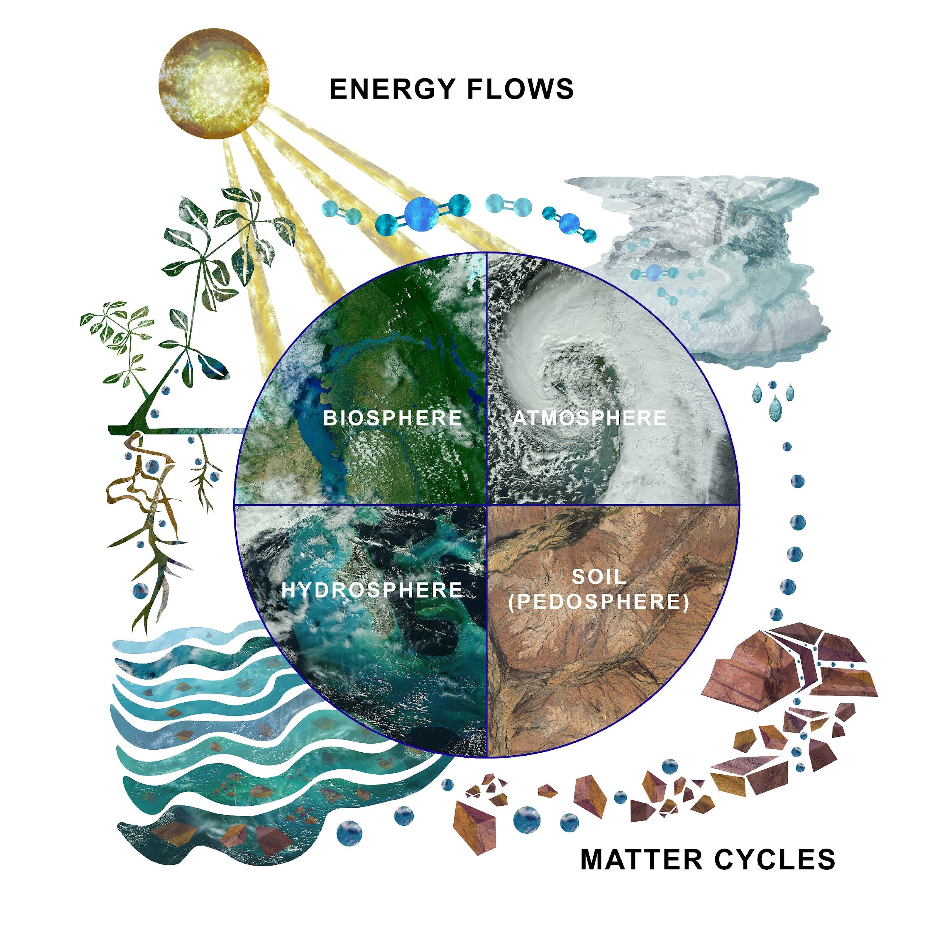
The Hydrosphere
The hydrosphere is the part of the Earth system that includes water, ice and water vapor. Water participates in many important natural chemical reactions and is a good solvent. Changing any part of the Earth system, such as the amount or type of vegetation in a region or from natural land cover to an impervious one, can affect the rest of the system. Rain and snow capture aerosols from the air. Acidic water slowly dissolves rocks, placing dissolved solids in water. Dissolved or suspended impurities determine water's chemical composition.
Current measurement programs in many areas of the world cover only a few water bodies a few times during the year. GLOBE Hydrosphere protocols will allow you to collect valuable data to help fill these gaps and improve our understanding of Earth's natural waters.
The Earth System: Energy flows and matter cycles.

Slide 4
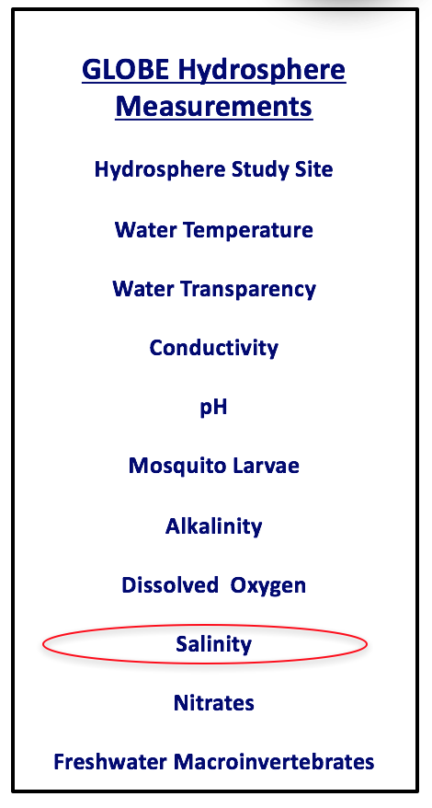
What is Salinity?
Salinity is one of the measurements in the GLOBE Hydrosphere investigation
The salinity measurement is used to find the total dissolved solids of brackish or salt water. This may be a site along an ocean, estuary, or salt lake. Fresh water has too little dissolved solids to accurately determine the total dissolved solids using the hydrometer or titration methods. The concentration of dissolved solids are measured in parts per thousand or ppt.
A related measurement is electrical conductivity. This protocol is used for freshwater locations and uses a meter that measures electrical conductivity µS /cm up to 2000 µS /cm. Beyond the 2000 µS /cm, you need to use the salinity protocol. Here is a link to the : Electrical Conductivity Protocol.
Note: µS /cm is microsiemens/cm and a measure of electrical conductance

Slide 5
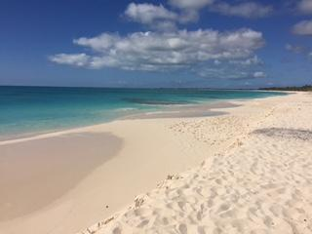
What is Salinity?
Salinity is the measurement of the amount of dissolved solids in water. There are many different types of solids dissolved in water, but the most common dissolved solid is sodium chloride (NaCl). Dissolved solids are often called salts.
Salinity is commonly measured in parts per thousand (ppt). The Earth’s oceans average 35 ppt salinity. Fresh water measures 0.5 ppt or less. Coastal waters and surface waters of the ocean far from shore can be less salty than 35 ppt due to fresh water input from land or rain, or more salty due to high rates of evaporation in hot climates. Brackish water is water that is saltier than fresh water, but not as salty as seawater. It is found in estuaries and bays where salt water and fresh water mix. Estuaries are bodies of water that are partly enclosed from the open ocean and usually have a freshwater river source.
Factors that can influence salinity in a location include tides and fresh water inputs during rain or snowmelt events.

Slide 6
Why Collect Water Salinity Data?
The salinity of water greatly affects what types of animals and plants can live there. All animals and plants have salts inside the cells of their bodies. The concentration of those salts is about one third that of seawater. Plants and animals in both fresh and salt water have special mechanisms to maintain a proper salt balance between their cells and their environment. Organisms adapted to one type of salinity environment cannot be moved into another without serious injury or death.
Scientists are interested in the long-term trends in salinity in estuaries. There are increasingly more demands on the fresh water that supplies estuaries, so they may be becoming more saline over time.
At ocean sites, we expect changes in salinity to be related to changes in temperature. An increase in temperature can cause an increase in evaporation. This results in an increase in salinity. Near the poles, however, an increase in temperature may cause an increase in the melting of fresh water ice and result in a decrease in salinity.

Slide 7
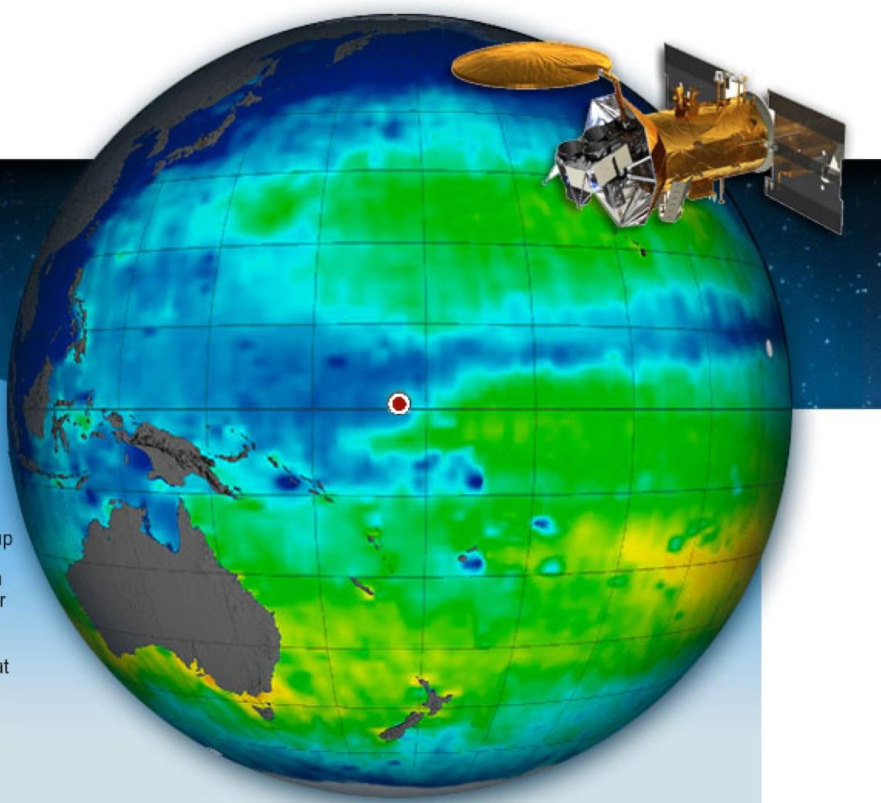
Evaporation, Salt, and Climate Change
Recent studies have shown Earth's water cycle is speeding up in response to climate change, which affects global precipitation patterns. Currently, scientists study the water cycle by making inferences from measurements of how much water is discharged from rivers and by measuring precipitation and evaporation rates using satellites like NASA's Tropical Rainfall Measuring Mission. About 80 percent of Earth's water cycle takes place over the ocean. By measuring ocean surface salinity, Aquarius tracks how the water cycle is changing in response to climate change
Find out more about the role of the ocean’s salinity in ocean circulation and climate change here:
Aquarius Satellite: Sea Surface Salinity from Space
Scientific visualization of ocean salinity as sensed remotely by the Aquarius satellite. Source: NASA.

Slide 8
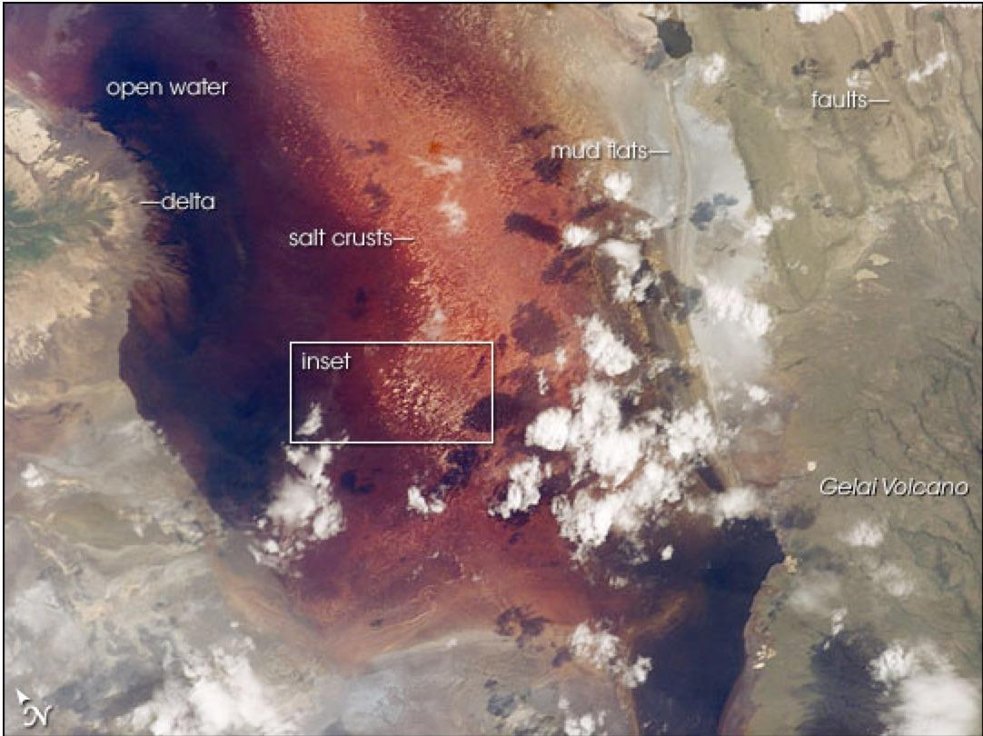
Example of Salt Lake: Lake Natron, Tanzania
The salinity of a water body increases when evaporation exceeds water input, so salinity can tell us about hydrology as well as changes in climate. Salinity also plays a role in the ecology of a lake. This image of the southern half of Lake Natron shows the characteristic colors of lakes where very high evaporation occurs. As water evaporates during the dry season, salinity levels increase to the point that salt-loving organisms begin to thrive. Salt-loving organisms include some cyanobacteria, tiny bacteria that grow in water and make their own food with photosynthesis as plants do. The red pigment in the cyanobacteria produce the deep reds of the open water of the lake, and orange colors of the shallow parts of the lake. In the inset, numerous, near-white salt-crust “rafts” pepper the shallowest parts of the lake. Bright white clouds are also visible just right of center and on the top margin. The lake is quite shallow, less than three meters deep, and varies in width depending on its water level. In this image, the lake is about ten kilometers wide.
Image and Text: NASA Earth Observatory

Slide 9
Let’s test your knowledge so far! Question 1
True or False: Saline water can hold more oxygen than fresh water at the same pressure and temperature

Slide 10
Let’s test your knowledge so far! Answer to Question 1
True or False: Saline water can hold more oxygen than fresh water at the same pressure and temperature
Answer: False ☺

Slide 11
Let’s test your knowledge so far! Question 2
True or False: Freshwater has too little dissolved solids to accurately determine the total dissolved solids using the Salinity Protocol.

Slide 12
Let’s test your knowledge so far! Answer to Question 2
True or False: Freshwater has too little dissolved solids to accurately determine the total dissolved solids using the Salinity Protocol.
Answer: True. For freshwater, use the Electrical Conductivity Protocol.

Slide 13
Let’s test your knowledge so far! Question 3
Both the Electrical Conductivity Protocol and the Salinity Protocol are used as a way to understand the amount of total dissolved solids in water. Which protocol would you use for a sample that measures electrical conductance of 2500 µS /cm?
Electrical Conductivity Protocol
Salinity Protocol

Slide 14
Let’s test your knowledge so far! Answer to Question 3
Both the Electrical Conductivity Protocol and the Salinity Protocol are used as a way to understand the amount of total dissolved solids in water. Which protocol would you use for a sample that measures electrical conductance of 2500 µS /cm?
Electrical Conductivity Protocol
Salinity Protocol- correct ☺

Slide 15
Let’s test your knowledge so far! Question 4
If your sample measures 0.4 ppt salinity, your sample is likely to be
Ocean water or a saline lake
Fresh water
Brackish water (such as a lagoon)

Slide 16
Let’s test your knowledge so far! Answer to Question 4
If your sample measures 0.4 ppt salinity, your sample is likely to be
Ocean water or a saline lake
Fresh water- correct ☺
Brackish water (such as a lagoon)
Explanation: ocean water averages 35 ppt salinity, and freshwater is defined as a salinity of 0.5 ppt or less.

Slide 17
Site Selection: Hydrosphere Study Site
Select a specific site where the hydrosphere measurements (water temperature, dissolved oxygen, nitrate, pH, alkalinity, turbidity, and either conductivity or salinity) will be taken. For brackish or saline waters, a pier may be a good location. You will need to know the times of high and low tide at a location as close as possible to your study site.
All your hydrosphere measurements are taken at the same Hydrosphere Study Site. This may be any surface water site that can be safely visited and monitored regularly, although natural waters are preferred. Sites may include (in order of preference):
1. stream or river
2. lake, reservoir, bay or ocean
3. pond
4. an irrigation ditch or other water body, if natural body is not available
http://estuaries.noaa.gov/teachers/climate.aspx

Slide 18
Simultaneous or Prior Investigations Required
You need to determine the the times of the high tide and low tide that occur before and after your salinity measurement is taken.
Here we will show you how to use the hydrometer method. In order to understand how the hydrometer method works, you need to become familiar with density and specific gravity.
Check the accuracy of the hydrometer using a standard. Ideally, measurements are to be taken weekly and quality control check every six months.
GLOBE Study Site Definition Sheet
Hydrosphere Investigation Data Sheet
Mapping your Hydrosphere Study Site Field Guide

Slide 19
Hydrometer? Advantages and Disadvantages
Hydrometer
Advantages
Easy and quick to use
No chromium by-products
Disadvantages
Breakable

Slide 20
Tides
In order to take salinity measurements, it is helpful to have tide information to help interpret the data.
Most areas have two low and two high waters per day with one set of high and low more extreme than the others. Tide cycles actually occur over a lunar day, which is 24 hours and 50 minutes long. The two low tides in a day occur on average every 12 hours 25 minutes.
The time of the first low tide each day occurs on average approximately 50 minutes later than the day before. Local topographic features may cause these times to vary.
Zero tide datum (also expressed as + 0, or “plus 0”) is a measure of the average low tide level. There are two different definitions used worldwide for the zero tide datum: mean lower low water and mean low water. Mean lower low water is the mean of the lowest tides for that area. Mean low water is the mean of all of the low tides for that area. The zero tide datum will be found in the legend of the tide table. Students will need to check off on the data sheet which definition of zero tide datum is used on their tide table.

Slide 21
How to Read Tide Tables
You need a tide table calculated for the local area to determine the tides in your area. The tide table will give you the dates, times and water levels for high and low water. These are available from government agencies, private fisheries and tourist agencies.
To determine the tidal height at a particular time and date, read on the tide table the times of high and low water for the date you sampled that bracket the time you sampled.
To determine the time and date of the lowest tide for a particular month, use your tide table to find the heights of the tides over the entire month.
You may need to consult two tide tables - a primary tide table based on a tide station in the general region of your site and an auxiliary tide table with corrections for time and tidal height for your particular site.

Slide 22
Overview of Water Salinity Protocol: Hydrometer Method-1
Density is the measurement of how “heavy” something is compared to its volume. Salinity is the measurement of how much salts are in the water. If there are more salts in a liter of water, you would expect it to be heavier than another liter of water with less salts.
Specific gravity is also a measure of density. When we measure specific gravity, we are comparing the density of a material to the density of pure water at 4˚ C. We use water as a standard because it is a common substance. We use 4˚ C because that is the temperature at which water is most dense. The specific gravity of pure water at 4˚ C is by definition 1.0. A substance denser than pure water at 4˚ C has a specific gravity greater than 1.0.
Specific gravity = mass of an object of a certain volume
mass of an equal volume of pure water

Slide 23
How to Measure Salinity: Hydrometer Method-2
The hydrometer measures specific gravity of a fluid. It is a small float with a scale on its stem. If you put the hydrometer in pure water at 4°C, it will float and show a reading of 1 at the stem of the instrument toward the end. As salts are added to the water, it begins to float higher. As the water gets denser, more of the hydrometer is exposed. Marks along the hydrometer allow you to read the specific gravity directly.

Slide 24
How to Measure Salinity: Hydrometer Method-3
With the hydrometer, you will collect a specific gravity reading. You also need to take the temperature of the water. With the temperature and specific gravity values, you use a table to determine the salinity in parts per thousand (ppt). For instance, if you had a hydrometer reading of 1.005 and a temperature reading of 11°C, you would have a salinity of 7.0 ppt.

Slide 25
Sources for Equipment You Need for the Water Salinity Protocol
The following resources summarize the measurements associated with each protocol, associated skill level, scientific specifications for the instruments, and how to access the equipment you need (purchase, build, or download).
Where to find specifications for instruments used in GLOBE investigations
Where to find scientific instruments used in GLOBE investigations

Slide 26
Equipment Needed for Water Salinity Protocol Using a Hydrometer
Assemble Necessary Documents:
Hydrosphere Investigation Data Sheet
Salinity Protocol Field Guide
Time: 10 minutes
Suggested Frequency: weekly

Slide 27
Salinity Water Protocol: Quality Control Procedure (1/3)
The quality control procedure checks the accuracy of the hydrometer. First you make the standard and then use the hydrometer to take measurements of the standard and distilled water.
Making the 35 ppt Standard
Use the balance to measure 17.5 g of salt
Pour the salt into graduated cylinder
Fill graduated cylinder with 500 mL of distilled water
Stir gently until salt is dissolved
Be sure to pay close attention to the quality control procedure; without it, the data you collect using the Salinity Protocol will not be meaningful and cannot be compared with the data sets collected by others.

Slide 28
Salinity Water Protocol: Quality Control Procedure (2/3)
Fill graduated cylinder with 500 mL of distilled water
Use the Water Temperature Field Guide to measure water temperature with thermometer. Record data on Hydrosphere Investigation sheet.
Place hydrometer in the water (do not allow to touch sides of tube). Once the hydrometer is steady take reading at the bottom of the meniscus (take reading to three decimal places). Record on data sheet.
Using the conversion table look up the specific gravity and water temperature (should be between 0.0 and 1.0 ppt).
If salinity is not between 0.0 and 1.0, recheck measurements. If still incorrect hydrometer is not accurate.

Slide 29
Salinity Water Protocol: Quality Control Procedure (3/3)
Check the hydrometer using standard
Pour standard into graduated cylinder
Use the Water Temperature Field Guide to measure the water temperature with thermometer. Record data on Hydrosphere investigation sheet.
Gently place the hydrometer into the cylinder. When it stops bobbing, read the specific gravity at the bottom of the meniscus. It should not touch the sides of the cylinder. Read to three places and record on the Hydrosphere Investigation Quality Control Procedure Data Sheet.
Look up the specific gravity and water temperature on the conversion table to find the salinity of the water. Record the salinity on the Hydrosphere Investigation Quality Control Procedure Data Sheet.
If the salinity standard is off by more than 1 ppt, mix a new standard and repeat the procedure. If it is still off by more than 1 ppt, you may not be able to trust the accuracy of the hydrometer.
Discard the 35-ppt standard or pour it into a clean and dry 1-L bottle, cap, and label. Rinse equipment with distilled water, dry, and store.

Slide 30
Salinity Water Protocol: Hydrometer Method (1/5)
Fill out the top portion of your Hydrosphere Investigation Data Sheet.
In the Salinity section of the Hydrosphere Investigation Data Sheet, record the times of the high tide and low tide that occur before and after your salinity measurement is taken. Also record the place where the times from your Tide Table occur.
Put on gloves.

Slide 31
Salinity Water Protocol: Hydrometer Method (2/5)
Rinse the 500-mL cylinder with sample water twice.
Fill the cylinder with sample water to within 2 or 3 cm of the top.
Measure and record the temperature of the water in the cylinder. (See Hydrosphere Investigation, Water Temperature Protocol Field Guide)
Gently put the hydrometer into the cylinder.
Wait for the hydrometer to stop bobbing. It should not touch the sides of the cylinder.

Slide 32
Salinity Water Protocol: Hydrometer Method (3/5)
9. Read the hydrometer at the bottom of the meniscus. Read the specific gravity to three decimal places. Record the specific gravity on the Hydrosphere Investigation Data Sheet.

Slide 33
Salinity Water Protocol: Hydrometer Method (4/5)
10. Look up the specific gravity and water temperature on the Conversion Table to find the salinity of the water. Record the salinity on the Hydrosphere Investigation Data Sheet as Test 1.

Slide 34
Salinity Water Protocol: Hydrometer Method (5/5)
11. Repeat Steps 3-9 using new samples of water. Record the salinity measurements as Tests 2 and 3.
12. Calculate the average of the three measurements.
13. Each of the three measurements should be within 2 ppt of the average. If one or more of the observations is not within 2.0 ppt, do the measurement again and calculate a new average.
If the measurements are still not within 2.0 ppt of the new average, consult a master trainer to troubleshoot your procedure.

Slide 35
Let’s test your knowledge- Question 5
Each of the three salinity measurements should be within
2.0 ppm of the average of three sample measurements
.2 ppm of the average of the three sample measurements
2.0 ppt of the average of three sample measurements
.2 ppt of the average of three sample measurements

Slide 36
Let’s test your knowledge- Answer to Question 5
Each of the three salinity measurements should be within
2.0 ppm of the average of three sample measurements
.2 ppm of the average of the three sample measurements
2.0 ppt of the average of three sample measurements- correct! ☺
.2 ppt of the average of three sample measurements

Slide 37
Let’s test your knowledge- Question 6
Specific Gravity of a sample is a measure of:
Salinity of the sample
Ratio of the density of the sample to the density of a standard
Tides that take place because of the gravitational pull of the moon.

Slide 38
Let’s test your knowledge- Answer to Question 6
Specific Gravity of a sample is a measure of:
Salinity of the sample
Ratio of the density of the sample to the density of a standard- correct! ☺
Tides that take place because of the gravitational pull of the moon.

Slide 39
Let’s test your knowledge- Question 7
If you add salt to a water sample in a beaker, what happens to the hydrometer that is floating in it?
It floats higher
It sinks
Nothing happens to the hydrometer, but the volume of water increases so that the hydrometer sinks

Slide 40
Let’s test your knowledge- Answer to Question 7
If you add salt to a water sample in a beaker, what happens to the hydrometer that is floating in it?
It floats higher- correct! ☺
It sinks
Nothing happens to the hydrometer, but the volume of water increases so that the hydrometer sinks

Slide 41
Entering Data on the GLOBE Website
Live Data Entry: Upload your data to the official GLOBE science database
Email Data Entry: Send data in the body of your email (not as an attachment) to DATA@GLOBE.GOV
Mobile Data App: Download the GLOBE Science Data Entry app to your mobile device and select the right option.
For Android via Google Play
For IOS via the App Store

Slide 42
Entering your data via Live Data Entry or Data Entry Mobile App-1

Slide 43
Entering your data via Live Data Entry or Data Entry Mobile App-2

Slide 44
Entering your data via Live Data Entry or Data Entry Mobile App-3

Slide 45
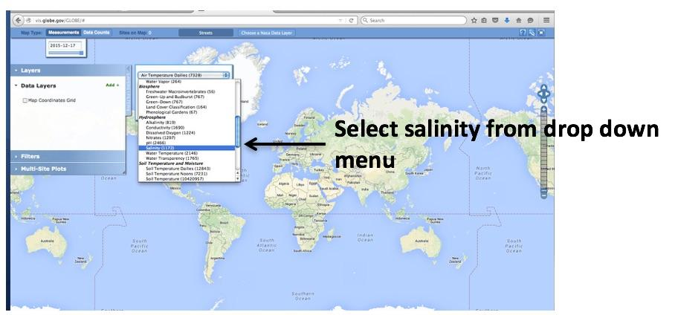
Visualize and Retrieve Salinity Data: 1/3
GLOBE provides the ability to view and interact with data measured across the world. Select our visualization tool to map, graph, filter and export nitrate data that have been measured across GLOBE protocols since 1995. Here are screenshots steps you will use when you use the visualization tool:
Link to step-by-step tutorials on Using the Visualization System will assist you in finding and analyzing GLOBE data

Slide 46
Visualize and Retrieve Salinity Data: 2/3
Select the date for which you need salinity data, add layer and you can see where data is available.

Slide 47
Visualize and Retrieve Salinity Data: 3/3
Select the sampling site for which you need salinity data, and a box will open with data summary for that site.

Slide 48
Review questions to help you prepare to conduct the Hydrosphere Salinity Protocol
What substance is measured in water when using the salinity protocol?
What is the average salinity of the ocean, in ppt?
Drinking water and fresh water typically have a salinity value of ____ or less
What environmental factors influence water salinity ?
What other GLOBE protocol measurement is related to salinity and is measured in µS/cm?
How do you use a hydrometer? How do you read a hydrometer?
What are the safety precautions you should take when doing any of the hydrology protocols?
What is the acceptable range of error of the three replicate samples you take, in ppt?
What procedure do you need to complete before starting the Salinity protocol?
Fill in the equation: Salinity (ppt)= __________(ppt) x 1.80655

Slide 49
Are you Ready to Take the Quiz?
You have now completed the slide stack. If you are ready to take the quiz, sign on and take the quiz corresponding to Water Salinity Protocol Using a Hydrometer.
You can also review the slide stack, post questions on the discussion board, or look at the FAQs on the next page.
When you pass the quiz, you are ready to take Water Salinity measurements!

Slide 50
FAQ: Frequently Asked Questions
Why does the standard for the salinity titration methods measures 38.6 ppt while the standard for the hydrometer method measures 35 ppt? The standards are made exactly the same way.
The hydrometer measurement is based the actual density of the ocean water. In the titration measurement, you are only measuring chlorine. In seawater, there in a constant ratio between chlorine and other anions, which is taken into account in the values you get when you measure the salinity of ocean water. These other anions are not present in the standard. To calculate the seawater salinity from 17.5 g NaCl in 500 mL (35 ppt NaCl), you need to take into account the molecular composition of NaCl. The ratio of the molecular weight of Cl to NaCl is 0.61. So, 35 ppt x 0.61 = 21.35 ppt chlorinity of the sample. The kits have been designed to use the constant ratio of chlorine and other anions to convert the chlorinity value to a salinity value. To do this the ppt chlorinity value (here it is 21.35) is multiplied by a conversion constant of 1.80655. 21.35 ppt x 1.80655 = 38.6 ppt.

Slide 51
Questions for Further Investigation
Would brackish water be good to use for irrigation? Why or why not?
Why do all of Earth’s oceans have approximately the same salinity (35 ppt)?
How might a rise in ocean level affect estuary and bay areas?
How does salinity at your site compare to salinity at other sites at the same and different latitudes?
How does outflow of freshwater from nearby rivers influence salinity at your site?
Are there seasonal patterns of river water use in your area?
Would you expect to find seasonal changes in salinity levels at your site?
How does salinity vary with average monthly air temperature at your site?

Slide 52
We want your Feedback!
Please provide us with feedback about this module. This is a community project and we welcome your comments, suggestions and edits! Comment here: Training@nasaglobe.org
Credits:
Slides:
Russanne Low, Ph.D., University of Nebraska-Lincoln, USA
Rebecca Boger, Ph.D., Brooklyn College, NYC, USA
Photos: Russanne Low
Art: Jenn Glaser, ScribeArts
More Information:
The GLOBE Program, NASA Earth Science
NASA Global Climate Change: Vital Signs of the Planet
The GLOBE Program is sponsored by these organizations:

