Slide 1
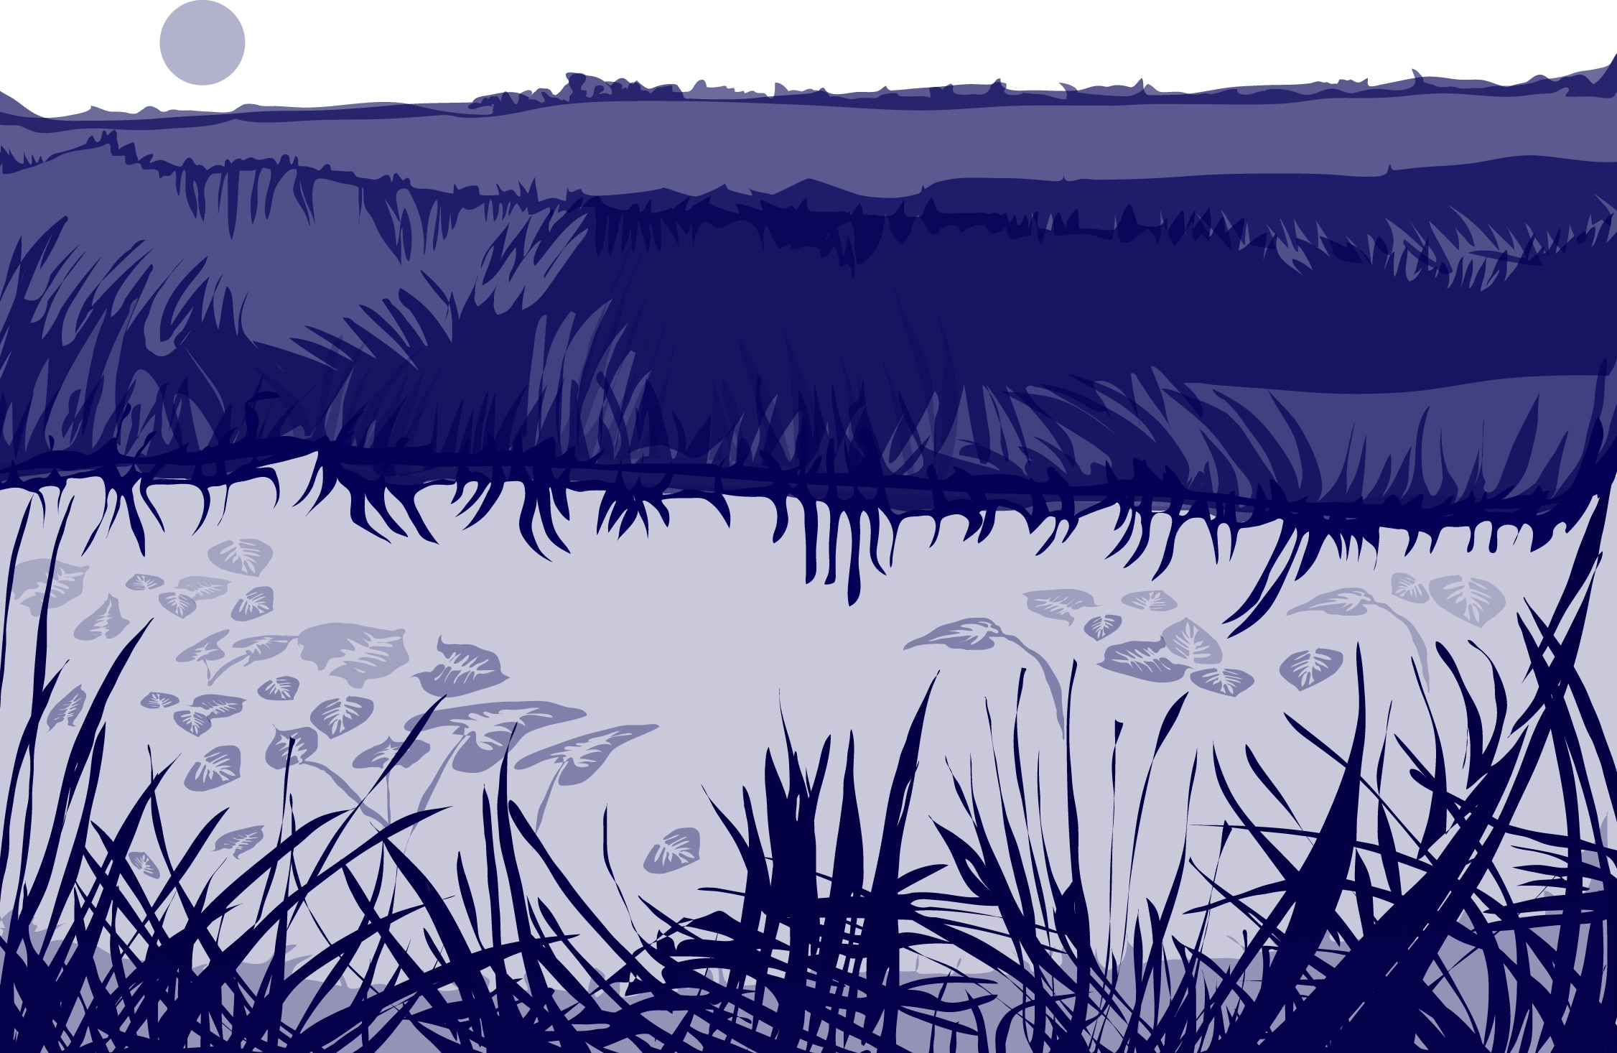
Slide One

Slide 2

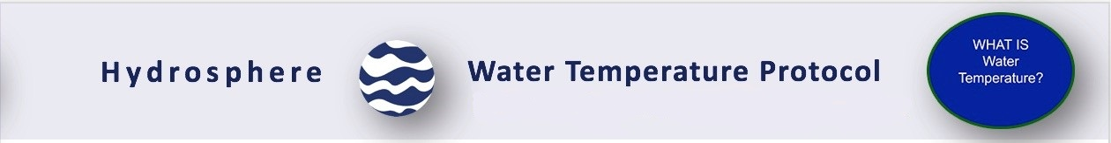
Overview
This module:
Reviews the selection of a GLOBE hydrology site
Reviews the water sampling technique used in GLOBE hydrosphere protocols
Guides the calibration of the necessary instruments for this protocol
Provides a step by step introduction of the protocol method
Learning Objectives
After completing this module, you will be able to:
Describe why water temperature is considered a master variable
Explain why this measurement accompanies all other hydrology measurement taken using GLOBE protocols
Describe how the protocol procedures ensure the collection of accurate data
Conduct the calibration and measurement steps of this protocol
Upload data to the GLOBE portal
Visualize data using GLOBE’s Visualization Site
Estimated time to complete module: 1.5 hours

Slide 3
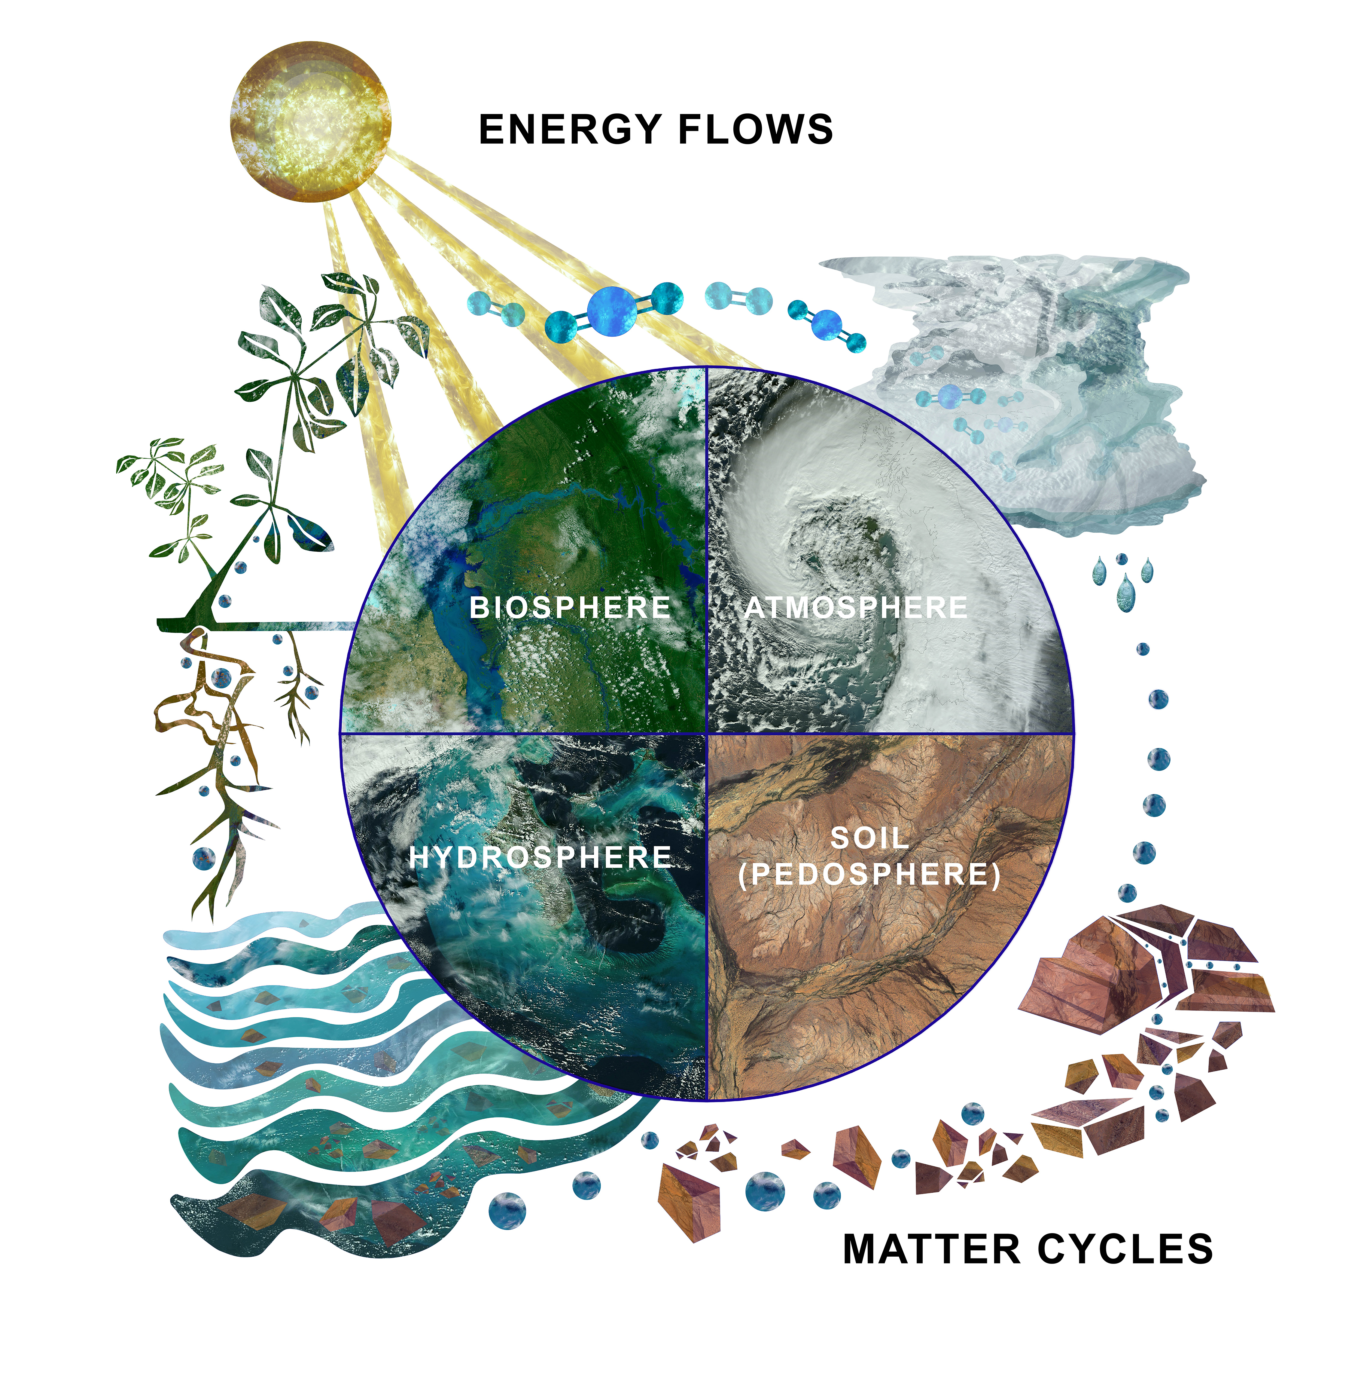
The Hydrosphere
The hydrosphere is the part of the Earth system that includes water, ice and water vapor. Water participates in many important natural chemical reactions and is a good solvent. Changing any part of the Earth system, such as the amount or type of vegetation in a region or from natural land cover to an impervious one, can affect the rest of the system. Rain and snow capture aerosols from the air. Acidic water slowly dissolves rocks, placing dissolved solids in water. Dissolved or suspended impurities determine water's chemical composition.
Current measurement programs in many areas of the world cover only a few water bodies a few times during the year. GLOBE Hydrosphere protocols will allow you to collect valuable data to help fill these gaps and improve our understanding of Earth's natural waters.
The Earth System:
Energy flows and matter cycles.

Slide 4
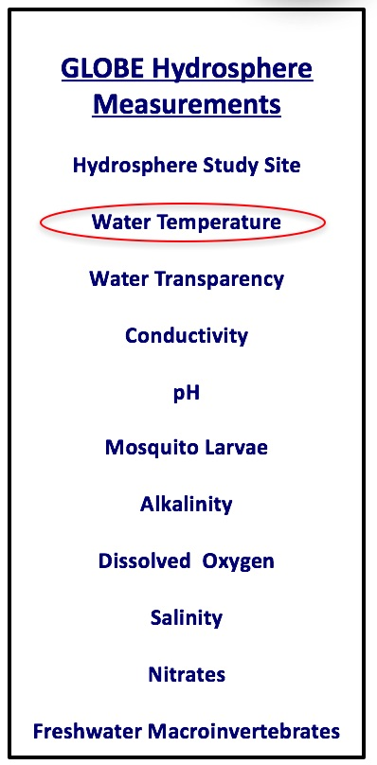
What is Water Temperature?
The measurement of water temperature determines how hot or cold the water is.
Water temperature is sometimes called a master variable because almost all properties of water, as well as chemical reactions taking place in it, are affected by it. Most of the GLOBE Hydrosphere Protocols require water temperature measurements.
Sudden increases or decreases of water temperature are unusual. Water has a higher heat capacity (specific heat) than air, thus it heats and cools more slowly.

Slide 5

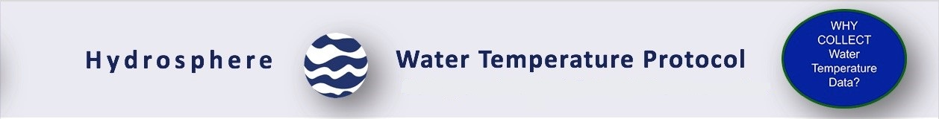
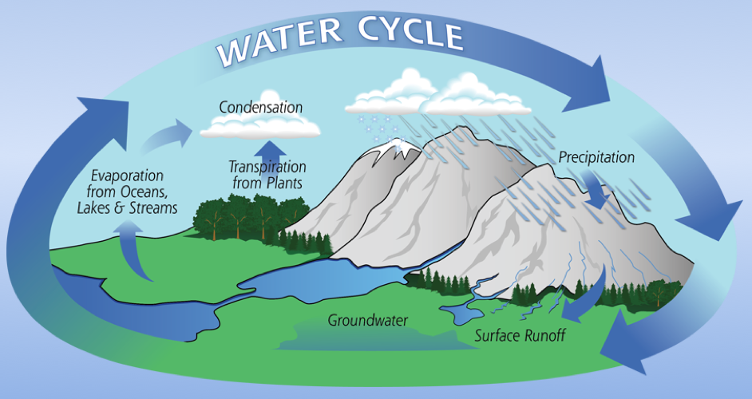
The Water Cycle
Water temperature is important for understanding local and global weather patterns. Water temperatures change differently than air temperatures because water has a higher heat capacity than air. Water also helps to change air temperature through the processes of evaporation and condensation. The flow of energy, the hydrologic cycle and weather are closely connected.
Image Credit: NASA

Slide 6
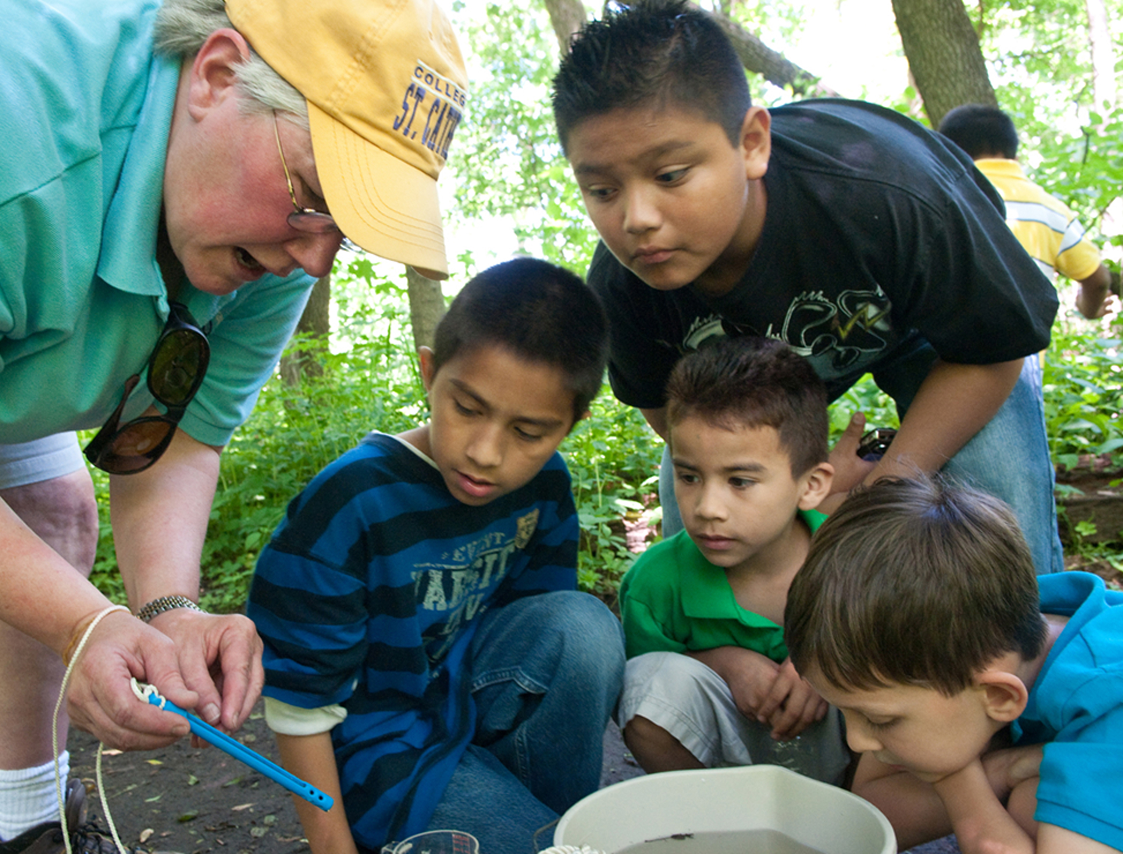
Why Collect Water Temperature Data?
Temperature influences the amount and diversity of aquatic life. Lakes that are cold and have little plant life in winter, bloom in spring and summer when water temperatures rise and the nutrient-rich bottom waters mix with the upper waters. Because of this mixing and the warmer water temperatures, the spring overturn is followed by a period of rapid growth of microscopic aquatic plants and animals.
Many fish and other aquatic animals also spawn at this time of year when the temperatures rise and food is abundant. Shallow lakes are an exception to this cycle, as they mix throughout the year.
Water temperature is also important because warm water can be fatal for sensitive species, such as trout or salmon, which require cold, oxygen-rich conditions. Warmer water tends to have lower levels of dissolved oxygen.

Slide 7
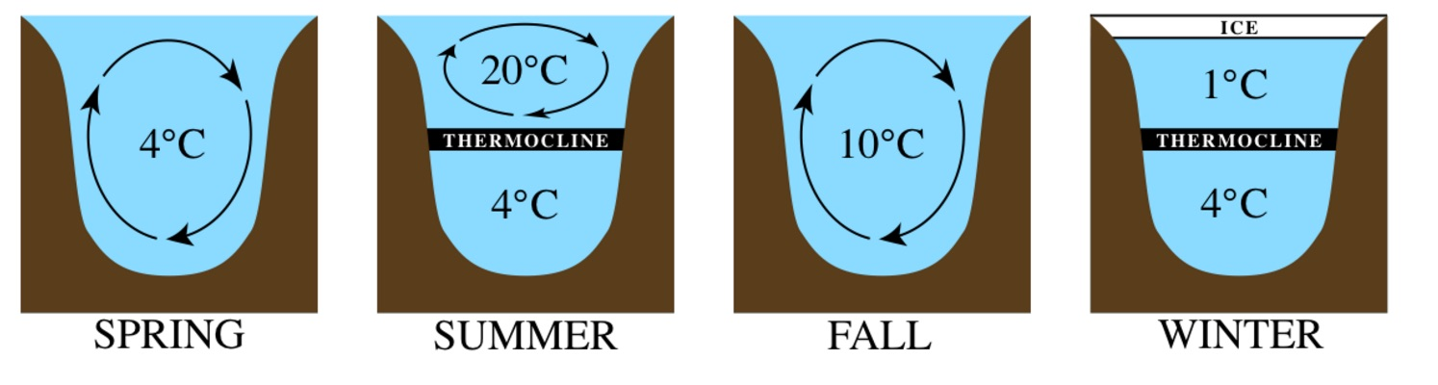
Why Collect Water Temperature Data-2
Temperature influences the amount and diversity of aquatic life. Lakes that are cold and have little plant life in winter, bloom in spring and summer when water temperatures rise and the nutrient-rich bottom waters mix with the upper waters. Water temperature determines the density of water. Water is at its most dense at 4 °C. Because of this mixing and the warmer water temperatures, the spring overturn is followed by a period of rapid growth of microscopic aquatic plants and animals. Many fish and other aquatic animals also spawn at this time of year when the temperatures rise and food is abundant. Shallow lakes are an exception to this cycle, as they mix throughout the year.
Image: Wikipedia Commons

Slide 8
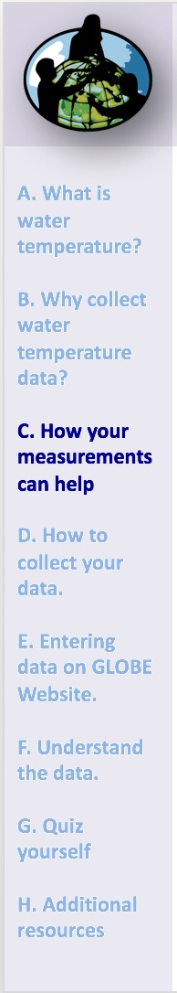
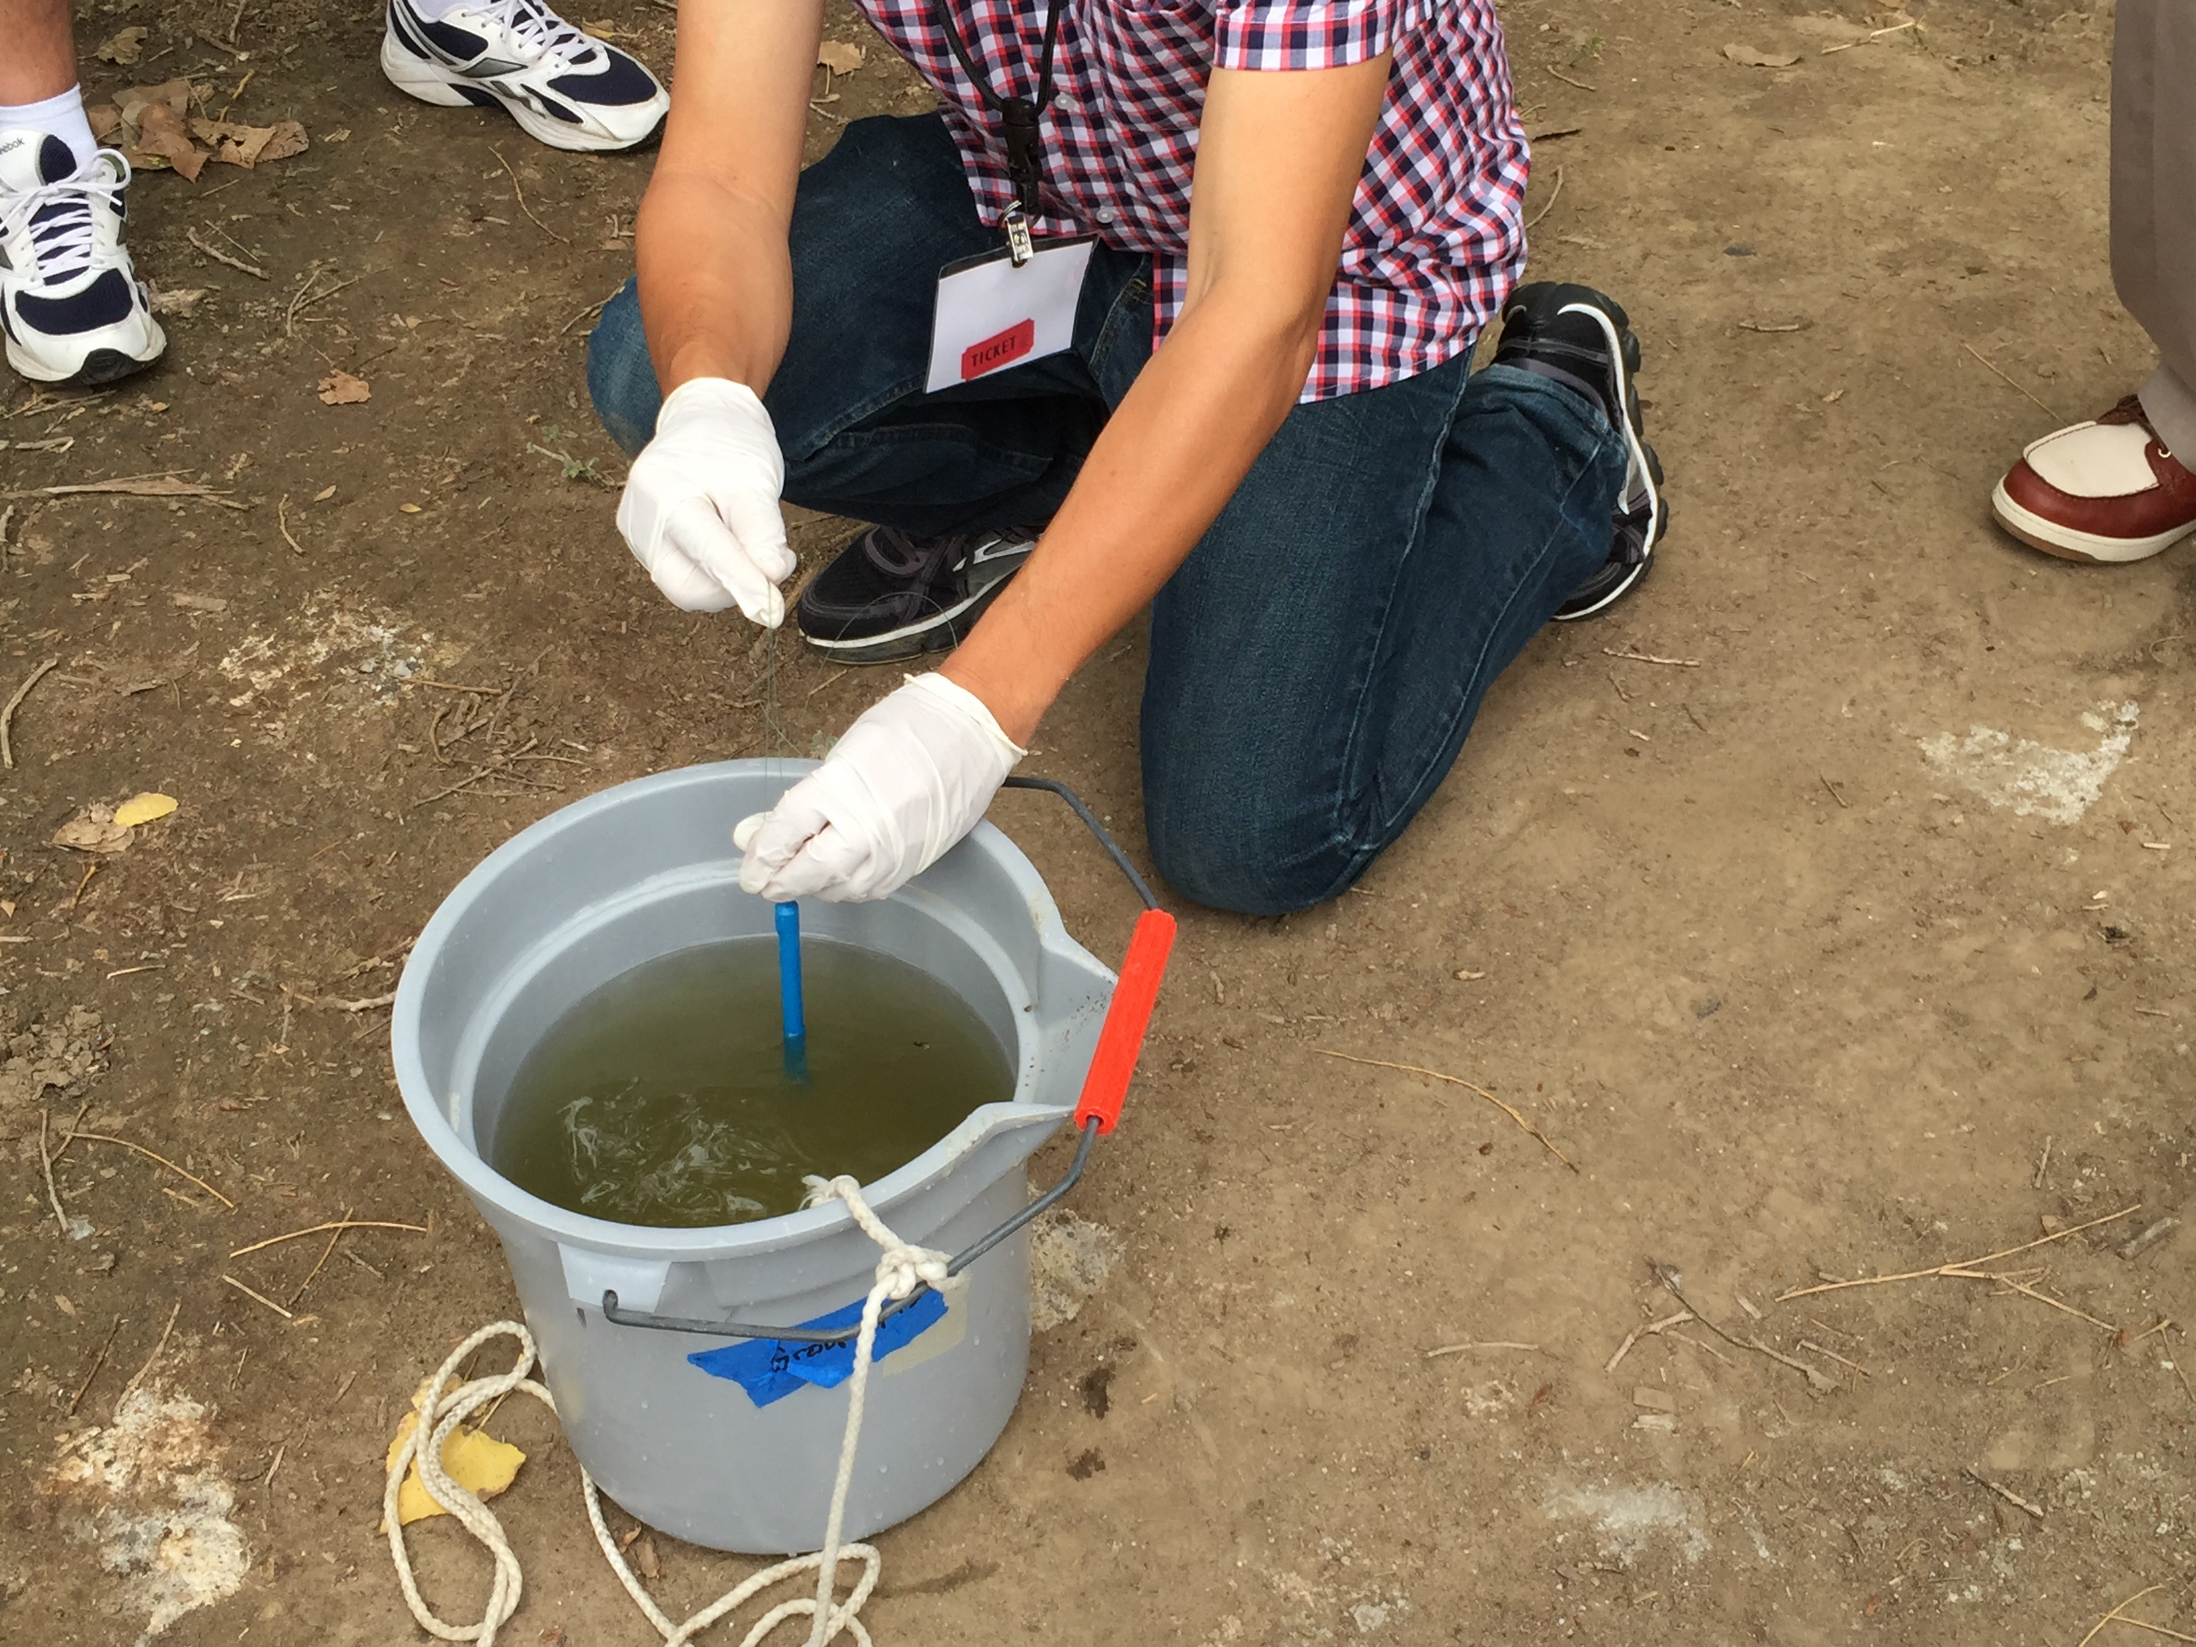
How Your Measurements Can Help
Your water temperature measurements can help in different ways. At the local scale, you are monitoring your local water body and over time keeping track on how it is changing throughout the seasons and over the years.
On a regional and global scale, yours and other GLOBE measurements of water temperature data are helping to better understand hydrologic and energy cycles.

Slide 9
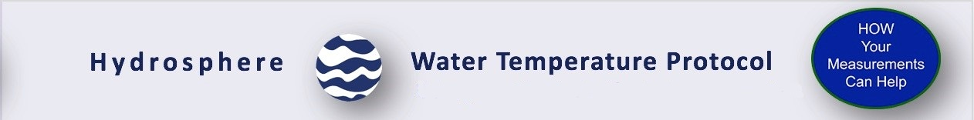
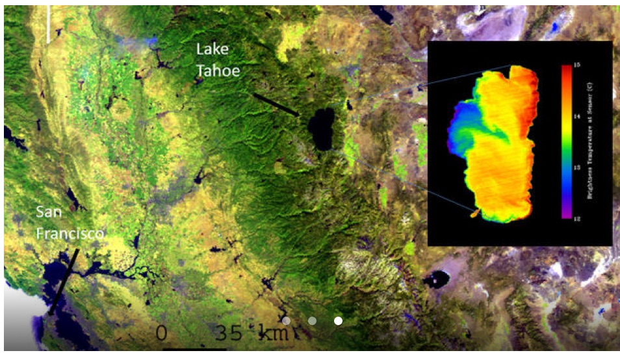
Climate change is warming Earth’s lakes
Climate change is rapidly warming lakes around the world, threatening freshwater supplies and ecosystems. Several large lakes are seen in this image of the California/Nevada border region acquired by the MODIS instrument on NASA's Terra spacecraft. The inset image of Lake Tahoe, from the ASTER instrument on Terra, shows the lake's temperature variations- from about 15 degrees C (red) to about 12.5 degrees C (blue). Credit: NASA.

Slide 10
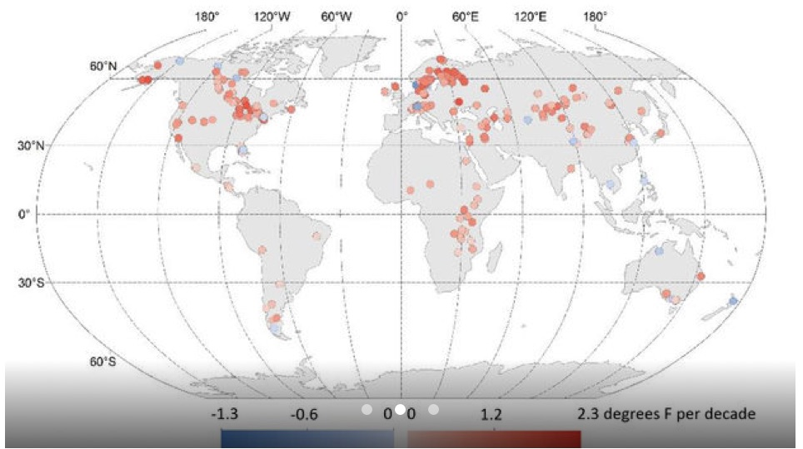
Ground-based Observations Validate Satellite Data
Global changes in lake temperatures over the past 25 years. Red shades indicate warming; blue shades indicate cooling. The study found Earth's lakes are warming about 0.61 degrees Fahrenheit (0.34 degrees Celsius) per decade on average, faster than overall warming rates for the ocean and atmosphere. Credit: Illinois State University/USGS/California University of Pennsylvania. Story: NASA JPL

Slide 11
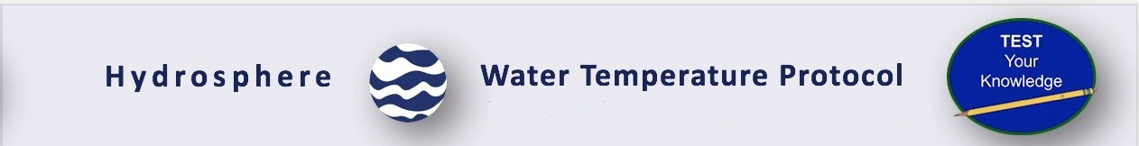
Let’s do a quick review before moving onto data collection! Question 1
Why does the water warm and cool more slowly than the same volume of air?
It has a higher heat capacity than air
Air has a higher specific heat
It is a master variable
A and B only
What is the answer?

Slide 12
Let’s do a quick review before moving onto data collection! Answer to Question 1
Why does the water warm and cool more slowly than the same volume of air?
It has a higher heat capacity than air ☺ correct!
Air has a higher specific heat
It is a master variable
A and B only
Were you correct?

Slide 13
Let’s do a quick review before moving onto data collection! Question 2
Warmer water tends to have ______levels of oxygen.
Higher
Lower
What is the answer?

Slide 14
Let’s do a quick review before moving onto data collection! Answer to Question 2
Warmer water tends to have ______levels of oxygen.
Higher
Lower ☺ Correct!
Were you correct?

Slide 15
Let’s do a quick review before moving onto data collection! Question 3
Recent scientific studies of lakes and other water bodies around the Earth are displaying an overall ___trend.
Warming
Cooling
Stable and unchanging
What is the answer?

Slide 16
Let’s do a quick review before moving onto data collection! Answer to Question 3
Recent scientific studies of lakes and other water bodies around the Earth are displaying an overall ___trend.
Warming ☺ Correct!
Cooling
Stable and unchanging
Were you correct?
Let’s now look at the GLOBE protocol steps for the water temperature protocol.

Slide 17
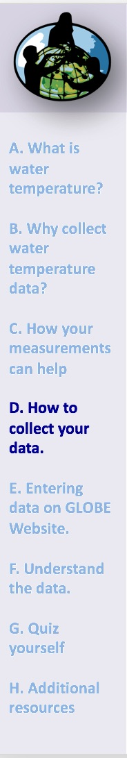
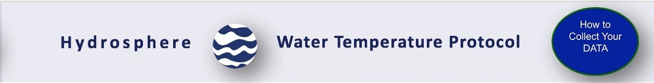
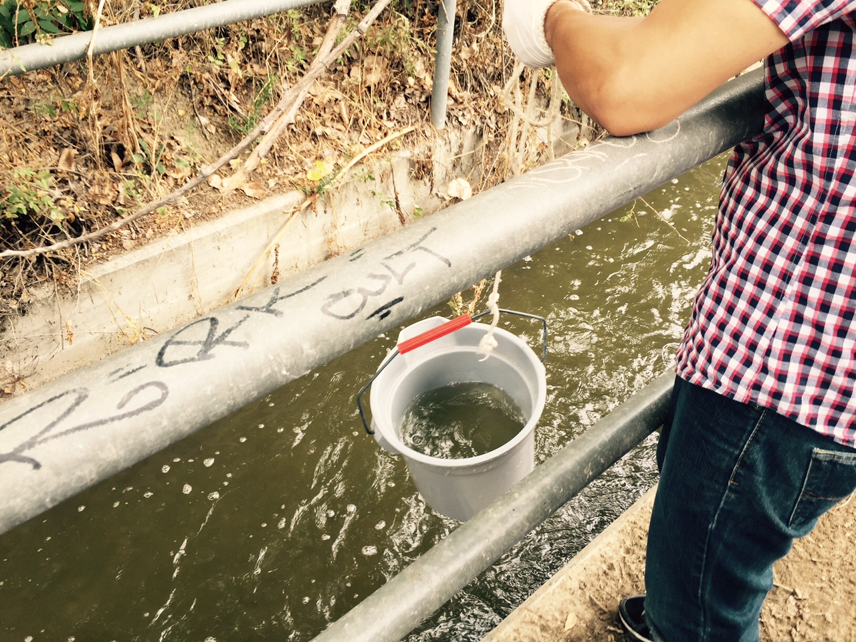
Site Selection: Hydrosphere Study Site
Select a specific site where the hydrosphere measurements (water temperature, dissolved oxygen, nitrate, pH, alkalinity, turbidity, and either conductivity or salinity) will be taken. If the selected study site is a moving body of water (i.e. stream or river), locate your sampling site at a riffle area as opposed to still water or rapids. This will provide a more representative measurement of the water in the stream or river.
If the selected study site is a still body of water (i.e. a lake or reservoir), find a sampling site near the outlet area or along the middle of the water body. Avoid inlet areas. A bridge or a pier are good choices. If your water body is brackish or salty, you will need to know the times of high and low tide at a location as close as possible to your study site.

Slide 18
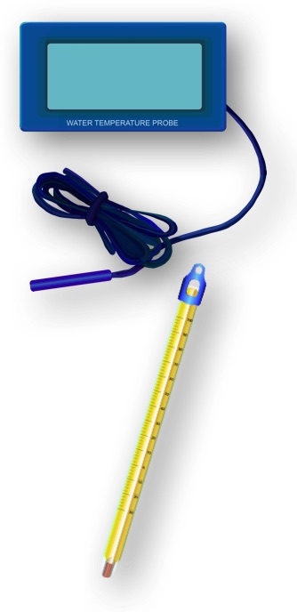
How to Collect Water Temperature Data
There are two ways to collect water temperature for GLOBE: Using an alcohol-filled thermometer or a temperature probe.
When using temperature probes, you will hear references to either temperature probes or meters. For clarification, probes are the instruments that measure voltage or resistance in a water sample. Meters are instruments that convert voltage or resistance measurements to concentrations. In order to measure temperature (or other types of measurements), both a probe and meter are required. Sometimes the probe and meter are within one instrument and cannot be taken apart. Other instruments have probes that are separate from the meters and need to be connected to the meters in order to take the water measurements.

Slide 19
How to Collect Water Temperature Data: Overview
Except for transparency, take water temperature before the other water measurements.
Take the water temperature measurement as soon as possible after the water sample is taken because temperature tends to change very rapidly after a sample is collected.
Read the temperature value on the thermometer or meter while the bulb of the thermometer or probe is in the water. The temperature reading can change quickly once the thermometer is out of the water, especially if the air temperature is very different from the water temperature or if it is windy. Wind can cause evaporation to occur rapidly, lowering the temperature.
It is important that the water temperature be taken at the same place every week. There may be several degrees of difference in water temperature over a small area in your water body: sunny areas vs. shady areas, or shallow and deeper areas.
The alcohol column in the thermometer may become separated, especially if the thermometer is not stored in an upright position. The column may be rejoined by holding tightly to the top of the thermometer and shaking it down or swinging it.

Slide 20
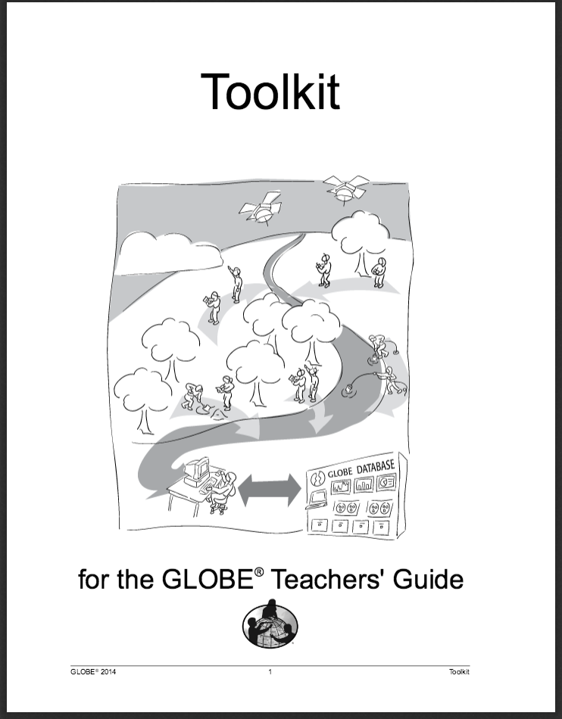
Sources for Equipment You Need for the Water Temperature Protocol
The following resources summarize the measurements associated with each protocol, associated skill level, scientific specifications for the instruments, and how to access the equipment you need (purchase, build, or download).
Where to find specifications for instruments used in GLOBE investigations
Where to find scientific instruments used in GLOBE investigations

Slide 21
What do you need to start?
When Weekly (if possible)
Where Hydrosphere Study Site
Time Needed 10 minutes
Prerequisites Hydrosphere Study Site
Key Instrument Alcohol-filled Thermometer / Temperature Probe
References:
Hydrosphere Investigation Data Sheet
Water Temperature Protocol for Thermometers
Calibrating an Alcohol-filled Thermometer Lab Guide
Water Temperature Protocol for Thermometer Probes Field Guide

Slide 22
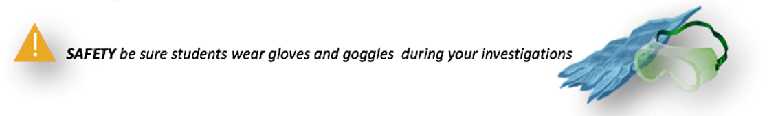
Start your Fieldwork and Lab Work with Safety Steps
Safety is important when conducting the Hydrosphere protocols. While you will need to use your judgment in selecting only hydrosphere study sites that are safe to access and sample, additional precautions are needed:
Students should wear protective gloves and goggles when handling water samples and chemicals to avoid splashing on exposed areas.
When doing GLOBE Hydrosphere Protocols, it is important to protect students from exposure to biting insects, including mosquitoes. Ask your students to wear clothes that cover the body so there is little bite area exposed. It is also advisable to apply insect repellent if you are sampling during the mosquito breeding season.

Slide 23
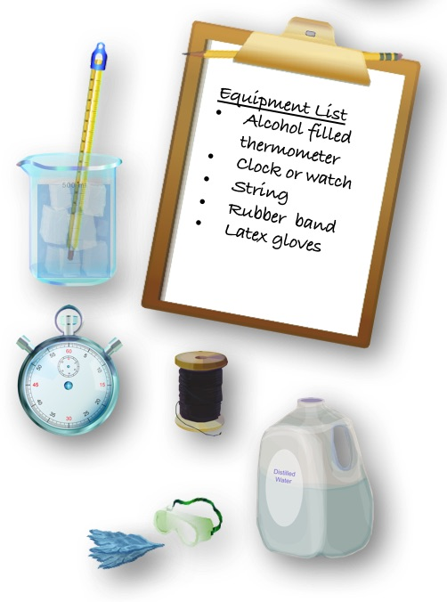
Water Temperature with Alcohol Filled Thermometer Protocol
Assemble Equipment:
Alcohol-filled thermometer
Latex gloves and goggles
Clock or watch
Rubber band
Enough string to lower the thermometer
into the water
For Calibration, You Also Need:
Thermometer
400 mL ice
Distilled water
500 mL beaker

Slide 24
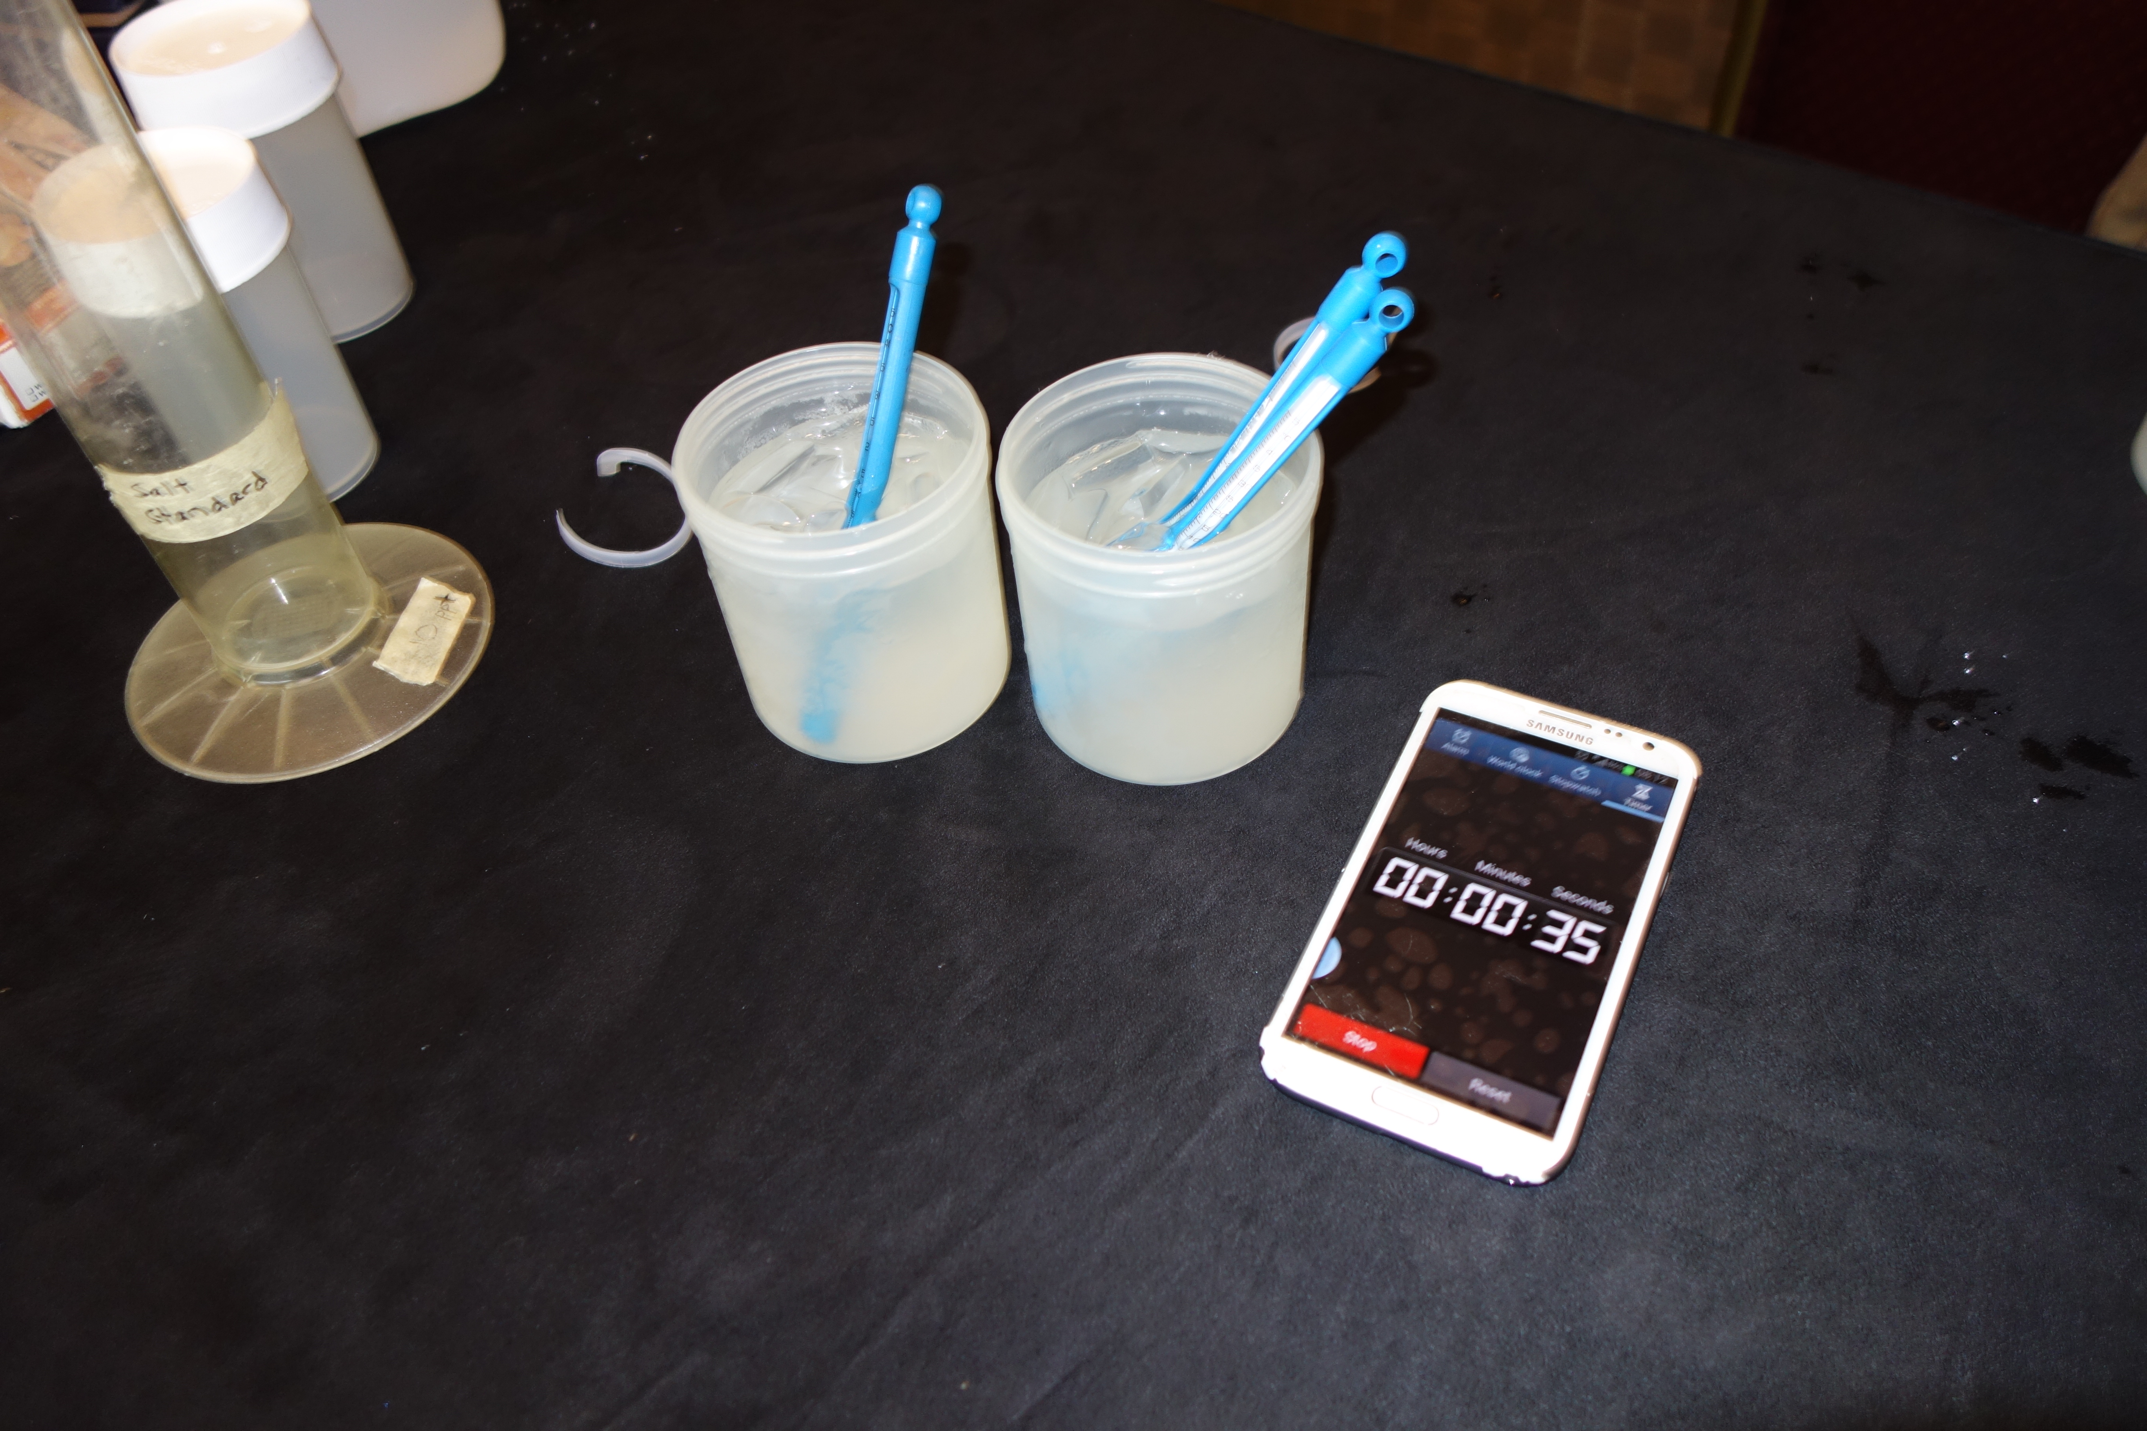

Thermometer Calibration- Steps 1-4
Stir together 100 mL of water and 400 mL of crushed ice in the beaker to make an ice-water bath.
Let the ice-water bath sit for 10 to 15 minutes so that it reaches its lowest temperature.
Put the bulb of the thermometer into the bath. Gently move the thermometer around in the ice-water bath.
Leave the thermometer in the water for three minutes.
Pay close attention to your calibration procedure. Without the calibration step your temperature data will not be meaningful or comparable to data collected by others!

Slide 25
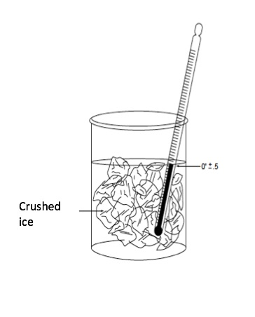
Thermometer Calibration: Steps 5-9
Read the temperature without removing the bulb of the thermometer from the water.
Let the thermometer stay in the water sample for one more minute.
Read the temperature again. If the temperature has not changed, go to Step 8. If the temperature has changed since the last reading, repeat Step 6 until the temperature stays the same.
The thermometer should read between -0.5˚ and 0.5˚ C.
Alcohol-filled thermometers do not have an adjustment and must be replaced if they do not read temperature with the expected accuracy (± 0.5° C).
Perform calibration every 3 months

Slide 26
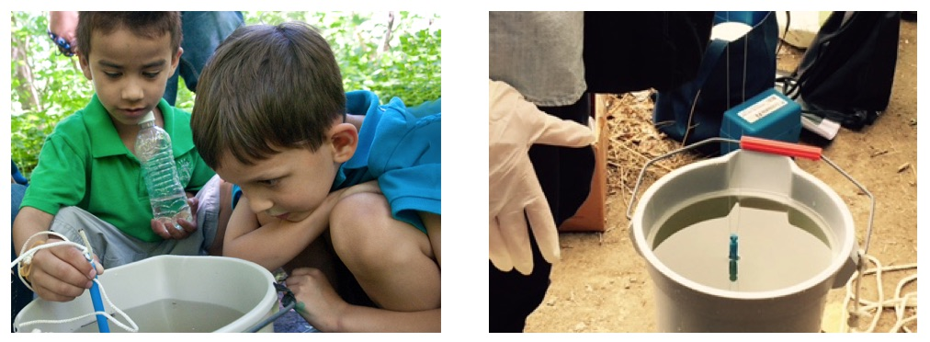
Collecting Data in the Field with Alcohol Filled Thermometer - Steps 1-5
Fill out the top portion of your Hydrosphere Investigation Data Sheet.
Put on the gloves.
Slip the rubber band around your wrist so that the thermometer is not accidentally lost or dropped into the water.
Check the alcohol column on your thermometer to make sure there are no air bubbles trapped in the liquid. If the liquid line is separated, notify your teacher.
Put the bulb end of the thermometer into the sample water to a depth of 10 cm.

Slide 27
Collecting Data in the Field with Alcohol Filled Thermometer - Steps 6-10
6. Leave the thermometer in the water for three minutes.
7. Read the temperature without removing the bulb of the thermometer from the water.
8. Let the thermometer stay in the water sample for one more minute.
9. Read the temperature again. If the temperature has not changed, go to Step 10. If the temperature has changed since the last reading, repeat Step 8 until the temperature stays the same.
10. Record the temperature on the Hydrosphere Investigation Data Sheet

Slide 28
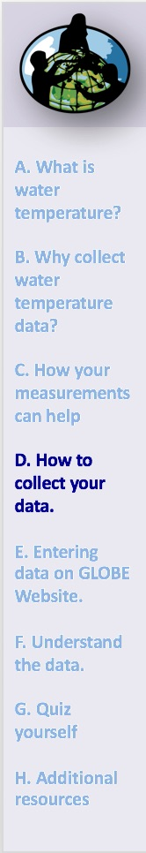
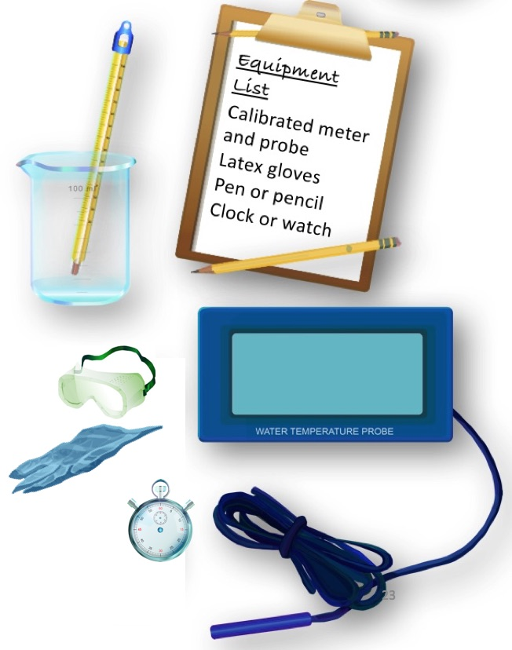
Water Temperature with Temperature Probe Protocol
Assemble Equipment:
Calibrated meter and probe
Latex gloves/goggles
Pen or pencil
Clock or watch
For Calibration:
See Manufacturer’s instructions

Slide 29
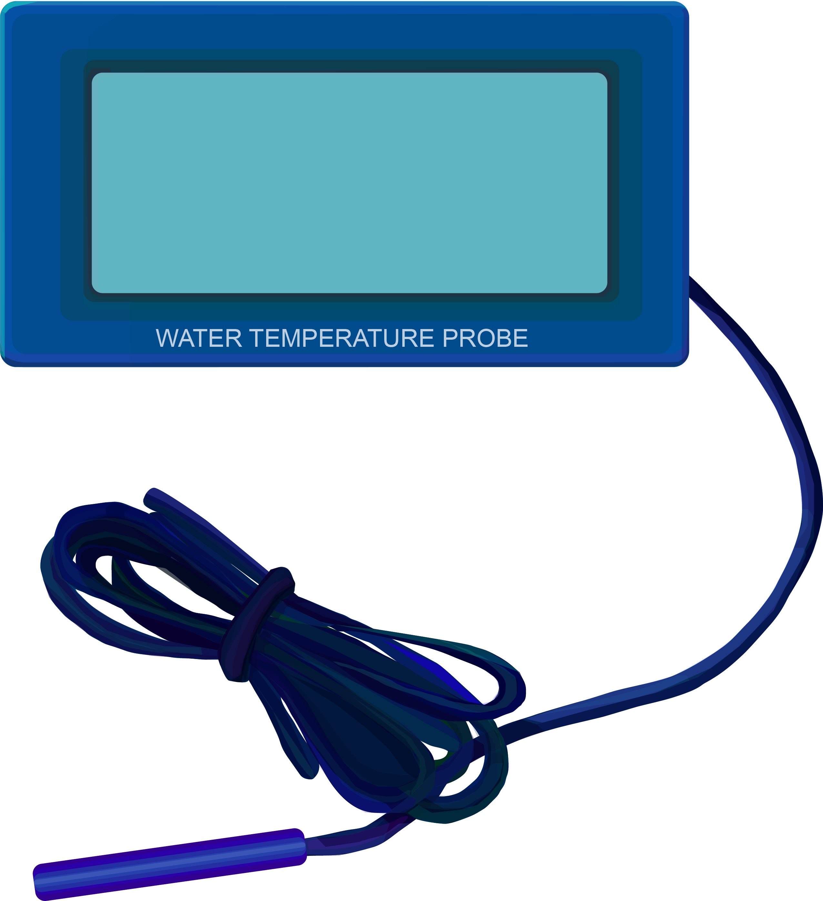
Temperature Probe Calibration
Temperature meters must be calibrated before use. Check with your meter manufacturer to be sure it stores the most recent calibration. If it does, the temperature meter should be calibrated in the classroom or lab before going to the Hydrosphere Study Site. If your meter does not keep the most recent calibration, you will need to calibrate it just before you take your measurements taking care not to turn the meter or any associated software off.
Pay close attention to your calibration procedure. Without the calibration step your temperature data will not be meaningful or comparable to data collected by others!

Slide 30
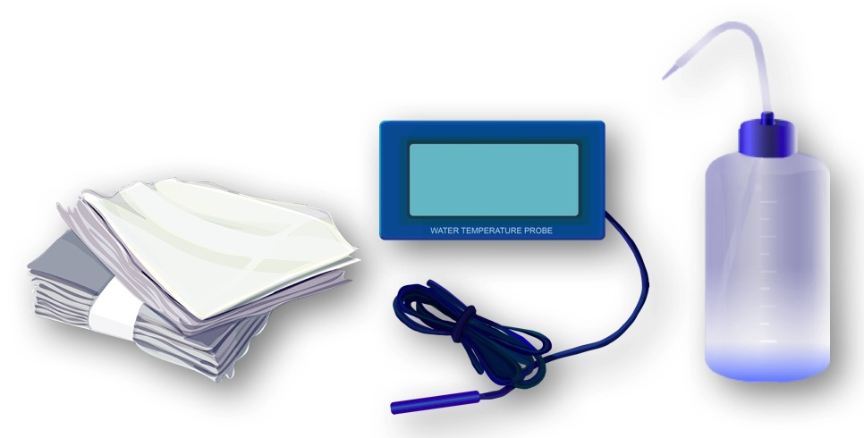
Temperature Probe Care
The probe should be stored with the cap on.
The probe should be well rinsed with distilled water after use to avoid mineral deposit accumulation.
The probe should periodically be cleaned with alcohol.

Slide 31
Collecting Data in the Field with Temperature Probe Steps: 1-7
Make sure that your temperature probe and meter have been calibrated within the last 24 hours (see Manufacturer’s Instructions).
Fill out the top portion of your Hydrosphere Investigation Data Sheet.
Put the probe into the sample water to a depth of 10 cm.
Leave the probe in the water for three minutes.
Read the temperature on the meter without removing the probe from the water.
Let the thermometer probe stay in the water sample for one more minute.
Read the temperature again. If the temperature has not changed, go to Step 8. If the temperature has changed since the last reading, repeat Step 6 until the temperature stays the same.

Slide 32
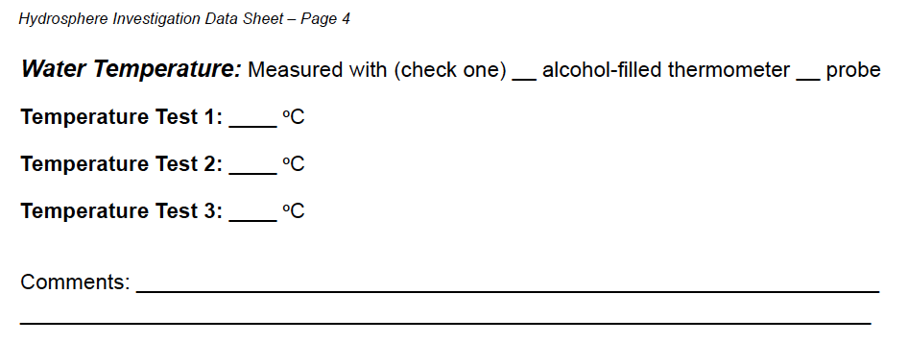
Collecting Data in the Field with Temperature Probe Steps: 8-11
Record the temperature on the Hydrosphere Investigation Data Sheet.
Have two other students repeat the measurement with new water samples.
Calculate the average of the three measurements.
All temperatures should be within 1.0˚ C of the average. If they are not, repeat the measurement.

Slide 33
Let’s do a quick review before moving onto GLOBE data reporting and visualization Question 4
True or False: Temperature probes must be calibrated before use.
What is the answer?

Slide 34
Let’s do a quick review before moving onto GLOBE data reporting and visualization Answer to Question 4
True or False: Temperature probes must be calibrated before use.
The answer is True.
Were you correct?

Slide 35
Let’s do a quick review before moving onto GLOBE data reporting and visualization, Question 5
All temperatures should be within _____ of the average.
1.0˚ C of the average of 3 replicate readings of the sample
.5˚ C of the average of 3 replicate readings of the sample
they all need to be identical, otherwise repeat the measurements
What is the answer?

Slide 36
Let’s do a quick review before moving onto GLOBE data reporting and visualization, Answer to Question 5
All temperatures should be within _____ of the average.
1.0˚ C of the average of 3 replicate readings of the sample ☺ Correct!
.5˚ C of the average of 3 replicate readings of the sample
they all need to be identical, otherwise repeat the measurements
Were you correct?
Now let’s review how to report your data to GLOBE.

Slide 37
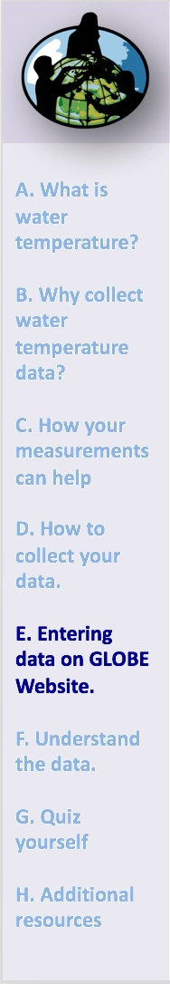
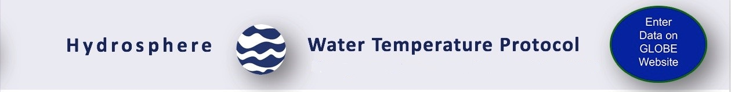
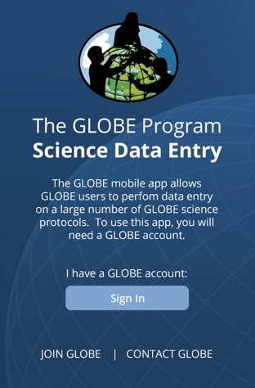
Report Data to the GLOBE Database
Live Data Entry: Upload your data to the official GLOBE science database.
Email Data Entry: Send data in the body of your email (not as an attachment) to DATA@GLOBE.GOV.
Mobile Data App: Download the GLOBE Science Data Entry app to your mobile device and select the right option:
  For Android via Google Play
  For IOS via the App Store

Slide 38
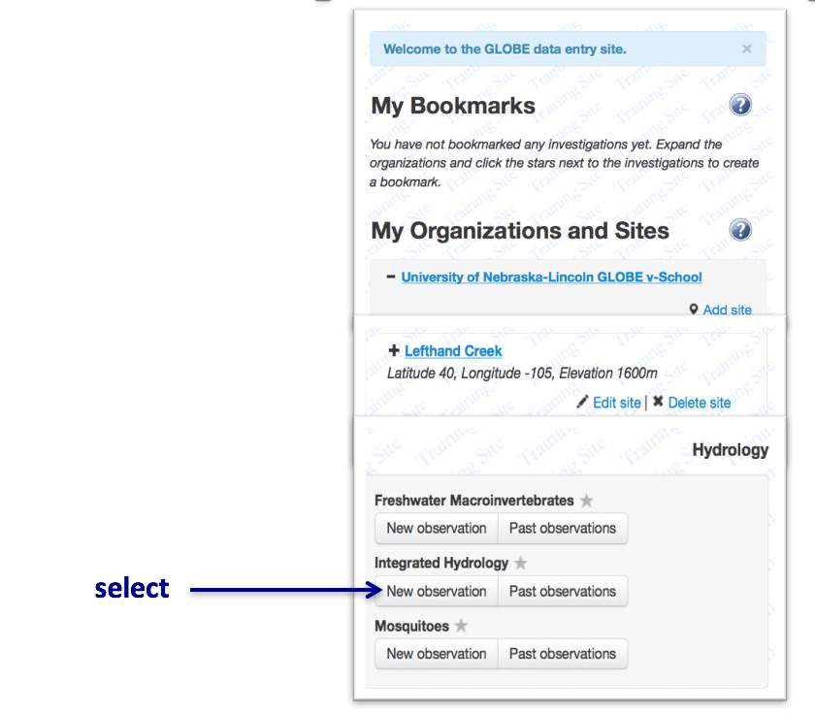
Entering your data via Live Data Entry or Data Entry Mobile App-Step 1

Slide 39
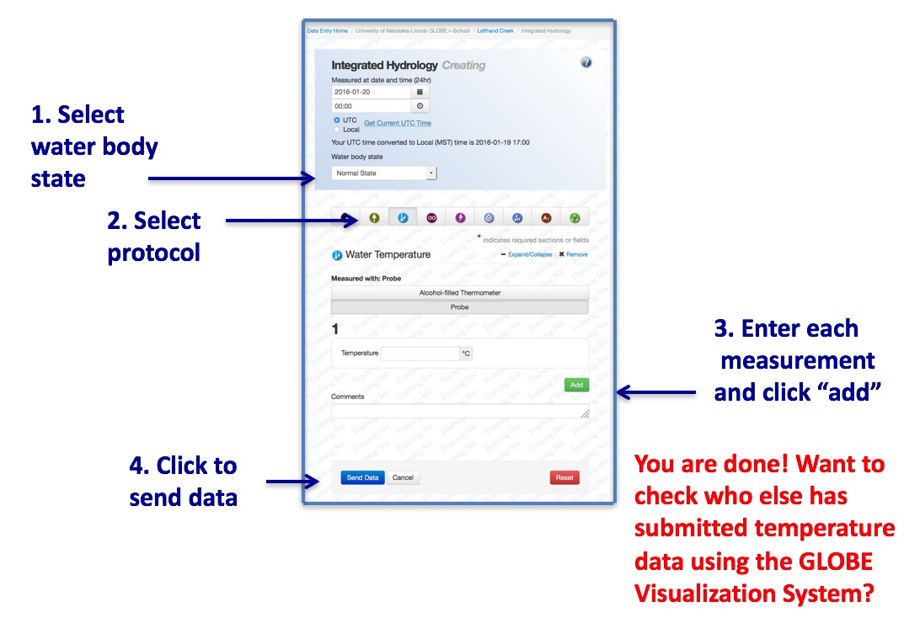
Entering your data via Live Data Entry or Data Entry Mobile App-Step 2

Slide 40
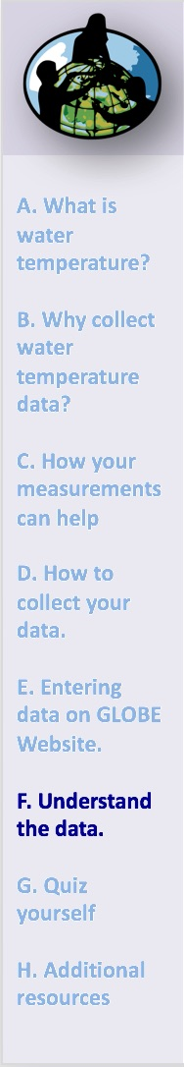
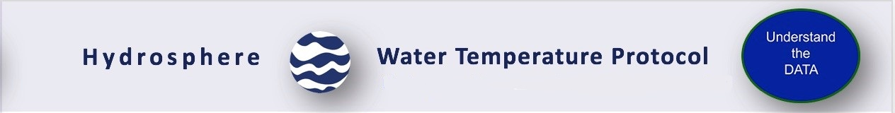
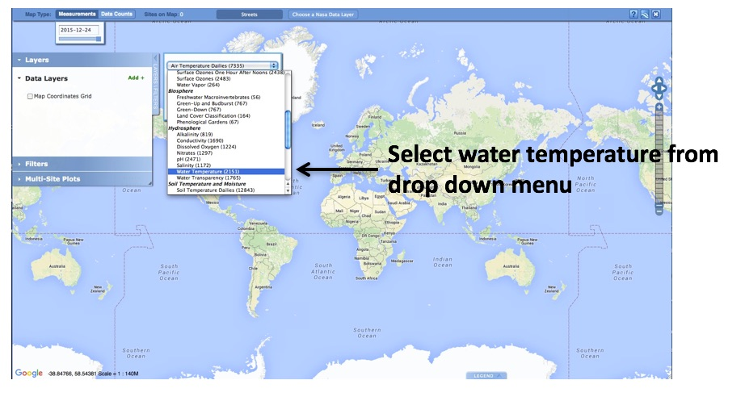
Visualize and Retrieve Water Temperature Data- Step 1
GLOBE provides the ability to view and interact with data measured across the world. Select our visualization tool to map, graph, filter and export water temperature data that have been measured across GLOBE protocols since 1995. Here are screenshots steps you will use when you use the visualization tool:
Link to step-by-step tutorial on using the GLOBE Data Visualization Tool

Slide 41
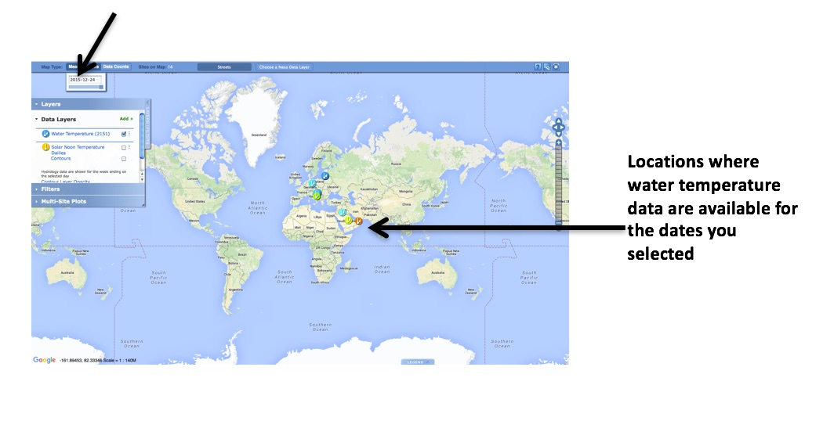
Visualize and Retrieve Water Temperature Data- Step 2
Select the date for which you need water temperature data, add layer and you can see where data are available:

Slide 42
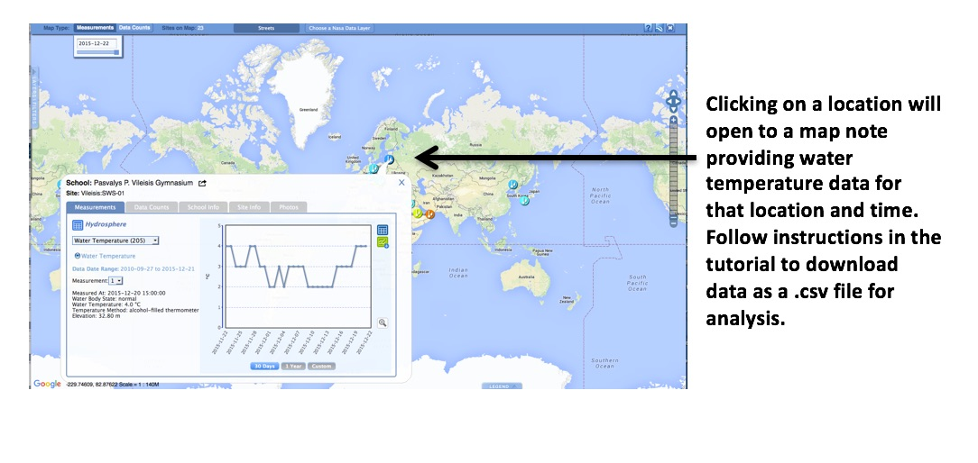
Visualize and Retrieve Water Temperature Data- Step 3
Select the sampling site for which you need water temperature data, and a box will open with data summary for that site.

Slide 43

Review questions to help you prepare to conduct the water temperature protocol
Which measurement should you take first, if you are conducting water protocols: dissolved oxygen, pH, or temperature?
Do you read the water temperature measurement when the probe or thermometer is in the water, or held just above the water surface?
What step must be conducted on the instruments before the water temperature measurement is made?
All three replicate measurements should be within ___˚ C of the average.
Water has a (higher/lower) heat capacity than air, so it heats and cools more (slowly/quickly).
Warmer water tends to have higher/lower concentrations of dissolved oxygen.
Where would you get the most representative water temperature sample: from a still area of the water, from rapids, or from a riffle?
What are the safety precautions you should take when doing any of the hydrology protocols?

Slide 44
Ready to Take the Quiz?
You have now completed the slide stack. If you are ready to take the quiz, sign on and take the quiz corresponding to Water Temperature Protocol.
You can also review the slide stack, post questions on the discussion board, or look at the FAQs on the next page.
When you pass the quiz, you are ready to take Water Temperature Protocol measurements!

Slide 45


FAQ: Frequently Asked Questions
I noticed on the GLOBE Web site that some schools were reporting water temperatures below 0.0˚ C. Is this possible?
Yes. Distilled water will freeze at 0.0˚ C, but adding dissolved particles in the water may lower the freezing point.
Why is the water temperature sometimes colder and sometimes warmer than the air temperature?
Water has a higher specific heat than air. This means it takes water longer to heat up and longer to cool down than it does air. As a result, air responds much more quickly than water to changes in temperature.

Slide 46

Please provide us with feedback about this module. This is a community project and we welcome your comments, suggestions and edits! Comment here: eTraining Feedback
Questions about module content? Contact GLOBE: help@globe.gov
Credits
Slides:
Russanne Low, Ph.D., University of Nebraska-Lincoln, USA
Rebecca Boger, Ph.D., Brooklyn College, NYC, USA
Cover Art:
Jenn Glaser, ScribeArts
More Information:
The GLOBE Program
NASA Earth Science
NASA Global Climate Change: Vital Signs of the Planet
The GLOBE Program is sponsored by these organizations:
Version 12/1/16. If you edit and modify this slide set for use for educational purposes, please note “modified by (and your name and date) “ on this page. Thank you.

