Slide 1
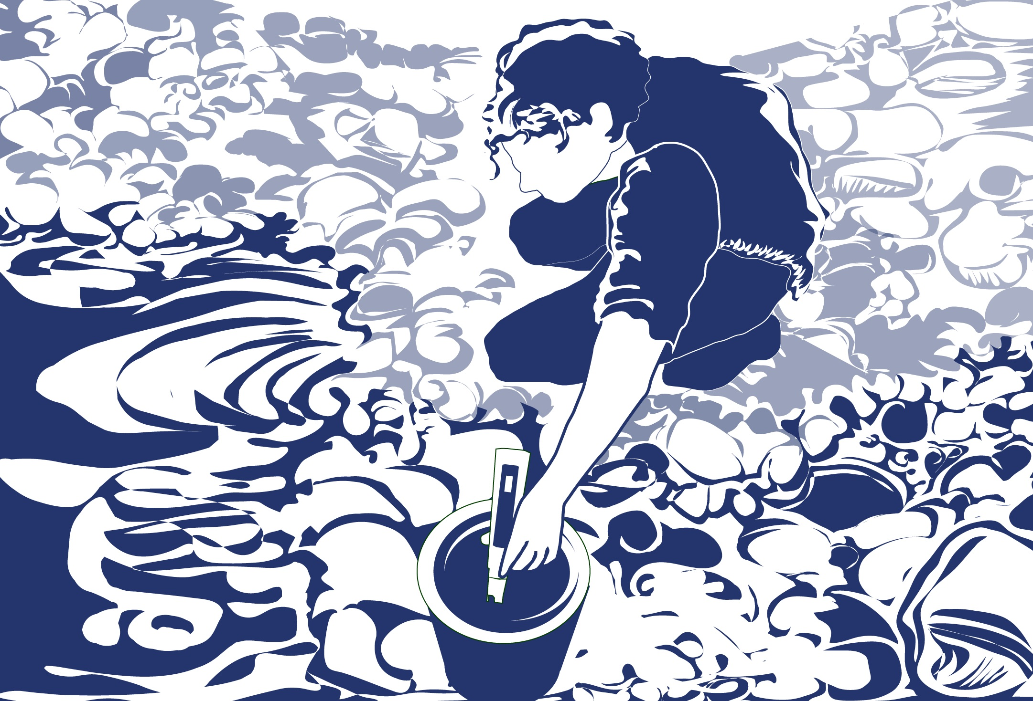
Slide One

Slide 2
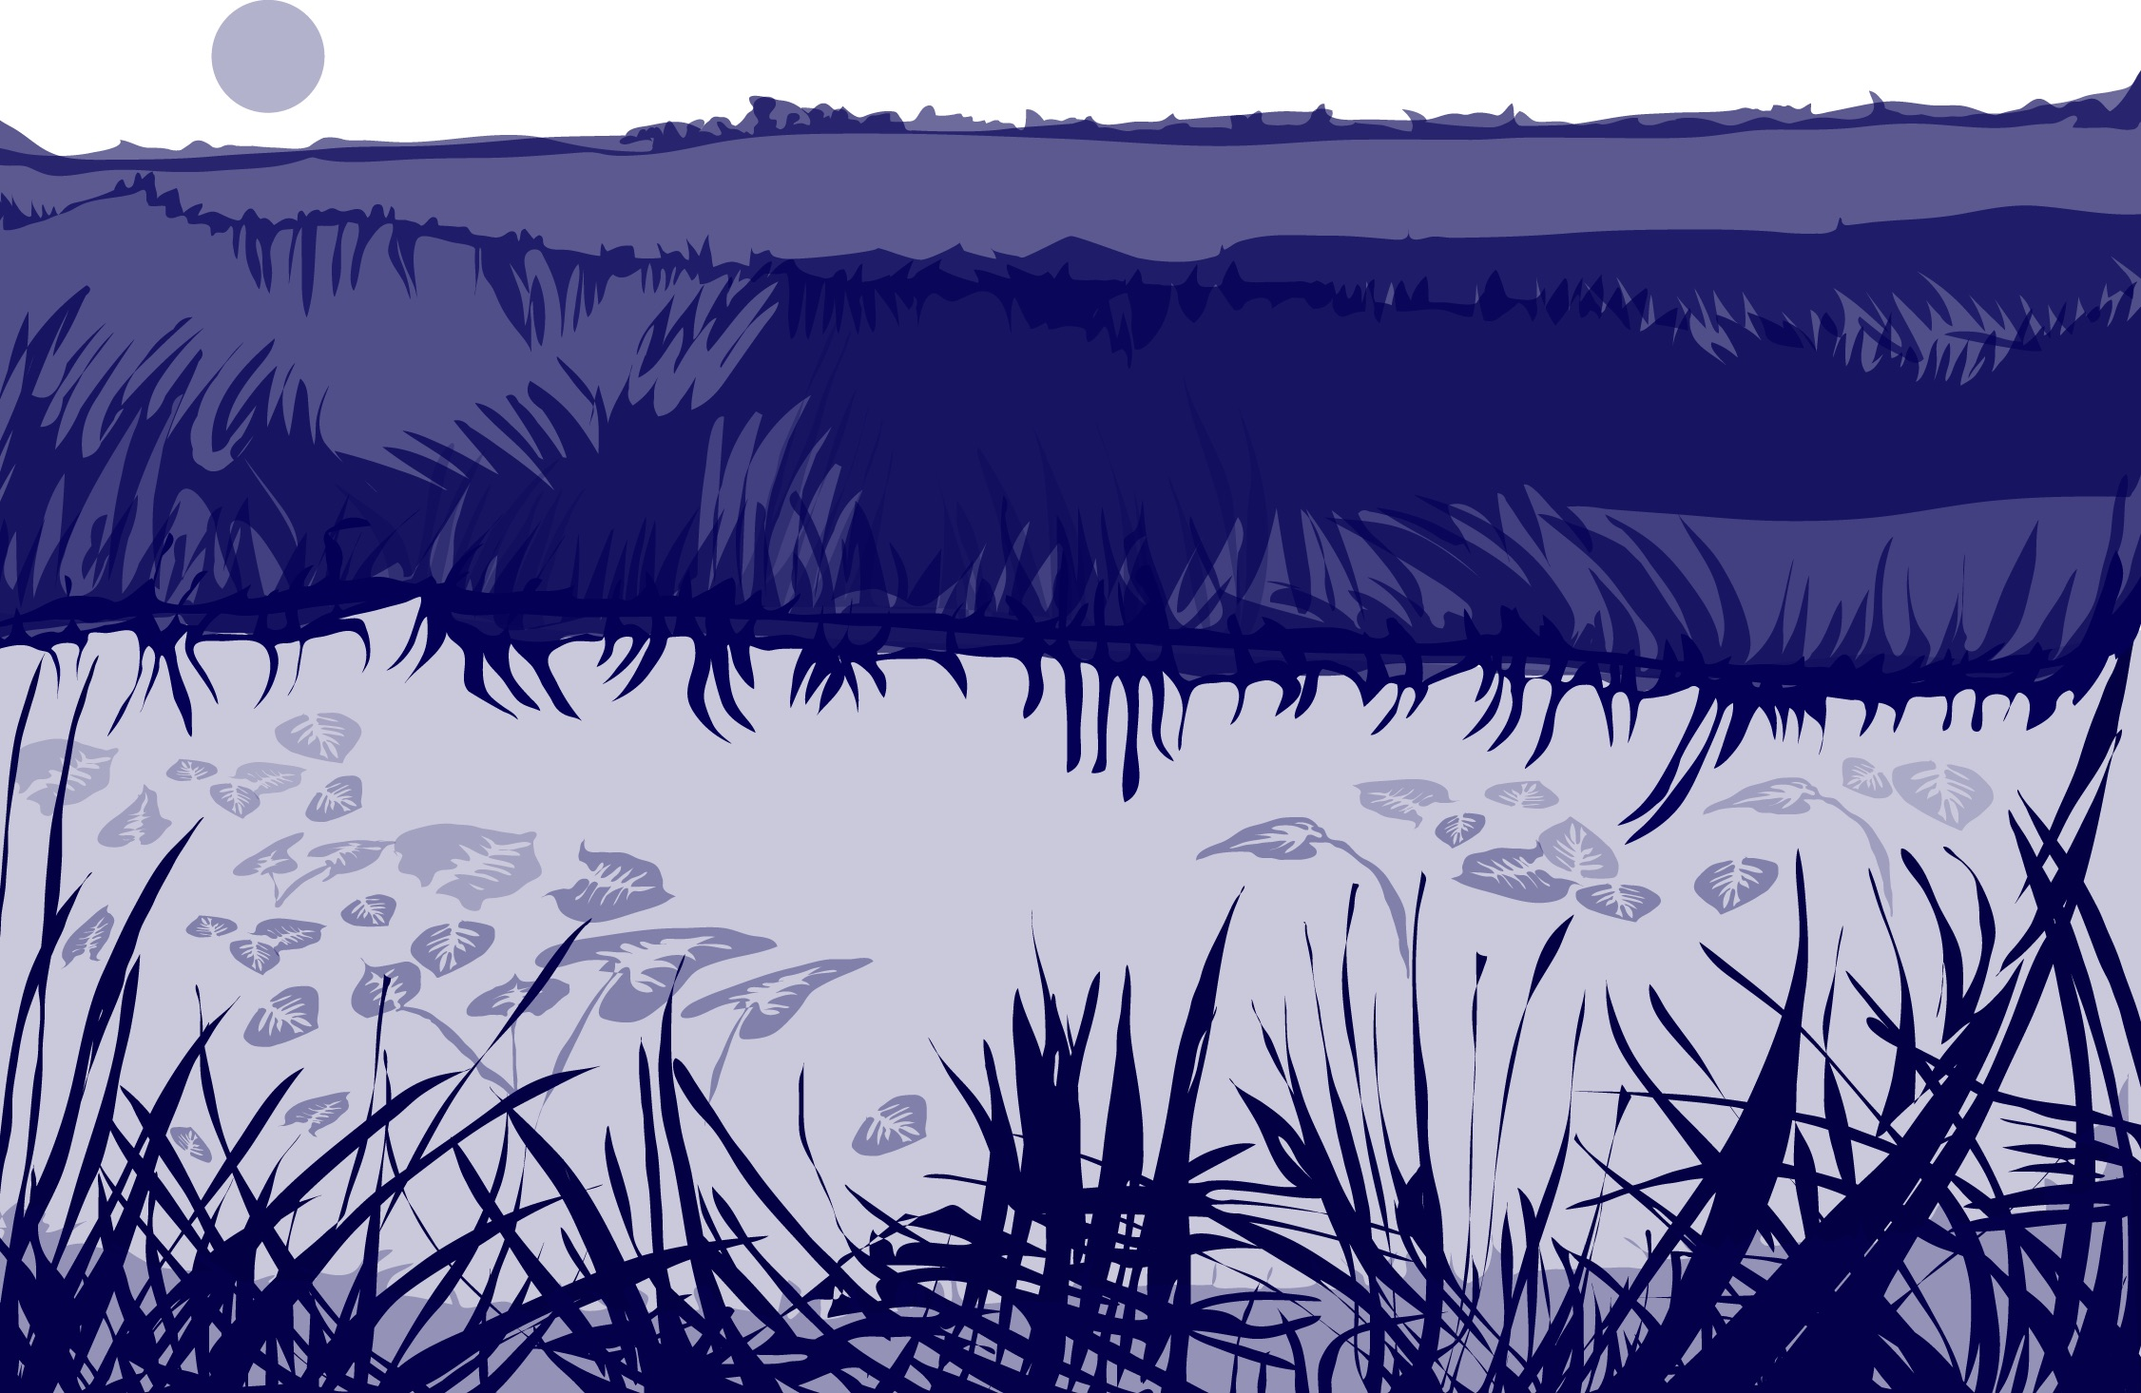
Overview: Water pH Protocol
This module:
Reviews the selection of a GLOBE hydrology site
Reviews the water sampling technique used in GLOBE hydrology protocols
Provides a step by step introduction of the protocol method
Learning Objectives
After completing this module, you will be able to:
Define water pH and explain how environmental variables result in different measurements
Describe the importance of instrument calibration in the the collection of accurate data
Conduct water pH measurements using a pH meter or pH paper
Upload data to the GLOBE portal
Visualize data using GLOBE’s Visualization System
Estimated time needed to complete this module: 1.5 hours

Slide 3
The Hydrosphere in the Earth System
The hydrosphere is the part of the Earth system that includes water, ice and water vapor. Water participates in many important natural chemical reactions and is a good solvent. Changing any part of the Earth system, such as the amount or type of vegetation in a region or from natural land cover to an impervious one, can affect the rest of the system. Rain and snow capture aerosols from the air. Acidic water slowly dissolves rocks, placing dissolved solids in water. Dissolved or suspended impurities determine water's chemical composition.
Current measurement programs in many areas of the world cover only a few water bodies a few times during the year. GLOBE Hydrosphere protocols will allow you to collect valuable data to help fill these gaps and improve our understanding of Earth's natural waters.
The Earth System: Energy flows and
matter cycles.

Slide 4
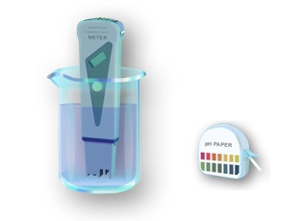
The Hydrosphere
GLOBE has a number of protocols that are part of the Hydrosphere Investigation. To measure the acidity of a water body, you will use one of the water pH protocols. You have the choice of using either a pH meter or pH paper in your investigations.

Slide 5
What is Water pH?
PH is a measure of the relative amount of free hydrogen ions there are in the water, which determines the acidity of the water body.
The concentration of the hydrogen ion [H+] activity in a solution determines the pH. Mathematically this is expressed as:
pH = - log [H+]
pH is reported in logarithmic units from 0-14, with 7 being neutral. Each number represents a 10x change in the acidity or alkalinity of the water.
The pH values for your water site will depend on the geology, soil and vegetation of your area as well as other inputs into your water body. The origin of the air masses that precipitate into your water body may affect the pH of the water. Most lakes and streams have pH values that range between 6.5 and 8.5. Oceans have a pH value of 8.2. Pure water not in contact with the air has a neutral pH value of 7.0.
Naturally occurring basic waters are found typically in areas where the surrounding geology is rich in minerals such as calcite or limestone.

Slide 6
pH and Aquatic Life
pH affects most chemical and biological processes that take place in water. pH affects the solubility (amount that can be dissolved in water) and biological availability of nutrients. It also determines the degree to which potentially toxic materials, such as heavy metals, are soluble.
pH has a strong influence on what can live in the water; aquatic organisms have certain pH ranges they prefer or require. Salamanders, frogs and other amphibian life, as well as many macroinvertebrates, are particularly sensitive to extreme pH levels. Most insects, amphibians and fish are absent in water bodies with pH below 4.0 or above 10.0.
Since most organisms are sensitive to changes in water pH, scientists monitor unusual decreases or increases in the pH of water bodies.

Slide 7
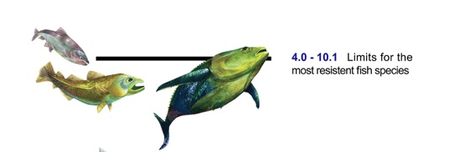
Acid pH and Aquatic Ecosystems
Without pollution, rain would have a pH of about 5.6. However, in most parts of the world, rain pH is more acidic than this. Sulfur dioxide (SO₂) and nitrogen oxides (No_{x}) and other compounds mix with water vapor and return to the Earth surface as acid rain. Acid rain can have a pH of 4.3-4.7 – nearly 10x the acidity of natural deposition.
Acid deposition has many harmful effects on aquatic ecosystems:
As the pH approaches 5, invasion of non-desirable species of plankton and mosses can occur and some fish, such as smallmouth bass, begin to disappear.
Below a pH of 5, fish populations dwindle and disappear, the bottom is covered with non-decayed material, and mosses may colonize in wetlands.
Below a pH of 4.5, the water is essentially devoid of fish.

Slide 8
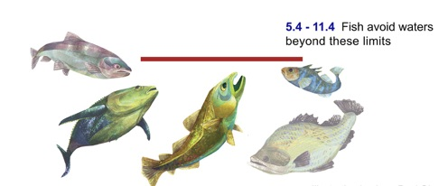
Alkaline pH and Aquatic Ecosystems
Highly alkaline (basic) waters are also hazardous for aquatic life. For example, ammonia is ten times more toxic at a pH of 8 than it is at pH 7.
When the pH of freshwater becomes highly alkaline (e.g. 9.6), the effects on fish may include:
death
damage to outer surfaces like gills, eyes, and skin inability to dispose of metabolic wastes
Source : http://www.lenntech.com/aquatic/acids-alkalis.htm#ixzz4CnIUVwOU

Slide 9
Monitoring Water Bodies is Critical to Ecosystem Health
There are waters that are naturally more acidic when there are certain types of minerals in the water, such as sulfides. Mining can also release acid forming compounds to water bodies.
Pollution can change a water's pH, which in turn can harm animals and plants living in the water. For instance, the 2015 spill of mine waste into the Animas River, caused the Animas to have a pH of 5- acidic. By using the logarithm scale, this mine-drainage water would be 100 times more acidic than neutral water.
pH does not normally change a great deal, although you may find some seasonal trends due to changes in temperature, rainfall patterns, or land cover. However, a dramatic change in pH in a water body can be an indicator of increasing pollution or other environmental factor, as seen here.
The Animas River between Silverton and Durango in Colorado, USA, within 24 hours of the 2015 Gold King Mine waste water spill Credit: Riverhugger, Wikipedia Commons.

Slide 10
Let’s do a quick review before moving onto data collection! Question 1
When determining pH, you are measuring:
The relative amount of free hydrogen ions there are in the water
The total dissolved solids in the water
The ability of water to transmit an electrical current
What is the answer?

Slide 11
Let’s do a quick review before moving onto data collection! Answer to Question 1
When determining pH, you are measuring:
The relative amount of free hydrogen ions there are in the water ☺ Correct!
The total dissolved solids in the water
The ability of water to transmit an electrical current
Were you correct?

Slide 12
Let’s do a quick review before moving onto data collection! Question 2
Logarithmic scale- Between pH 5 and 6, there is a ___ change in acidity.
2 x
10 x
100 x
1000 x
What is the answer?

Slide 13
Let’s do a quick review before moving onto data collection! Answer to Question 2
Logarithmic scale- Between pH 5 and 6, there is a ___ change in acidity.
2 x
10 x ☺ Correct!
100 x
1000 x
Were you correct?

Slide 14
Let’s do a quick review before moving onto data collection! Question 3
Which of the following pH values has greater acidity?
pH 4
pH 7
pH 9
What is the answer?

Slide 15
Let’s do a quick review before moving onto data collection! Answer to Question 3
Which of the following pH values has greater acidity?
pH 4 -☺ Correct!
pH 7
pH 9
Were you correct?
Let’s now look at the data collection procedures!

Slide 16
Overview of Water pH Protocol
pH of a water body can be measured using either a pH meter or pH paper. The accuracy of either method depends on the electrical conductivity of the water. The electrical conductivity needs to be at least 200 µS/cm for these methods to report accurately.
If you are sampling ocean or brackish water, you can assume that the electrical conductivity of your sample is greater than 200 µS/cm. If you are not sure if the fresh water at your Hydrosphere Study Site has a conductivity value high enough for the measurement technique (paper or meter), you will need to measure the electrical conductivity before taking your pH measurements. After you know the electrical conductivity value of the water, use the appropriate pH field guide.
For more information, see the Electrical Conductivity Field Guide Protocol

Slide 17
Simultaneous or Prior Investigations Required to do Water pH Measurements: Hydrosphere Study Site Description
You will need to define your Hydrosphere Study Site. A Hydrosphere Study Site can be any surface water site that can be safely visited, although natural waters are preferred.
The Hydrosphere Investigation Data Sheet is used to record all the hydrosphere measurements, including Water pH. You will also want to map your Hydrosphere Site at some point.
To define you study site you will need these documents:
Selecting and Documenting your Hydrosphere Study Site
Hydrosphere Investigation Data Sheet
Mapping your Hydrosphere Study Site Field Guide

Slide 18
Simultaneous or Prior Investigations Required: Study Site Selection
Ideally, your Hydrosphere Study Site should be within the major watershed of the 15 km by 15 km GLOBE Study Site, and connected to water systems that flow into larger river or estuary systems.
All your hydrosphere measurements are taken at the same Hydrosphere Study Site. This may be any surface water site that can be safely visited and monitored regularly, although natural waters are preferred. Sites may include (in order of preference):
1. stream or river
2. lake, reservoir, bay or ocean
3. pond
4. an irrigation ditch or other water
body, if natural body is not available

Slide 19
Site Selection and Sampling- Hydrosphere Study Site
If the selected study site is a moving body of water (i.e. stream or river), locate your sampling site at a riffle area as opposed to still water or rapids. This will provide a more representative measurement of the water in the stream or river. If the selected study site is a still body of water (i.e. a lake or reservoir), find a sampling site near the outlet area or along the middle of the water body.
Avoid inlet areas. A bridge or a pier are good choices. If your water body is brackish or salty, you will need to know the times of high and low tide at a location as close as possible to your study site.

Slide 20
Prior Investigations Required: Electrical Conductivity
To obtain accurate pH measurement of your water sample, the electrical conductivity of your sample must be at least 200 µS/cm. After completing the Electrical Conductivity Protocol, refer to your results and select the pH protocol that is appropriate. In this tutorial, we will review all of the protocols, so you can see the differences in procedure between them. You will see that if the Electrical Conductivity is less than 200 µS/cm, you will need to do an extra step, and add salt to the sample until it is at least 200 µS/cm. This is true for both pH paper and pH meter methods.
This slide set includes these protocols:
I. Using pH Meter (electrical conductivity greater than 200 mS/cm)
II. Using pH Meter (electrical conductivity less than 200 mS/cm)
III. Using pH Paper (electrical conductivity greater than 200 µS/cm)
IV. Using pH Paper (electrical conductivity less than 200 mS/cm)

Slide 21
pH Protocol: What do you need to start?
When Suggested Frequency: Weekly
Where Hydrosphere Study Site
Time Needed 10 minutes
Prerequisites Site Definition (can be done at the same time)
Key Instruments pH meter, pH paper, Electrical Conductivity meter
Skill Levels All
Assemble Necessary Documents:
Hydrosphere Investigation Data Sheet
Electrical Conductivity Field Guide
Using A pH Meter (Electrical Conductivity Greater than 200 mS-cm) Field Guide (pdf)
Using A pH Meter (Electrical Conductivity Less than 200 mS-cm) Field Guide (pdf)
Using pH Paper (Electrical Conductivity Greater than 200 mS-cm) Field Guide (pdf)
Using pH Paper (Electrical Conductivity Less than 200 mS-cm) Field Guide (pdf)

Slide 22
Sources for Equipment You Need for the Water pH Protocol
The following resources summarize the measurements associated with each protocol, associated skill level, scientific specifications for the instruments, and how to access the equipment you need (purchase, build, or download).
Where to find specifications for instruments used in GLOBE investigations
Where to find scientific instruments used in GLOBE investigations

Slide 23
Start your Field and Lab work with Safety Steps
Safety is important when conducting the Hydrosphere protocols. While you will need to use your judgment in selecting only hydrosphere study sites that are safe to access and sample, additional precautions are needed.
Students should wear protective gloves and goggles when handling water samples and chemicals to avoid danger from splashes.
When doing GLOBE Hydrosphere Protocols, it is important to protect students from exposure to biting mosquitoes. Ask your students to wear clothes that cover the body so there is little bite area exposed. It is also advisable to apply insect repellent if you are sampling during the mosquito breeding season.

Slide 24
I. pH Water Protocol using a pH Meter: Electrical Conductivity Greater than 200 µS/cm

Slide 25
I. pH Water Protocol using a pH Meter: Electrical Conductivity Greater than 200 µS/cm (1/4)
If your study site is brackish or the Ocean, you can assume that the Electrical Conductivity is greater than 200 µS/cm.
Assemble Water pH Equipment
pH meter
100-ml beaker
Protective gloves
Pen or Pencil
Distilled water in wash bottle
Clean paper towels or tissue
pH Water Protocol using a pH Meter: Electrical Conductivity Greater than 200 µS/cm

Slide 26
I. pH Water Protocol using a pH Meter: Electrical Conductivity Greater than 200 µS/cm (2/4)
1. Fill in the top part of the Hydrosphere Investigation. In the
pH section of the Data Sheet, check the box next to “pH meter”.
2. Put on protective gloves.
3. Remove the cap from the meter that covers the electrode (the glass bulb on the pH meter).
4. Rinse the electrode on the meter and the area around it with distilled water in the wash bottle. Blot the meter dry with a clean paper towel or tissue. Note: Do not rub the electrode or touch it with your fingers.
5. Rinse the electrode with distilled water and blot dry again.

Slide 27
I. pH Water Protocol using a pH Meter: Electrical Conductivity Greater than 200 µS/cm (3/4)
6. Calibrate the pH meter according to the manufacturer’s directions, using the three buffer solutions.
7. Rinse a 100-mL beaker three times with sample water.
8. Pour 50 mL of sample water into the 100-mL beaker.
9. Put the electrode part of the meter into the water.
10. Stir once with the meter. Do not let the meter touch the bottom or sides of the beaker. Wait one minute. If the pH meter is still changing numbers, wait another minute.

Slide 28
I. pH Water Protocol using a pH Meter: Electrical Conductivity Greater than 200 µS/cm (4/4)
14. Calculate the average of the three observations and record on the
Data Sheet:
Calculate Average: Observer 1 + Observer 2 + Observer 3
3
15. Rinse the electrode with distilled water and blot dry. Turn off the meter. Put on the cap to protect the electrode
16. Enter your data on the GLOBE Website.
*End of data collection for this pH Water Protocol*

Slide 29
II. pH Water Protocol using a pH Meter Electrical Conductivity Less than 200 µS/cm

Slide 30
pH Water Protocol using a pH Meter Electrical Conductivity Less than 200 µS/cm (1/8)
Assemble Necessary Equipment:

Slide 31
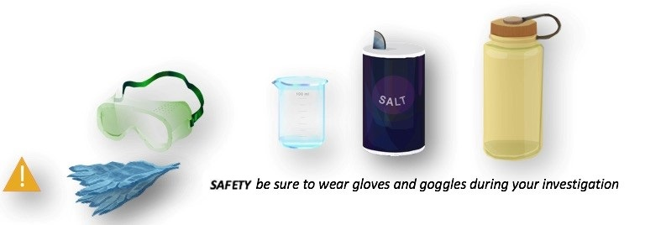
pH Water Protocol using a pH Meter Electrical Conductivity Less than 200 µS/cm (2/8)
1. Fill in the top part of the Hydrosphere Investigation, and check the box next to “pH paper”.
2. Put on protective gloves.
3. Rinse tweezers in sample water and dry with paper towel.
4. Rinse two beakers or cups with sample water three times.

Slide 32
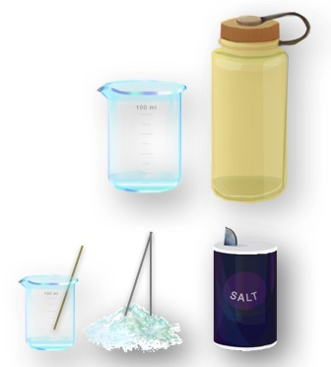
pH Water Protocol using a pH Meter Electrical Conductivity Less than 200 µS/cm (3/8)
Fill one beaker or cup with about 50 mL of sample water.
Using the tweezers, place one crystal of salt in the sample water. (If you do not have salt crystals, use a few grains of table salt and pour that into the sample water)*.
Stir thoroughly with stirring rod or spoon.
*Crystal of about 0.5 – 2.0 mm in diameter are much easier to work with than the very finely ground “table salt” used is some countries. In North America, the larger salt crystals are often marketed as “sea salt”.

Slide 33
pH Water Protocol using a pH Meter Electrical Conductivity Less than 200 µS/cm (4/8)
8. Measure the electrical conductivity of the treated sample water (with the added salt) using the Electrical Conductivity Protocol.
a. If the electrical conductivity is at least 200 µS/cm, record value on Data Sheet. Go to step 9.
b. If the electrical conductivity is still less than 200 mS/cm, go to step 6 and repeat until you get a value that is at least 200 µS/cm.

Slide 34
pH Water Protocol using a pH Meter Electrical Conductivity Less than 200 µS/cm (5/8)
9. Remove the cap from the meter that covers the electrode (the glass bulb on the pH meter).
10. Rinse the electrode on the meter and the area around it with distilled water in the wash bottle. Blot the meter dry with a clean paper towel or tissue. Note: Do not rub the electrode or touch it with your fingers.
11. Rinse the electrode with distilled water and blot dry again.

Slide 35
pH Water Protocol using a pH Meter Electrical Conductivity Less than 200 µS/cm (6/8)
12. Calibrate the pH meter according to the manufacturer’s directions, using the three buffer solutions.
13. Put the electrode part of the meter into the water.
14. Stir once with the meter. Do not let the meter touch the bottom or sides of the beaker. Wait one minute. If the pH meter is still changing numbers, wait another minute.

Slide 36
pH Water Protocol using a pH Meter Electrical Conductivity Less than 200 µS/cm (7/8)
15. Record the pH value on the Hydrosphere Data Sheet (see inset below).
16. Repeat steps 3-10 twice using new water samples. You do NOT need to calibrate the pH meter again. Record conductivity and pH values on the Data Sheet.
17. Check to see if each of the three observations is within 0.2 of the average. If all three are within 0.2, record the average on the Data Sheet. If all three observations are not within 0.2, repeat the measurements.

Slide 37
pH Water Protocol using a pH Meter Electrical Conductivity Less than 200 µS/cm (8/8)
18. Calculate the average of the three observations and record on the Data Sheet.
Calculate Average= Observation 1 + Observation 2 + Observation 3
3
19. Rinse the electrode with distilled water and blot dry. Turn off the meter and put on cap to protect the electrode.
20. Enter your data on the GLOBE Website.
*End of data collection for this pH Water Protocol*
If you cannot get all three measurements within 0.2 of one another, talk to a master trainer about possible problems

Slide 38
III. pH Water Protocol using pH Paper: Electrical Conductivity Greater than 200 µS/cm

Slide 39
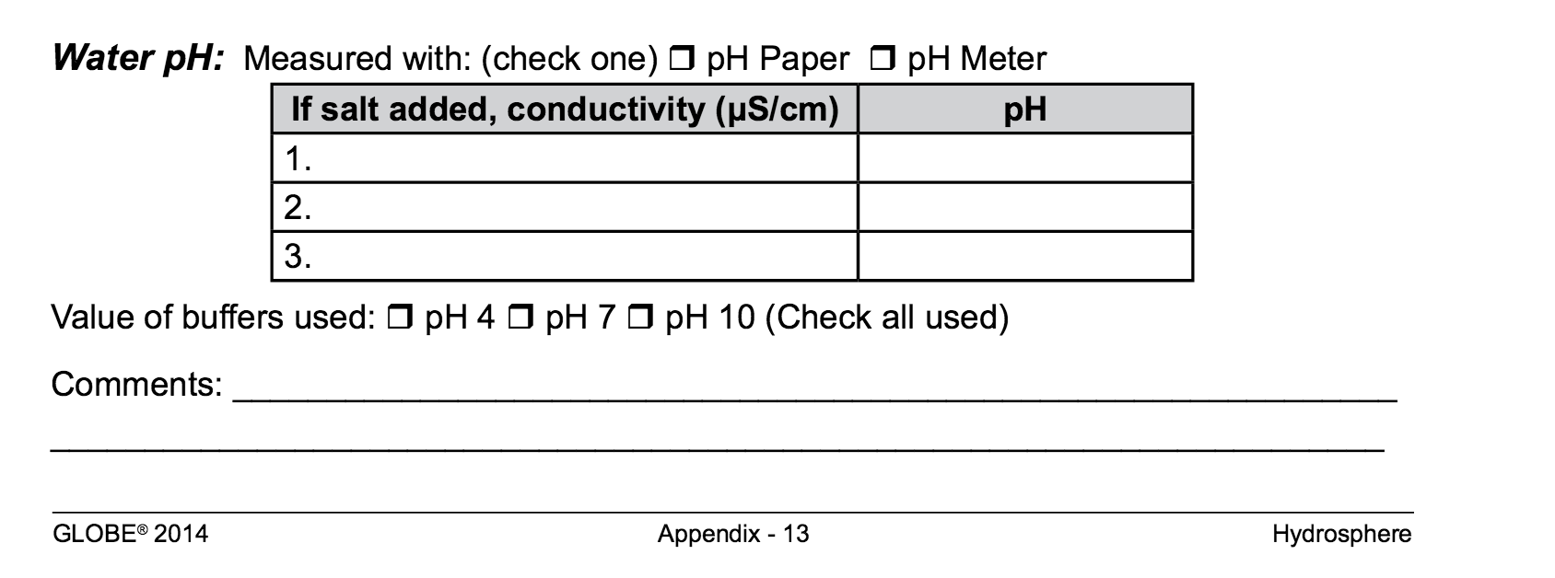
III. pH Water Protocol using pH Paper: Electrical Conductivity Greater than 200 µS/cm (1/3)
Fill in the top part of the Hydrosphere Investigation Sheet.
In the pH section of the Data Sheet, check the box next to “pH paper”.
Put on protective gloves and goggles.

Slide 40
III. pH Water Protocol using pH Paper: Electrical Conductivity Greater than 200 µS/cm (2/3)
4. Rinse the beaker with sample water three times.
5. Fill the beaker halfway with your water sample.
6. Follow instructions that come with your pH paper for testing the sample.
7. Record your pH on the Data Sheet as Observer 1.

Slide 41
III. pH Water Protocol using pH Paper: Electrical Conductivity Greater than 200 µS/cm (3/3)
Repeat steps 4-6 two more times, using fresh sample water and new pH paper.
Record your data, and find the average of the three observations:
Calculate Average:
Observer 1 + Observer 2 + Observer 3 3
Discard used pH paper and gloves in waste container. Rinse beaker with distilled water using the wash bottle.
11. Enter your data on the GLOBE Website.
*End of data collection for this Water pH Protocol *
Check to make sure that each observation is within 1.0 pH units of the average.
If they are not within 1.0 units of the average, repeat the measurements.

Slide 42
IV. pH Water Protocol using pH Paper: Electrical Conductivity Less than 200 µS/cm

Slide 43
IV. pH Water Protocol using pH Paper: Electrical Conductivity Less than 200 µS/cm (1/6)
Assemble Necessary Additional Document:
pH Water Protocol using pH Paper: Electrical Conductivity Less than 200 µS/cm
Check to make sure that each observation is within 1.0 pH units of the average.
If they are not within 1.0 units of the average, repeat the measurements.

Slide 44
IV. pH Water Protocol using pH Paper: Electrical Conductivity Less than 200 µS/cm (2/6) 1
1. Fill in the top part of the Hydrosphere Investigation Sheet. In the pH section of the Data Sheet, check the box next to “pH paper”.
2. Put on protective gloves and goggles.
3. Rinse tweezers in sample water and dry with paper towel.
4. Rinse the beakers with sample water three times.

Slide 45
IV. pH Water Protocol using pH Paper: Electrical Conductivity Less than 200 µS/cm (3/6) 2
5. Fill one beaker or cup with about 50 mL of sample water.
6. Using the tweezers, place one crystal of salt in the sample water. (If you do not have salt crystals, use several grains of table salt (a pile about 2mm wide at the bottom).
7. Stir thoroughly with stirring rod or spoon.
*A note regarding salt crystals. Crystals of about 0.5 – 2.0 mm in diameter are much easier to work with than the very finely ground “table salt” used in some countries. In North America, the larger salt crystals are often marketed as “sea salt”.

Slide 46
IV. pH Water Protocol using pH Paper: Electrical Conductivity Less than 200 µS/cm (4/6)
8. Measure the electrical conductivity of the treated sample water (with the added salt) using the Electrical Conductivity Protocol.
a. If the electrical conductivity is at least 200 µS/cm , record value on Data Sheet. Go to step 9.
b. If the electrical conductivity is still less than 200 µS/cm , go back to step 6 and repeat until you get a value that is at least 200 µS/cm. Record conductivity value on Data Sheet.

Slide 47
IV. pH Water Protocol using pH Paper: Electrical Conductivity Less than 200 µS/cm (5/6)
9. Follow instructions that come with your paper for testing of the pH of the sample.
10. Record your pH on the Data Sheet as Observer 1.
11. Repeat steps 3-9 using new water samples and new pieces of paper. Record the data on the Data Sheet as Observer 2 and Observer 3.
Find the average of the three observations.
Calculate Average: Observer 1 + Observer 2 + Observer 3
3
If you are unable to get readings within 1 pH unit in your three samples, there may be problems with your pH paper.

Slide 48
IV. pH Water Protocol using pH Paper: Electrical Conductivity Less than 200 µS/cm (6/6)
13. Check to make sure that each observation is within 1.0 pH units of the average. If they are not within 1.0 units of the average, repeat the measurements.
14. Discard used pH paper and gloves in a waste container. Rinse the beaker with distilled water.
15. Enter your data on the GLOBE Website.
*End of data collection for this pH Water Protocol*

Slide 49
Let’s do a quick review before moving onto data reporting and visualization! Question 4
To obtain an accurate pH measurement, your water sample should have:
An electrical conductivity of 200 µS/cm or greater
A temperature of greater than 30 degrees C
Both A and B
None of the above, you can just stick the pH paper in the water and take the measurement, and it will be accurate
What is the answer?

Slide 50
Let’s do a quick review before moving onto data reporting and visualization! Answer to Question 4
To obtain an accurate pH measurement, your water sample should have:
An electrical conductivity of 200 µS/cm or greater-correct ☺
A temperature of greater than 30 degrees C
Both A and B
None of the above, you can just stick the pH paper in the water and take the measurement, and it will be accurate
Were you correct?

Slide 51
Let’s do a quick review before moving onto data reporting and visualization! Question 5
How many replicate measurements should be taken for each sample you are testing for pH to ensure accuracy?
2
3
4-6
What is the answer?

Slide 52
Let’s do a quick review before moving onto data reporting and visualization! Answer to Question 5
How many replicate measurements should be taken for each sample you are testing for pH to ensure accuracy?
2
3- ☺ Correct!
4-6
Were you correct?

Slide 53
Let’s do a quick review before moving onto data reporting and visualization! Question 6
To accept your measurements for reporting to GLOBE, each of the independent pH measurements should be:
within 1.0 pH units of the average of the replicate measurements
within –log10 of the average
within 1.0 pH units of pure water
What is the answer?

Slide 54
Let’s do a quick review before moving onto data reporting and visualization! Answer to Question 6
To accept your measurements for reporting to GLOBE, each of the independent pH measurements should be:
within 1.0 pH units of the average of the replicate measurements - ☺ Correct!
within –log10 of the average
within 1.0 pH units of pure water
Were you correct?
Let’s move on to GLOBE data entry and visualization!

Slide 55
Submit your Data to GLOBE
Live Data Entry: Upload your data to the official GLOBE science database.
Email Data Entry: Send data in the body of your email (not as an attachment) to DATA@GLOBE.GOV.
Mobile Data App: Download the GLOBE Science Data Entry app to your mobile device and select the right option.
For Android via Google Play
For IOS via the App Store

Slide 56
Entering your data via Live Data Entry or Data Entry Mobile App- Step 1

Slide 57
Entering your data via Live Data Entry or Data Entry Mobile App- Step 2

Slide 58
Visualize and Retrieve Water pH Data- Step 1
GLOBE provides the ability to view and interact with data measured across the world. Select our visualization tool to map, graph, filter and export pH data that have been measured across GLOBE protocols since 1995. Here are screenshots steps you will use when you use the visualization tool:
Link to step-by-step tutorial on using the GLOBE Data Visualization System

Slide 59
Visualize and Retrieve Water pH Data- Step 2
Select the date for which you need pH data, add layer and you can see where data are available.

Slide 60
Visualize and Retrieve Water pH Data- Step 3
Select the sampling site for which you need pH data, and a box will open with data summary for that site.

Slide 61
Review questions to help you prepare to conduct the Hydrosphere pH Protocol
What is the importance of pH to aquatic life?
What is a logarithmic scale? Why is it a useful way to report pH?
True/False: pH affects the solubility and biological availability of nutrients.
In a water body, what happens to aquatic life in waters with pH values below 4.0 or above 10.0?
What other measurement, in addition to pH, must you do to ensure that your pH paper or meter is reporting accurately?
What are the safety precautions you should take when doing any of the hydrology protocols?
What is the acceptable range of error of the three replicate samples you take?
What kinds of environmental events could change water pH?
Which pH value is more acid: a pH value of 1 or a pH value of 14?
What is the pH value of pure water?

Slide 62
Are you ready to take the quiz?
You have now completed the slide stack. If you are ready to take the quiz, sign on and take the quiz corresponding to Water pH Protocol.
You can also review the slide stack, post questions on the Hydrosphere discussion area, or look at the FAQs on the next page.
When you pass the quiz, you are ready to take Water pH Protocol measurements!

Slide 63
FAQ: Frequently Asked Questions
Does water temperature affect my pH reading?
A change in water temperature can actually change the pH value of your water. Since we want to know the actual pH value, we do not correct for this change.
Temperature can also affect the performance of the meter. The electrode is designed so there is no temperature sensitivity when the pH is 7.0. As the pH moves away from this value, the water temperature affects meter accuracy. Meters with automatic temperature compensation (ATC) correct for the temperature of the water at values above and below 7.0 by a factor of 0.003 pH/ ̊C/pH unit away from pH 7. They correct for meter error.
Does high salt concentration affect pH?
Salt concentration can affect pH. As salt concentration increases, pH can increase. This is not a linear relationship, but can be important in estuaries, where the salinity varies with the tide. Taking into account salinity or conductivity data may be useful in understanding variations in your pH measurements.

Slide 64
FAQ: Frequently Asked Questions-2
Why may pH measurements be inaccurate in low conductivity waters?
To measure the hydrogen ion concentration, you are actually measuring the potential of the hydrogen ions. Other ions have to be present to pass the current to make this measurement. When they are at too low of a concentration the meter slowly drifts and if the drift is really slow, the meter locks in on an incorrect measurement.
Can I use a pH meter that connects to my Smart Phone?
Yes, pH meters that connect to iPhones, iPads and other Smart devices can be considered pH meters. For most of these meters an app is required.

Slide 65
Please provide us with feedback about this module. This is a community project and we welcome your comments, suggestions and edits! Comment here: eTraining Feedback Questions about module content? Contact GLOBE: help@globe.gov
Credits
Slides:
Russanne Low, Ph.D., University of Nebraska-Lincoln, USA
Rebecca Boger, Ph.D., Brooklyn College, NYC, USA
Photos: Russanne Low
Art: Jenn Glaser, ScribeArts
More Information:
The GLOBE Program
NASA Wavelength NASA’s Digital Library for Earth and Space Education
NASA Global Climate Change: Vital Signs of the Planet
The GLOBE Program is sponsored by these organizations:
Version 12/1/16. If you edit and modify this slide set for use for educational purposes, please note “modified by (and your name and date) “ on this page. Thank you.

