Slide 1
GLOBE Africa Regional Meeting New and Upcoming Web and App Enhancements
April 30, 2024
Cornell Lewis
Axient Corporation

Slide 2
Recent Web Site Enhancements

Slide 3
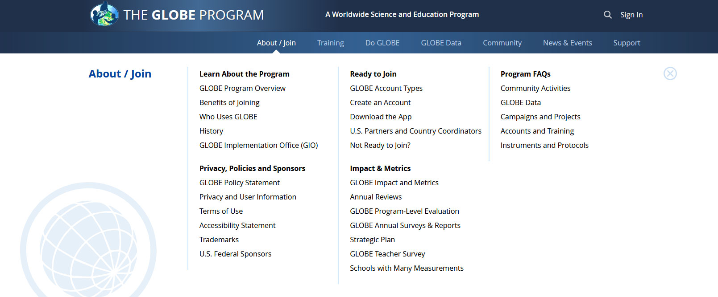
New ‘Mega’ Menus
Easy to use menus to get a quick glance of content
Restructured some content to improve findability

Slide 4
Improved ‘About GLOBE’ Section
The section was re-structured to provide clearer information on what GLOBE is, how teachers, citizen scientists and other use GLOBE, and the benefits of joining.
Account Type definitions and capabilities are better explained.

Slide 5
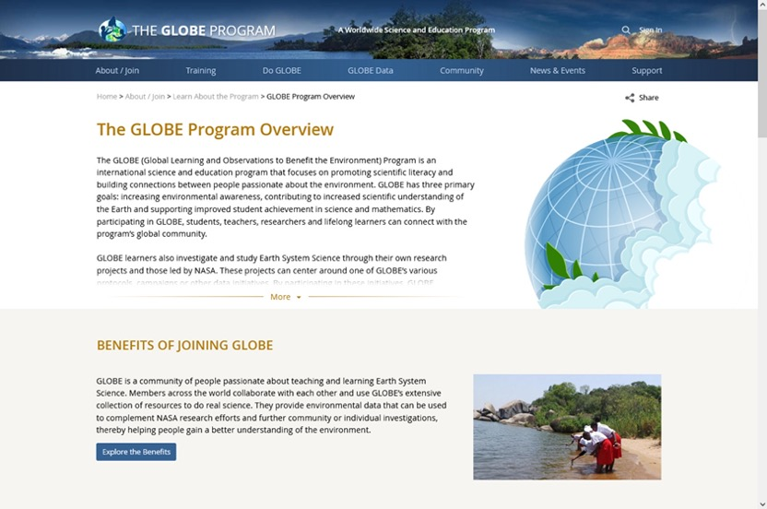
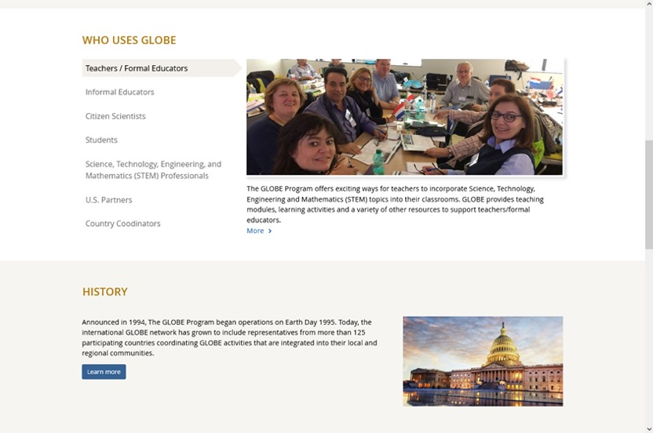
Improved ‘About GLOBE’ Section

Slide 6
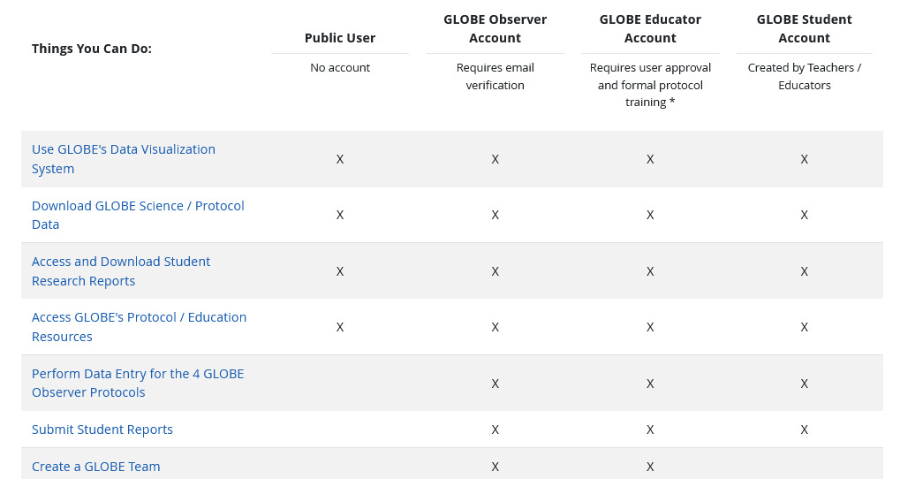
Improved ‘About GLOBE’ Section

Slide 7
New Account Creation Forms
One path for all users.
One form for both the website and GLOBE Observer app.
Users can identify which best describes them (formal or informal educator, citizen scientist, STEM professional) to allow us provide targeted content.
Teachers / Educators can elect to create a GLOBE Observer or a GLOBE Educator account depending on their needs.
A step counter was added to the form to help guide users through the account creation process.
All users are now required to verify their email address.
Country Coordinators still approve all requests for GLOBE Educators, Schools and Informal Educators in their country.

Slide 8
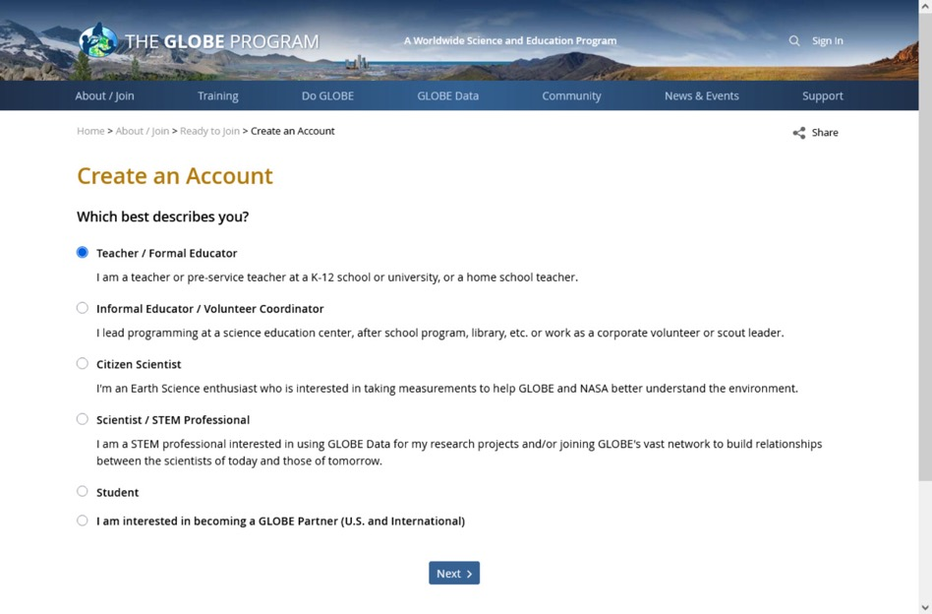
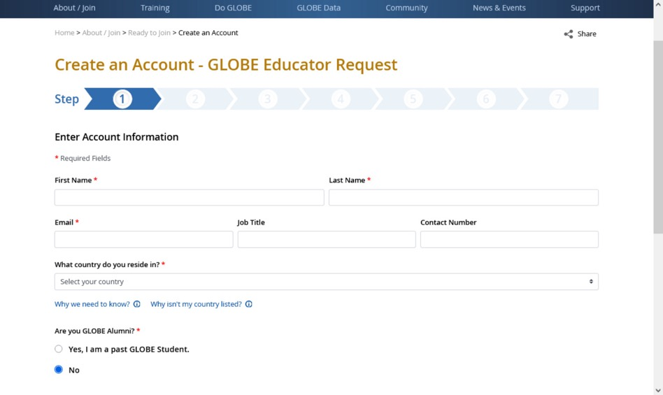
New Account Creation Forms

Slide 9
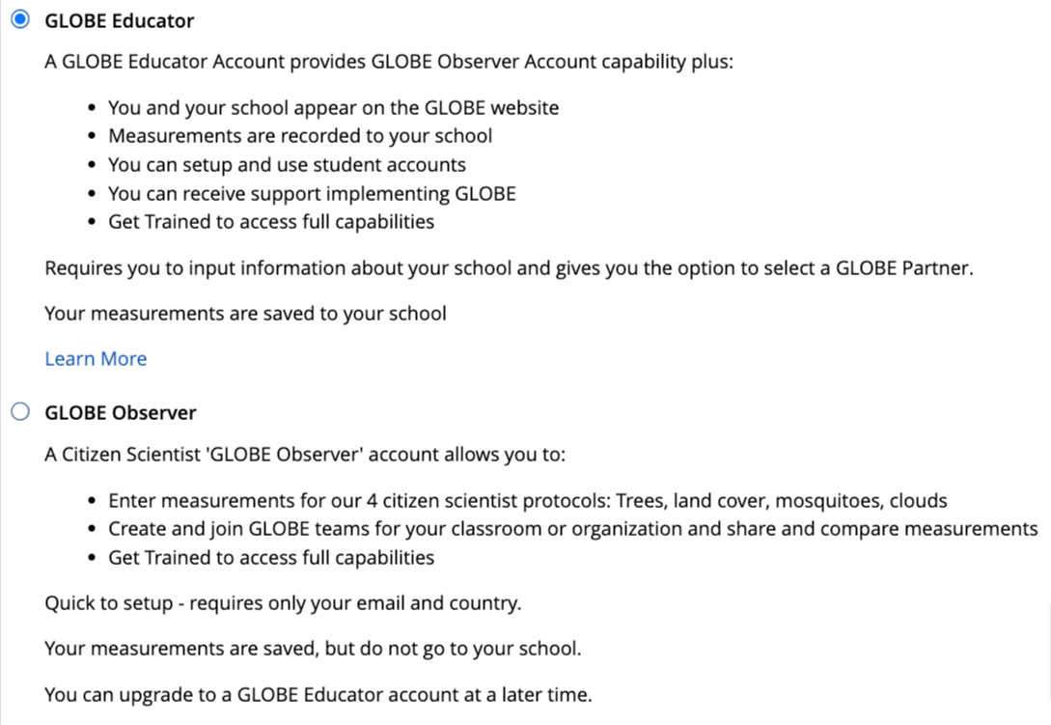
Educators can choose Educator or Observer path
For teachers who just want to try things out, select Observer Option
Same as GLOBE Observer, except we can see in the system if they are a citizen scientist or an educator (how many teachers are just doing observer?)

Slide 10
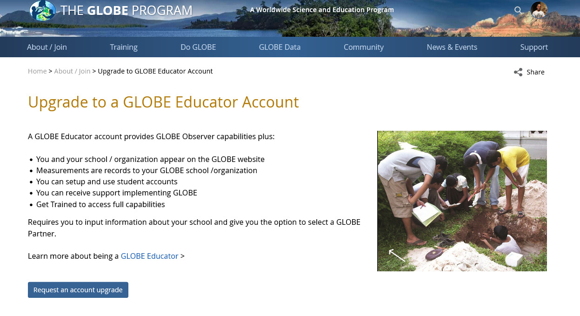
Account Upgrade Form for GLOBE Observers
Educators with a GLOBE Observer account are now able to request an upgrade to a GLOBE Educator account via an on-line application.
The application is sent to the Country Coordinator for approval
They will be able to enter their school information and be submitted for approval as a GLOBE Educator

Slide 11
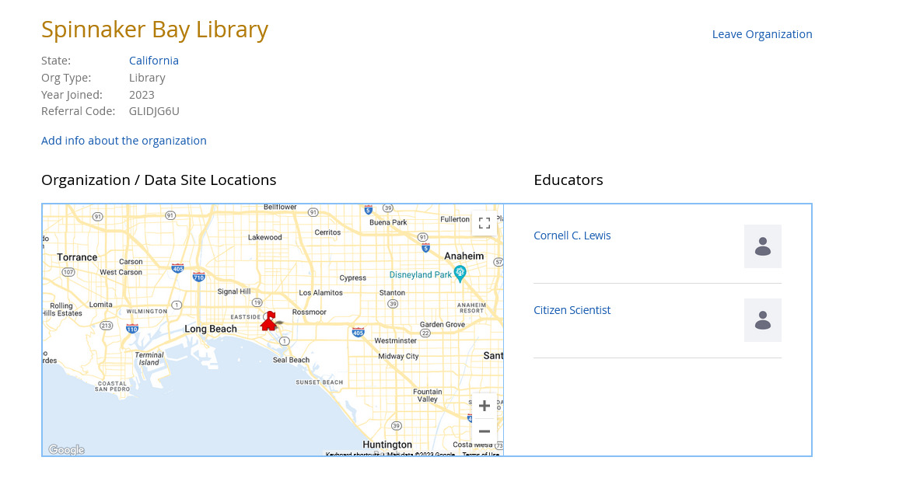
Introduction of Informal Education Organizations
Informal Educators who create a GLOBE account can now request to have their informal education organization become a GLOBE organization.
Libraries, science centers, museums, aquariums, etc. are given a presence on the GLOBE website and can have their GLOBE data associated with their organization.

Slide 12
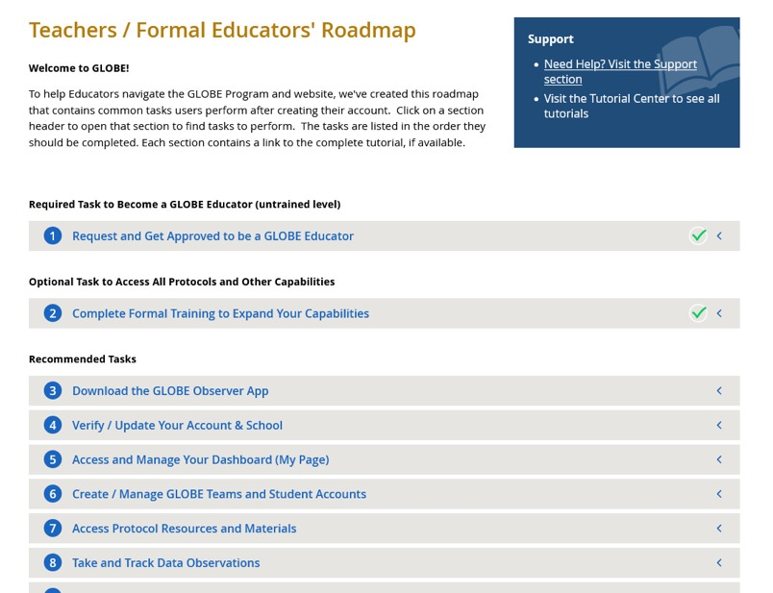
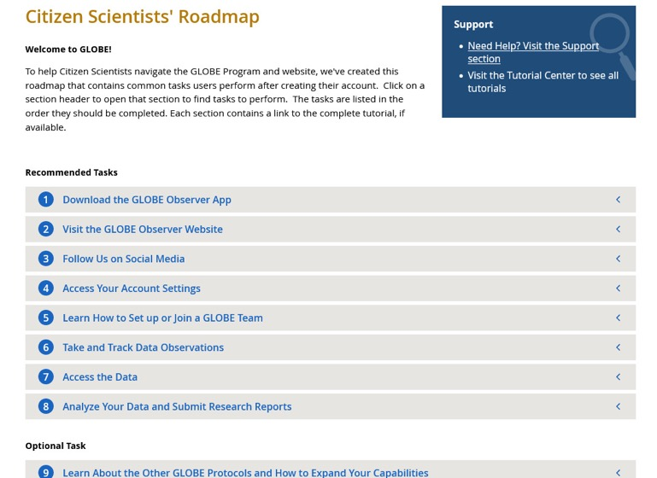
User Roadmaps
User Roadmaps are guides to help new and existing GLOBE members navigate the website by providing a list of commonly performed tasks by GLOBE users.
There’s a roadmap for each user type with links to tutorials and content on the website.

Slide 13
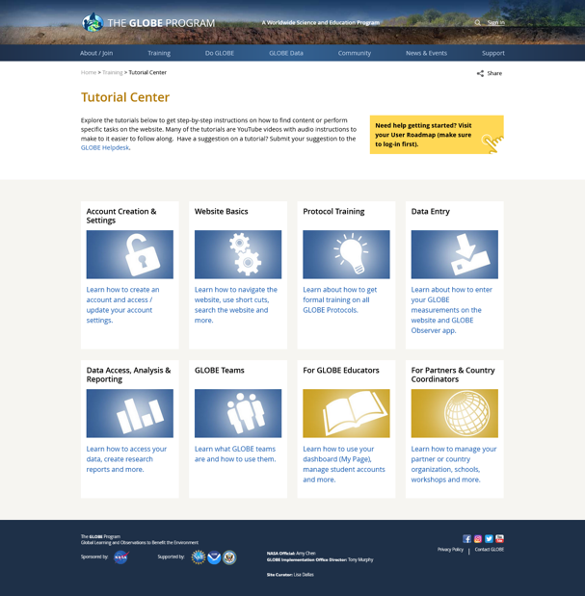
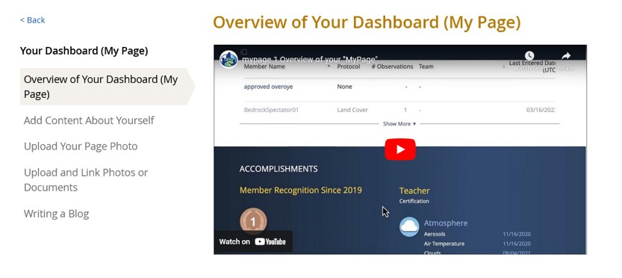
Tutorial Center
All site tutorials are now in one place.
Most tutorials are short ‘chapters’ to allow users to quickly find the help they need.
YouTube videos are available for most of the tutorials.

Slide 14
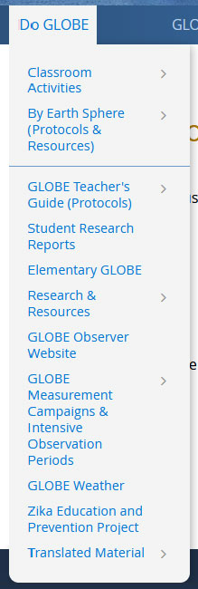
Site Re-Architecture (Phase 1) – Restructuring the Do GLOBE Section
Do GLOBE section was simplified to reduce the number of content areas.
Sphere communities and Teacher’s Guide pages were merged to reduce confusion on where to go to learn about Spheres and Protocols.
1st phase of site re-architecture with goal to make it easier for the community to find content and have a central place to learn about the GLOBE Protocols.

Slide 15
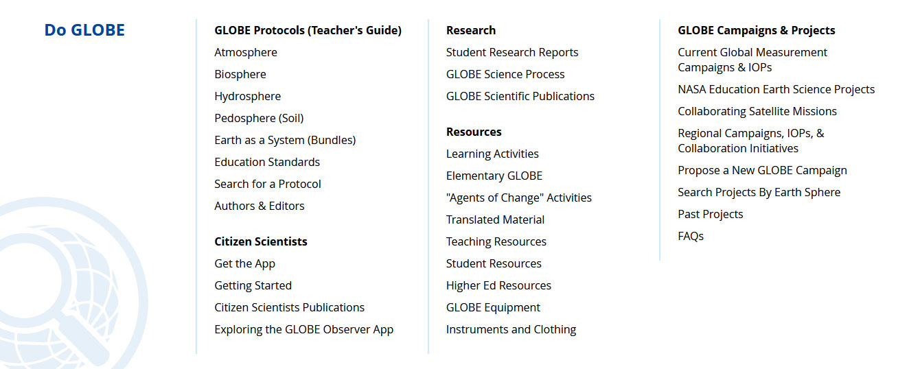

Slide 16
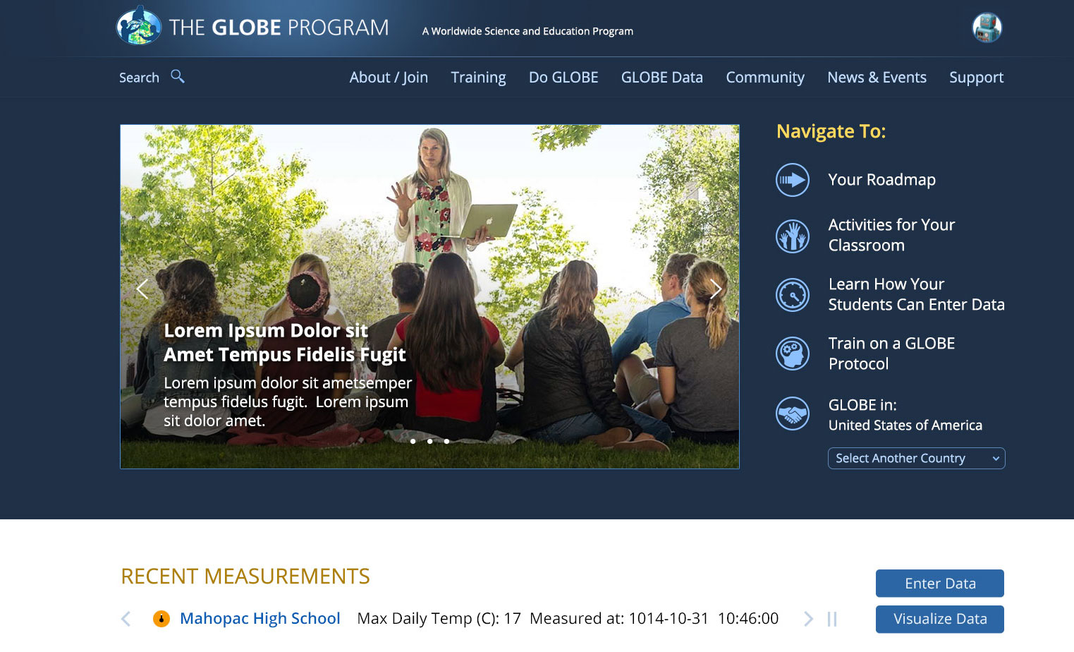
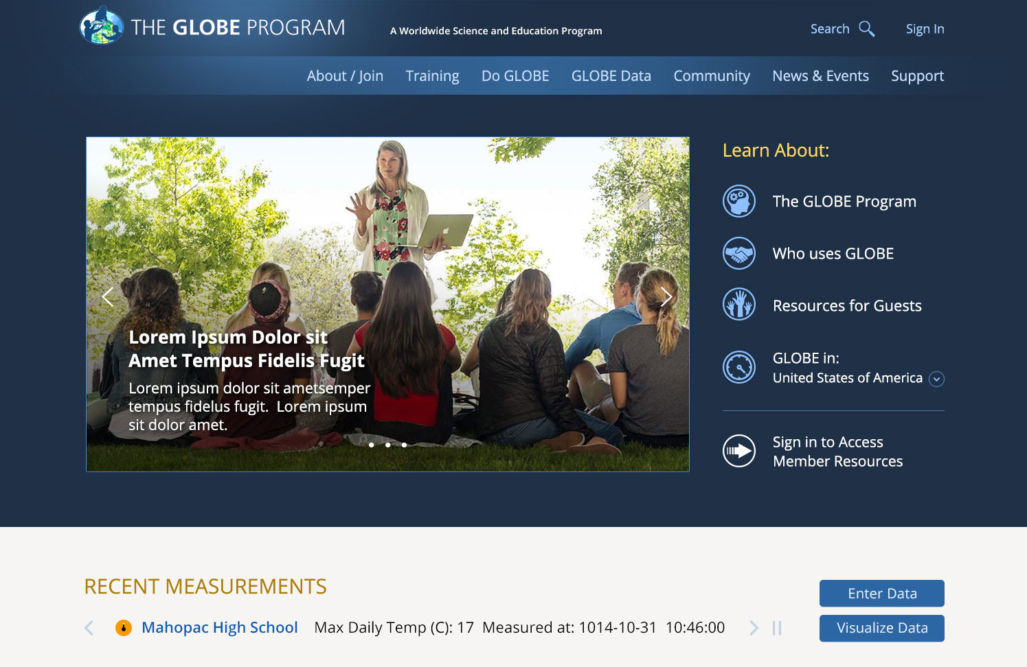
Enhanced Featured Content Area on the Home Page
Content users quickly want to access will be featured at the top of the home page.
Content will be customized for the different user types – Educators, Citizen Scientists, Students, Guests, etc.
Reduced Area of Featured Rotator

Slide 17
New Web-Based eTraining Modules (courses)
New Web-Based e-Training modules are now available.
Replaces the PowerPoint Presentations.
Incorporates interactive features to improve the user experience.
Downloadable version is still available.

Slide 18
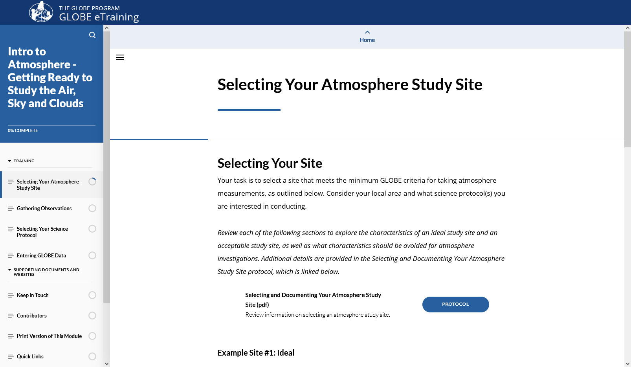
New Web-Based eTraining Modules (courses)

Slide 19
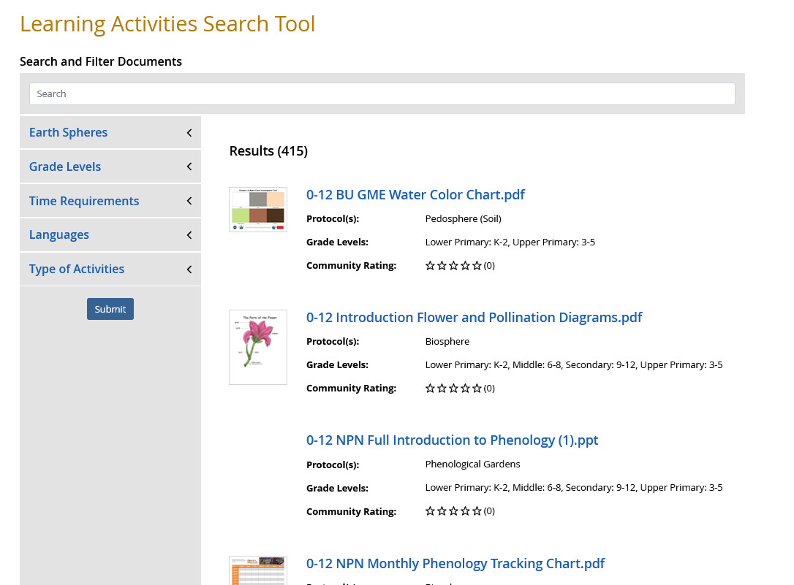
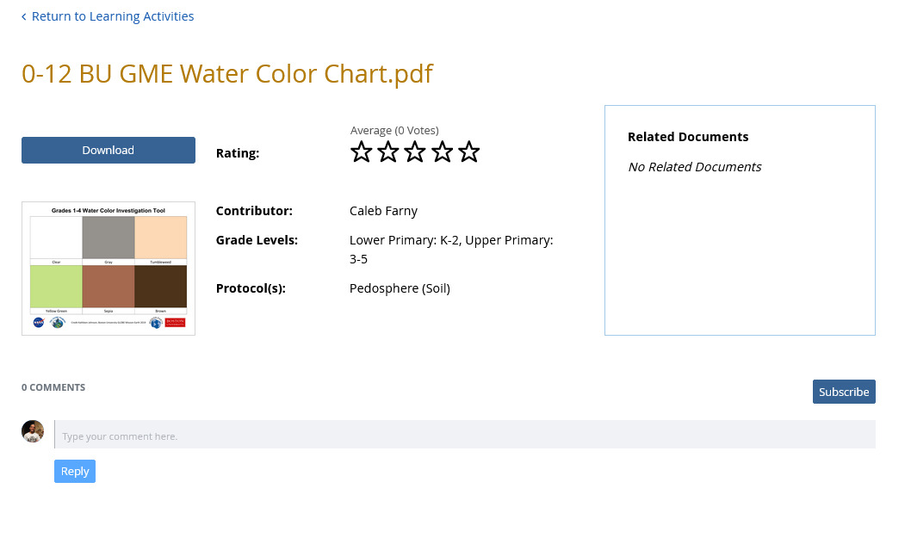
GLOBE Learning Materials Search and Submission Tool
New search tool to allow the GLOBE community to easily find learning activities
Tool allows community members to contribute to the GLOBE library of resources by allowing them to upload resources for others to use, comment and “like” submitted resources

Slide 20
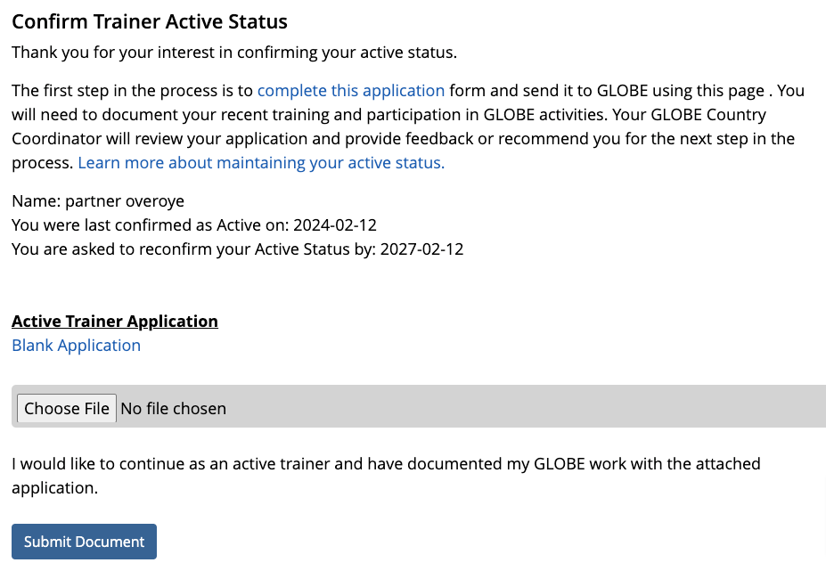
GLOBE Active Trainer Status
Allows GLOBE Trainers to re-certify as active trainers through the online tool.
CCs will get requests as they do now for people who want to become trainers – except this is for people who want to recertify as an active trainer.
This is a two-step approval process – CC approval and EWG approval required

Slide 21
Note on recent enhancements – we’re listening
Megamenu and partial site re-architecture to make it easier to find content
Roadmaps – list specific steps for each user type to get the most out of GLOBE
New Tutorial Center to consolidate all of GLOBE’s tutorials and provide on-screen demonstrations
Account types by user (Educator/Citizen Scientist/Informal Ed)
New Informal Education Support for the informal education audience
Ability to upgrade from GLOBE Observer to GLOBE Educator
Support for teachers who “just want to do Observer” – with student accounts, mypages and school pages
“I just want to do GLOBE Observer”
“The site is confusing”
“I can’t find anything”
“Where do I go for xyz”
“There’s just too much there”
“Which account should I get?”
“My teacher made a GO account – now what?”
“What’s the next step?”
“I need help with xyz”
“Is my science center a school?”

Slide 22
Site Demo

Slide 23
Coming Soon Website Enhancements

Slide 24
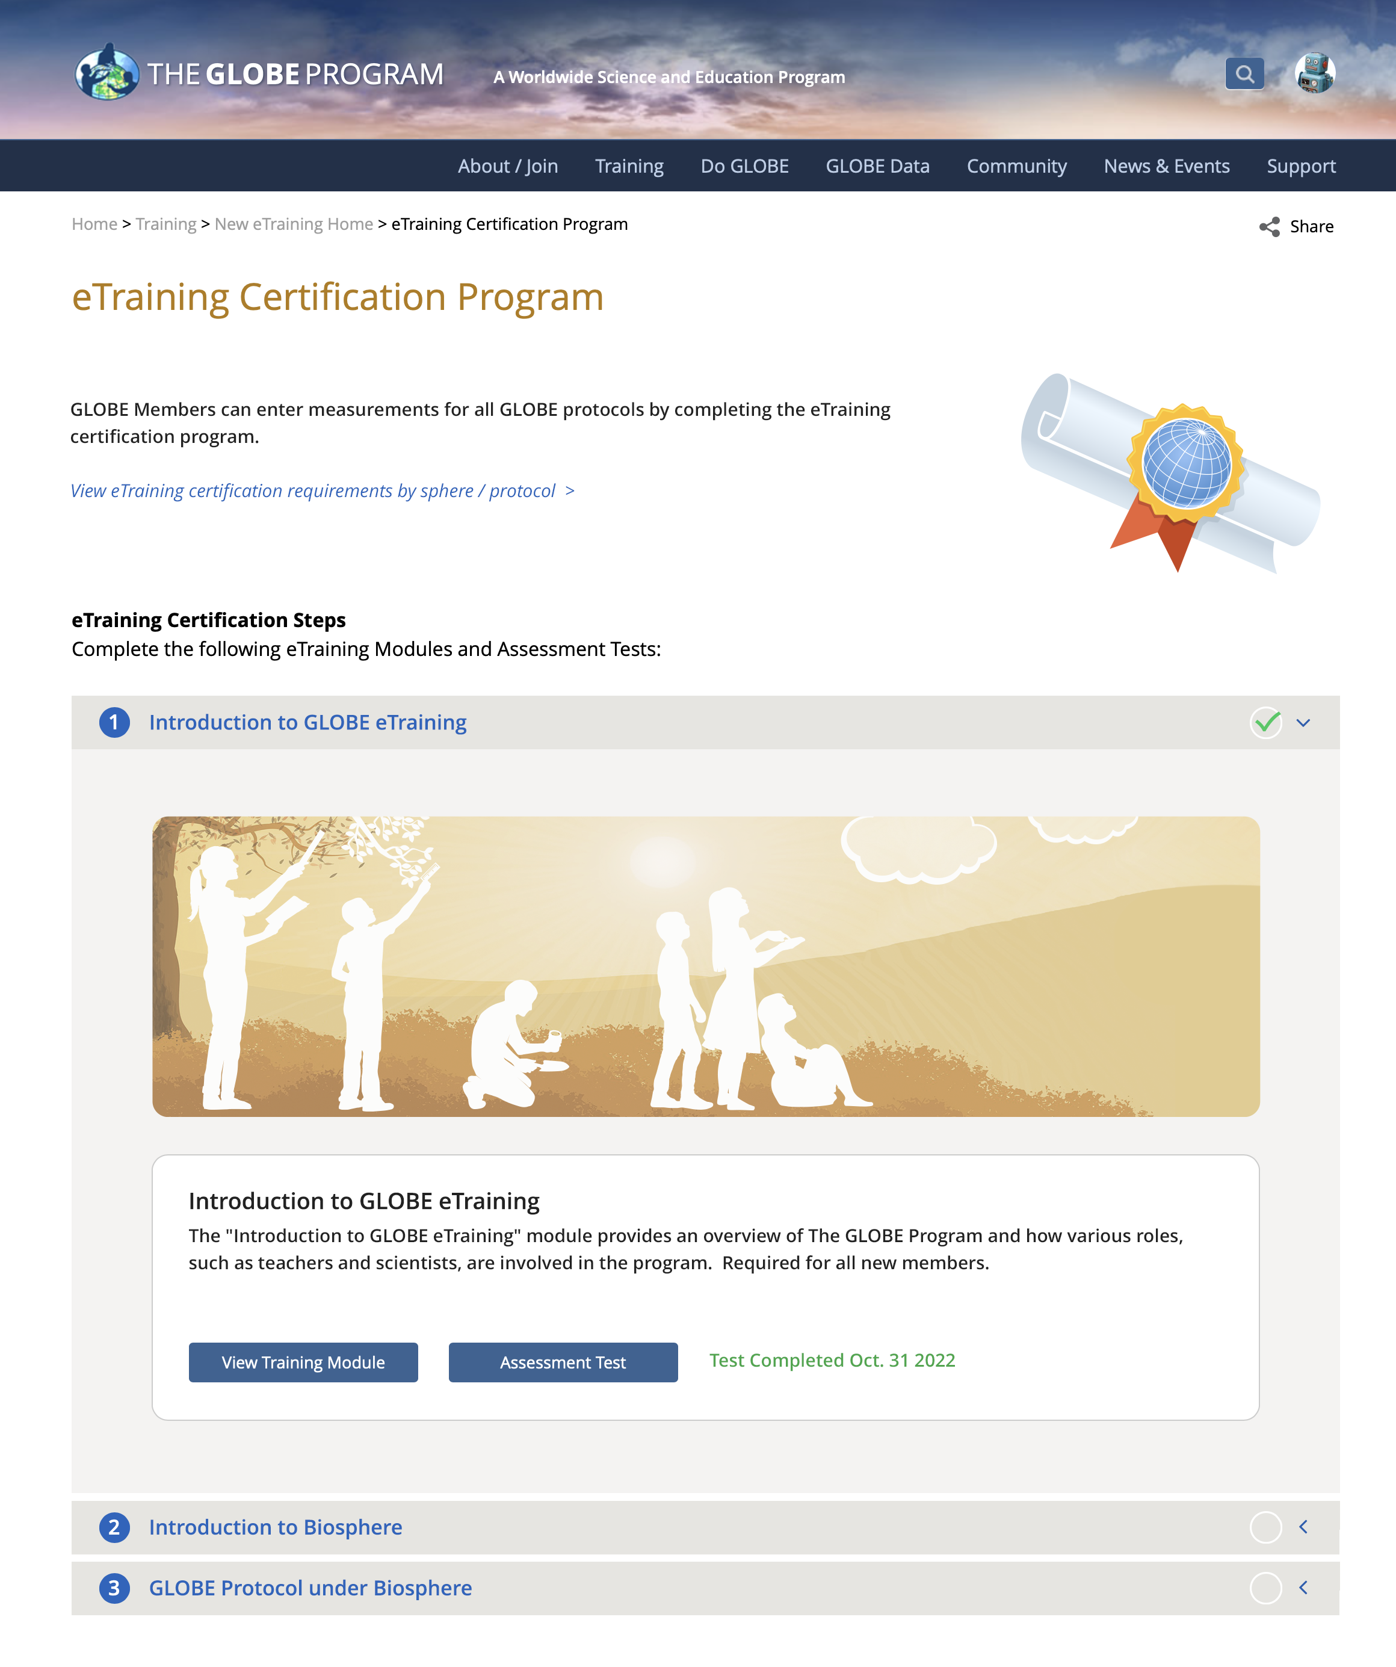
Improved eTraining Protocol Certification Process
Addresses the issue of users not being sure which eTraining modules are needed to become Protocol Certified (role required to enter measurements for all protocols).
New system will step the user through the required modules.

Slide 25
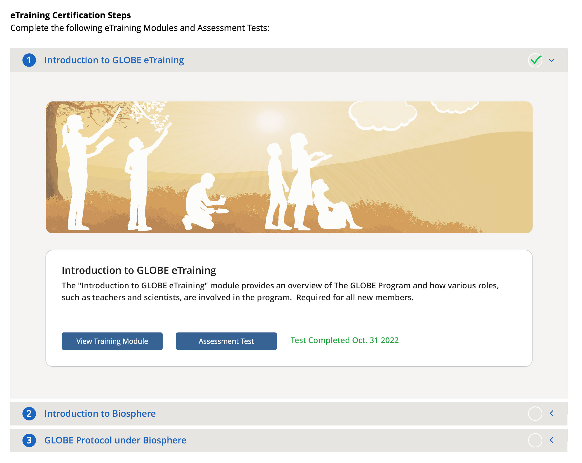
Improved eTraining Protocol Certification Process
Step 1:
Complete Introduction to GLOBE eTraining Module.

Slide 26
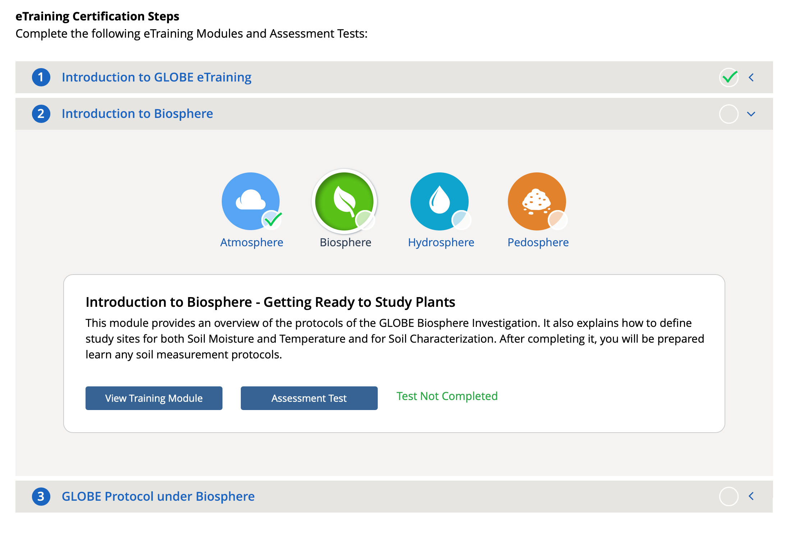
Improved eTraining Protocol Certification Process
Step 2: Select a Sphere

Slide 27
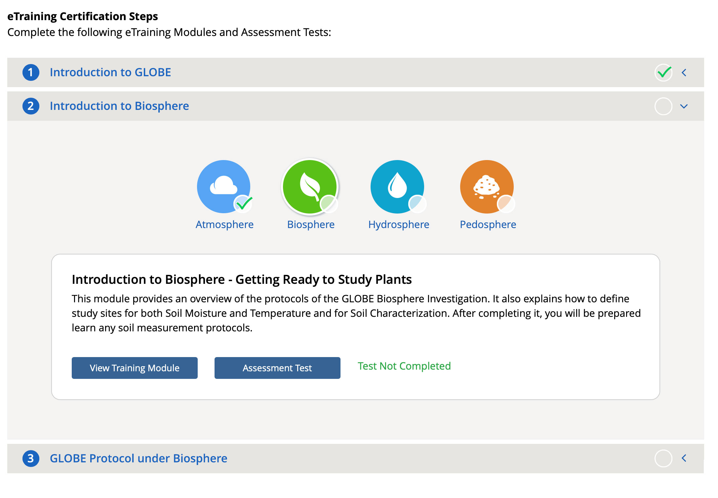
Improved eTraining Protocol Certification Process
Step 2:
Complete the Introduction module of the selected sphere.

Slide 28
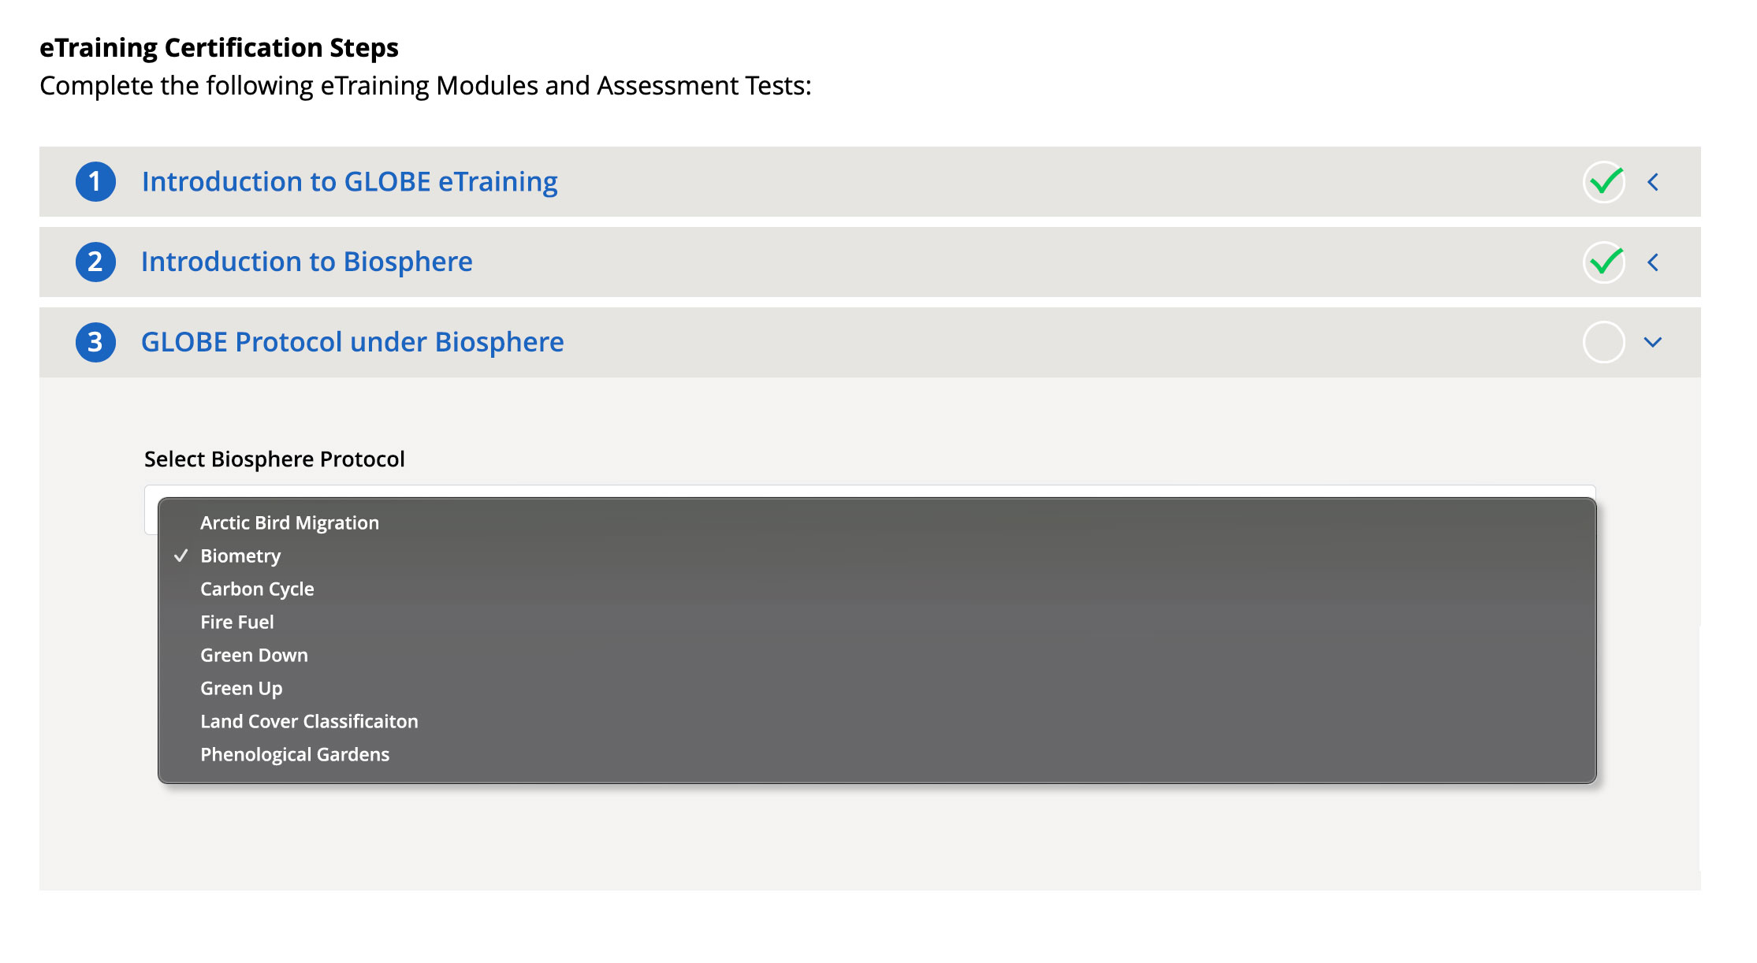
Improved eTraining Protocol Certification Process
Step 3:
Select a protocol under the sphere selected.

Slide 29
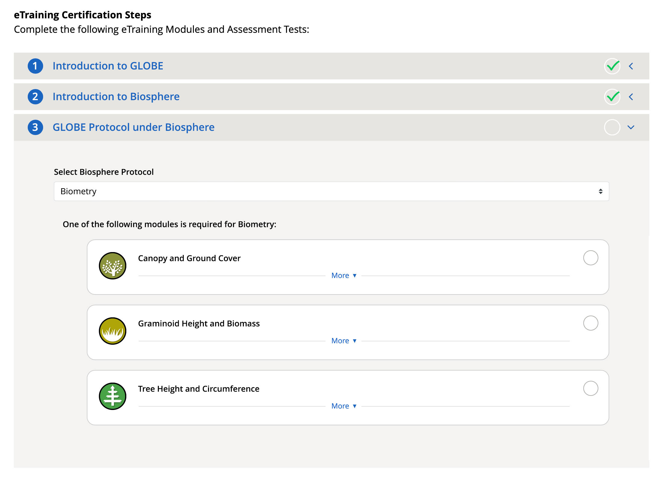
Improved eTraining Protocol Certification Process
Step 3:
Complete one of the required protocol modules

Slide 30
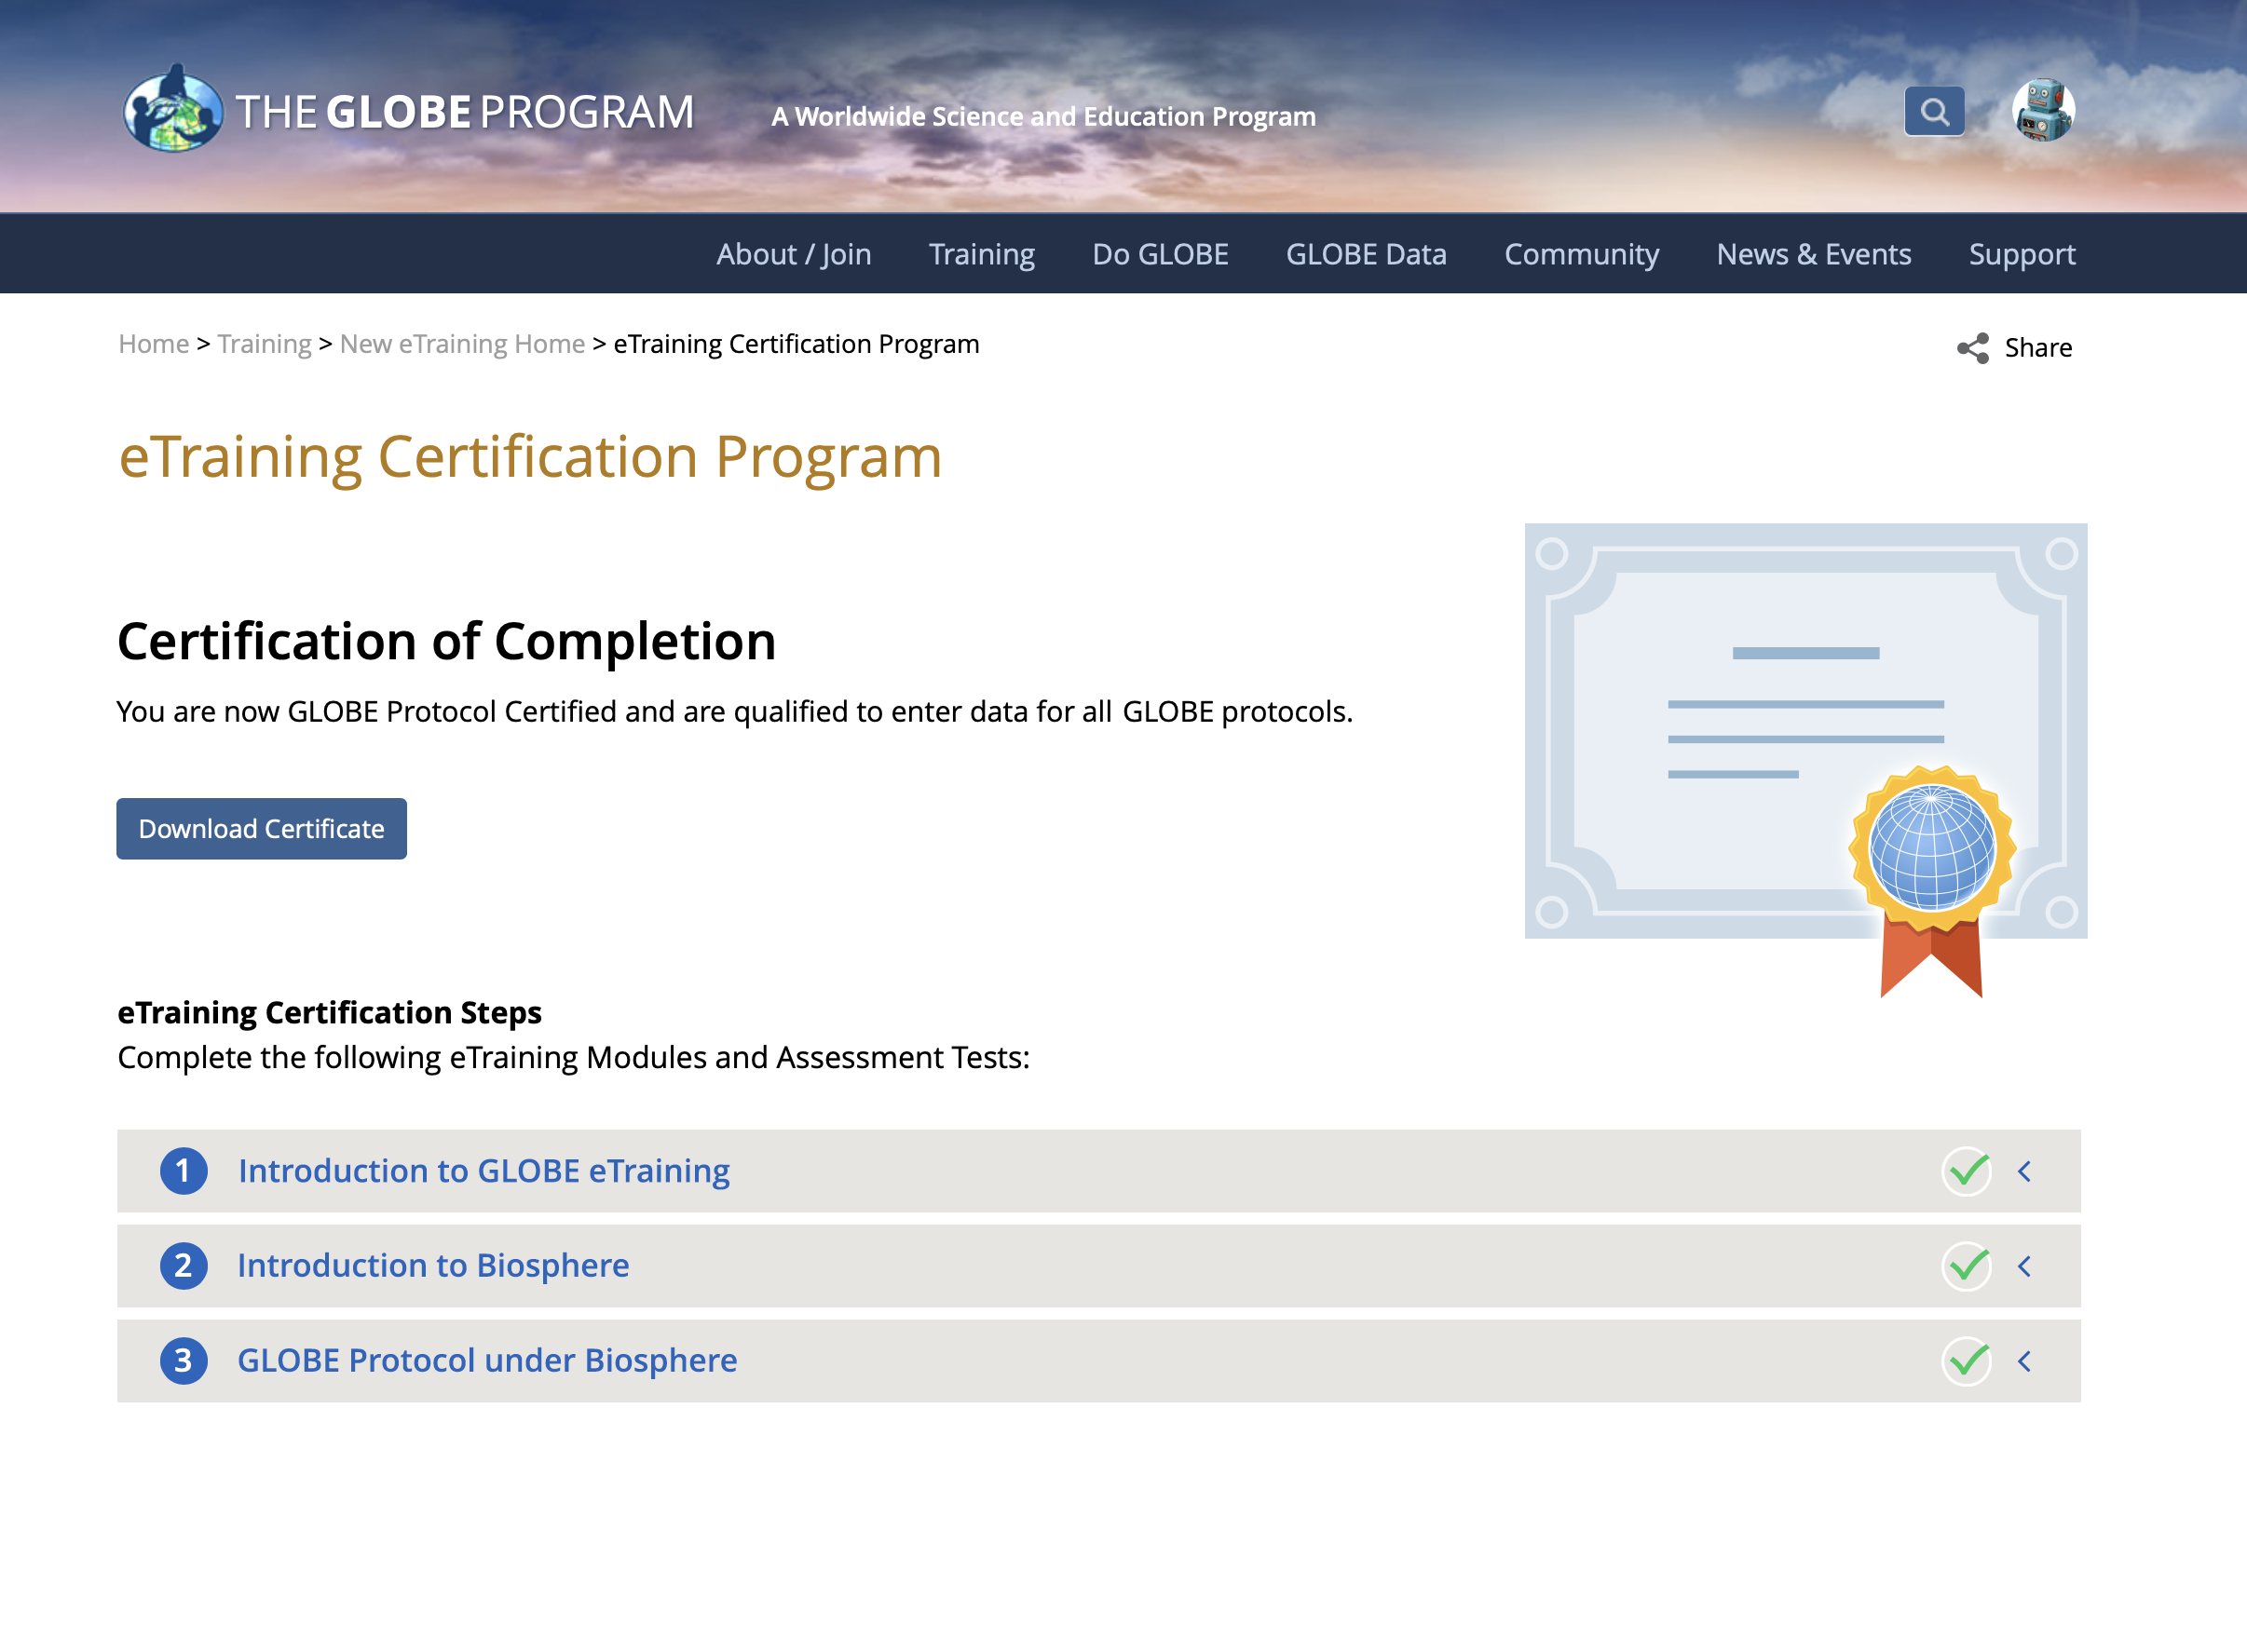
Improved eTraining Protocol Certification Process
Training is complete and you are now certified.

Slide 31
GLOBE Observer Recent Enhancements

Slide 32
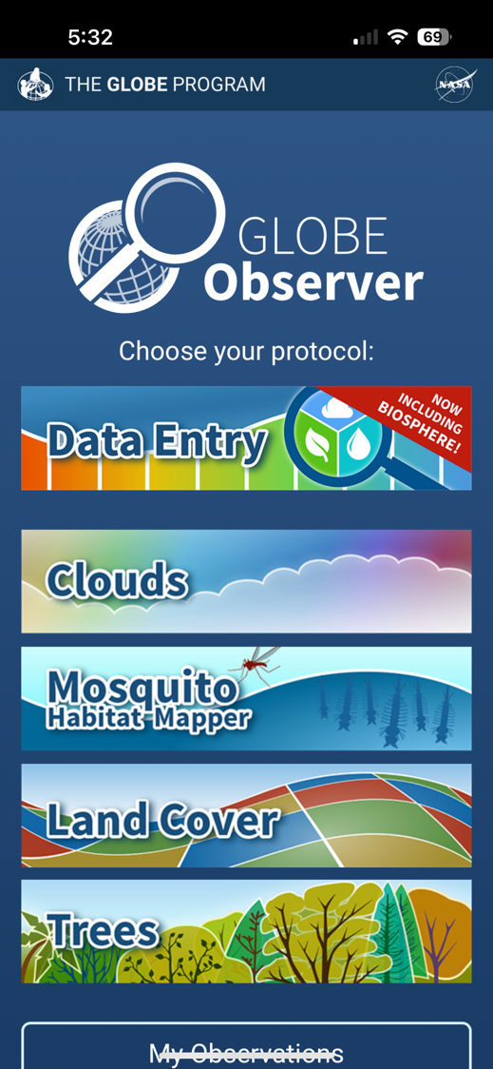
Biosphere Protocols Now on the GLOBE Observer Data Entry App
The latest update to the GLOBE Observer app includes all Biosphere, Atmosphere & Hydrosphere protocols for trained users
All trained Educators and their Student accounts can access Data Entry.

Slide 33
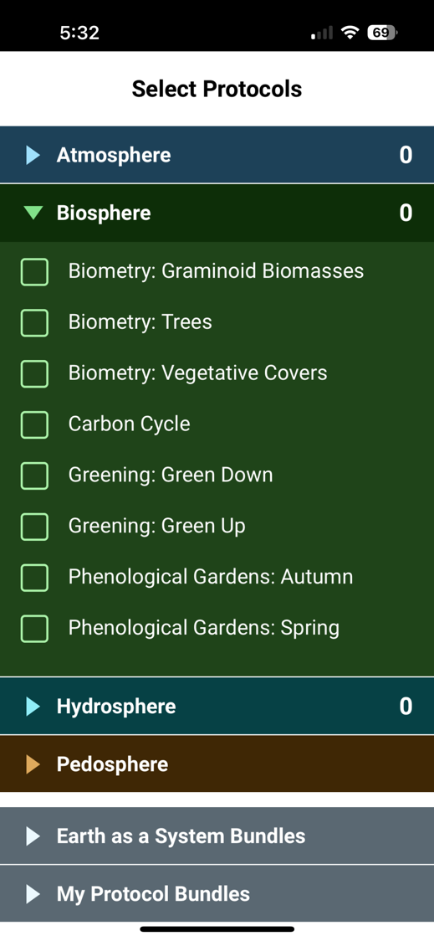
All Biosphere Protocols are Available
Note we isolated sub protocols from each other, so you can choose which you want to do
Biometry you can choose 1, 2 or all 3 options
You can choose Green Up or Green Down (not the generic Greenings)
You can choose Phen Gardens Autumn or Spring
You can combine them with any of the other protocols
You can use the “Earth as a System Bundles” to automatically choose a set of protocols

Slide 34
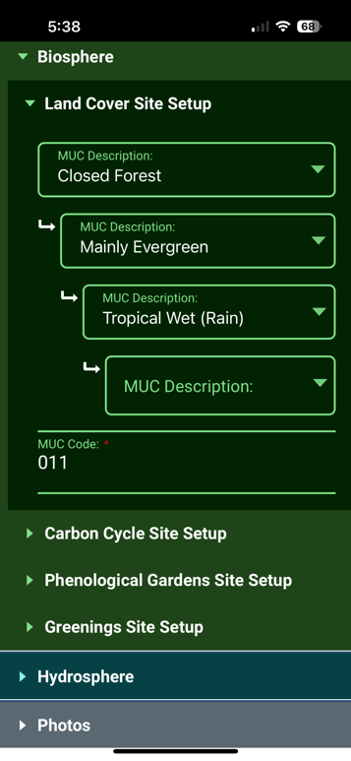
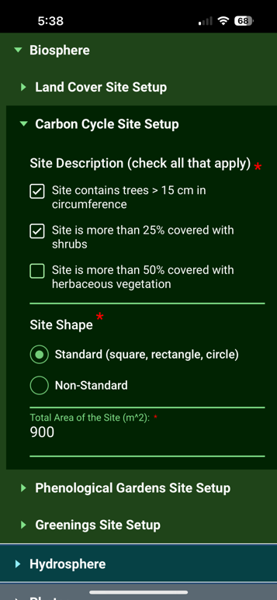
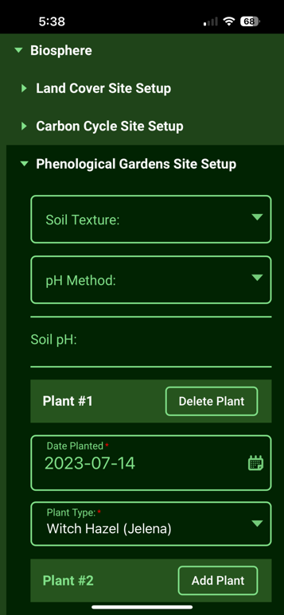
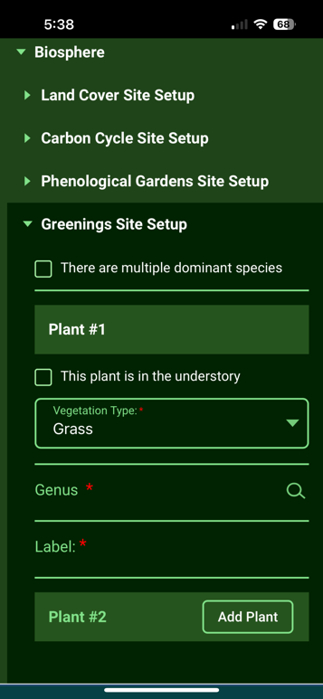
Biosphere Protocols in GLOBE Observer
All site setup features are available to setup a site separately, or while entering data for the first time

Slide 35
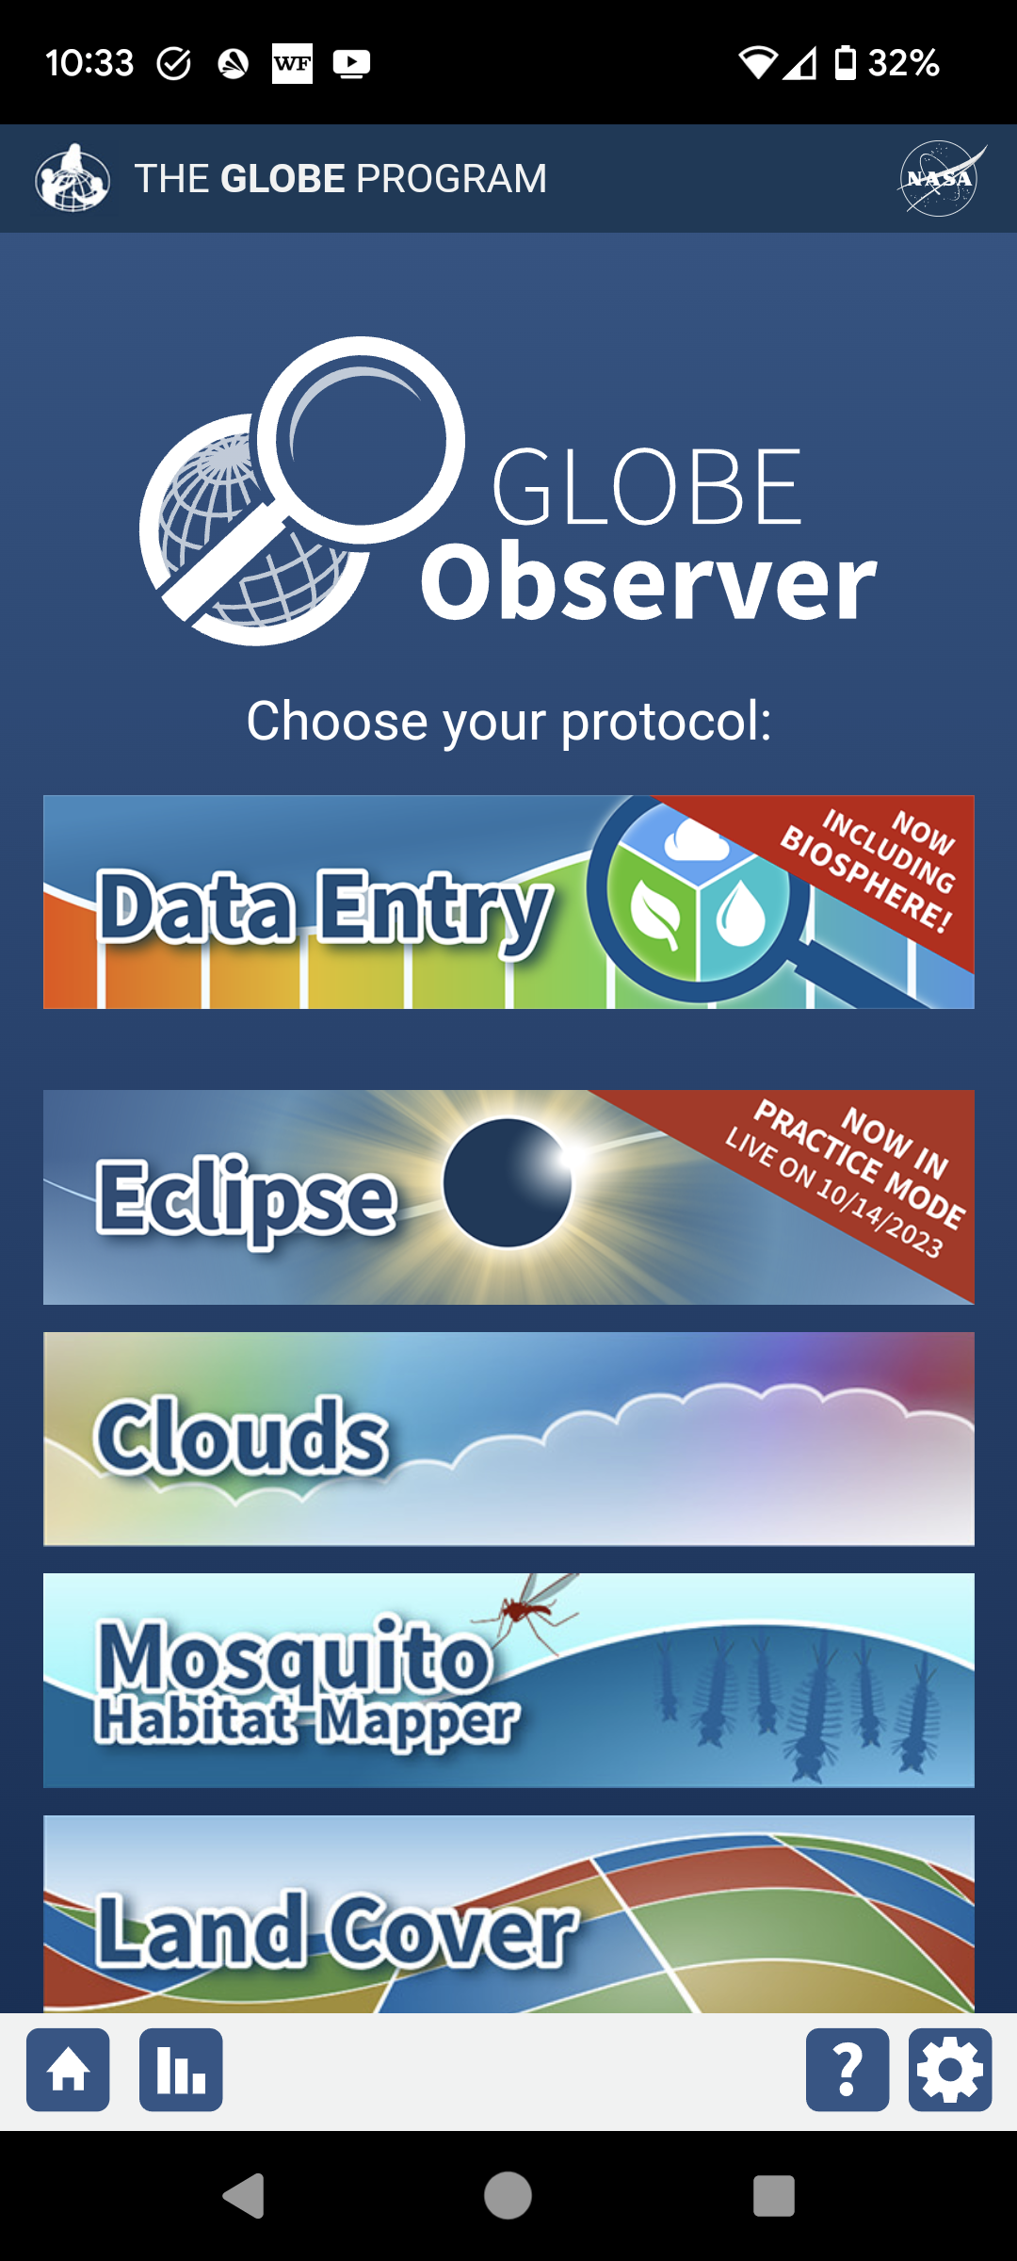
Eclipse App Added to GLOBE Observer App for 2023 and 2024 Eclipses
North and South American Regions Only

Slide 36
Landcover - Extra photos
Inspired by Eyes on Ice requirements
Added a capability to add additional photos during land cover protocol to capture things of interest
Up to four additional photos

Slide 37
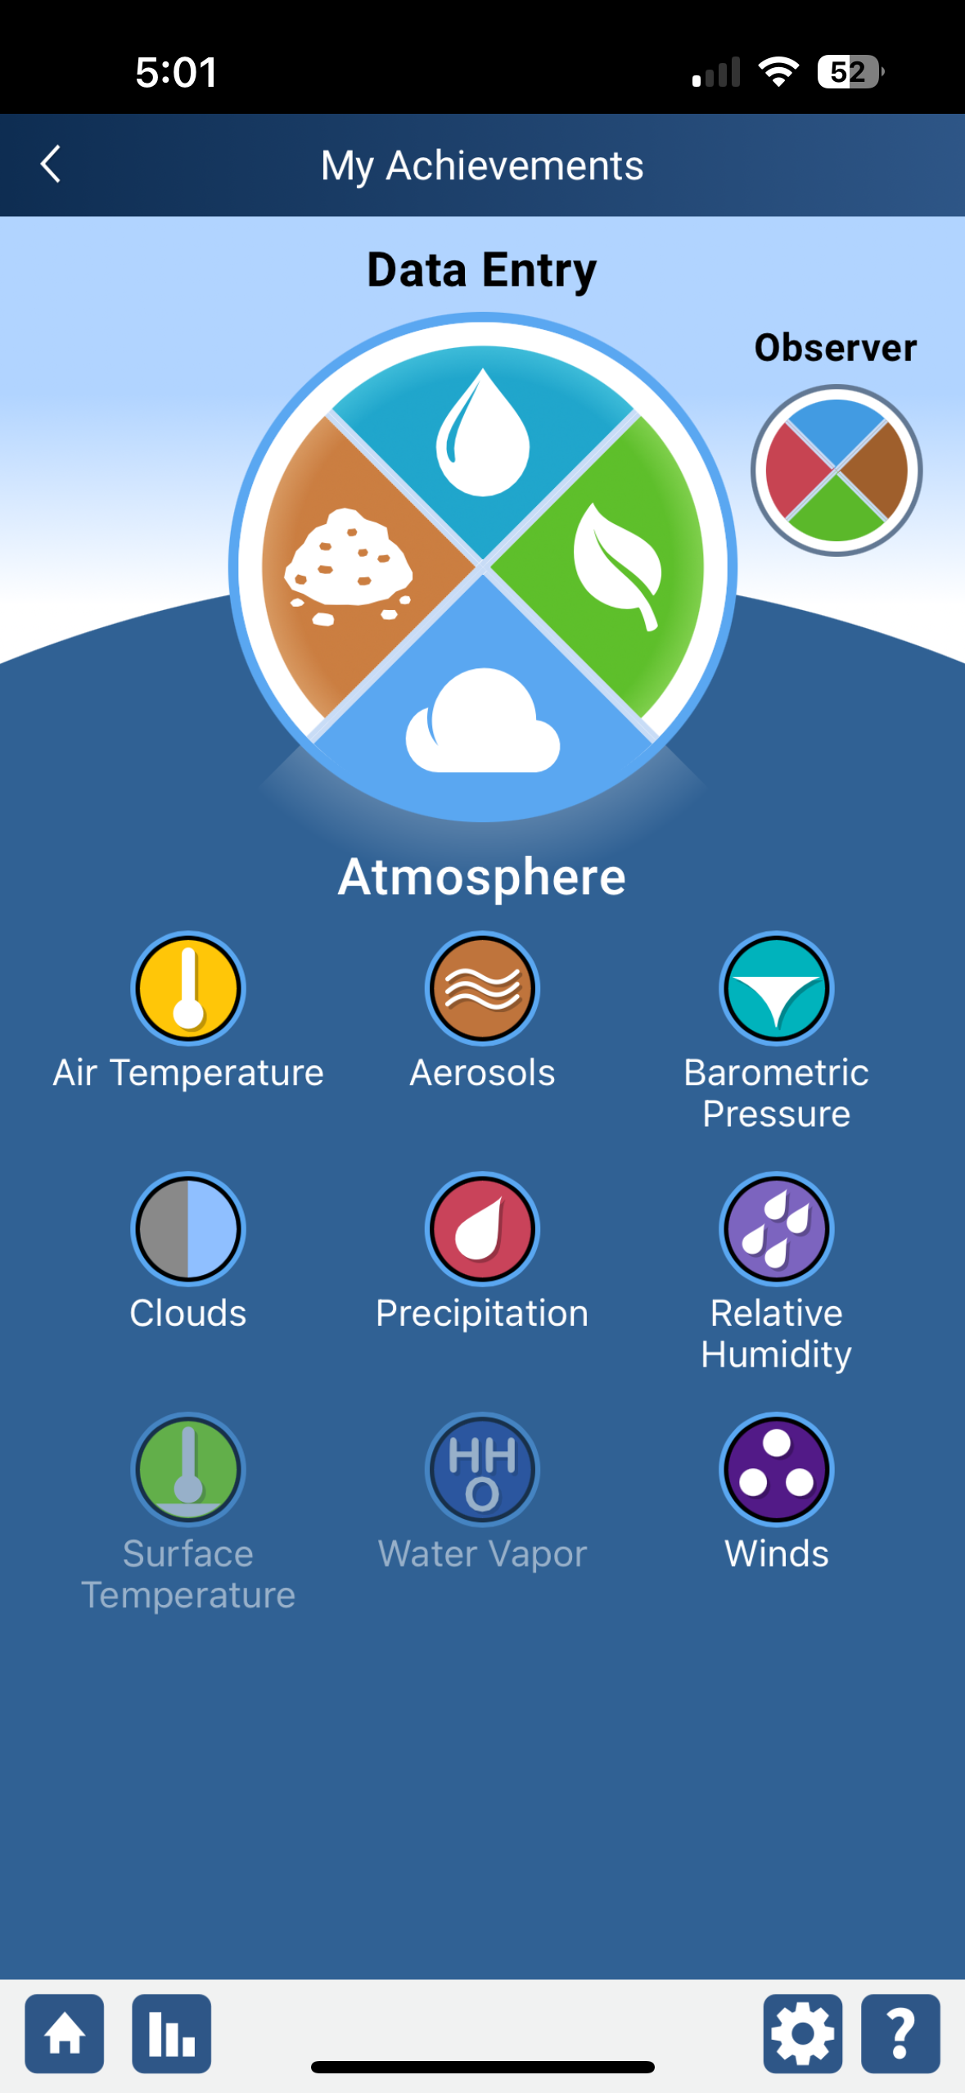
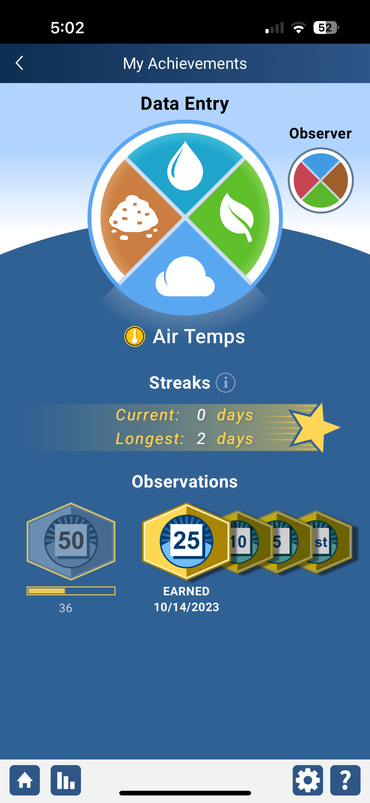
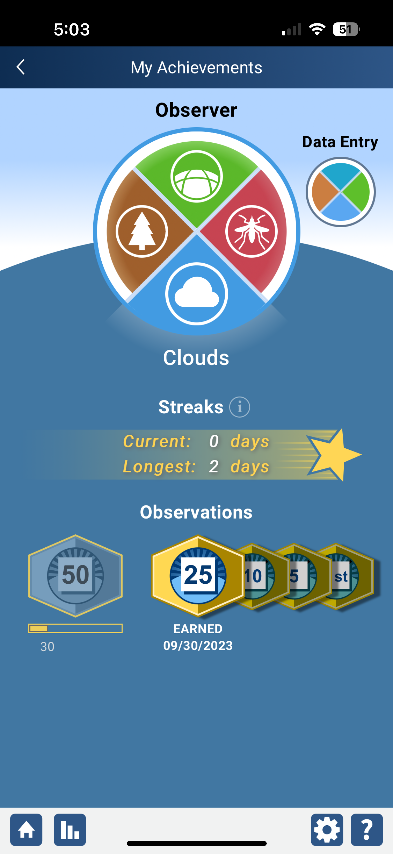
Awards and Recognition
Added improved awards and recognition to GLOBE Observer for all users
Recognition Awards:
First time measurements
Streaks
Milestone measurements (5, 10, 25, 50 etc)
Email generated congratulating the user (you can opt-out if desired)

Slide 38
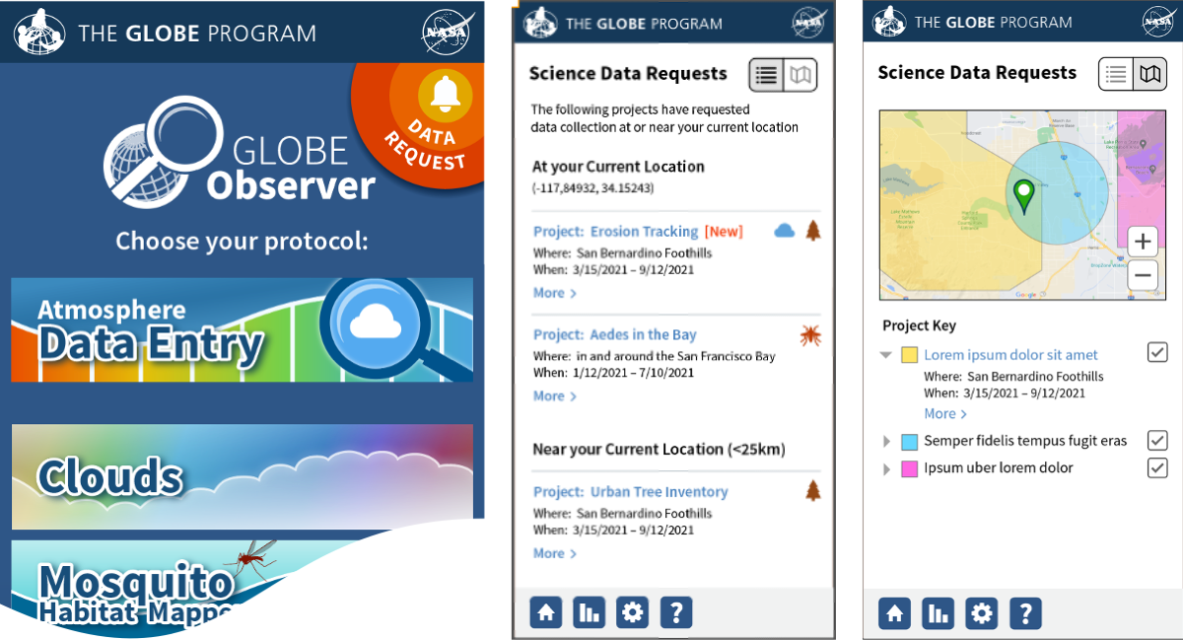
Request a Geofence Project
Allow users to submit a request for data collection (U.S. only right now)
Submit project information and goals
Select the area for data collection
All requests are reviewed
If approved
Any user who is near the area of interest will see a bell icon informing them to collect data for the location and time period requested.
Information for all projects will be visible

Slide 39
Planned Enhancements for 2024 / 2025

Slide 40
Upgrade Content Management System (Liferay) to the latest version (7.4)
Improved page and content management tools.
More stable version of Liferay.
Better supported.
Minimal enhancements during this time.

Slide 41
Adding Pedosphere Protocols to GLOBE Observer
Completing the full set of GLOBE protocols by adding the Pedosphere protocols to GLOBE Observer
Once completed, all protocols will be available through the GLOBE Observer app and new GLOBE Observer desktop forms (dataentry.globe.gov).
Once Pedosphere is complete, the old GLOBE Data Entry app will be retired.

Slide 42
Other Coming Soon Site Enhancements
Integrated Language Translation Tool for all Pages.
Improved Protocol Section
Improved Campaign & Projects Section
Enhanced User Dashboards

Slide 43
Our priorities
We hear from you what is important in your country. Please tell us what you think would improve things.
Work with your technology working group representative for your region to carry messages and ideas to us.
Tell us what’s working and what you think could be done better – We don’t improve without your input

Slide 44
Questions on anything in the site?
Any areas of the site you want to focus on?
Any suggestions for improvement?
Any features you find especially useful?

Slide 45
Cornell.lewis@axientcorp.com David.overoye@axientcorp.com
Contact Information

