Slide 1
GLOBE African Regional Meeting
Training for new CCs: GLOBE Website Administration
April 30, 2024
Cornell Lewis
Axient Corporation

Slide 2
Agenda
Start with the Country Coordinator Roadmap
Metrics available to you
GLOBE Management capabilities
  Your Dashboards
  Editing/Adding Schools
  Editing/Adding Users
  Editing/Adding Content

Slide 3
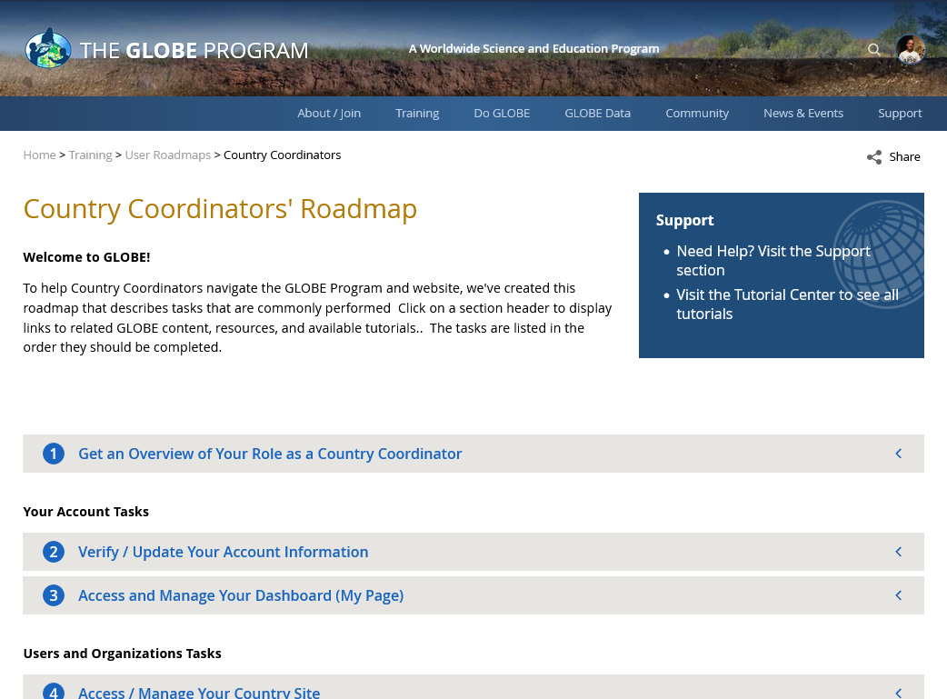
Country Coordinator Roadmap
Good place to start for new and existing CCs.
Contains all the necessary tasks to manage your account, users and organizations.
Training > User Roadmaps > Country Coordinators

Slide 4
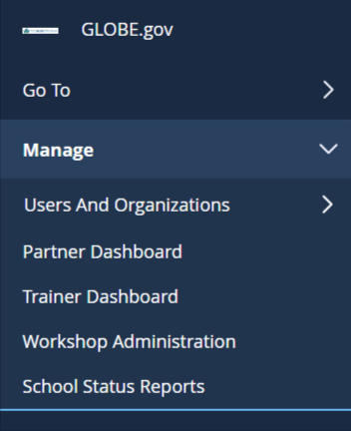

Dashboards
Your Dashboards and management tools are on the left side menu under this tool:

Slide 5
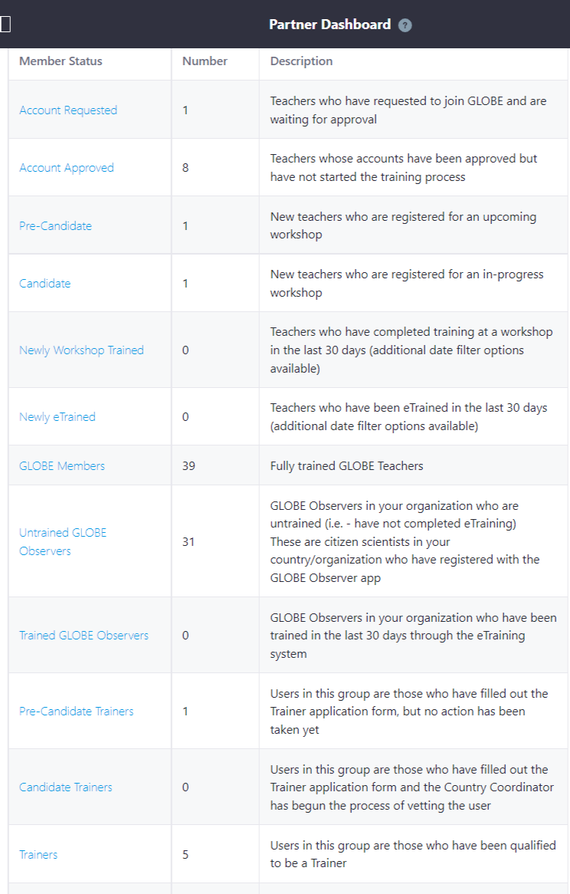
Partner Dashboard
See everyone who has an account in your country
Check Account Requested – these are people who have requested to be a GLOBE Teacher in your country
Your trained GLOBE Members
Pre-Candidate and Candidate Trainers indicate people who are in the process of becoming GLOBE Trainers

Slide 6
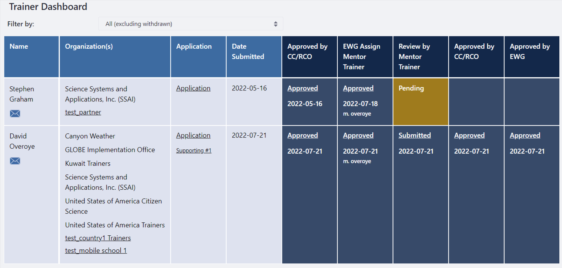
Trainer Dashboard (CCs only)
See everyone in your country who has applied to become a GLOBE Trainer or Mentor Trainer.
Review, approve and check status of all applicants

Slide 7
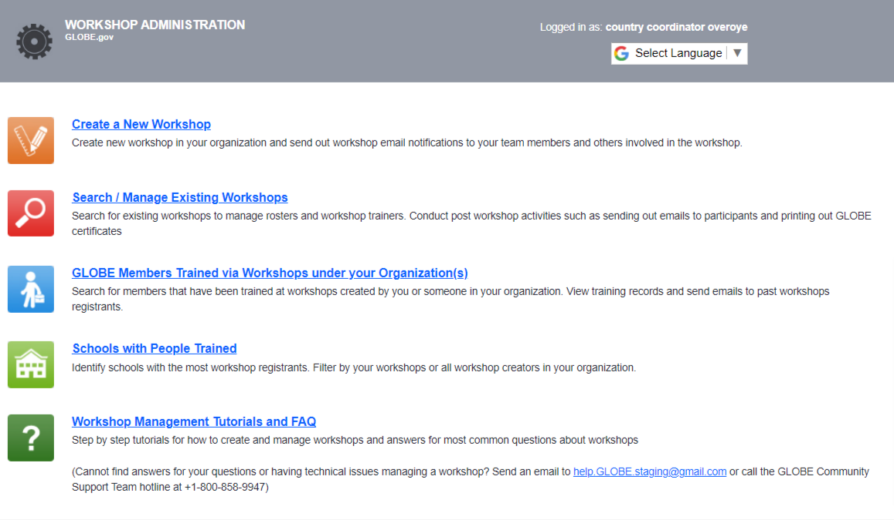
Workshop Administration
Create new workshops
Search for existing or previous workshops
Find people and schools you’ve trained

Slide 8
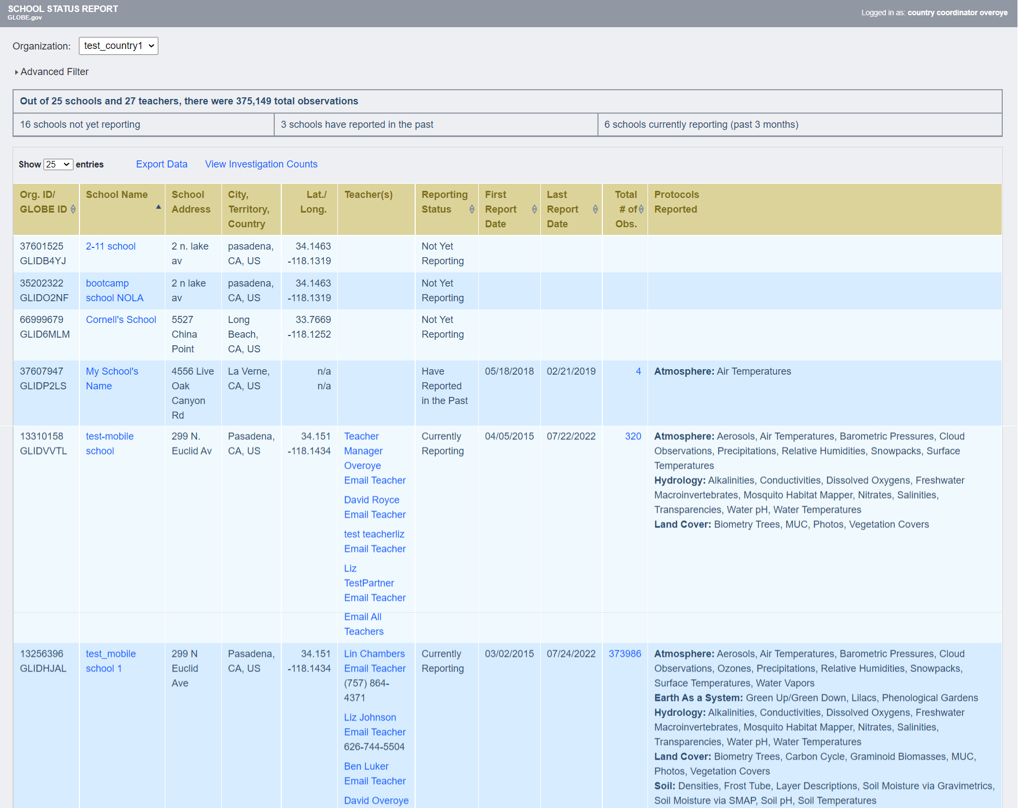
School Status Reports
See the status of each school in your country.
  Reporting Status
  Teacher contact information
  What protocols are being used

Slide 9
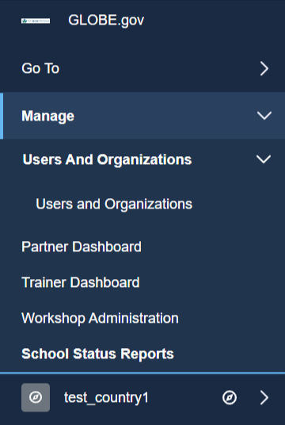
Managing Schools, Users and Country/Partner content
Manage users and schools under the Manage option on the left-hand menu

Slide 10
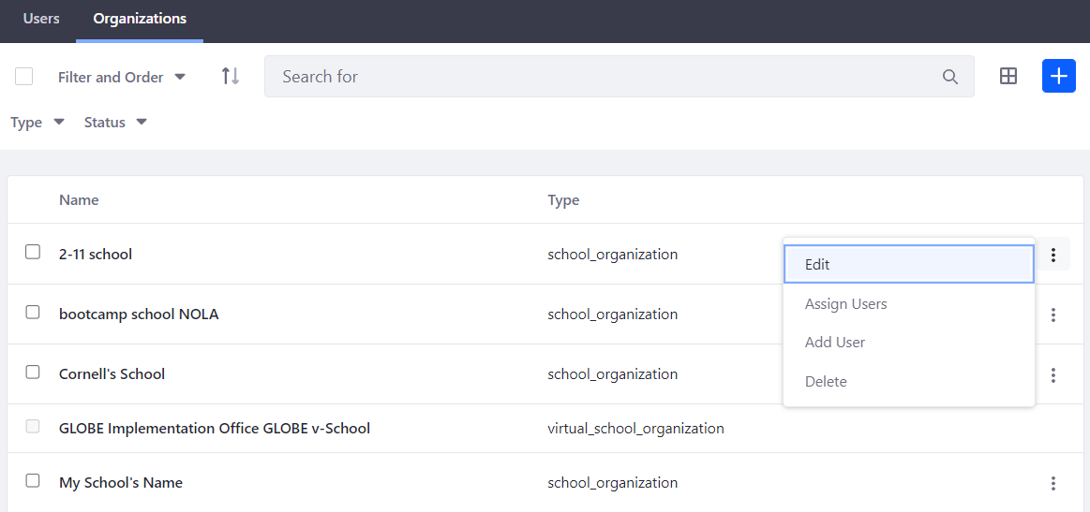
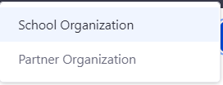
Managing Schools
Create and Edit the information associated with the schools in your country
Add a new school
Edit an existing school

Slide 11
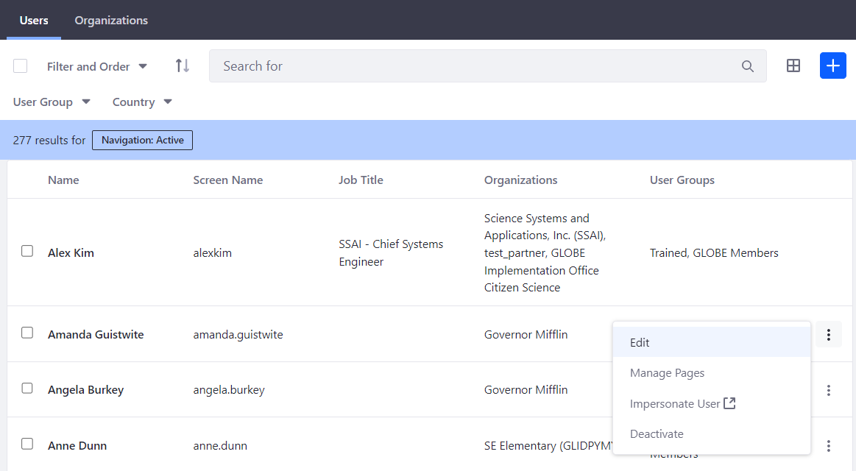
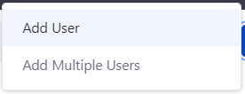
Managing Teachers and User Accounts
Create and Edit the information associated with the people in your country
Add a new user
Edit an existing user

Slide 12
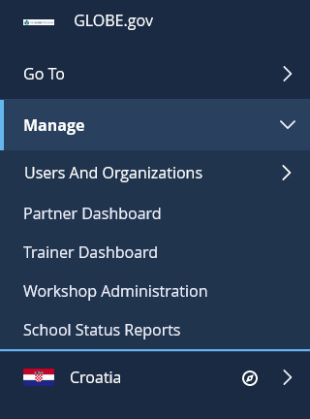
Managing Country Content
Manage your country page and content by
  Go to your country page
  Select your country name to see content and page options

Slide 13
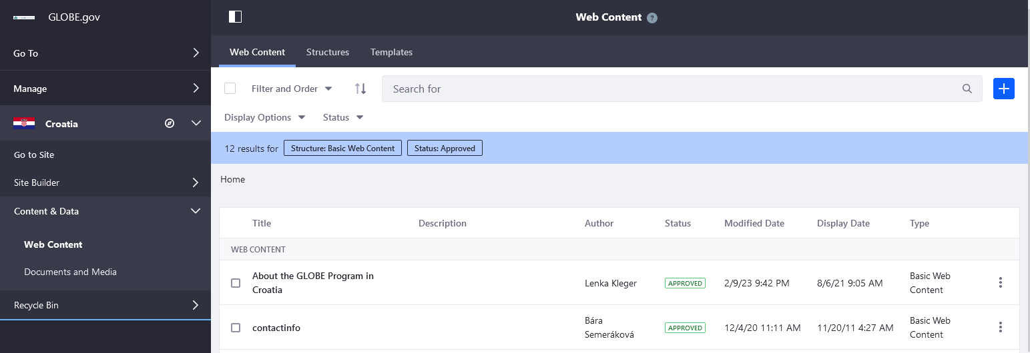
Managing Content
Add News/Events to your page
Go to your country page and select “Web Content”

Slide 14
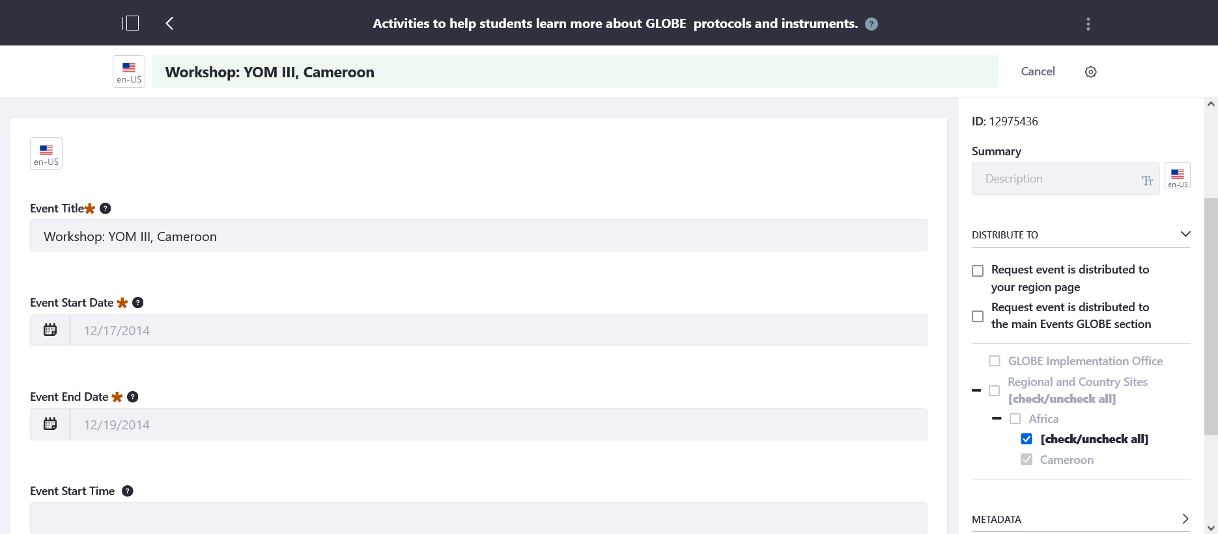
Managing Content
Request to have your news or event pushed up to your region or the main GLOBE website

Slide 15
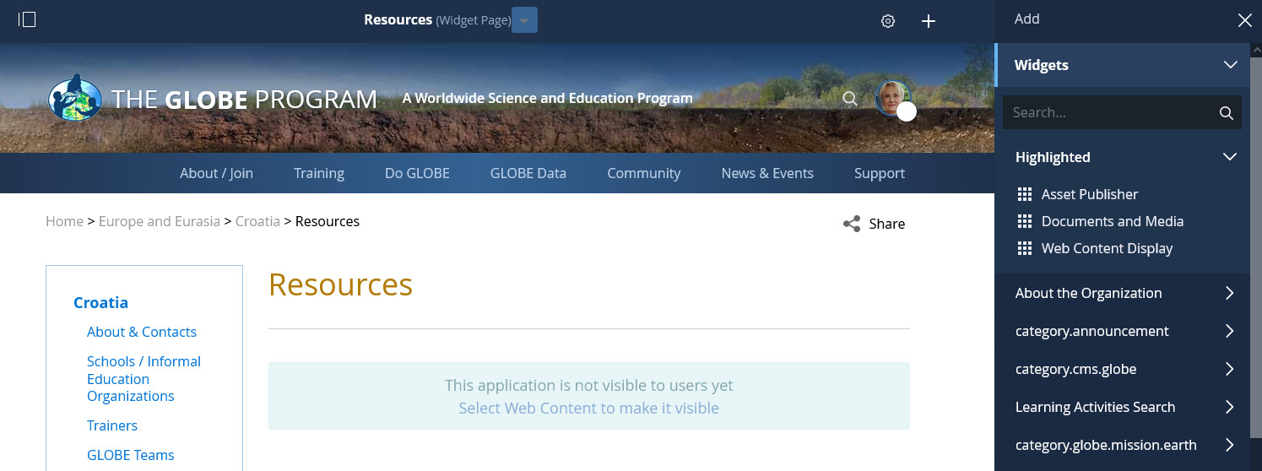
Managing Content
Modify existing Web Content directly on the page

Slide 16
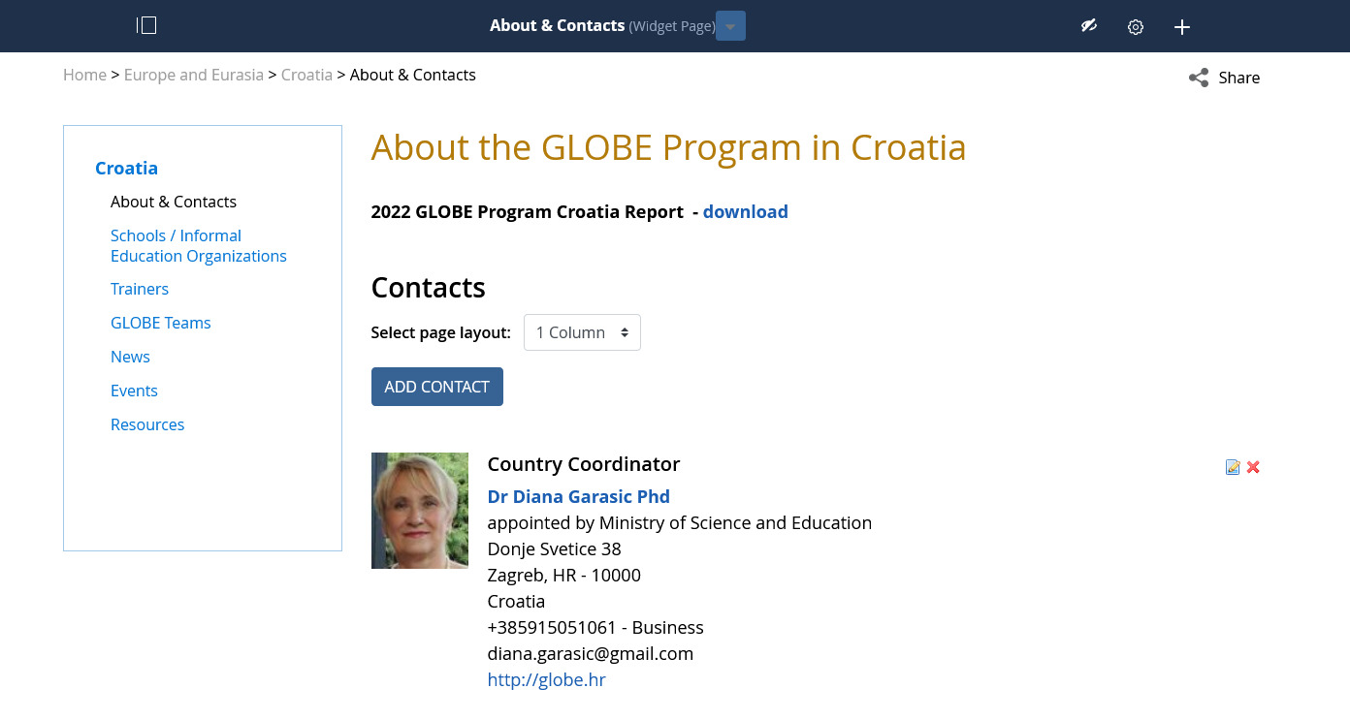
Managing Content
Add your country contacts

Slide 17
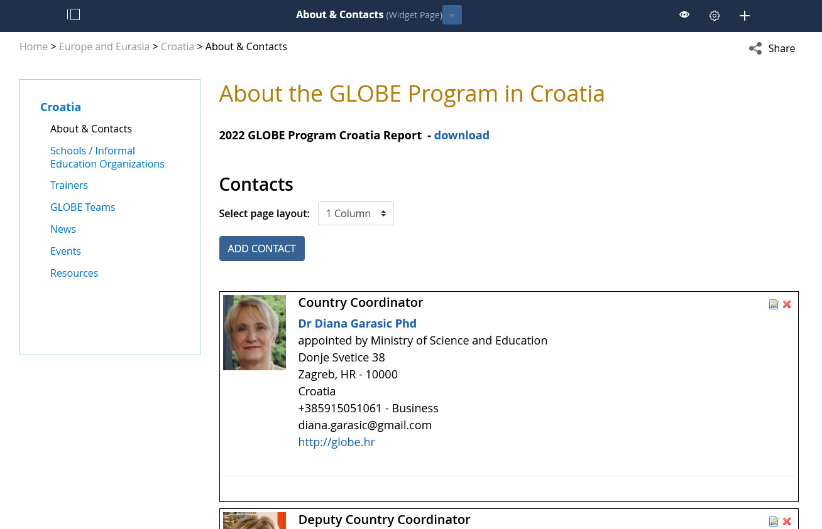
Managing Content
Click eye icon to turn on/off box to re-order contact list (requires page refresh)
Re-order contact list by dragging box.

Slide 18
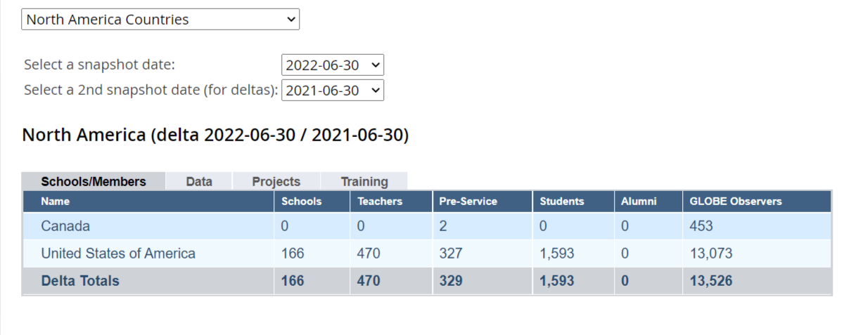
Impact & Metrics
https://www.globe.gov/about/impact-and-metrics
https://www.globe.gov/globe-community/people/partners-ccs/metrics
You can enter 2 dates to see change over time
To:
From:

Slide 19
CC Consultation
Anyone need help getting their Country Coordinator account setup?
Please see me if you are unsure about anything.
Please use the sign-up sheet for one-on-one consultation.

Slide 20
Cornell.lewis@axientcorp.com
David.overoye@axientcorp.com
Contact Information

