Slide 1
GLOBE Website For Teachers / Educators
May 01, 2024
Cornell Lewis, Axient

Slide 2
Agenda
Student Accounts Review
School Referral Codes
GLOBE Teams
eTraining
Collaboration

Slide 3
Student Accounts Review

Slide 4
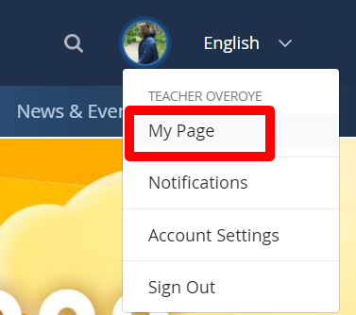
Setting up Student Accounts
Student accounts can be created and given to your students to enter data into GLOBE. A Student account has the same data entry capabilities as your teacher account, but they can’t enter their names or upload a profile pictures.
To access - go to your My Page to find the new Manage Student Accounts portlet

Slide 5
My Students / Team Members Portlet
Create and manage your student accounts.
See observations for your student accounts and other members who are associated with your GLOBE team(s) or school.
Click on the member’s screen name to view their My Observations page and see all their observations.
The screen name is displayed for students and GLOBE Observers while the person’s full name is displayed for approved users (GLOBE Educators, etc.)

Slide 6
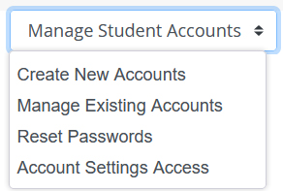
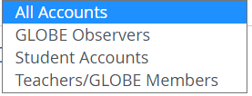
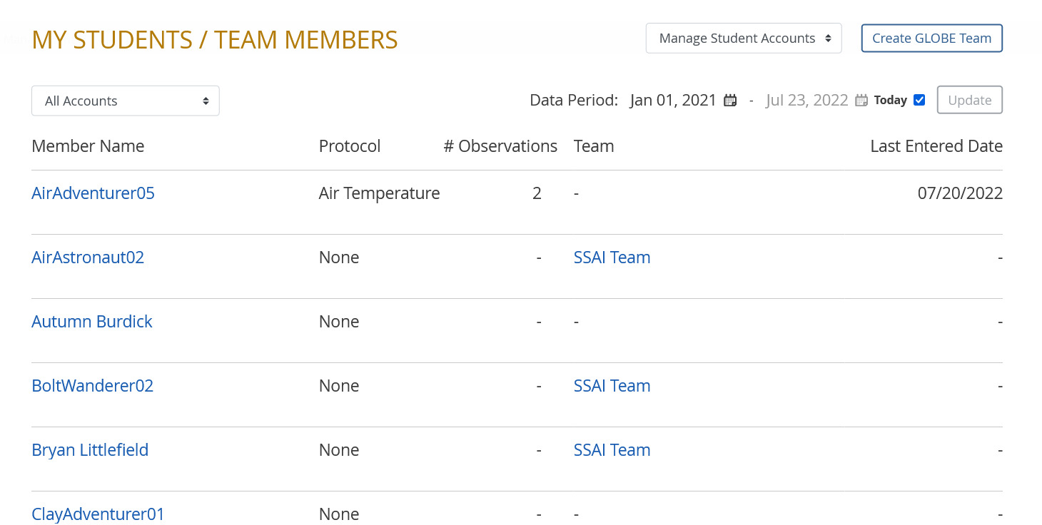
My Students / Team Members Portlet
Select which type of accounts to show
Create/edit
Student Accounts

Slide 7
Creating Student Accounts
Create up to 20 accounts at a time (300 in total with your Teacher account).
System auto-generates and assigns a screen name and password to each student account.
Log-in and screen names will match to make it easier to remember them
Ex – CloudsMaker01, CloudsMaker01@globe.gov
You can assign students to a GLOBE team during the account creation process if you created the team first.
Export the list of student accounts to an Excel or Google Classroom spreadsheet to assign the accounts to your students.

Slide 8
Introduction of screen names for GLOBE Observers and student accounts
Both GLOBE Observers and students accounts have a “Screen Name” option which identifies them on the site. They can choose from two options:
A custom screen name option where they can choose an Earth Science word (Clouds, Flower, Glacier) and an explorer or science type profession (Doctor, Pilot, Astronomer).
Screen name example: CloudsPilot10
A generic screen name option which has GO or GS as a prefix followed by 5 alphanumeric characters
GO-F2TR6 (GLOBE Observer generic)
GS-G1RE2 (GLOBE Student generic)
These screen names are used to identify the user on the website.They can be changed under Account Settings.

Slide 9
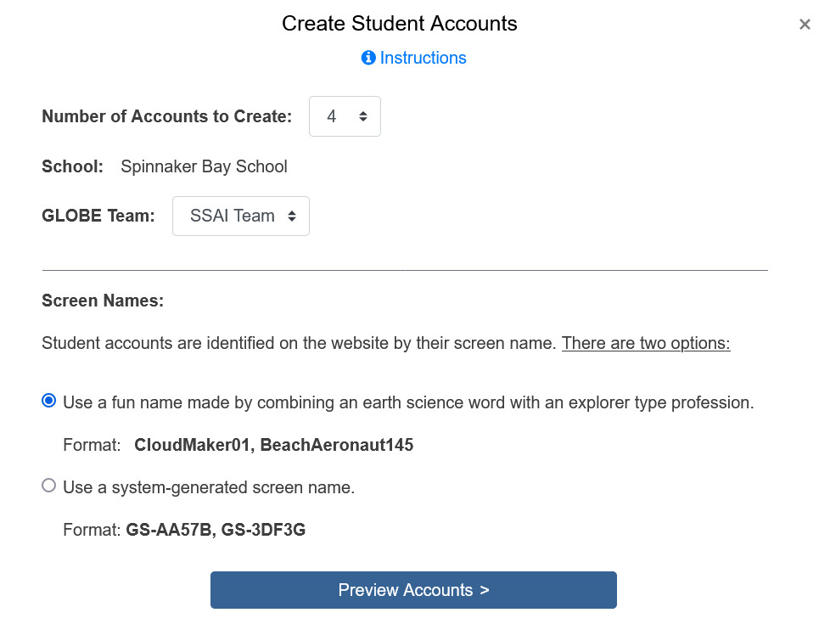
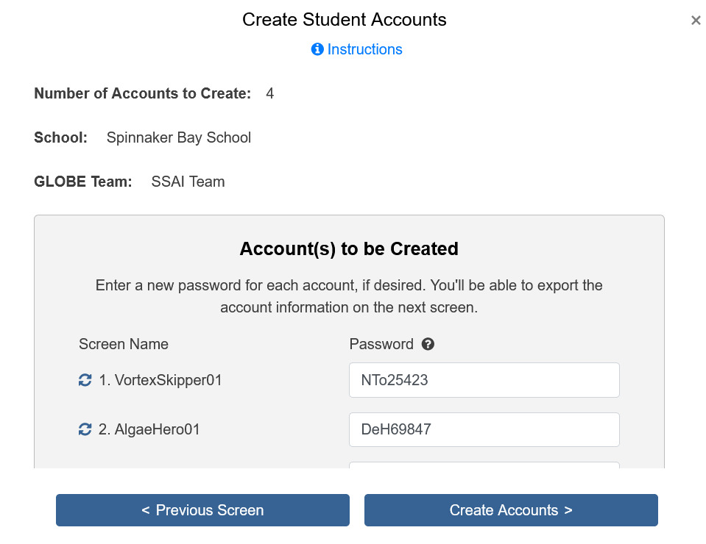
Creating Student Accounts

Slide 10
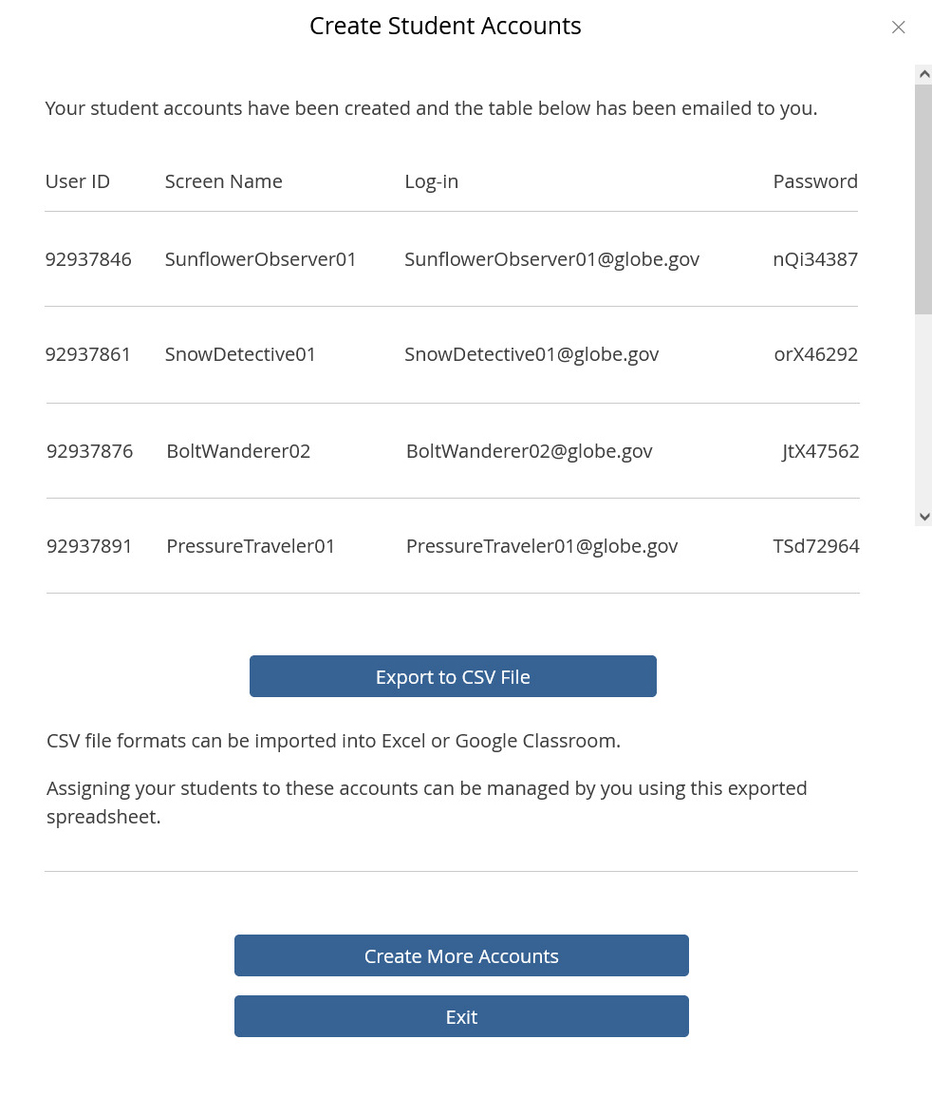
Creating Student Accounts

Slide 11
Student Account Capabilities
All student and trained teacher accounts can log in to GLOBE Observer, and:
Enter data for the 4 GLOBE Observer protocols
Enter data for any of the biosphere, hydrosphere or atmosphere protocols.
Use any existing school data sites
Create new school data sites
All student data entered is associated with the student, teacher and school.

Slide 12
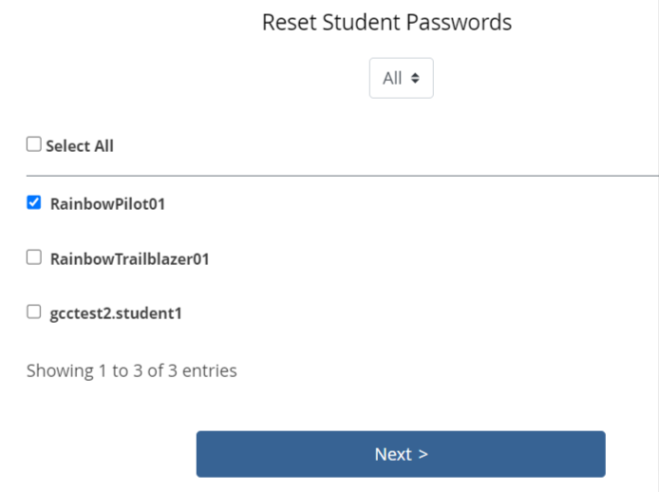
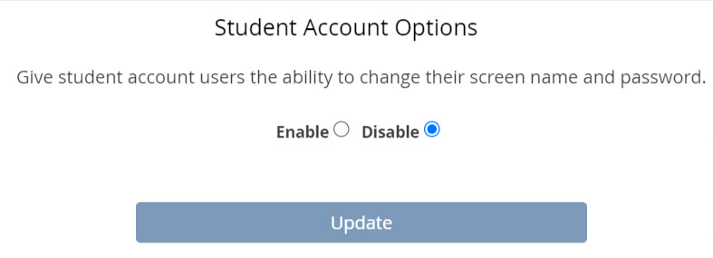
Other Student Account Management Functions
Reset all or selected Student Account passwords.
Enable/Disable ability for students to change their screen name and password.
View all your student accounts in the control panel (to change screen names/log-ins and passwords, delete accounts, etc.)

Slide 13
“I need to know what my students are doing – are they entering data? What data did they enter?”
Go to your My Page to find the new Manage Student Accounts portlet

Slide 14
My Students / Team Members Portlet
Go to this user’s My Observations to see what data they’ve entered
Set the Date Range you desire
Total number of Observations for this user

Slide 15
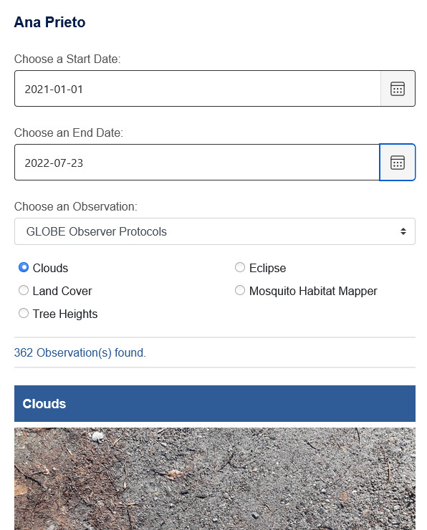
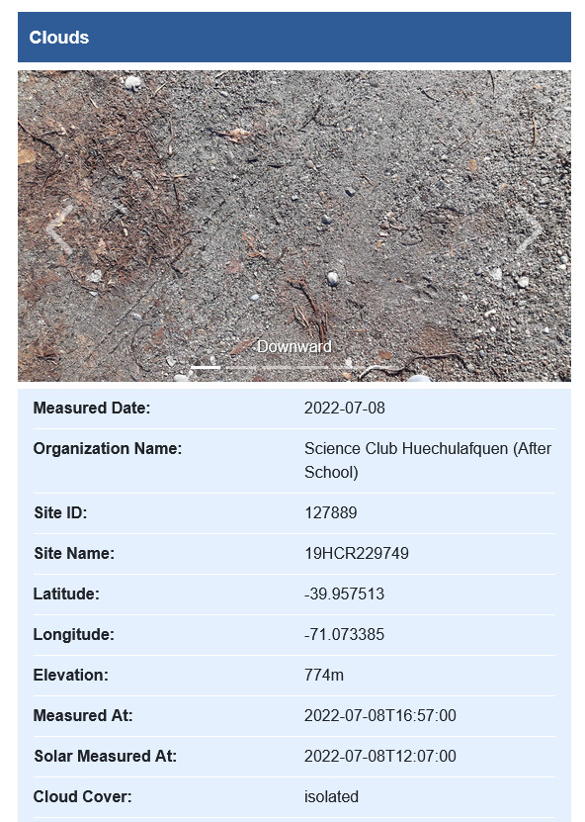
‘My Observations’ Portlet

Slide 16
Student Account or GLOBE Observer Account?
Student Accounts
Student Accounts are primarily used for younger students who do not have a personal email account.
Student Accounts use a system generated log-in (not a real email address) based off the student’s assigned screen name. For example: Cloudmaker01@globe.gov.
Student Accounts are associated with the teacher AND the school. Therefore, the account does not stay with the student once they move on to another teacher or school.
The account also does not follow the teacher. Thus, if the teacher leaves the school, the student accounts are automatically deactivated.
Student Accounts are created by the teacher and are automatically associated with the teacher’s school when created.

Slide 17
Student Account or GLOBE Observer Account?
GLOBE Observer Accounts for Students
If a student has their own personal email address, they can create their own GLOBE Observer account.
A GLOBE Observer account stays with the student.
These accounts use the student’s email address as the log-in.
Like student accounts, the student’s name isn’t displayed on the website.
Students with a GLOBE Observer account should join their school when they create their account (by name or referrer code).
Student should find out from their teacher which account type they should use.

Slide 18
Student Accounts Demo

Slide 19
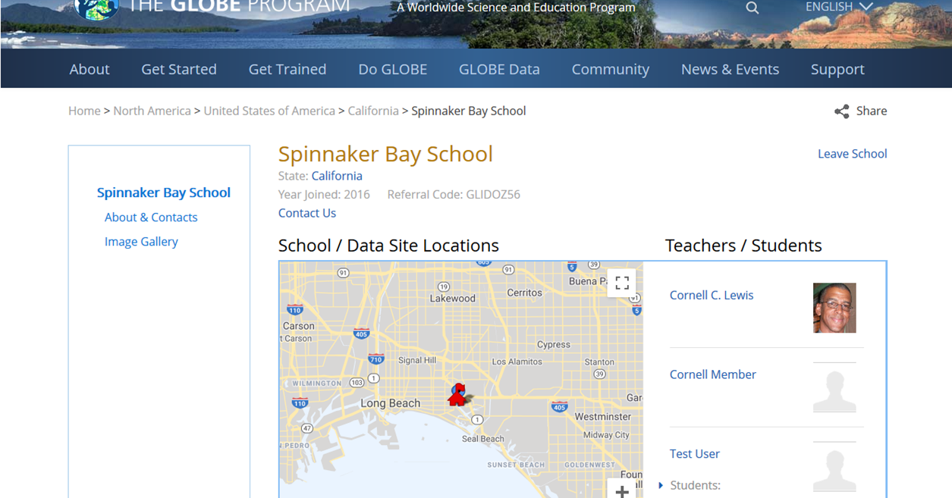
Using School Referral Codes
Every school in GLOBE has a referral code. The referral code is only visible to the country coordinator and the school’s teacher

Slide 20
Using School Referral Codes
Any user can login to GLOBE, go to the school’s page, click “Join School” and enter the referral code (provided by the teacher)
Parents, Family, students, friends…
Any data entered using GLOBE Observer will become part of the school’s data record once you’ve joined a school

Slide 21
GLOBE Teams

Slide 22
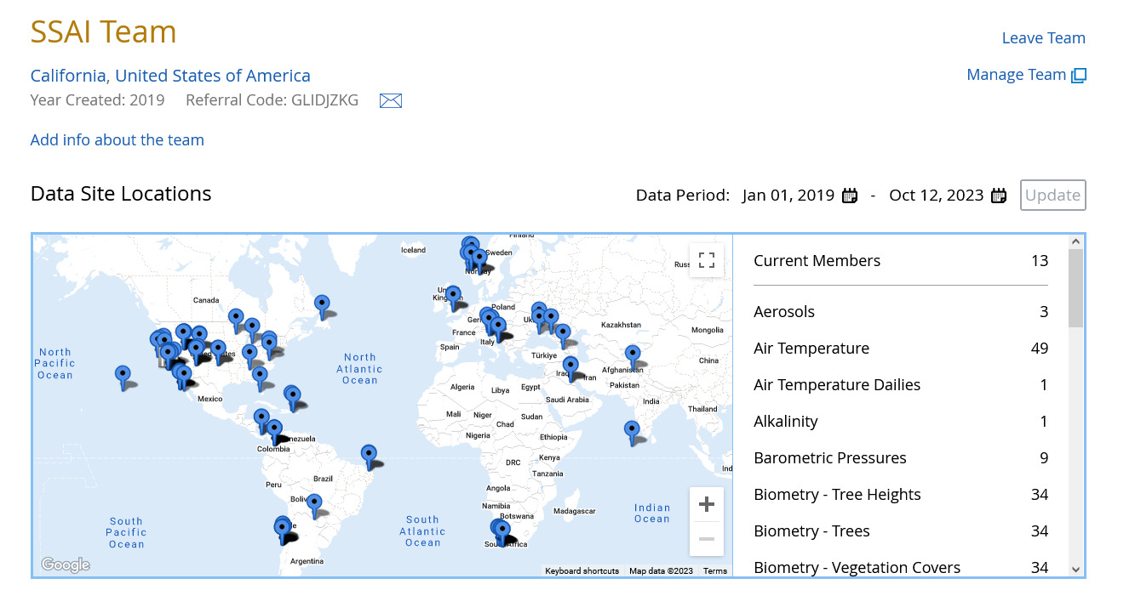
Using GLOBE Teams
A “Team” might be an after-school group, a class period, a community group, or company.
A “Team” has a page on GLOBE which shows the total number of measurements submitted by that team, the team’s Referral Code and the Members and their measurements.
Anyone with a valid GLOBE account can join a team.
You can join a team by going to the team page and entering the referral code, or by using the GLOBE Observer app and selecting “Join Team” under the settings.
Go to Community > GLOBE Teams to create a team.

Slide 23
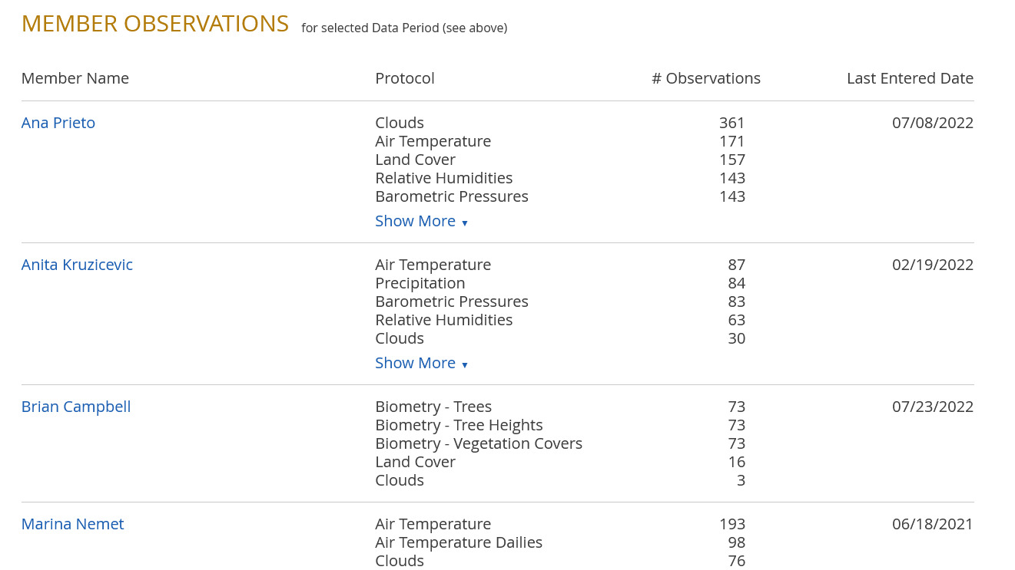
Should I use a GLOBE Team with my Classroom?
You don’t need a GLOBE Team. You can use your My Page/Student portlet to manage and track your student accounts….
But…
Why use a GLOBE Team?
You can divide your students into teams, create data competitions, and keep track of each team separately.

Slide 24
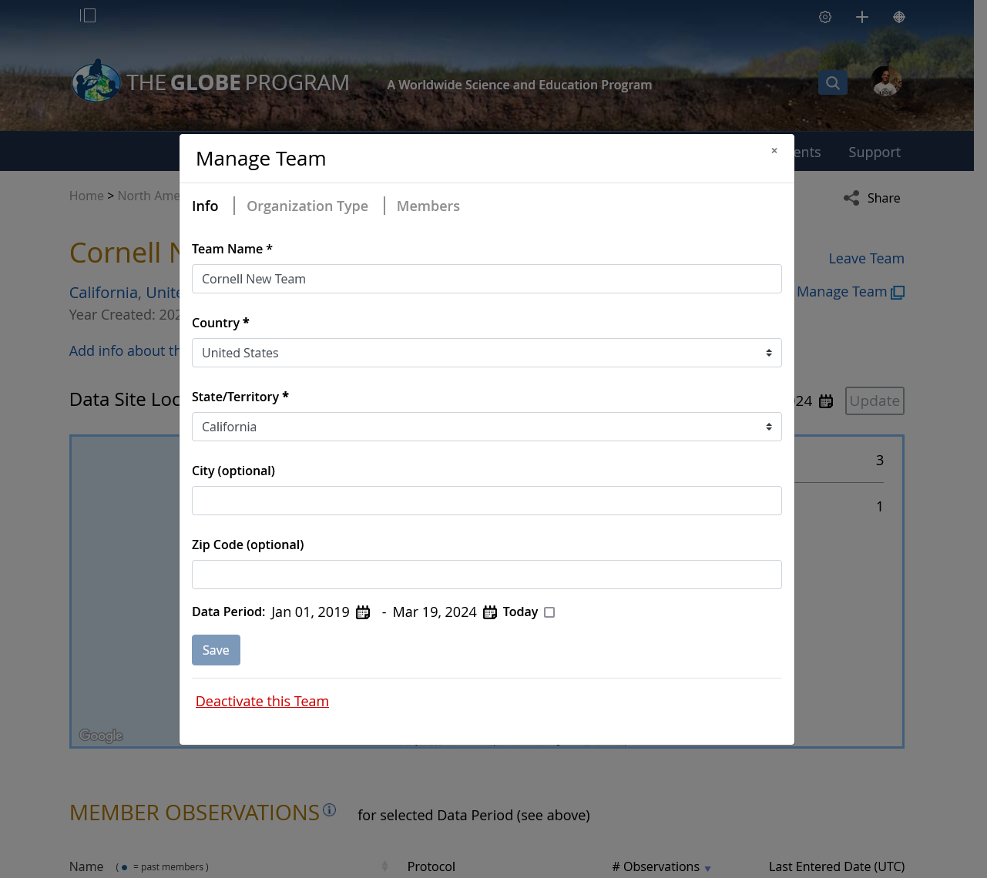
Managing a GLOBE Team
Click on Manage Team (only team managers will see this) to:
Edit the team's name
Change the team type (to public or private)
Define the default data period for the team
Deactivate the team
Add a team manager

Slide 25
GLOBE Teams Demo

Slide 26
Protocol eTraining

Slide 27
Who can do eTraining?
In your country, any approved educator can take eTraining.
Users who request a GLOBE Educator account must be approved by their country coordinator to do eTraining.
Once eTrained, educators will be able to enter measurements for all GLOBE Protocols.

Slide 28
eTraining Requirements for Certification
After studying the online training modules, users must pass the assessment tests for the following eTraining modules:
Introduction to GLOBE
Introduction to any one of the four GLOBE spheres
Training for any single protocol within the GLOBE sphere selected for #2
Review the requirements by sphere on the website:
https://www.globe.gov/get-trained/protocol-etraining/protocol-requirements

Slide 29
eTraining Demo

Slide 30
Collaboration

Slide 31
Collaboration Topics
How to find someone to collaborate with
How and why to “friend” someone
Joining and using GLOBE communities and forums

Slide 32
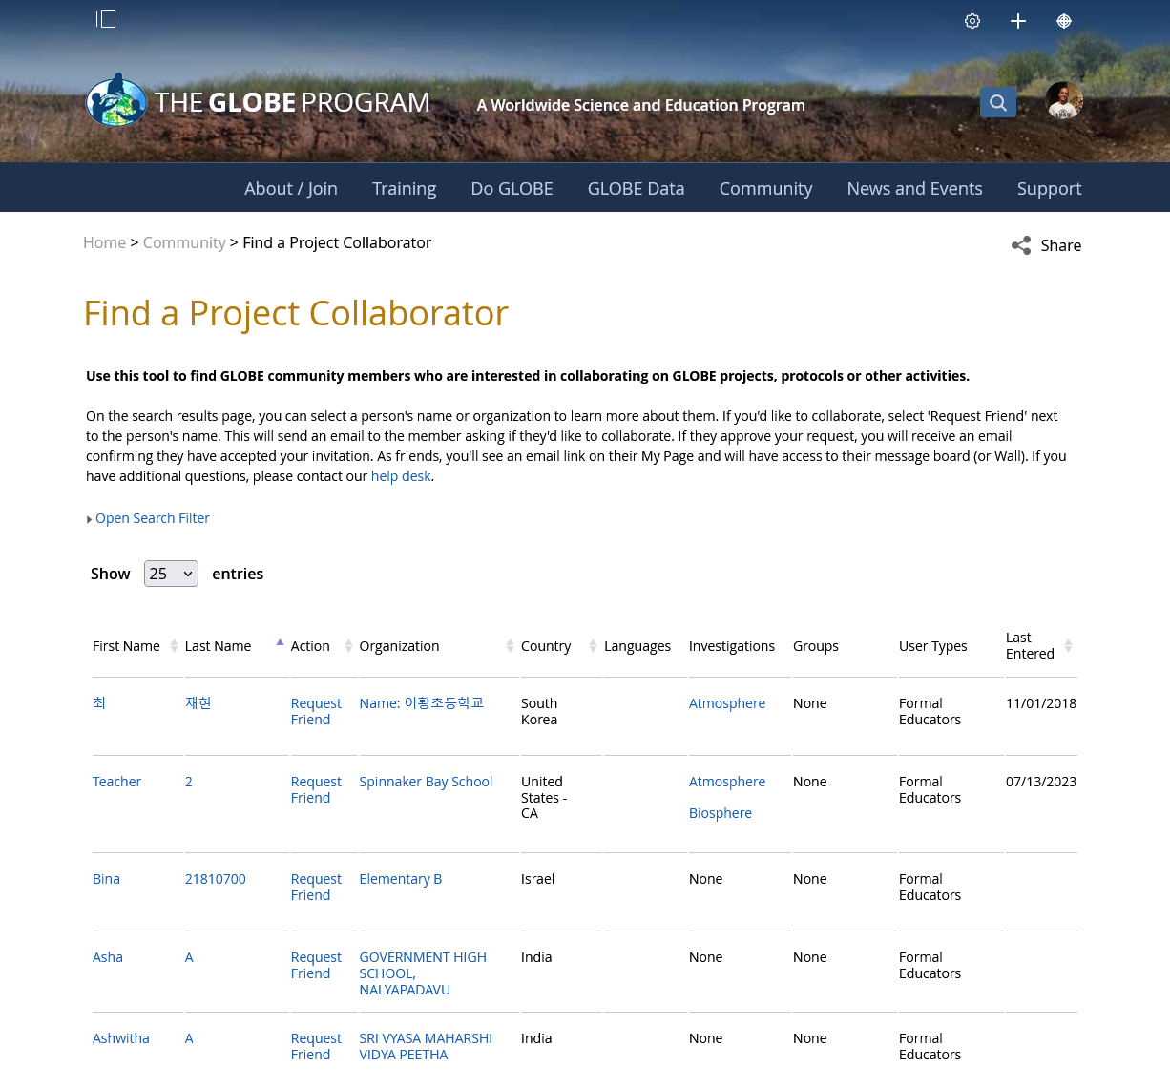
Find someone to collaborate with
Know the person’s name?
Use Search
Know the name of the person’s organization?
Use Search
Know which country they are in?
Use the community map, or drill down
What if I want to find someone who is currently doing a protocol?
Find a Collaboration Partner
Allows you to search for people by various parameters including protocol
Use “Most Active” on the GLOBE Home page, or a country page
Use the Vis system
Select the protocol you are interested in and select the data counts tab
Slide the date range to see if their data is current
Find the school associated with the data, and the teacher at the school

Slide 33
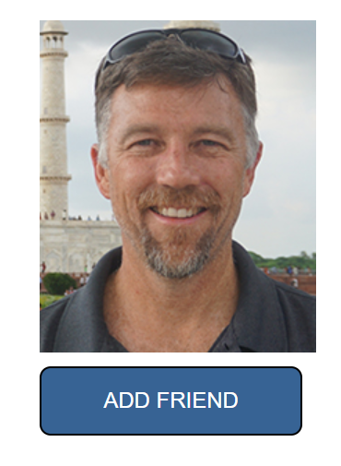
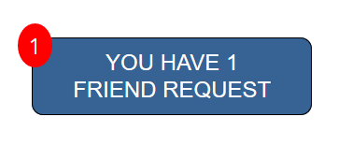
How and Why to ‘Friend’ Someone
You can click “request to be a friend” on anyone’s My Page/Collaboration tab, or from the “Find a collaboration partner” page and send them a note.
They will receive an email letting them know that you have asked to be their friend
When they approve, you will be linked.
You will see them in your friends list
You can access their email address

Slide 34
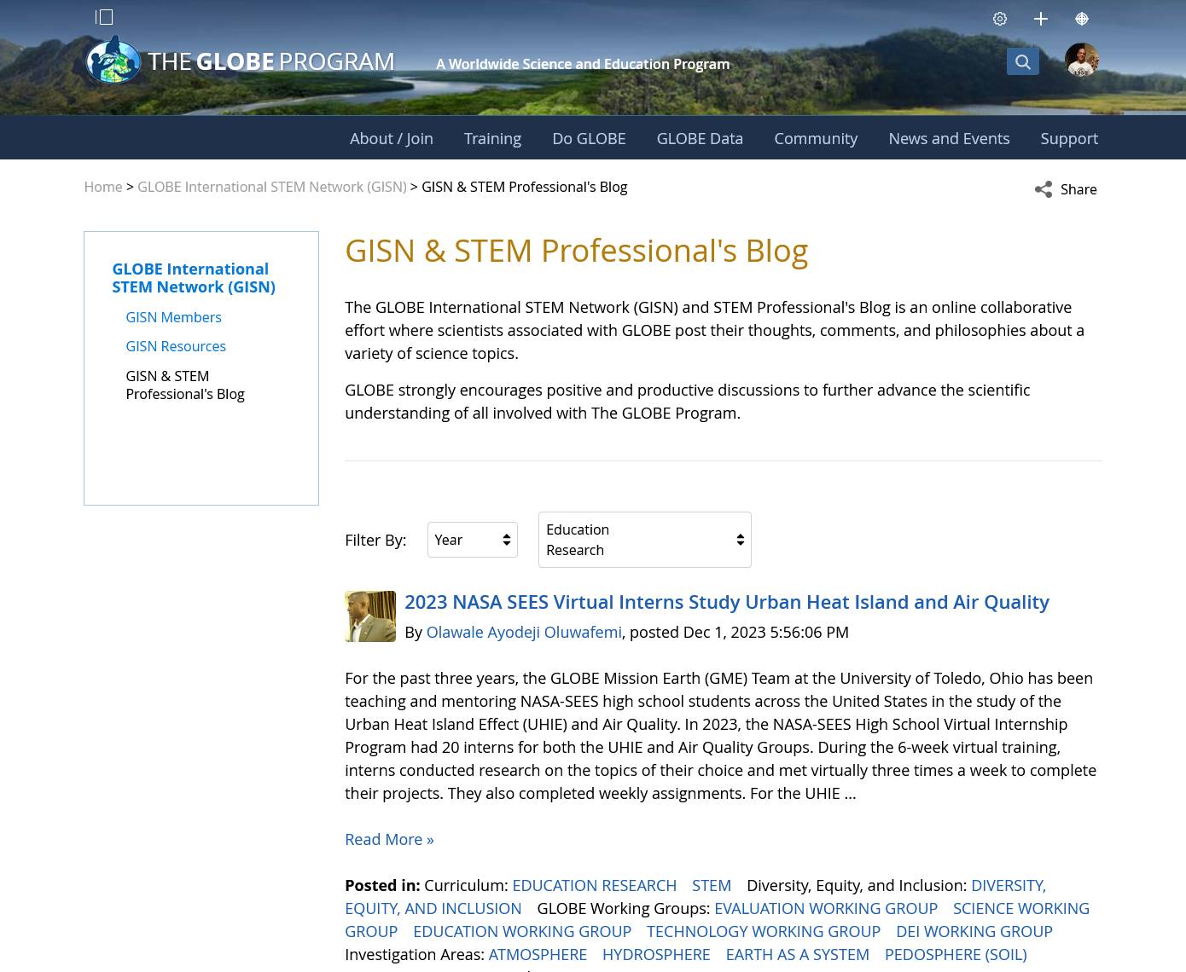
Forums
Read and post questions to scientists on the GISN & STEM Professional’s Blog
Nearly every community has a forum
You can post comments and questions to a forum
Everyone is automatically subscribed to the questions and help forum.

Slide 35
Your Turn
Try to find my MyPage and “friend” me – try two different ways to find me (Cornell Lewis / Axient) (search by name, organization or collaboration tool for example)
Try to find someone (using the collaboration tool) that is doing the clouds protocol in a different part of the world.

Slide 36
Questions
Any suggestions for improvement?
Any features you find especially useful?

Slide 37
Cornell.Lewis@axientcorp.com
Contact Information

