Slide 1
GLOBE Data Entry with GLOBE Observer
May 02, 2024
Cornell Lewis
Axient Corporation

Slide 2
Agenda
GLOBE Observer App Features
Selecting Protocols
Creating Sites
Reviewing and Sending Data
Account Settings
Before we go out
Time to make measurements
When we return

Slide 3
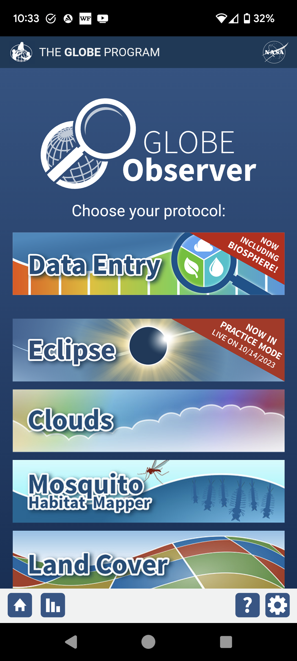
GLOBE Observer App
GLOBE Observer
Clouds, Mosquitoes, Land Cover and Trees are the 4 “Observer protocols”
Easy to use
Any created account with a verified email can do these protocols
If you login with your GLOBE Educator account, or your student accounts, the data you enter will be counted with your school.
GLOBE Eclipse is available as needed
GLOBE Observer/Data Entry (Atmosphere, Biosphere and Hydrology)
Only available to trained users – i.e. teachers and their student accounts

Slide 4
GLOBE Observer - Features
You don’t need to create a site before you start entering data – the app will prompt you if necessary
You can edit/delete sites and measurements
You can enter clouds and other data and associate it with an existing school site
You can have more than one person’s account on a single phone
There are matching data entry forms available through a web browser on desktop, laptop or chromebook: https://dataentry.globe.gov/. Note: some functionality isn’t available on the desktop version.

Slide 5
GLOBE Observer - Features
You can make your own “bundles” of protocols which you use frequently
You can use GLOBE created bundles – Earth Systems bundles
You can create and join GLOBE Teams
Multiple languages available with more translations coming (and needed – especially the newer data entry forms)

Slide 6
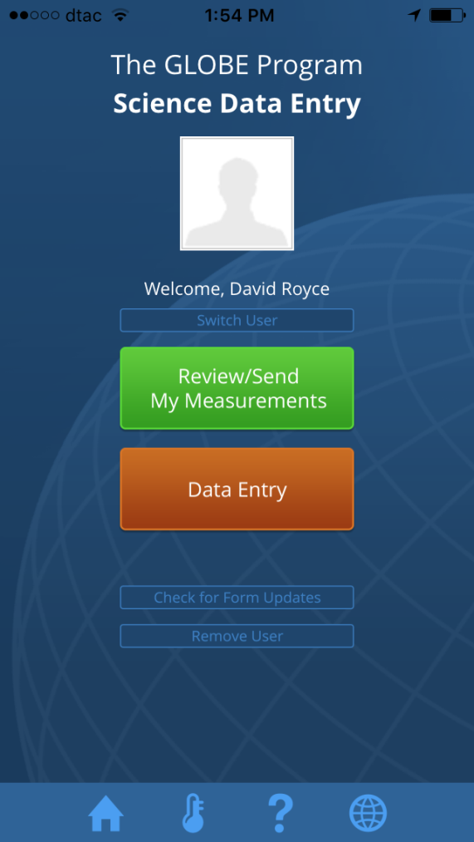
“Old Data Entry”
The existing data entry forms remain available: data.globe.gov.
You can continue to use them for all Pedosphere protocols.
The old data entry app is still available but is no longer maintained

Slide 7
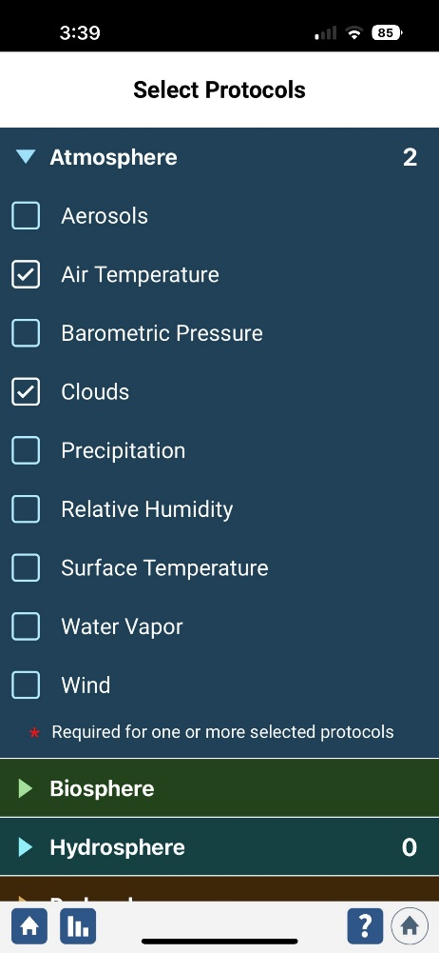
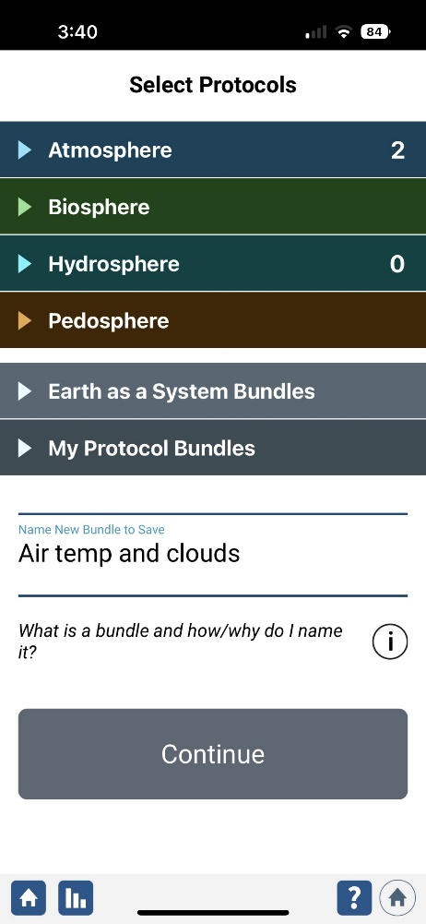
Observer Data Entry – Select Your protocols

Slide 8
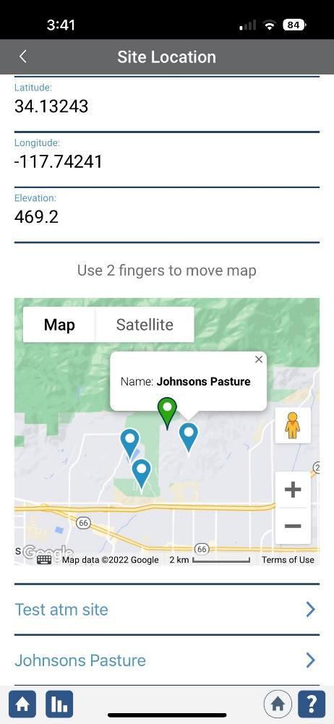
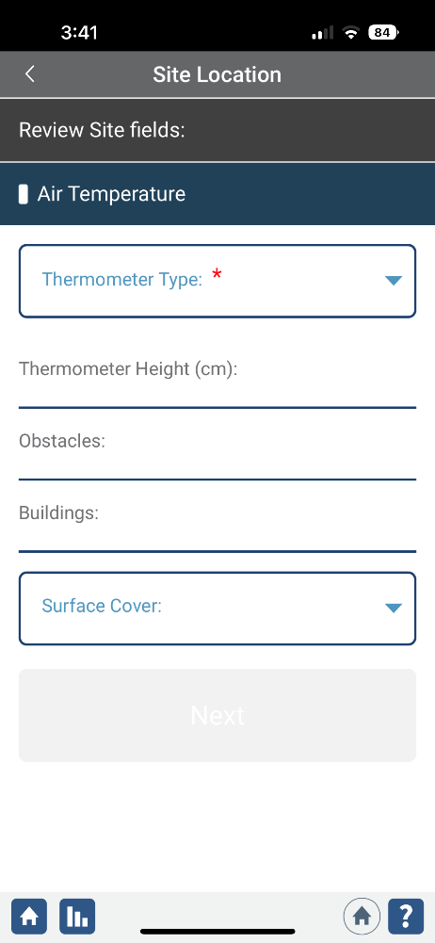
Choose/Create/Define your site and enter data

Slide 9
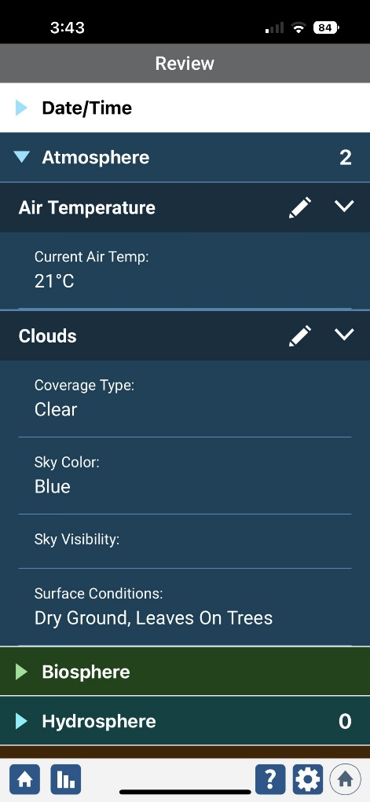
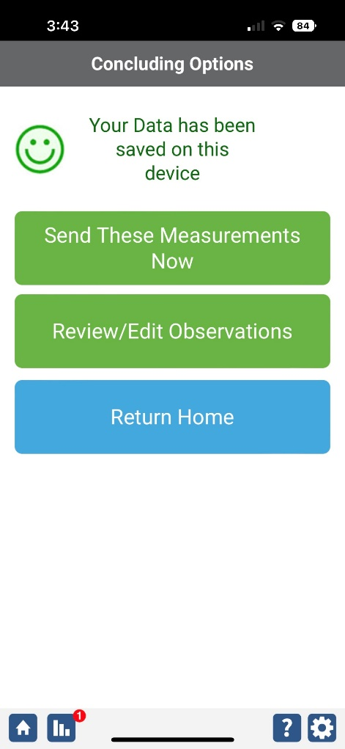
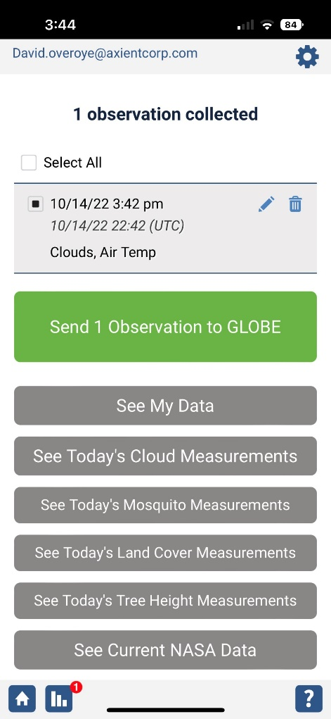
Review and Send Your Data

Slide 10
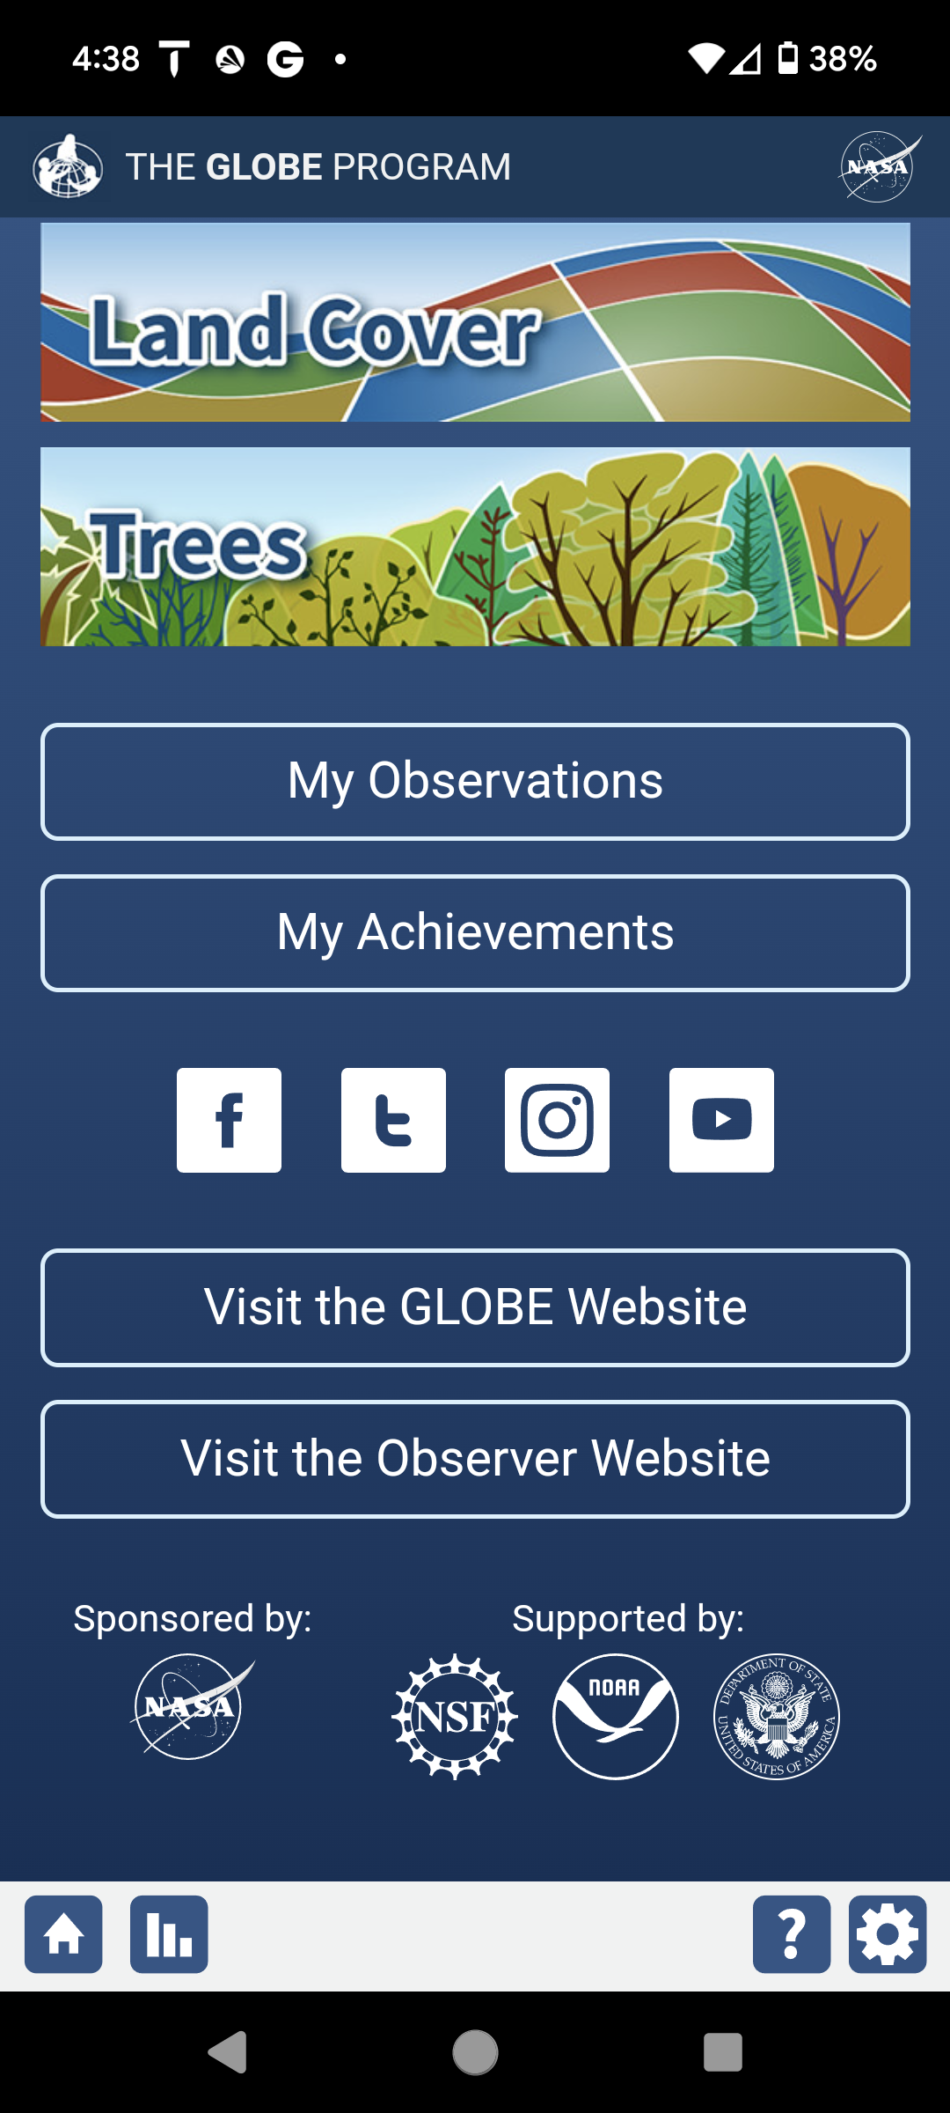
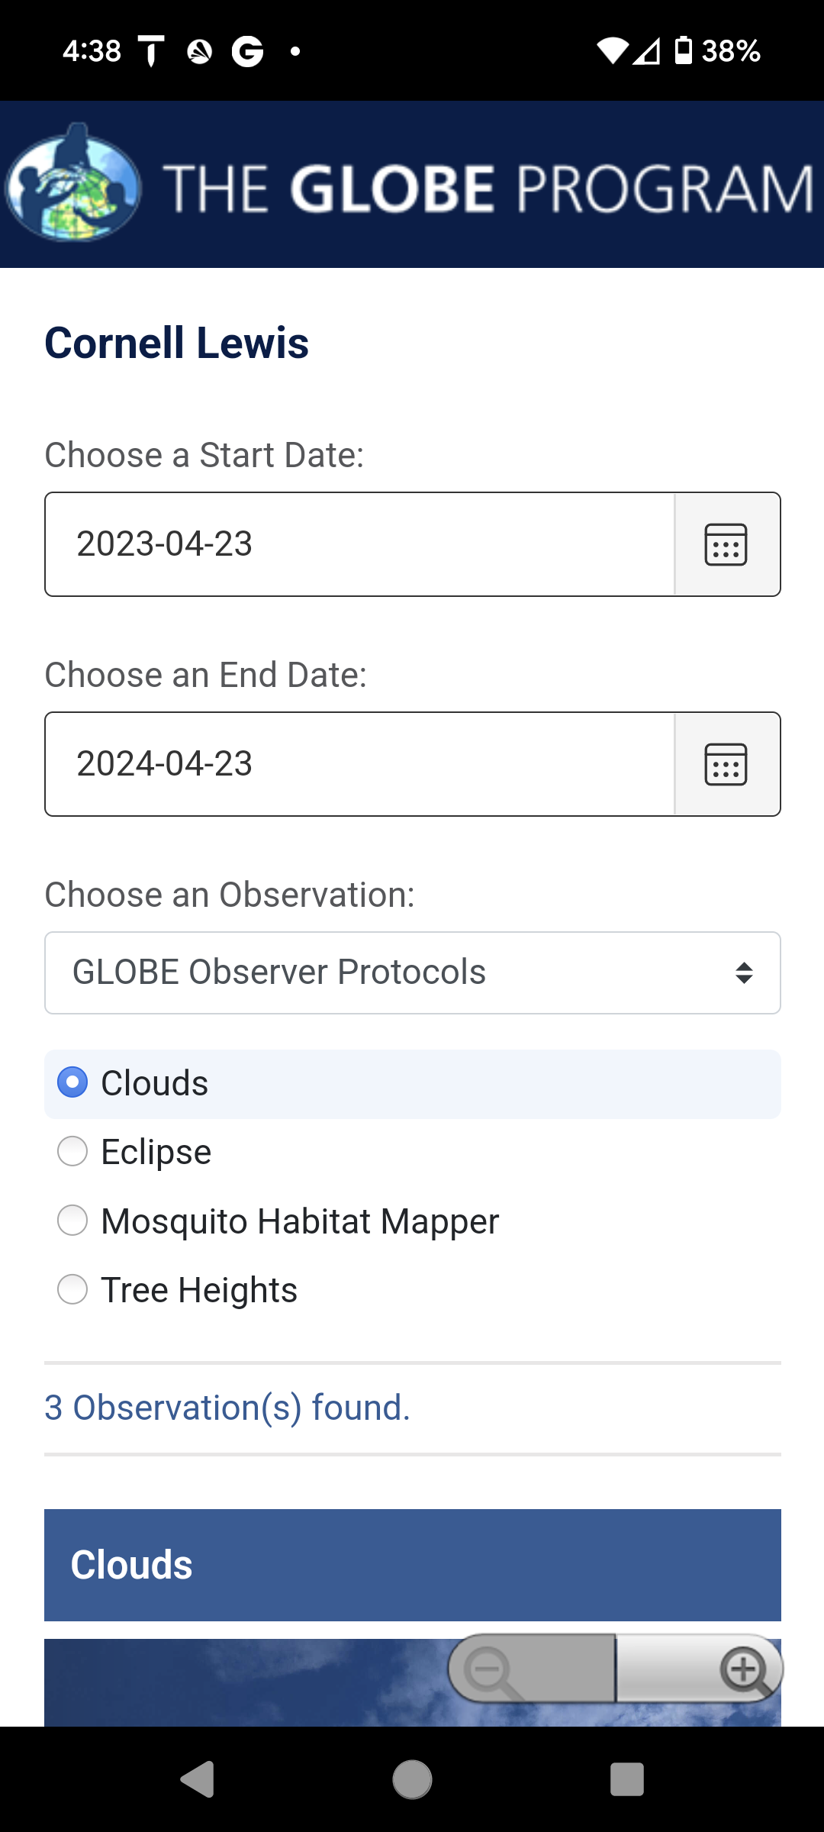
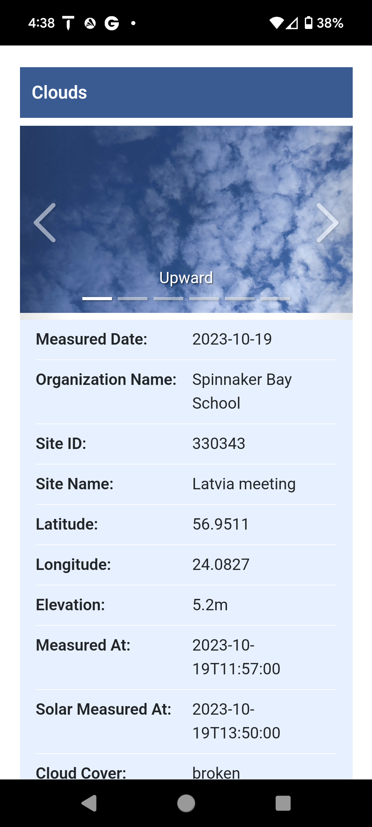
My Observations
See all your observations
Filter by Protocol and date range

Slide 11
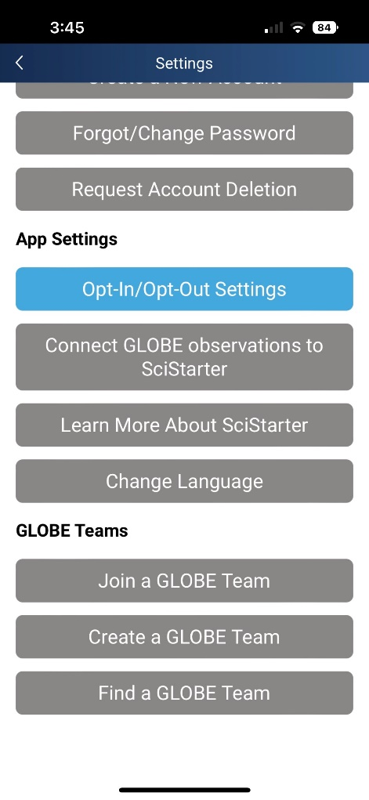
Account Settings
Many options available in account settings
Support for multiple accounts and switching accounts
Language Options
GLOBE Team options

Slide 12
Observer Data Entry Demo (desktop version)

Slide 13
Before we go out….
Verify the GLOBE Observer app is downloaded and updated.
Verify you can login or create an account
Launch your app and join the team I just created
https://www.globe.gov/web/africa-2024-regional-meeting
Referral Code: GLIDDTN6
Once you’ve joined, check and see if your name or screen name is listed on the team page.
Verify you can see the “Data Entry” Option on the app (trained users)

Slide 14
Time to Make Measurements
Let’s do Clouds and Air Temperature (if available on your phone) using the Data Entry Interface on the GLOBE Observer App.
You can create a new site or use an existing one.

Slide 15
When we come back
Check our team to see what data now appears
https://www.globe.gov/web/africa-2024-regional-meeting
Cloud observations take 30 min to an hour to show up on the website.
Look at ‘My Observations’ to see your data.

Slide 16
When we come back
See the Data on the Vis Tool: https://vis.globe.gov/
Measurement Date Range: today’s date
Protocols:
Air Temperature
Clouds
Zoom into Cameroon or filter by Cameroon

Slide 17
When we come back
Retrieve the Data using ADAT: https://datasearch.globe.gov/
Date Range: bracket today’s date
School / Teacher / Partner / Team: Africa 2024 Regional Meeting
Protocols:
Air Temperature
Clouds

Slide 18
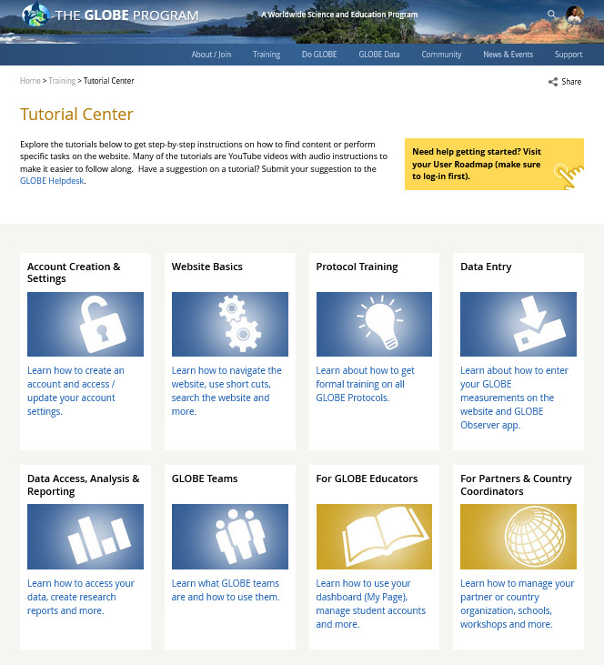
GLOBE Observer and Data Entry Tutorials
For additional training, visit the Tutorial Center to access the Data Entry Tutorials
Training > Tutorial Center

Slide 19
Remember – you can always use your browser
Data entry is available on your browser on any device
Data.globe.gov – old data entry forms (for Pedosphere)
Dataentry.globe.gov – new data entry forms (some functionality is not available)

Slide 20
Questions?

Slide 21
Cornell.Lewis@axientcorp.com
Contact Information

