Slide 1
GLOBE Visualization System “Vis”
May 03, 2024
Cornell Lewis
Axient Corporation

Slide 2
How to access GLOBE Data
Visualize Data – “GLOBE Vis”
See Data on the map
https://vis.globe.gov
Retrieve Data – Advanced Data Access Tool (ADAT)
Save Data into a spreadsheet
https://datasearch.globe.gov
My Observations
Shows you just your observations
Can be shared with others
GLOBE API – “API-Out”
More for programmatic connections
Fast for retrieving larger amounts of data into GeoJSON format
https://api.globe.gov/search
Notes:
https://www.polleverywhere.com/home /gmail

Slide 3
Visualize and Retrieve your Data
Used for mapping data
Focus is on one site, or possibly comparing 2-3 sites
Simple X/Y charts available
Demonstration Topics – Visualization – vis.globe.gov
Navigate to the visualization system
The pieces of the visualization system
Layers, Dates, Filters, Legend, Graphs
How to view data from a specific protocol on the map
How to graph and retrieve data for a specific protocol
Advanced Features
How to use data counts to find schools that are active in a given protocol
Your Turn
Activities for you to try with “vis”

Slide 4
The Basics of the Visualization System
Select Go to -> from the top and “Visualize Data”
Or Go to the homepage and select “Visualize Data”
Or http://vis.globe.gov

Slide 5
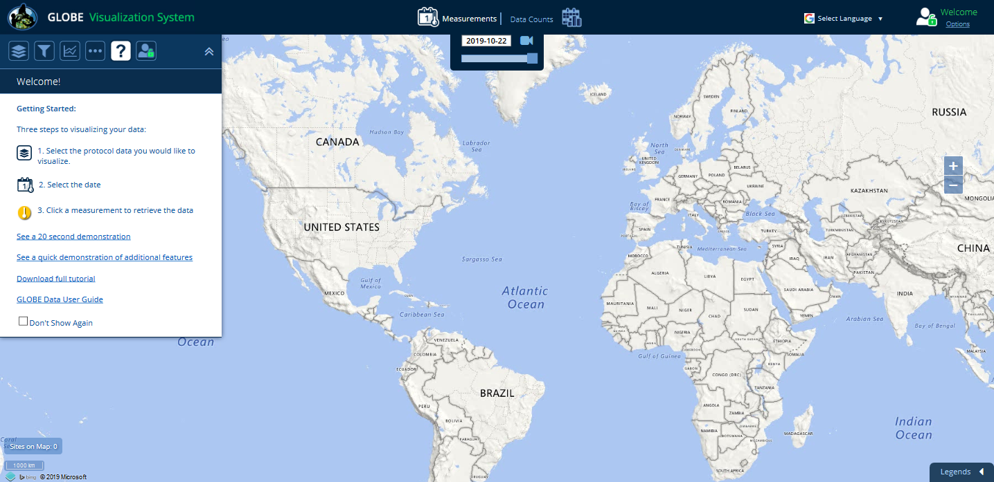
The Basics of the Visualization System
This is the GLOBE Visualization Landing Page. The help tab is the default tab when you first come to Vis. There are getting started steps, links to quick demonstrations and this complete tutorial. Check the ‘Don’t show again’ to default to the layer screen for future visits.
Notes:
Now we are looking at the Visualization Tool. The Welcome box will open each time you reload the tool unless you click the check box next to Don’t Show Again (please don’t do this). The Welcome box contains a reminder about how to add layers and basic filter options. It also contains a link to the Help page. For now, close the Welcome box.
Hmm, maybe the original text for this slide is better…it seems funny to say “close the welcome box” but then again we don’t want them to try adding layers until we get to that point….

Slide 6
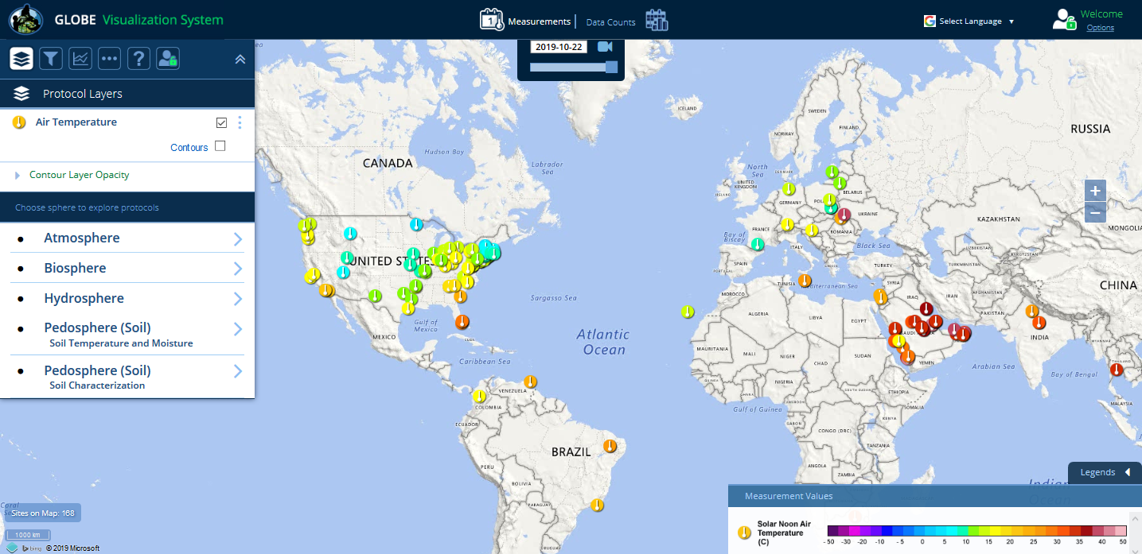
Sign-in / Sign-out
Map Type
Map Date Selector
Language
Selector
Open/Close Layer and Filter Menus
Zoom Controls
Data Site Icons
Open/Close Legend
Notes:
Now let’s review the different sections of the Visualization Window. Besides the map itself there are 5 sections within the window:
The Top Bar
Layers Control Pop-out Box (left side)
Advanced Features Control Pop-out Box (right side)
Movement Controls (just left of Advanced Features)
Legend (bottom* only visible if there is at least 1 layer added)
Cursor Lat/Long report (bottom left)
Throughout the tutorial we will cover the options available in each section.
Added Slide.
Slide needs to be corrected to have the official names of each of these sections.

Slide 7
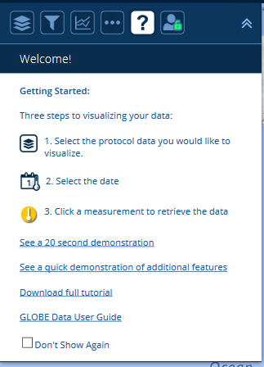
Layer and Filter Menu Icons
User Options / Sign-in and out
Layers
Welcome and
Tutorials
Open/close
menu
Filters
Multi-Site
Plots
Base Map, Language and
Map Grid Controls
Notes:
Now let’s review the different sections of the Visualization Window. Besides the map itself there are 5 sections within the window:
The Top Bar
Layers Control Pop-out Box (left side)
Advanced Features Control Pop-out Box (right side)
Movement Controls (just left of Advanced Features)
Legend (bottom* only visible if there is at least 1 layer added)
Cursor Lat/Long report (bottom left)
Throughout the tutorial we will cover the options available in each section.
Added Slide.
Slide needs to be corrected to have the official names of each of these sections.

Slide 8
The Basics of the Visualization System
Three Steps to Visualize your Data:
Select the protocol data you want to see (Add Layers)
Select the Date you want to see the data for
Click on a data point on the map to receive table and graph information

Slide 9
Step 1 – Add Data Layers
Select Which Data to Plot
Start by selecting the Protocol Layers icon, then the sphere your data is in

Slide 10
Step 1 – Add Data Layers
Select Which Data to Plot
Select your protocol and “SUBMIT”

Slide 11
Step 2 – Select the Date
Select the Date
Days which have data will have a small data icon on them

Slide 12
Step 3 – Select the Data Point
Select the Data Point
Click on the data point to see the data at that location

Slide 13
Vis system popup window
Go to this School’s Page
See Plot Data in a Table
See All Atmosphere Data
Add this Data to a Multi-site Plot
Change the X-axis Timeline

Slide 14
Advanced Features
Use Filters - Location/Site/Elevation to find specific locations – school, country, city etc.
Create an animation
Use the graph with the + icon to select multiple data sets to graph
Allows you to overlay data from multiple sites
Export layers to KMZ format for using with Google Earth and other similar tools

Slide 15
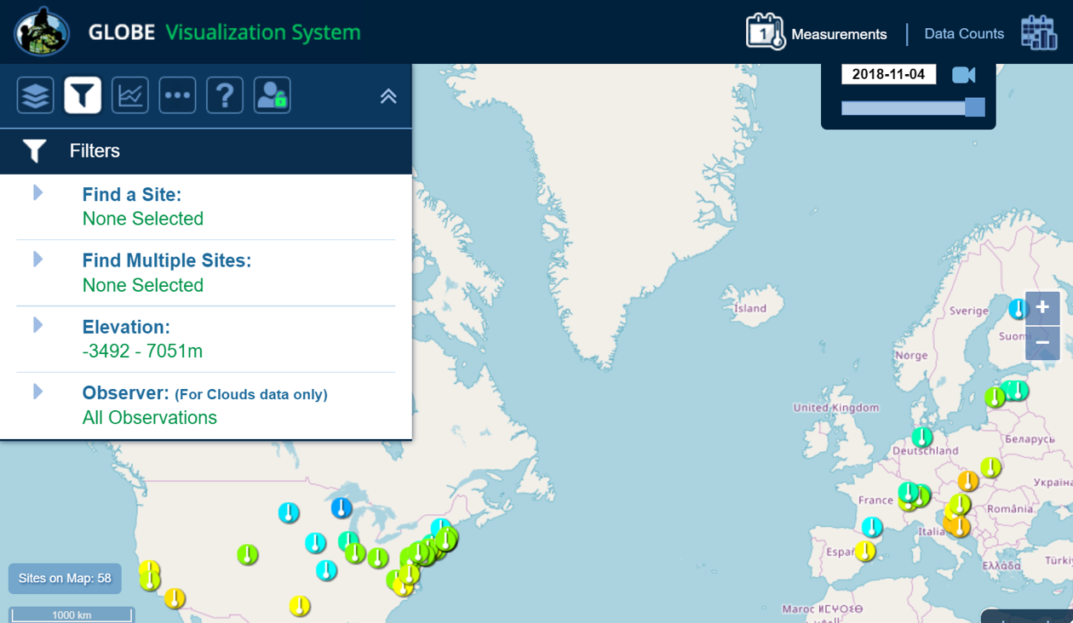
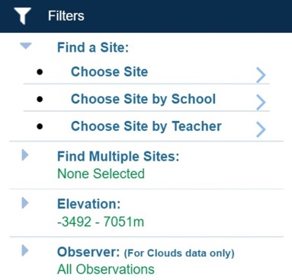
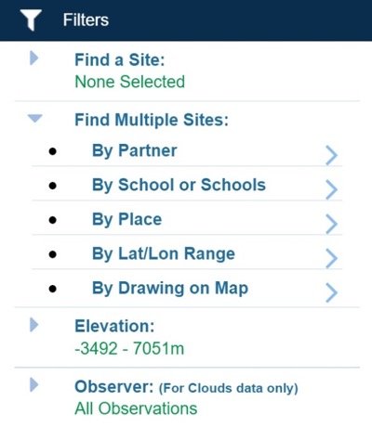
Filter your results
Select Filter Icon
Filter by teacher, school, country, lat/long or other options

Slide 16
Export Layer
Select Vertical Circles
Any Data Layer can be exported as a table, or downloaded as a KMZ file.

Slide 17
Setup Multi-Site Plot
Overlay multiple plots
Click on the “+” icon in the popup window to select multiple datasets to plot.

Slide 18
Setup Multi-Site Plot
Multi-plot up to 6 data sets
Manual or Auto scale
Choose the time duration you want

Slide 19
Save Your Filters / Protocols
My Vis Select “My Vis” to show all of my sites, filter the display by my measurements, or share/save/load a set of filters and protocols

Slide 20
Animating Vis
1) Click on the camera to create an animation
3) Press Play or use the record icon to save your animation
2) Use the sliders to adjust the date range

Slide 21
Why use Data Counts?
The Data Counts tab tells you how much data a given location has entered in a particular period of time for a given protocol.
Looking for someone to collaborate with? Looking for the most current data? Use Data Counts.

Slide 22
How to Use Data Counts
Select Data Counts on the top menu of the vis system
Select the protocol(s) you are interested in (ie Solar Noon Temperature Dailies)
The map will show the total number of measurements which have occurred at any location since the beginning of the GLOBE program.
Use the Date Range Filter to adjust the date range
Select a site which has data
You can find the school and teacher if you are interested in collaborating.

Slide 23
Data Counts
Select Data Counts and a Time Range
Data counts show how much data was entered at any site for the selected period of time.
Bigger dots = More Data
Data Counts
Use Data Counts to see which sites have the most data in the selected time frame

Slide 24
Demonstration
Select Air Temperature – Daily Average Temperature
Let’s find who’s been entering a lot of data in Africa in the last 5 years.
Go to Data Counts
Select the school in Ghana - Westphalian Senior H.S. Very active from 2019-2021.
Switch to Measurements and select Oct 2020.
Select the school again
Enlarge the Daily Average Temp graph

Slide 25
Demonstration
Expand to 1 year
Show how to get the data
View plot data in a table, export to .csv
Click the enlarge icon
Click share links
Go to the school.
Add this school to the multi-site plot (we’ll come back to this later)

Slide 26
Demonstration
Show how to switch protocols in the popup to see the data in other protocols for this school – Relative Humidities Noons
Show data counts (large view in chart) school info, site info, site photos
Go back to Measurements and select 2020-10-01 (if not already selected)
Select a school in Estonia and click the Add Site to Multi-plot button (green “+”) to compare the temperature for the two schools (the one in Ghana and the school in Estonia).

Slide 27
Compare Estonia to Ghana
Blue=Ghana
Red=Estonia

Slide 28
Try This….
Your Assignment
On May 2, 2024, how many schools in Saudi Arabia reported a water pH reading greater then 7?
Which measurement technique did the school(s) use?
What was the range of pH values reported for this site between Jan 1, 2023 and Dec 31, 2023?

Slide 29
Answers
Your Assignment
One (Filter by Saudi Arabia using the place filter and date and then use the ‘View Table Layer’ option). Yamama School
meter (Clicked on the site on the map, it’s the lightest color icon).
4.7 – 6.9 pH. (Open the site information window and enter the custom dates in the chart and then plot. Then, view Plot Data in Table and sort by the ph column. Alternatively, enlarge the plot and select the highest and lowest values).

Slide 30
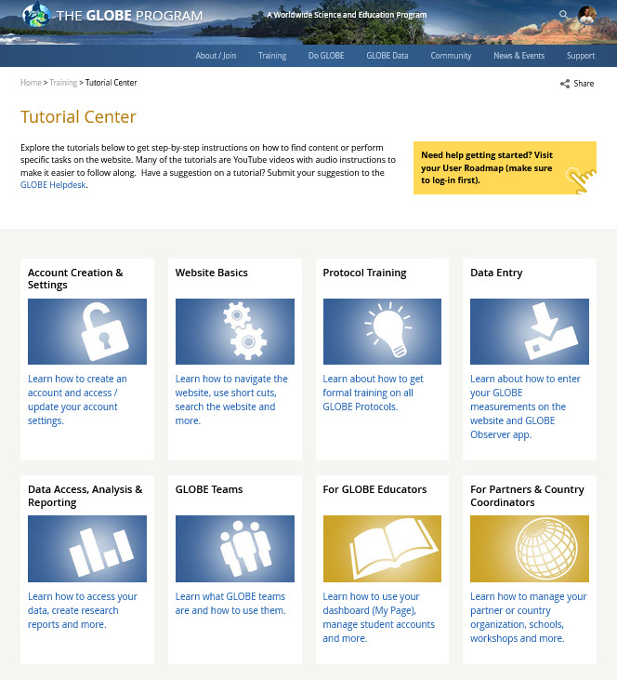
Vis Tutorials
For additional training, visit the Tutorial Center to access the Vis Tutorials
Training > Tutorial Center

Slide 31
Questions?

Slide 32
Cornell.Lewis@axientcorp.com
Contact Information

