Slide 1
GLOBE Advanced Data Access Tool (ADAT)
May 03, 2024
Cornell Lewis
Axient Corporation

Slide 2
Retrieving Data
Using the Advanced Data Access Tool (ADAT)
Tool allows you to download GLOBE data from multiple protocols, schools, regions or dates without using the map
  Used for downloading large quantities of data – multiple protocols and multiple sites
Select GLOBE Data -> Retrieve GLOBE Data or http://datasearch.globe.gov/
Three Steps –
  Select the Protocols you’re interested in
  Select Filters
    Date Range, Country, School or Teacher etc.
  Select “Download Measurement Data” (may take a little while!)

Slide 3
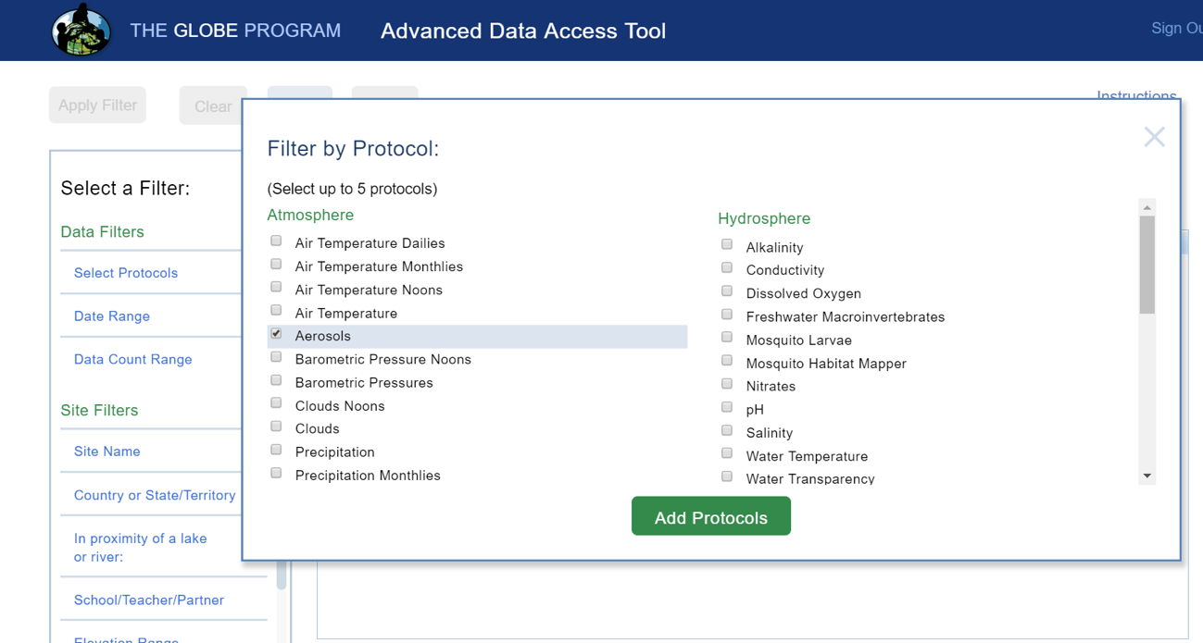
Select your protocols
Select Protocols
Up to 5 protocols can be selected

Slide 4
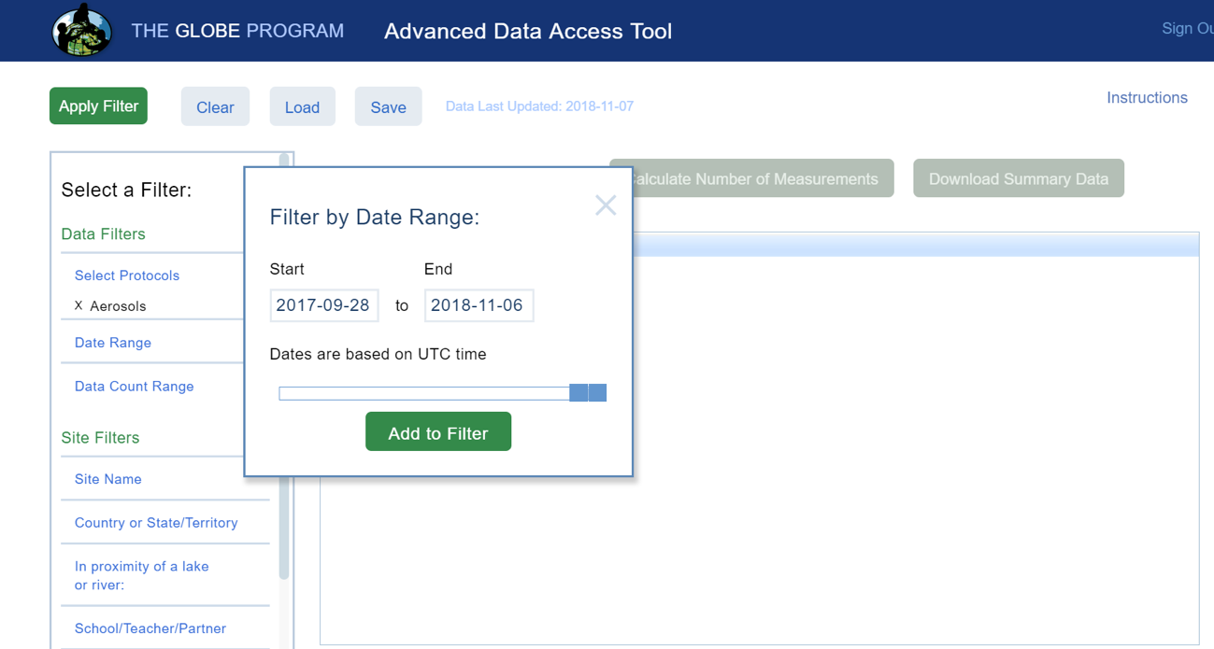
Select the date range
Select Date Range
Use sliders or enter a date range

Slide 5
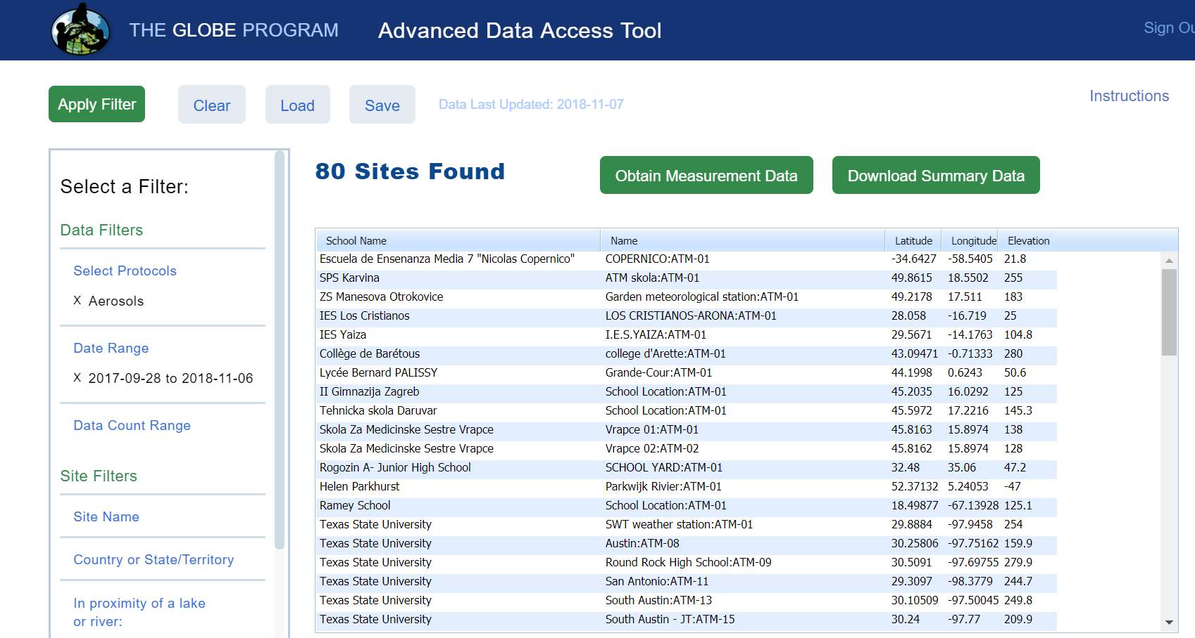
Add other filters if needed then “Apply Filter”
Apply Filters
Select any additional filtering, then click “Apply Filter” to see how much data is available for download

Slide 6
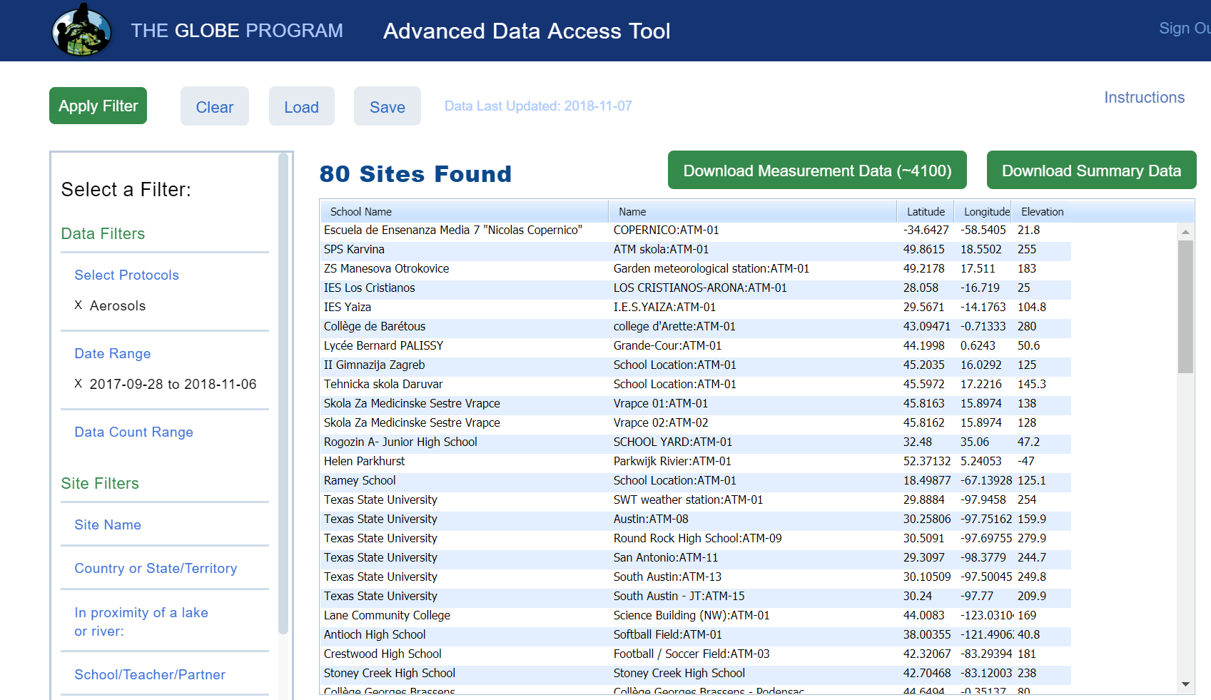
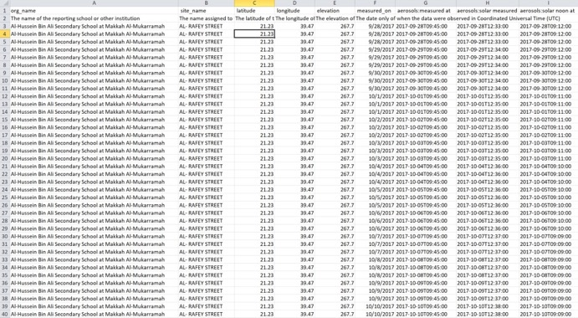
Download the Measurement Data
Download Data
Select Obtain Measurement data and download the data

Slide 7
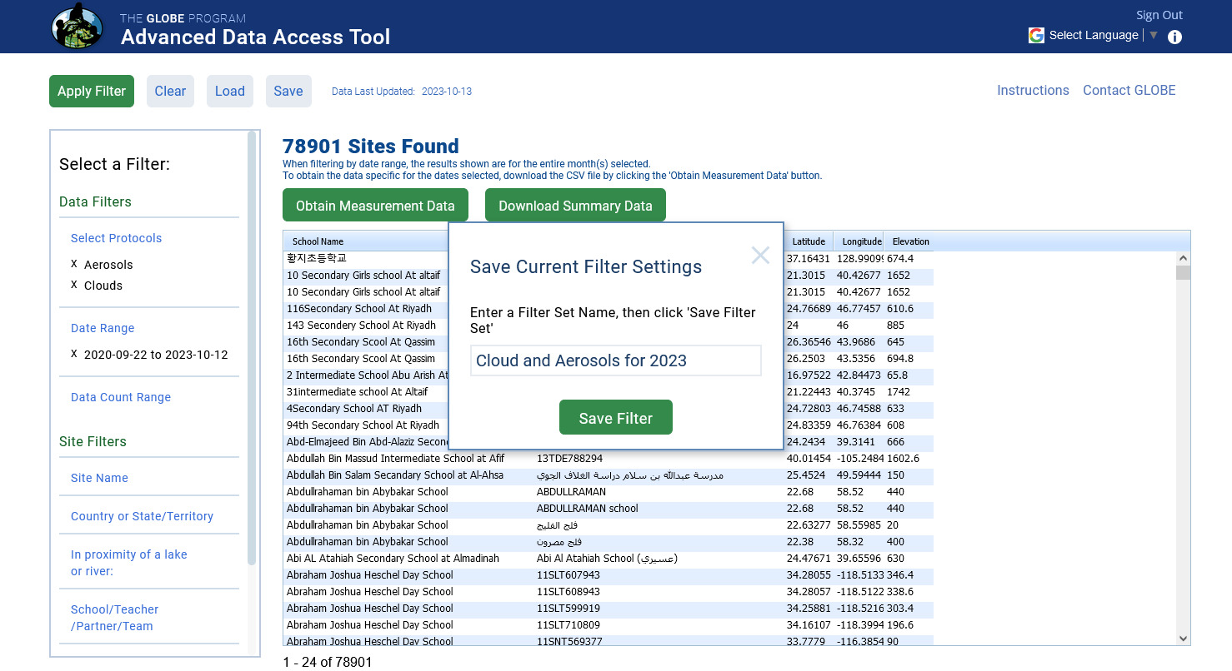
Save Your Filters
Save Your Filters
Store your filter sets to retrieve or share with others.

Slide 8
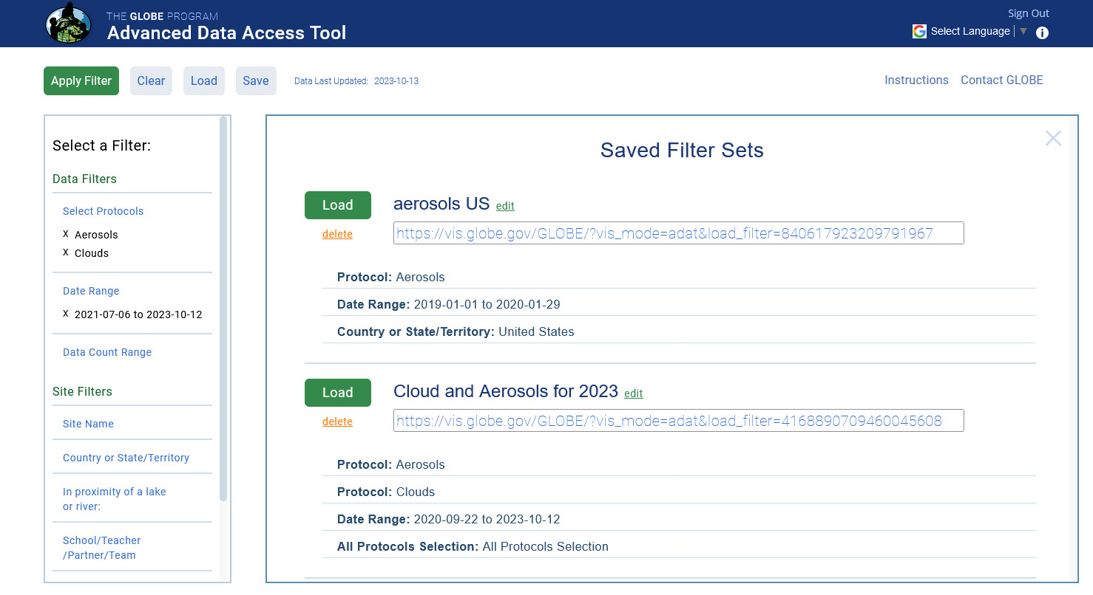
Load Your Filters
Load Your Filters
Select from a list of saved filters to load or copy the URL to share with your students.

Slide 9
Demo

Slide 10
Try This….
Your Assignment
Obtain the measurement data for Clouds in your country between January 1, 2024 and today.
How much measurements data is there (approximately)?
What is the Sky Conditions : Cloud Cover of the first school in the Excel spreadsheet.
Share your Data Filter with someone.

Slide 11
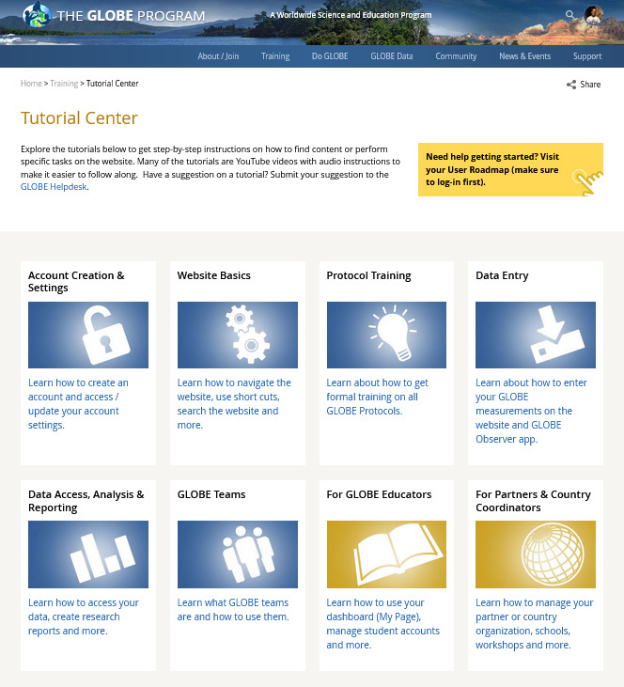
ADAT Tutorials
For additional training, visit the Tutorial Center to access the ADAT Tutorials
Training > Tutorial Center

Slide 12
Questions?

Slide 13
Cornell.Lewis@axientcorp.com
Contact Information

