Slide 1
Asia and Pacific Region Meeting March 10-13 Hanoi, Vietnam
GLOBE Implementation Office Update

Slide 2
Welcome Back to in-person meetings
Welcome to the 10 Country Coordinators and Assistant Country Coordinators from 11 countries attending the meeting
Update from GLOBE Implementation Office (GIO) and the Data Information Systems (DIS)
Update from you about the development of GLOBE in your countries
Update from the Regional Coordination Office (RCO)

Slide 3
Highlights from 2022
Engagement accelerates as travel restrictions fade and movement increases
Science data continue to increase, pushing the count to almost 240 million measurements
Work continues on protocol deactivation and proposal process
Over 1 million satellite matches for the GLOBE Observer Cloud matches
Trainer certification process launched and online processing continues to be refined
Capacity Building Project launched with RCOs around data literacy activities (workshop here after meeting concludes)
New staff hired at GIO

Slide 4
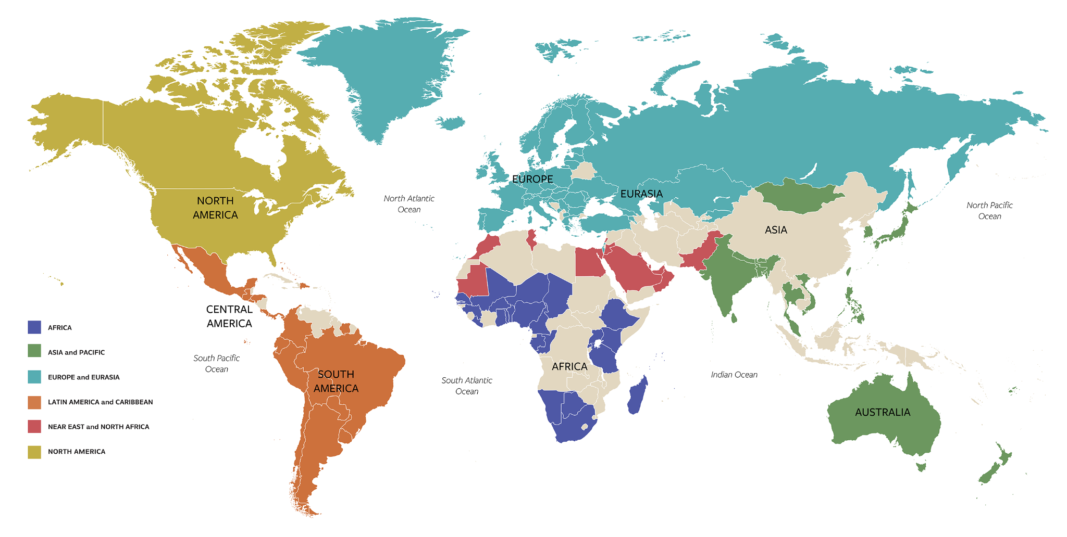
GLOBE-UN Science Summit 2022
On September 15th, GIO Director and one representative from each of the GLOBE six regions
presented on the alignment of their work with the SDGs at the 2022 UN General Assembly Science Summit. Two US partners acted as moderators for the panel. Over 200 participants.

Slide 5
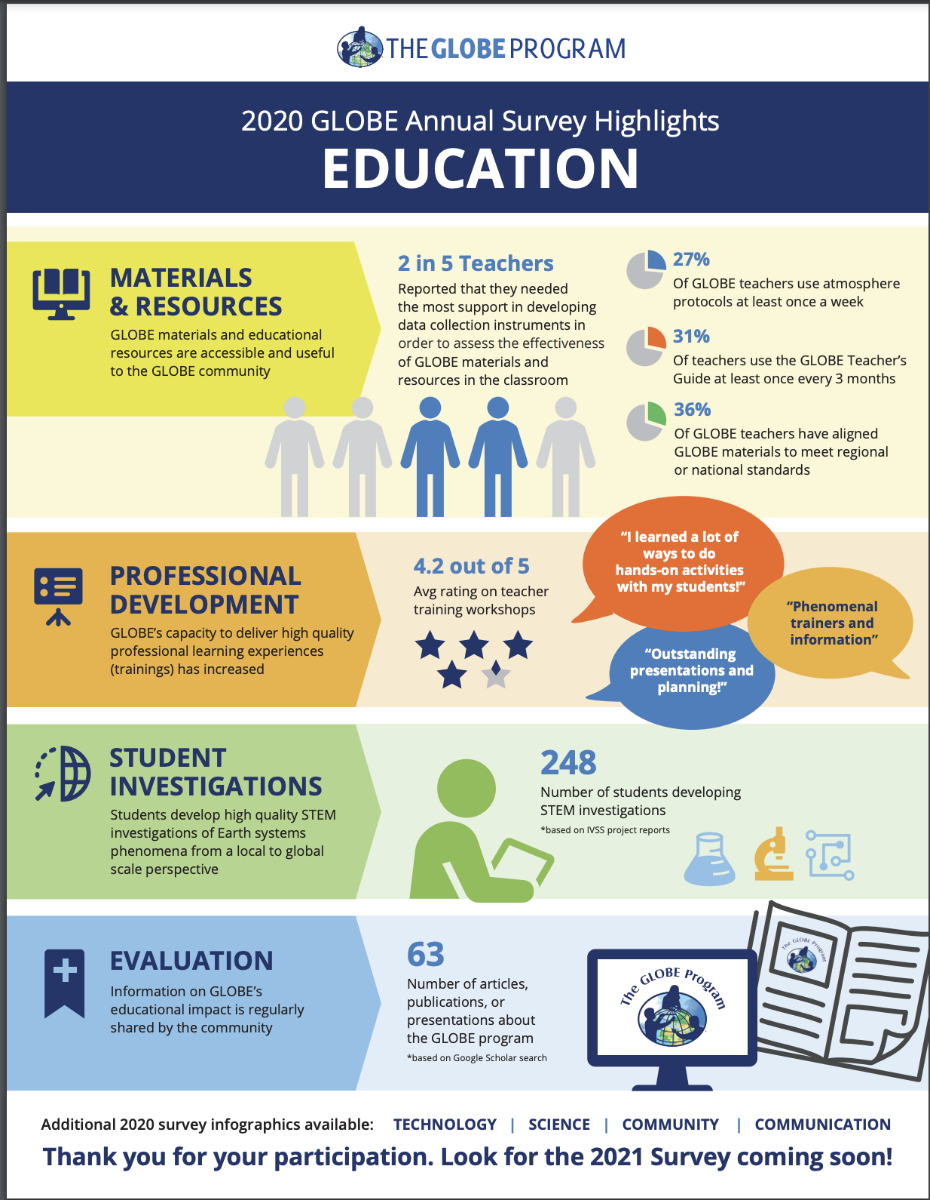
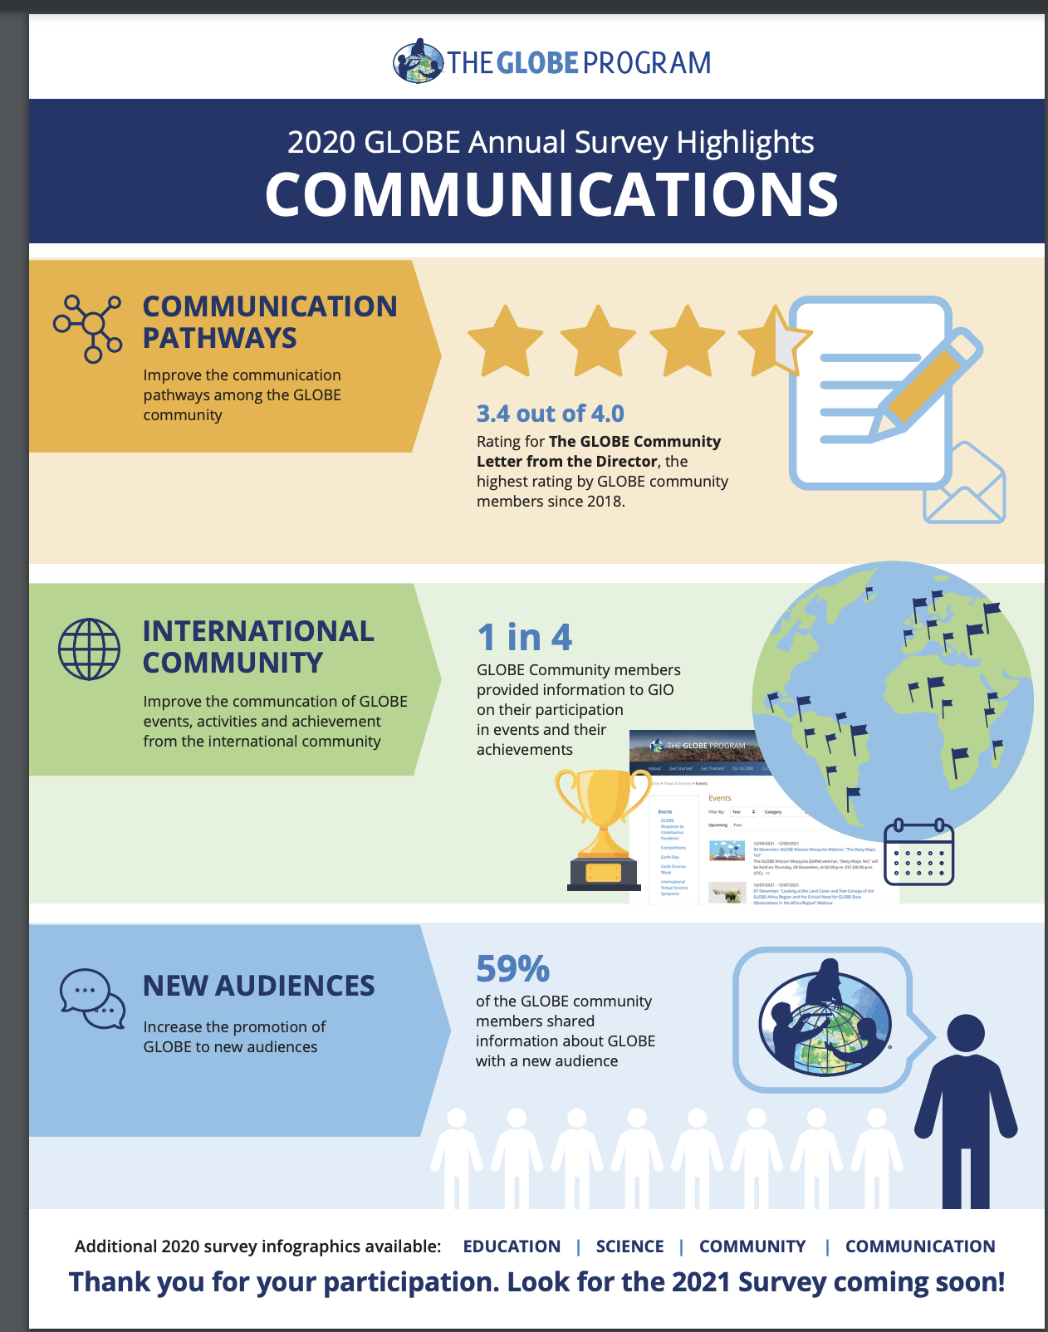
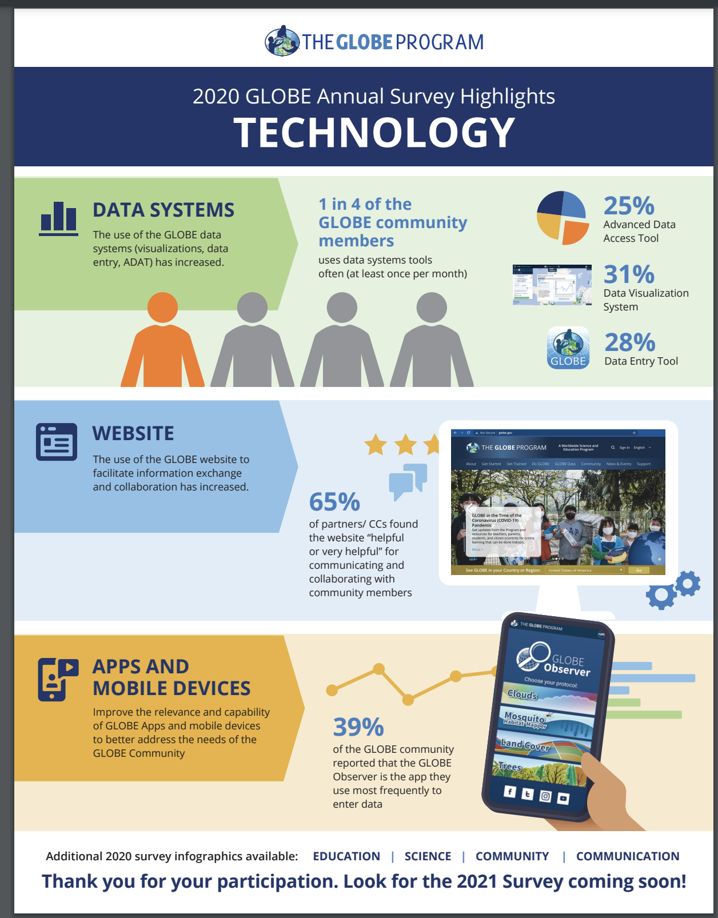
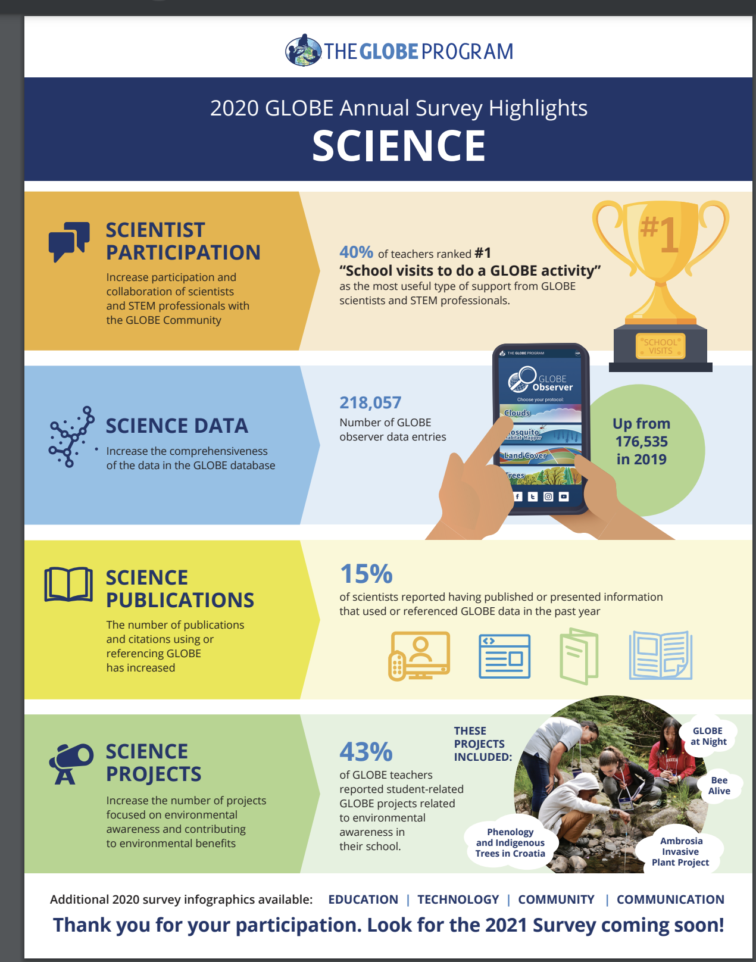
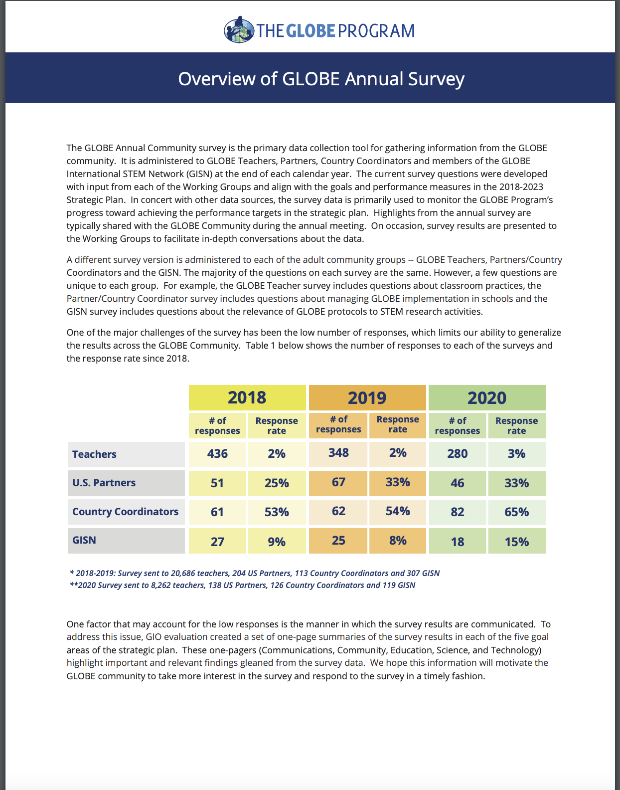
Notes:
Still produce products in multiple languages with the assistance of the RCOs, such as the GLOBE Strategic Plan.
Publish infographics from the annual survey in more useable formats for you.
All available on the website.

Slide 6
Highlights for 2023
New learning activity submission process and repository
Increased outreach to the GISN and involvement with the group
Revisioning with the Working Groups the role of the groups over the next 10 years
Enhancements to and content refresh for the website (DIS and GIO)
All data entry forms in The GLOBE Program’s app, GLOBE Observer
Continuing field campaigns and expeditions in regions
First in person GLOBE Annual Meeting since 2019.
To be Held in Denver
July 16-21

Slide 7
A
BIG
BIG
BIG
THANK YOU

Slide 9
GLOBE Implementation Office For assistance contact Community Support Team globehelp@ucar.edu Regional Coordination Office For assistance contact ap.region.globe@gmail.com iesindia@gmail.com

