Slide 1
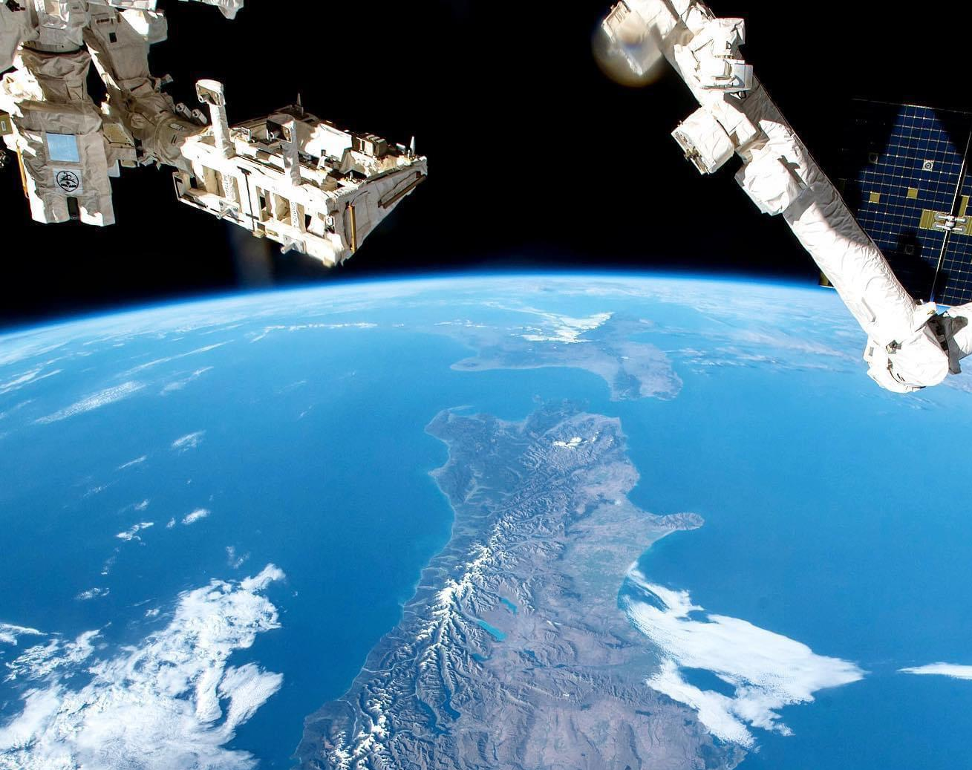
NEW ZEALAND 2024
COUNTRY COORDINATOR: DR VICTORIA METCALF

Slide 2
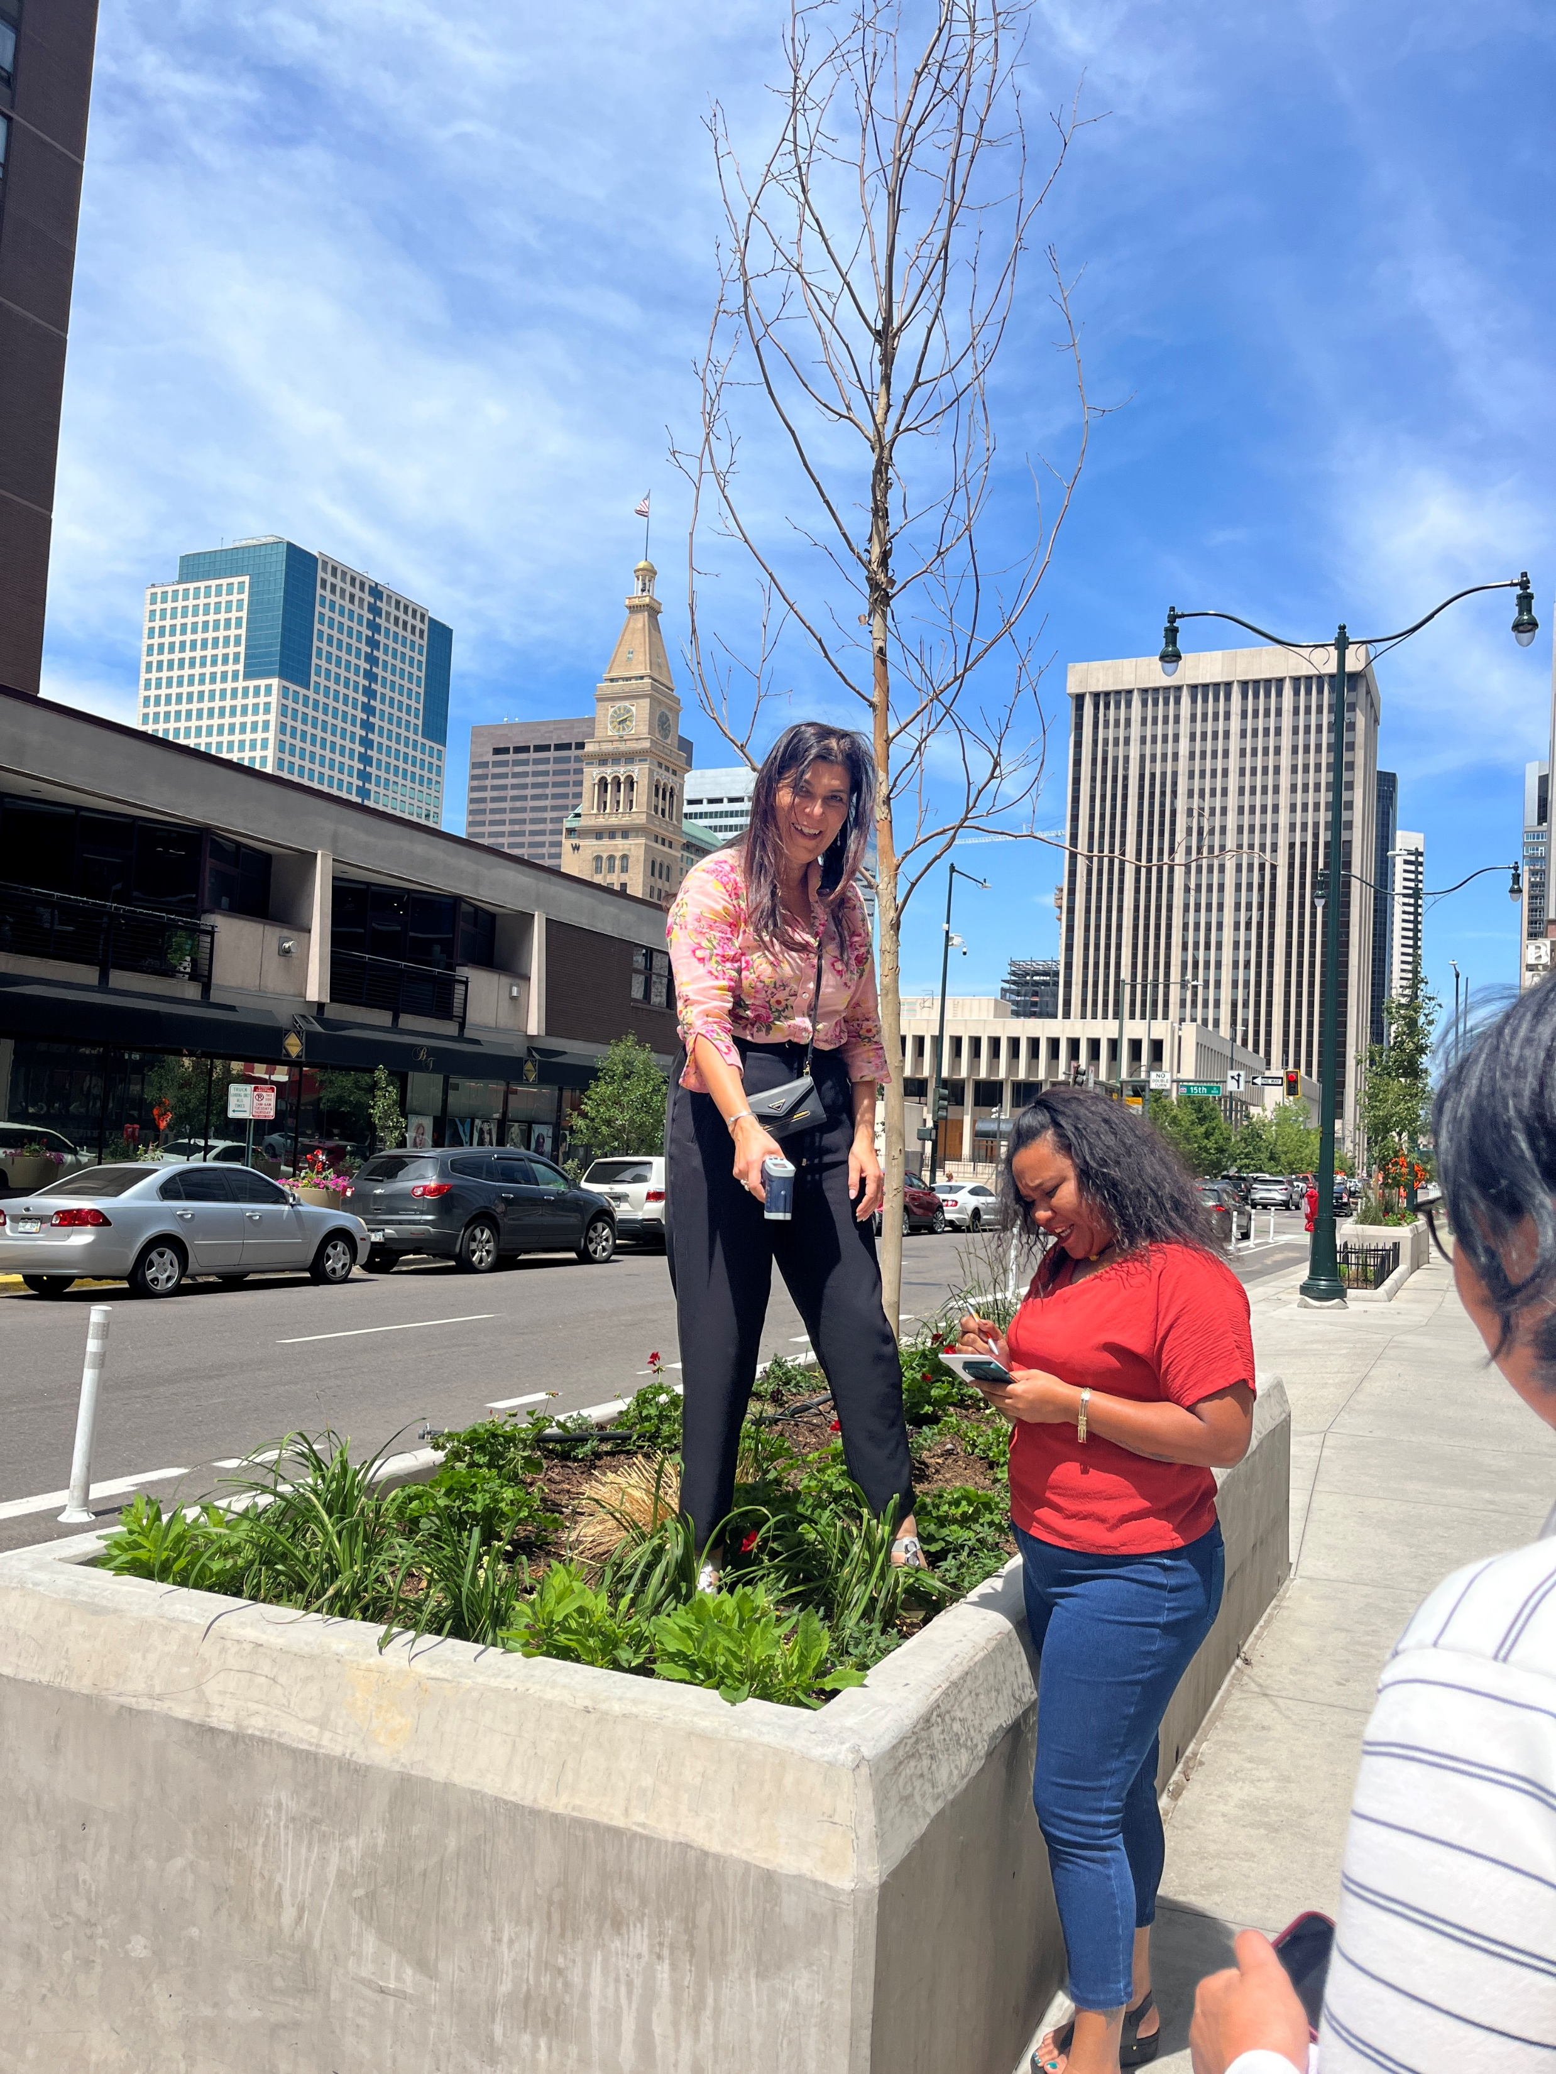
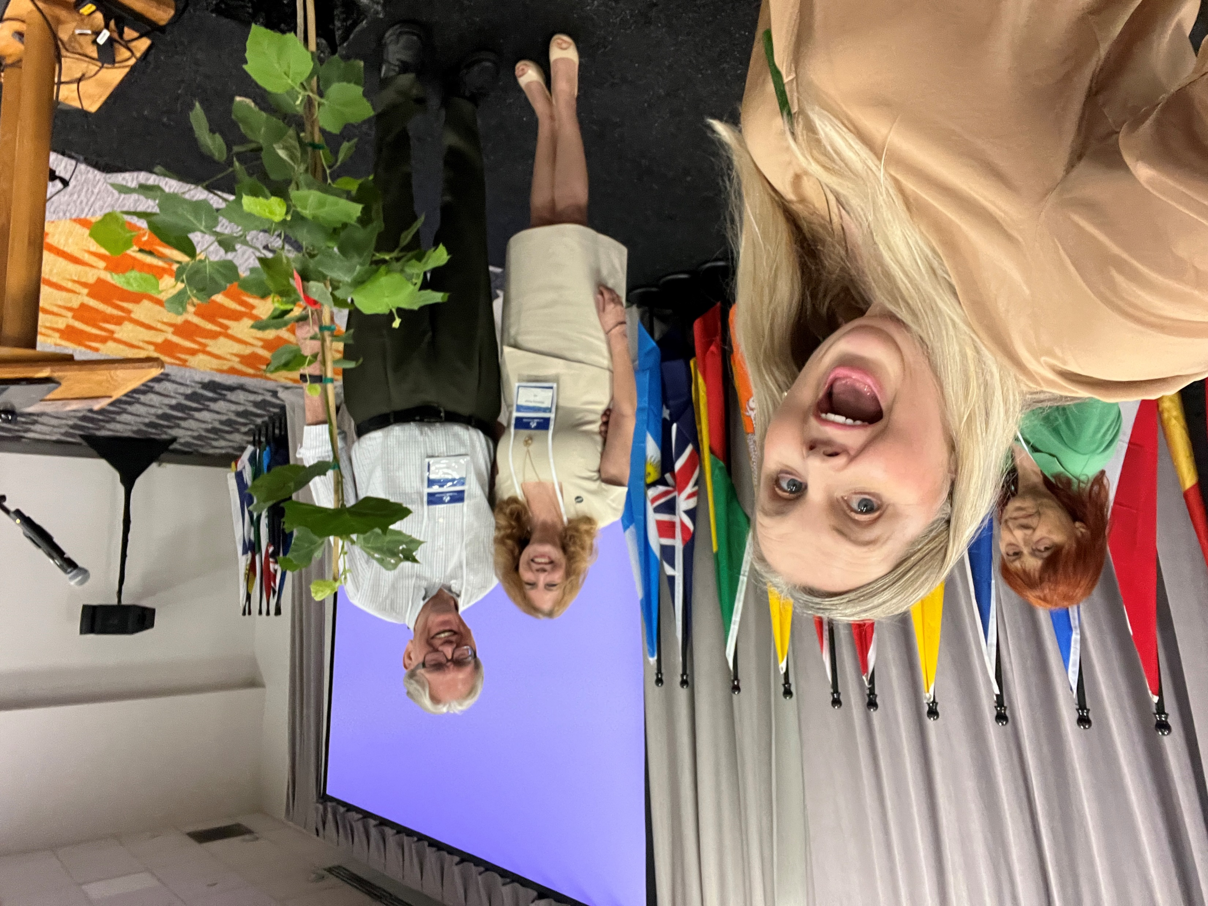
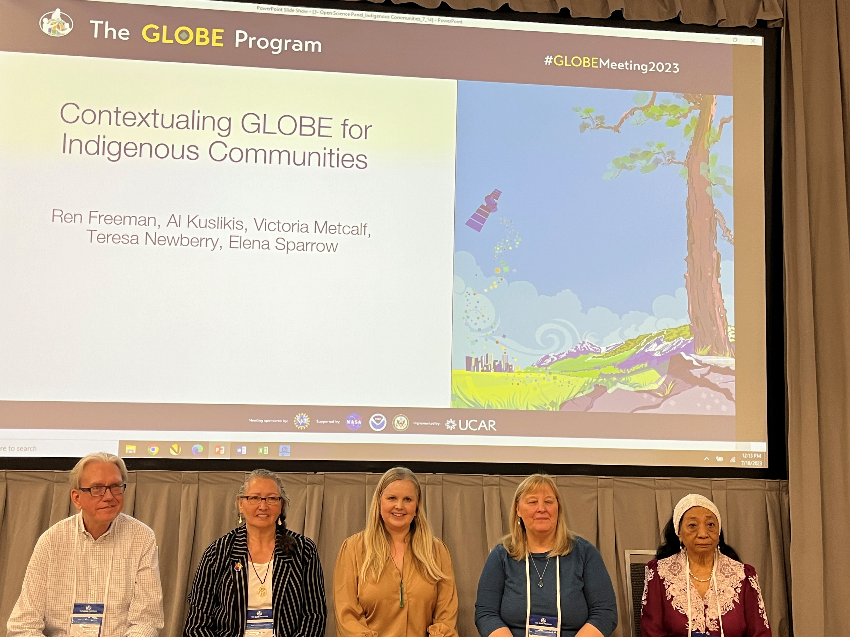
Significant Achievement
Annual Meeting
Keynote Panel Teacher Training Connections
Gail Goodwin – “as a keynote speaker you were excellent and that the range of hands-on activities led by diverse presenters was inspiring.”
Notes:
AM was transformative.
Being asked to give a keynote.
Being part of the panel on contextualising GLOBE for indigenous communities.
Being able to bring educator Gail Goodwin to the meeting and do training.
Making many connections across GLOBE, including GIO, WG, other countries.

Slide 3
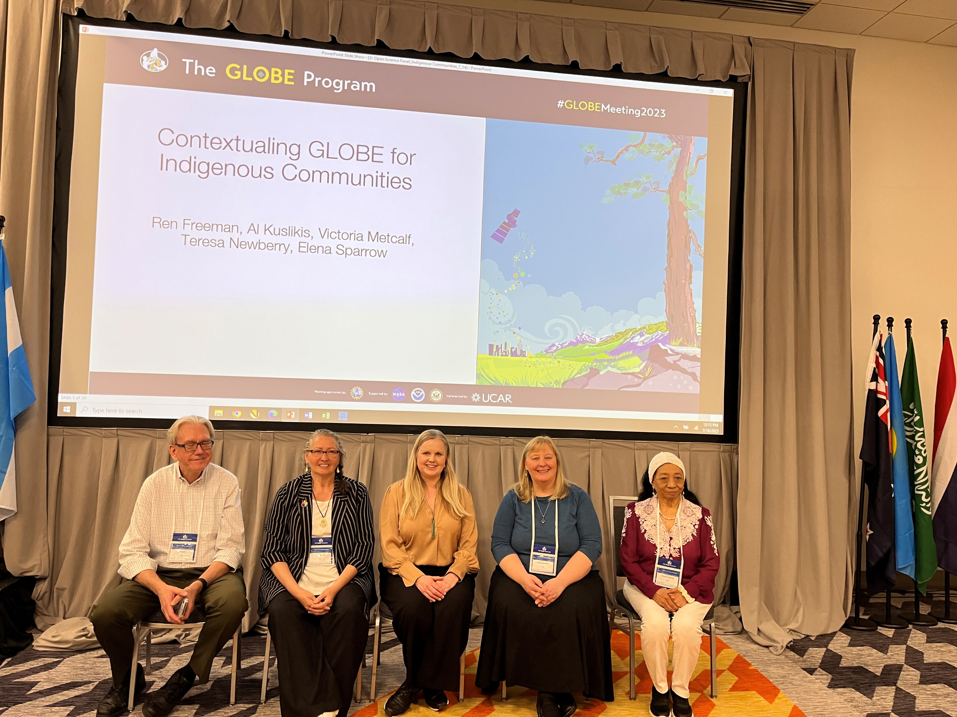
Achievement
Webinar to gifted class (Peter Falcon) iGLOBE
“My class are buzzing - thank you so much for your time and we loved the presentation! My manager has asked if we can post the video on the NZCGE Science Club online?”.
GLOBE New Zealand Auckland-20230727_153642-Meeting Recording.mp4.
“We are keen to start up with GLOBE activities and connect. I am all for real world experiences. I've been teaching for 30 years, I trained in GLOBE way back in 2004 with John Lockley from Waikato University at that time. I am re-registering so I can teach my class now.”
Notes:
An additional achievement is a teacher re-reengaging with GLOBE after many years, having Peter Falcon do a webinar and uploading cloud data.

Slide 4
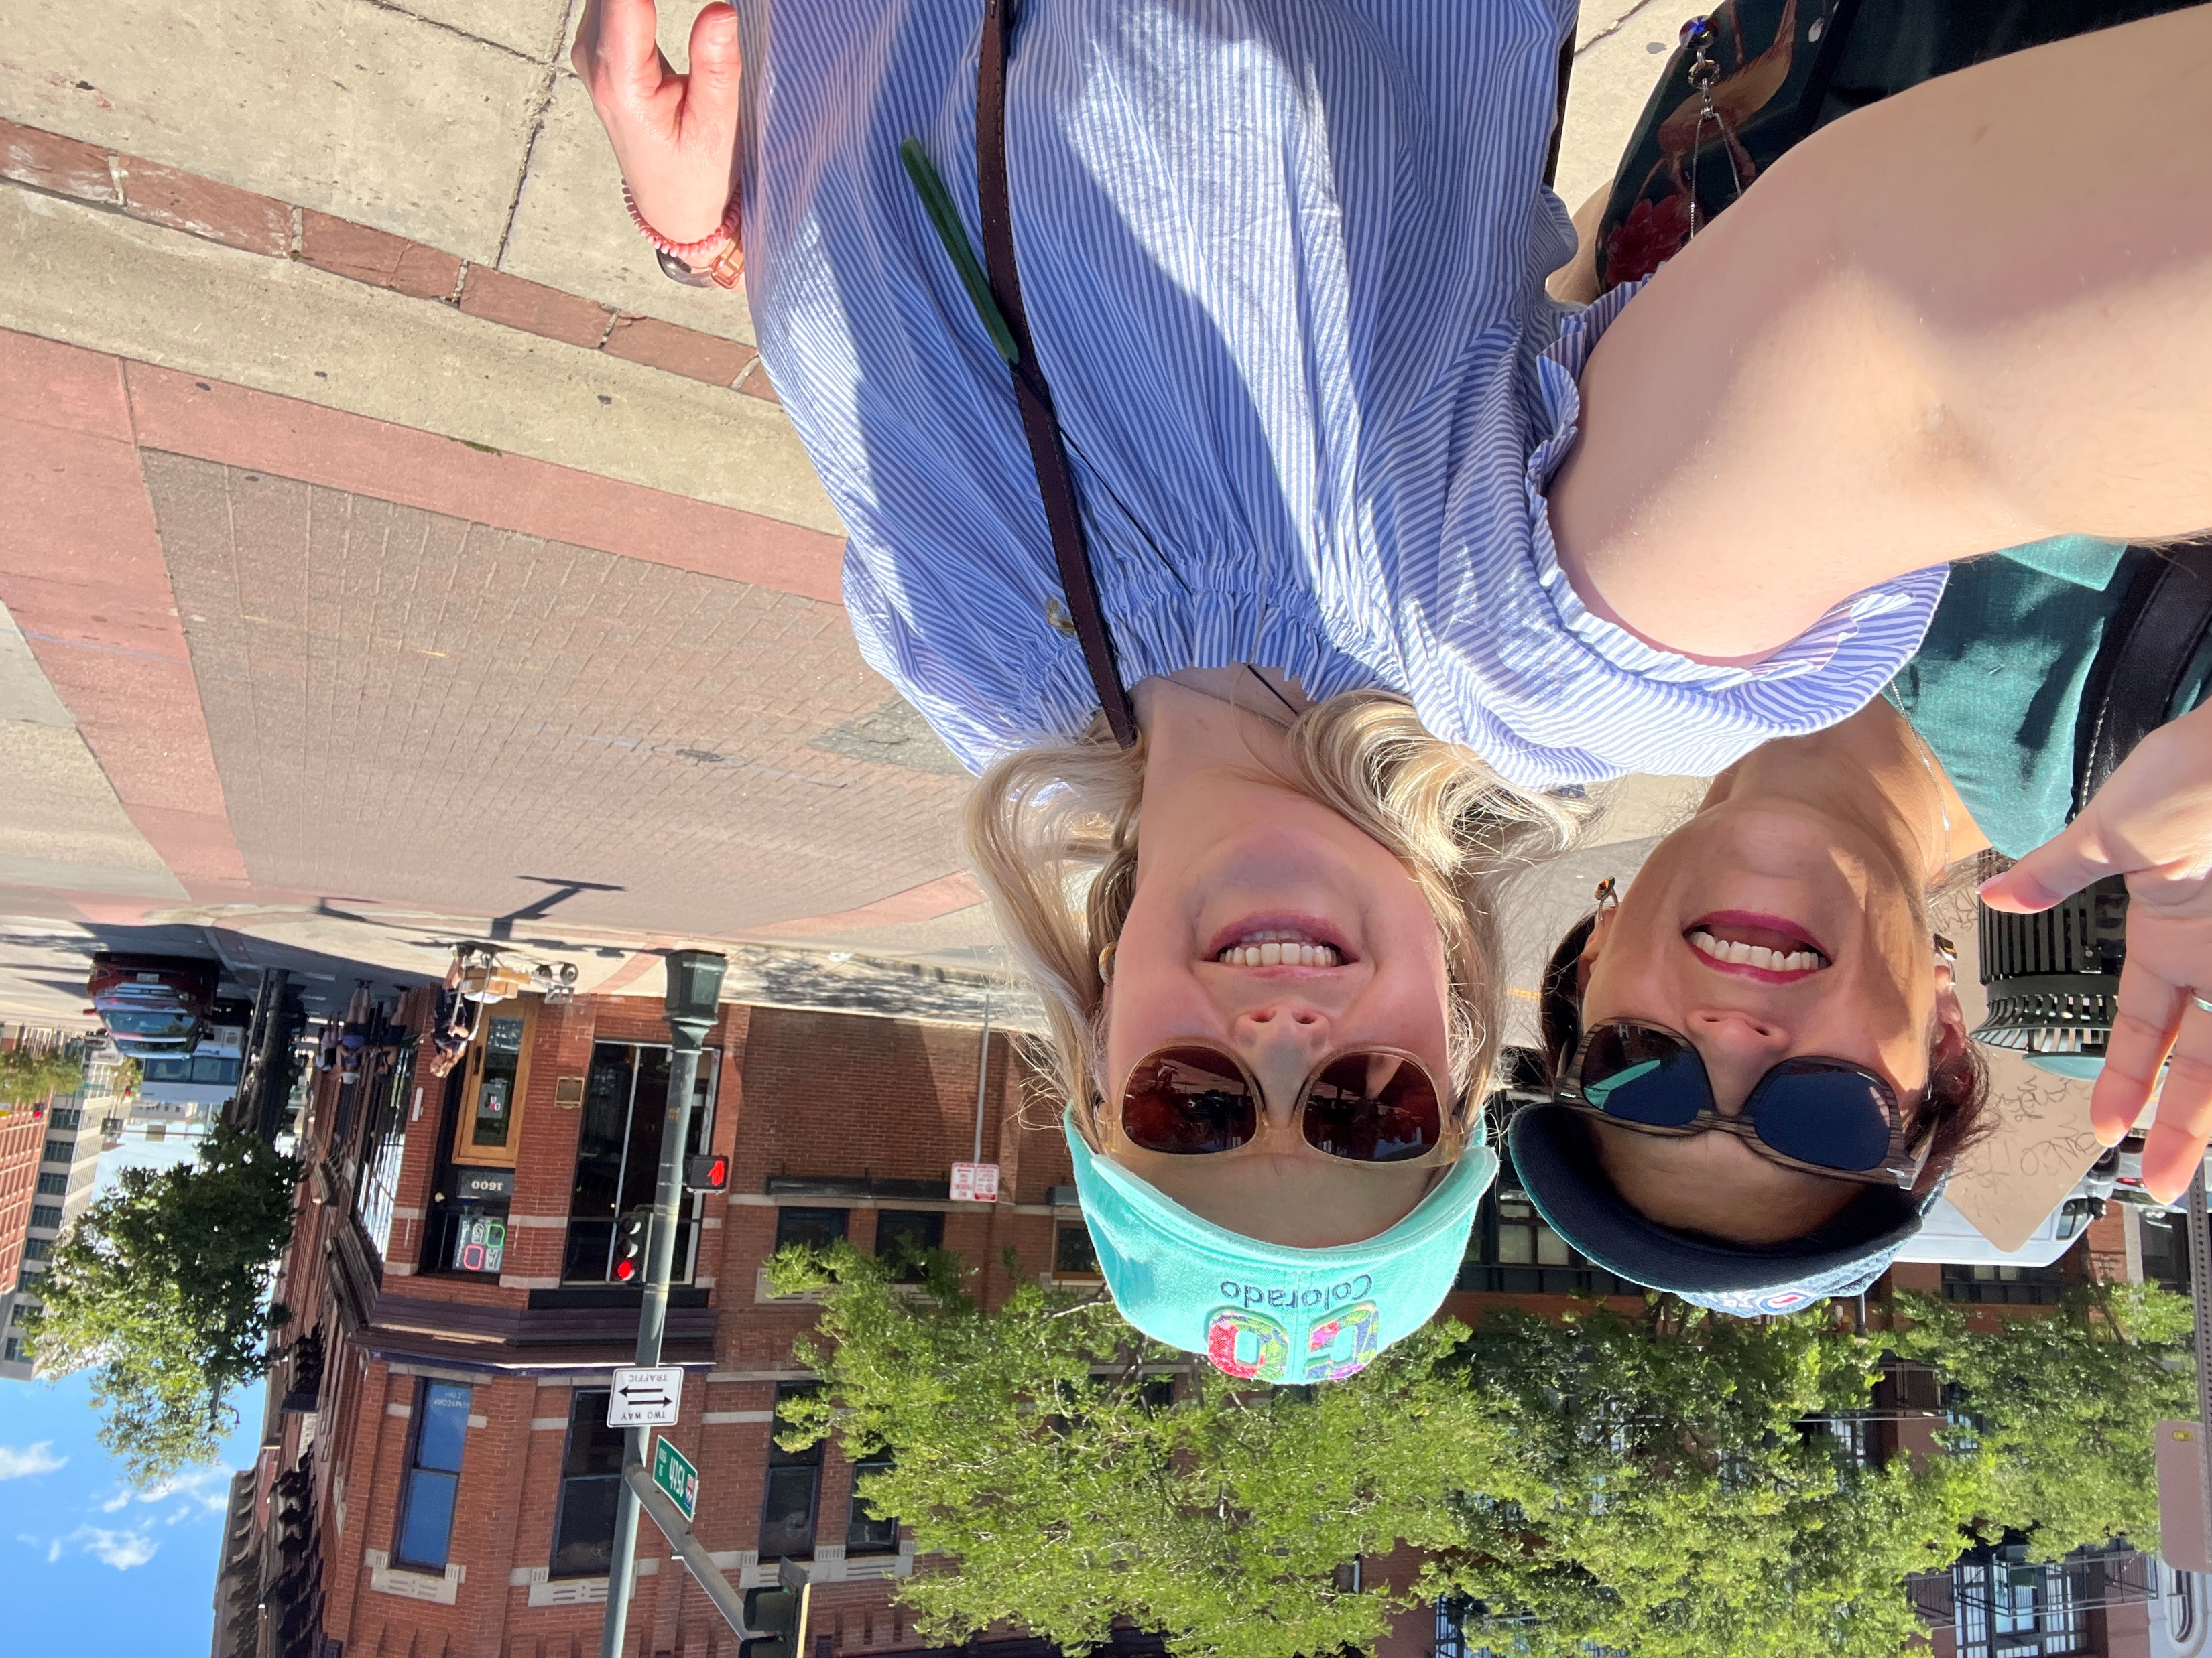
Challenges
Volunteer role; singular person
No financial or other resource
Engaging educators – very pressured environment
Teacher burnout
Changed political situation
Notes:
Only a volunteer role over and above my work – not part of my working role.
Only a single person – need to get more people helping.
No financial or other resource attached, so hard to do thing.
Engaging educators is very hard – they are so stretched in NZ and post COVD it is even harder, so finding people to upskill who are allowed to spend time etc is not easy – but there are always some!
There is marked teacher burnout in NZ as a result of increasing student challenges, post COVID and increasing admin – it’s a global issue too, so bandwidth is hard.
New government means a changed political situation and more pressures on teachers – lit and numeracy focus will take away from science time etc.

Slide 5
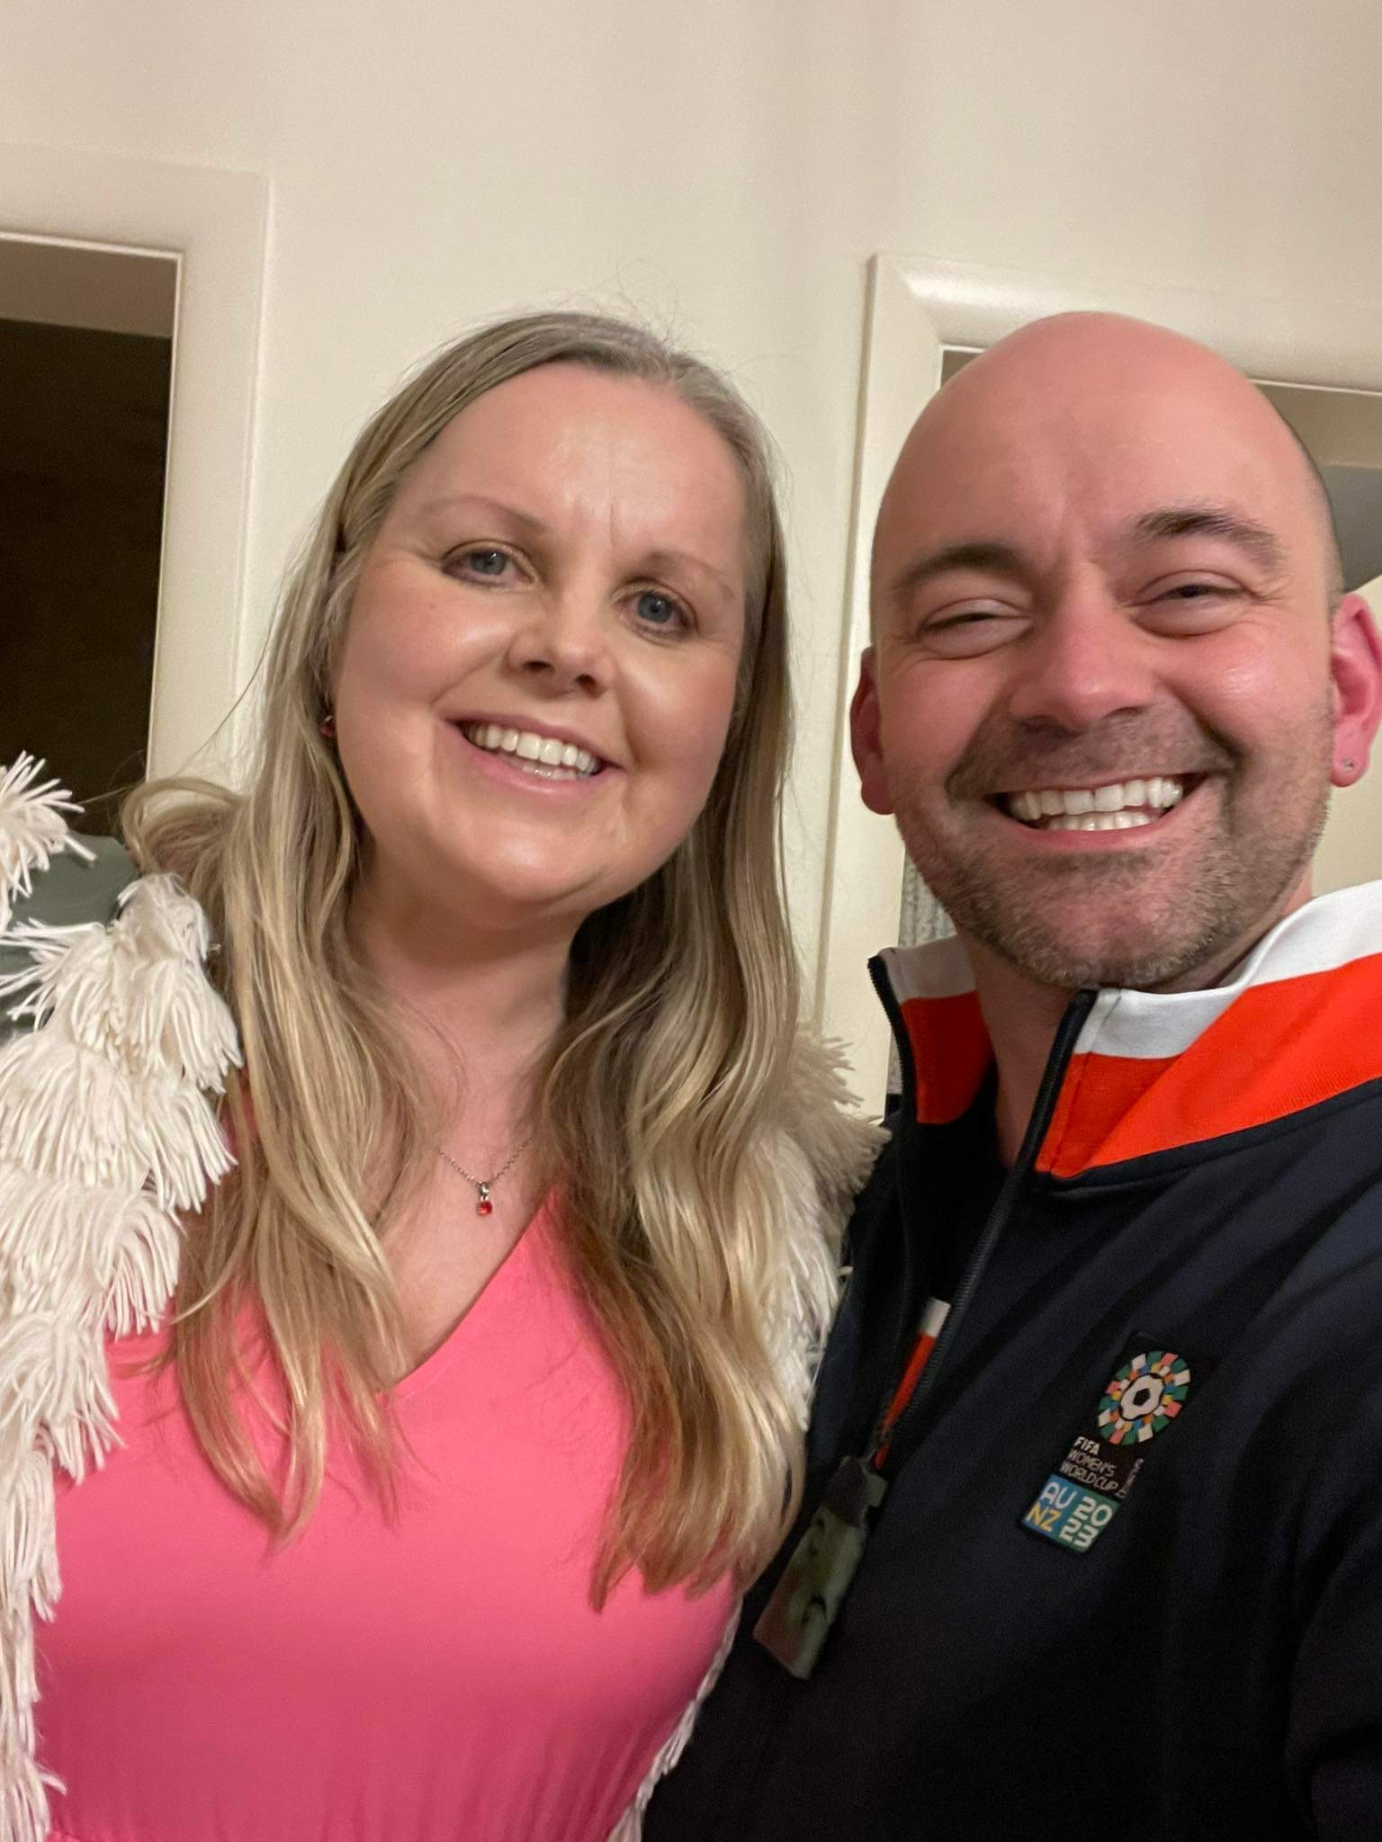
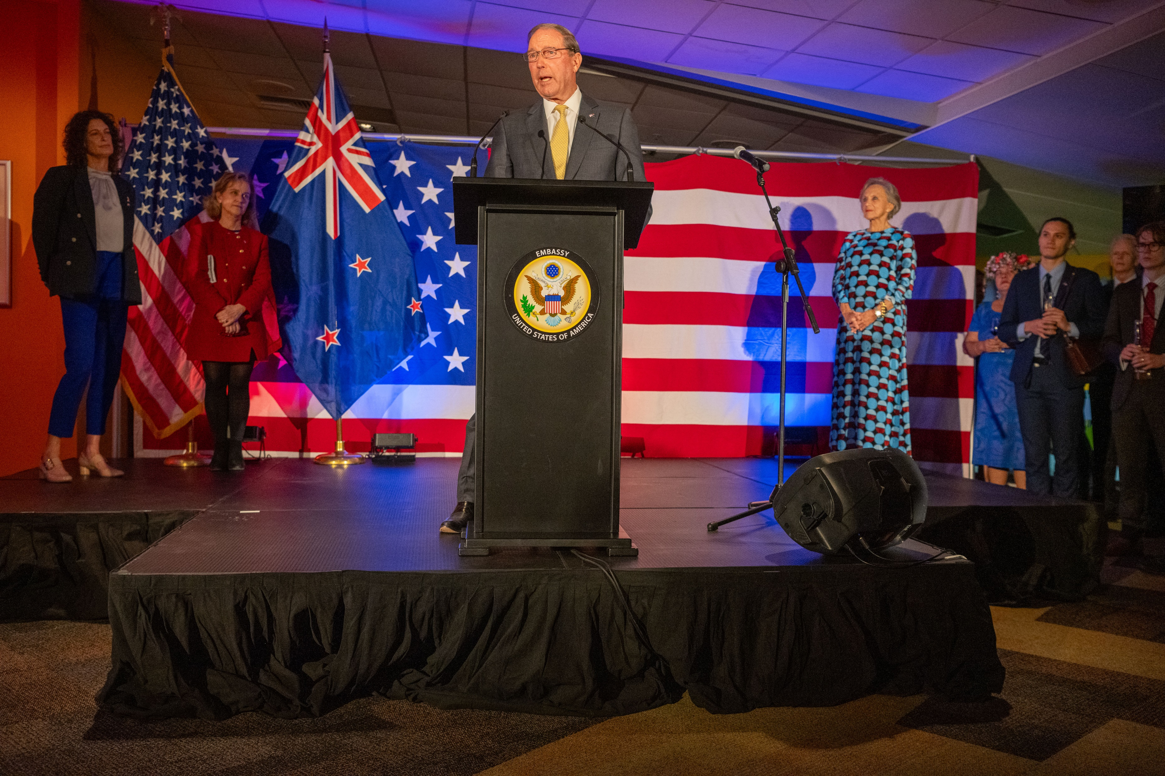
US Embassy & Consulate
Continue to interact - TechCamp
Challenges:
Changed consulate staff
Changed Embassy way of working
Notes:
Continue to attend Embassy events.
Had an offer to participate In TechCamp but couldn’t – future option
Great relationship with Wes and Lesley – but now changed staff, so engagement a little harder with consulate
Also Embassy has changed WoW.

Slide 6
Request for support -RCO
Country training
Connecting Gail/educators to expertise to help with protocol training and building confidence
Support for interested educators to regional events
Flow-on effects to nearby Pacific Islands
Notes:
Country training would be number 1 importance that would make a difference.
Would also help with South PI connections.
Gail doesn’t feel confident but doesn’t have time to teach herself – she wants to be connected to expertise for protocols for training and building confidence.
Other teachers would be the same.
Support for other educators to learn about GLOBE through sending to regional events.

Slide 7
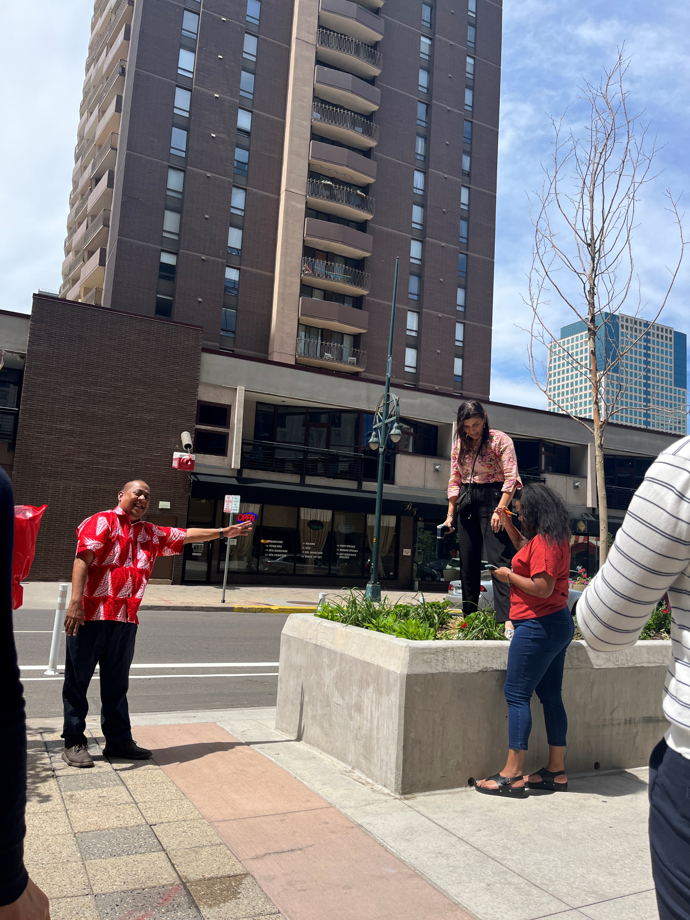
Request for Support - GIO
Webinars to interested teachers
Tech support for Gail/teachers on protocols/data
Supporting interested educators to GLOBE activities
Liaising with Embassy/Consulate
Notes:
GIO running webinar(s) with interested teachers- could come up with a series of topics for 1-2 webinars
Tech support for Gail or other teachers so she gains confidence to use GLOBE and upload GLOBE data. Also true for other teachers we might engage.
Also looking at how to support other educators to attend GLOBE activities to get them hooked.
Helping liaise with Embassy and Consulate to raise support for GLOBE and help with Embassy support for educators and events etc.

