Slide 1
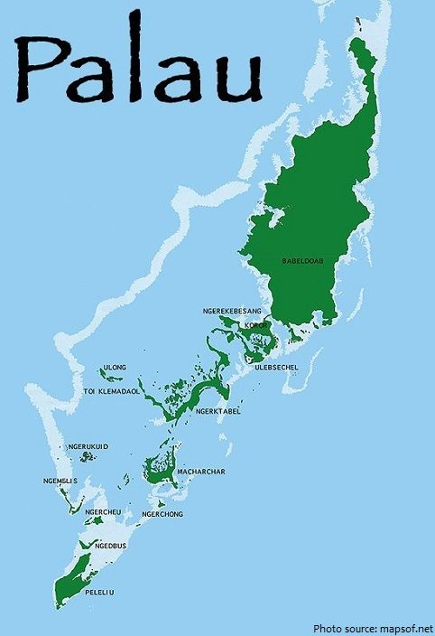
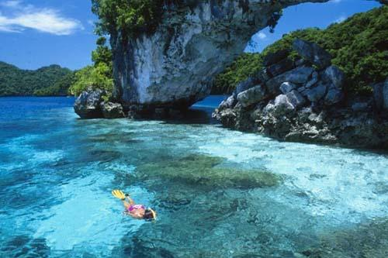
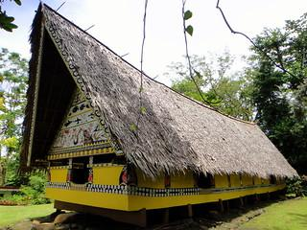
Republic of Palau
Over 500 islands
Population: 20,000
Size: 458.4 km²
This Photo by Unknown Author is licensed under CC BY-SA

Slide 2
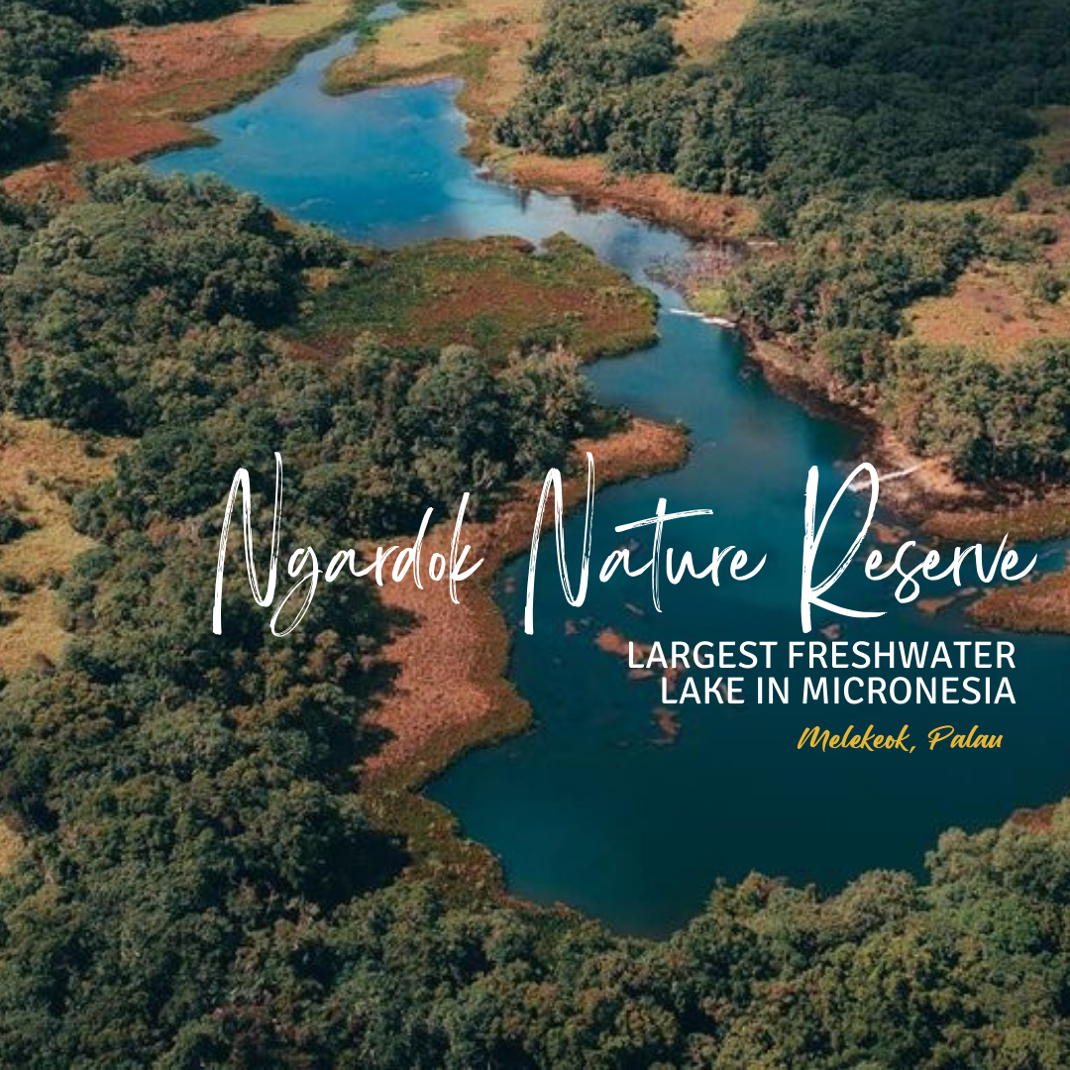
Ngardok Nature Reserve
Lake Ngardok is located in Melekeok State about 4 km northwest of the main residential area in Melekeok .
In December 1997 Ngardok Nature Resere was Established.
The Reserve became the first member of PAN on January 14, 2008.
Lake Ngardok is the largest permanent natural freshwater lake in Micronesia.
The Reserve contains forests, freshwater swamp, forests, a large marsh, streams.
Lake Ngardok is Palau’s only official recognized Wetland of International Importance (Ramsar Site).
The Ngardok Nature Reserve on Babeldaob was selected as the site for the first permanent forest dynamic plot in Palau.

Slide 3
Achievements and Future Support

Slide 4
Ngardok Nature Reserve Overview
Lake Ngardok is located in Melekeok State about 4 km northwest of the main residential area in Melekeok .
In December 1997 Ngardok Nature Resere was Established.
The Reserve became the first member of PAN (Protected Areas Network) on January 14, 2008.
Lake Ngardok is the largest permanent natural freshwater lake in Micronesia.
The Reserve contains forests, freshwater swamp, forests, a large marsh, streams.
Lake Ngardok is Palau’s only official recognized Wetland of International Importance (Ramsar Site).
The Ngardok Nature Reserve on Babeldaob was selected as the site for the first permanent forest dynamic plot in Palau.

Slide 5
Significant Achievements

Slide 6
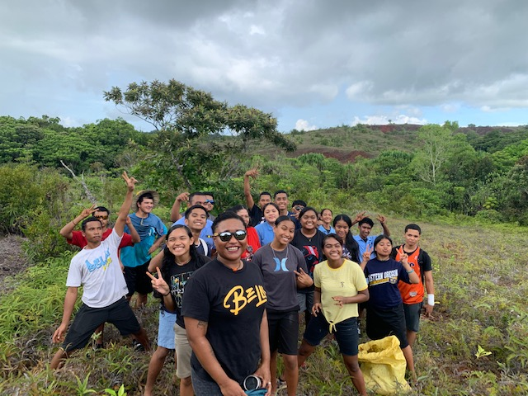
Successful Habitat Restoration
In the past year, Ngardok Nature Reserve has been the successful restoration of critical habitats through community engagement and scientific monitoring. Through collaborative efforts between local communities, conservation organizations, and government agencies, Ngardok Nature Reserve has seen remarkable progress in biodiversity conservation and ecosystem restoration.

Slide 7
Project Highlight: Wetland Restoration

Slide 8
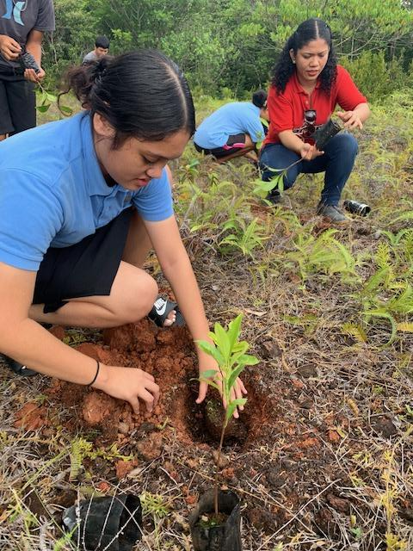
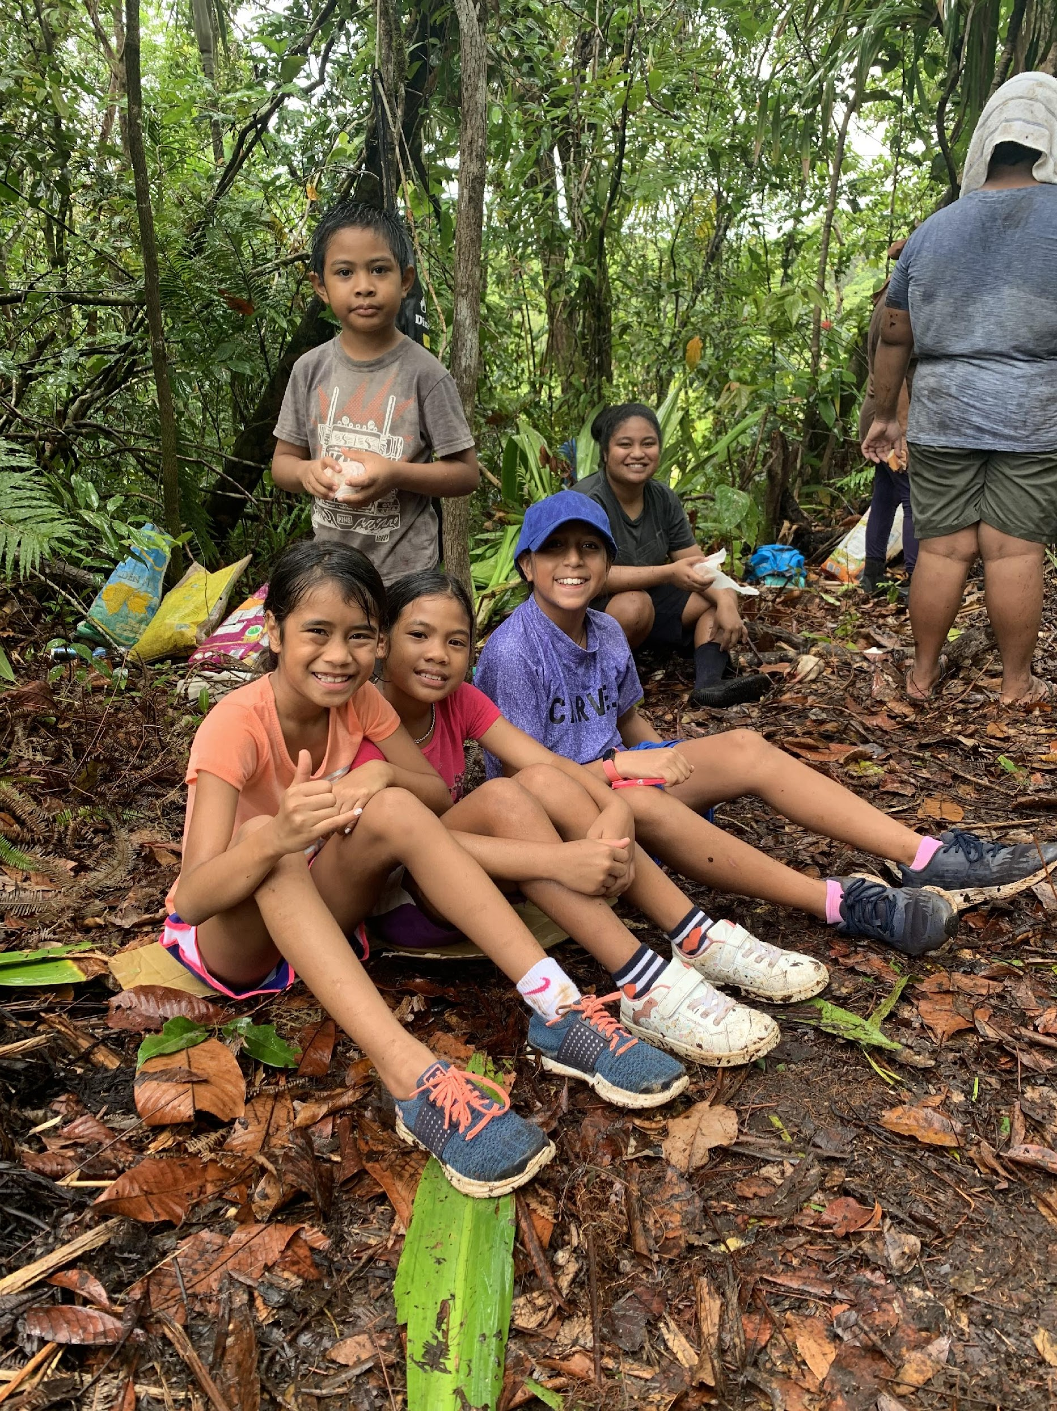
Restoration Actions Taken:
Native plant reforestation,
Invasive species removal, and
Habitat enhancement.

Slide 9
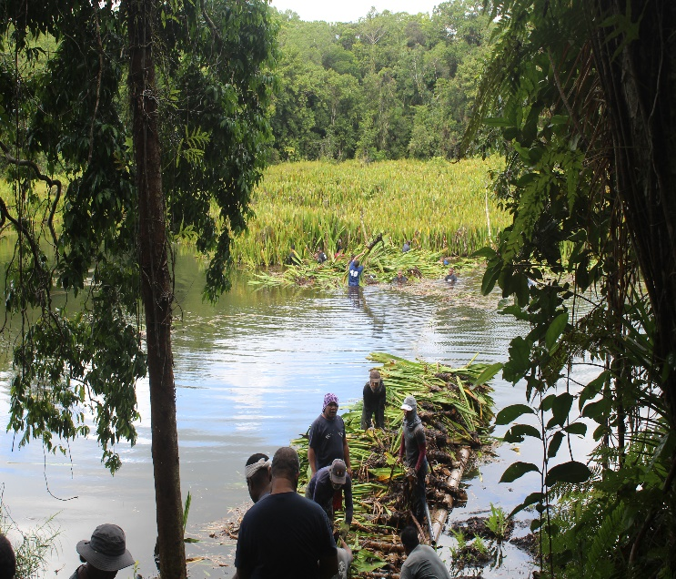
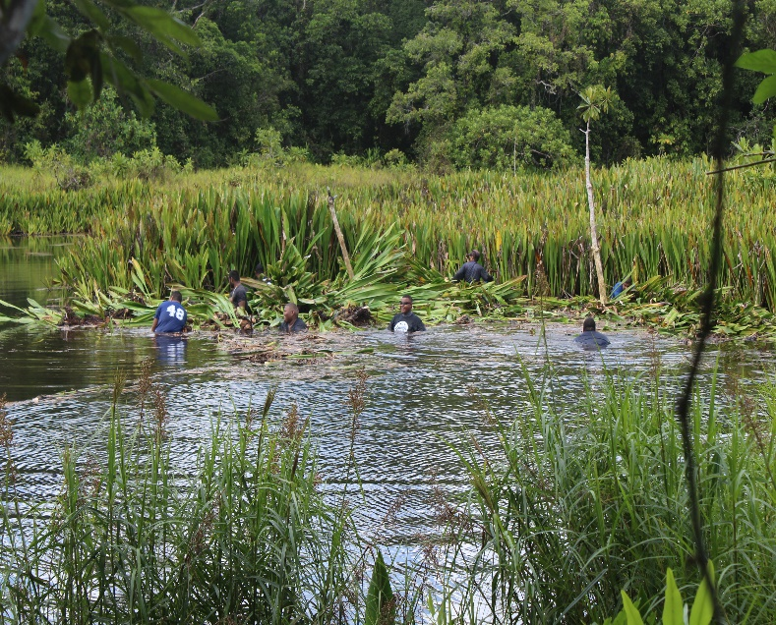
Community Engagement
Community engagement played a crucial role in the success of this project, with local residents actively participating in restoration activities.
By involving the community in conservation efforts, the GLOBE program not only fosters a sense of stewardship among residents but also ensures the long-term sustainability of restoration initiatives.

Slide 10
Current Challenges

Slide 11
Resource Constraints:
Limited funding and resources have been a significant challenge for the GLOBE program. Adequate financial resources are essential for conducting scientific research, implementing conservation projects, and engaging local communities effectively.

Slide 12
Capacity Building:
Building the capacity of local stakeholders, including community members, government agencies, and conservation organizations

Slide 13
Policy and Regulatory Chalenges:
Inconsistent or inadequate policies and regulations related to environmental conservation can hinder the implementation of conservation projects and undermine the effectiveness of the GLOBE program. Clarifying land tenure rights, strengthening protected area management frameworks, and addressing regulatory barriers to community-based conservation initiatives are essential for creating an enabling environment for sustainable development and biodiversity conservation.

Slide 14
Support From the US Embassy

Slide 15
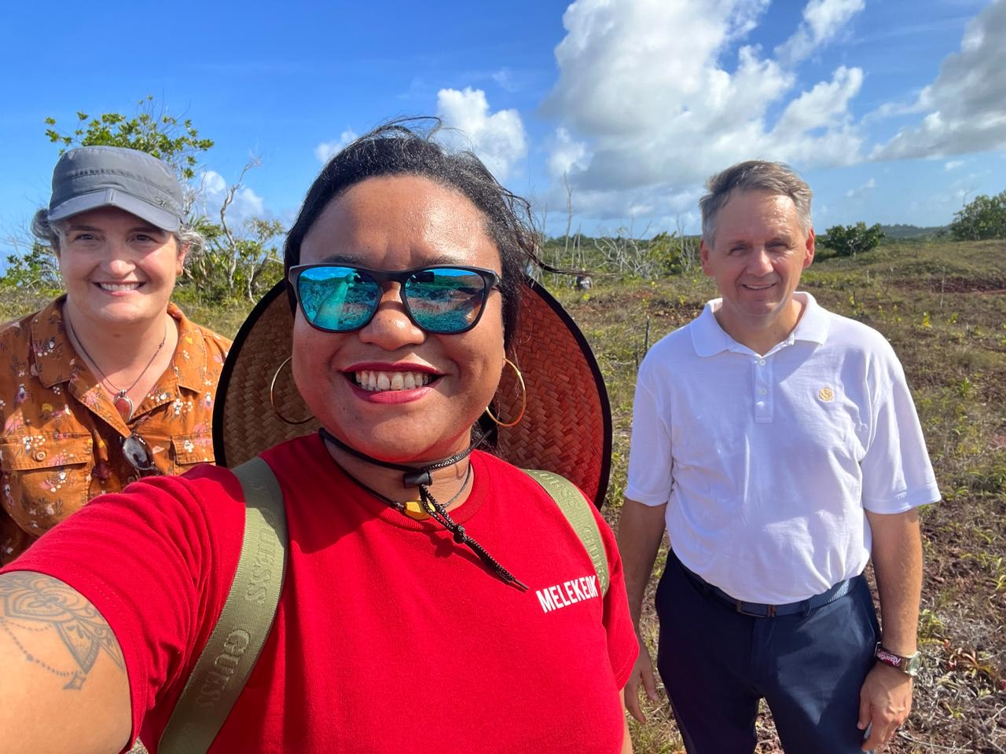
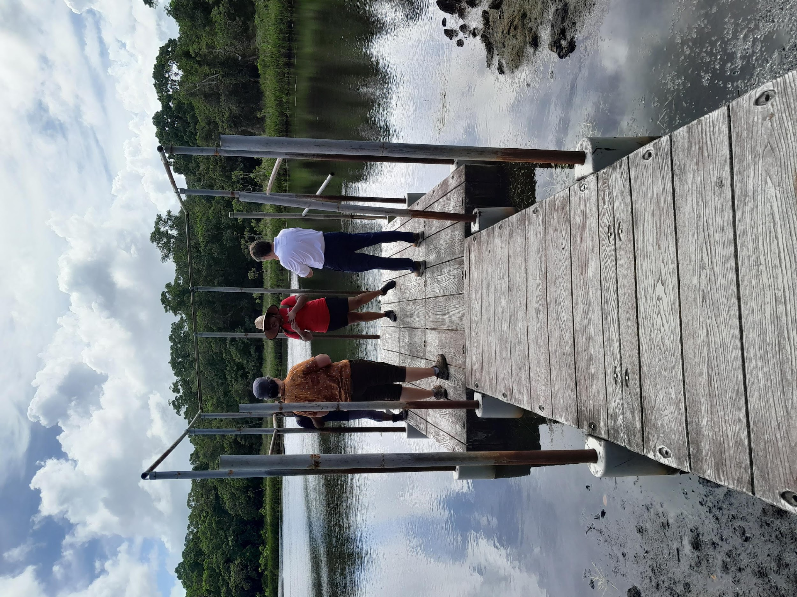
Facilitated Connections and Collaborations
The US Embassy has facilitated connections with experts and organizations such as NRCS/US FS/ USGS, working on similar conservation issues, enabling knowledge exchange and collaboration on shared conservation goals. By leveraging the expertise and resources of the US Embassy and its partners, the GLOBE program has been able to strengthen its capacity and impact in Ngardok Nature Reserve.

Slide 16
Request Support rom RCO

Slide 17
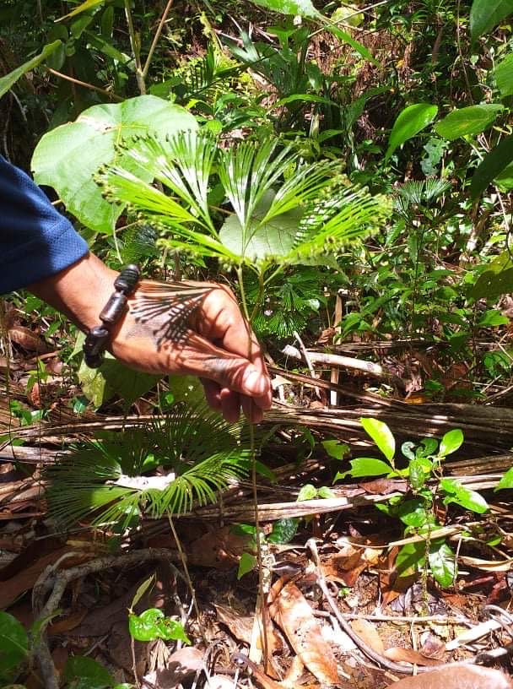
Training on Data Collection and Analysis:
The RCO could organize training sessions or workshops to build the capacity of local stakeholders in data collection, analysis, and interpretation. This could involve providing guidance on best practices for field data collection, using scientific instruments, and analyzing monitoring data.
By receiving support from the RCO in developing and implementing an M&E framework, our GLOBE program can enhance its capacity to track progress, measure impact, and effectively manage resources for conservation efforts in Ngardok Nature Reserve.

Slide 18
Request for Support from GIO/Program

Slide 19
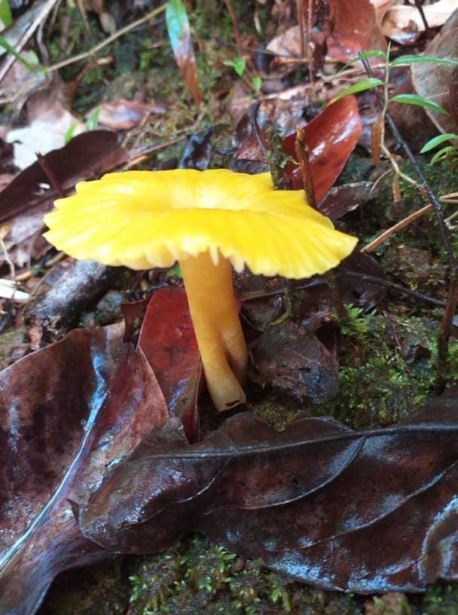
Evaluation and Impact Assessment:
Evaluating the effectiveness of environmental education programs implemented in local schools, using tools and methodologies developed by the GLOBE Program. This could help measure the impact of educational interventions on students' knowledge, attitudes, and behaviors towards environmental conservation.

Slide 20
Contact Information
Dearlynn Ediloy Rebluud- Program Manager of Melekeok Conservation Network
Email: dearlynnrebluud@gmail.com
Whatsapp: 775-5735
MCN Email: msgconservationnetwork@gmail.com
Landline:654-2018

Slide 21
End of Presentation

