Slide 1
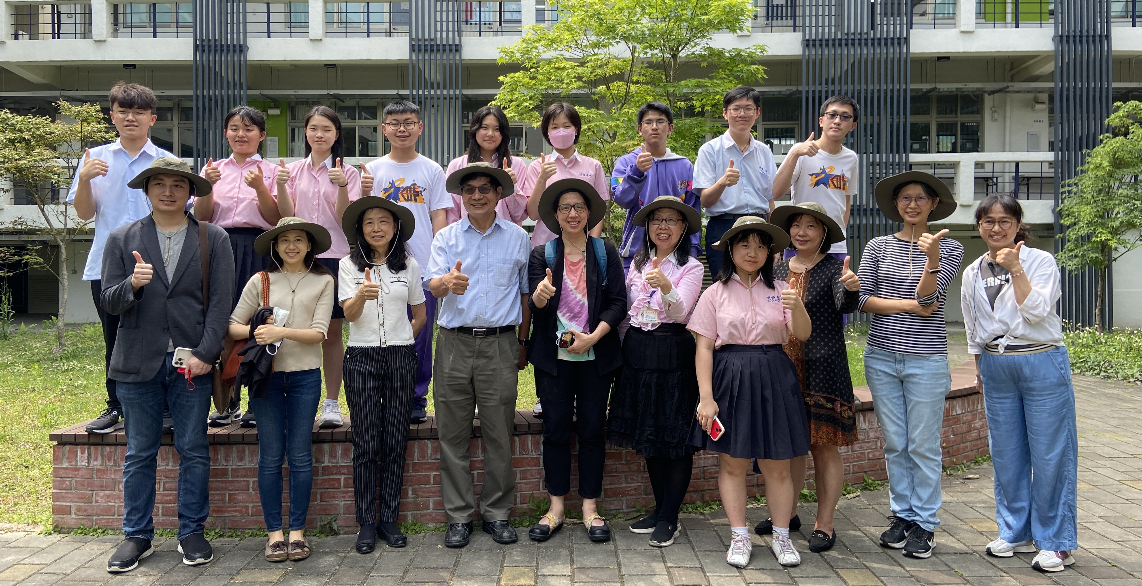
2024 GLOBE Asia-Pacific Regional Meeting 2023-2024 Taiwan Report
Coordinator: Dr. Pay-Liam Lin Date: April 15, 2024
Supported by:

Slide 2
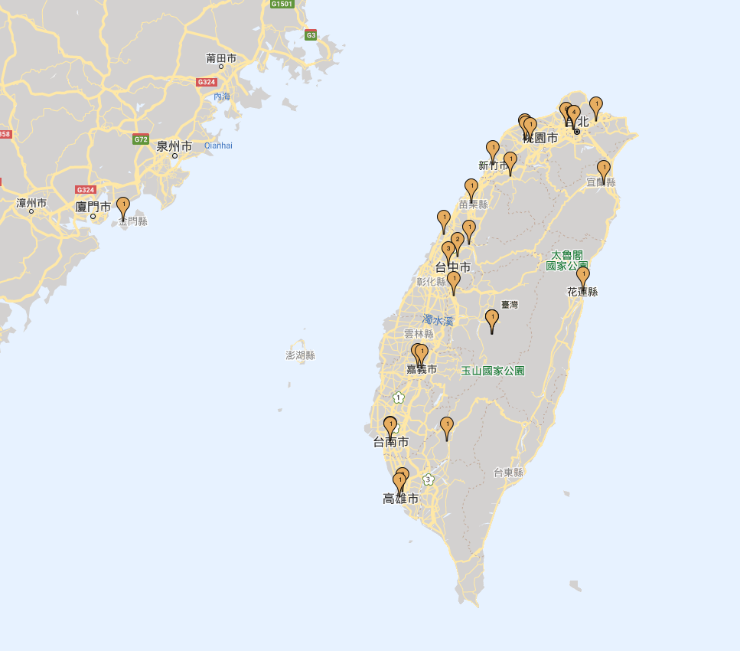

Slide 3
Observations in Taiwan
Barometric Pressure
Cloud Protocols
Relative Humidity
Precipitation
Digital Multi-Day Max/Min/Current Air and Soil Temperature
Surface Temperature
Davis Weather Station (Optional)
Water Transparency (Optional)
Electricity Conductivity (Optional)
Water pH (Optional)
Alkalinities
Dissolved Oxygen
Mosquito Habitat Mapper
Vegetation Covers
Nitrates
Salinities
Transparencies
Water Temperature
Biometry Trees
Carbon Cycle
Microplastics Monitoring

Slide 4
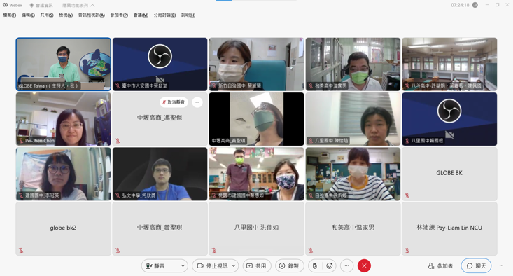
Education – Teachers Professional Deveopment
GLOBE Program Taiwan team and GLOBE school Kinmen High School jointly organized the “Introduction to the GLOBE Global Observation Program and Sharing of Practical Operations” on January 14, 2023.

Slide 5
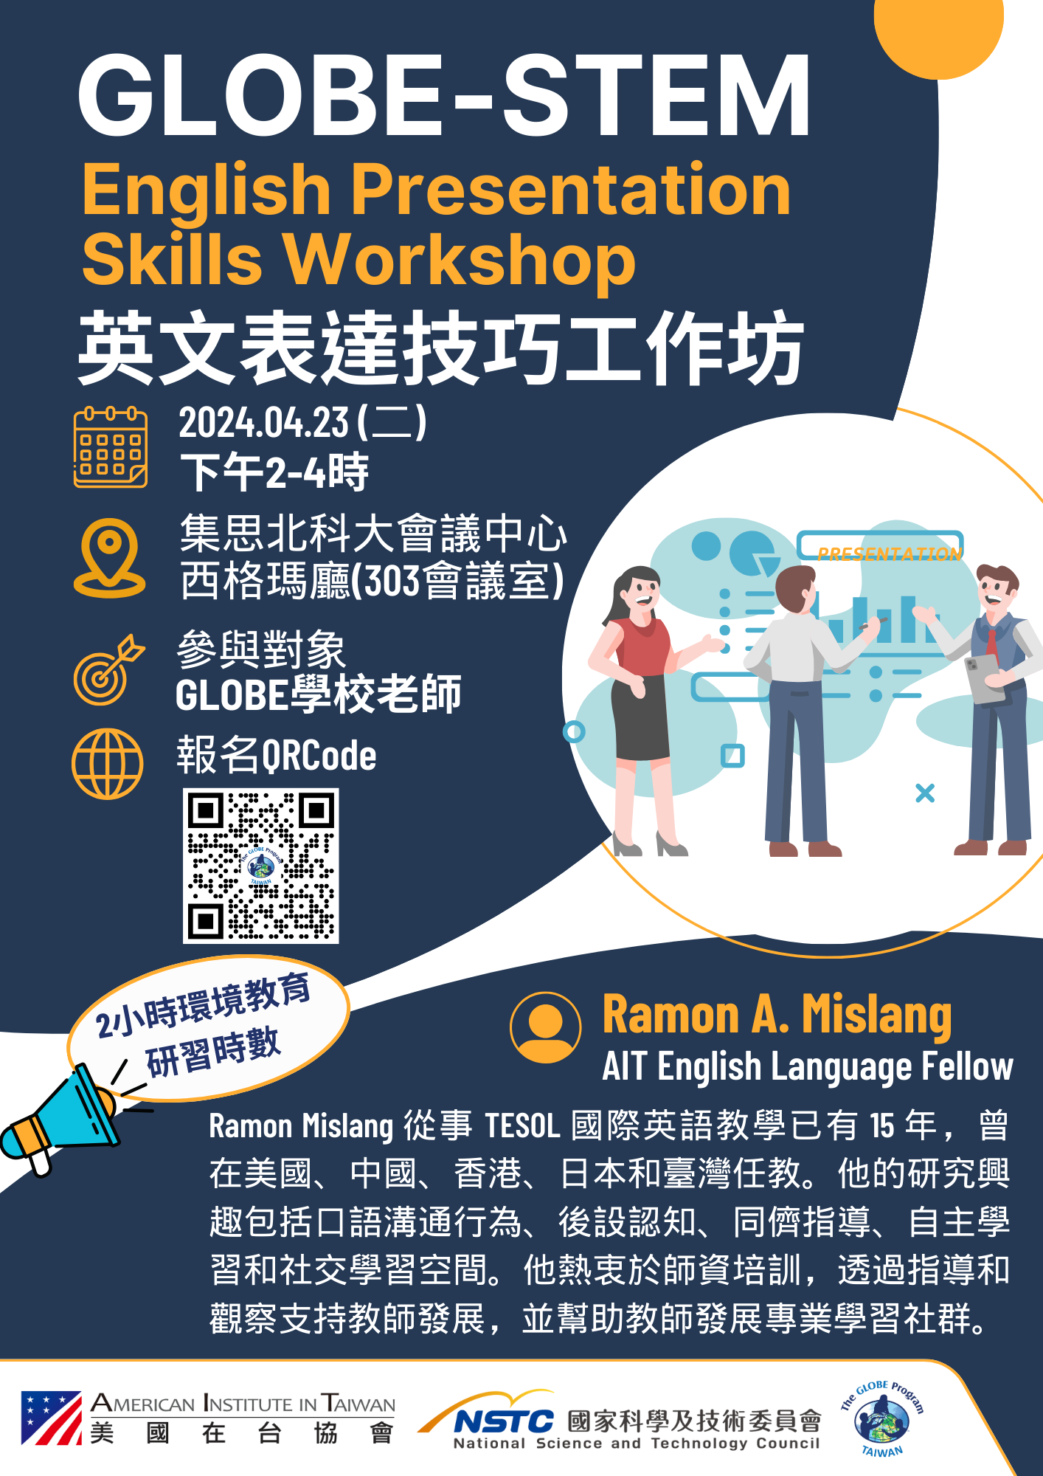
Education – Teachers Professional Deveopment
In 2024, GLOBE Program Taiwan plans to collaborate with the American Institute in Taiwan (AIT) to host the GLOBE-STEM English Presentation Skills Workshop on April 23, 2024.
The AIT English language fellow is going to teach GLOBE teachers how to instruct students in writing scientific English reports, and how to present STEM scientific reports in English through PowerPoint, posters and videos.

Slide 6
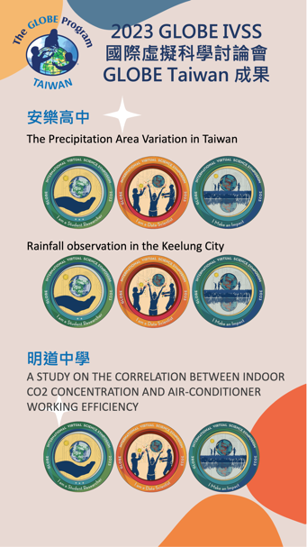
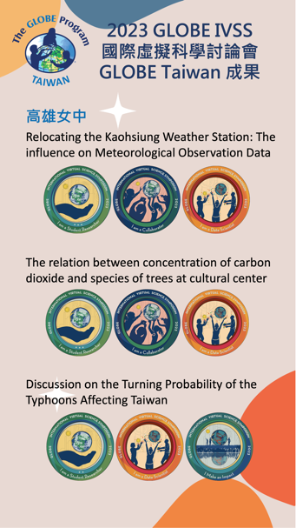
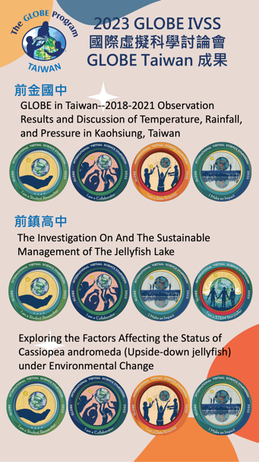
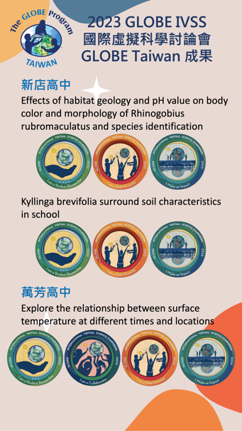
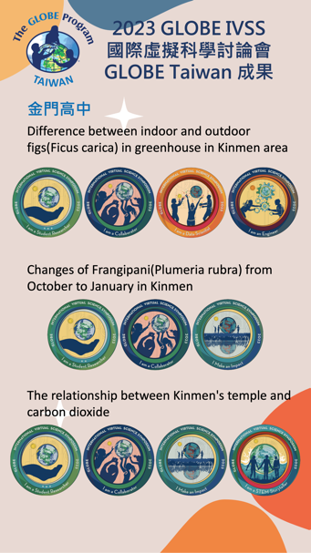
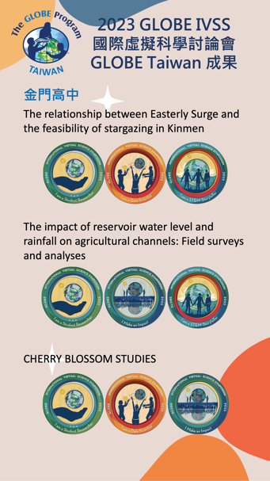
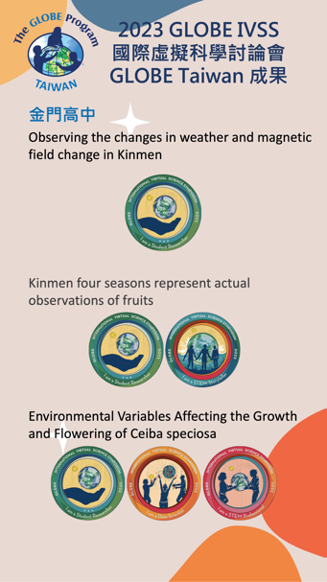
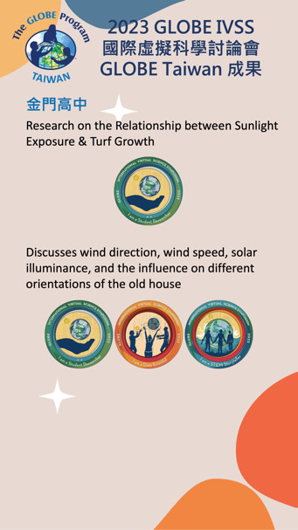
Education - 2023 GLOBE IVSS
There are 23 reports, from 8 schools. Among them, 4 reports gained four stars.

Slide 7
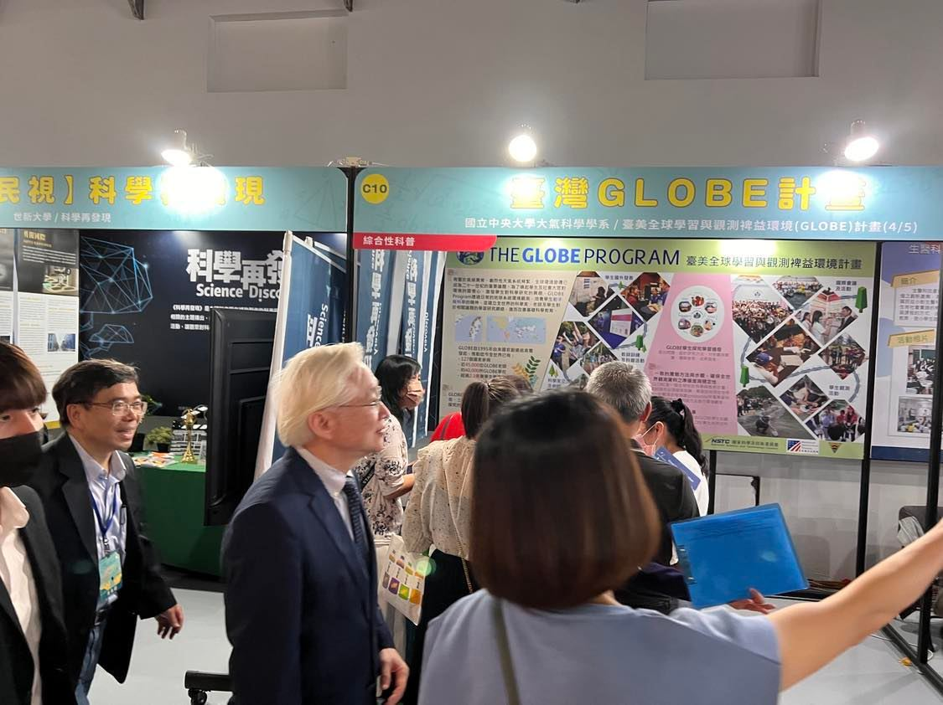
Education – Popular Science
We participated in the 'OpenCall Science Popularization Creative Fair' organized by the National Science and Technology Council on May 26, 2023. We showed the current status of the program, the teaching and learning experiences related to earth science ecology and environment by GLOBE schools globally and in Taiwan. We also introduced the GLOBE Observer mobile application to the public, demonstrating how to upload and utilize observational data collected by GLOBE citizen scientists, thereby integrating science into daily life.

Slide 8
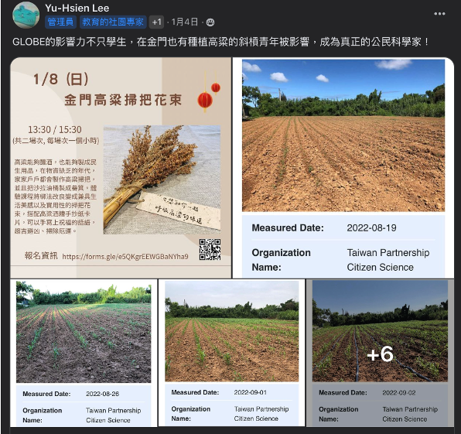
Science – Protocols Used and Data Entries
Until early April, there are currently 2,526,391 data entries accumulated.
It is worth mentioning that a farmer in Kinmen who utilized the Land Cover observation feature within the GLOBE Observer application to document changes in sorghum growth. Apart from aiding in refining his crop cultivation processes and enhancing his understanding of crops, he has also become a citizen scientist, assisting scientific research in understanding land cover conditions.

Slide 9
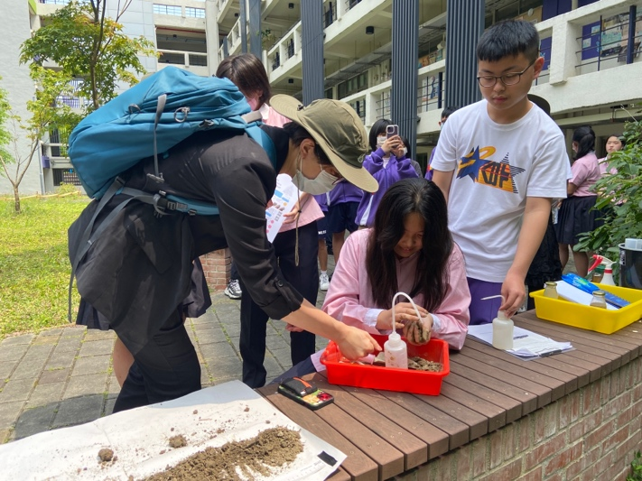
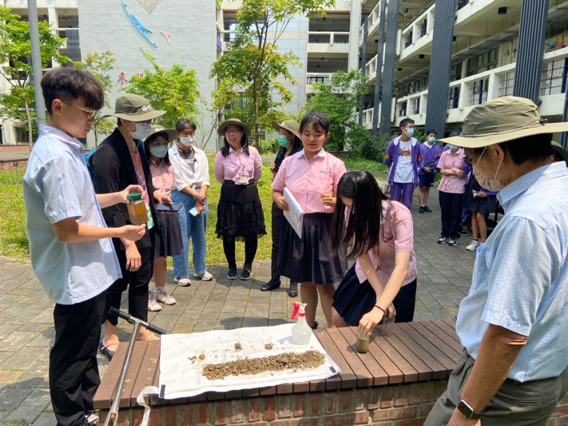
Science – Science Literacy Enhancement
We invited Dr. Amy P. Chen, project manager of the NASA GLOBE Program office, to visit Taiwan and participate in our project. Dr. Chen visited Ming Lun High School, a GLOBE school, to conduct a scientific lecture for Taiwanese GLOBE teachers and students.

Slide 10
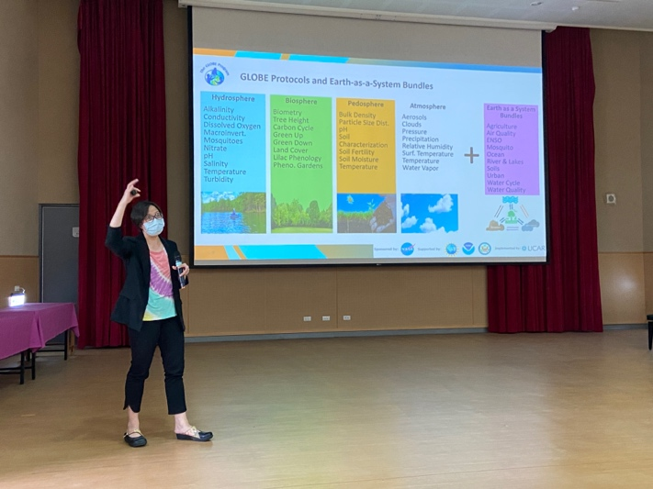
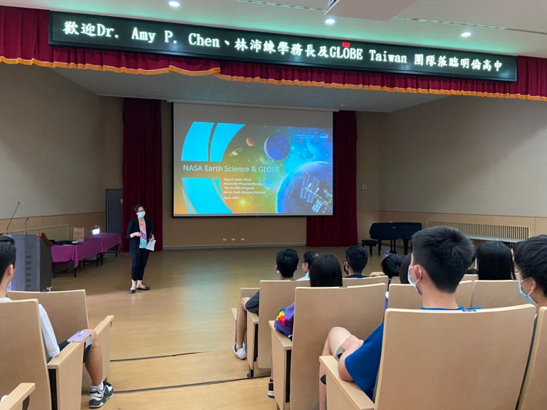
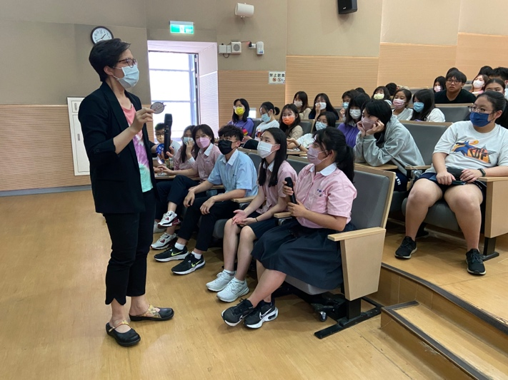
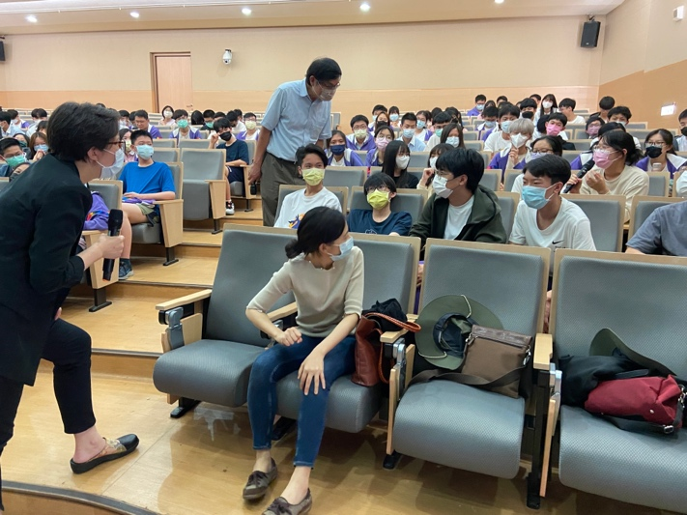
Science – Science Literacy Enhancement
Her topic is 'NASA Earth Science & GLOBE,' which provided an overview of the GLOBE program and the NASA Earth Science Division.

Slide 11
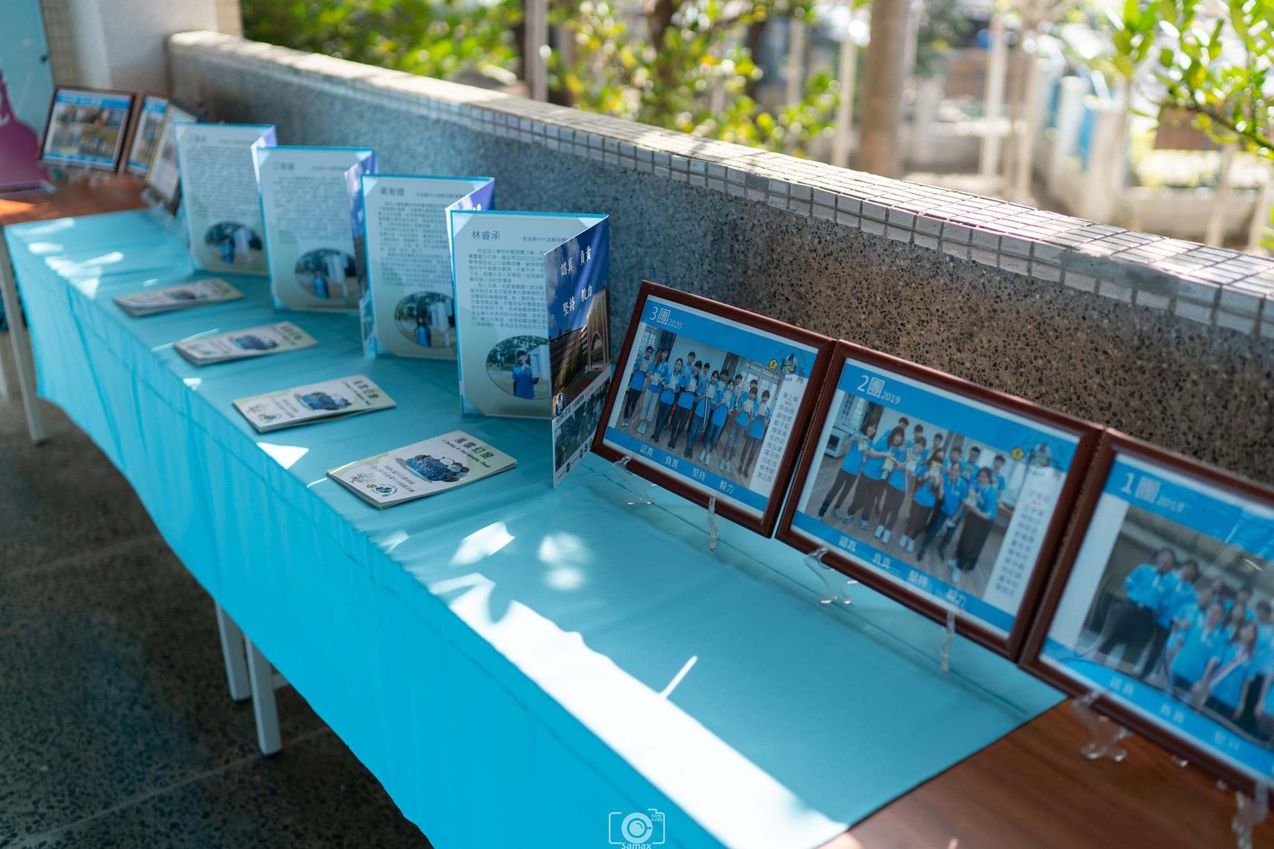
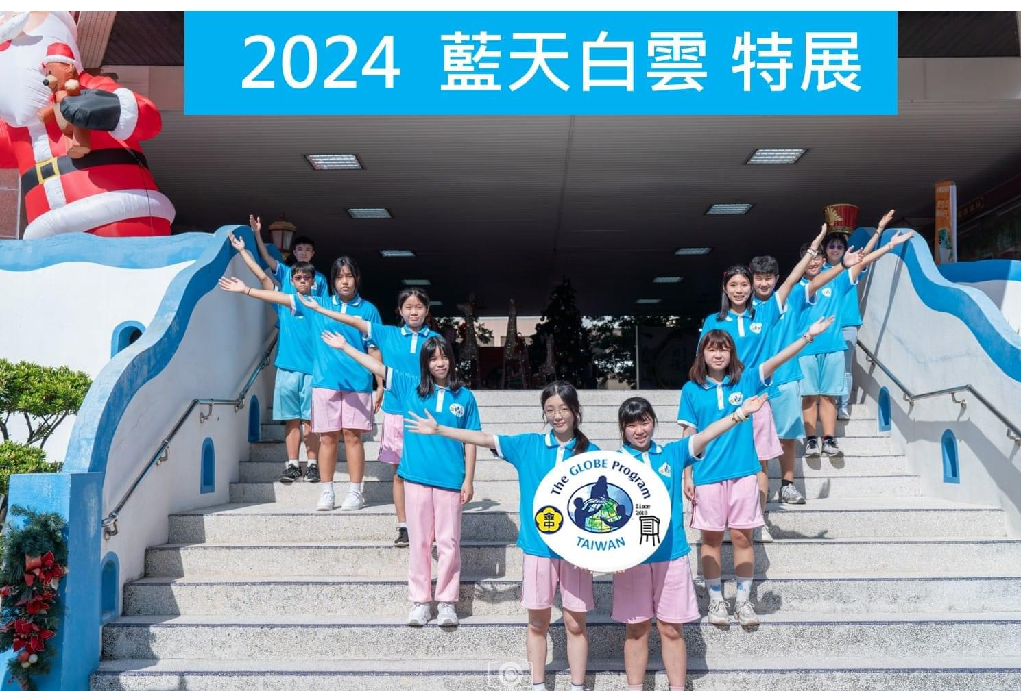
Science – GLOBE Investigation Sharing
The process of scientific inquiry includes asking questions, forming hypotheses, conducting experiments, collecting data, analyzing data, making conclusions, and sharing the results. One of the GLOBE schools, Kaohsiung Municipal Cianjin Junior High School, annually hosts the GLOBE Cianjin exhibition for their students. Students analyze the data they collect from their daily observations and show their results to the communities surrounding their schools through poster presentations.

Slide 12
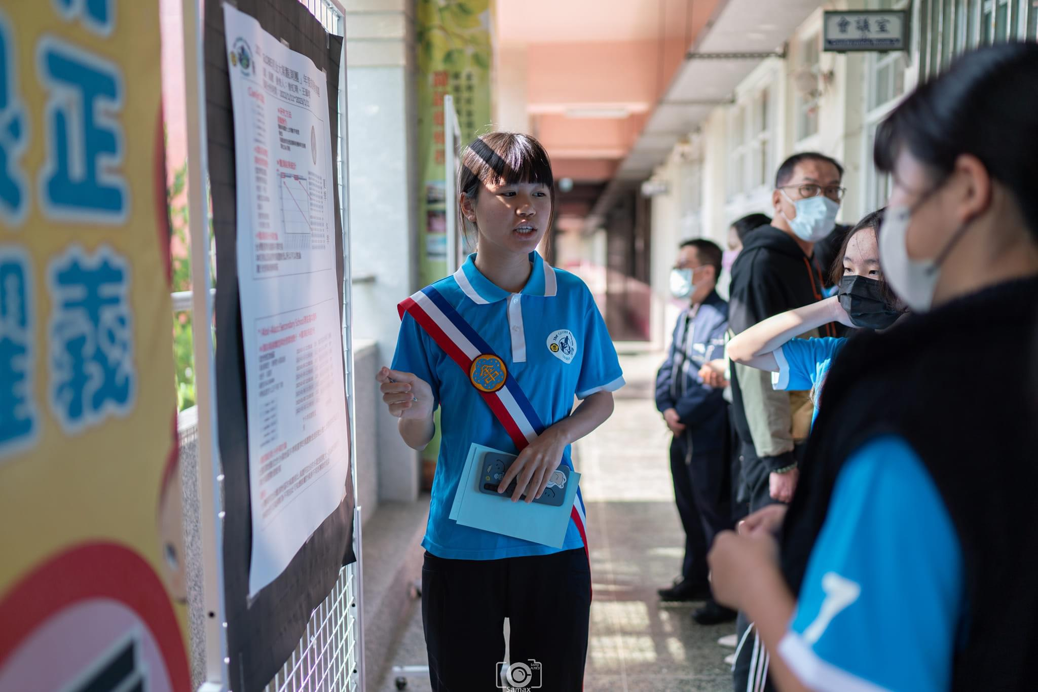
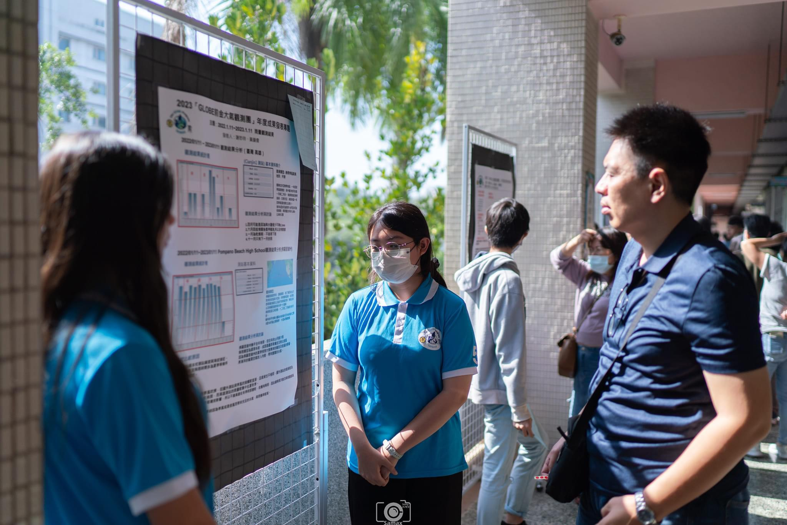
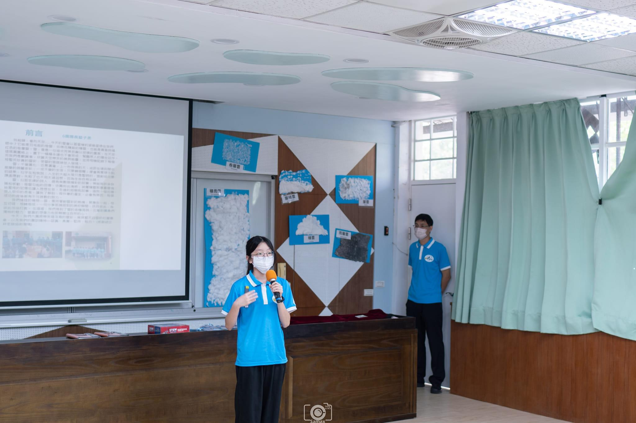
Science – GLOBE Investigation Sharing

Slide 13
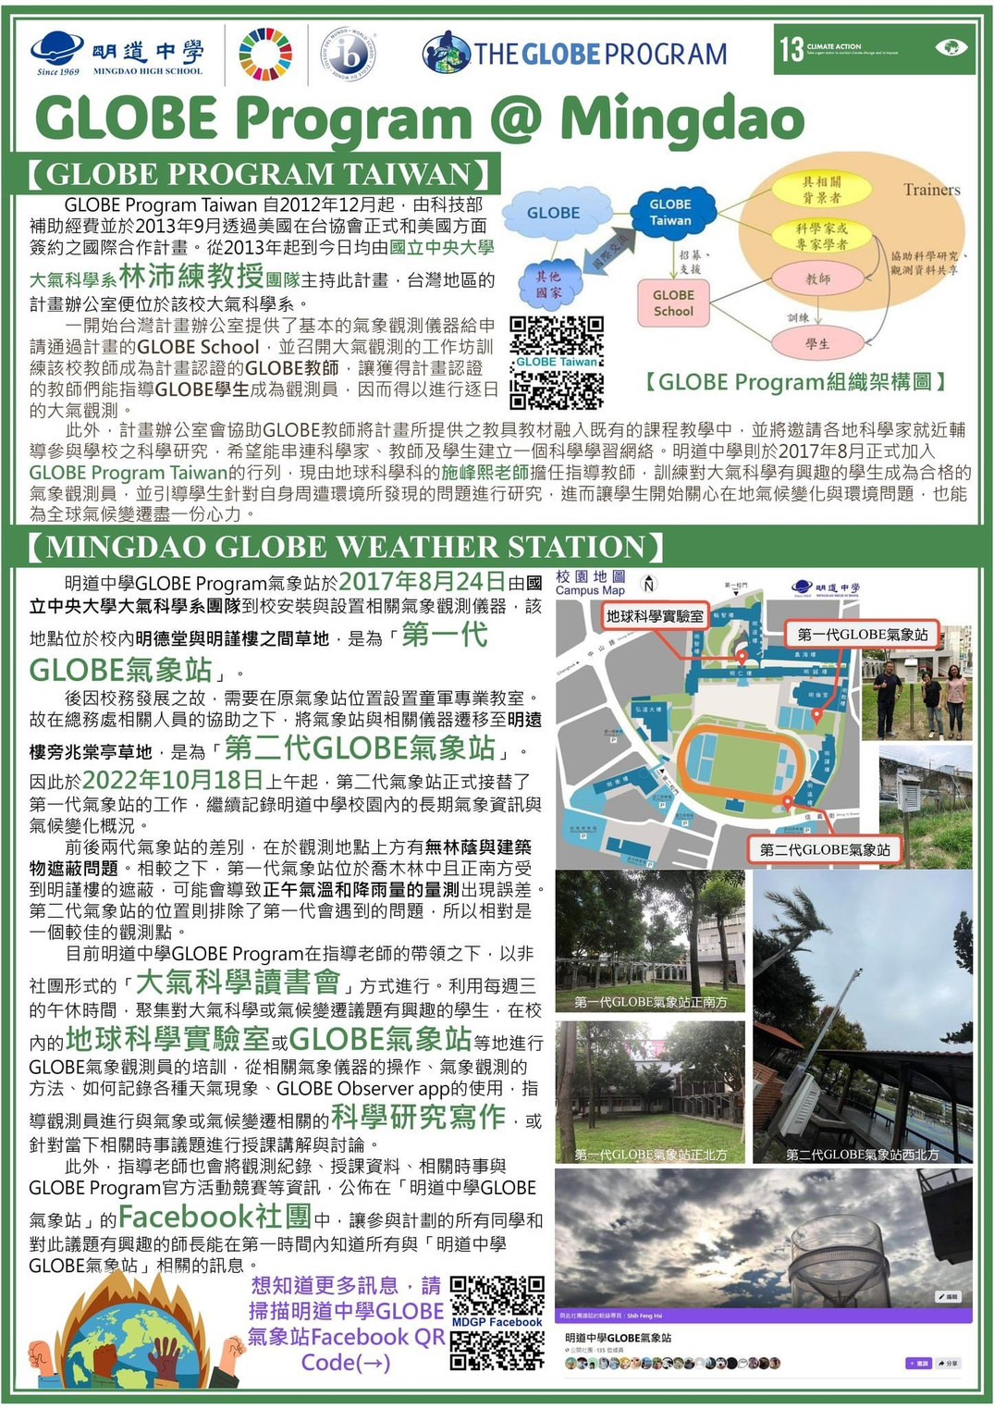
COMMUNITY – Activities Related to GLOBE
GLOBE school “Mingdao High School” hosts “2024 Asia-Pacific Young Leaders Convention (APYLC)” on April 15-19. GLOBE teacher, Mr. Feng-Hsi Shih is going to share the implementation of GLOBE in Mingdao High School.

Slide 14
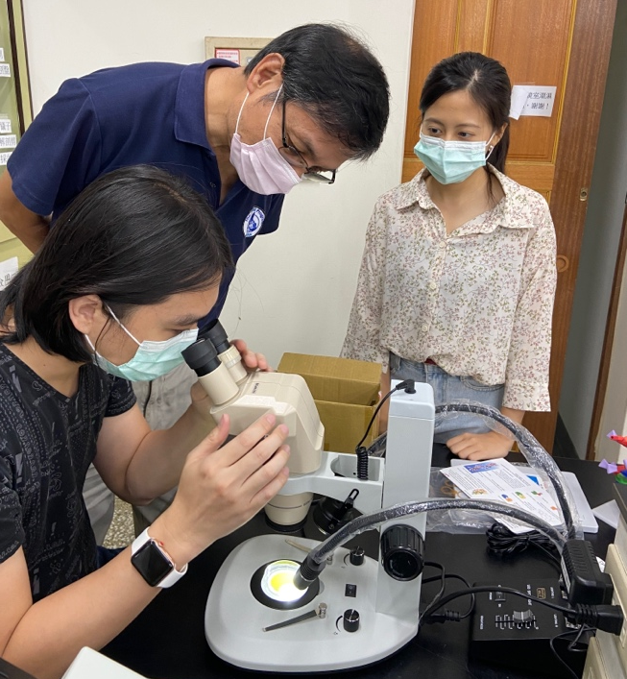
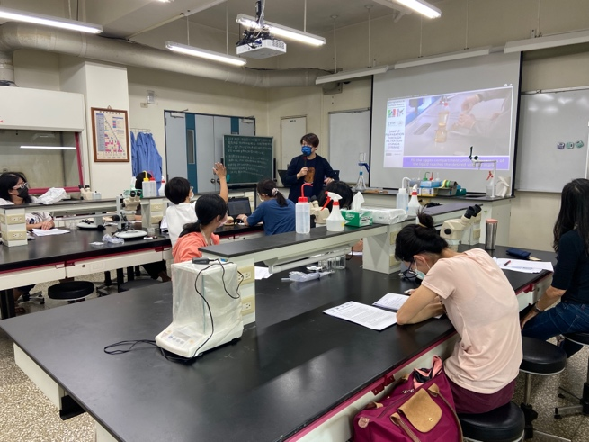
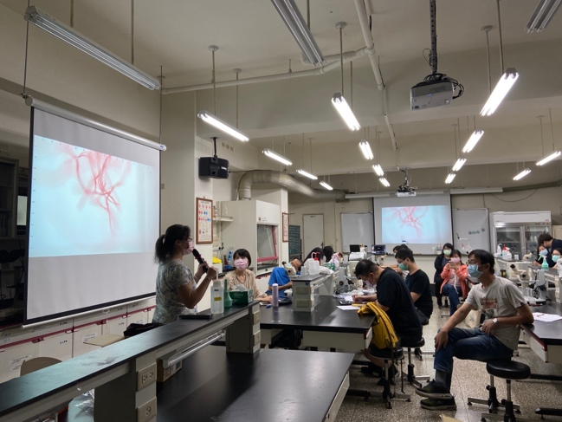
Microplastics monitoring teacher training
Time: Nov. 6, 2021
Participants: 15 teachers from 13 schools
After the training, 12 schools started the teaching about the microplastics investigation.

Slide 15
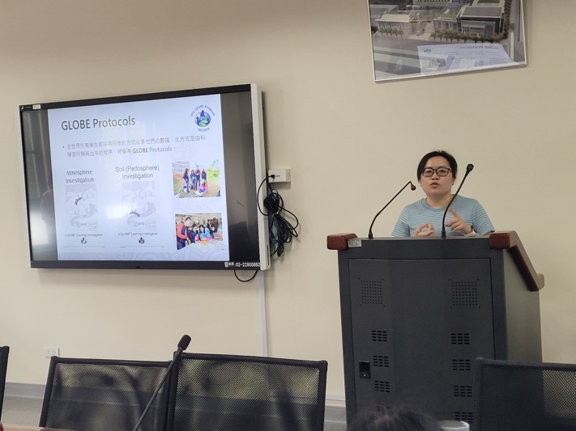
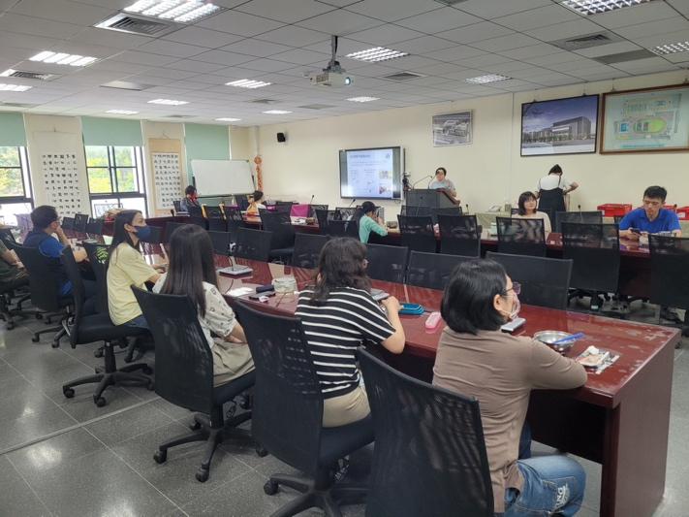
COMMUNITY – Encourage Interdisciplianary Teaching
GLOBE Program Taiwan was invited by Ming Lun High School to present and promote the project to teachers from various disciplines, introducing the teaching resources available through the project. A total of 10 teachers participated in the event.

Slide 16
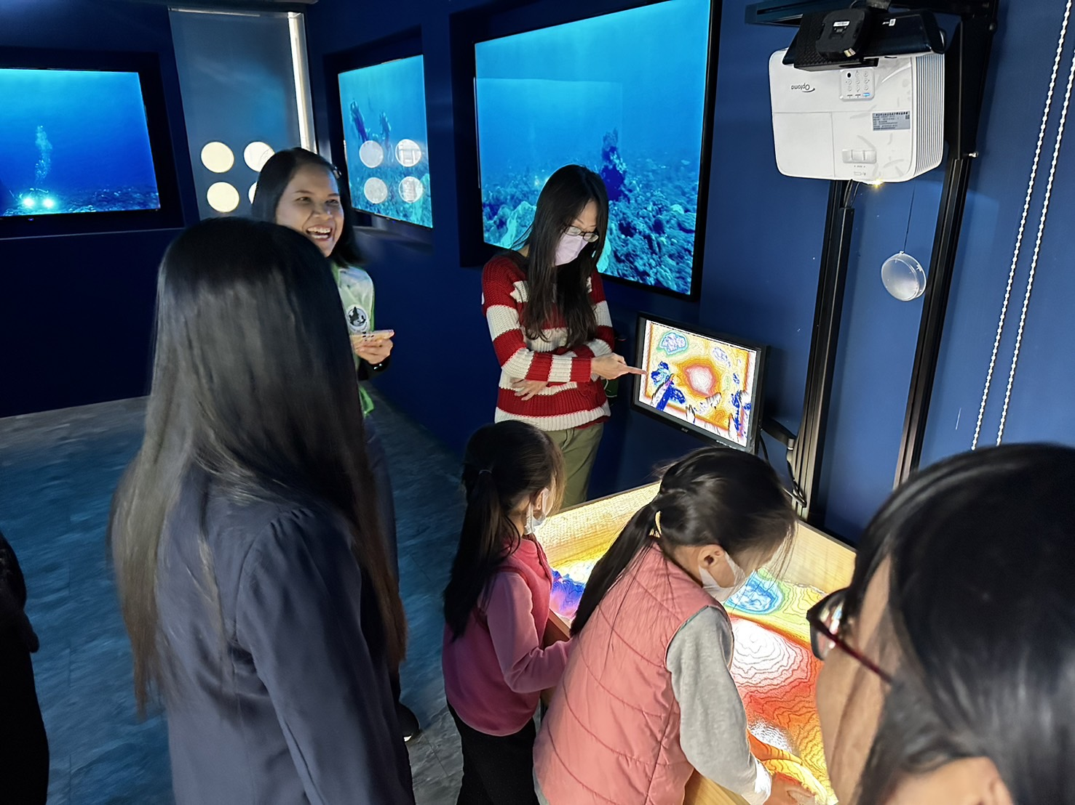
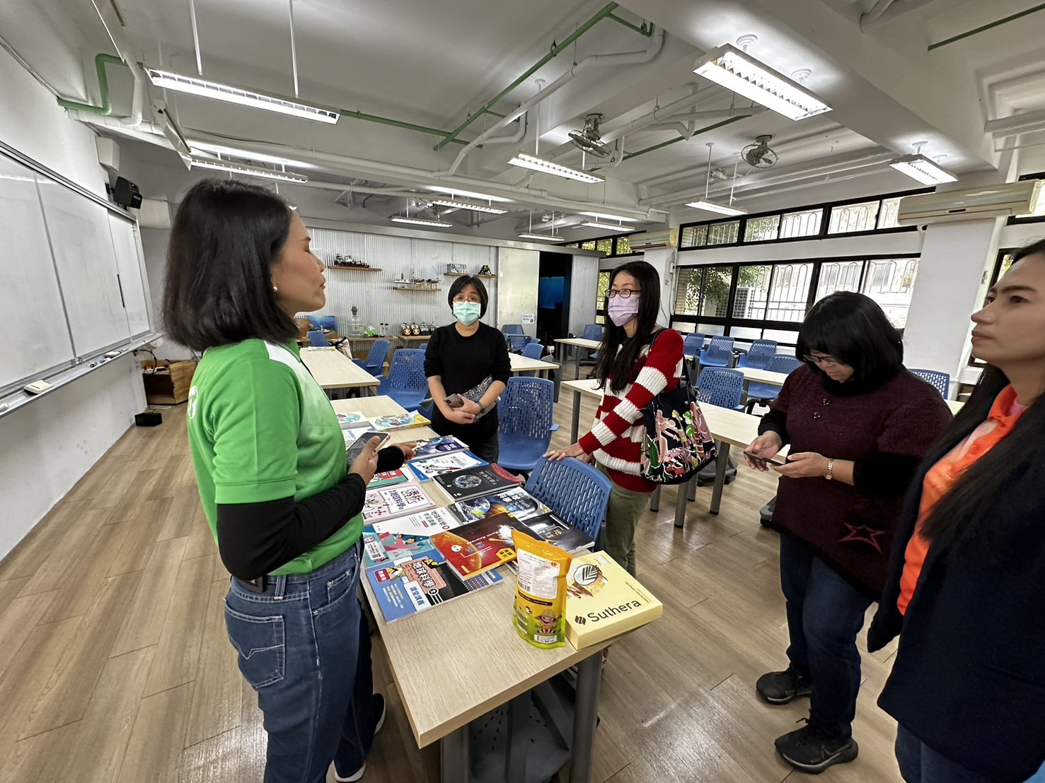
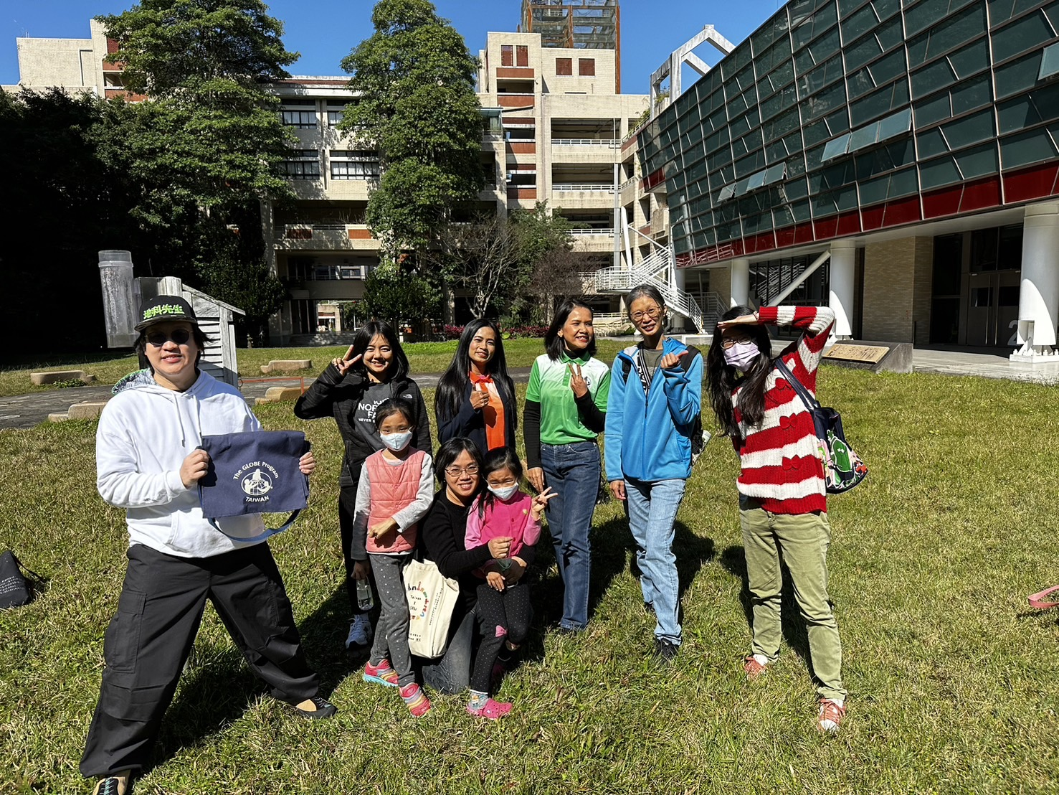
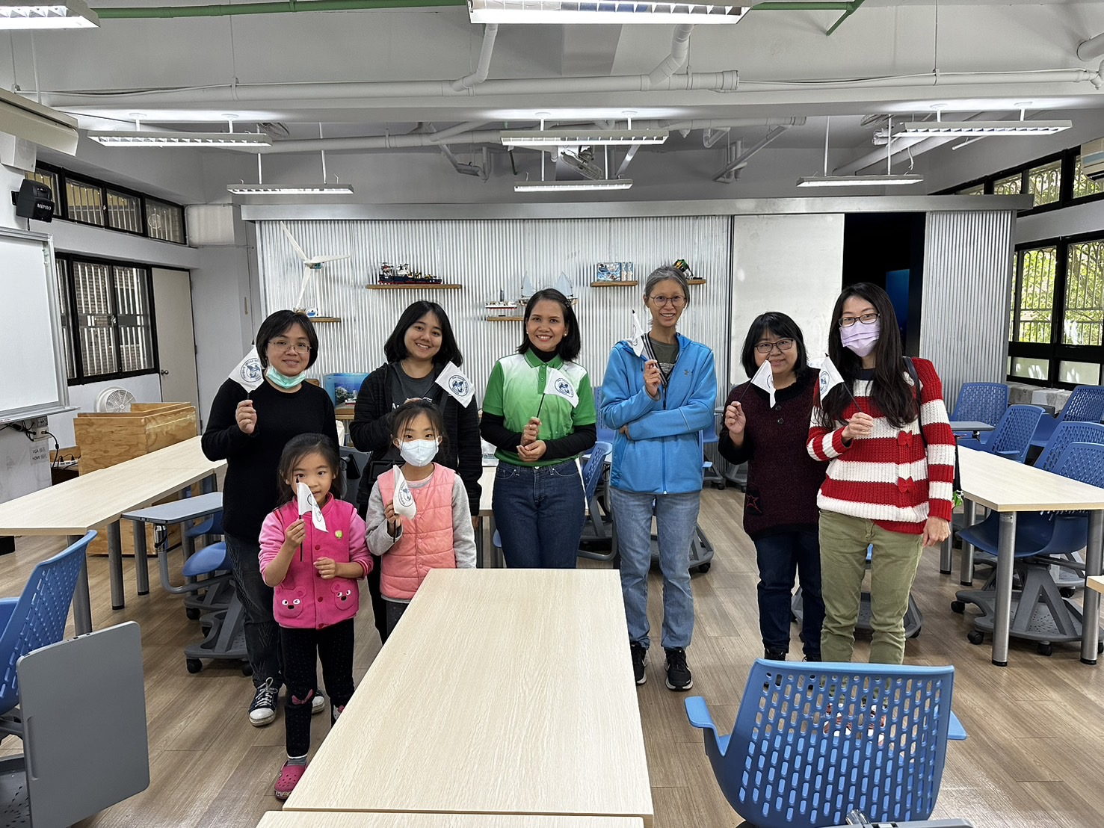
COMMUNITY – International Activities Involvement
GLOBE Thailand Dr. Watcharee Ruairuen and Ms. Ratchadaporn Thaikert visited GLOBE Taiwan on February 13, 2024. Six Taiwan teachers joined the event and interacted with Dr. Ruairuen. They shared about the implementation of GLOBE and the teaching of earth science.

Slide 17
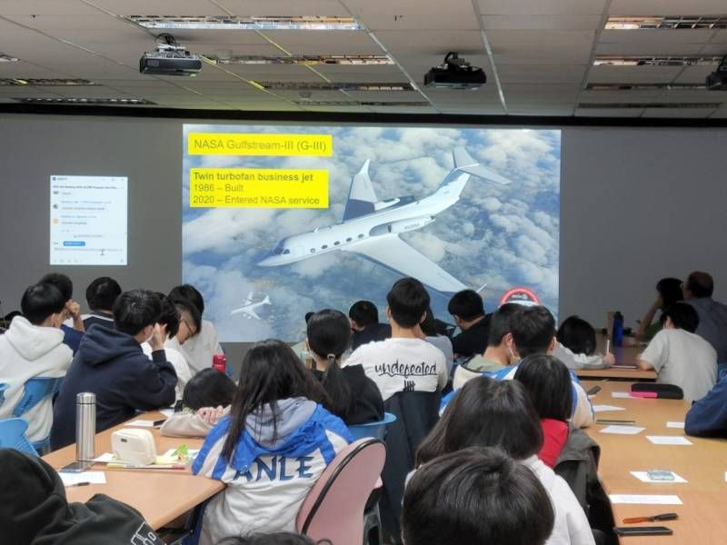
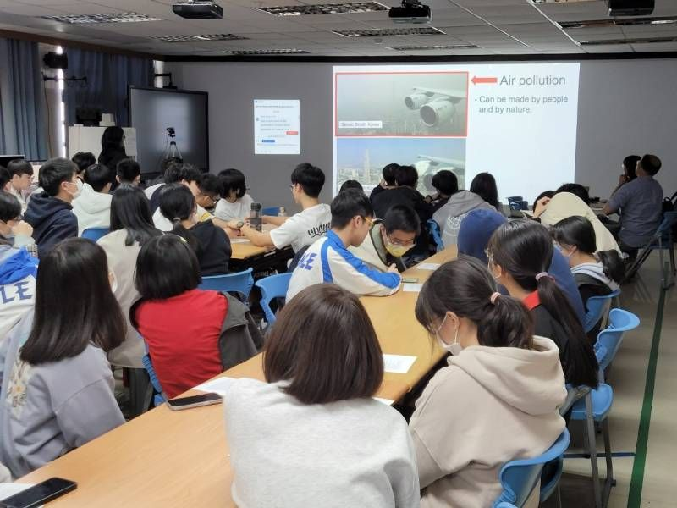
COMMUNITY – International Activities Involvement
We encourage teachers and students to join the webinar “NASA Asia-AQ Talk.”

Slide 18
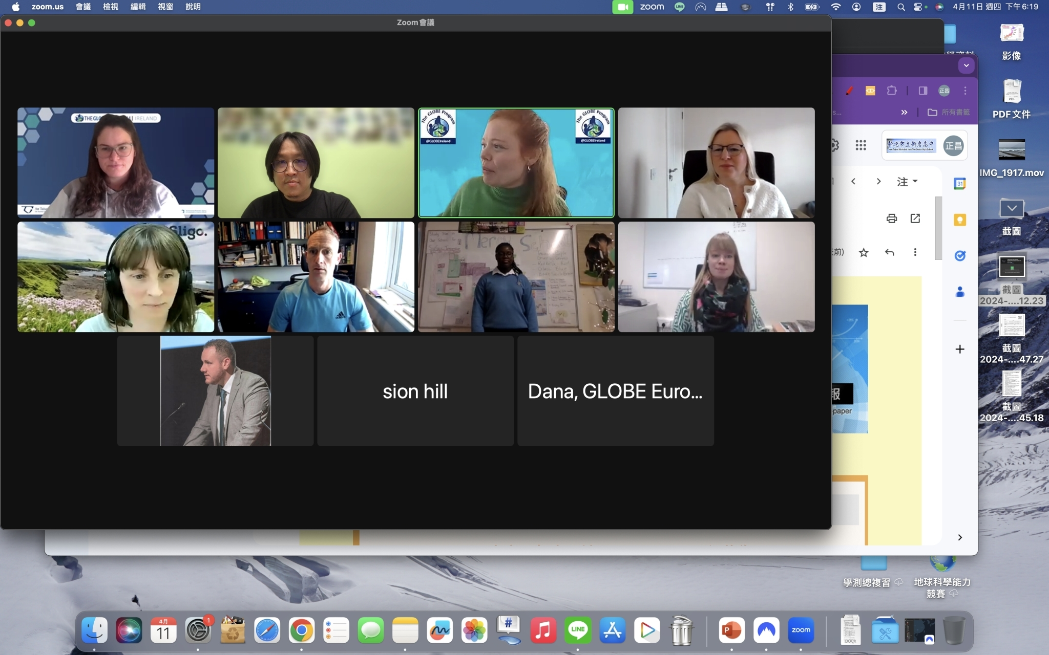
COMMUNITY – International Activities Involvement
One of GLOBE Taiwan teachers, Mr. Cheng-Chang Chen was invited to join the webinar ”How Cool is your school?”, which was hosted by GLOBE Ireland. The teacher learned about the investigation of surface temperature from the groups in Ireland. Participants come from Ireland, Oman, and Taiwan.

Slide 19
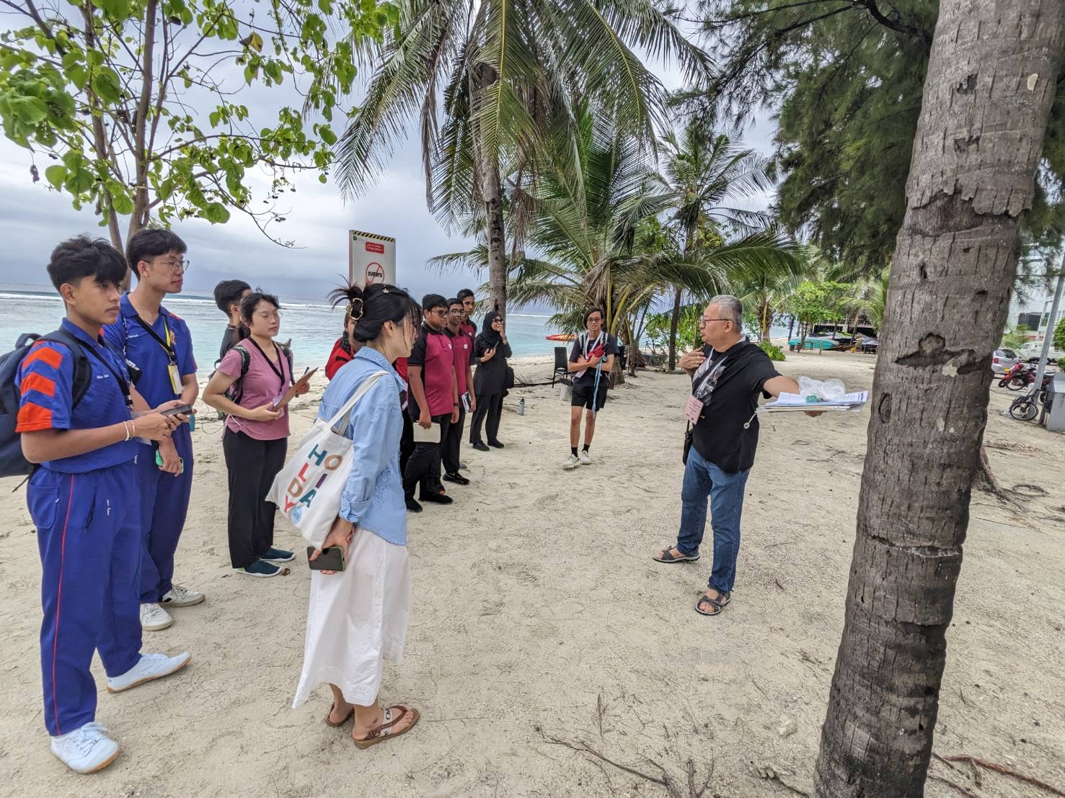
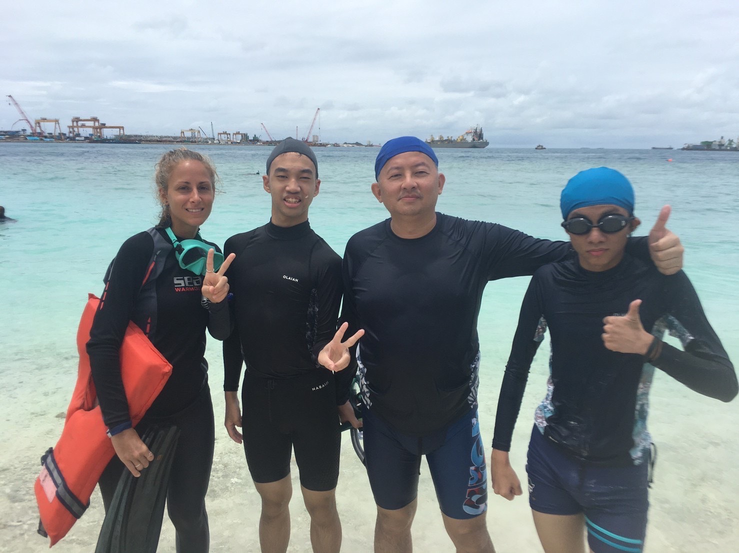
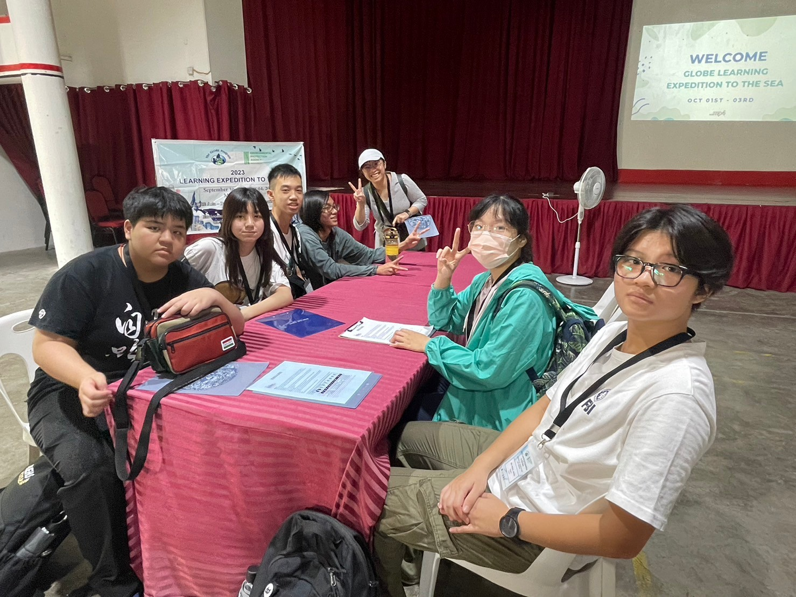
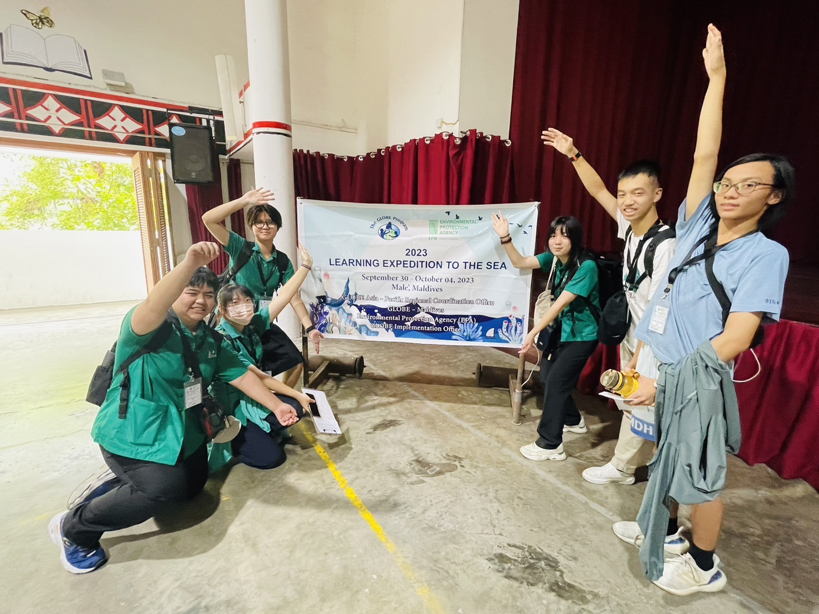
COMMUNITY – Students Exchange Program
Two teachers and seven students joined “Learning Expedition to the Sea” in Maldives from September 30 to October 4.

Slide 20
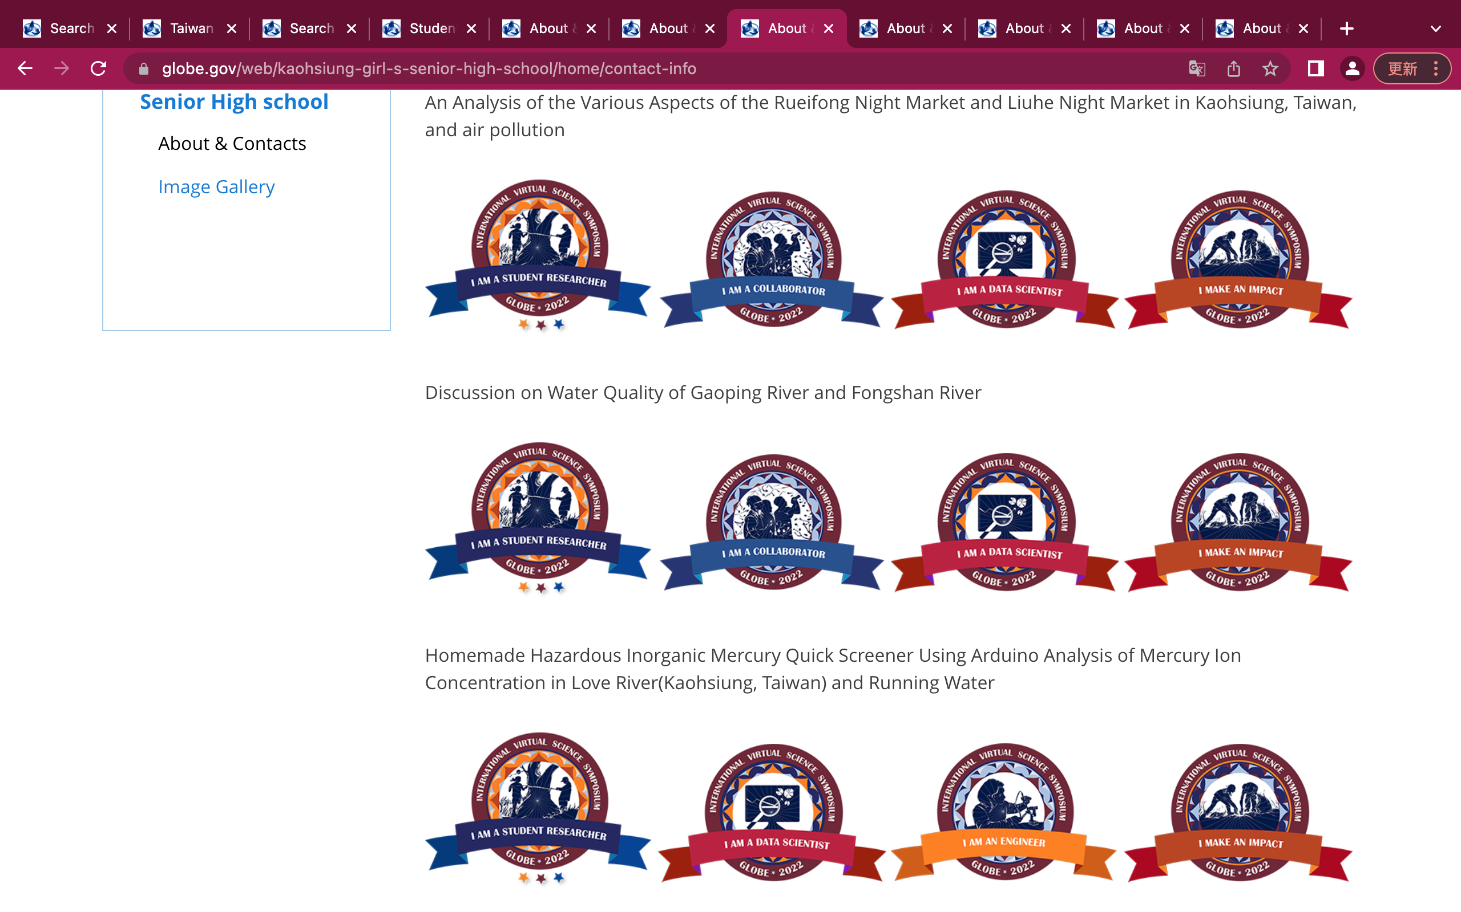
TECHNOLOGY
According to the feedback from GLOBE schools in Taiwan, we have two problems:
While using the GLOBE website to upload data, visualize data, and search resources, the webpage is very slow. Please increase the bandwidth of the website in the Asia-Pacific region.
Teachers cannot find their former IVSS results, like stars and badges, on their school pages. Is it possible to recover the webpage so that we can check the GLOBE IVSS results in “About & Contact” under the school page?
It is gone?!

Slide 21
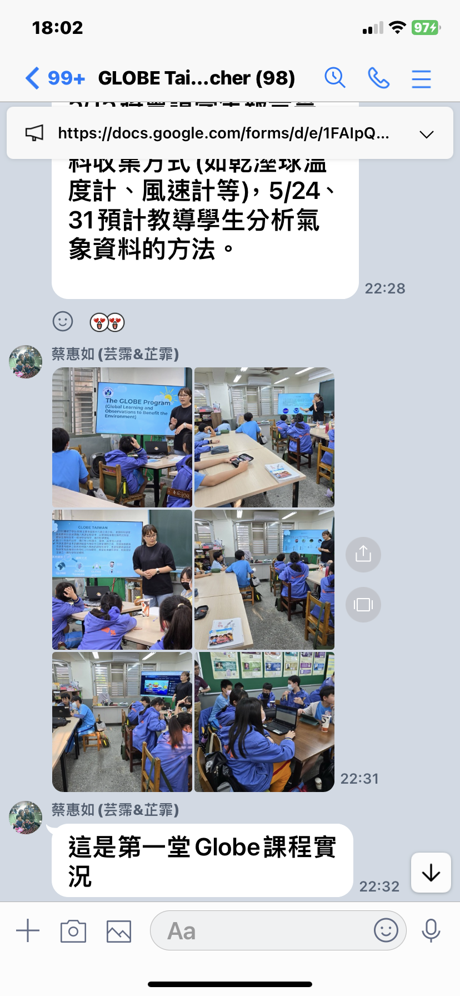
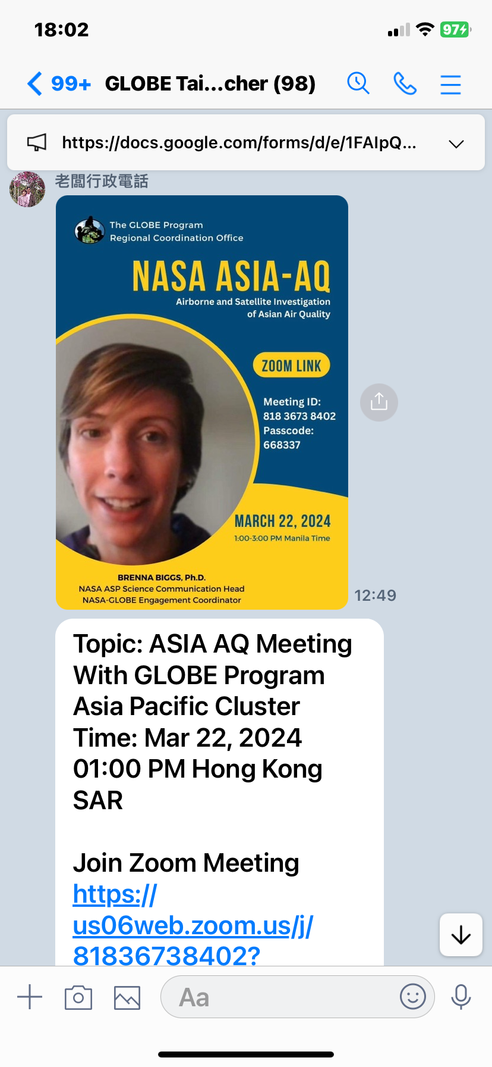
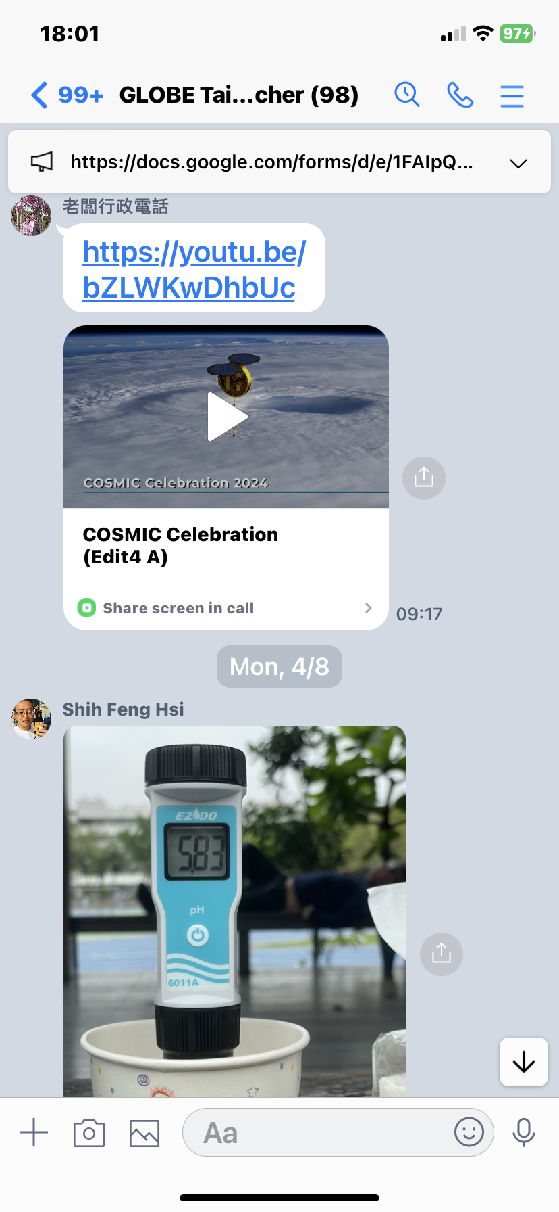
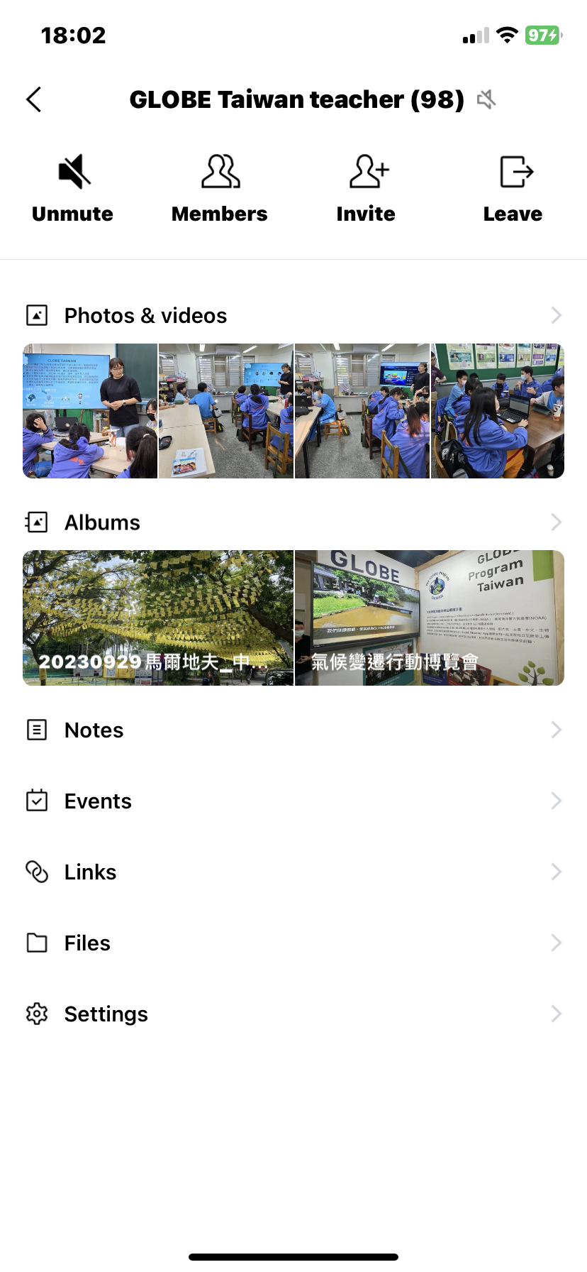
COMMUNICATION
GLOBE Taiwan Office keeps contact with GLOBE teachers by LINE app. New teachers can ask questions in the LINE group and experienced teachers can help them to solve their problems.

Slide 22
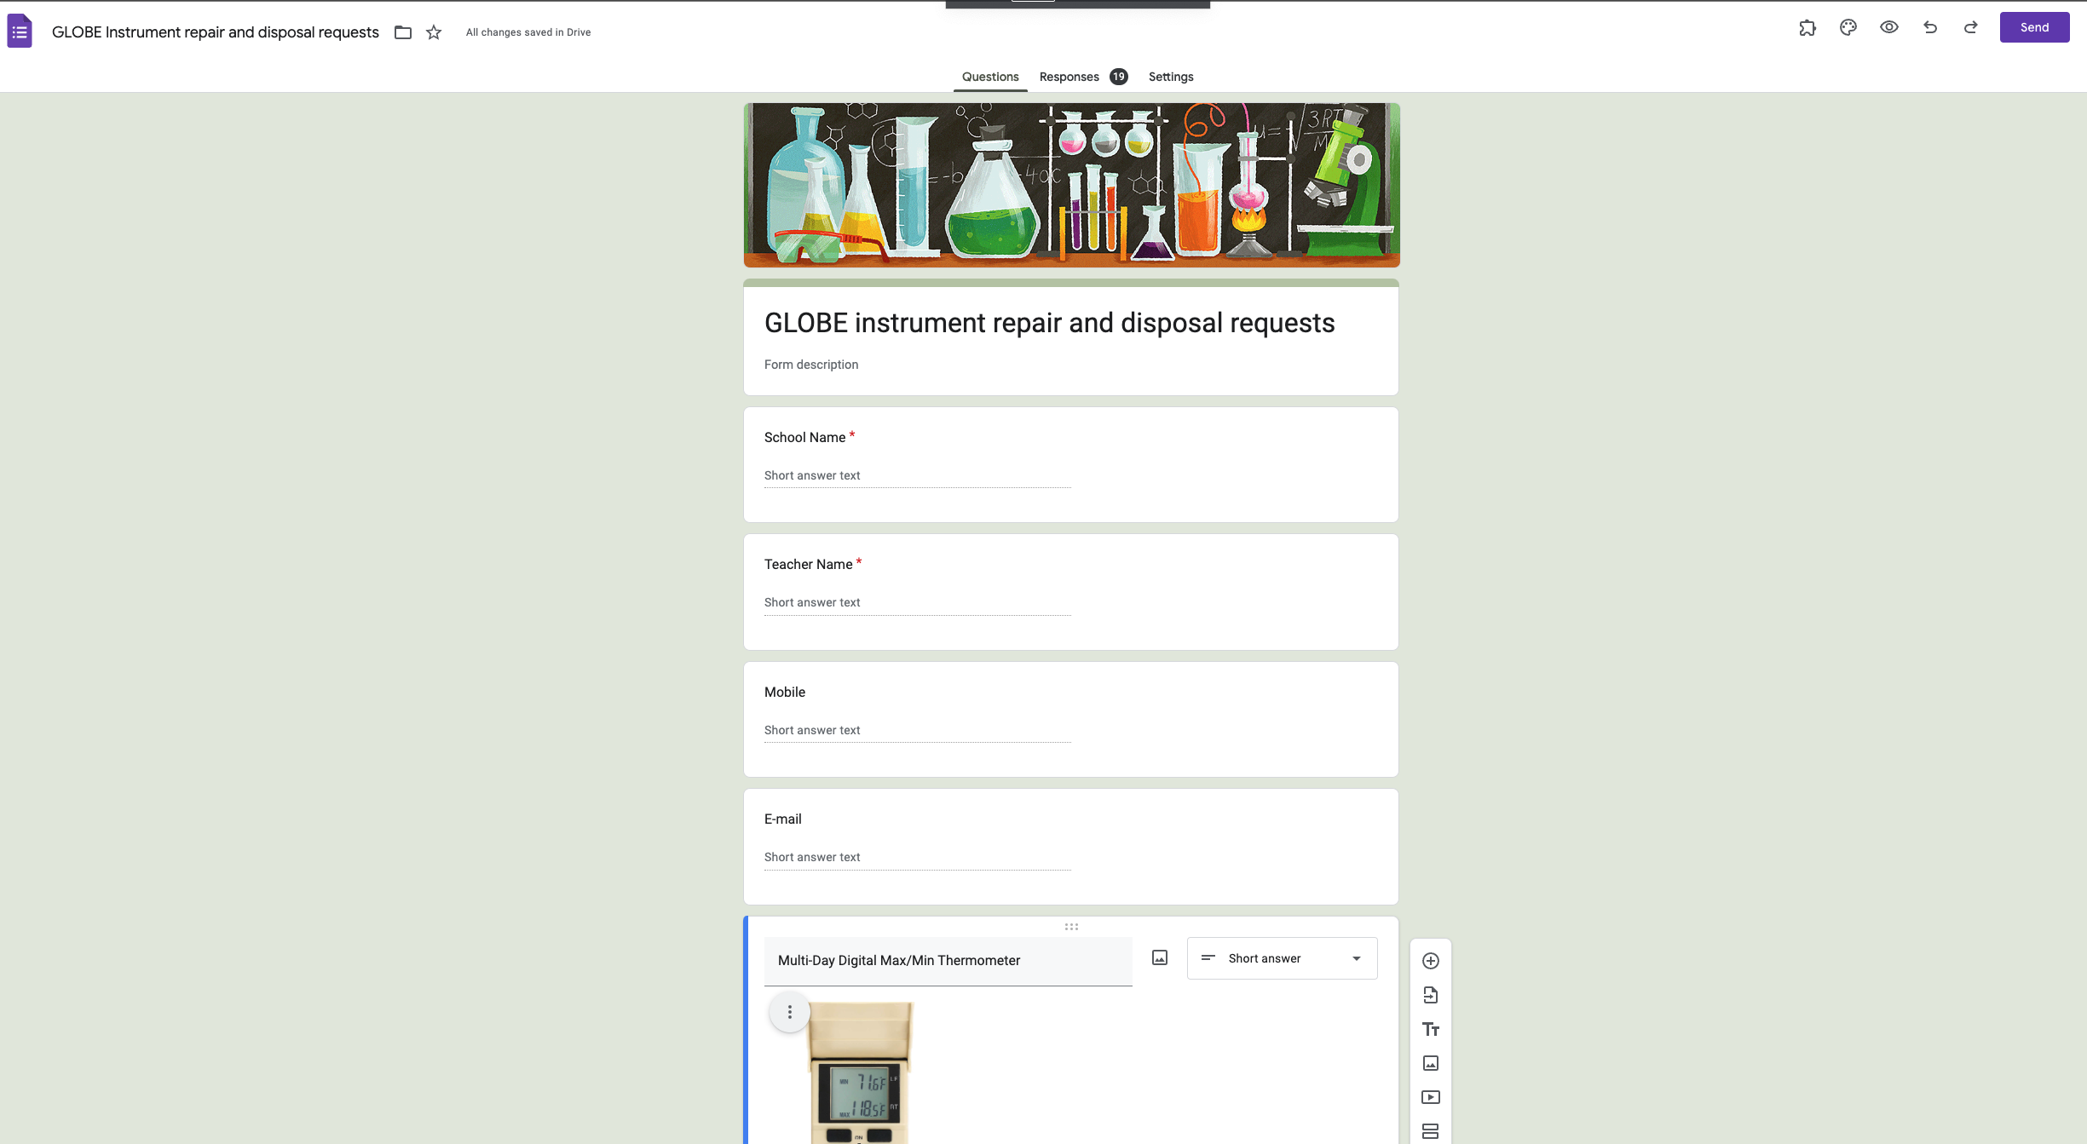
COMMUNICATION
If the GLOBE instrument requires repair, teachers can inform the GLOBE Taiwan Office by Google Forms.

Slide 23
Thanks for your attention!
globe@pblap.tw

