Slide 1
GLOBE Asia Pacific Regional Meeting New and Upcoming Web and App Enhancements Country Coordinator Essentials
Updated March 25, 2024

Slide 2
Agenda
Recently delivered website and GLOBE Observer app enhancements
Planned / Upcoming Tasks and Enhancements
Overview/Reminder of:
Metrics available to you
GLOBE Management capabilities
Your Dashboards
Editing/Adding Schools
Editing/Adding Users
Editing/Adding Content
How can we help you?

Slide 3
Recent Web Site Enhancements

Slide 4
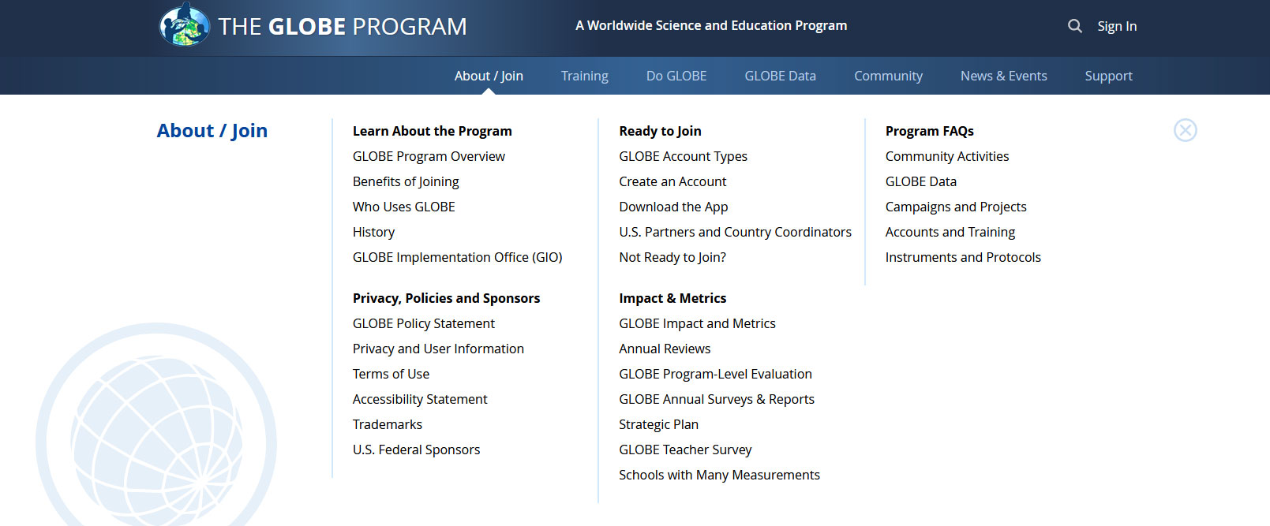
Easy to use menus to get a quick glance of content Restructured some content to improve findability Changing to “on click” with our next release
New ‘Mega’ Menus

Slide 5
Improved ‘About GLOBE’ Section
The section was re-structured to provide clearer information on what GLOBE is, how teachers, citizen scientists and other use GLOBE, and the benefits of joining.
Account Type definitions and capabilities are better explained.

Slide 6
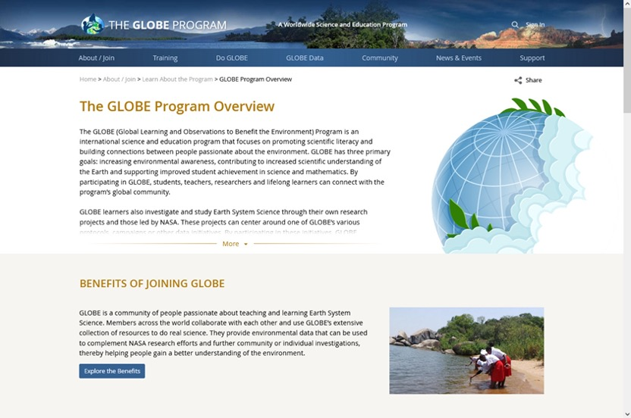
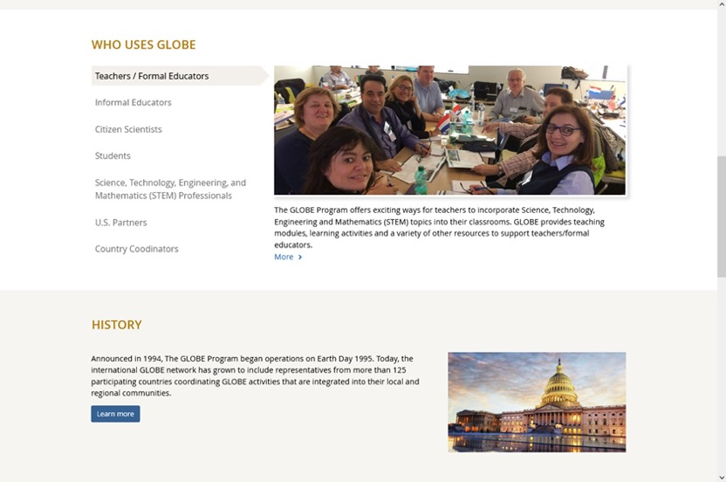
Improved ‘About GLOBE’ Section

Slide 7
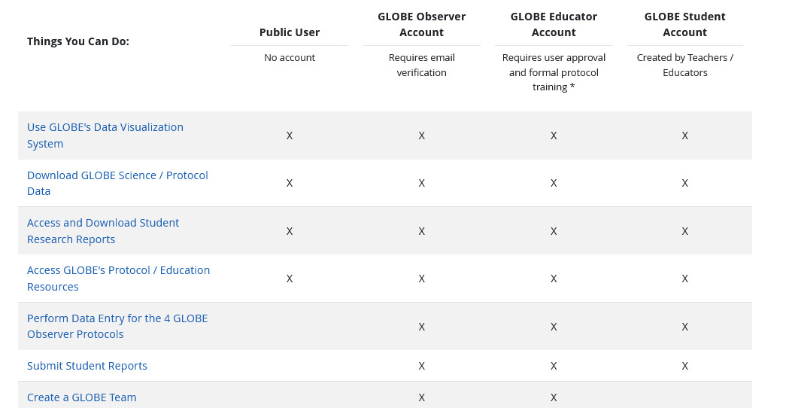
Improved ‘About GLOBE’ Section

Slide 8
New Account Creation Forms
One path for all users.
One form for both the website and GLOBE Observer app.
Users can identify which best describes them (formal or informal educator, citizen scientist, STEM professional) to allow us provide targeted content.
Teachers / Educators can elect to create a GLOBE Observer or a GLOBE Educator account depending on their needs.
A step counter was added to the form to help guide users through the account creation process.
All users are now required to verify their email address.
Country Coordinators still approve all requests for GLOBE Educators, Schools and Informal Educators in their country.

Slide 9
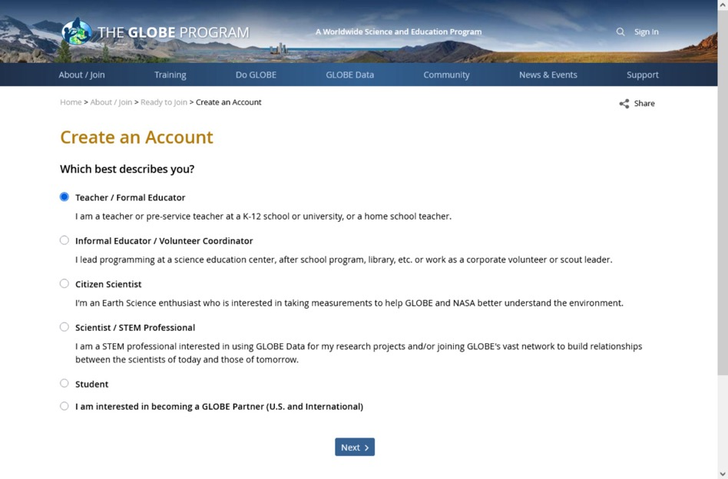
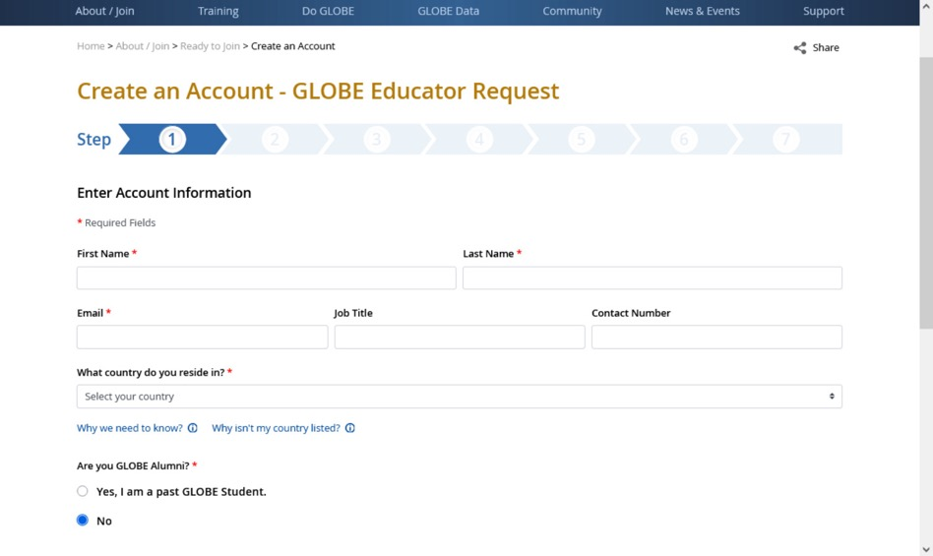
New Account Creation Forms

Slide 10
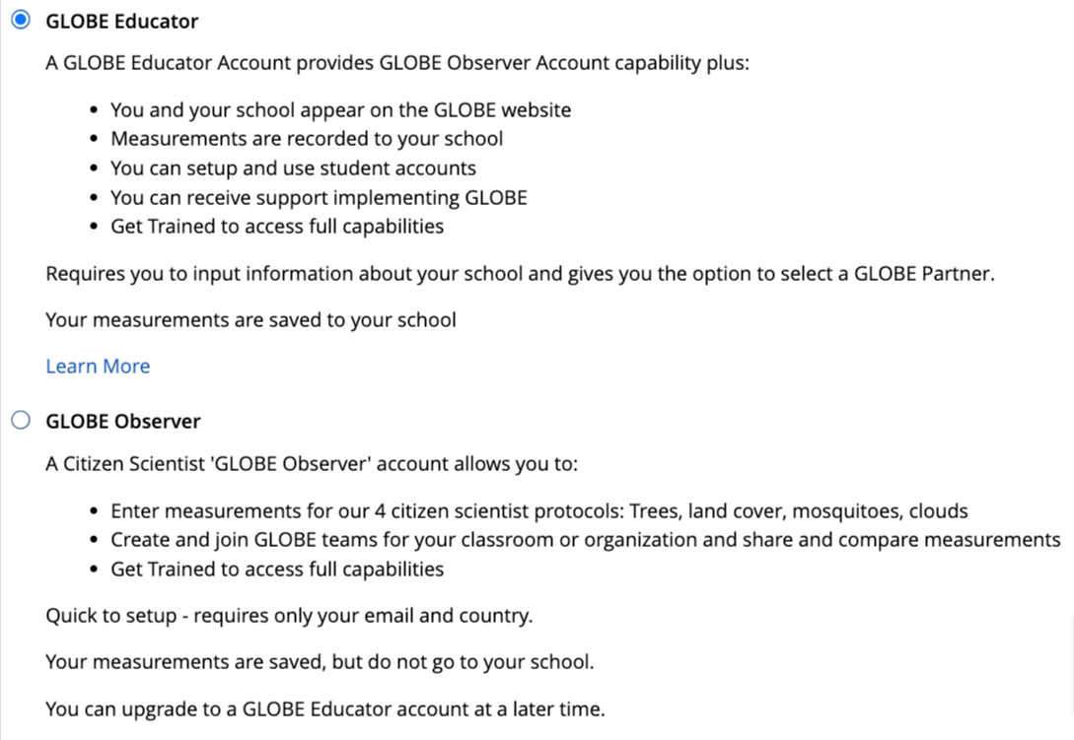
Educators can choose Educator or Observer path
For teachers who just want to try things out, select Observer Option
Same as GLOBE Observer, except we can see in the system if they are a citizen scientist or an educator (how many teachers are just doing observer?)

Slide 11
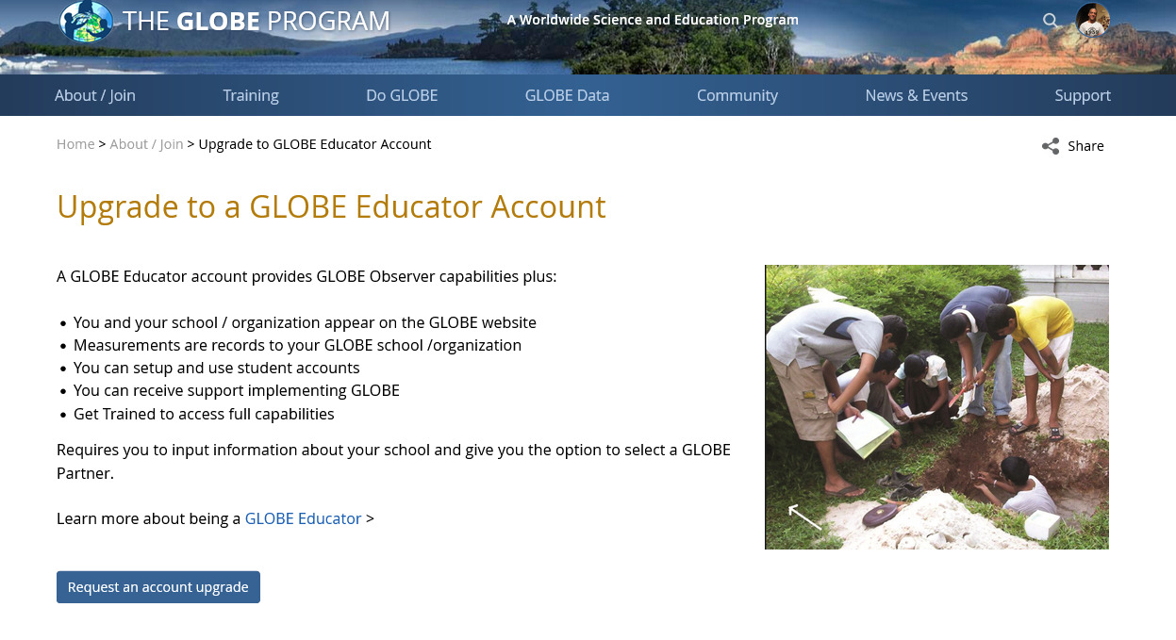
Account Upgrade Form for GLOBE Observers
Educators with a GLOBE Observer account are now able to request an upgrade to a GLOBE Educator account via an on-line application.
The application is sent to the Country Coordinator for approval
They will be able to enter their school information and be submitted for approval as a GLOBE Educator

Slide 12
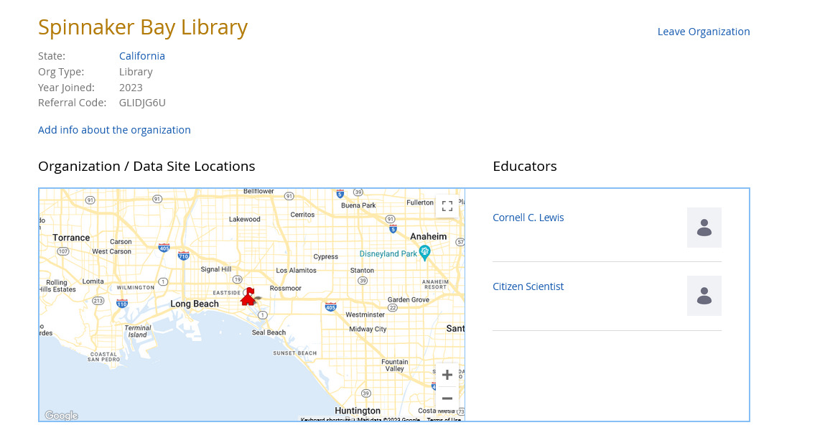
Introduction of Informal Education Organizations
Informal Educators who create a GLOBE account can now request to have their informal education organization become a GLOBE organization.
Libraries, science centers, museums, aquariums, etc. are given a presence on the GLOBE website and can have their GLOBE data associated with their organization.

Slide 13
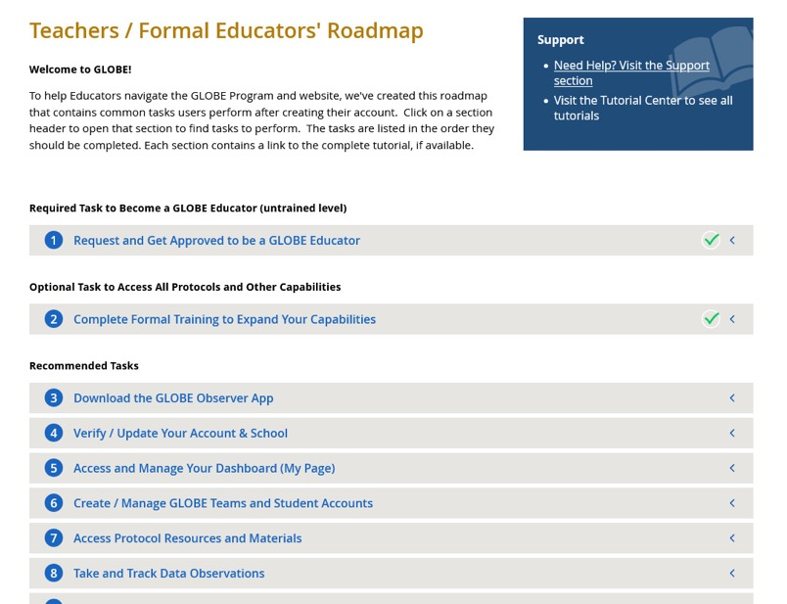
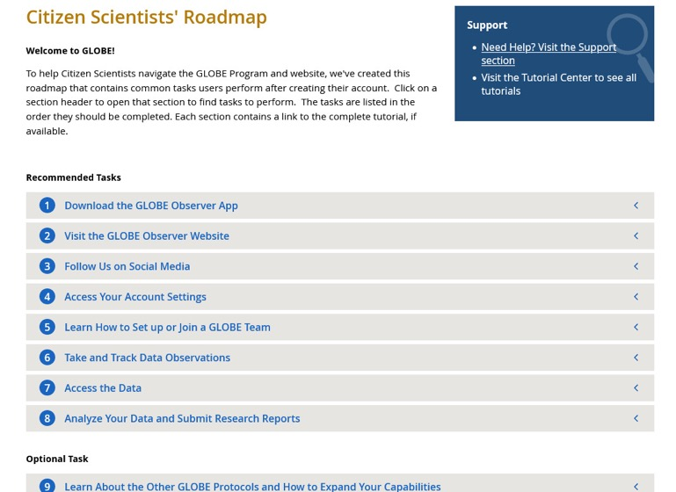
User Roadmaps
User Roadmaps are guides to help new and existing GLOBE members navigate the website by providing a list of commonly performed tasks by GLOBE users.
There’s a roadmap for each user type with links to tutorials and content on the website.

Slide 14
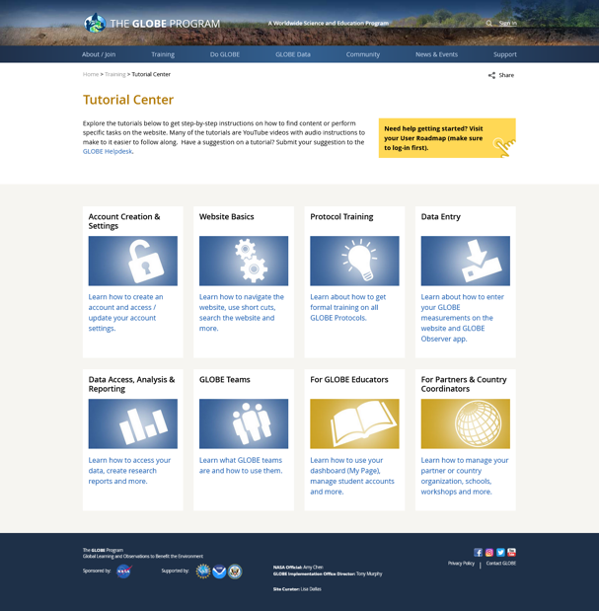
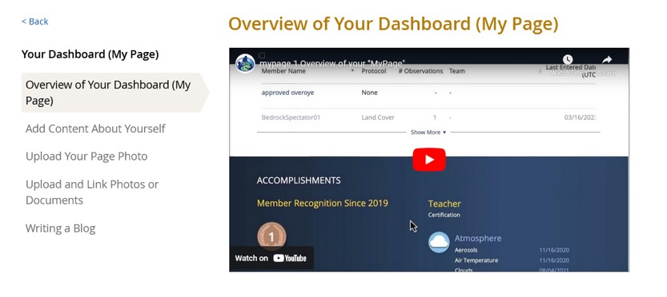
Tutorial Center
All site tutorials are now in one place.
Most tutorials are short ‘chapters’ to allow users to quickly find the help they need.
YouTube videos are available for most of the tutorials.

Slide 15
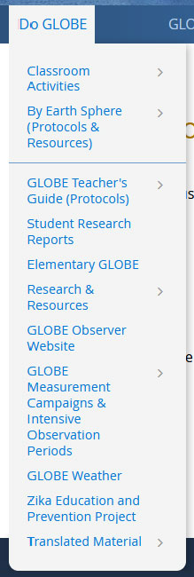
Site Re-Architecture (Phase 1) – Restructuring the Do GLOBE Section
Do GLOBE section was simplified to reduce the number of content areas.
Sphere communities and Teacher’s Guide pages were merged to reduce confusion on where to go to learn about Spheres and Protocols.
1st phase of site re-architecture with goal to make it easier for the community to find content and have a central place to learn about the GLOBE Protocols.

Slide 16
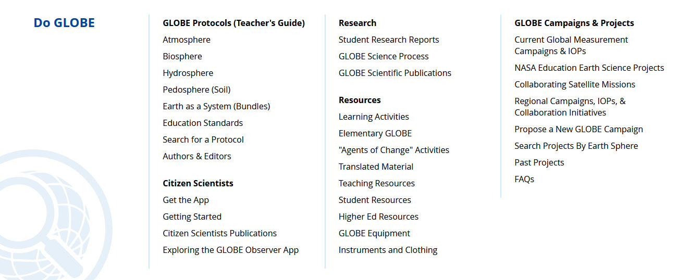

Slide 17
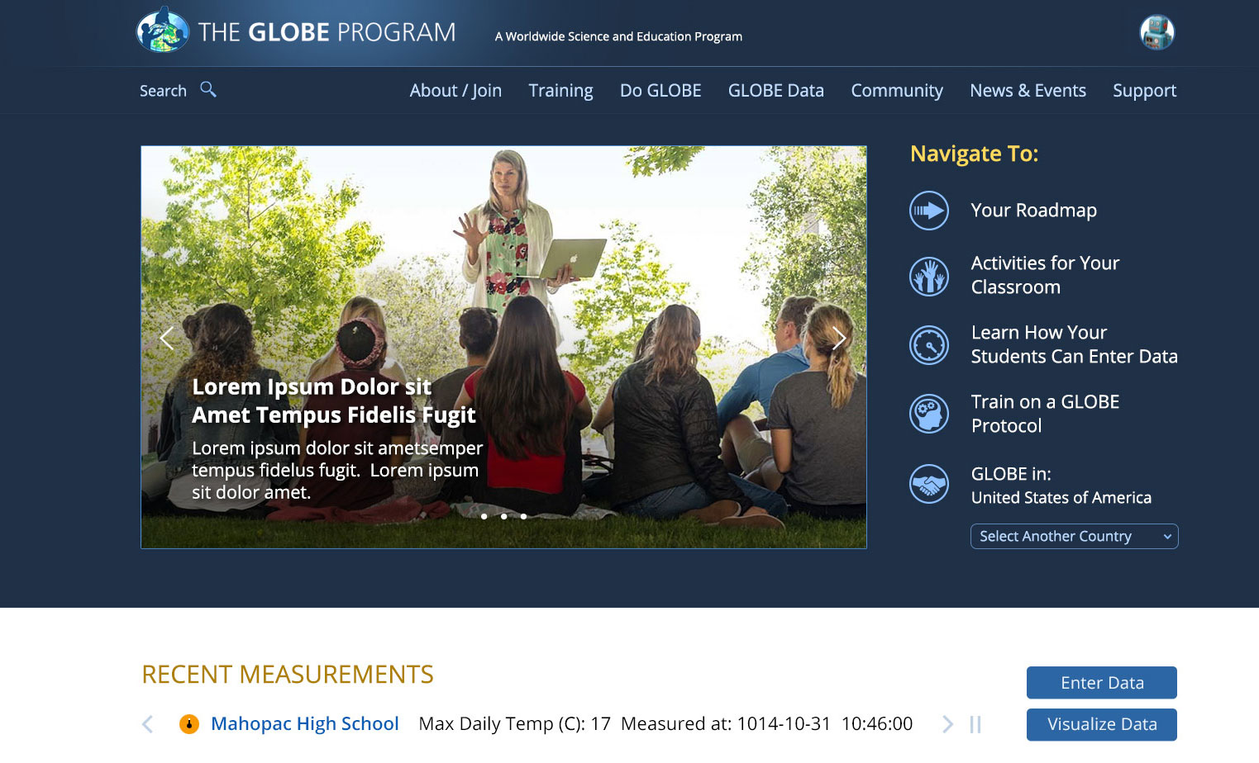
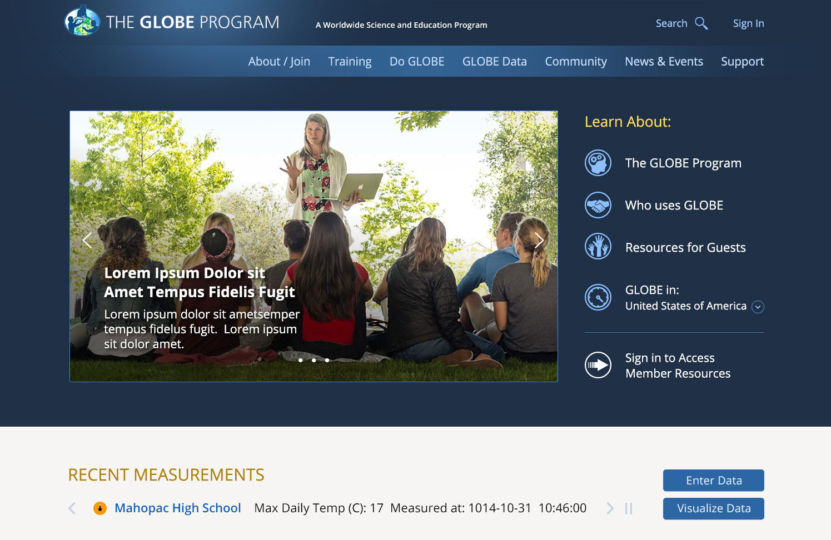
Enhanced Featured Content Area on the Home Page
Content users quickly want to access will be featured at the top of the home page.
Content will be customized for the different user types – Educators, Citizen Scientists, Students, Guests, etc.
Reduced Area of Featured Rotator

Slide 18
New Web-Based eTraining Modules (courses) - Pedosphere
New Pedosphere Web-Based e-Training modules are now available.
Replaces the PowerPoint Presentations.
Incorporates interactive features to improve the user experience.
Downloadable version is still available.
Other Spheres coming in May 2024

Slide 19
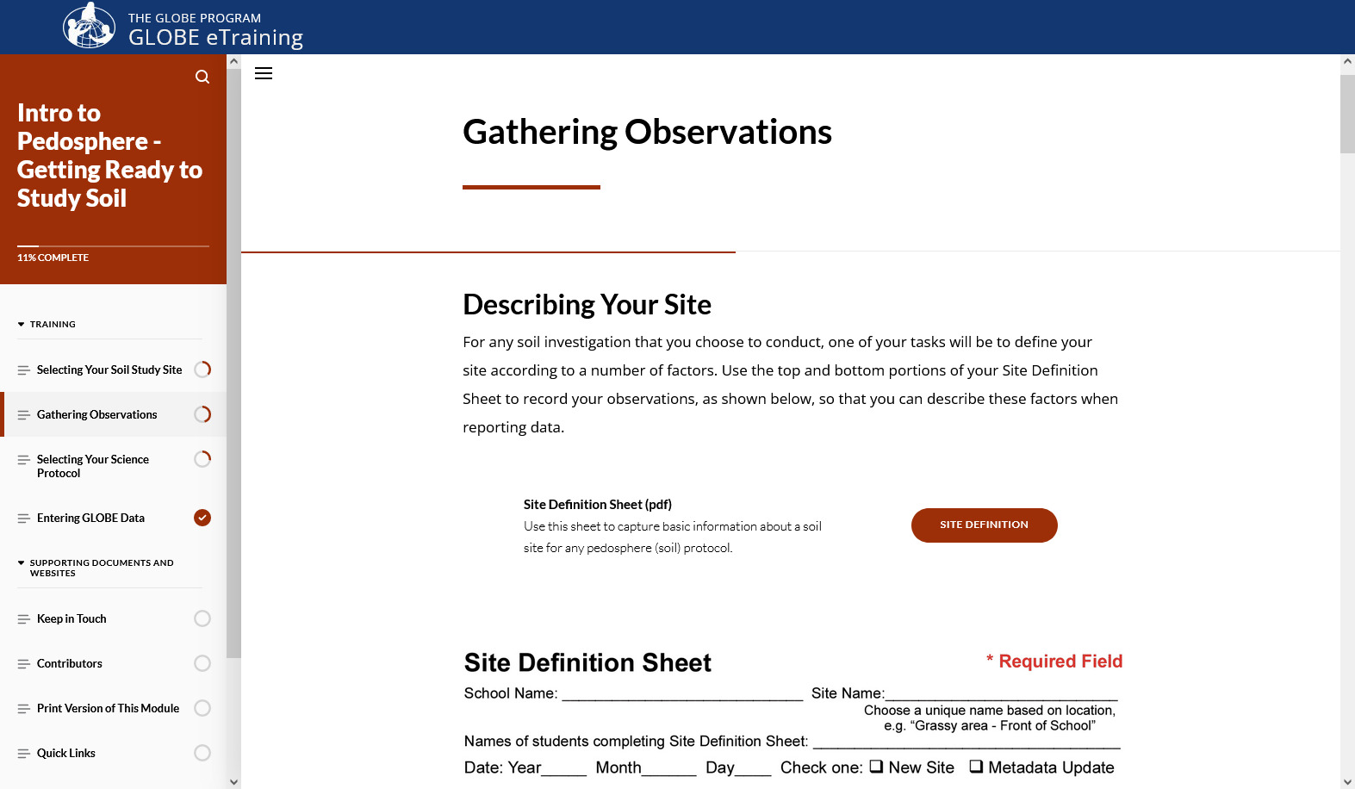
New Web-Based eTraining Modules (courses) - Pedosphere

Slide 20
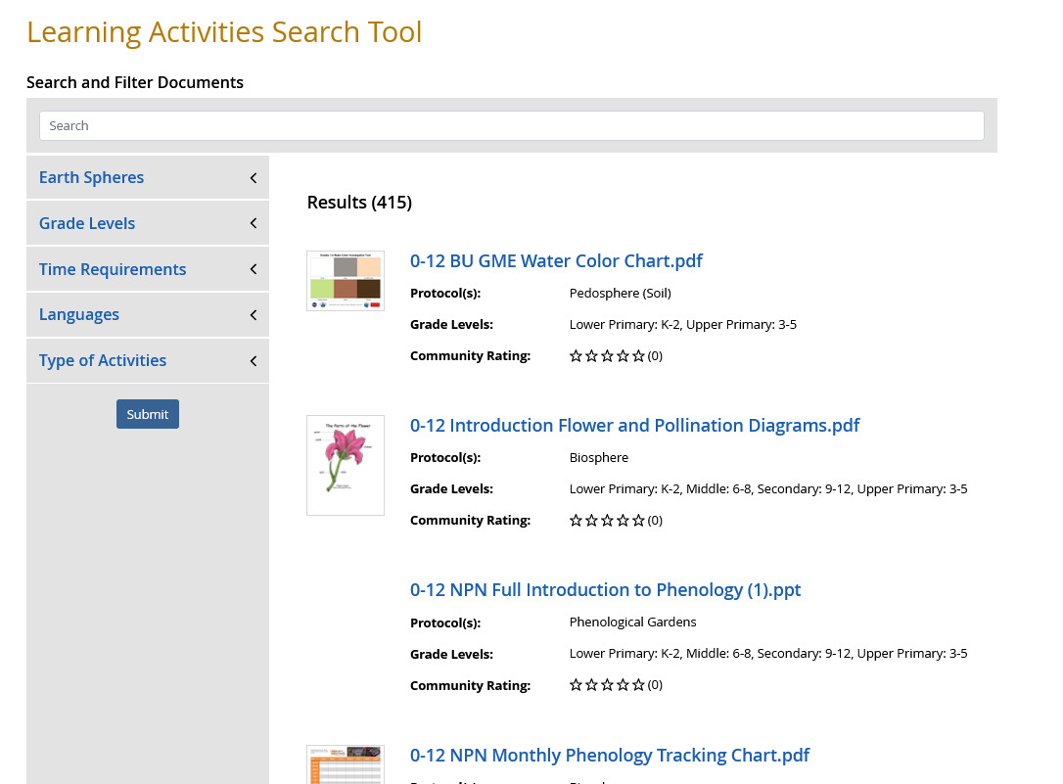
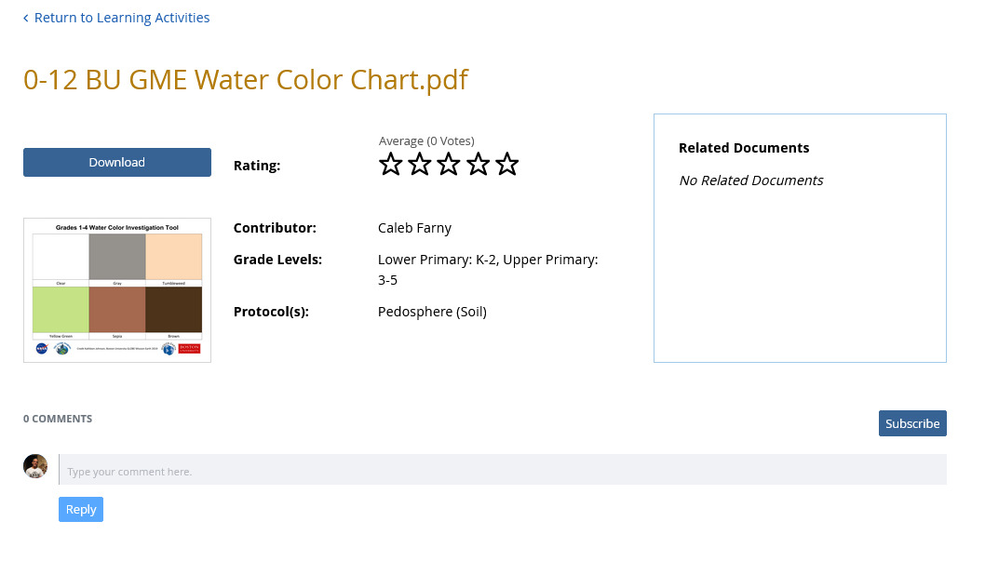
GLOBE Learning Materials Search and Submission Tool
New search tool to allow the GLOBE community to easily find learning activities
Tool allows community members to contribute to the GLOBE library of resources by allowing them to upload resources for others to use, comment and “like” submitted resources

Slide 21
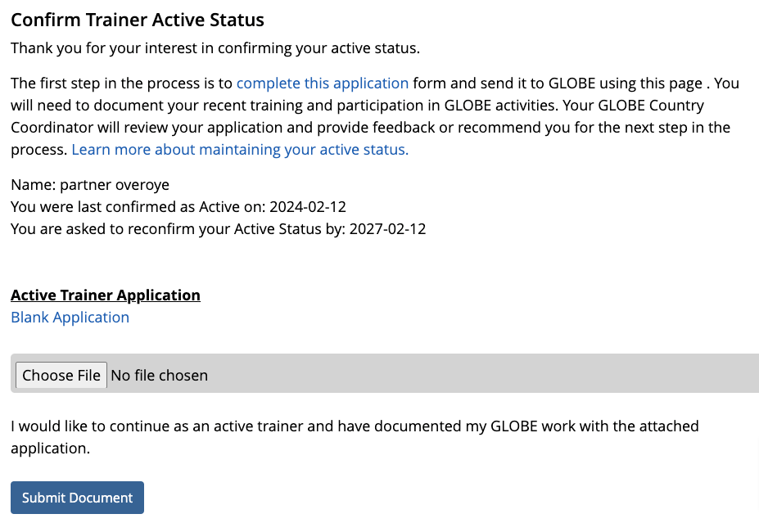
GLOBE Active Trainer Status
Allows GLOBE Trainers to re-certify as active trainers through the online tool.
CCs will get requests as they do now for people who want to become trainers – except this is for people who want to recertify as an active trainer.
This is a two step approval process – CC approval and EWG approval required

Slide 22
Note on recent enhancements – we’re listening
Megamenu and partial site re-architecture to make it easier to find content
Roadmaps – list specific steps for each user type to get the most out of GLOBE
New Tutorial Center to consolidate all of GLOBE’s tutorials and provide on-screen demonstrations
Account types by user (Educator/Citizen Scientist/Informal Ed)
New Informal Education Support for the informal education audience
Ability to upgrade from GLOBE Observer to GLOBE Educator
Support for teachers who “just want to do Observer” – with student accounts, mypages and school pages
“I just want to do GLOBE Observer”
“The site is confusing”
“I can’t find anything”
“Where do I go for xyz”
“There’s just too much there”
“Which account should I get?”
“My teacher made a GO account – now what?”
“What’s the next step?”
“I need help with xyz”
“Is my science center a school?”

Slide 23
Site Demo

Slide 24
Coming Soon Website Enhancements

Slide 25
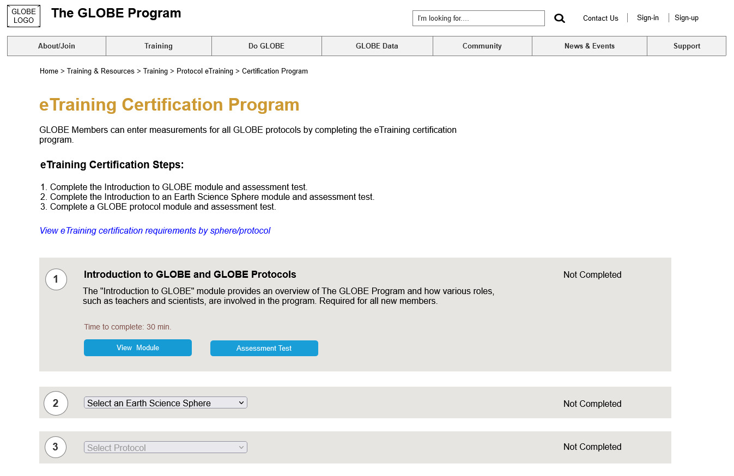
Improved eTraining Protocol Certification Process
Addresses the issue of users not being sure which eTraining modules are needed to become Protocol Certified (role required to enter measurements for all protocols).
New system will step the user through the required modules.

Slide 26
Improved eTraining Protocol Certification Process
Step 1:
Complete Introduction to GLOBE Protocols Module.

Slide 27
Improved eTraining Protocol Certification Process
Step 2: Select a Sphere

Slide 28
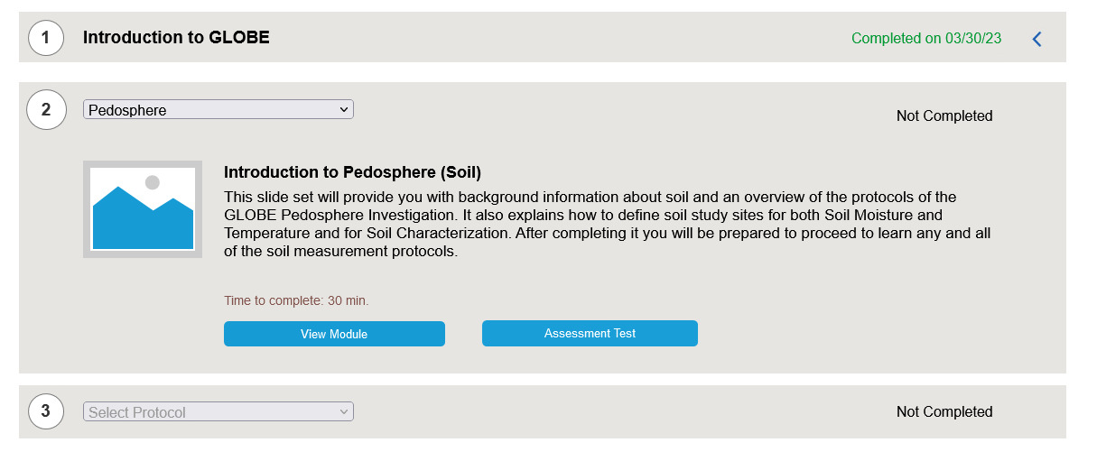
Improved eTraining Protocol Certification Process
Step 2:
Complete the Introduction module of the selected sphere.

Slide 29
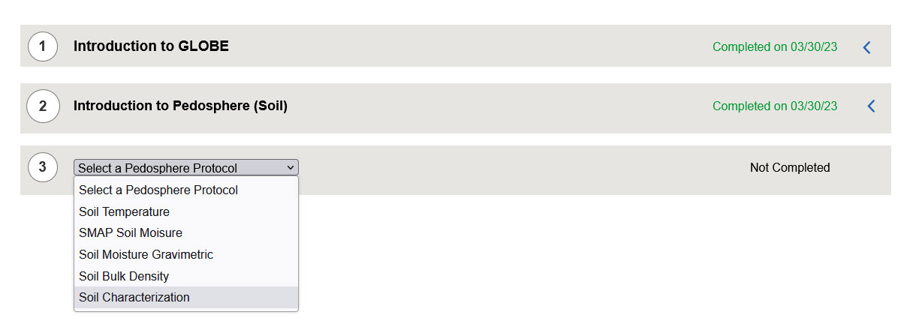
Improved eTraining Protocol Certification Process
Step 3:
Select a protocol under the sphere selected.

Slide 30
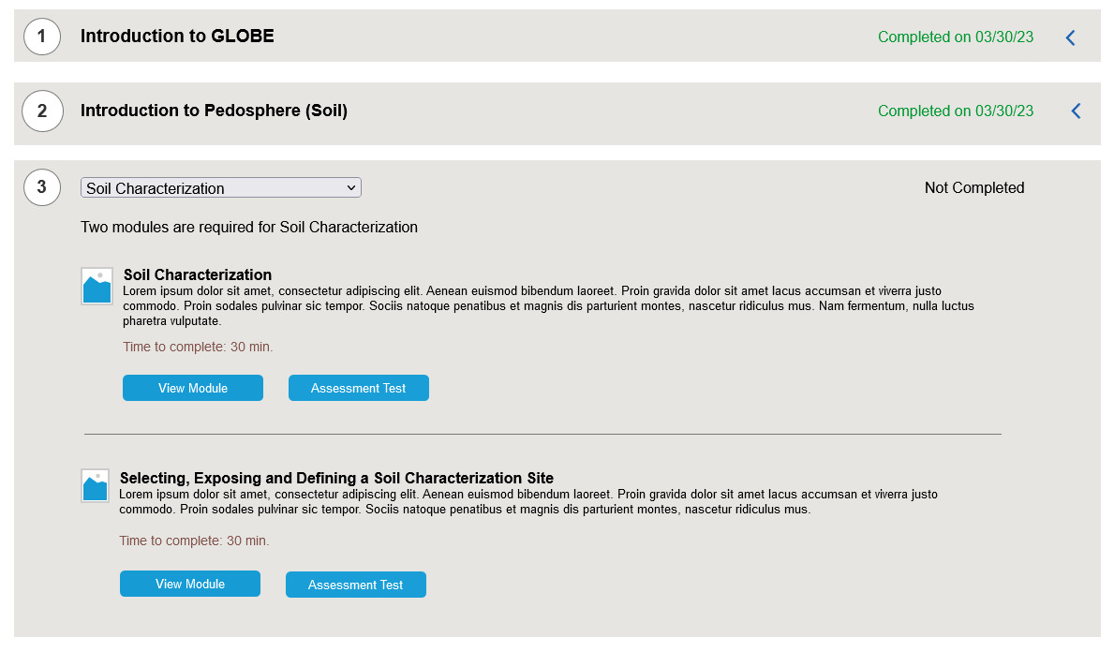
Improved eTraining Protocol Certification Process
Step 3:
Complete the required protocol modules

Slide 31
GLOBE Observer Recent Enhancements

Slide 32
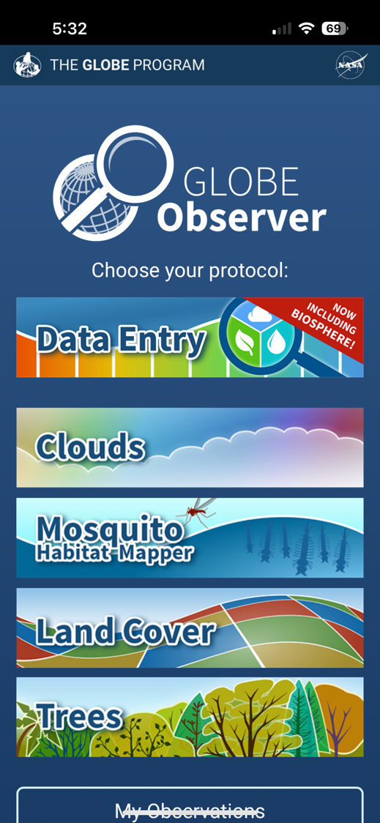
Biosphere Protocols Now on the GLOBE Observer Data Entry App
The latest update to the GLOBE Observer app includes all Biosphere, Atmosphere & Hydrosphere protocols for trained users
All trained Educators and their Student accounts can access Data Entry.

Slide 33
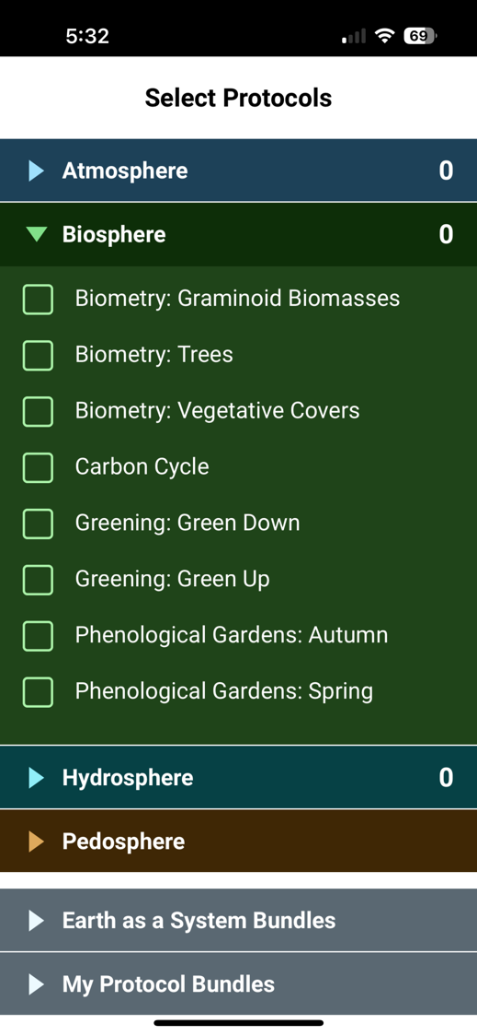
All biosphere protocols are available
Note we isolated sub protocols from each other, so you can choose which you want to do
Biometry you can choose 1, 2 or all 3 options
You can choose Green Up or Green Down (not the generic Greenings)
You can choose Phen Gardens Autumn or Spring
You can combine them with any of the other protocols
You can use the “Earth as a System Bundles” to automatically choose a set of protocols

Slide 34
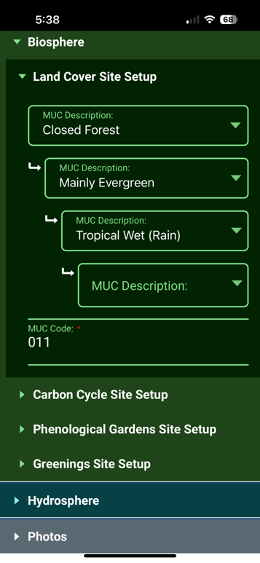
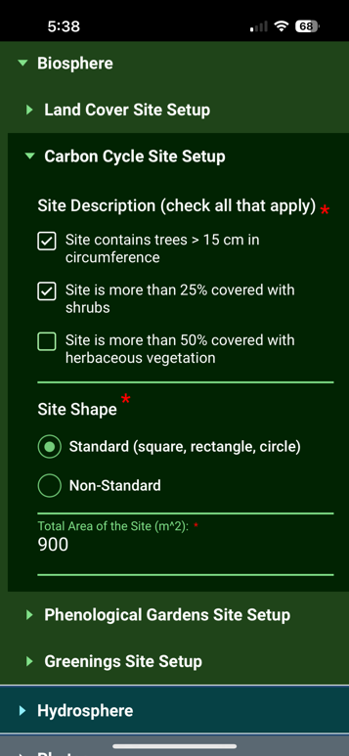
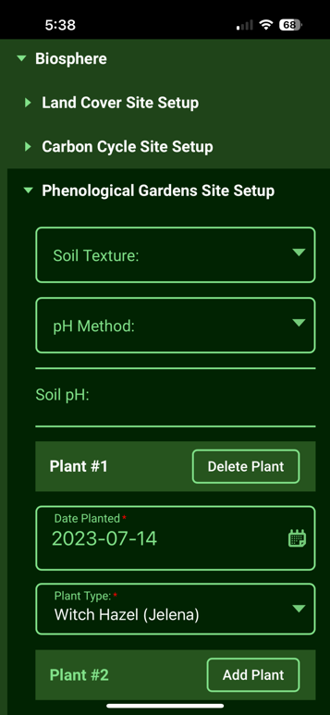
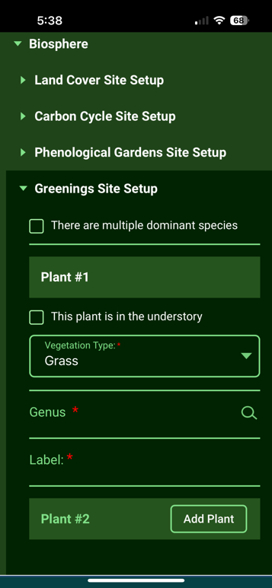
Biosphere Protocols in GLOBE Observer
All site setup features are available to setup a site separately, or while entering data for the first time

Slide 35
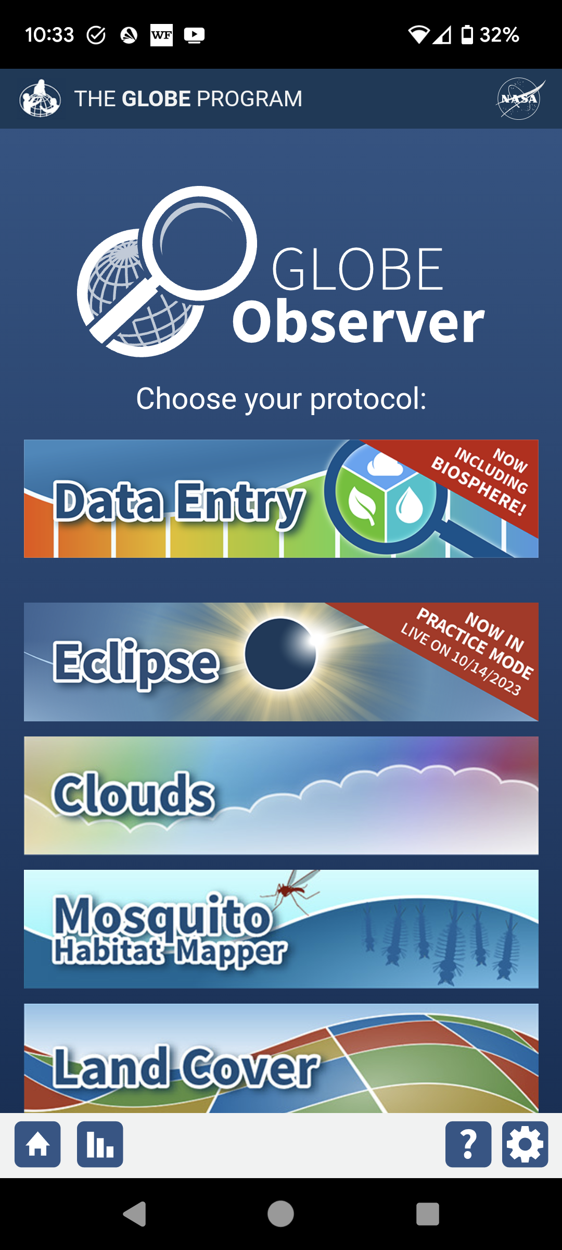
Eclipse App Added to GLOBE Observer App for 2023 and 2024 Eclipses
North and South American Regions Only

Slide 36
Landcover - Extra photos
Inspired by Eyes on Ice requirements
Added a capability to add additional photos during land cover protocol to capture things of interest
Up to four additional photos

Slide 37
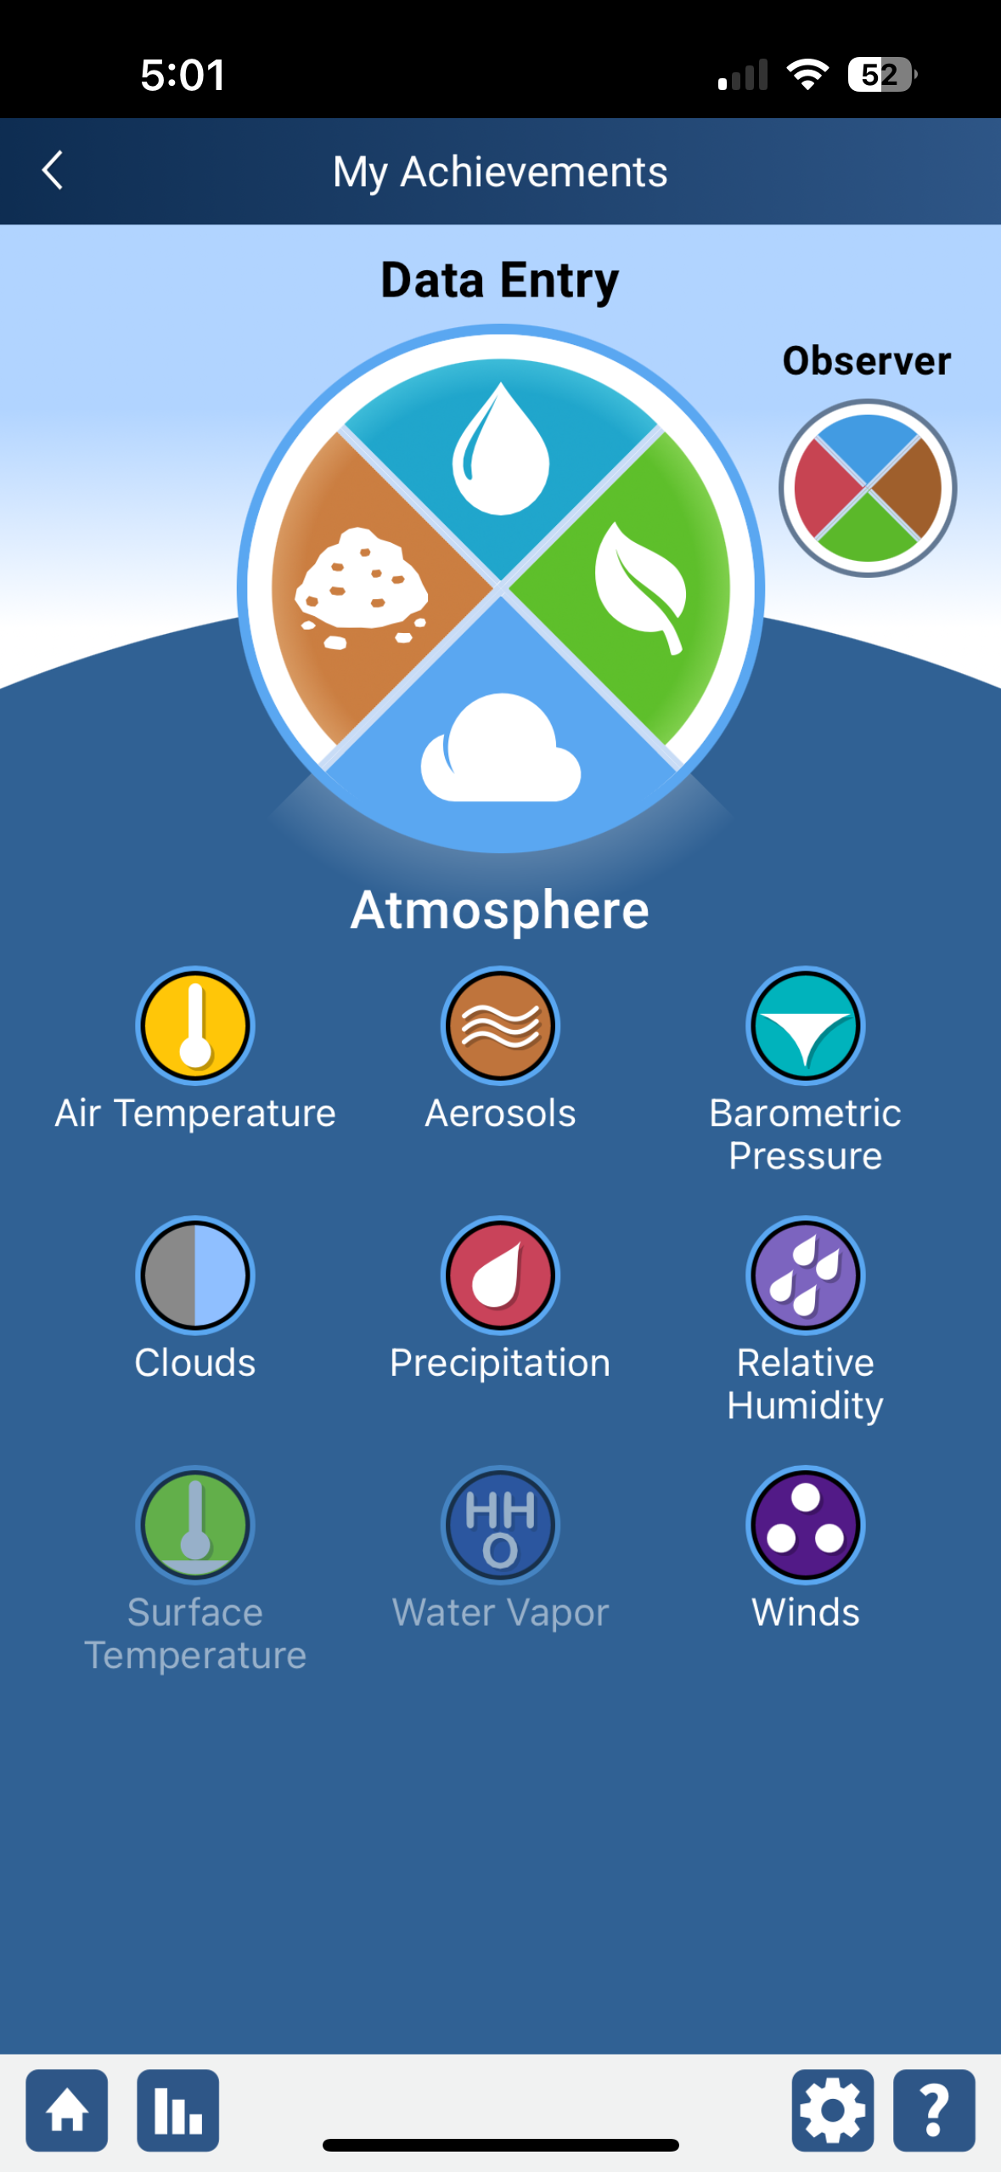
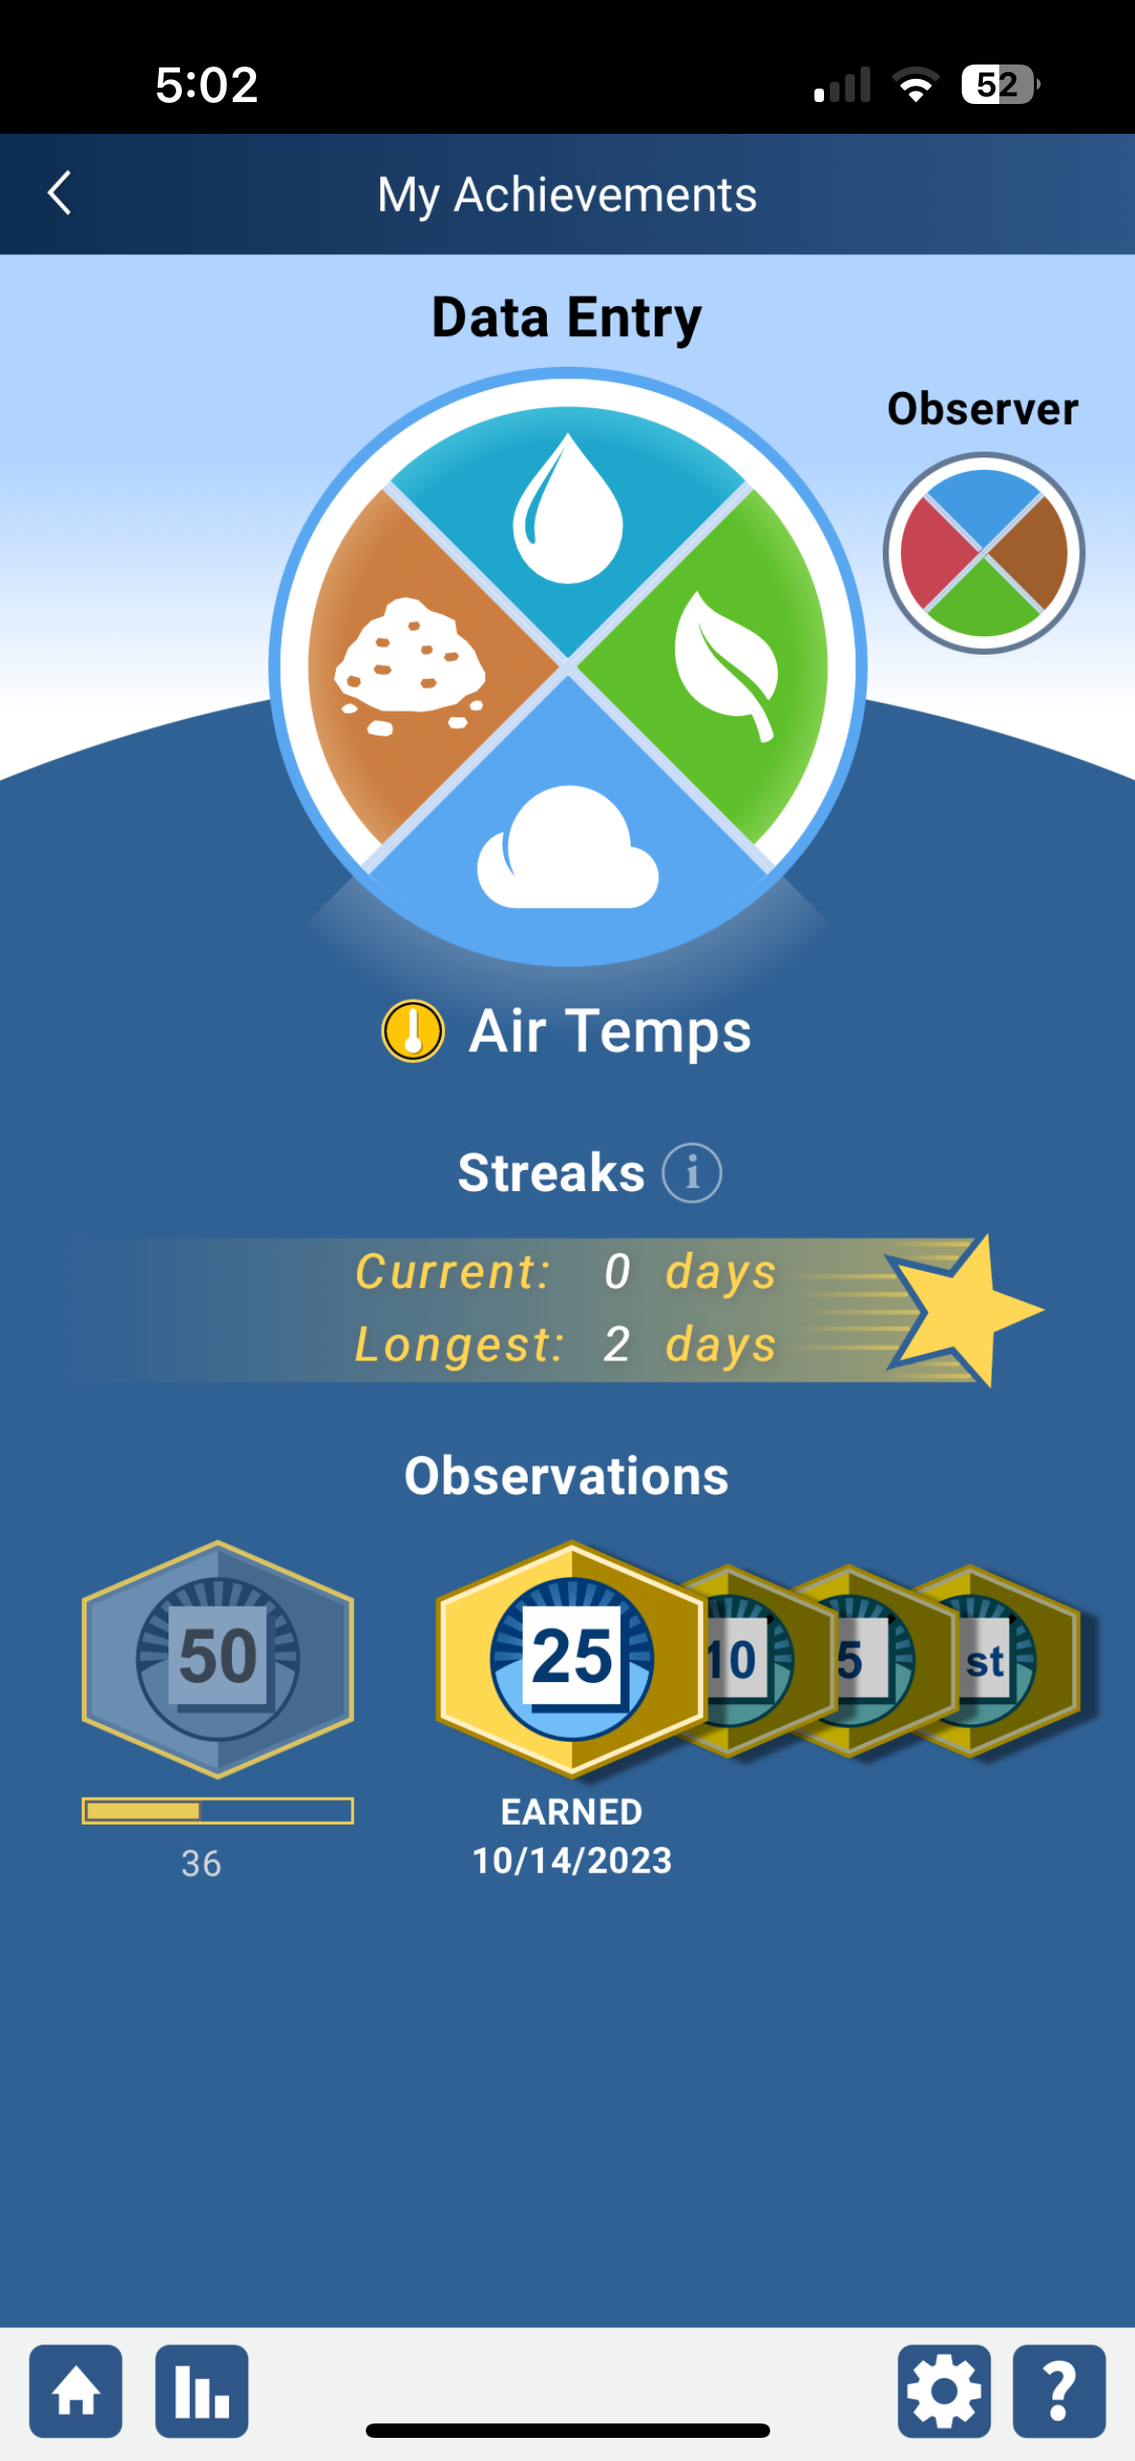
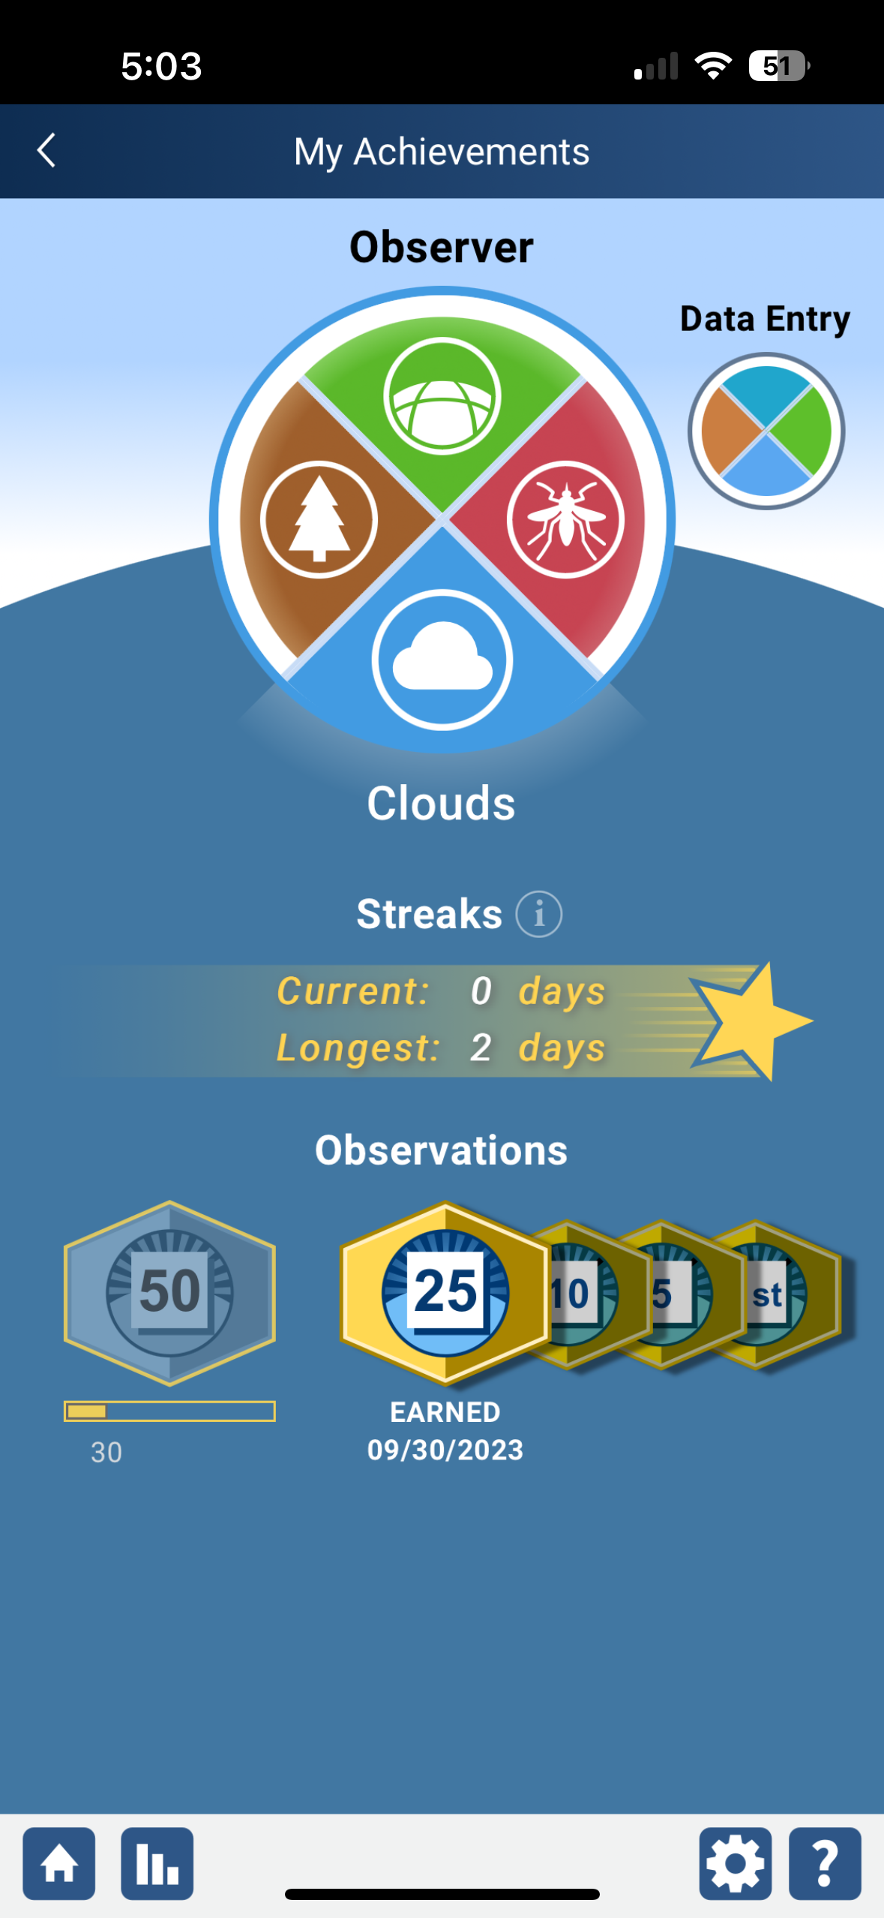
Awards and Recognition
Add improved awards and recognition to GLOBE Observer for all users
Investigating opportunities to support
First time measurements
Streaks
Milestone measurements (5, 10, 25, 50 etc)
Email generated congratulating the user (you can opt-out if desired)

Slide 38
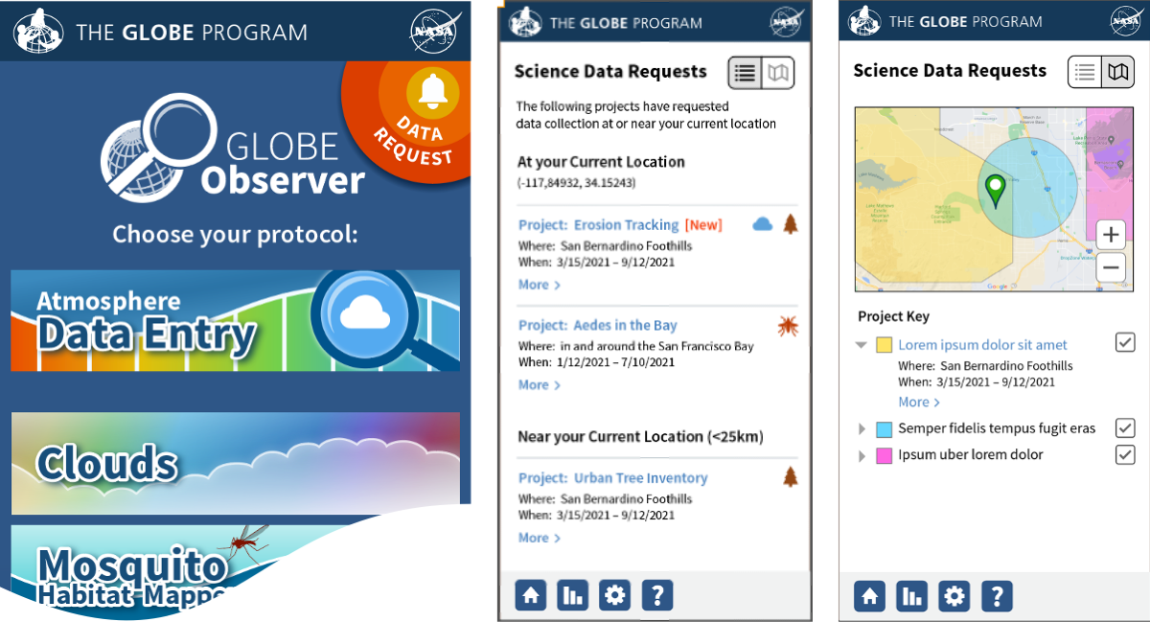
Request a geofence project
Allow users to submit a request for data collection
Submit project information and goals
Select the area for data collection
All requests are reviewed
If approved
Any user who is near the area of interest will see a bell icon informing them to collect data for the location and time period requested.
Information for all projects will be visible

Slide 39
Planned Enhancements for 2024

Slide 40
Upgrade Content Management System (Liferay) to the latest version (7.4)
Improved page and content management tools.
More stable version of Liferay.
Better supported.
Minimal enhancements during this time

Slide 41
Adding Pedosphere protocols to GLOBE Observer
Completing the full set of GLOBE protocols by adding the Pedosphere protocols to GLOBE Observer
Once completed, all protocols will be available through the GLOBE Observer app and new GLOBE Observer desktop forms (dataentry.globe.gov).
Will switch to a major app update (coding behind the scenes) once pedosphere is complete.

Slide 42
End of enhancements and changes
Questions?

Slide 43
Country Coordinator and US Partner Management Tools Review

Slide 44
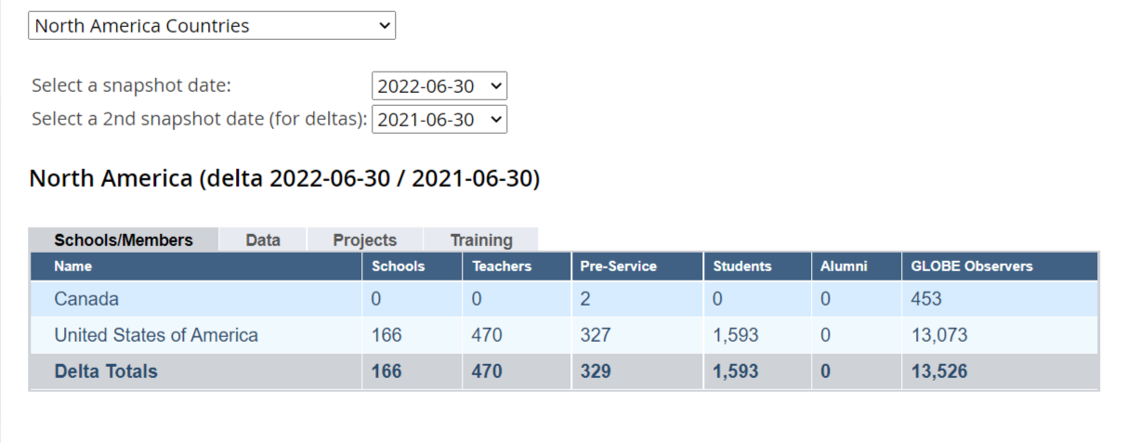
Impact & Metrics
https://www.globe.gov/about/impact-and-metrics
You can enter 2 dates to see change over time
To:
From:

Slide 45
Dashboards
Your Dashboards and management tools are on the left side menu under this tool:

Slide 46
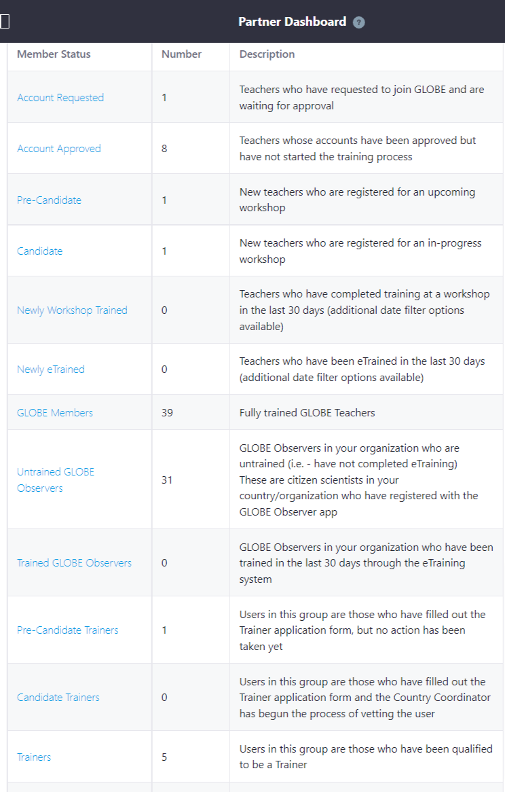
Partner Dashboard
See everyone who has an account in your country
Check Account Requested – these are people who have requested to be a GLOBE Teacher in your country
Your trained GLOBE Members
Pre-Candidate and Candidate Trainers indicate people who are in the process of becoming GLOBE Trainers

Slide 47
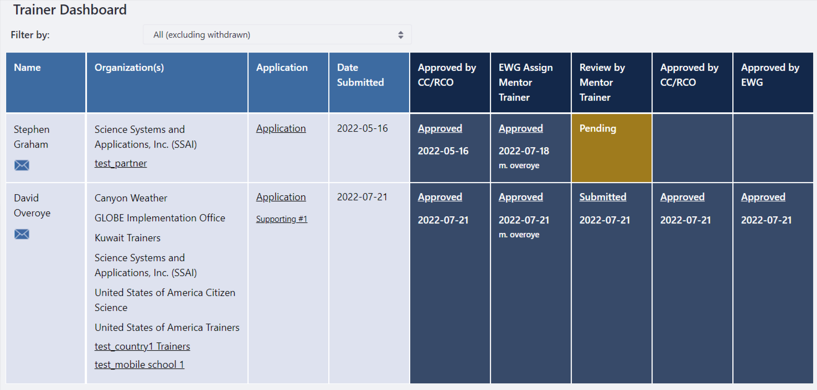
Trainer Dashboard (CCs only)
See everyone in your country who has applied to become a GLOBE Trainer or Mentor Trainer.
Review, approve and check status of all applicants

Slide 48
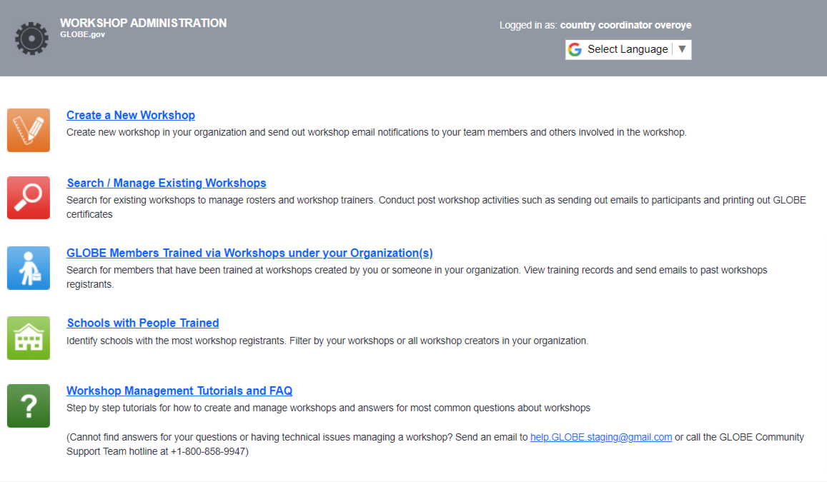
Workshop Administration
Create new workshops
Search for existing or previous workshops
Find people and schools you’ve trained

Slide 49
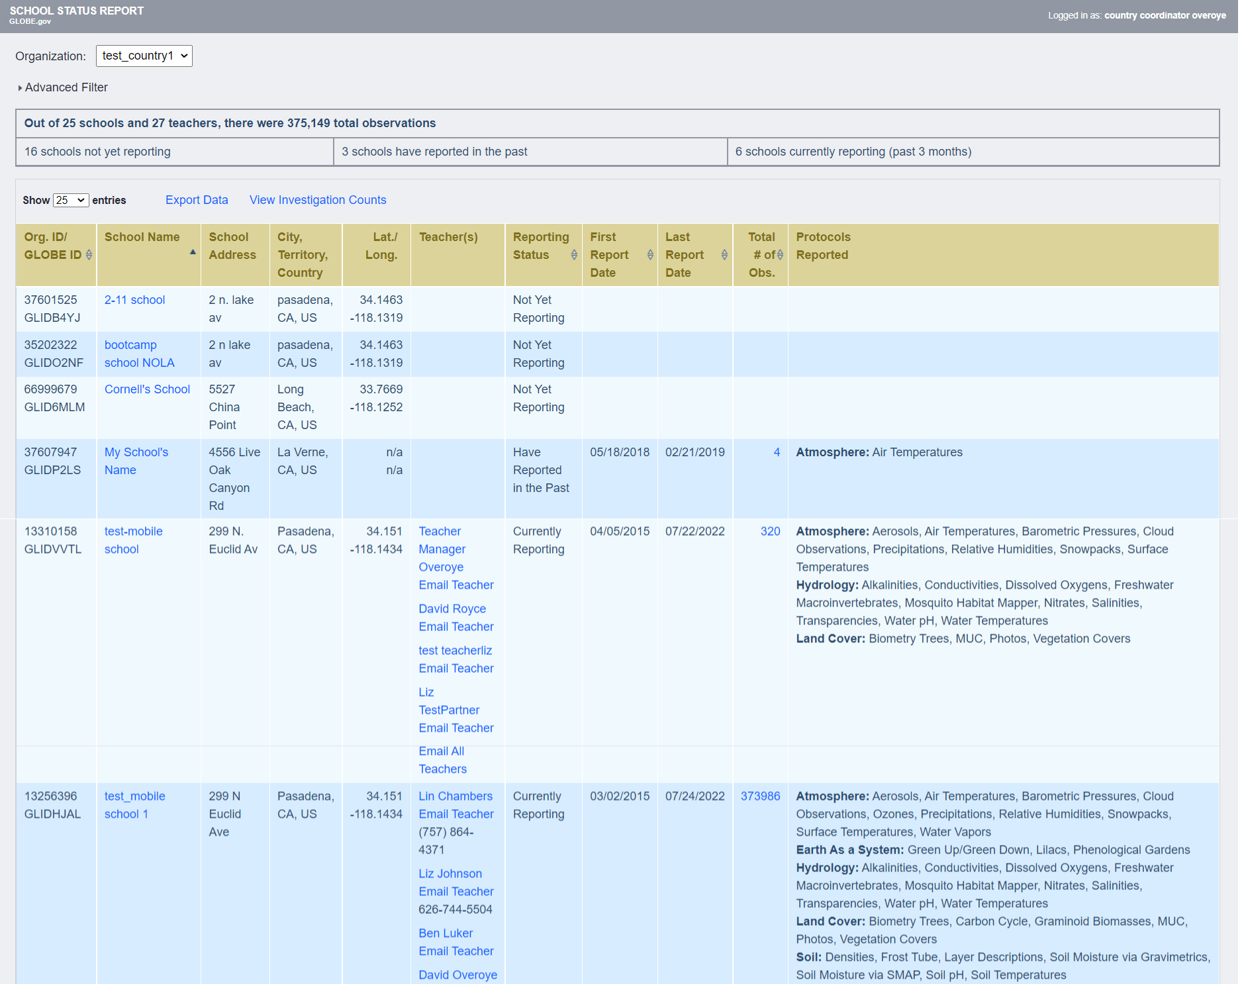
School Status Reports
See the status of each school in your country.
Reporting Status
Teacher contact information
What protocols are being used

Slide 50
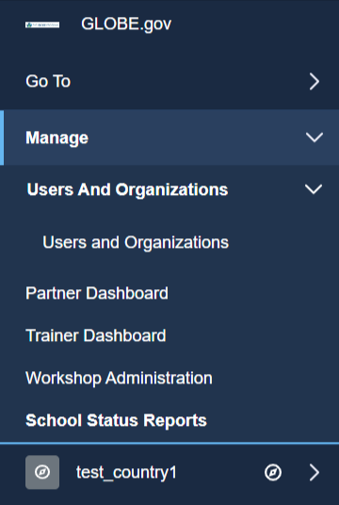
Managing Schools, Users and Country/Partner content
Manage users and schools under the Manage option on the left-hand menu

Slide 51
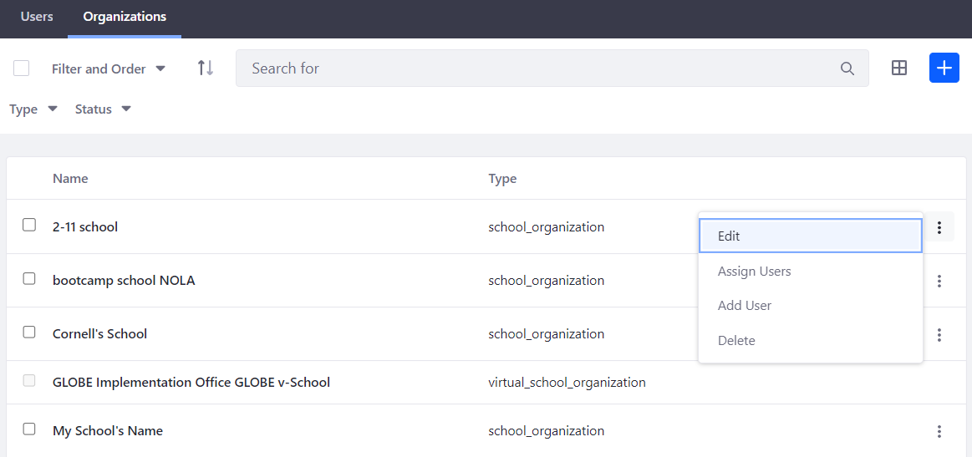
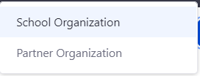
Managing Schools
Create and Edit the information associated with the schools in your country
Add a new school
Edit an existing school

Slide 52
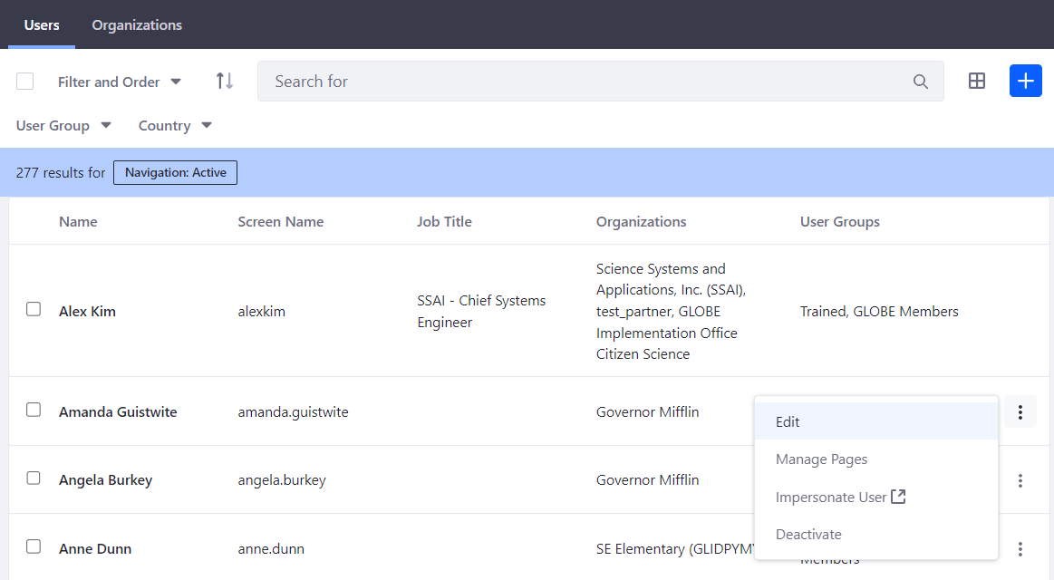
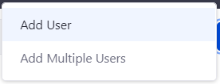
Managing Teachers and User Accounts
Create and Edit the information associated with the people in your country
Add a new user
Edit an existing user

Slide 53
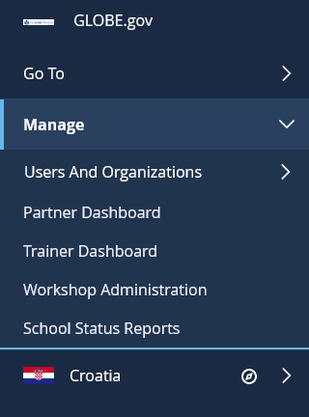
Managing Country/Partner content
Manage your country/partner page and content by
Go to your country/partner page
Select your country name to see content and page options

Slide 54
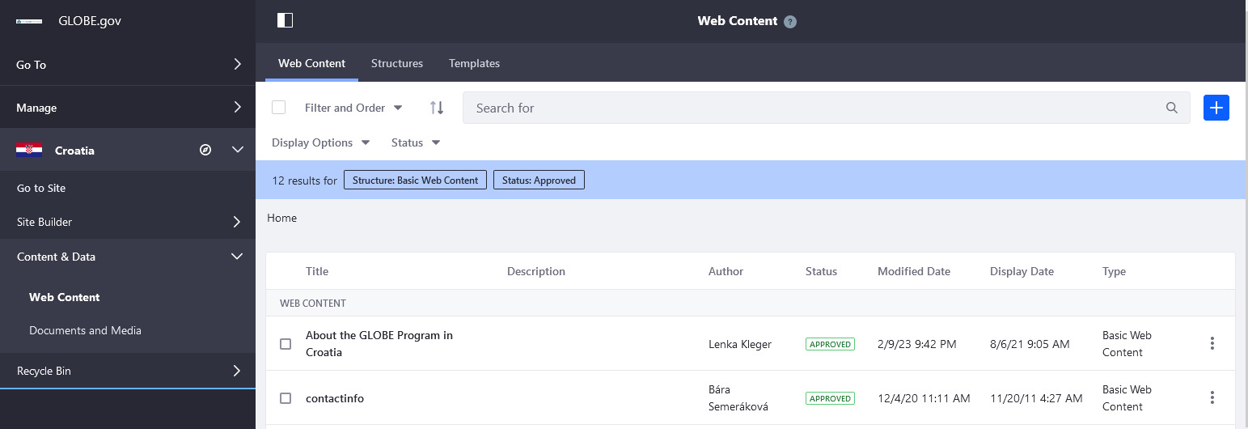
Managing Content
Add News/Events to your page
Go to your country/partner page and select “Web Content”

Slide 55
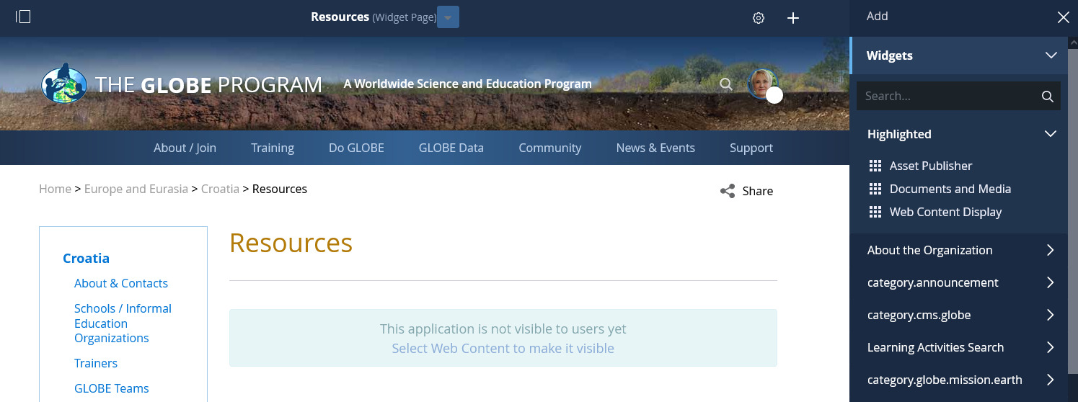
Managing Content
Modify existing Web Content directly on the page

Slide 56
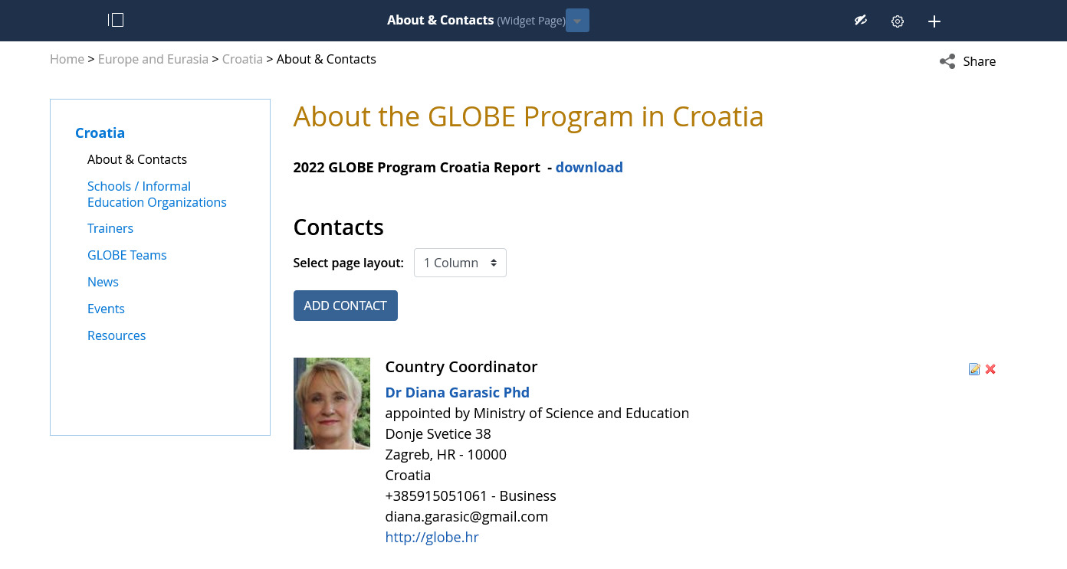
Managing Content
Add your country contacts

Slide 57
Managing Content
Click eye icon to turn on box to re-order contact list (requires page refresh)
Re-order contact list by dragging box.

Slide 58
Our priorities
We hear from you what is important in your country. Please tell us what you think would improve things.
Work with your technology working group representative for your region to carry messages and ideas to us.
Tell us what’s working and what you think could be done better – We don’t improve without your input

Slide 59
Questions on anything in the site?
Any areas of the site you want to focus on?
Any suggestions for improvement?
Any features you find especially useful?

Slide 60
David.overoye@axientcorp.com Cornell.lewis@axientcorp.com
Contact Information

