Slide 1
2021 Country Report GLOBE Taiwan
Coordinator: Dr. Pay-Liam Lin
Date: 2021/05/03

Slide 2
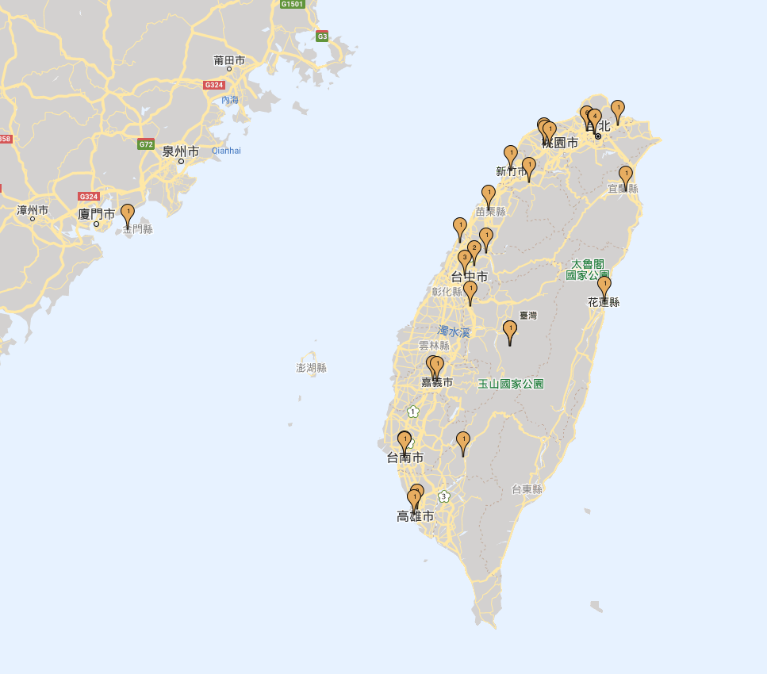
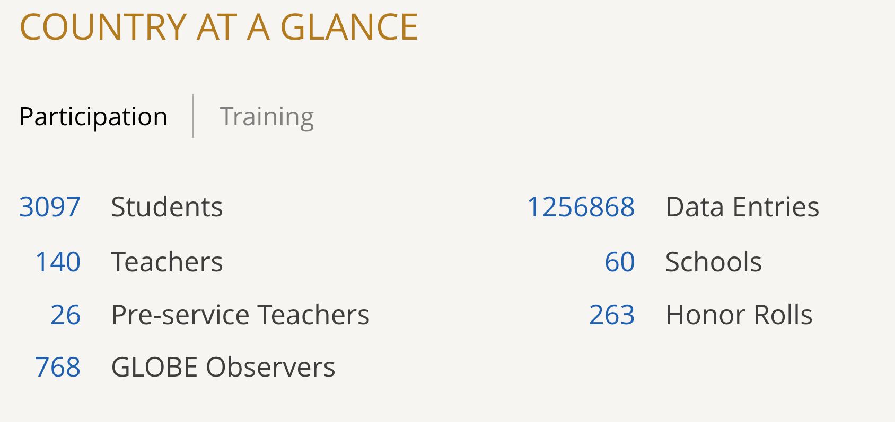
GLOBE Taiwan at a Glance

Slide 3
COVID-19 situation in Taiwan

Slide 4
Daily Observation in Taiwan
Barometric Pressure
Cloud Protocols
Relative Humidity
Precipitation
Digital Multi-Day Max/Min/Current Air and Soil Temperature
Surface Temperature
Davis Weather Station (Optional)
Water Transparency (Optional)
Electricity Conductivity (Optional)
Water pH (Optional)
Alkalinities
Dissolved Oxygen
Mosquito Habitat Mapper
Vegetation Covers
Nitrates
Salinities
Transparencies
Water Temperature
Biometry trees

Slide 5
Objectives in 2020-2021
International Interaction
GLOBE PLUS Post Project
IVSS
Try to develop GLOBE workshop
Construction of Instrument Shelter Workshop
GLOBE-STEM English Presentation Skills Workshop
2021 GLOBE Asia-Pacific Regional GLE

Slide 6
International Interaction - GLOBE PLUS Post Project
Cooperated with American Institute in Taiwan (AIT) to apply for GLOBE PLUS Post Project in 2020
We focus on these topics:
collecting data on mosquitos to combat Zika and other vector-borne diseases;
promoting citizen science to understand and protect the environment;
increasing scientific collaboration and encouraging STEAM education;
promoting English-language learning;
empowering women and girls

Slide 7
International Interaction - GLOBE PLUS Post Project
What we have done:
Help two new GLOBE schools to collect data
Invite US specialists to train Taiwan teachers and students
Use GLOBE Observer App – Mosquito habitat mapper to observe mosquitos and larvae
Invite more female students to get involved in GLOBE science activities
After the observations, students upload their data and submit research reports to the 2021 GLOBE IVSS

Slide 8
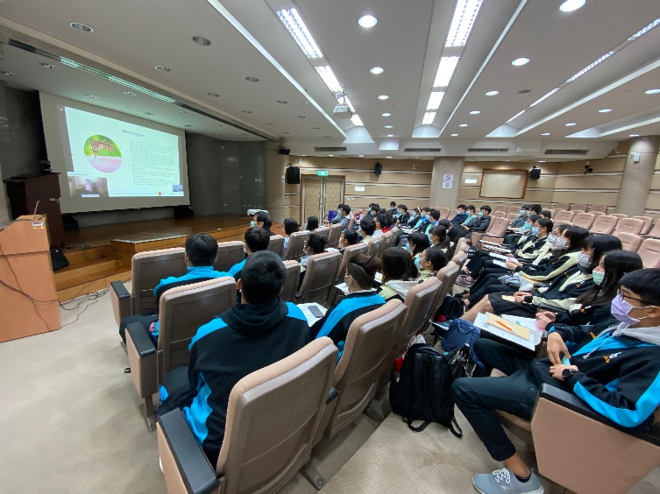
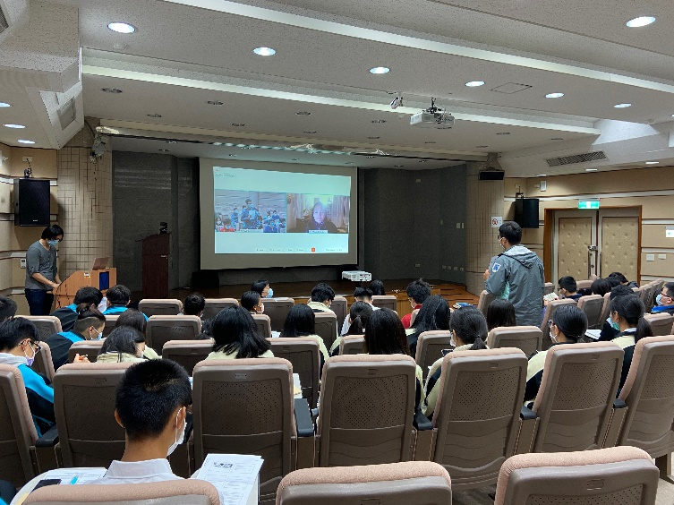
International Interaction GLOBE PLUS Post Project
GIO recommended Mindi DePaola to train Taiwan teachers and students

Slide 9
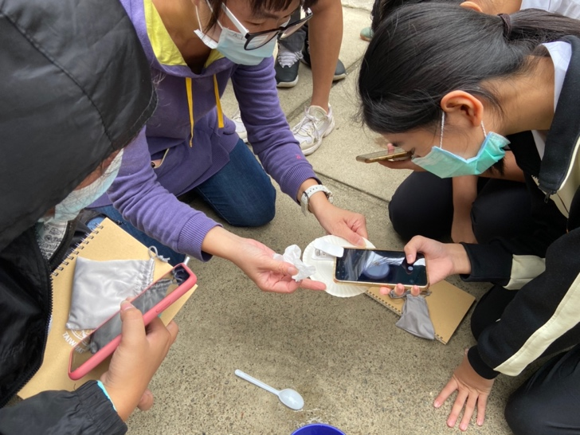
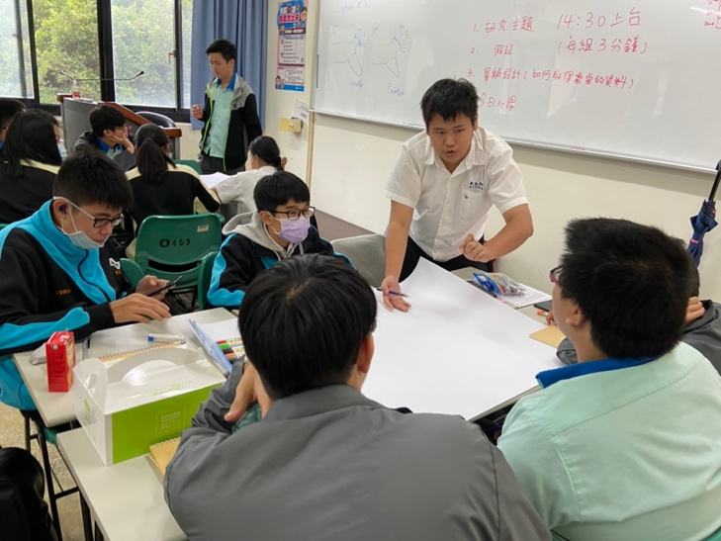
International Interaction - GLOBE PLUS Post Project
Use GLOBE Observer App – Mosquito habitat mapper to observe mosquitos and larvae
After collecting their data, students discussed the data classmates

Slide 10
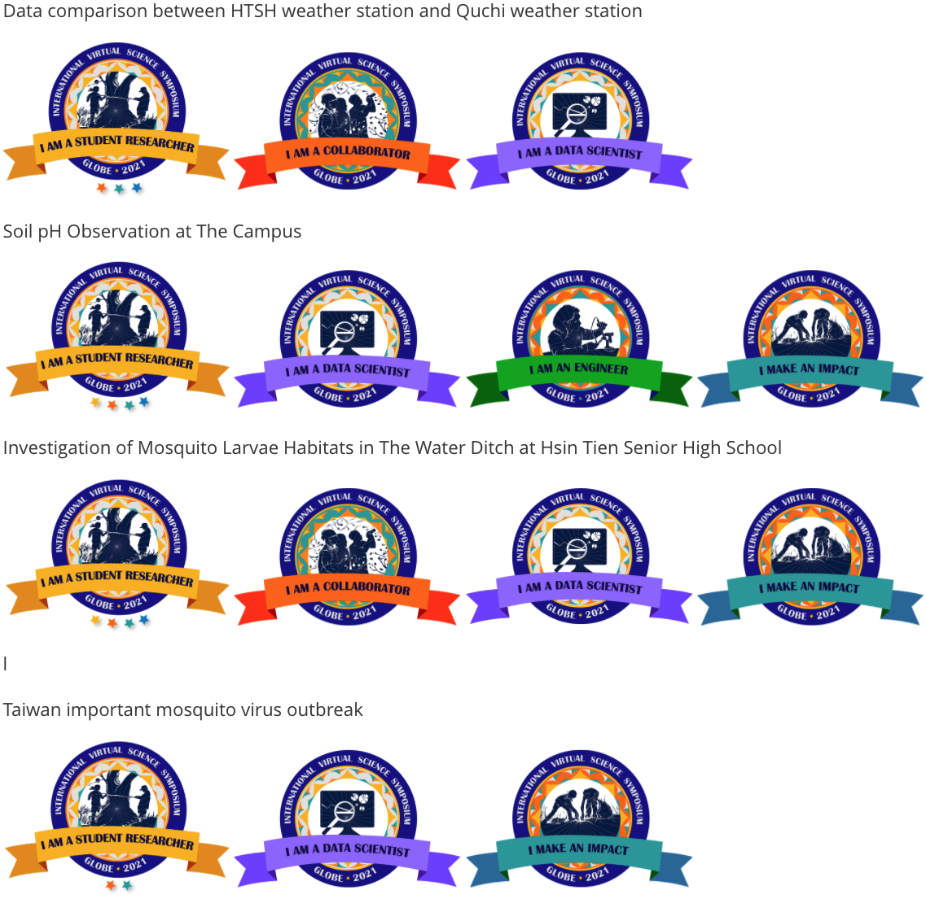
International Interaction - GLOBE PLUS Post Project
Students submitted their reports to 2021 GLOBE IVSS
Hsin Tien High School
XinWu High School

Slide 11
International Interaction - 2016~2021 GLOBE IVSS
29
13
11
9
6
6

Slide 12
International Interaction - 2021 GLOBE IVSS
Taiwan students successfully submitted 29 reports. 10 reports, from 6 schools, earned 4-star.
Hsin Tien High School

Slide 13
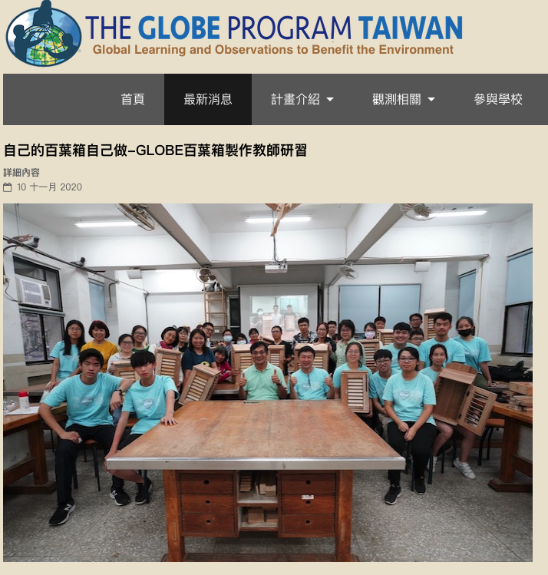
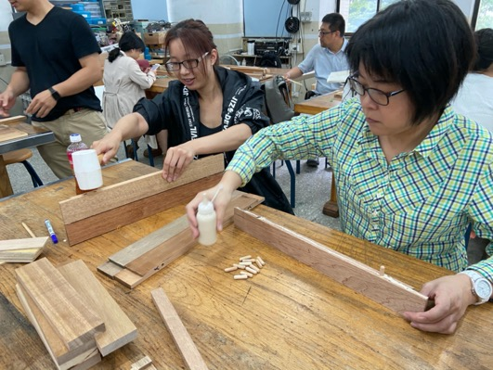
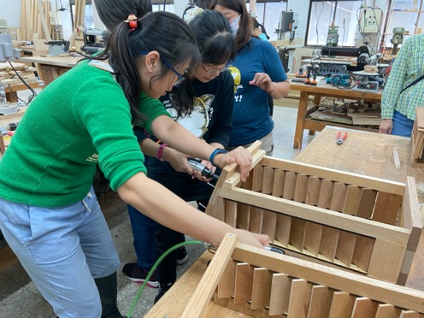
Trying to develop GLOBE Workshop - Construction of Instrument Shelter Workshop
Purpose:
Help teachers to maintain the shelter
Develop a training for teachers to know how and why the shelter is designed and manufactured, then increase teachers’ content knowledge and technological knowledge for improving their teaching

Slide 14
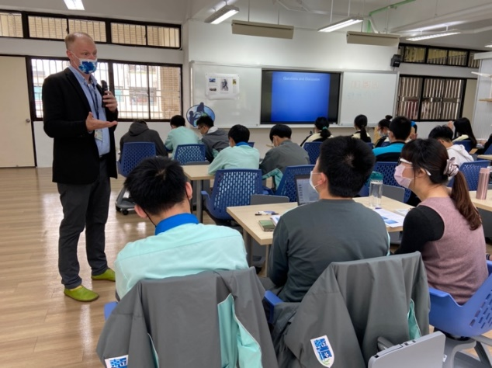
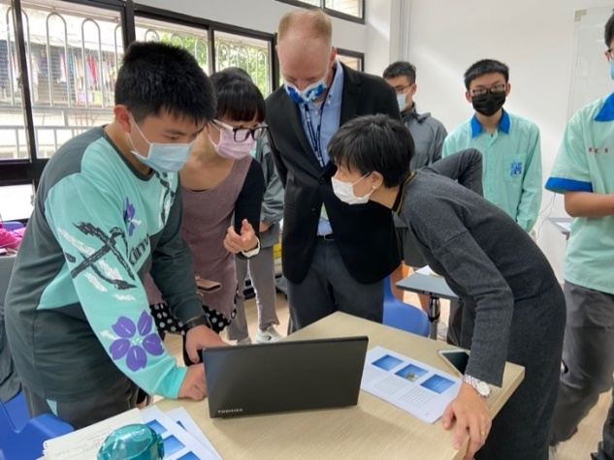
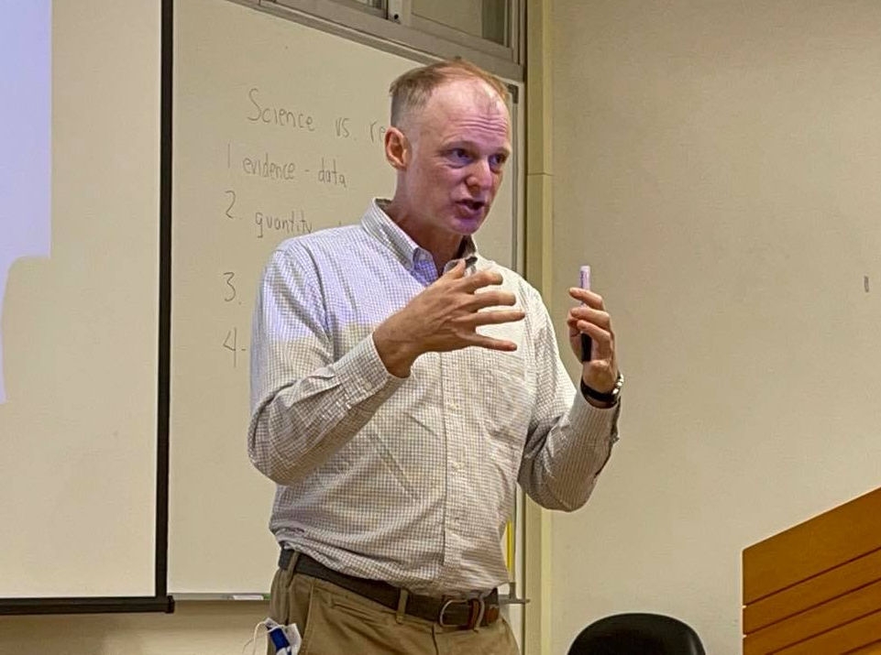
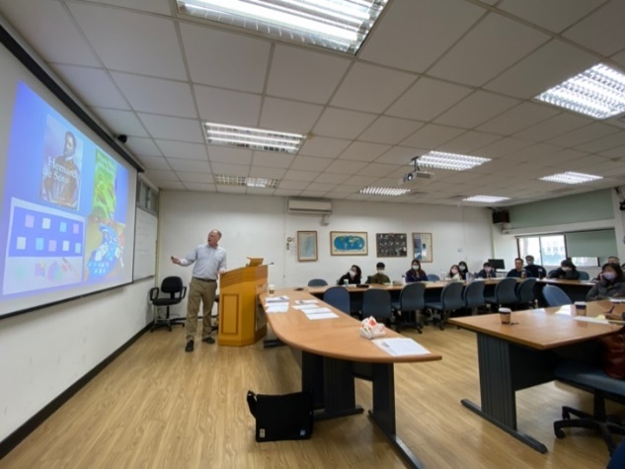
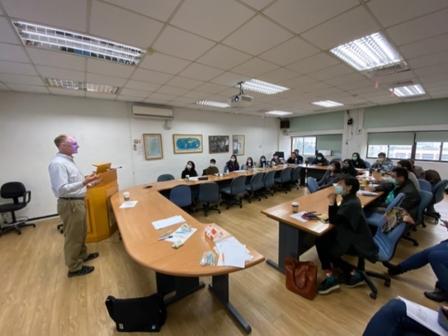
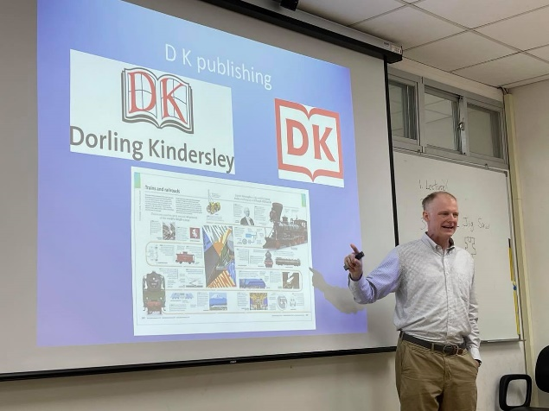
Try to develop GLOBE workshop -GLOBE-STEM English Presentation Skills Workshop
Cooperated with American Institute in Taiwan (AIT) to enhance teachers’ and students’ English-language teaching and learning

Slide 15
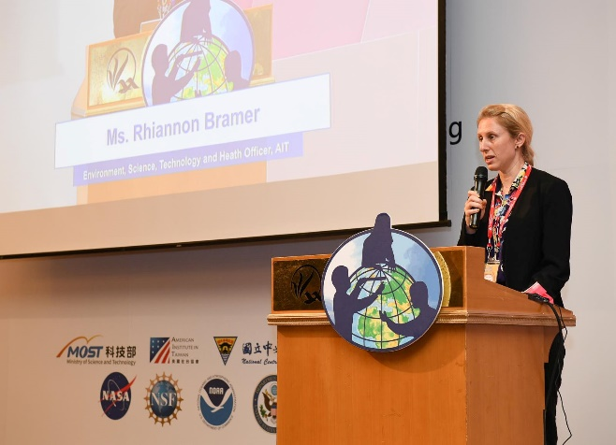
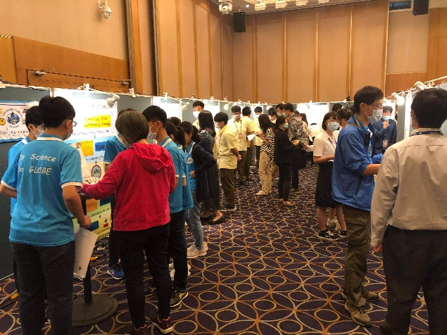
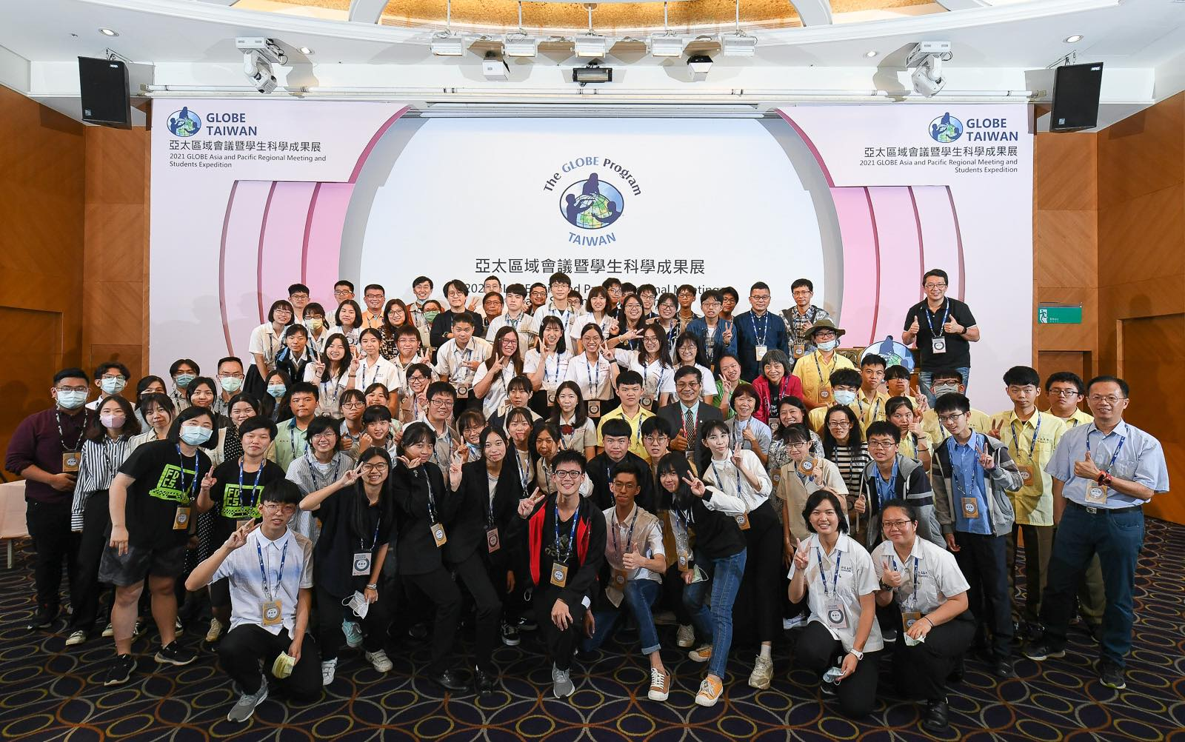
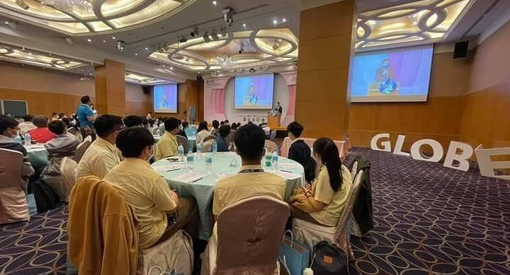
2021 GLOBE Asia-Pacific Regional GLE
On-site (Taiwan)
125 Taiwan participants
30 poster presentations by Taiwan teachers and students

Slide 16
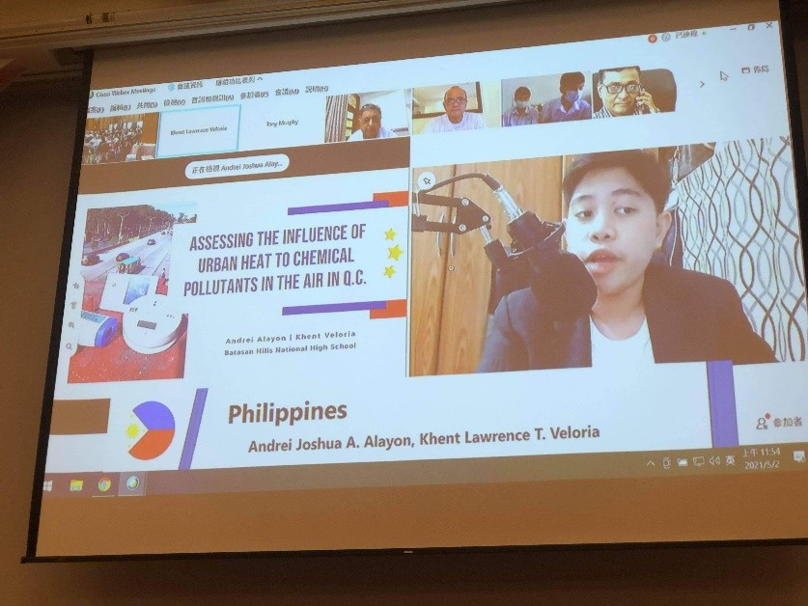
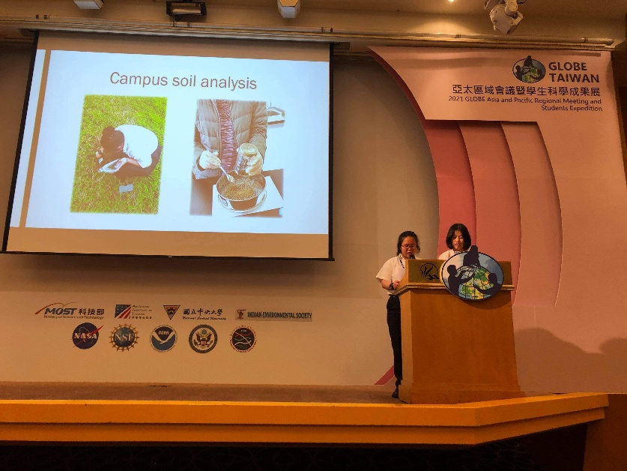
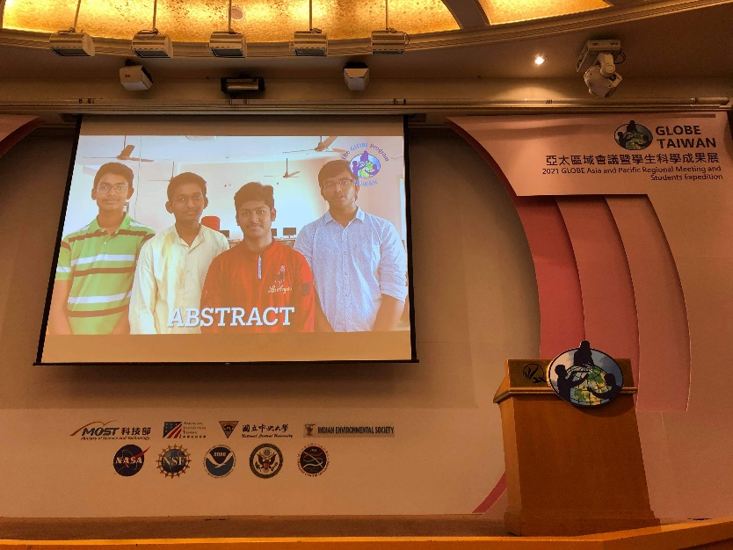
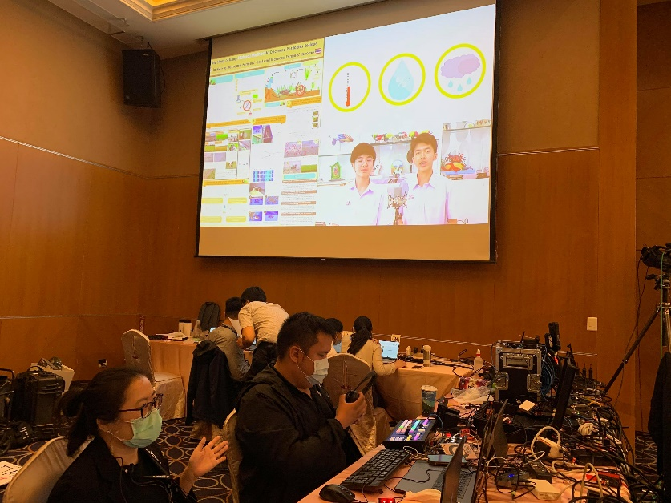
2021 GLOBE Asia-Pacific Regional GLE
International Students Presentations
(13 in total)
10 online presentations (6 videos+ppt, 4 ppt)
3 on-site presentations
Analytics Data from manage page:
59 accounts login, including country representatives, presenters, scientists

Slide 17
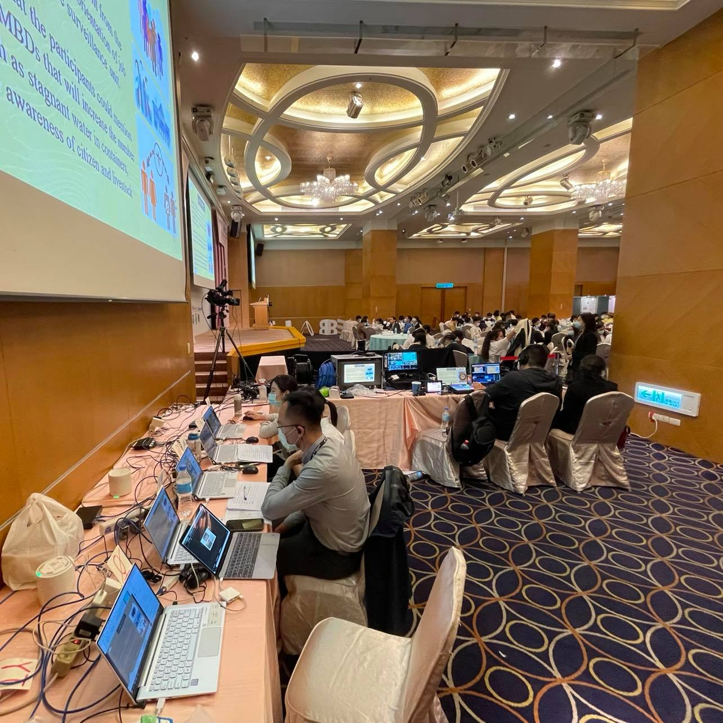
2021 GLOBE Asia-Pacific Regional GLE
Analytics Data from manage page
Total audience:

Slide 18
GLOBE Taiwan in the near future
Keep supporting existed GLOBE schools and invite more schools to join GLOBE
Keep cooperating with AIT for enhancing teachers and students English-language presentations skills, especially in STEAM
International Interaction and Cooperation, like students exchange, 2022 GLOBE IVSS, etc.
Support women in science, like hosting female scientists lecture, keep inviting more female students to join GLOBE

Slide 19
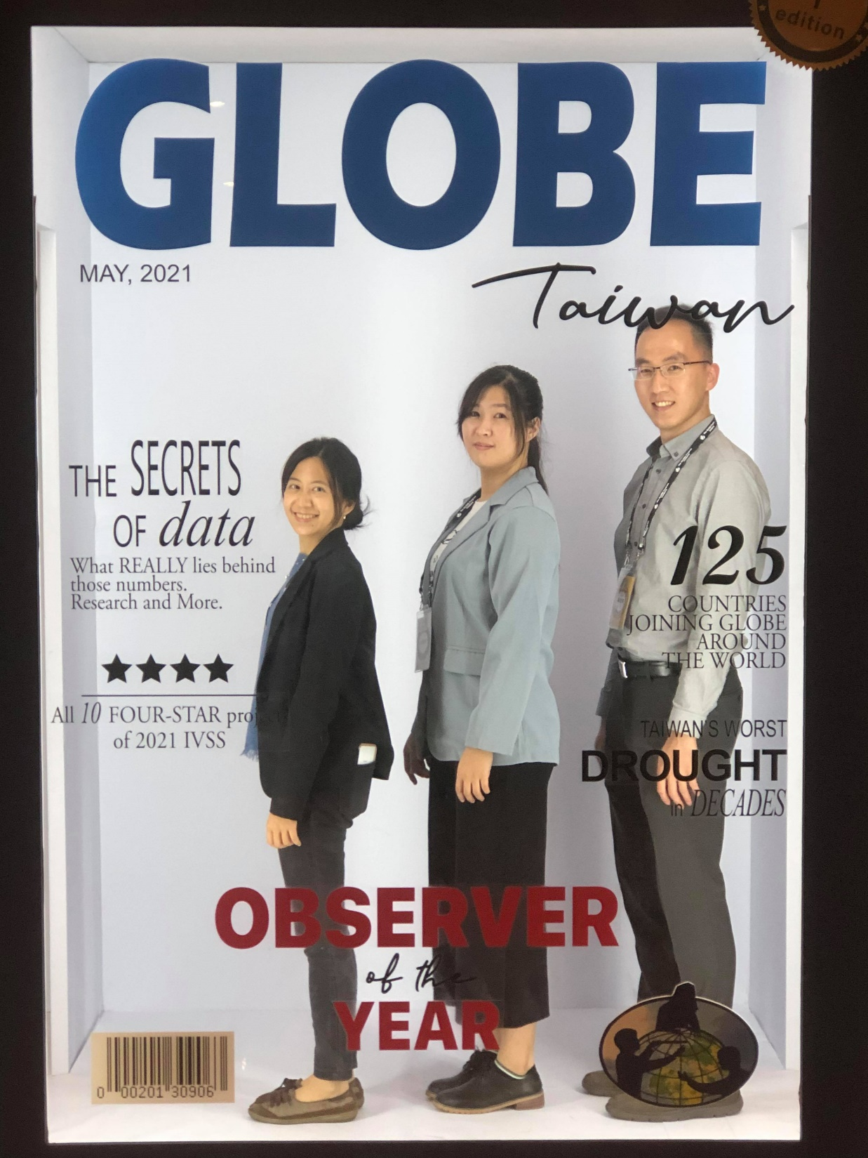
Thanks for joining 2021 GLOBE Asia-Pacific Regional GLE!

