Slide 1
Data Literacy Learning Activity - Atmosphere
Air Temperature across GLOBE during a year

Slide 2
Air Temperature across GLOBE during a year
Topic: Visual presentation and interpretation of air temperature annual pattern for sites in various countries/continents and located at similar elevation.
Age of students: 12-15
Skills developed: critical evaluation of the annual trends and patterns of the data, selecting the most efficient format of dataset visual presentation in graph, interpreting the visualized data, asking questions on why the data differ from each other
Prerequisities: knowledge on how to work with the GLOBE Visualization Tool
Big Idea: Everyone knows that air temperature is not the same at various locations across the planet. But it is not always easy to choose the best visual presentation to show that. The correct graph should not be misleading, confusing or too complicated to read. It is always important to know the limits of presentation datasets in graphs.

Slide 3
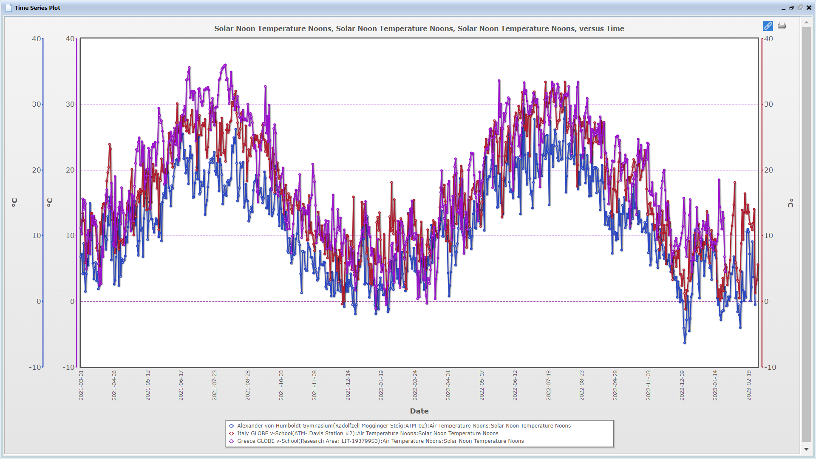
Content
Slide 4: Introduction
Slide 5: Work Assignement for students
Slide 6-7: Step 1 and 2: Instruction on how to filter out selected range air temperature data in the GLOBE Visualization Tool (for detailed instruction on how to work with the Tool please see one of the animated tutorials that are included in the Tool) – following the steps that the Greek team took.
Slide 8-10: Step 3: Examples of visual presentation of the data – 3 different graphs generated by the Visualization tool, each was customized in particulat way.
Slide 11: Step 4 – excercise on data interpretation – students evaluate the statements as true or false
Slide 13: Correct answers for Step 4
Slide 14: Additional graph that shows the same data in a longer dataset (in case you may need that).

Slide 4
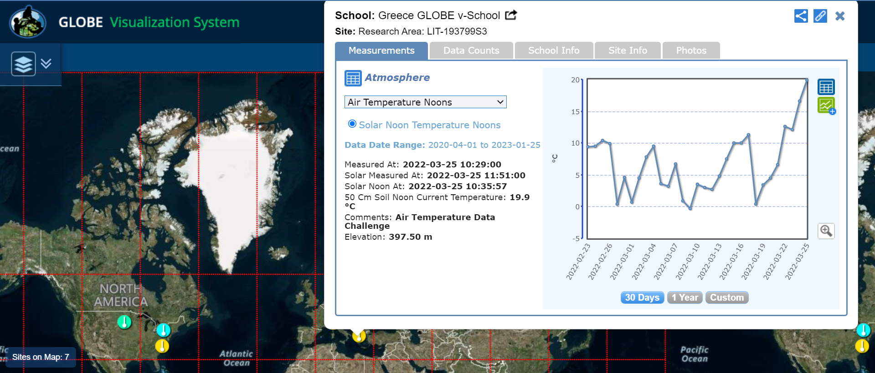
This data literacy activity is based on the student research and data interpretation done by the GLOBE citizen scientists team from Greece (Tinycore lab) that they did as a part of 2022 Earth Day Air Temperature Challenge.

Slide 5
Work assignment for students:
Task:
Compare air temperature in GLOBE schools with elevation 380-430 m.
Comment 1: Elevation range was derived from the elevation of the author´s site in Greece (397,7 m), you can come with your own.
Comment 2: The date range was selected for one year (25 March 2021 – 25 March 2022), feel free to select your own data range if you wish too.
Steps:
Find schools (sites) on the (moreless) the same elevation, which collected the data for air temperature in the given year.
Look at the longer period (1 year) and construct the graph in vizualization tool displaying the different air temperatures coming from the selected locations.
Think about how many different sites is reasonable to have in one graph, so that it is still possible to interpret the data (like for example different graphs A, B or C that you can see in next slides). Make sure you set up the y axis scale correctly.
Interpret the data displayed based on the sites that you selected for the graph (do excercise at slide 11).

Slide 6
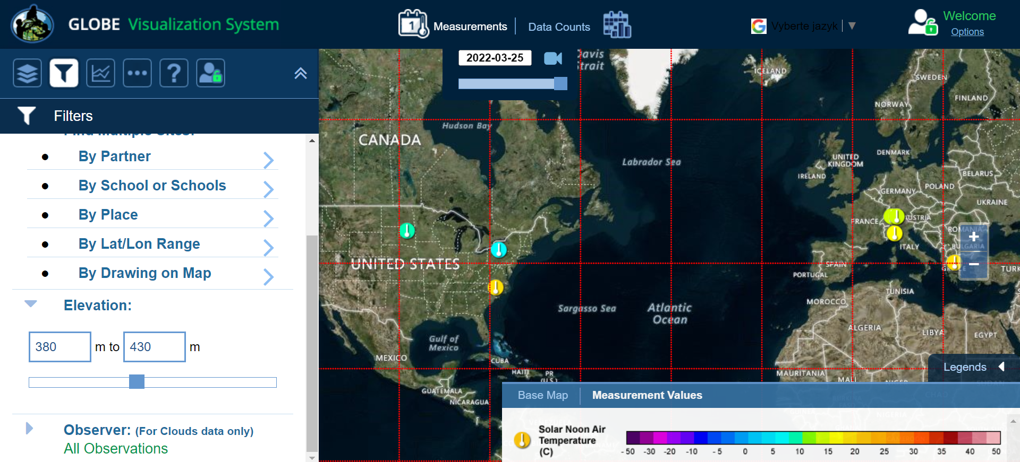
Step 1: finding schools that measured air temp. on 25 March 2022 and fall within the elevation range – see set up of the filter:

Slide 7
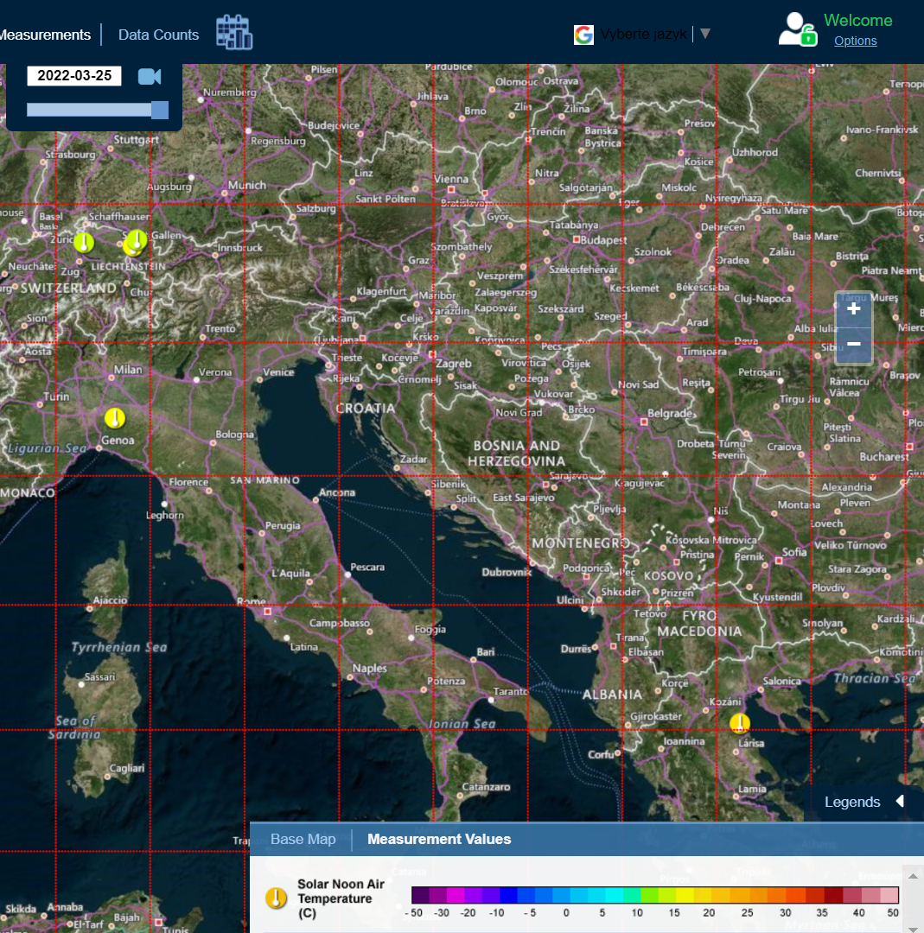
Step 2: analyzing results given by the Visualization Tool
3 schools in USA
3 schools in Switzerland
1 school in Italy
1 site in Greece

Slide 8
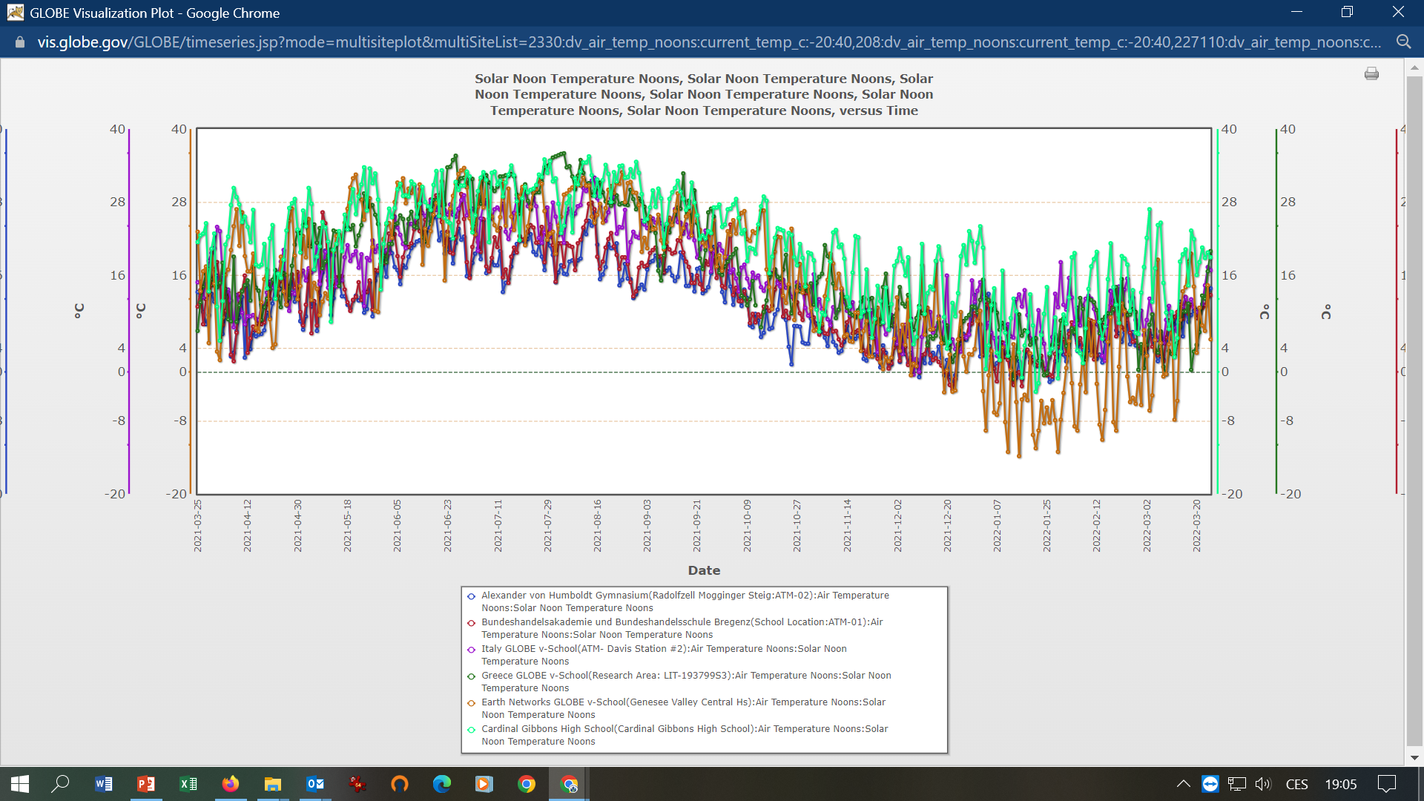
Graph A: air temperature values of 6 sites over 1 year displayed in one plot
Notes:
Link to the graph in Viz tool: https://vis.globe.gov/GLOBE/timeseries.jsp?mode=multisiteplot&multiSiteList=2330:dv_air_temp_noons:current_temp_c:-50:50,208:dv_air_temp_noons:current_temp_c:-50:50,227110:dv_air_temp_noons:current_temp_c:-50:50,193799:dv_air_temp_noons:current_temp_c:-50:50,162856:dv_air_temp_noons:current_temp_c:-50:50,36026:dv_air_temp_noons:current_temp_c:-50:50,&start_datepicker=03-25-2021&end_datepicker=03-25-2022&result_type=true&chartmodule=PowerCharts

Slide 9
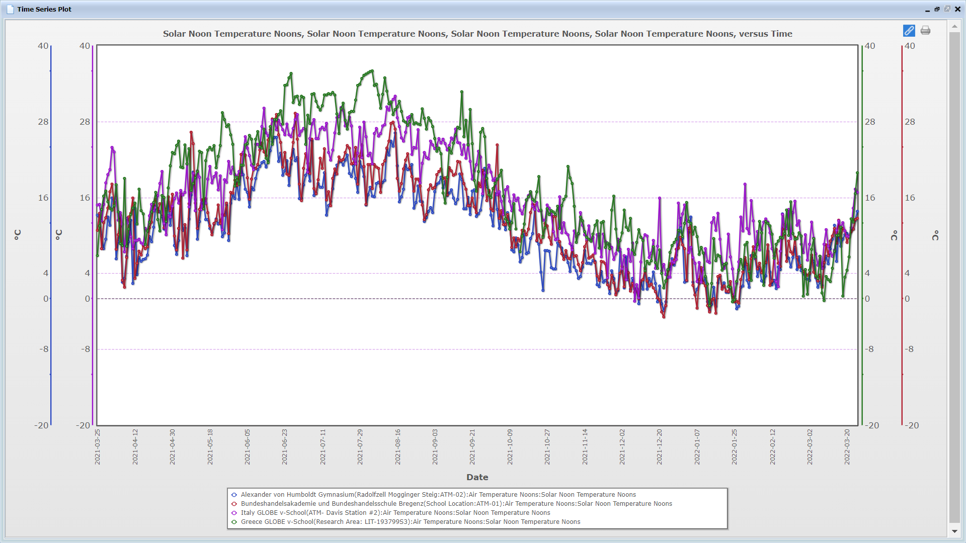
Graph B: Only values of 4 schools from Europe displayed (U.S. schools left out)

Slide 10
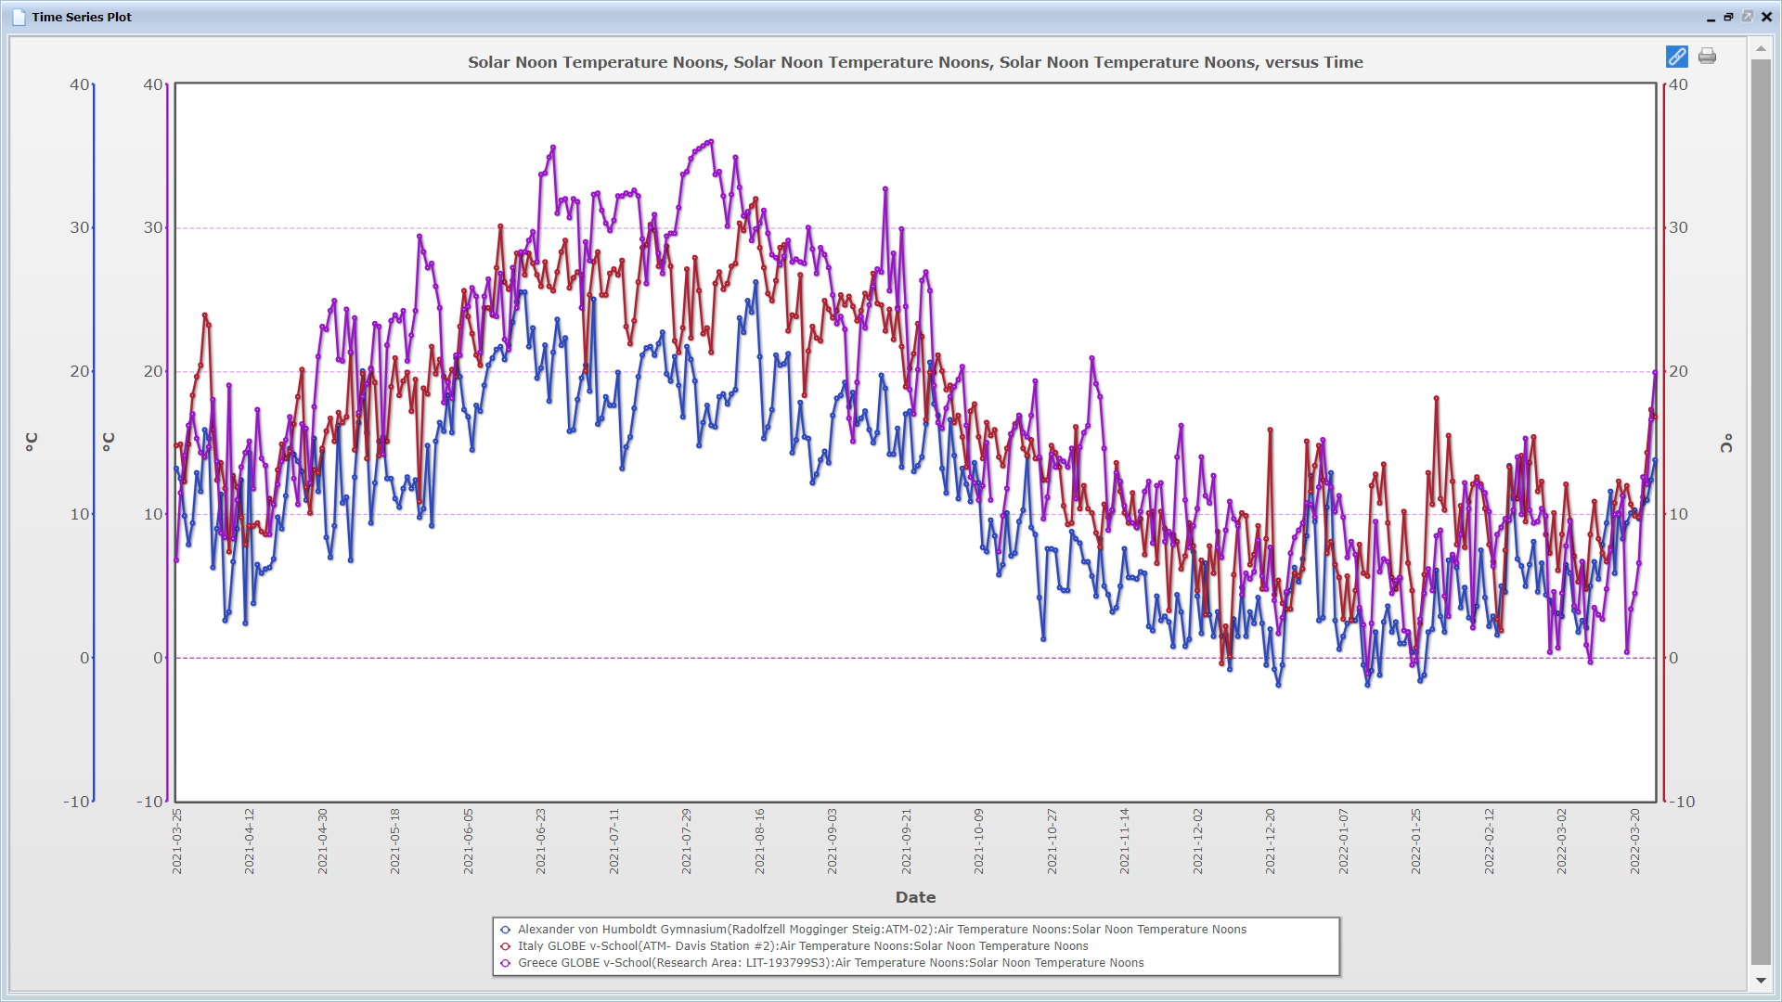
Graph C: values of 3 schools displayed - comparison of Swiss, Italian and Greek site

Slide 11
Step 4: Data interpretation – look at graph C and say what sentence is true/false
The temperatures in winter did not go below zero at any of the sites.
The place, which seems to be the coldest (in general) out of those three sites, is that one in Italy.
In all the sites, temperature crossed 30°C in summer.
The difference between the highest and the lowest temperature at the Greek site is more then 40 degrees.
When I compare the tempreatures at 3 sites, on average they differ only slightly in winter, but they are significantly different in summer.
The lowest temperature at Swiss site in summer (July-August) is higher than the highest temperature at Italian site in winter (December-January)

Slide 12
For answers to the questions go to the next slide ☺

Slide 13
Data interpretation – look at graph C and say what sentence is true/false
The temperatures in winter did not go below zero at any of the sites. FALSE
The place, which seems to be the coldest (in general) out of those three sites, is that one in Italy. FALSE
In all the sites, temperature crossed 30°C in summer. FALSE
The difference between the highest and the lowest temperature at the Greek site is more then 40 degrees. FALSE
When I compare the tempreatures at 3 sites, on average they differ only slightly in winter, but they are significantly different in summer. TRUE
The lowest temperature at Swiss site in summer (July-August) is higher than the highest temperature at Italian site in winter (December-January) FALSE

Slide 14
Addition - Graph D: The same 3 sites displayed (Swiss, Italian and Greek) over longer time

