Slide 1
Data Literacy Learning Activity – Hydrosphere
Water temperature trend

Slide 2
Water Temperature Trend
Topic: Comparison of water temperature at three locations near each other - in the river, at the mouth of the river and in the bay.
Age of students: 10 - 15
Skills developed: reading and comparing graphs; comparing water temperatures measured at different study sites; calculation of the difference between the highest and lowest measured water temperature; trend differences of water temperature during the year
Prerequisities: basic knowledge of the water temperature measurements
Big idea: Water temperature is influenced by a number of factors - atmospheric conditions, the topography of the land (altitude, vegetation...) and the structure of the river channel. Temperature varies along the river and affects its ecosystem.

Slide 3
Content of the activity
Slide 4: Introduction
Slide 5: Questions for students
Slide 7-10: Data to be used for the activity
Slide 12: Answers to the questions for students

Slide 4
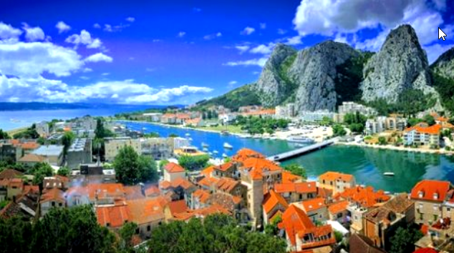
Introduction
The data were collected by students of Primary school Joseph Pupacic Omis, Croatia.
They measured water temperature during the whole year at 3 study sites:
at the river Cetina (study site Cetina – Planovo)
at the mouth of the river Cetina to the sea (study site Cetina – usce)
in a sea bay (study site More – Velika Plaža)

Slide 5
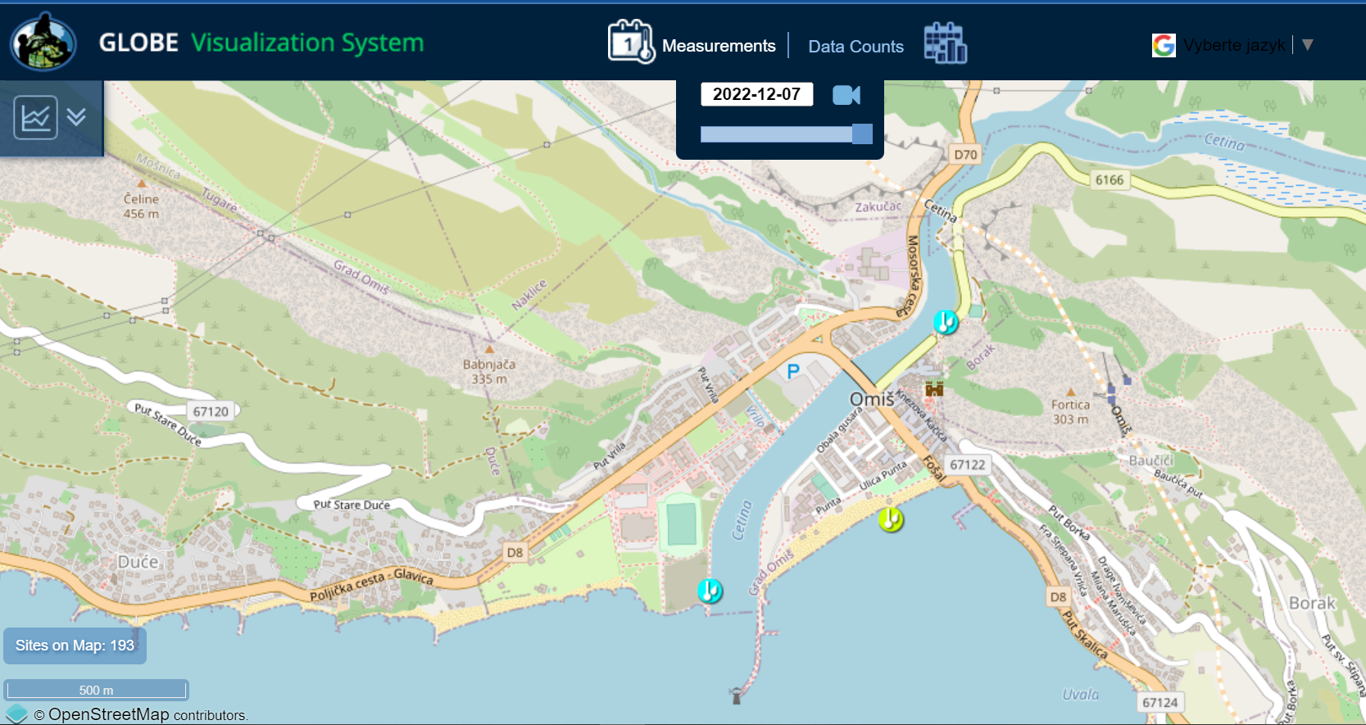
Looking at the study sites, make your guesses
At which study site was the coldest water measured during the year?
In what month was that?
At which study site was the warmest water measured during the year?
In what month was that?
What is the difference between the highest and lowest temperature at each of the site? Is it the same or different?
Does the fluctuation of water temperature differ in any way at individual sites?

Slide 6
Check your guesses looking at the data

Slide 7
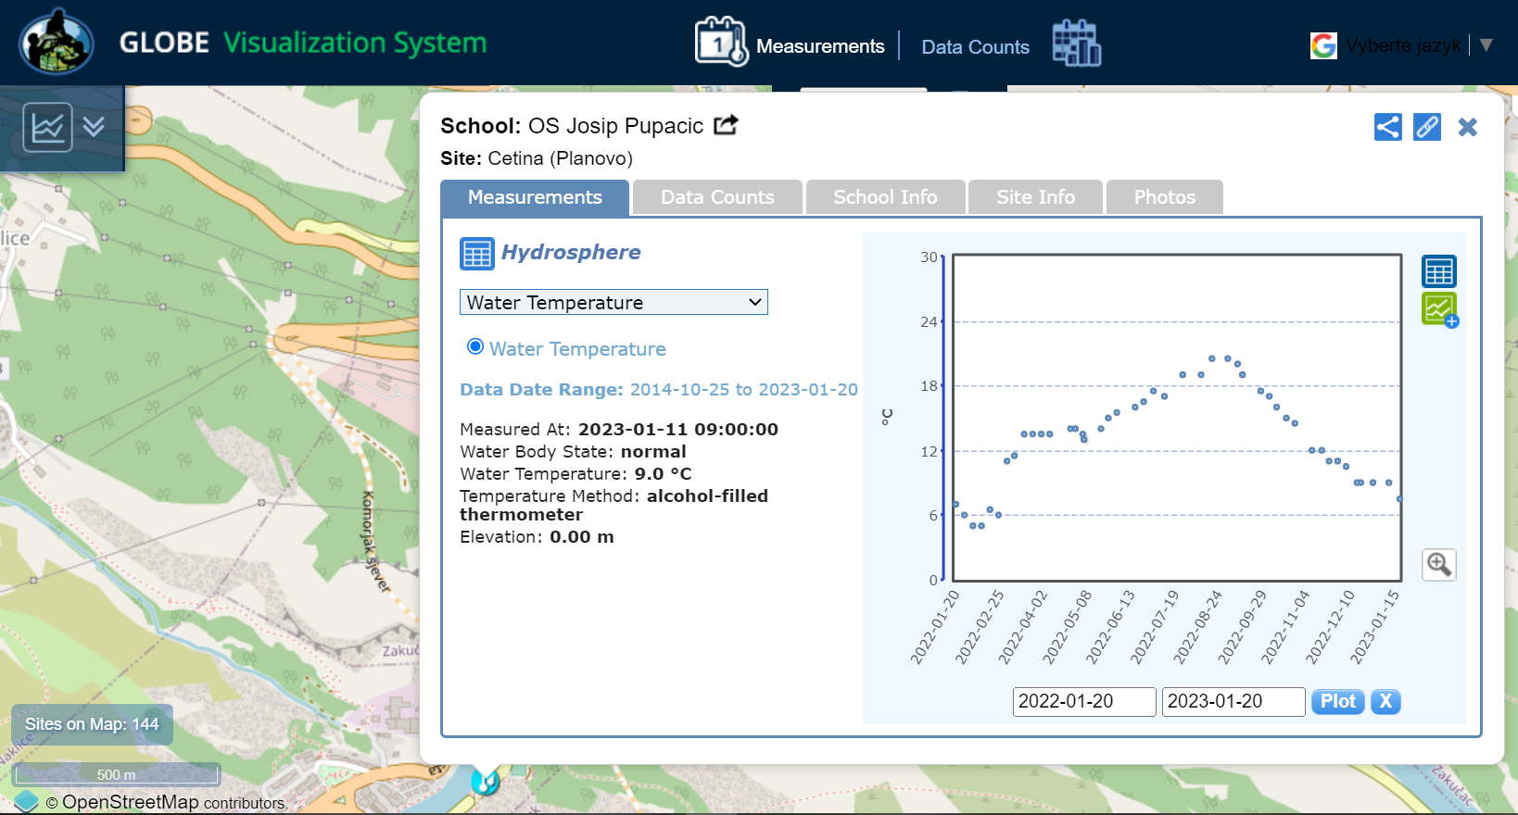

Slide 8
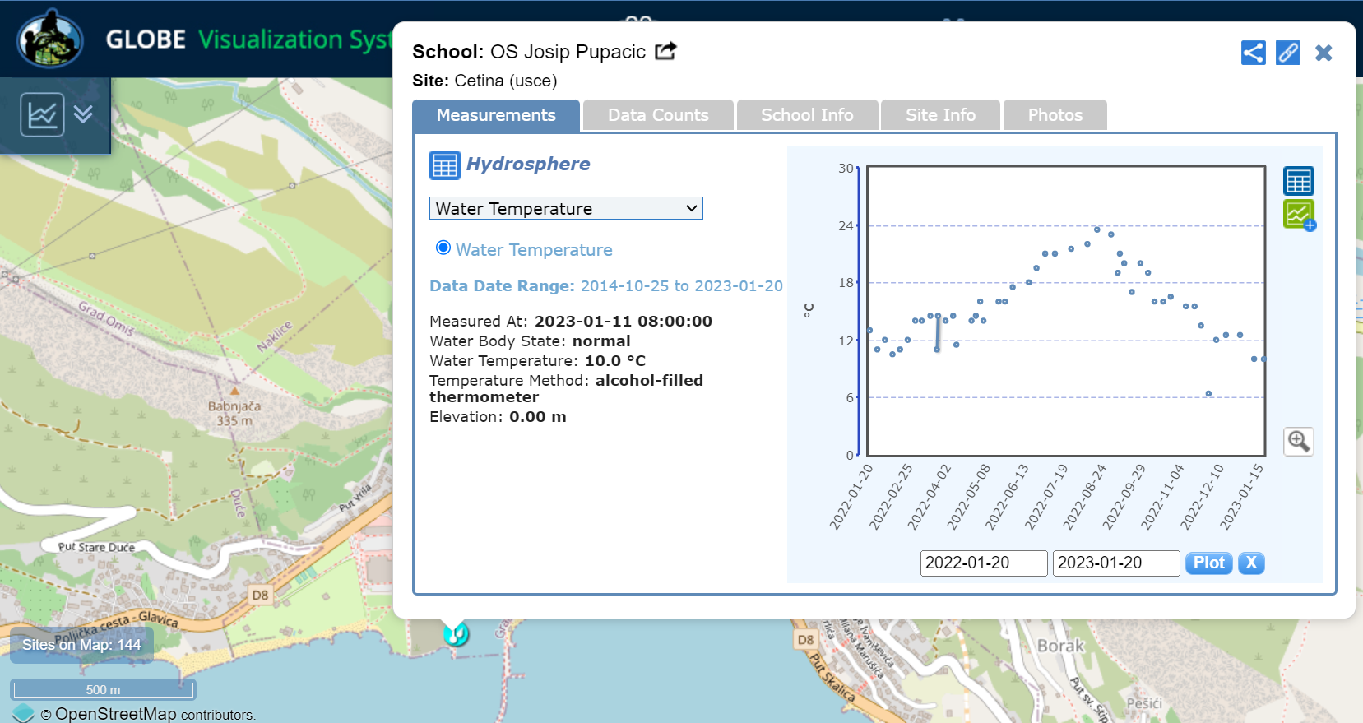

Slide 9
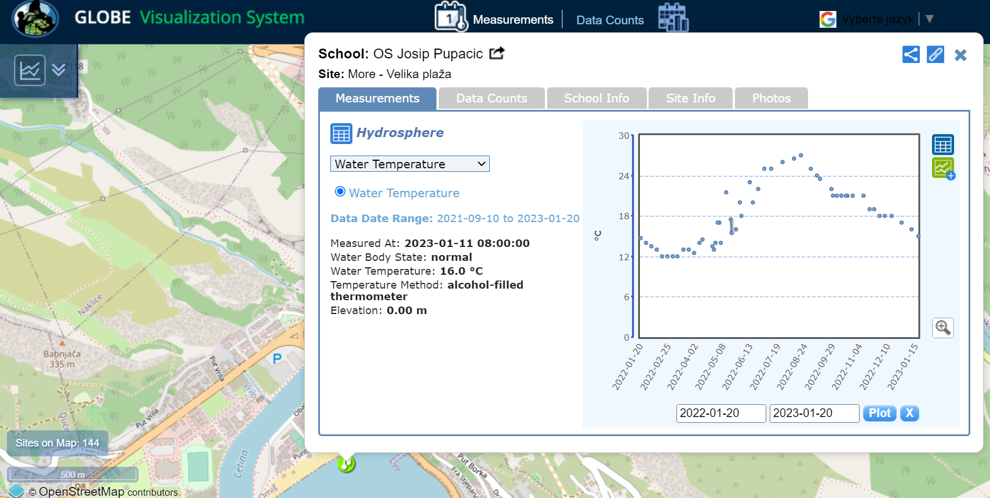

Slide 10
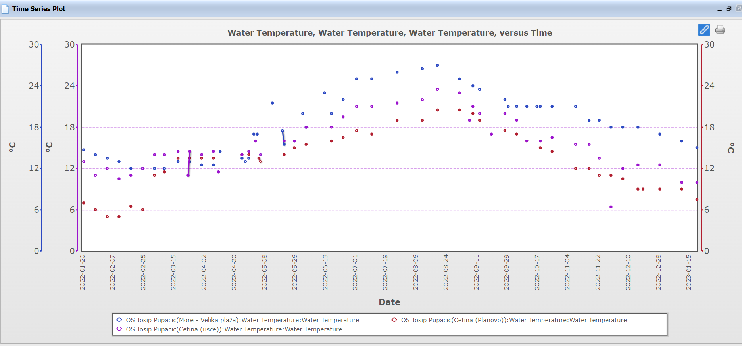
https://vis.globe.gov/GLOBE/timeseries.jsp?mode=multisiteplot&multiSiteList=253679:dv_water_temperatures:water_temp_c:0:50,33419:dv_water_temperatures:water_temp_c:0:50,33418:dv_water_temperatures:water_temp_c:0:50,&start_datepicker=01-20-2022&end_datepicker=01-20-2023&result_type=true&chartmodule=PowerCharts

Slide 11
For answers to the questions go to the next slide ☺

Slide 12
Correct answers
At which study site was the coldest water measured during the year? At the river Cetina (study site Cetina – Planovo)
In what month was that? February
At which study site was the warmest water measured during the year? In a sea bay (study site More – Velika Plaža)
In what month was that? August
What is the difference between the highest and lowest temperature at each of the site? Is it the same or different? River Cetina (20-5=15°C) /mouth of the river Cetina to the sea (23,5-10=13,5°C) / in a sea bay (27-12=15°C)
Does the fluctuation of the water temperature differ in any way at individual sites during the year? Cetina river and Sea bay have similar fluctuation of the water temperature; Mouth of the river has minor fluctuations

Slide 13
The data literacy learning activity was prepared by GLOBE Program Europe and Eurasia Region Coordination Office, inspired by a real classroom activity coming from a GLOBE school. Thanks to the teachers and students of Primary school Joseph Pupacic Omis, Croatia for the inspiring idea, photos and materials.

