Slide 1
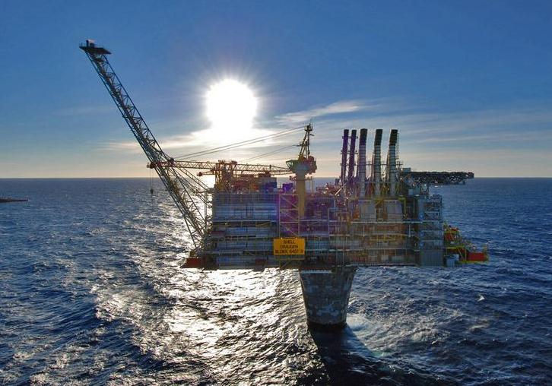
Can Norway remain an oil and gas producing country, if we are to reach the 2⁰ (or 1.5⁰) target?
Let’s solve some world problems…
Bjørn H. Samset, CICERO

Slide 2
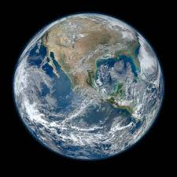
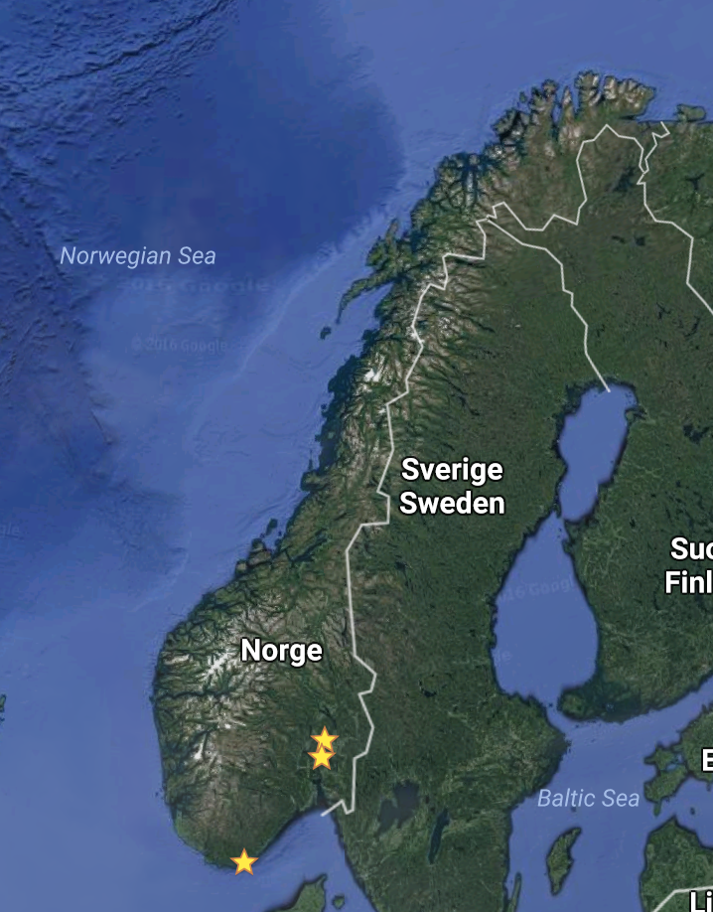
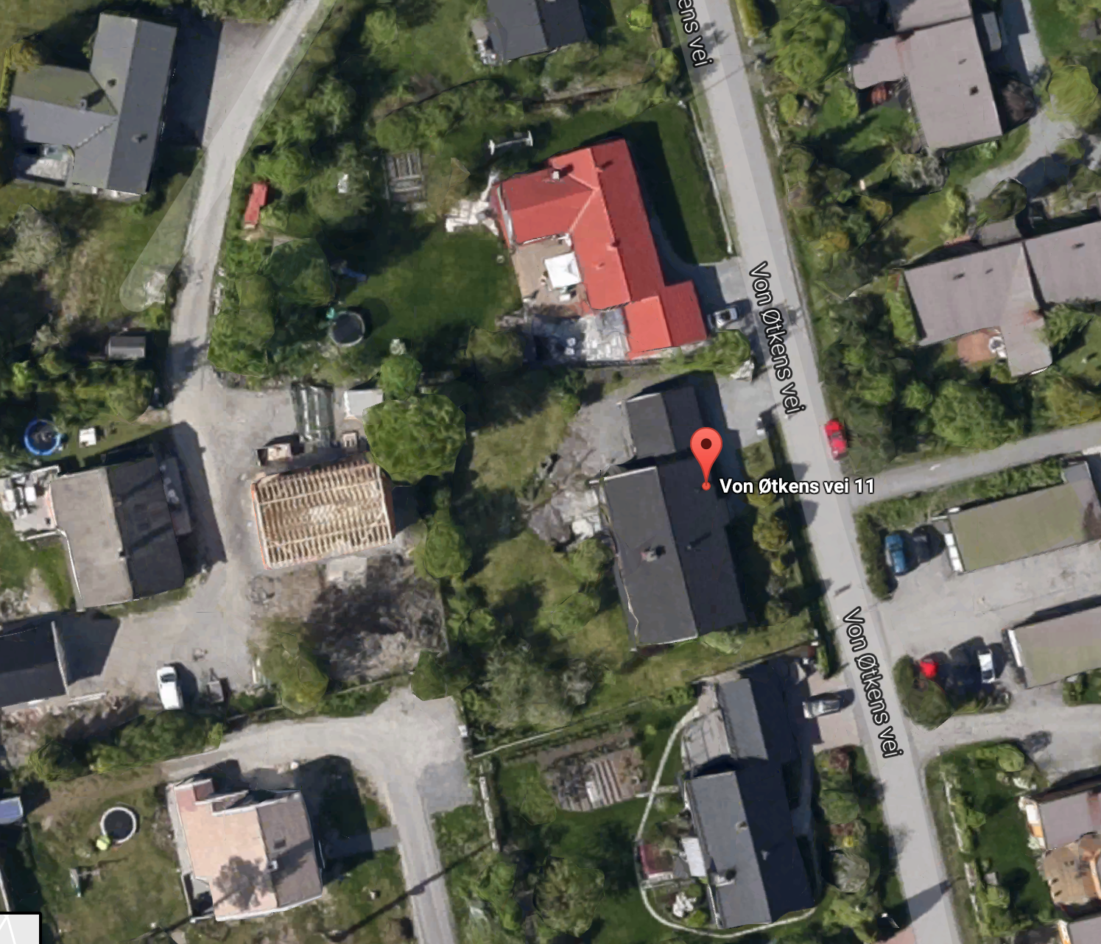

Slide 3
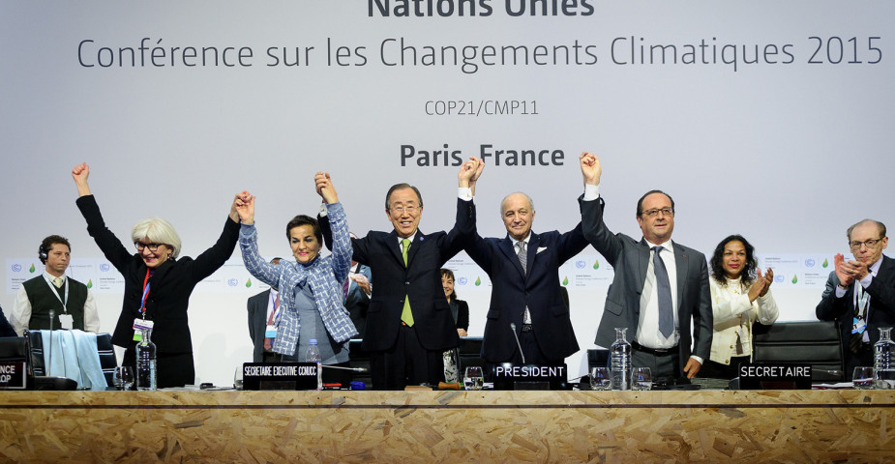
World leaders have deicided to act to limit climate change.

Slide 4
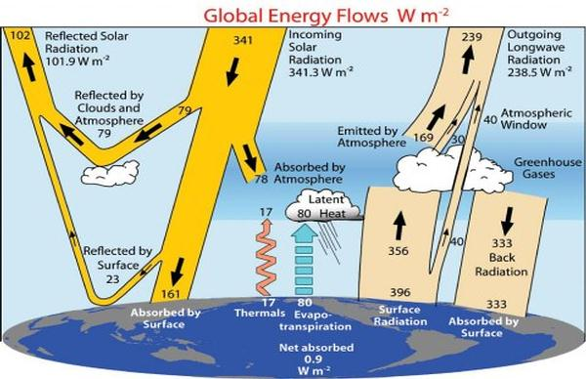
This means not altering the global energy balance further...

Slide 5
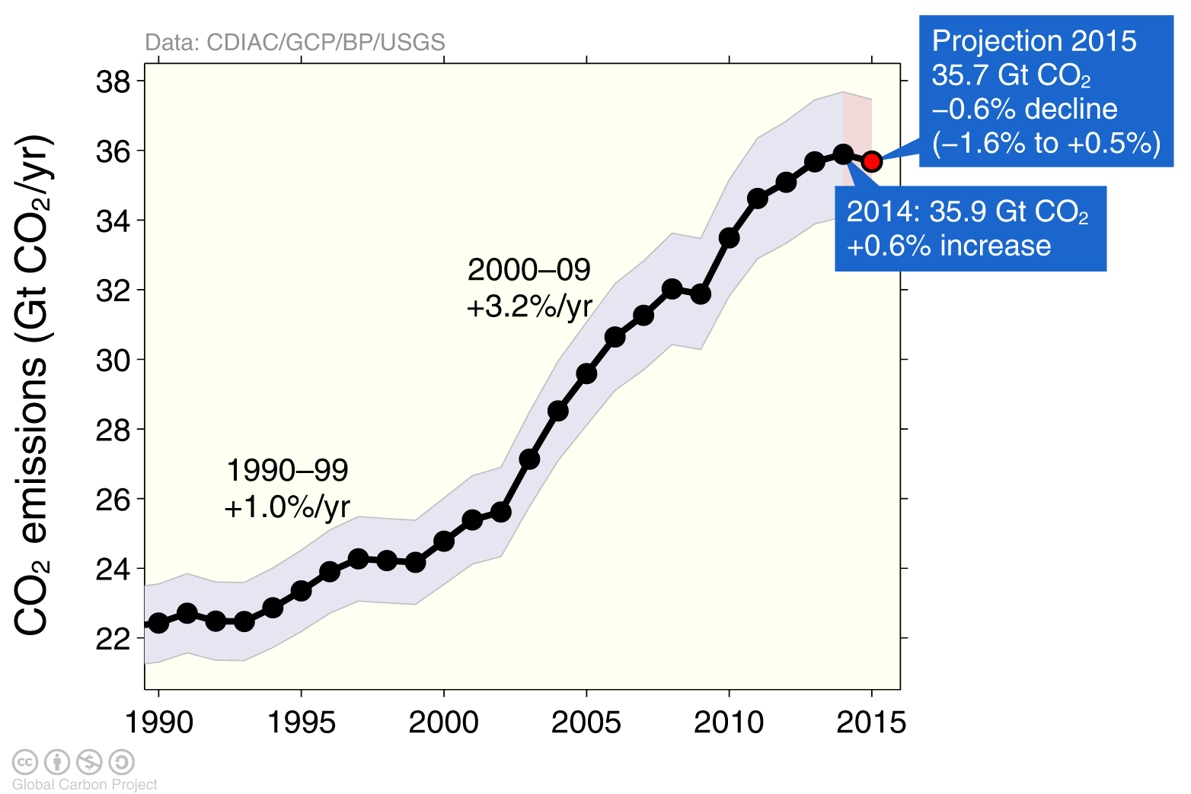
…which in turn – mainly – will mean curbing CO2 emissions.

Slide 6
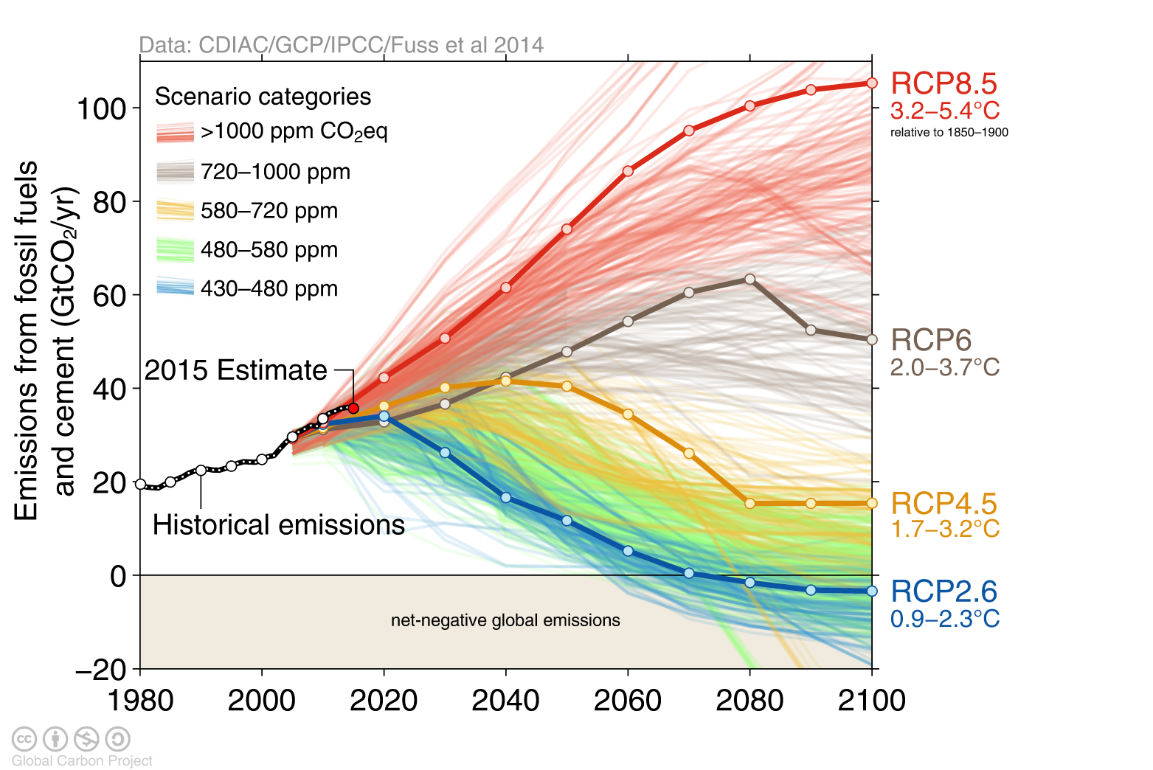
There is a confusing amount of possible CO2 emission pathways…

Slide 7
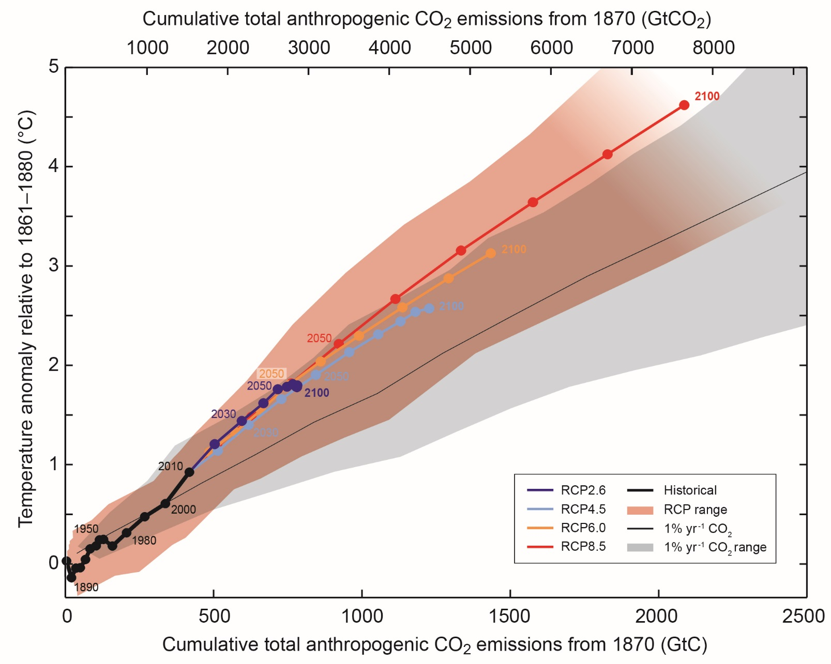
…but, luckily, there’s an almost linear relationship between temperature and cumulative (total) emissions.
IPCC AR5 WG1 SPM

Slide 8
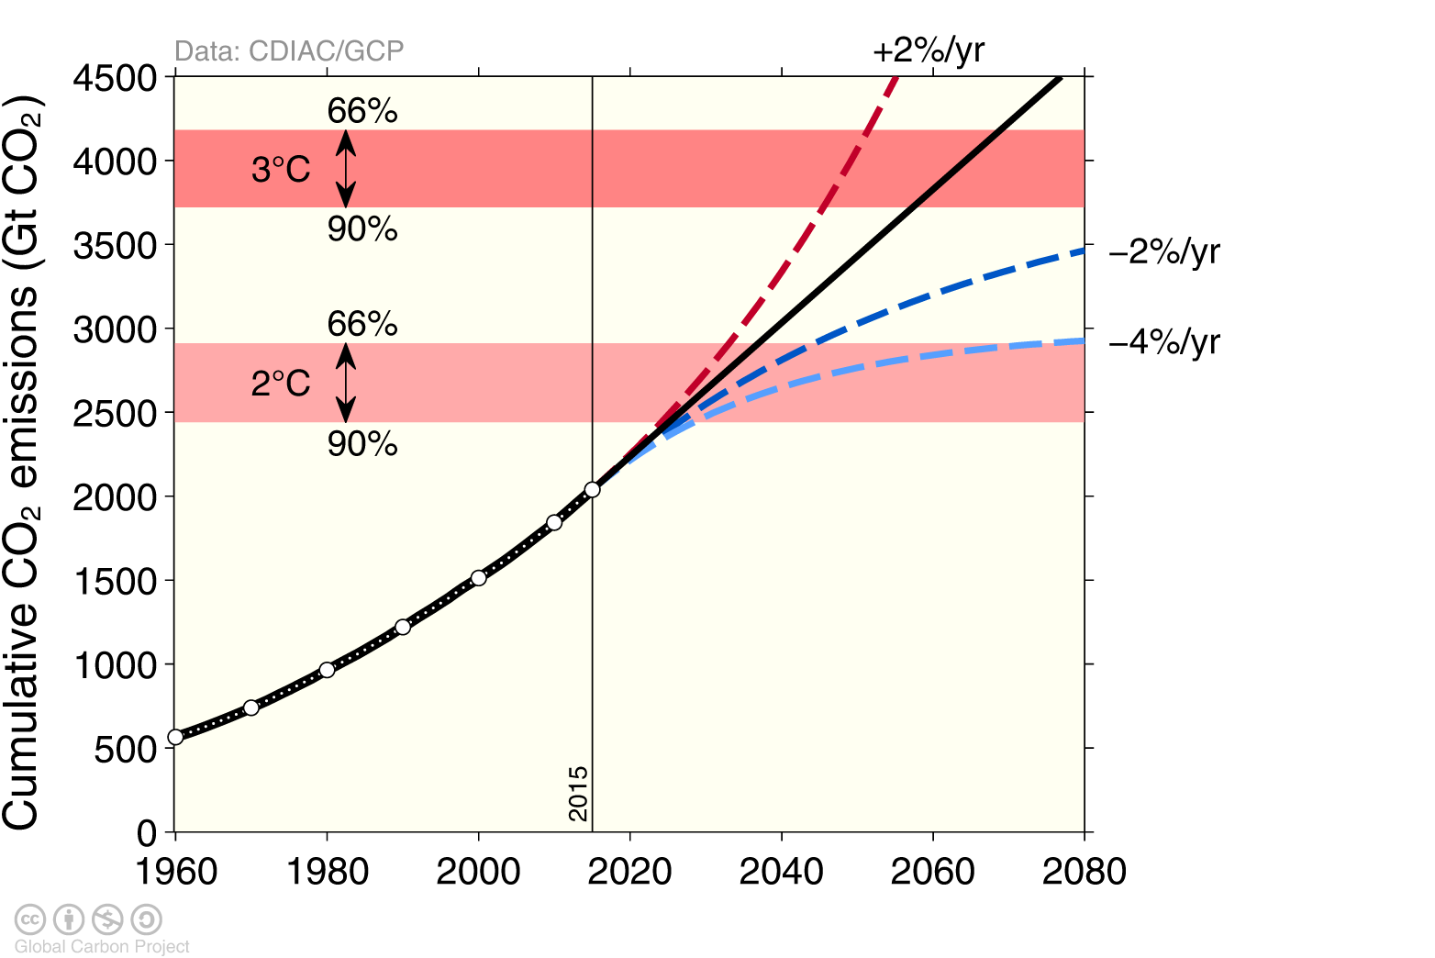
This lets us calculate a «carbon budget», i.e. what remains before we blow the 2 degree limit (whith some likelihood):

Slide 9
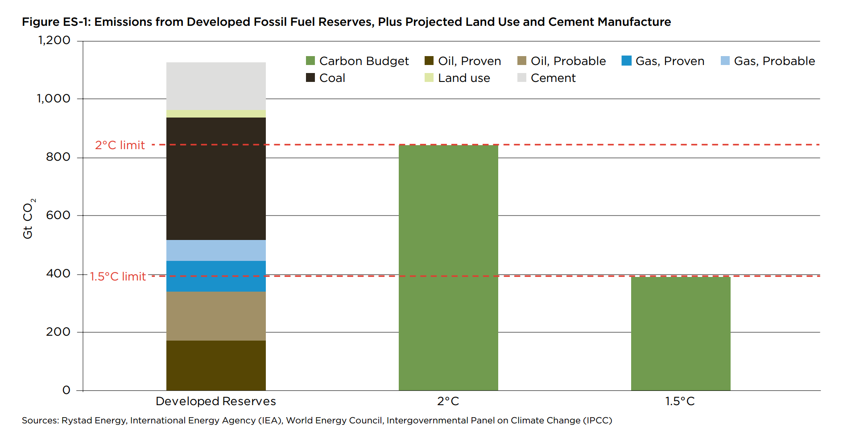
This budget happes to be smaller than the amount of carbon stored in alreadt developed fossis fuel reserves.

Slide 10
Hence, some producers can still deliver their goods – but not all. All countries and sectors must cut emissions – but some maybe more than others?

Slide 11
The «blame» picture isn’t clear,

Slide 12
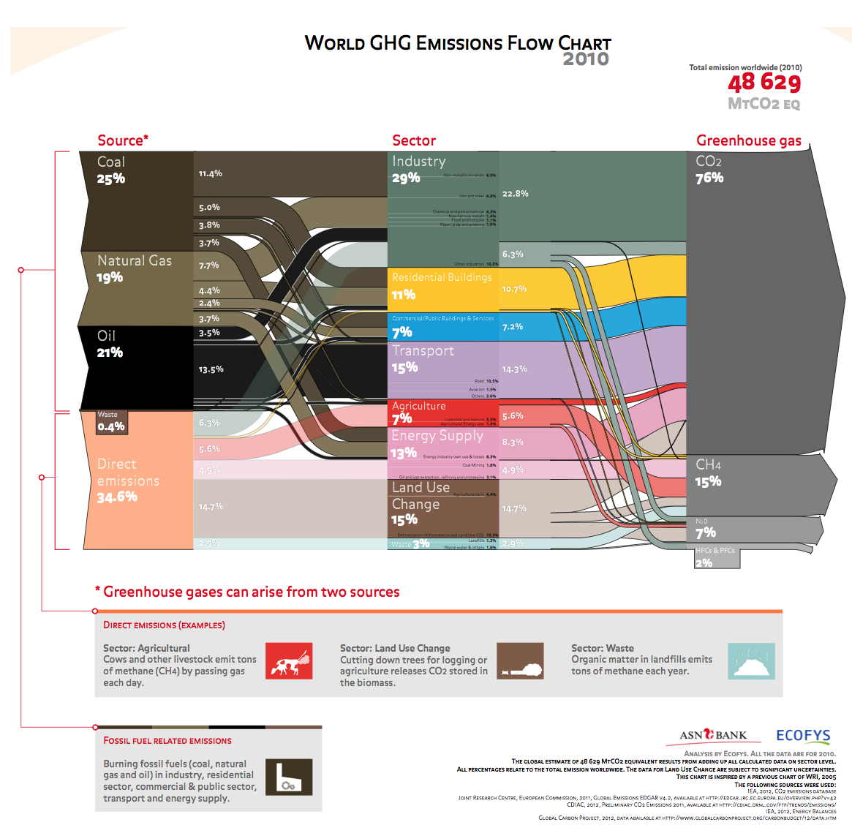
and neither is the emisson mix,
All carbon is equal

Slide 13
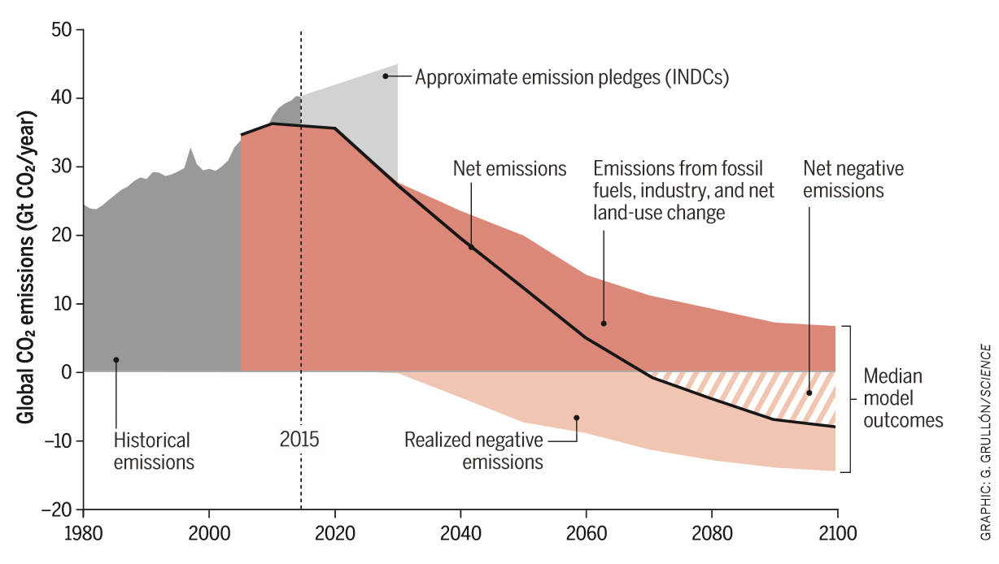
…but, overall, we know what needs to happen.

Slide 14
«The Green Shift», aka The Biggest Changes To Our Society Since The Industrial Revolution
Now:
Non-fossil energy production (wind, solar, nuclear, …)
Distribution of non-fossil energy carriers (electricity, hydrogen)
Usage of non-fossil energy carriers
By 2030:
Carbon Capture and Storage (CCS) + BECCS
By 2070:
Net Carbon Dioxide Removal

Slide 16
What should Norway do?
2% of oil production, 0.4% of reserves
2% of natural gas production, 1% of reserves
0% of coal production, 0% of reserves
What’s the global situation for fossil fuel usage in 2040?
What’s the global situation for fossil fuel usage after 2040?
Low production emissions
High production costs
Can Norwegian natural gas save the climate?

