Slide 1
How To Guide to Using Aerosol Data

Slide 2
Having recorded some measurements on Calitoo, you can now:
View the measurements on Calitoo
Export the measurements to a computer
Installing Calitoo software
Downloading measurements
Visualisation with Calitoo software
Visualisation with Excel
Upload the measurements to the GLOBE database
You can also view other schools’ data:
Visualise GLOBE data
Retrieve GLOBE data

Slide 3
View the measurements on Calitoo

Slide 4
Turn on Calitoo (very long press)
Long press allows you to move between Mode Measuring and Mode Reading
Once Mode Reading appears on the screen, short press to see your measurements
You will see your last recording first, then second last, etc.
Each measurement has data displayed on four pages (see next slides for details)

Slide 5
Mode Reading - Page 1
Internal temperature of the device; do not use to record air temperature.
Page number; here first out of four pages.
Recording number; here number 42.
Notes:
Now, you have recorded your measurements and you want to review them. Long press allows you to move between two menus: measuring and reading.
When you are in reading mode, short press to see your data.
You will use this screen to see the date, time and barometric pressure.
Short press to go to the next screen.

Slide 6
Mode Reading - Page 2
Notes:
You will use this screen to fill in the AOT data.
Short press to go to the next screen.

Slide 7
Mode Reading - Pages 3 & 4
GPS coordinates.
Altitude.
Angle of the sun over the horizon.
Size of particles.
Notes:
These screens will not be used for GLOBE data entry. They could be used for future analysis.
Third screen: GPS, elevation, angle of the sun.
Fourth screen: are the aerosols rather big or smaller in size.

Slide 8
Export the measurements to a computer

Slide 9
Installing Calitoo software
Why? To download your measurements to a computer, as well as to visualise and review them.
Steps:
Download the free Calitoo software available here on a computer
To install the software, consult pages 53 to 56 of the user manual

Slide 10
Downloading measurements
Why?
It is a safe way to keep your measurements; although measurements are saved on Calitoo, they can be erased by mistake when clicking the brush (see brush on the image below).
It also allows you to review and analyse data using Excel.
Steps:
Install Calitoo software on the computer (see here)
Connect Calitoo to the computer using the USB cable provided
Start the software by double-clicking the icon
An image of the Calitoo will appear and will show its reference number
Click the thumbnail Data and click on the folder to download the data:

Slide 11
Downloading measurements
The downloaded data is located under C:\Users\[user name]\CalitooData
Click on the folder with the Calitoo number (for example, 0262)
Raw data is available in a text format in the folder [Calitoo number]_10 (using the same example 0262_10)

Slide 12
Visualising data
You can either use 1) Excel or 2) Calitoo’s software to visualise data. This is a personal preference that may depend on your teaching objectives and student proficiency with software.

Slide 13
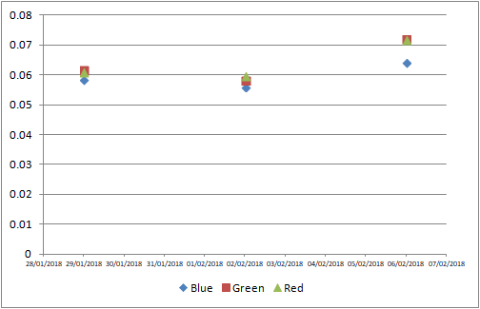
Using Excel to visualise data
Open the file with raw data
Copy all the data
Open an Excel spreadsheet
Paste the data
Select Data > Text to columns > ‘Delimited’ then click ‘Next’ > Tick ‘Semicolon’ then click ‘Next’ > Click ‘Finish’
Headers and values are now aligned and easier to read and handle. For example, data can be visualized using charts:

Slide 14
2) Using Calitoo software to visualise data
Install Calitoo software on the computer (see slide 9)
Click on the thumbnail ‘Tools’ then on the data visualisation icon
Take a look at the yellow boxes right of ‘Years’. If you have made measurements with the Calitoo device, you will see red lines. In this example, there are measurements for December 2017 (box 12, year 2017), January and February 2018:

Slide 15
2) Using Calitoo software to visualise data
Click on the yellow box whose data you want to review. It turns purple and the days of the month now show right of ‘Months & Days’. This time, the days with data are a more intense shade of purple
To view the data for a given day, click on the corresponding purple box:

Slide 16
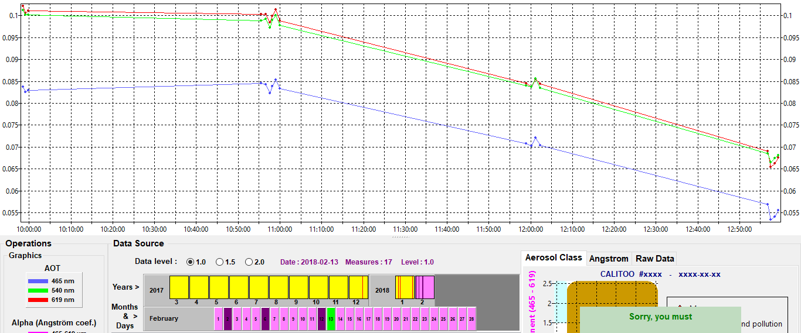
2) Using Calitoo software to visualise data
You can now see the AOT measurements taken that day graphed

Slide 17
Upload the measurements to the GLOBE database

Slide 18
Where & how to enter data
Training web page to practice data entry: GLOBE Data > Data entry > Training data entry
To upload data to the GLOBE database:
Using an Internet browser: GLOBE Data > Data entry > Data entry Desktop Forms
Or the Mobile app
How to guide:
Step-by-step instructions to enter data from the GLOBE website available here.
When using the app, the data is first saved and then needs to be sent to GLOBE (it assumes that you do not have access to the Wifi where you are). Make sure to complete this second step.
Notes:
To practice, you will use a training form. You can use ‘fake’ data as it will not be uploaded to the GLOBE database.
To enter your measurements, you will either use the real GLOBE form either on your computer or through a mobile App.

Slide 19
Visualise GLOBE data

Slide 20
Identifying schools collecting aerosol data
Go to the vis system
Select Data Count at the top of the page
Select the protocol(s) you are interested in (e.g. Aerosols > AOT)
The map will show the total number of measurements which have occurred at any location since the beginning of the GLOBE program.
Use the Date Range Filter to adjust the date range to 2017 and 2018 to see what schools have been recently active.

Slide 21
Select Data Counts and a Time Range
Data counts show how much data was entered at any site for the selected period of time
Bigger dots = More Data

Slide 22
Retrieve GLOBE data

Slide 23
Exporting global aerosol data
Go to the Advanced Data Access Tool
Select the Aerosol protocol
Select a date range
Click “Apply filter”
Click “Obtain Measurement Data”
Click “Download Measurement Data” (wait)
Click the Download link and open the file on your computer

Slide 24
The full video tutorial on visualising and retrieving GLOBE data is here.

