Slide 1
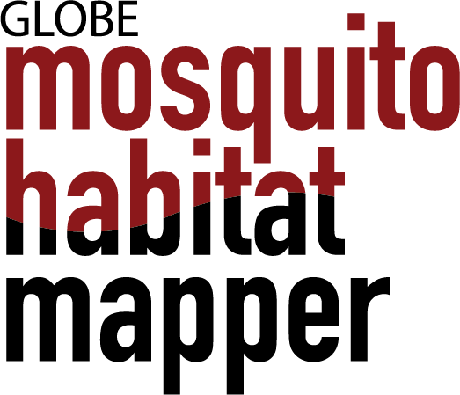
Supporting United Nations
Sustainable Development Goals
Russanne D. Low, PhD
Science Lead, GLOBE Observer Mosquito Habitat Mapper
Institute for Global Environmental Strategies, Arlington VA
SDG Launch Virtual Showcase
May 13, 2020

Slide 2
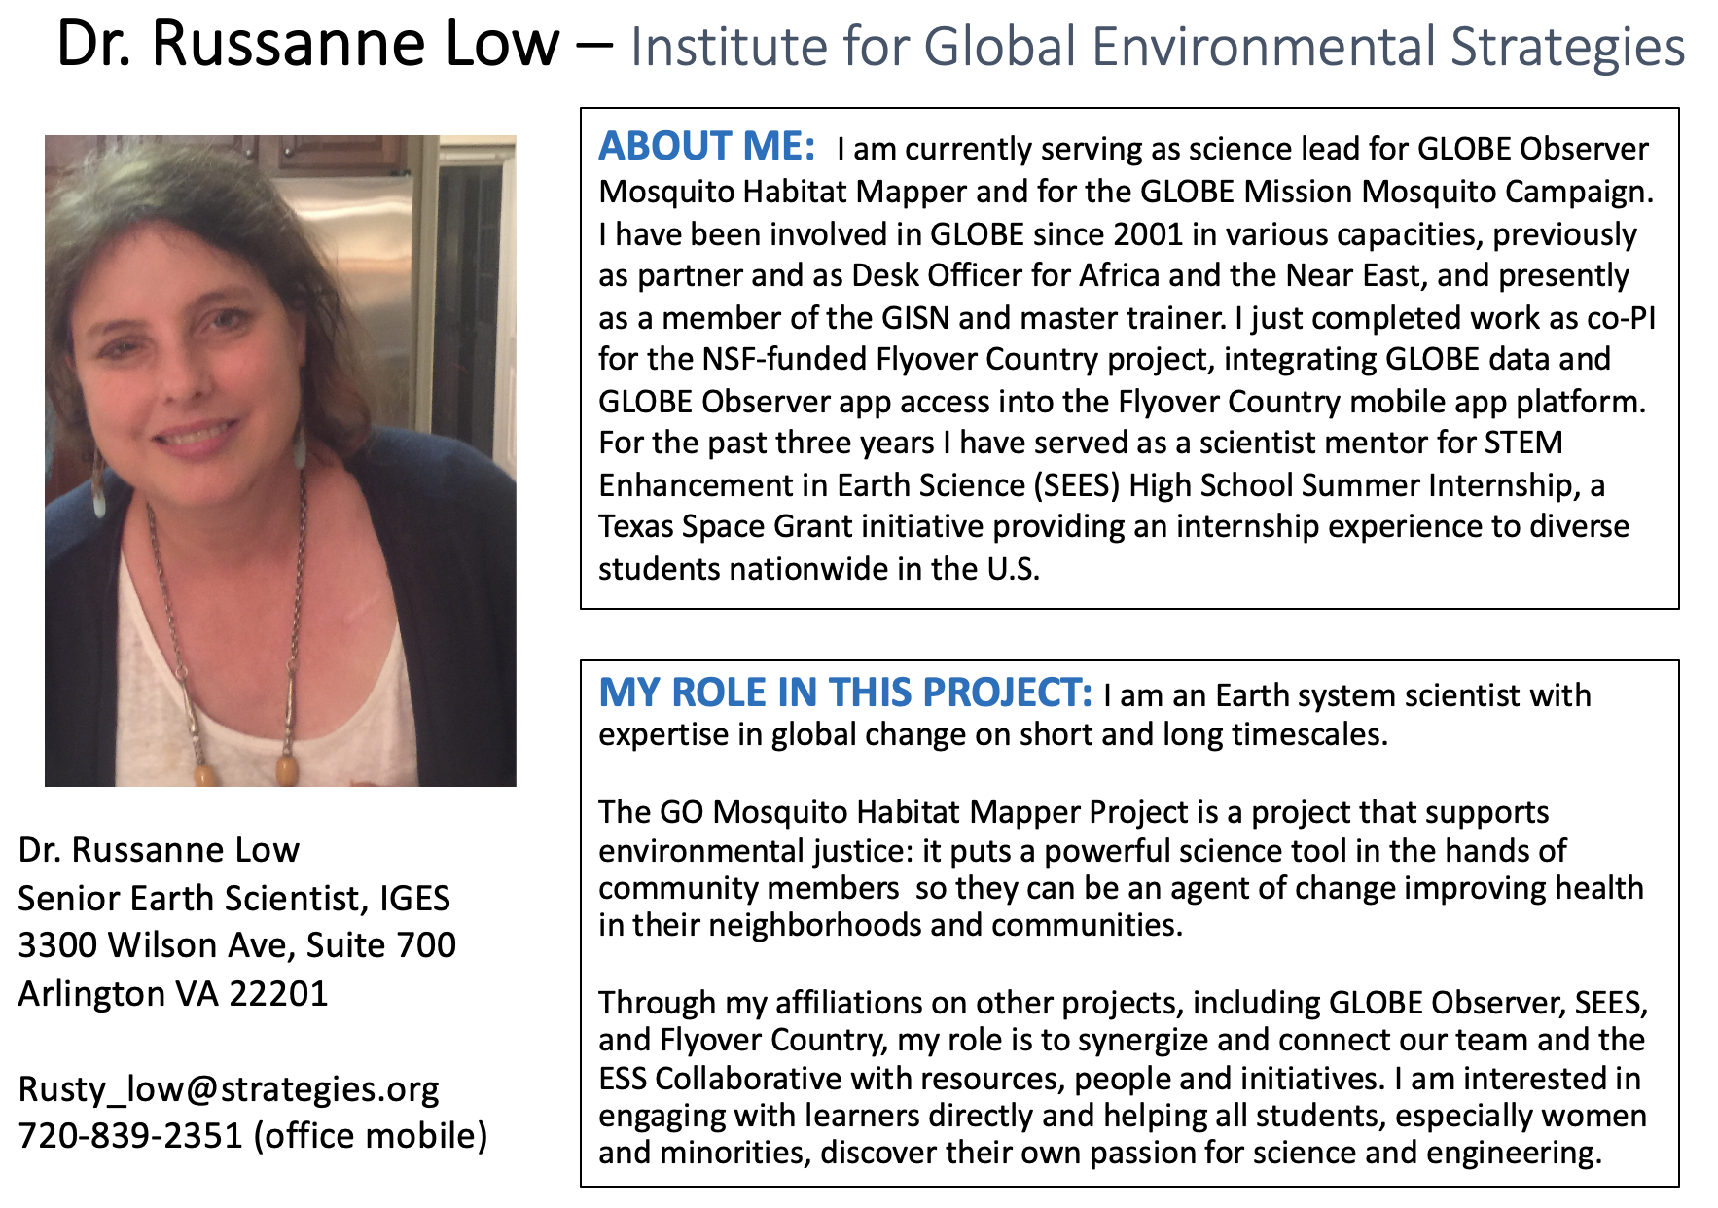

Slide 3
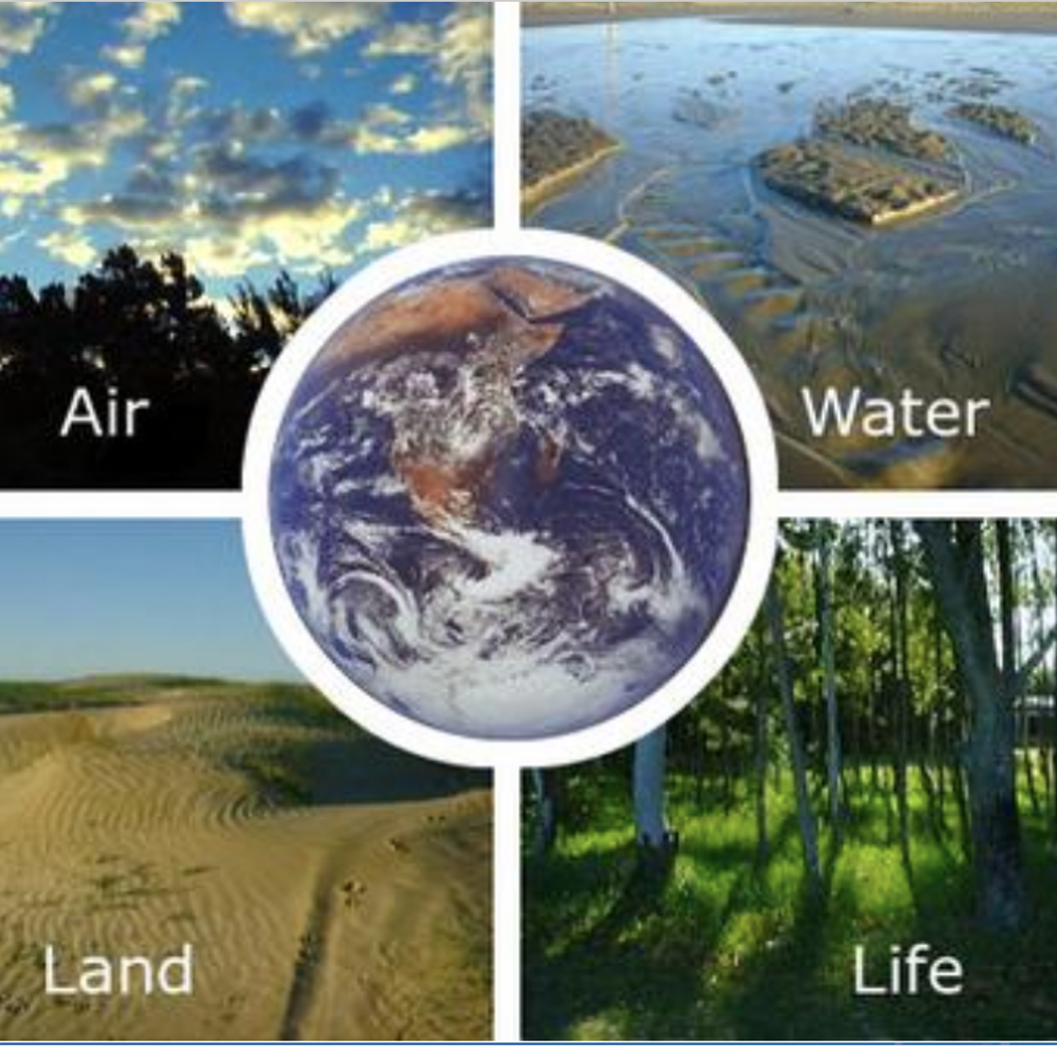
Vision: A worldwide community of students, teachers, scientists, and citizens working together to better understand, sustain, and improve Earth's environment at local, regional, and global scales.
Mission: To promote the teaching and learning of science, enhance environmental literacy and stewardship, and promote scientific discovery.
GLOBE Observer: Open access to everyone.
Notes:
By using the GLOBE Observer app, you are joining the GLOBE community and contributing important scientific data to NASA and GLOBE, your local community, and students and scientists worldwide.
By identifying potential breeding sites for mosquitoes, sampling and counting mosquito larvae, and by using optional equipment to examine, photograph and identify the genus of your specimens, you will be enabling scientists to verify predictive models of mosquito population dynamics. In addition, public health authorities can use your observations to inform where, when, and how to intervene in their communities to reduce disease risk.

Slide 4
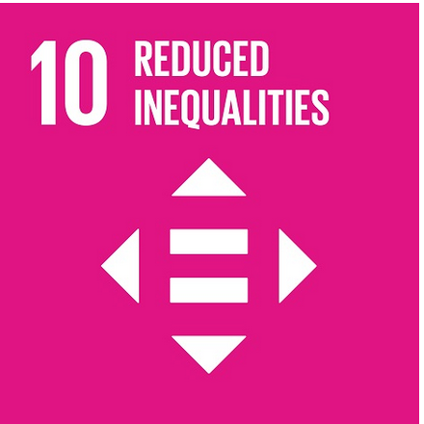
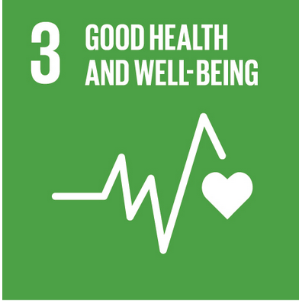
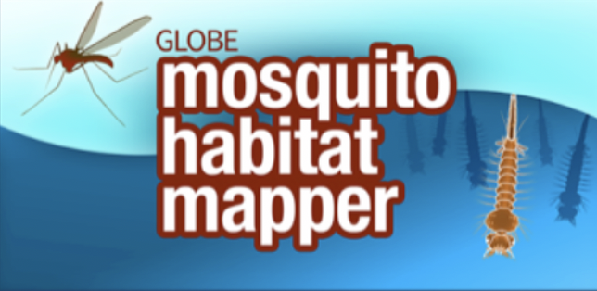
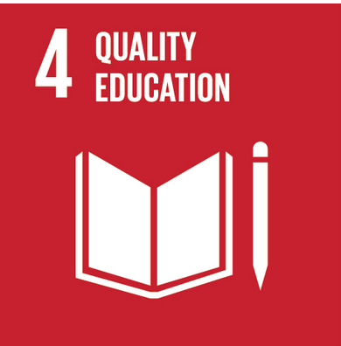
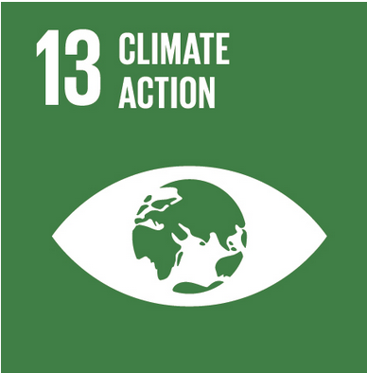
SDG #3: For mosquito disease where there is no vaccine, there are three ways to protect a community: education, surveillance, and breeding site elimination. The app does all three!
Notes:
GLOBE Observer Mission Mosquito Campaign coincides with the goals of Agenda 2030

Slide 5
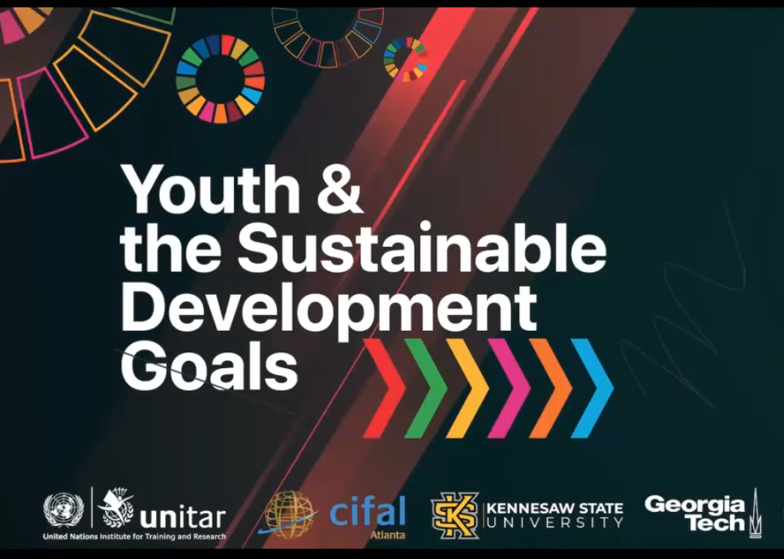
Link to video: https://www.youtube.com/watch?v=gdt_KVu9_L8&feature=youtu.be
Notes:
GLOBE Observer Mission Mosquito Campaign coincides with the goals of Agenda 2030

Slide 6
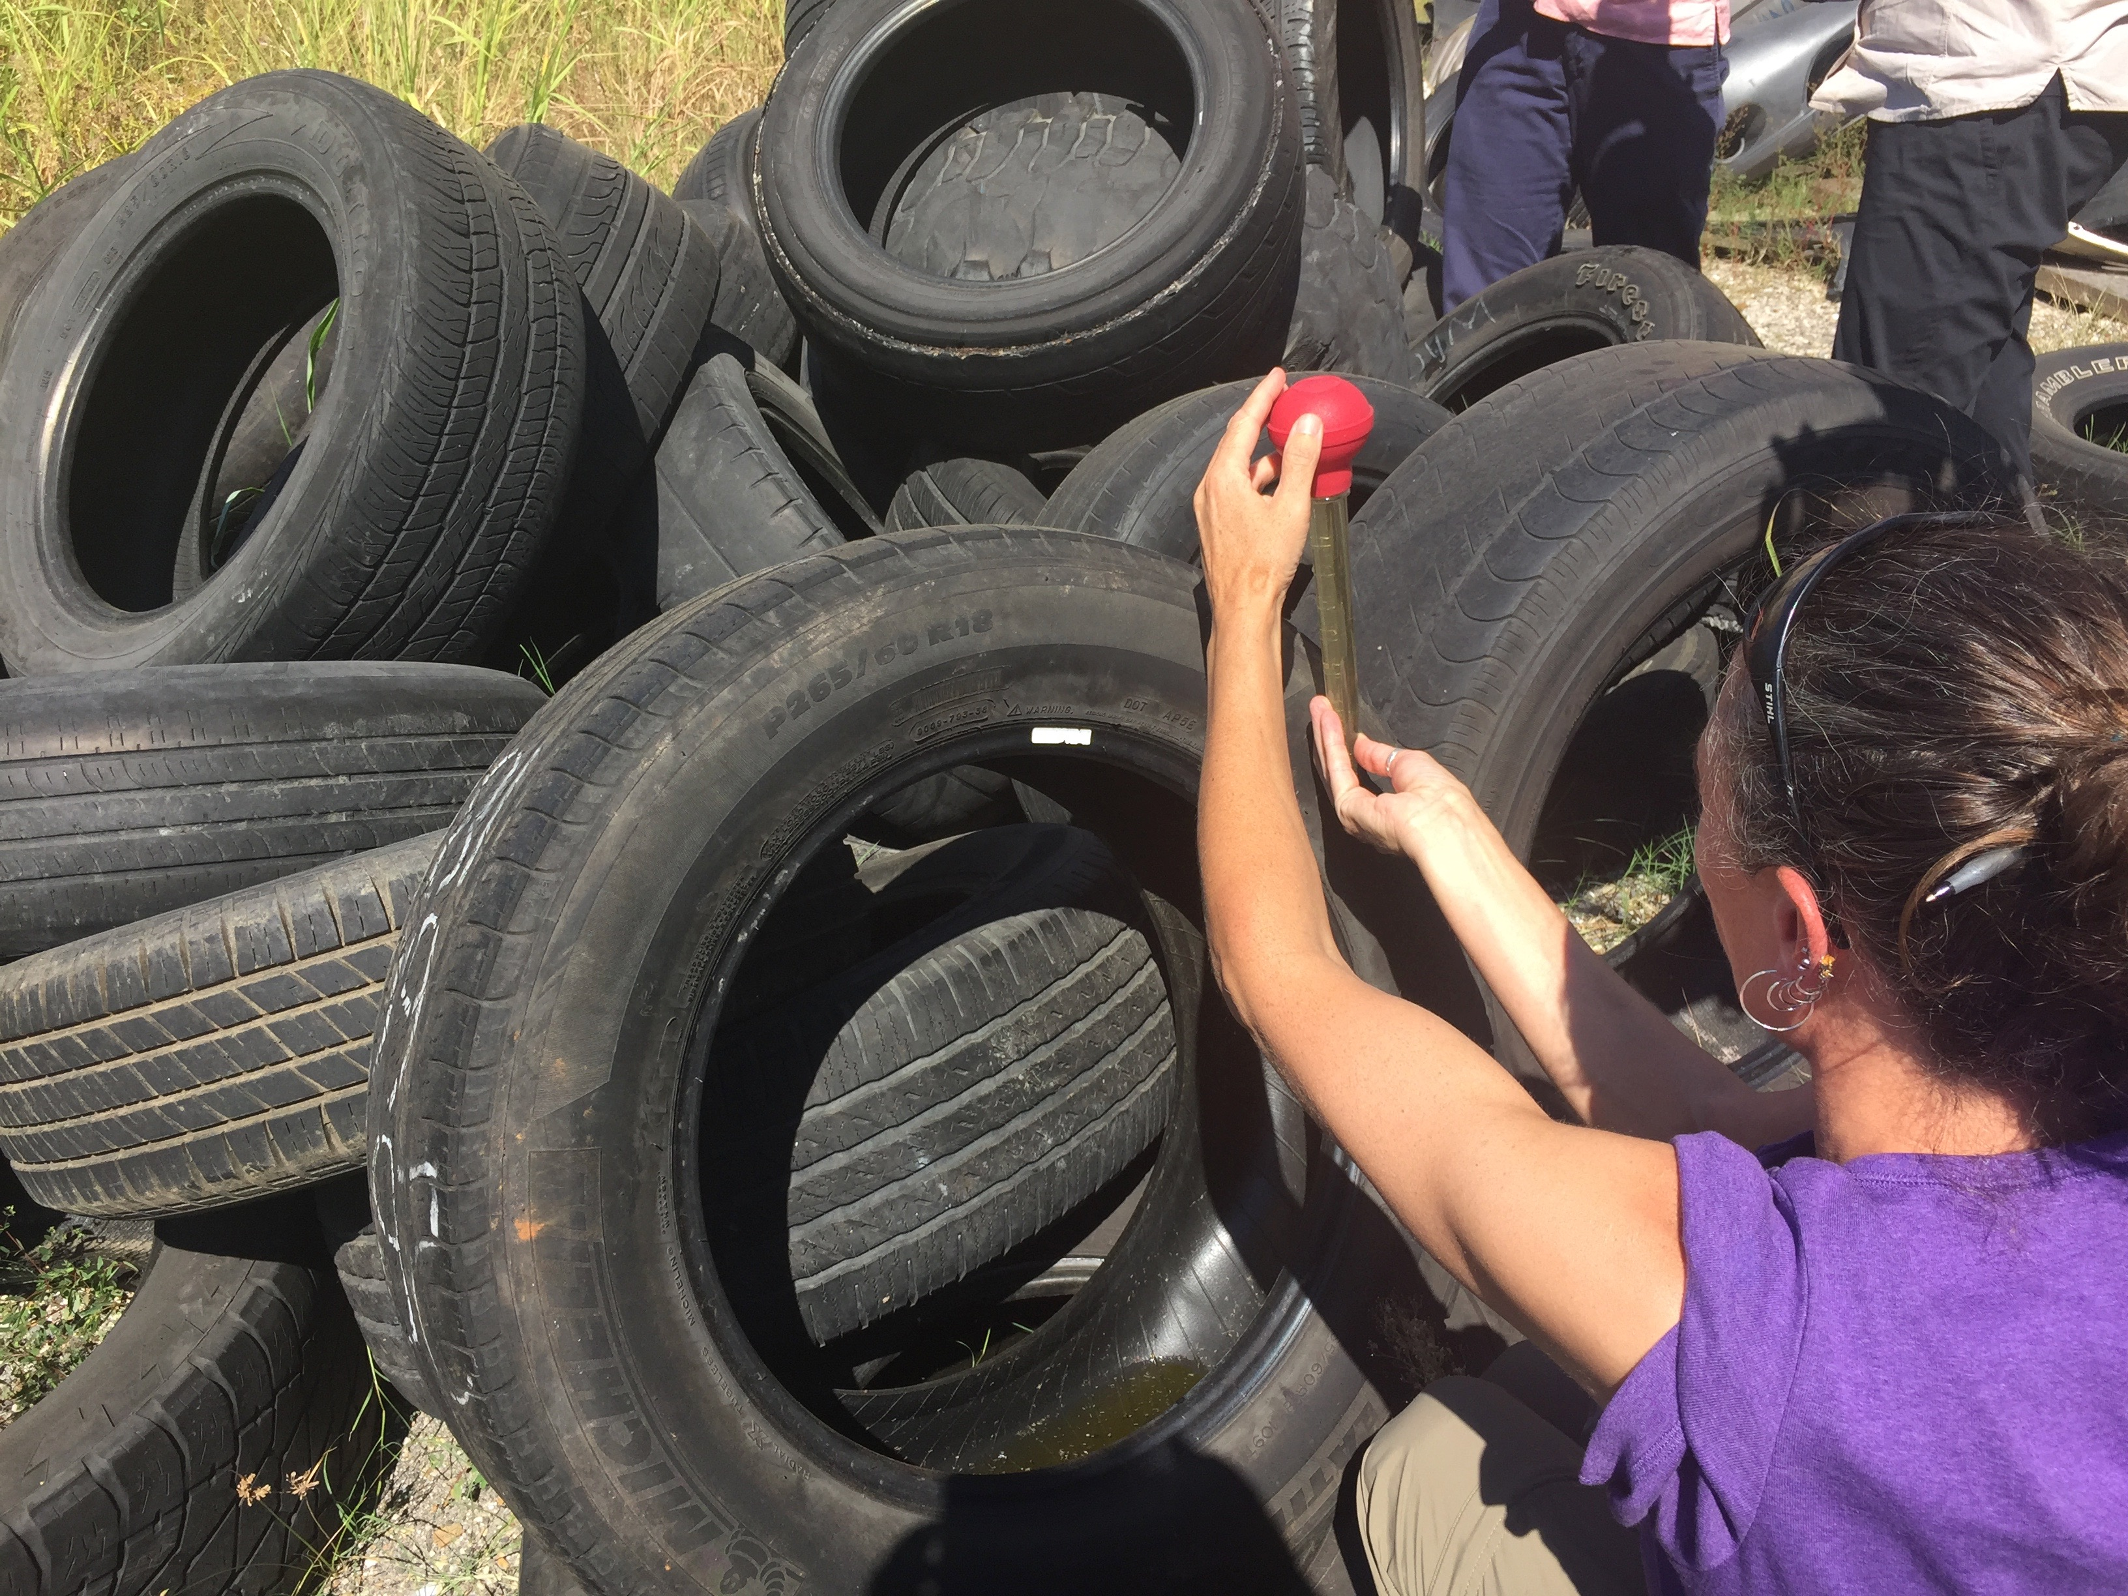
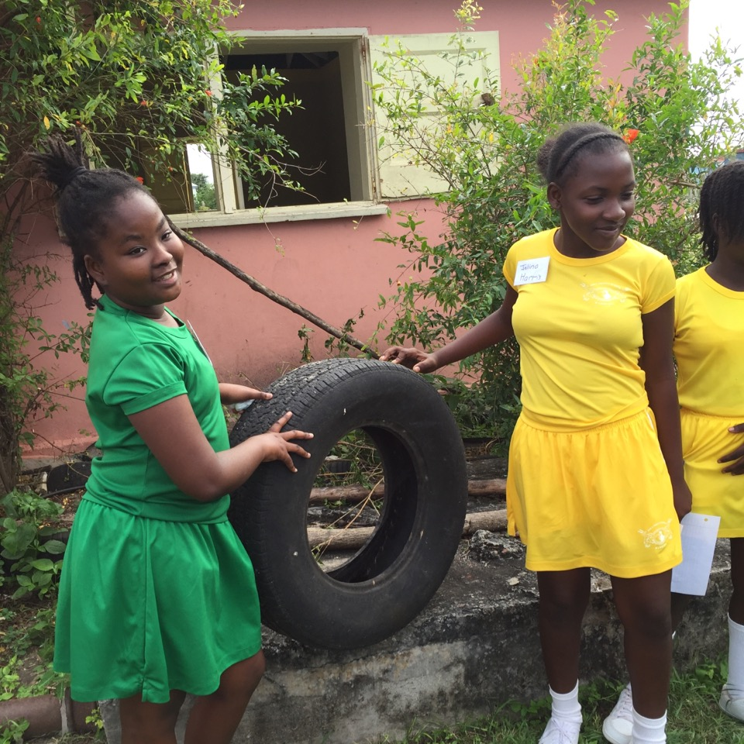
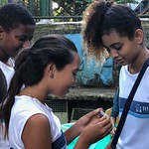
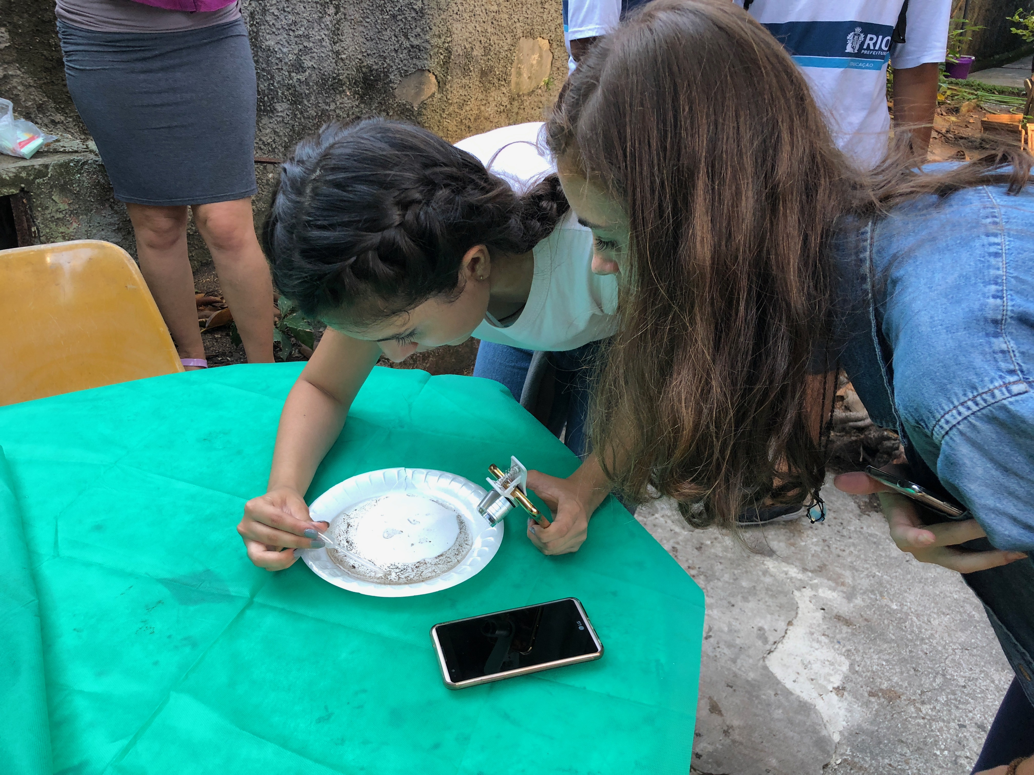
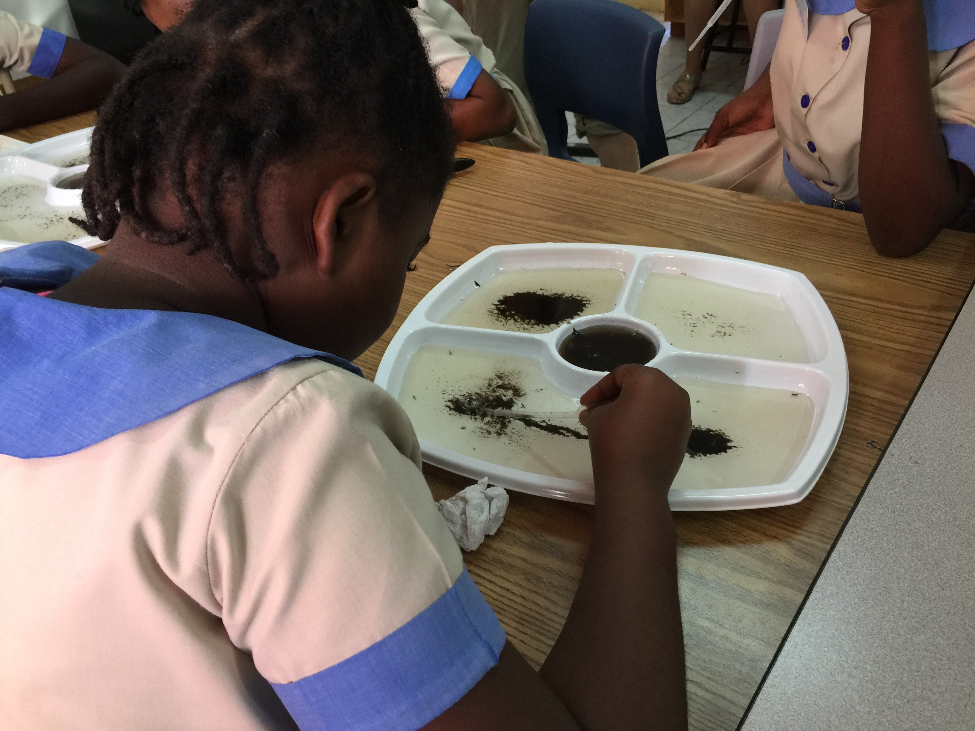
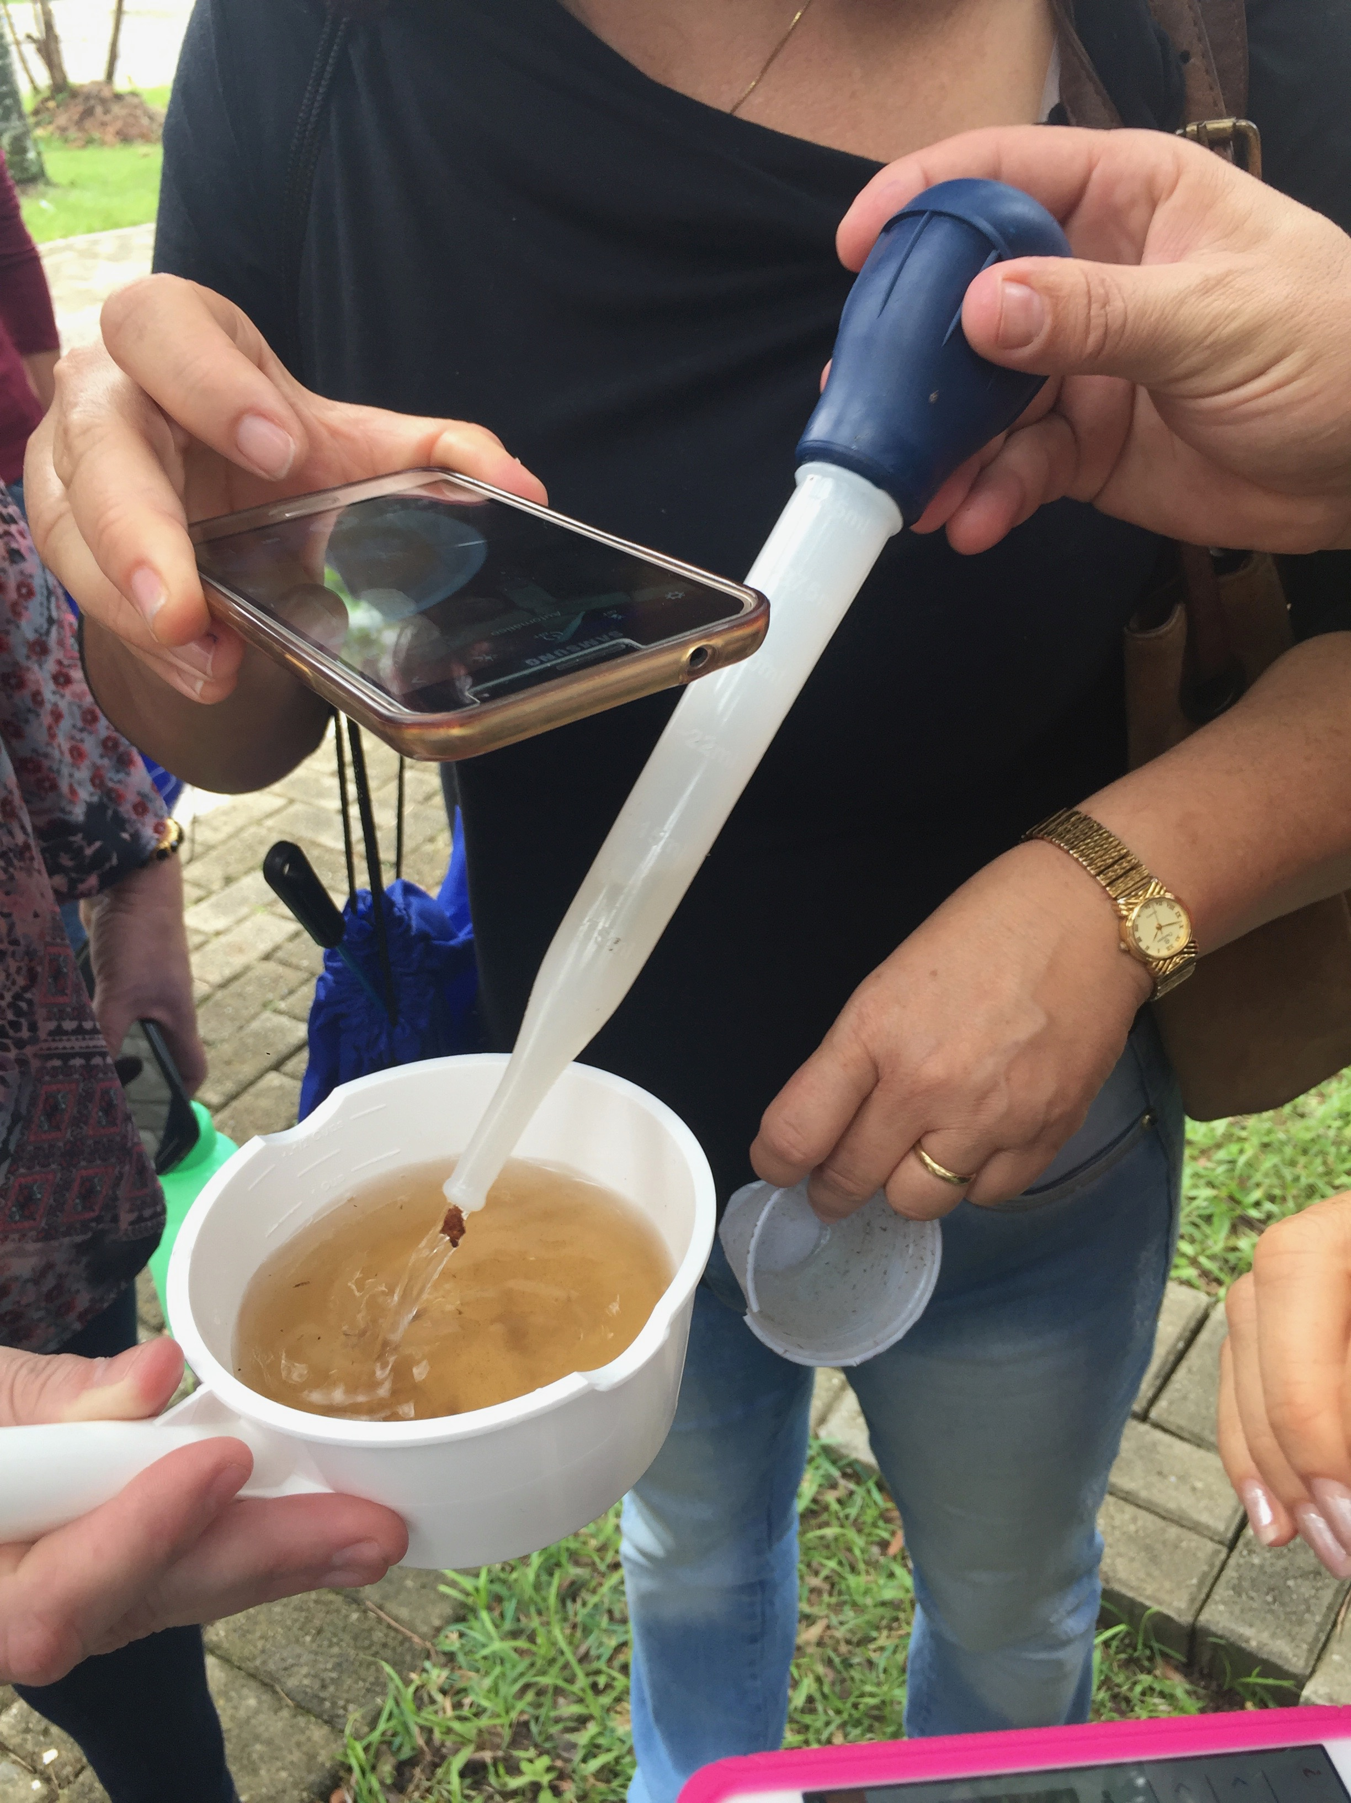
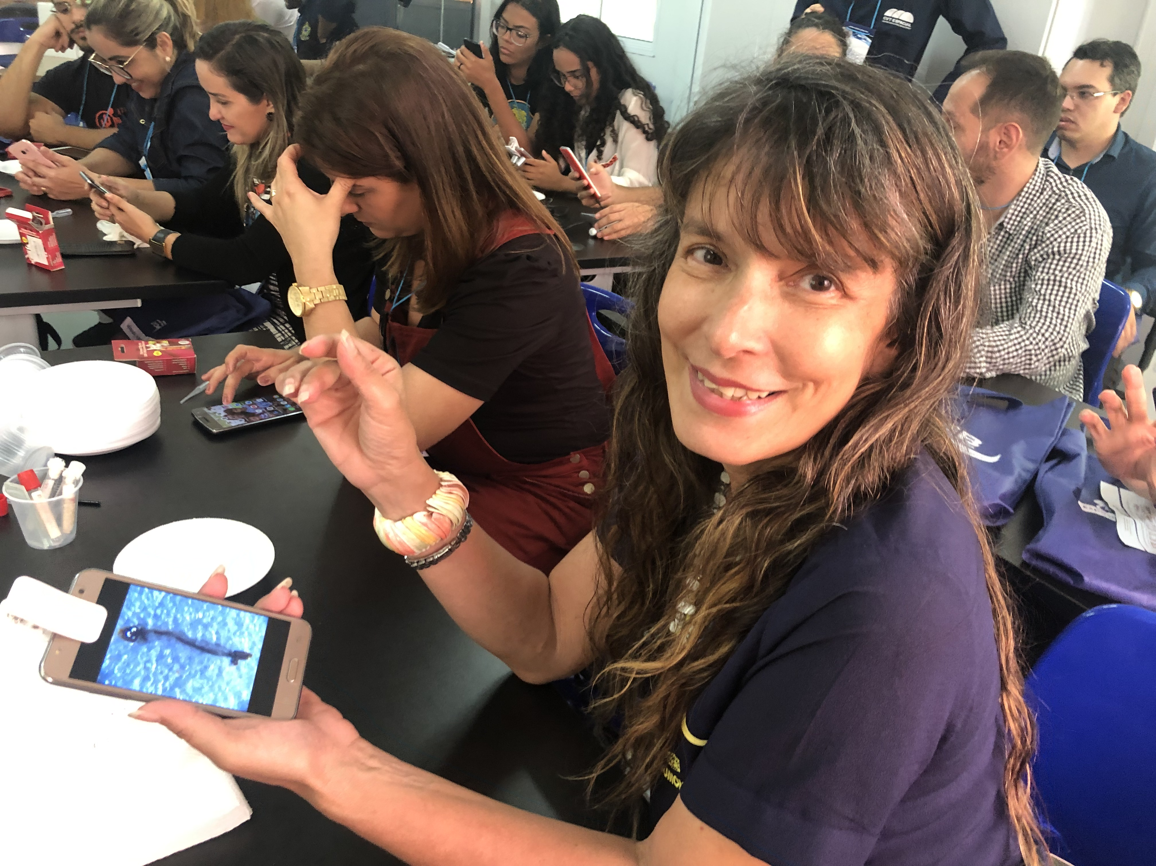
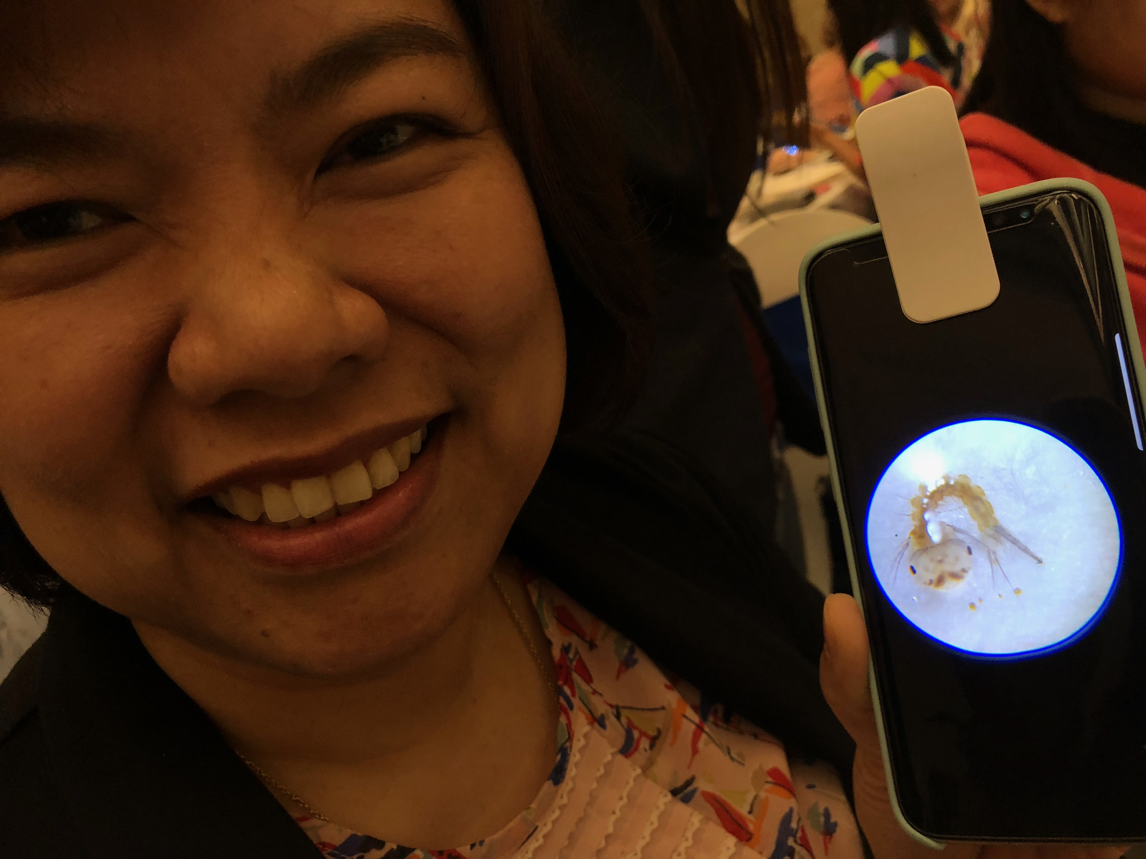
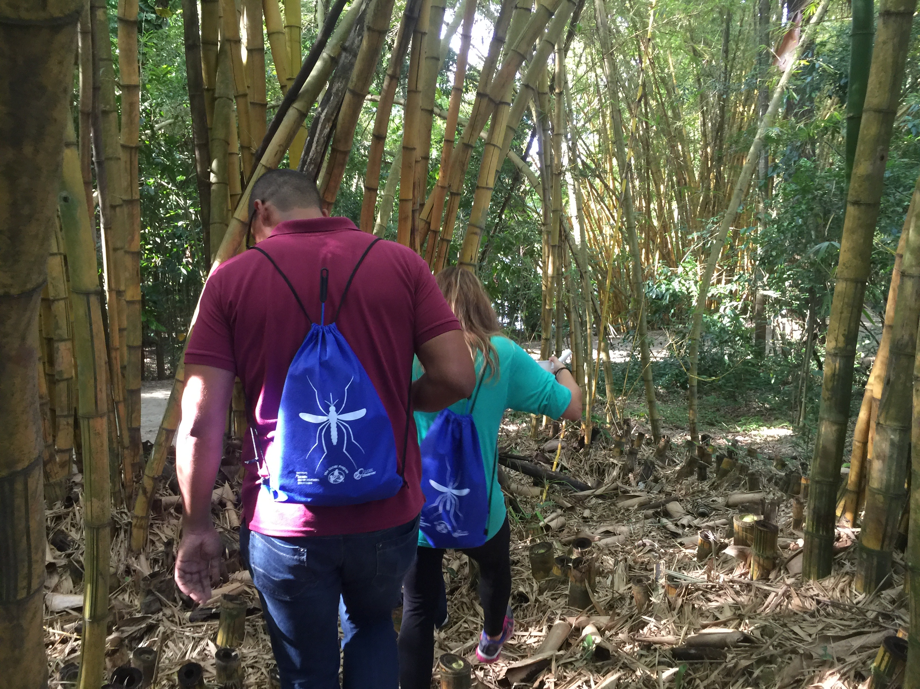
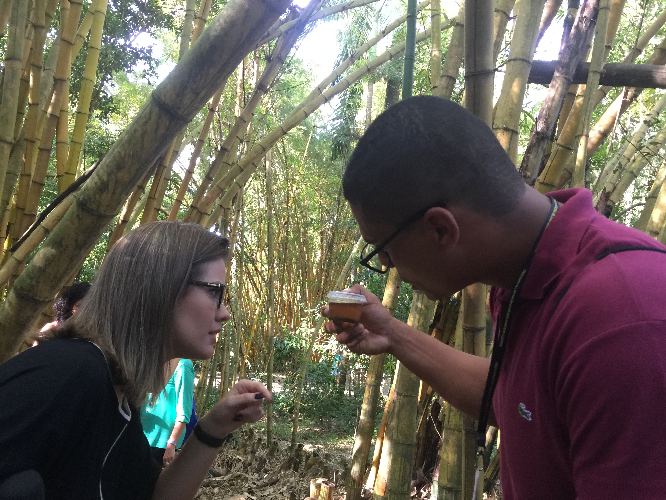
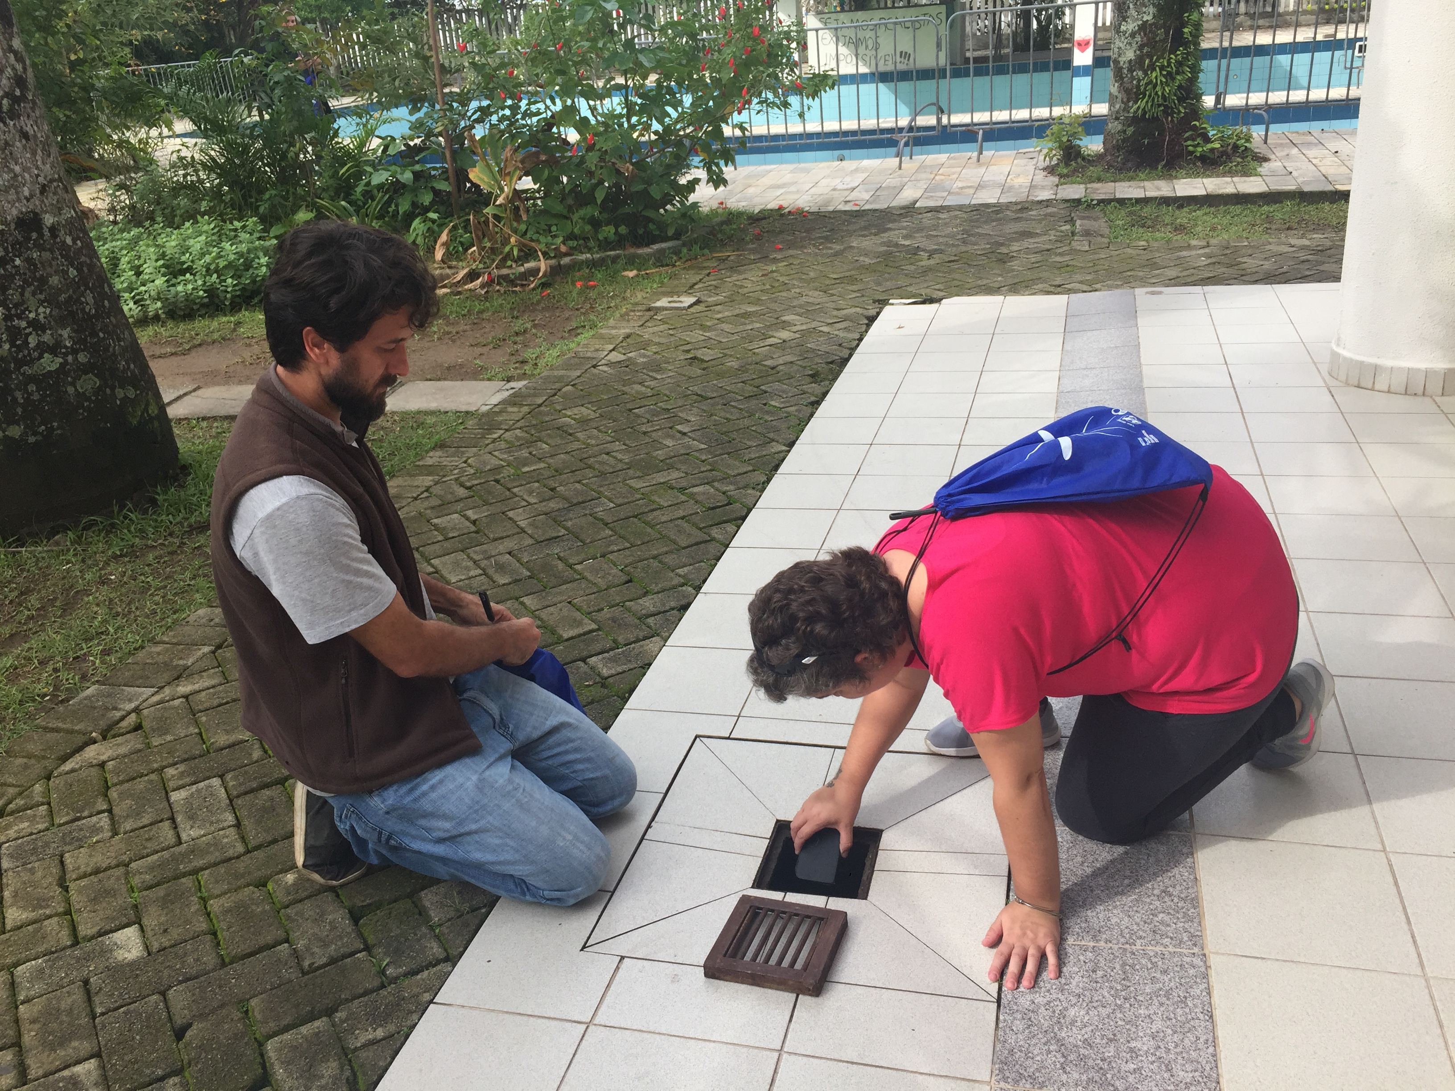
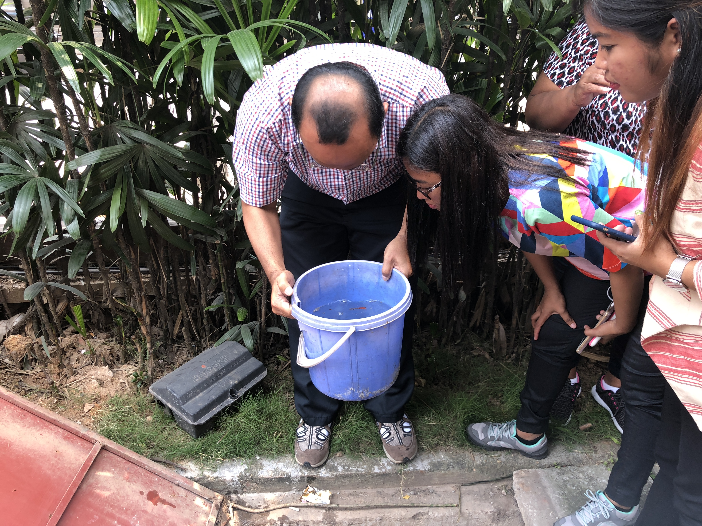
Sustainability= Building Local Capacity
Our approach to SDGs uses citizen science for:
capacity building in science & education
fighting mosquito vector-borne disease in communities around the globe.
Provide resources for local capacity building: Workshops, Campaigns, Webinars, Activities
Store and share data to public health
departments and communities
Notes:
Sustainability Concept: GLOBE Observer Mission Mosquito Campaign

Slide 7
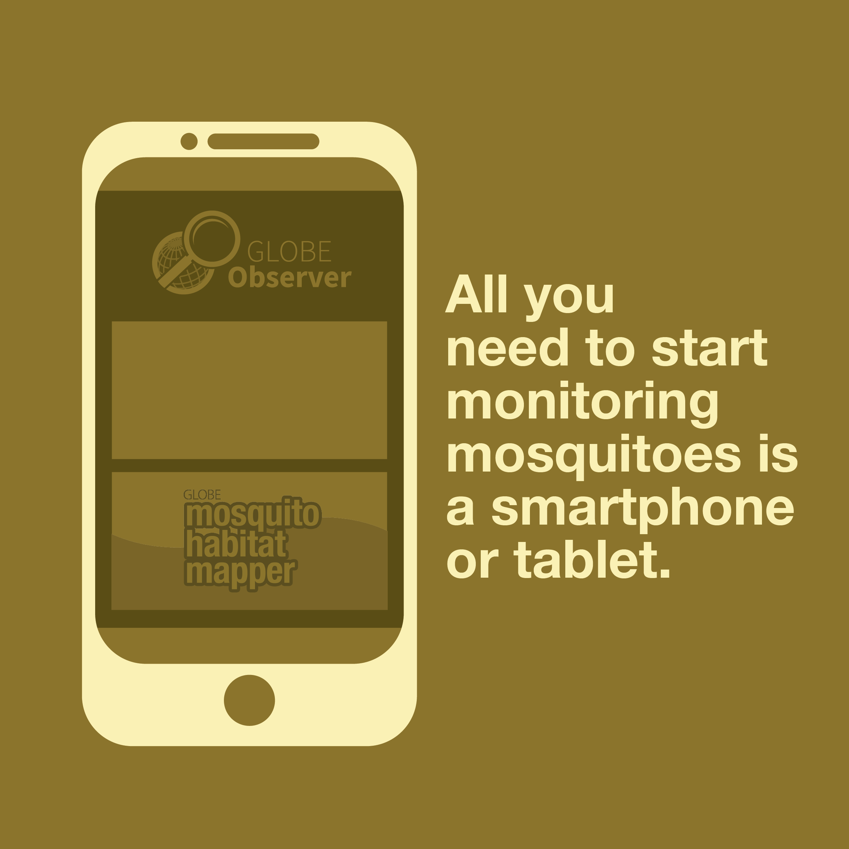
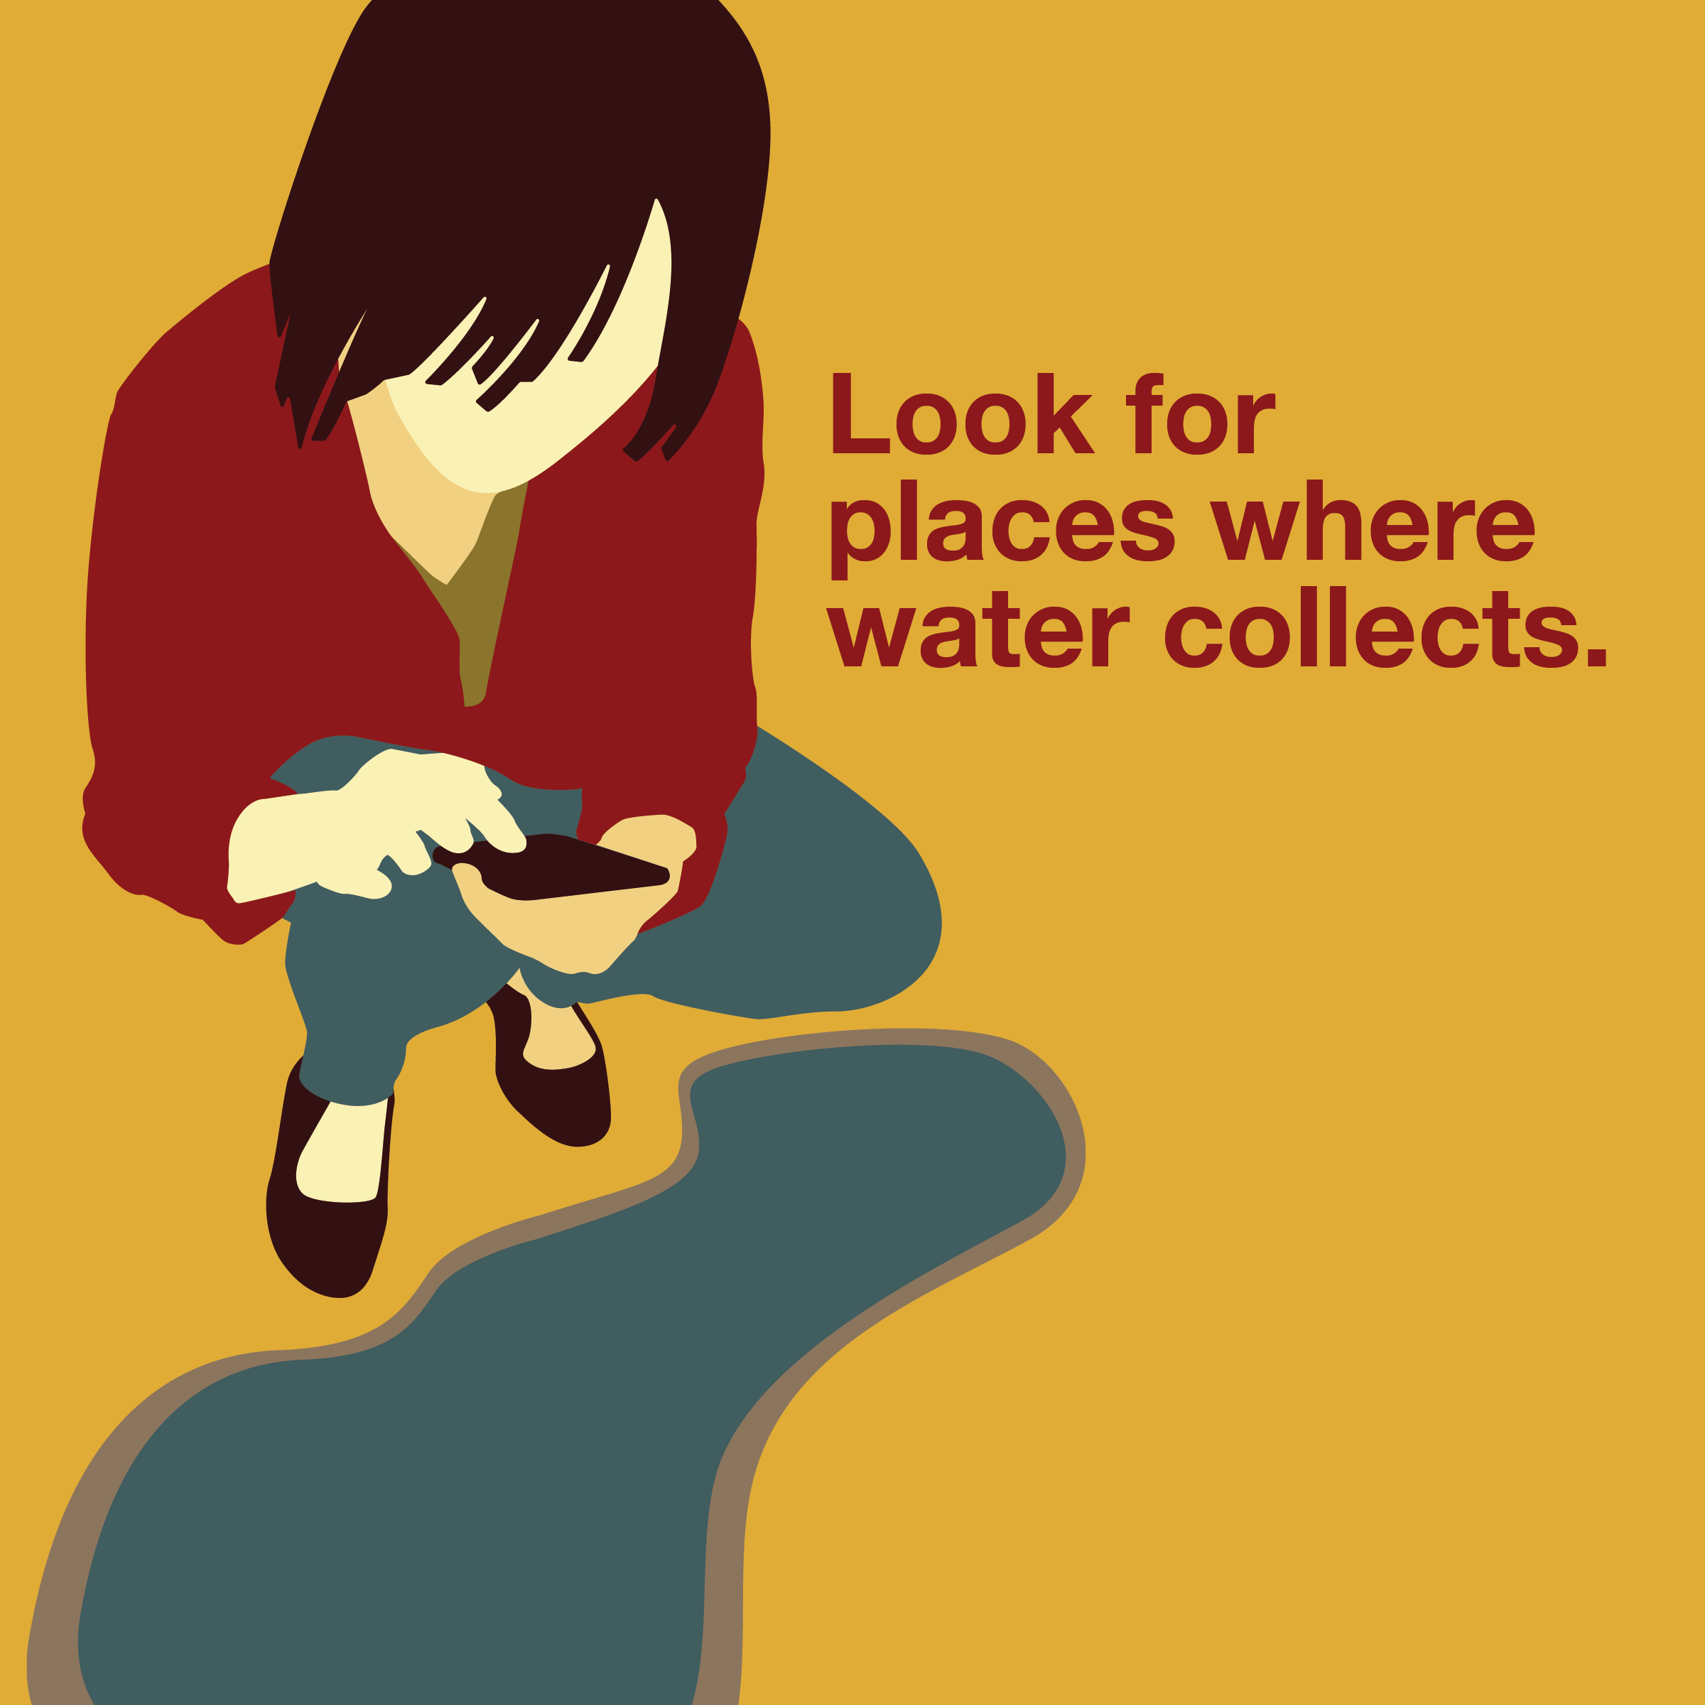
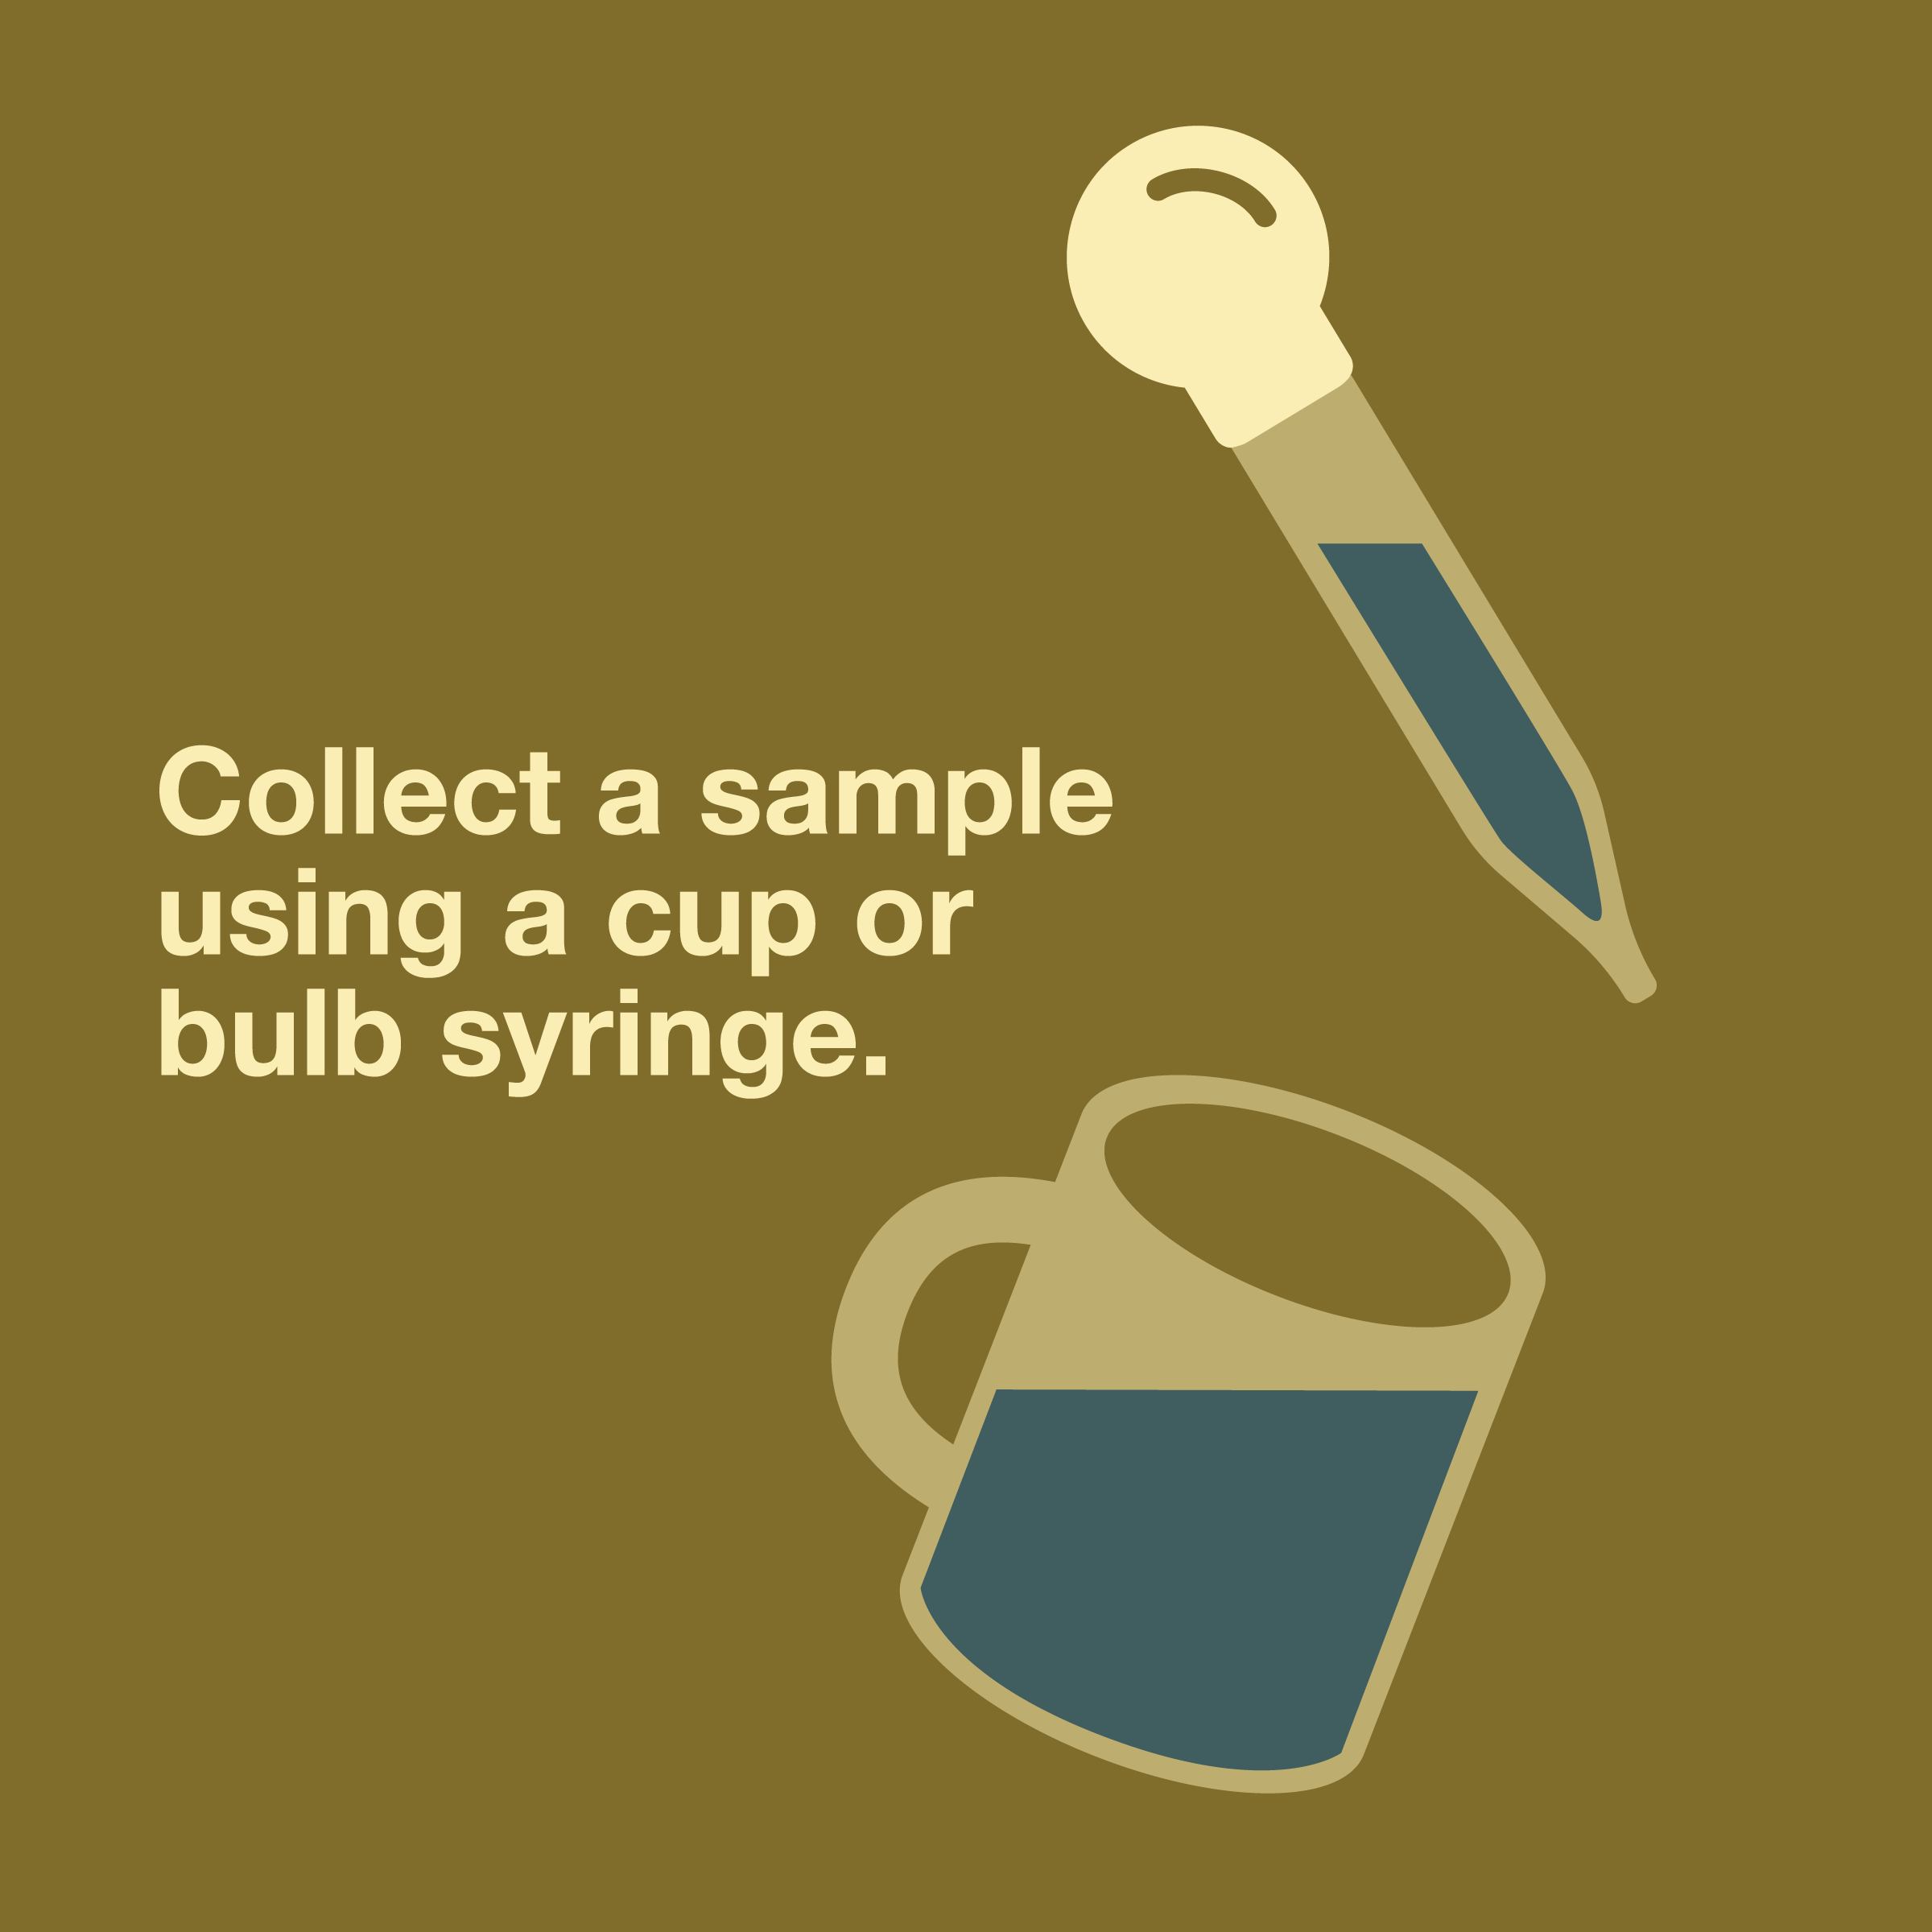
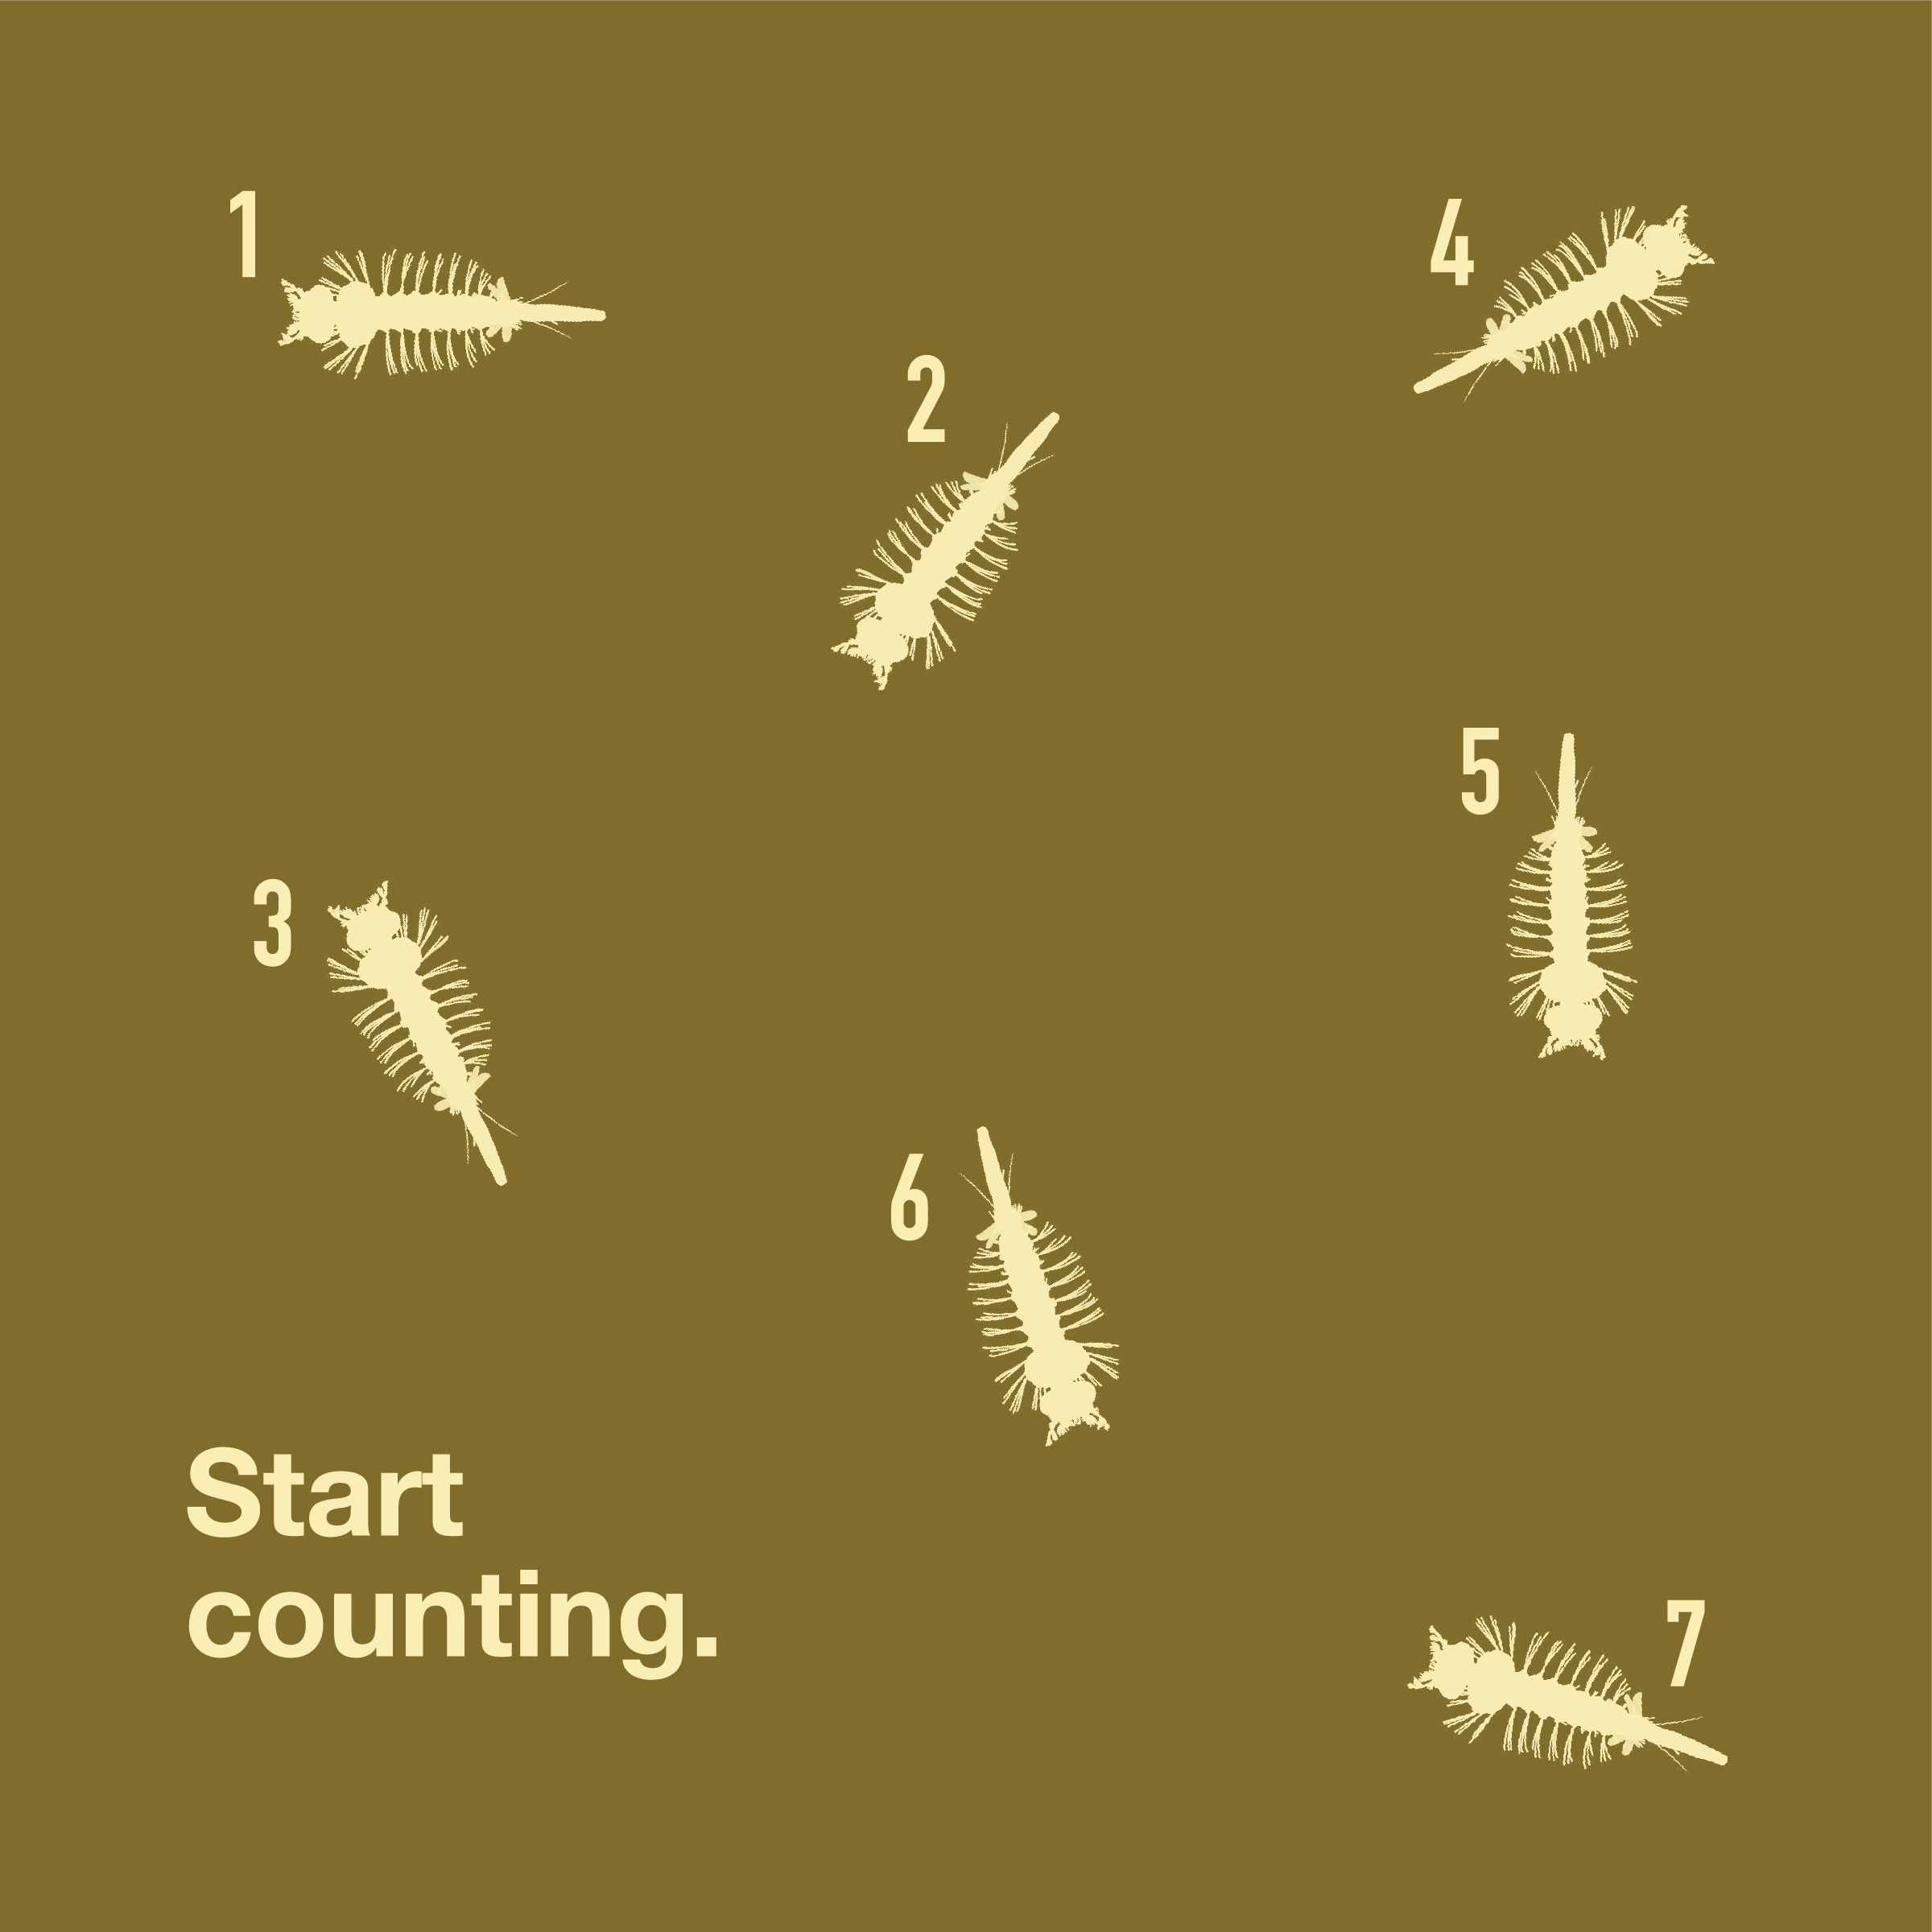
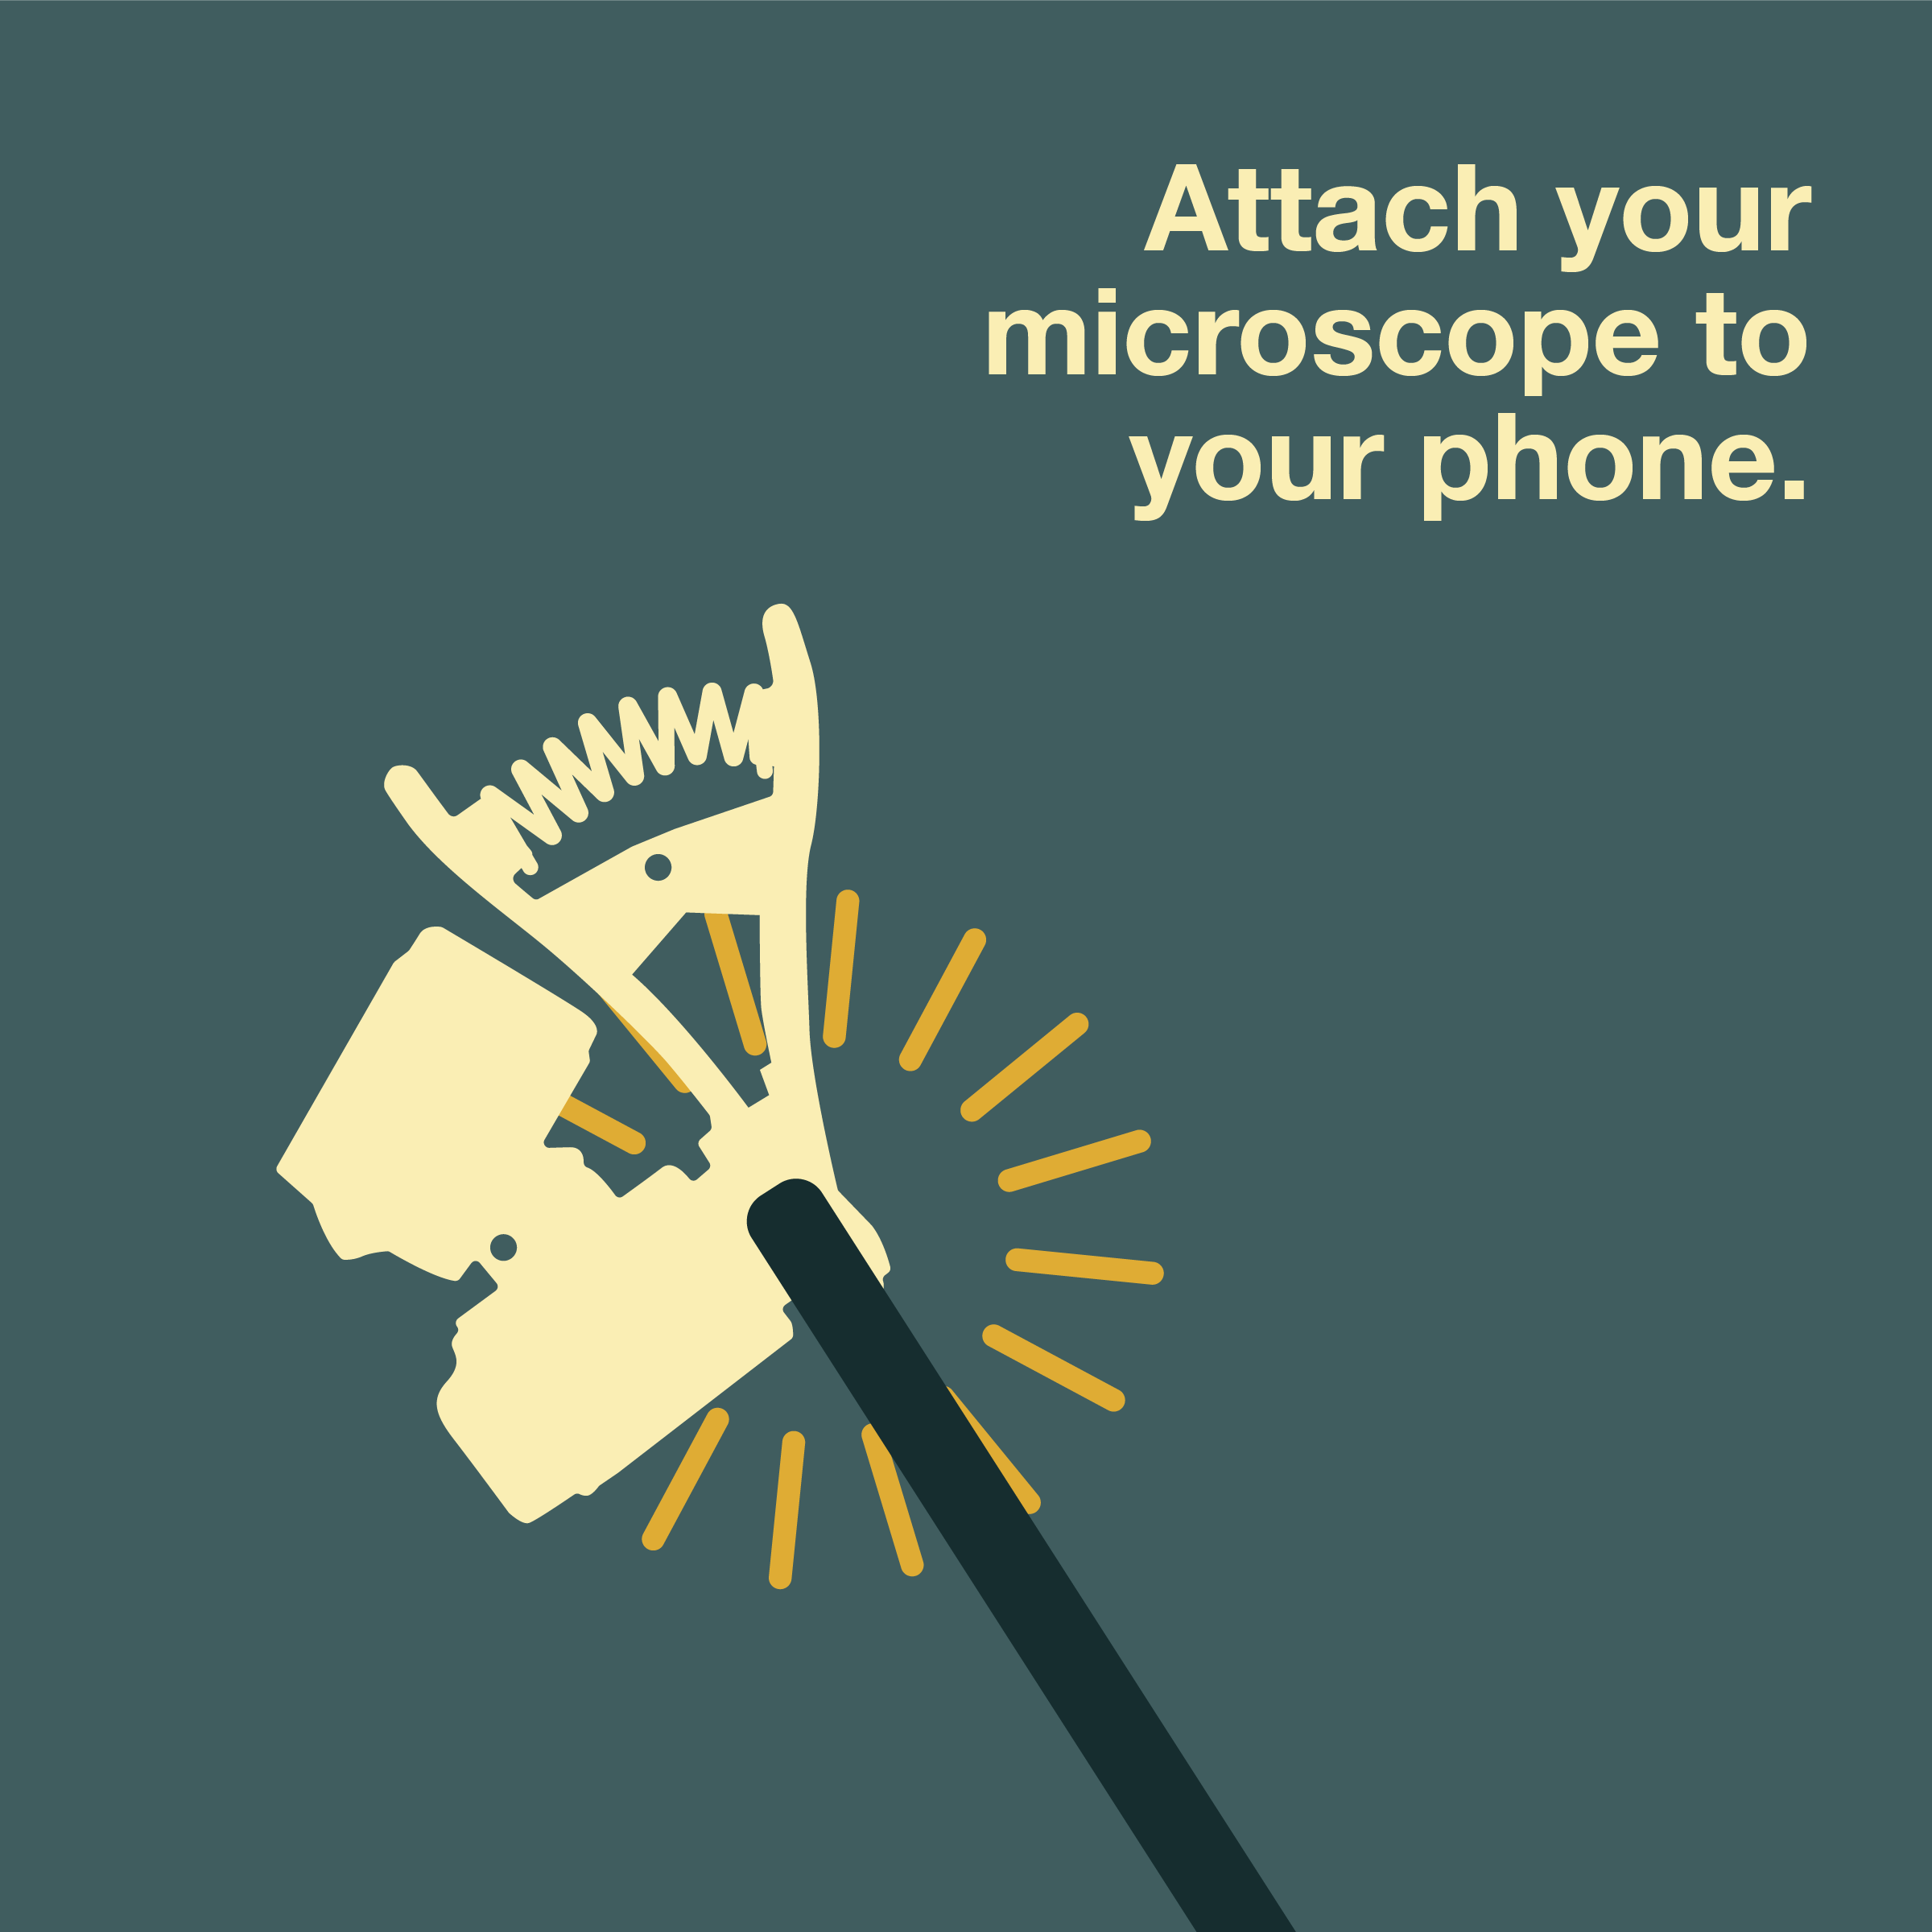
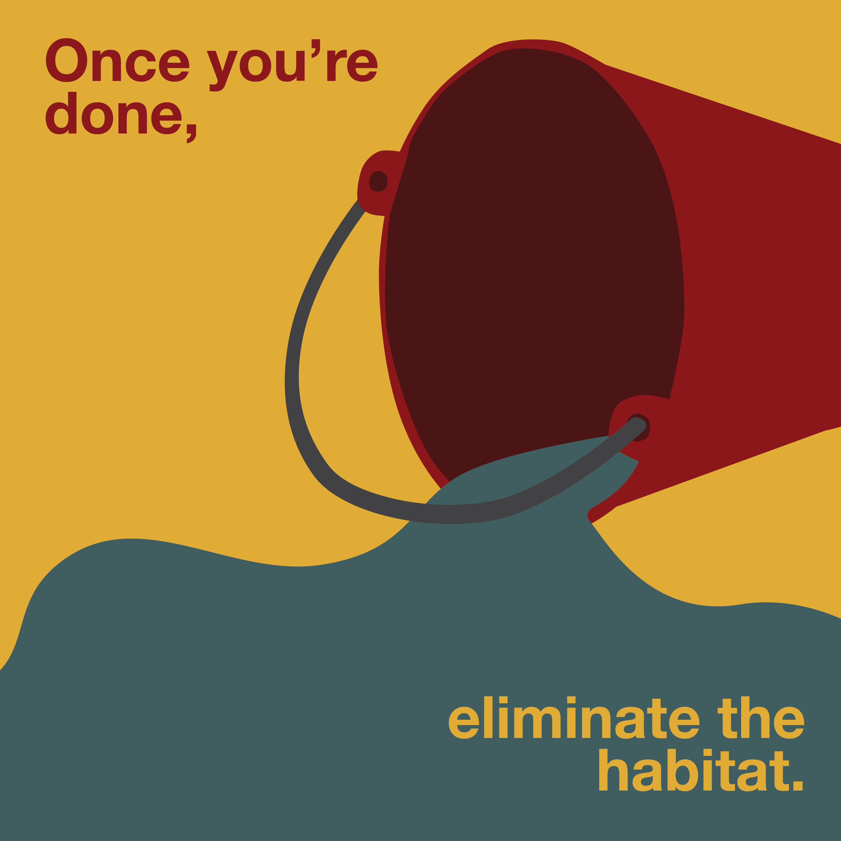
Steps to Good Health and Well Being:
Citizen scientists photograph, identify medically important taxa, upload data, and mitigate the breeding site.
Sharing technological tools that can make a difference in public health
Making opportunity available worldwide, especially in high need and disenfranchised, low resource communities
Promote access to technology and tools
Mobile device access is rapidly increasing- 68% of the world’s population has smartphones, in emerging economies, about 45% of mobiles are smartphones (2020)
Advice:
Yes, not everyone has smart phone but start now- and leverage technology for meaningful SDG outcomes.
Get ready for new technology: now we need to use a magnifying device, but phones will catch up.
Use technology to educate about health and to promote healthful behaviors
Build for multiple languages with ease of expansion
Work closely with community members and organizational partners
Notes:
Mention challenges and advice for future generations who want to also engage in similar sustainability work

Slide 10
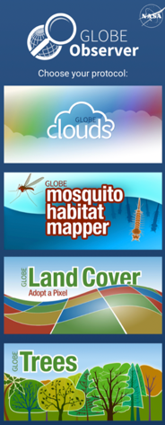

Slide 11
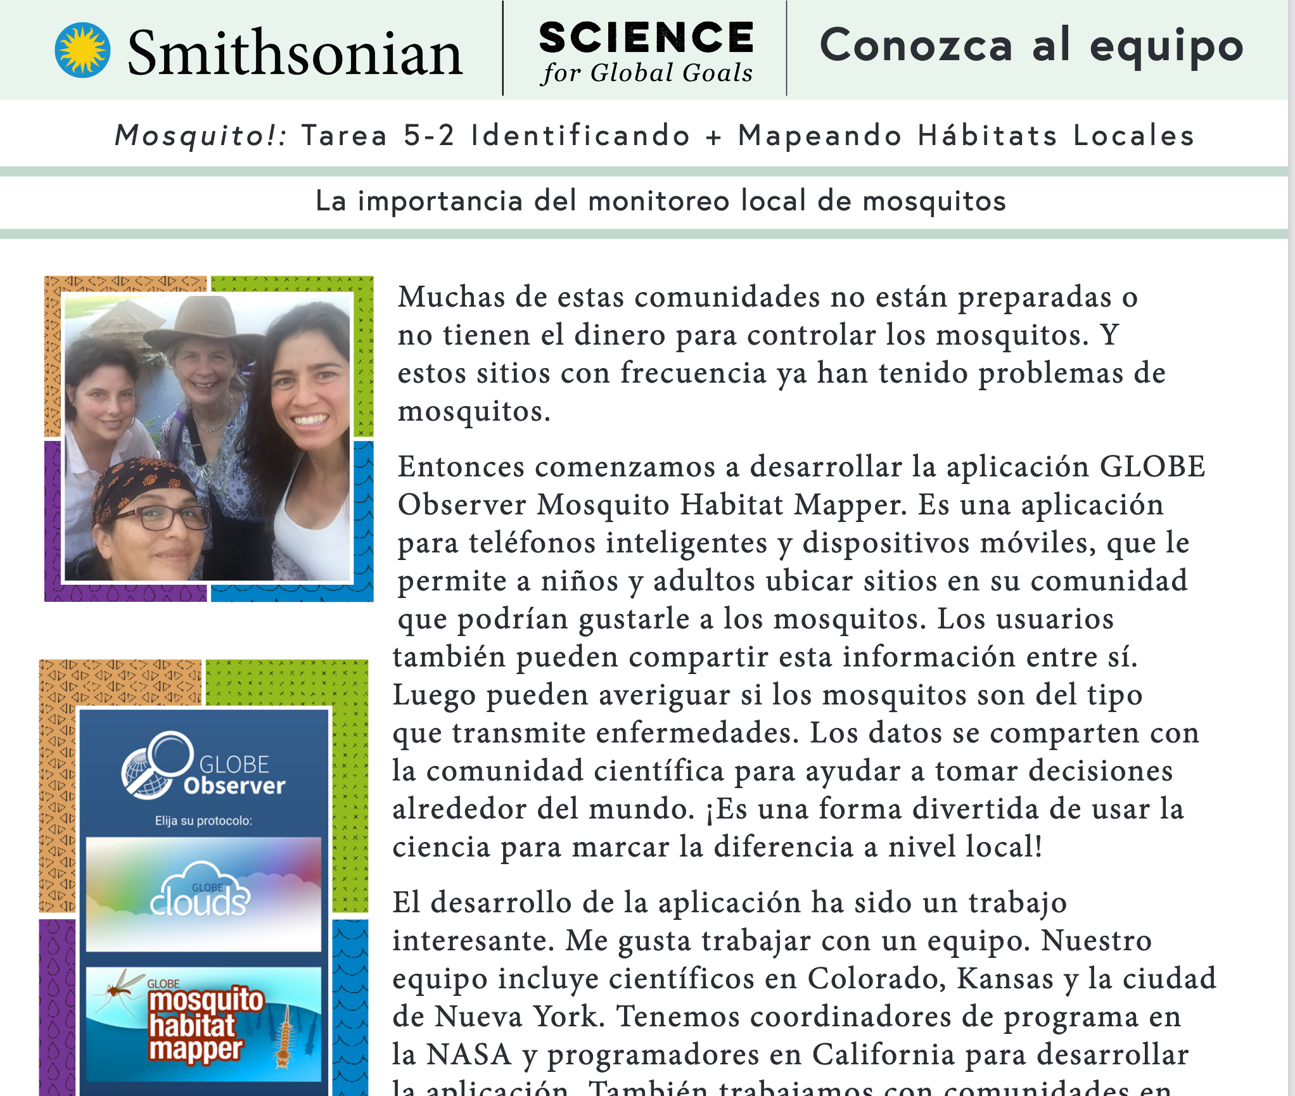
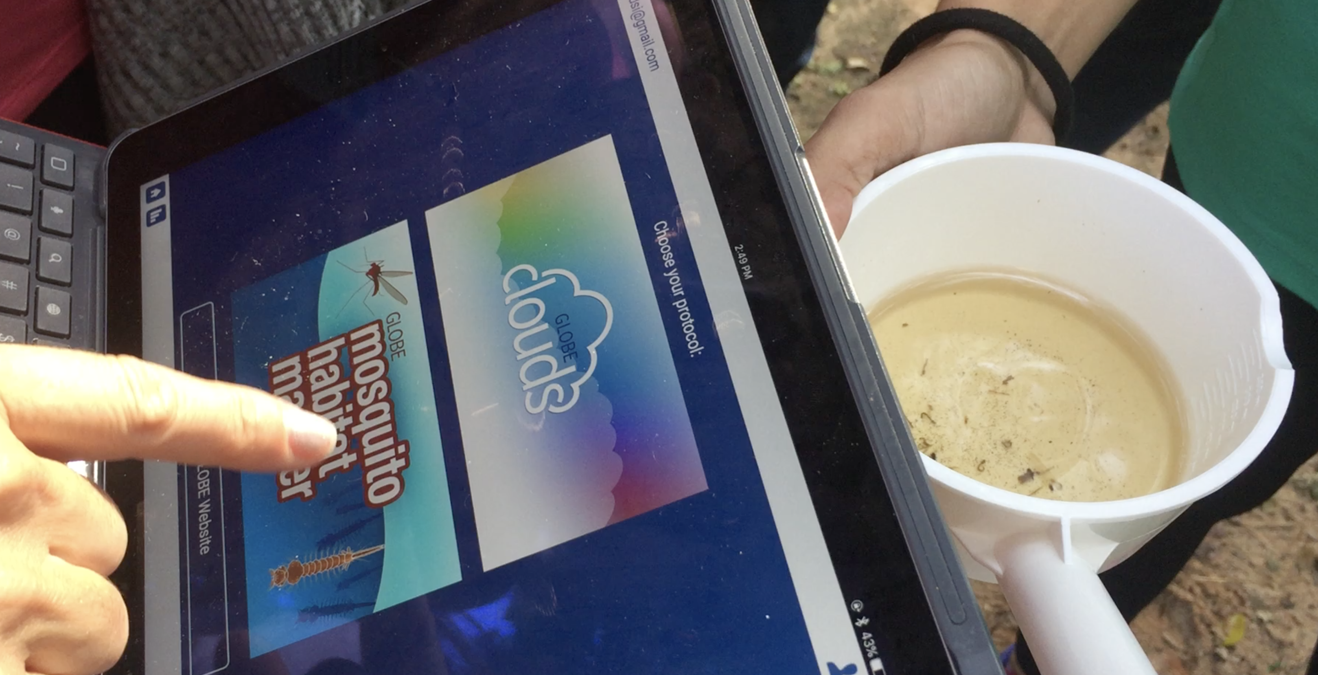

Slide 12
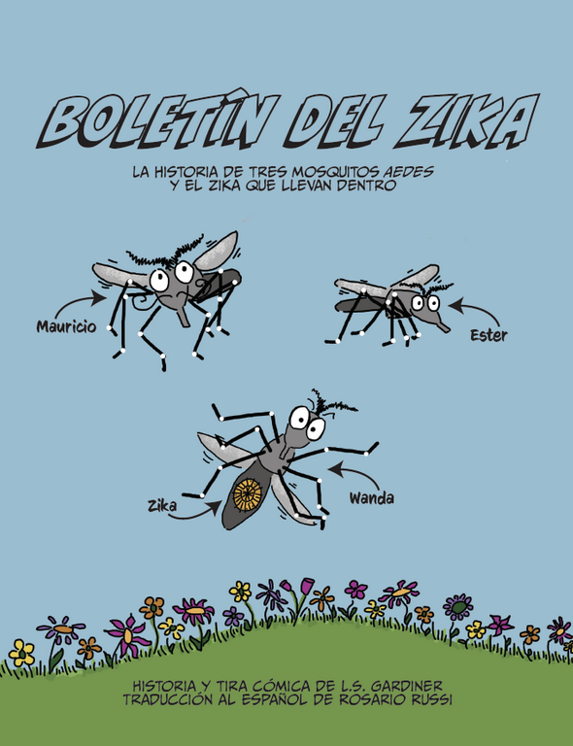
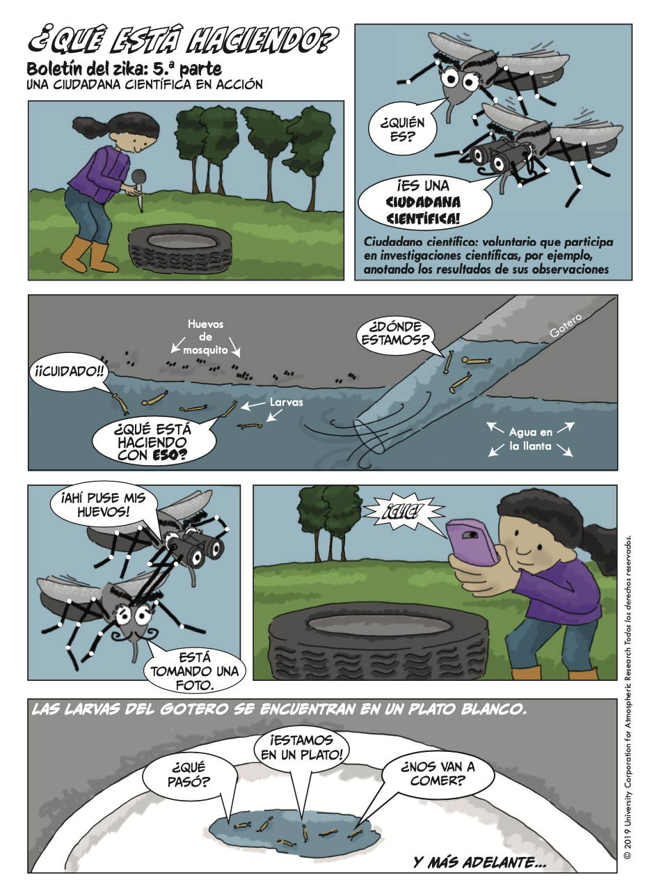

Slide 13
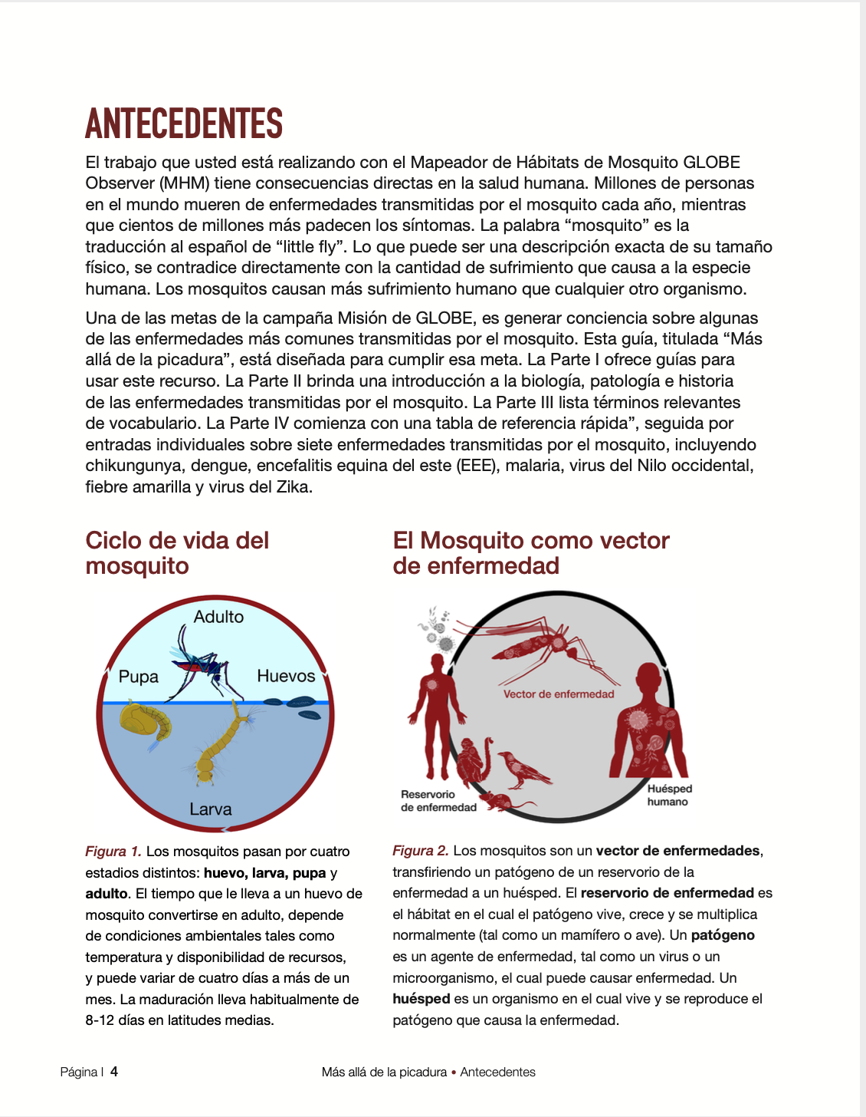
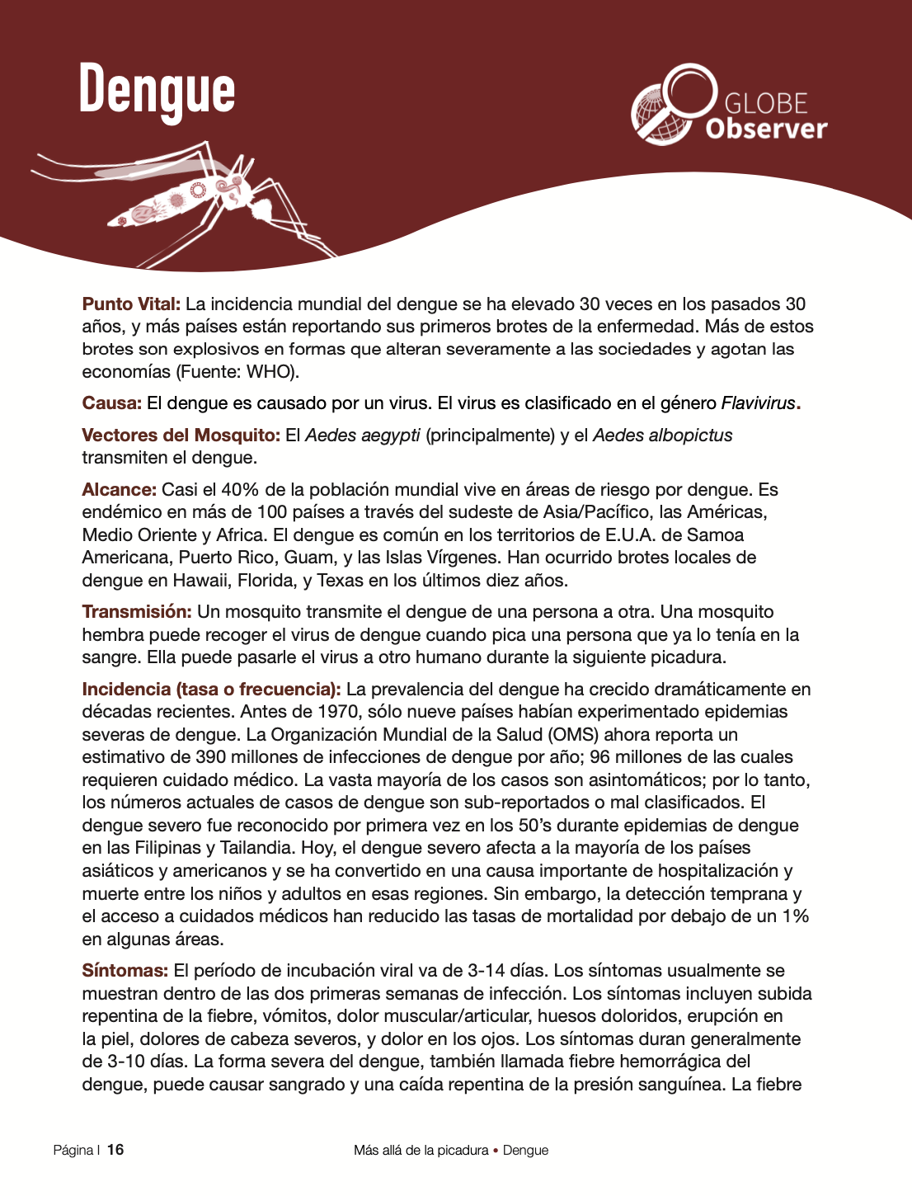
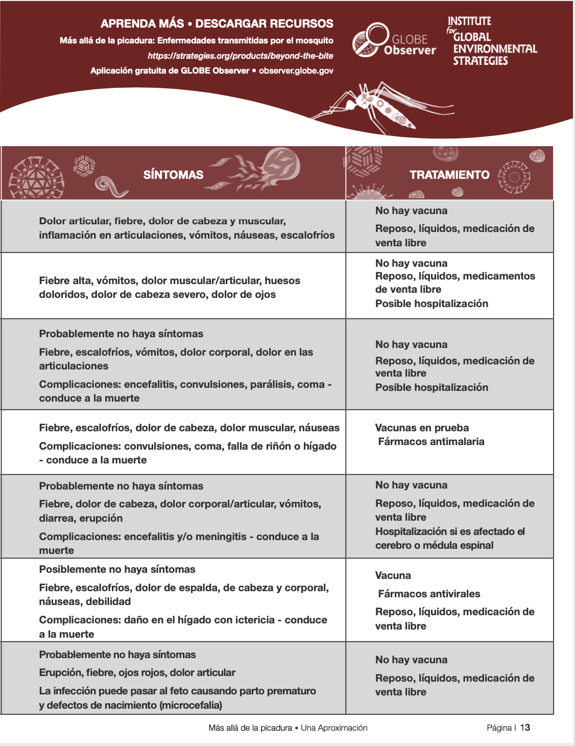
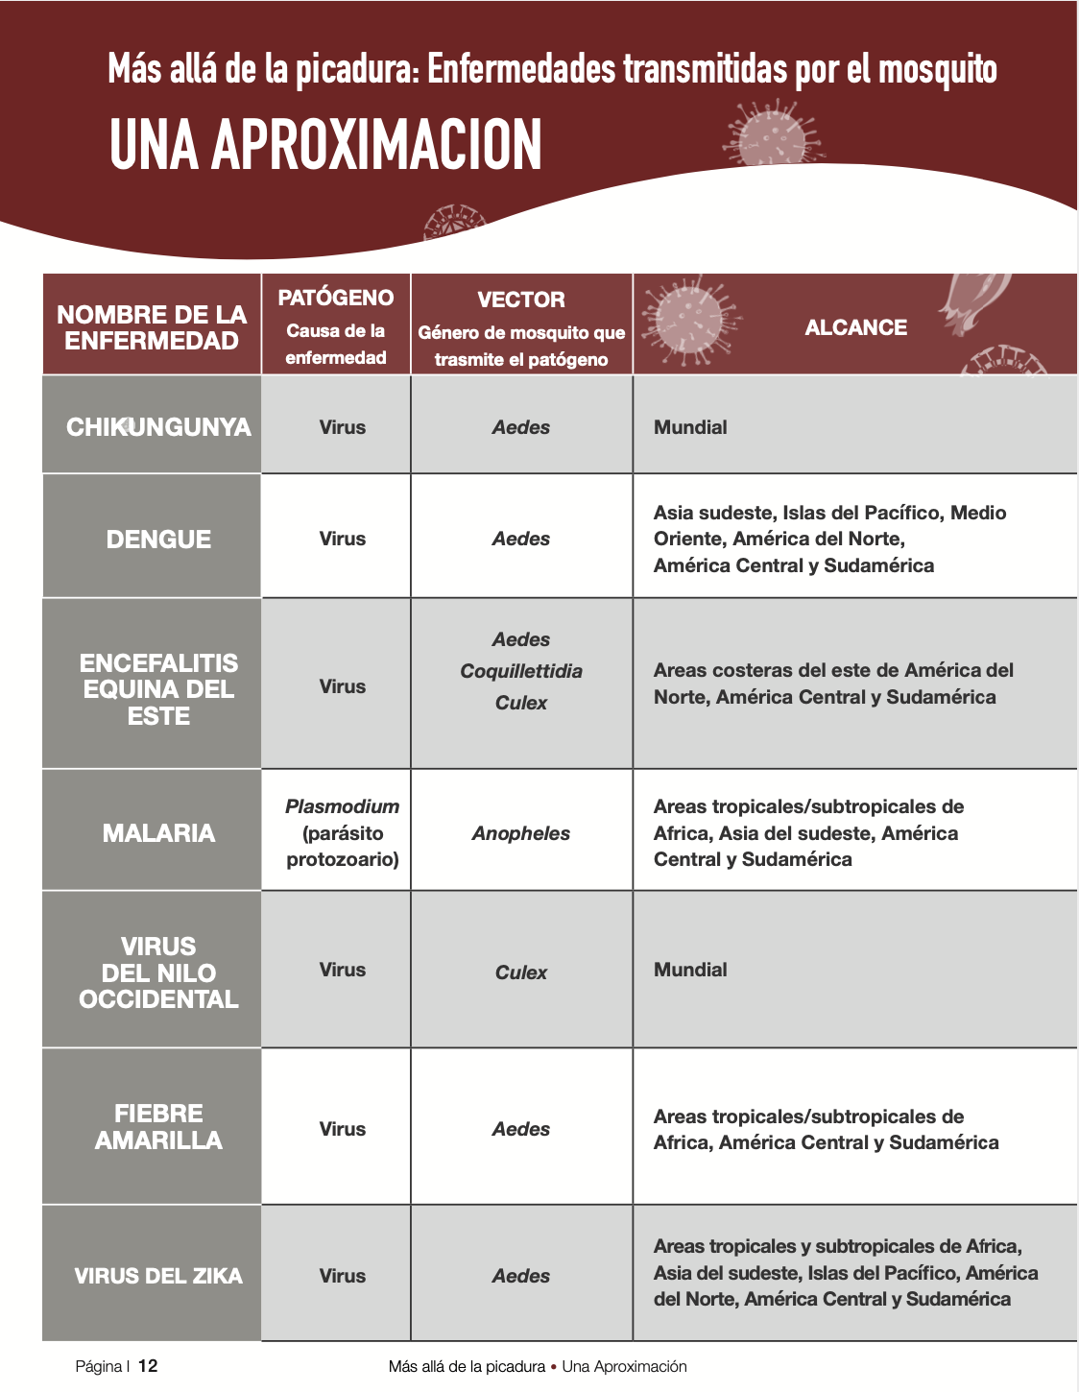

Slide 14
2020 Sustainable Development Goal 4. Youth and the Sustainable Development Goals. United Nations Institute for Training and Research. Course available at: https://www.unitar.org/event/full-catalog/youth-sustainable-development-goals.
Link to video: https://www.youtube.com/watch?v=gdt_KVu9_L8&feature=youtu.be
Notes:
GLOBE Observer Mission Mosquito Campaign coincides with the goals of Agenda 2030

Slide 15
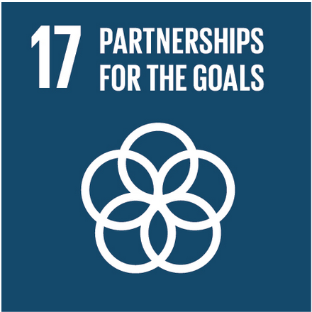
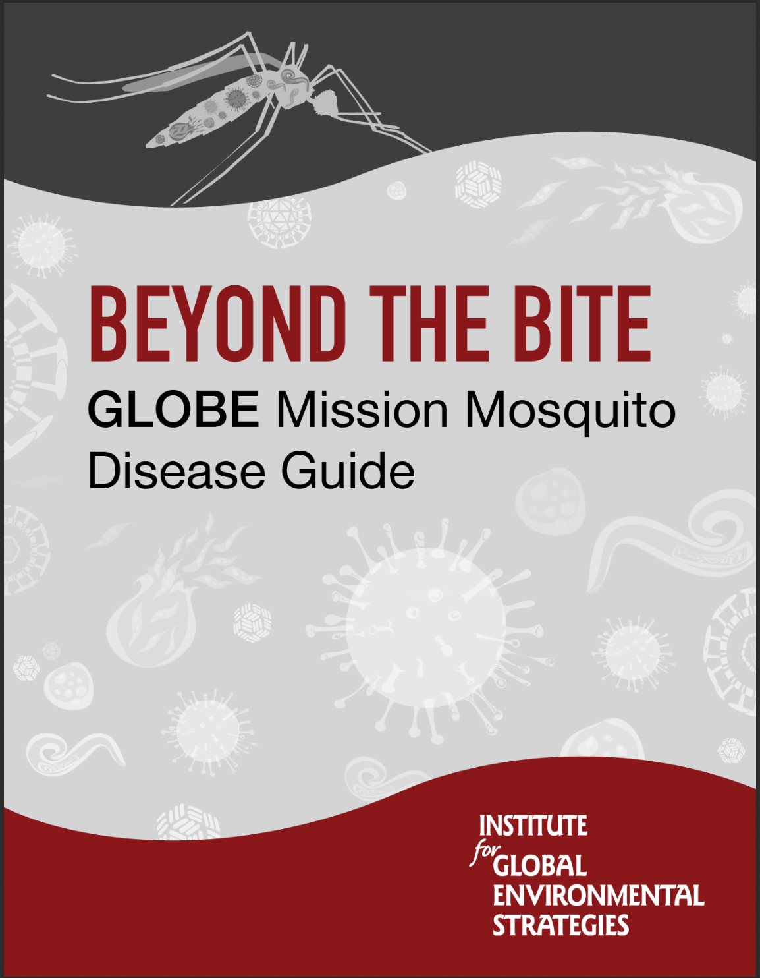
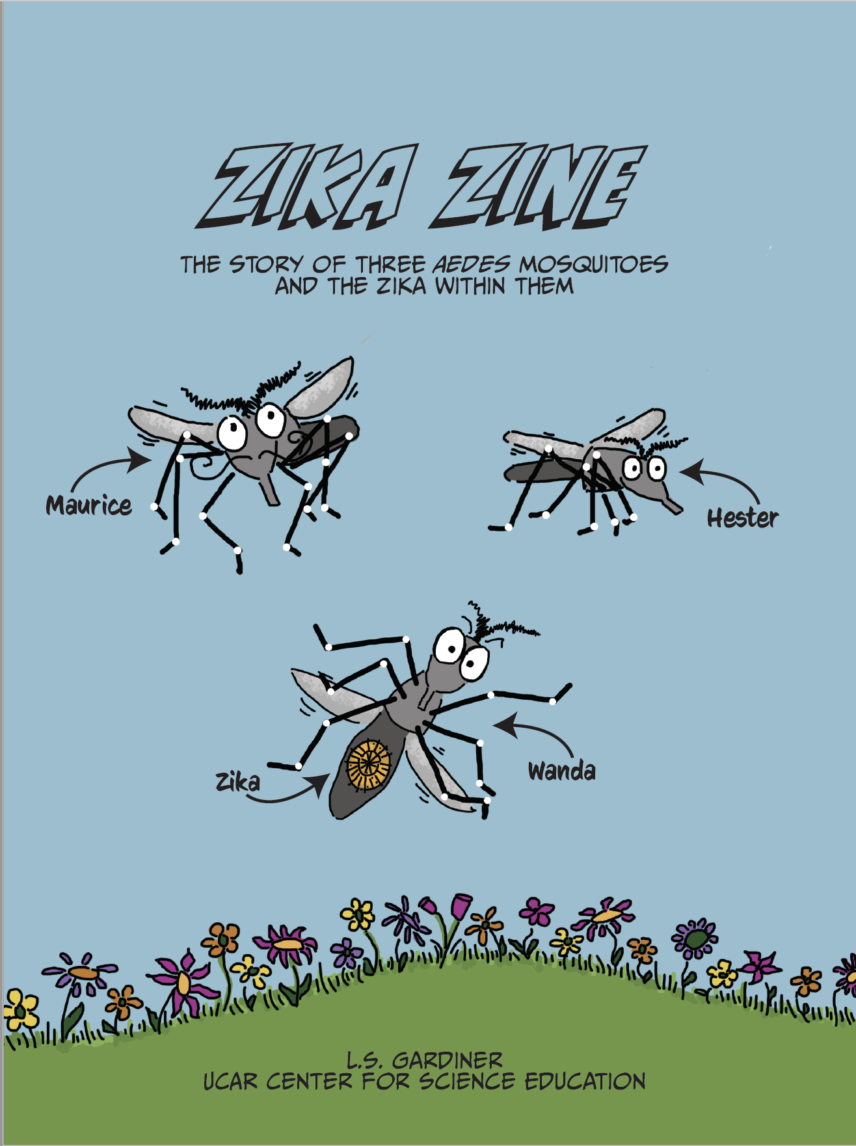
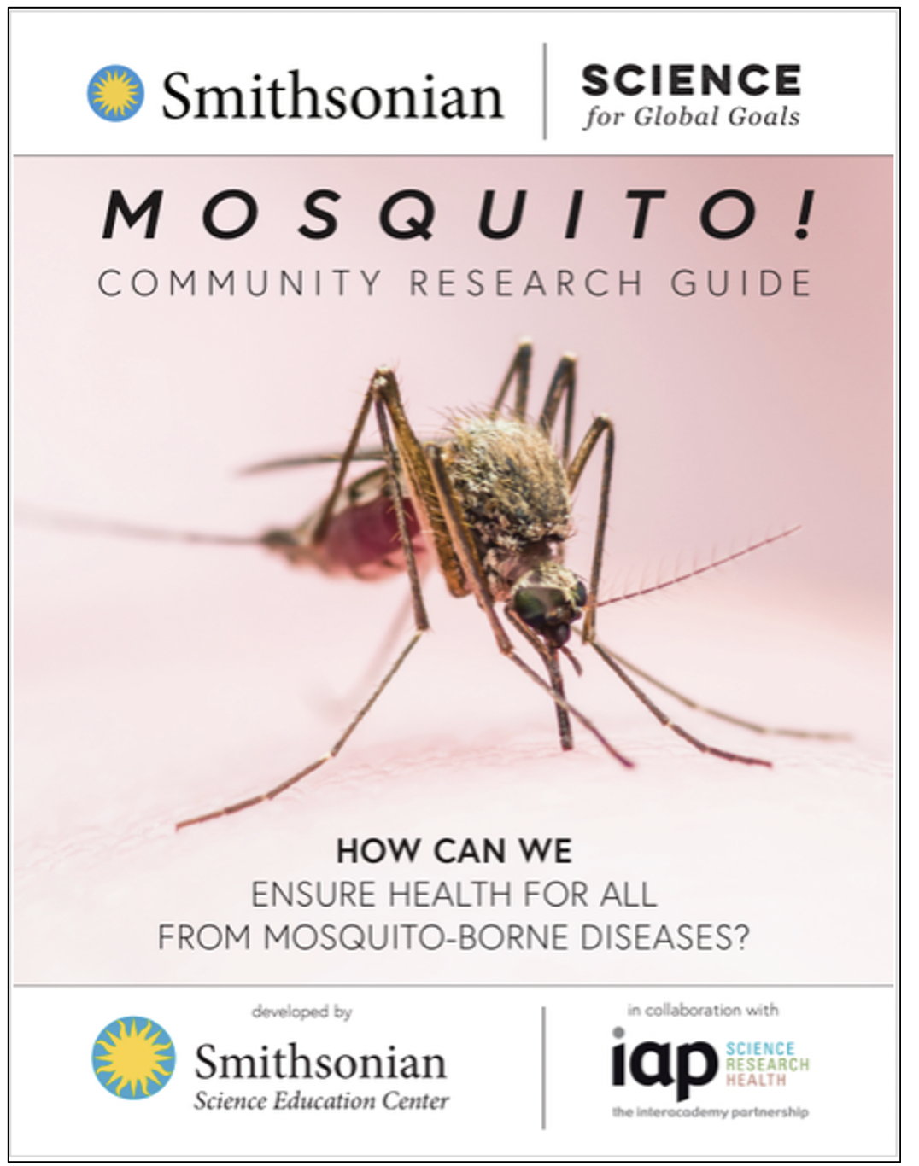
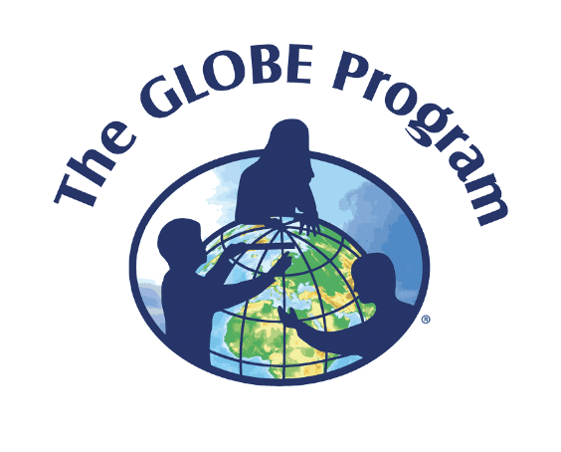
https://observer.globe.gov/
https://www.globe.gov/web/mission-mosquito/overview
https://ssec.si.edu/mosquito-espanol
https://strategies.org/wp-content/uploads/2020/06/BeyondTheBite_SPANISH.pdf
https://scied.ucar.edu/zikazine
Contact information:
GLOBE Observer Mosquito Habitat Mapper
rusty_low@strategies.org

