Slide 1
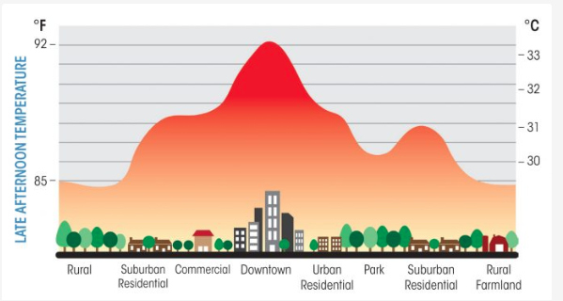
GLOBE Urban Heat Island Effect Intensive Observation Period (IOP)
Kevin Czajkowski
Department of Geography and Planning
The University of Toledo

Slide 2
Kevin Czajkowski - About me
Blizzard of ‘77 – Western NY
Became a Meteorologist
PhD Atmospheric Sciences at University of Michigan
Professor at U. Toledo

Slide 3
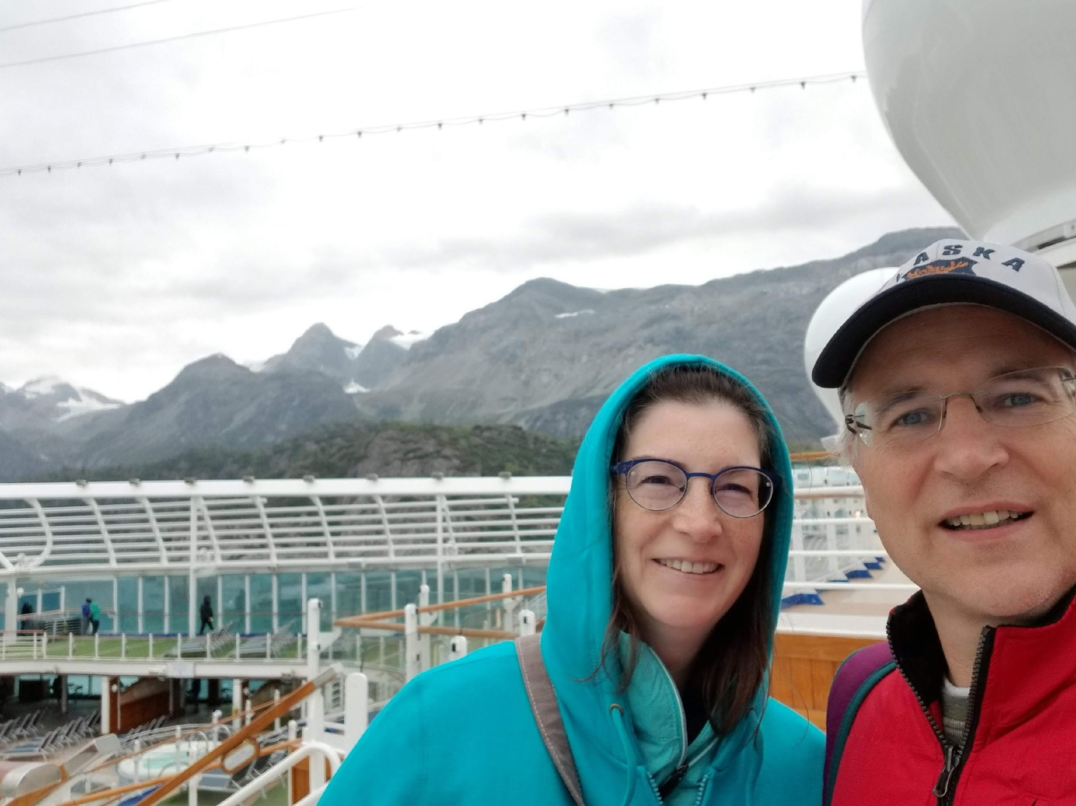
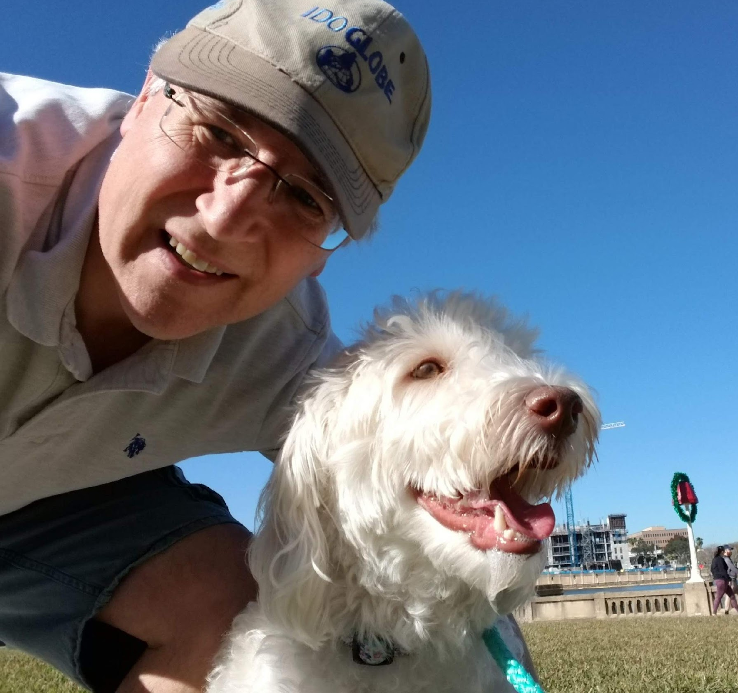
Kevin Czajkowski - About me
Married to Kathleen
Timmy 21
Robby 26
Ice rink in backyard
Coco

Slide 4
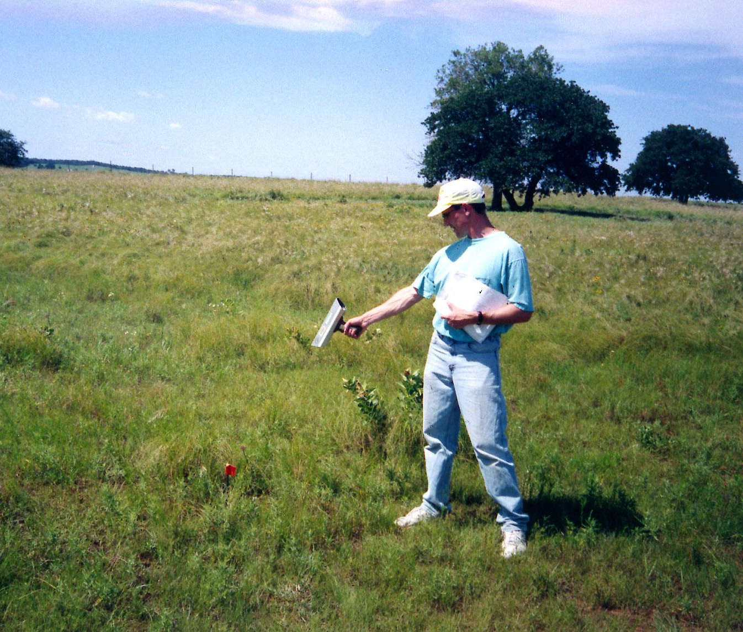
The Start: Southern Great Plains 1999 (SGP99) experiment
Tested surface temperature and soil moisture remote sensing on aircraft and field observations
Led to the SMAP satellite (Soil Moisture Active Passive)

Slide 5
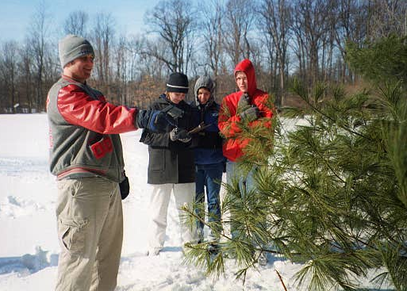
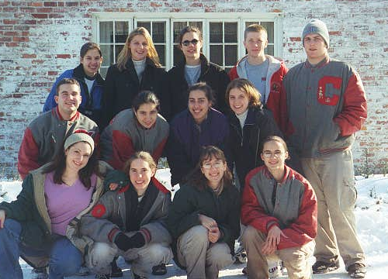
Central Catholic High School Students Tried Out the IRT’s - 2002
Inner-city schools
cannot take many other
GLOBE observations

Slide 6
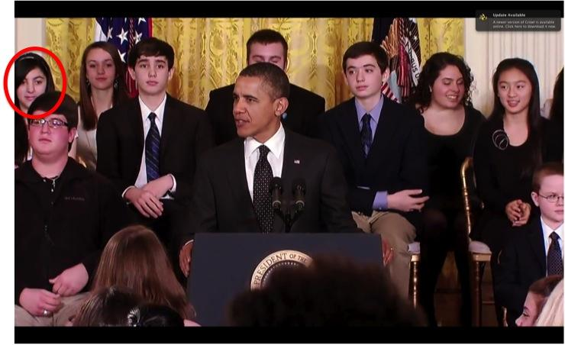
3 GLOBE Groups have visited the White House for Science Fairs

Slide 7
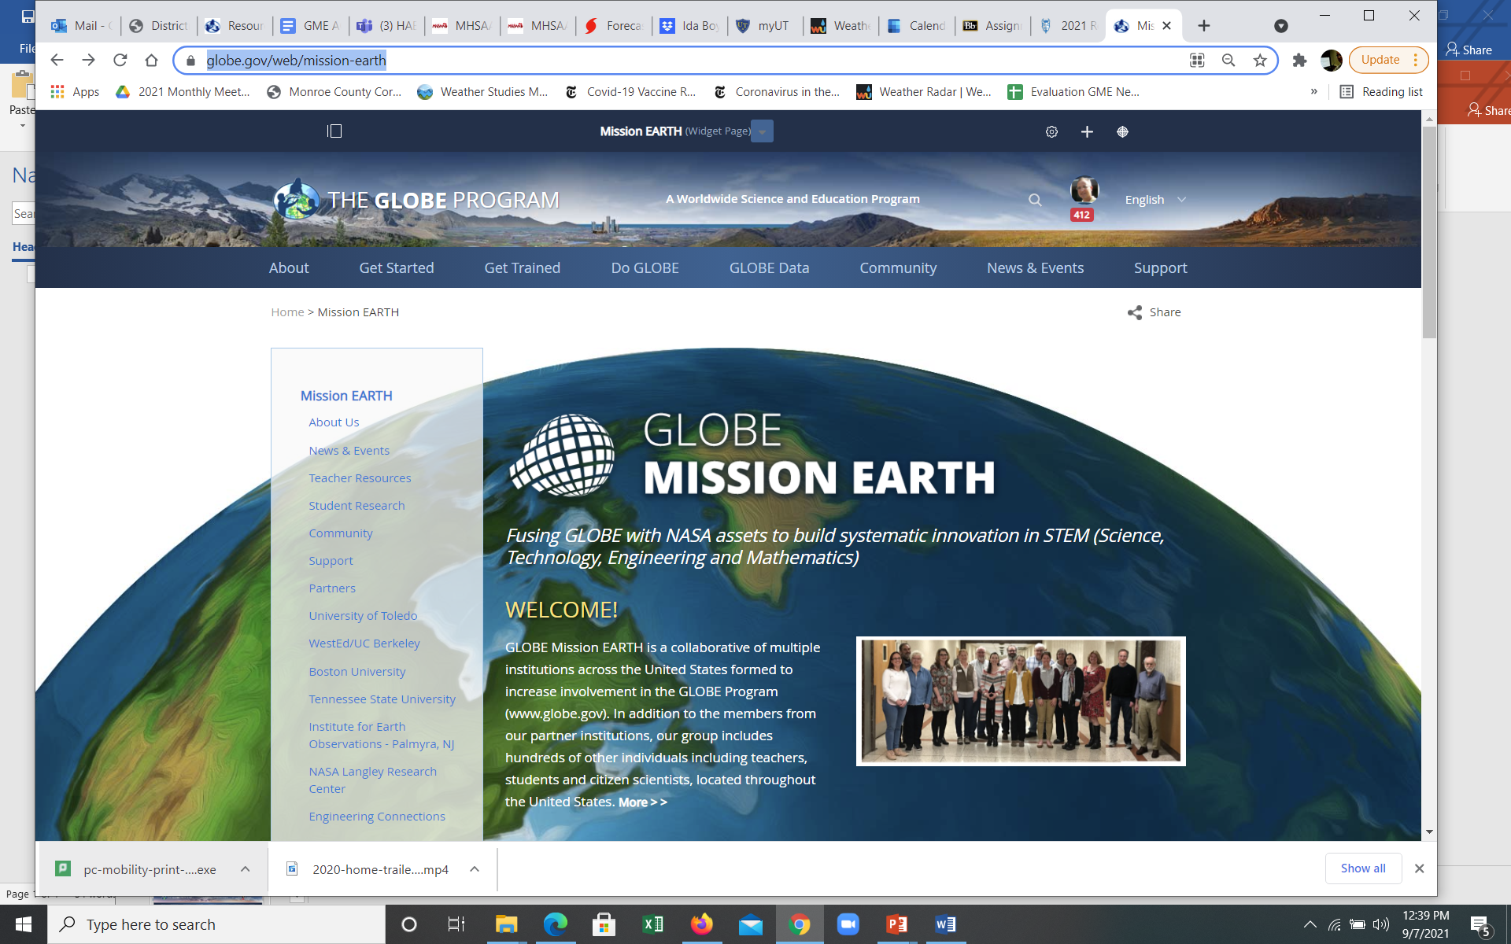
In 2016 GLOBE Mission EARTH was funded by NASA Science Activation Program

Slide 8
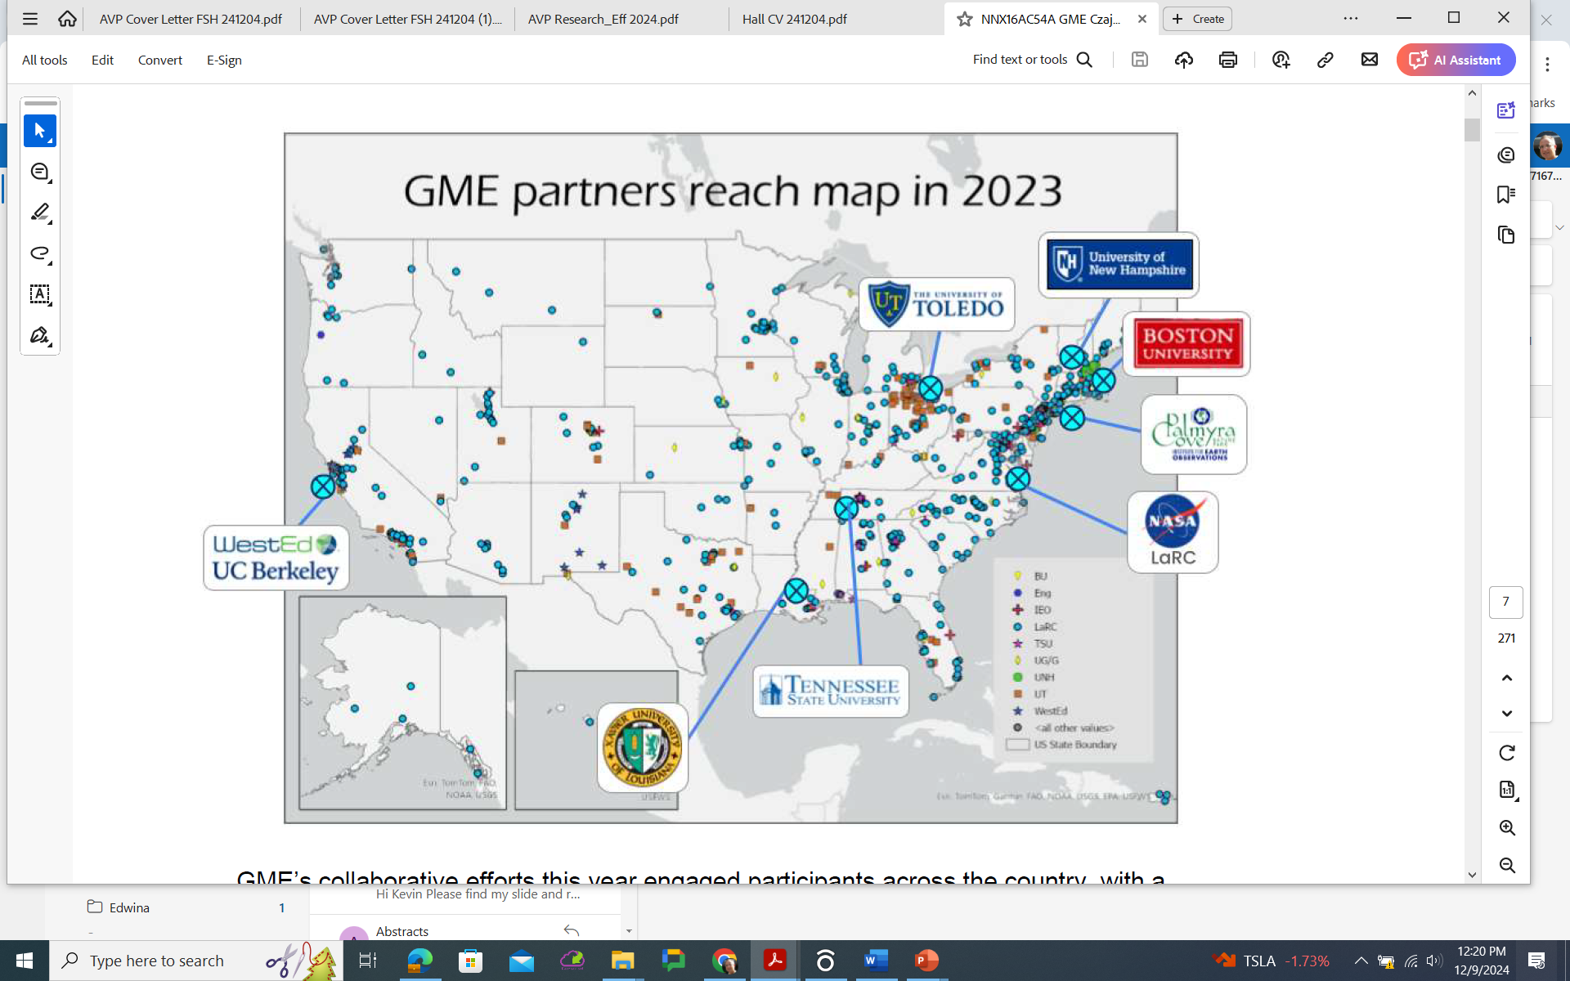
GLOBE MISSION EARTH
Fusing GLOBE with NASA Assets to Build Systemic
Innovation in STEM Education

Slide 9
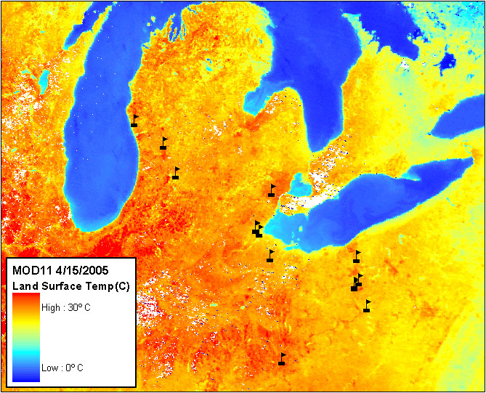
MOD11 Surface Temperature Image with GLOBE Ts Schools, April 15, 2005
Image from the Institute for Computational Earth System Science(ICESS), University of California, Santa Barbara, Zhengming Wan, Product PI

Slide 10
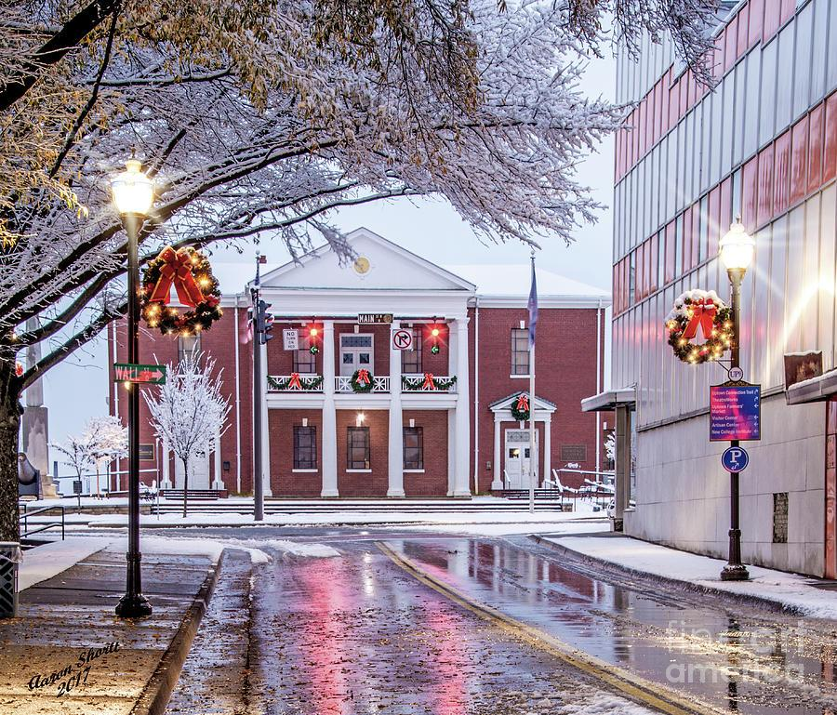
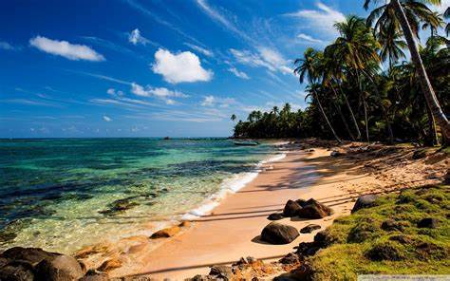
Think about
You experience your own “heat islands” every day
Coldest and warmest places outside?

Slide 11
Urban Heat Island in Winter – Driving from Rossford Dome to my house one cold evening
-11 F (-24 C)
7 F (-14 C)
-8 (-22 C) F

Slide 12
Surface temperature observations in the last 5 years

Slide 13
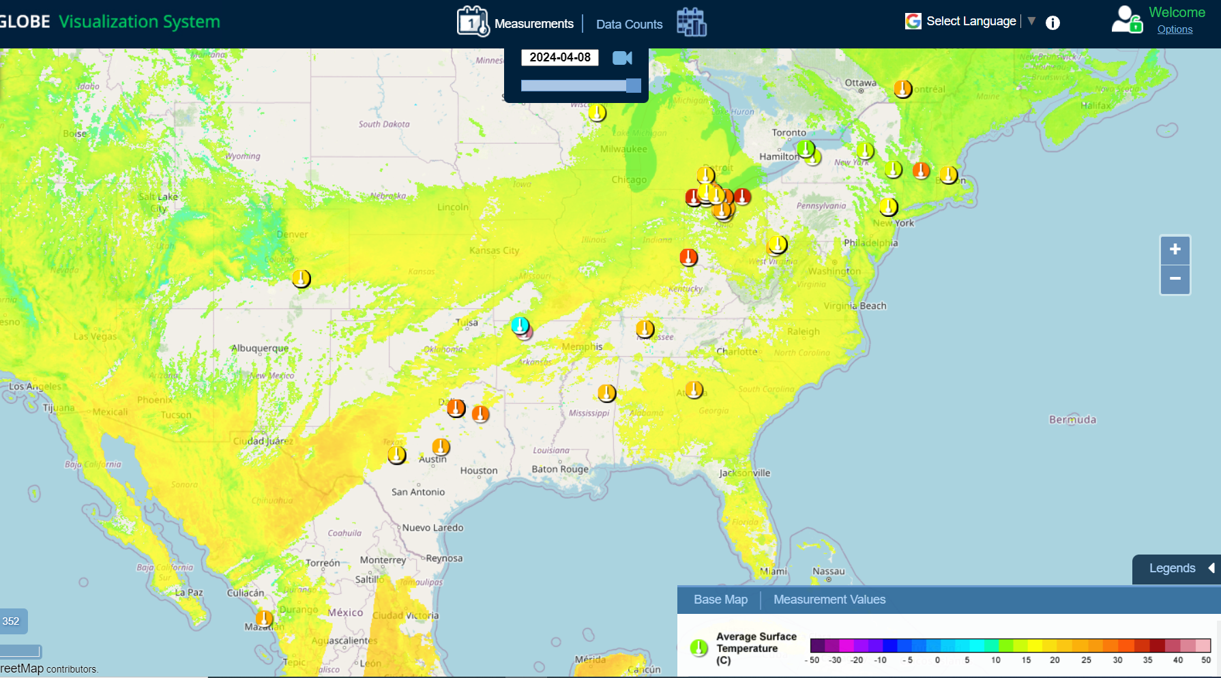
MODIS Terra LST vs. student surface temperature

Slide 14
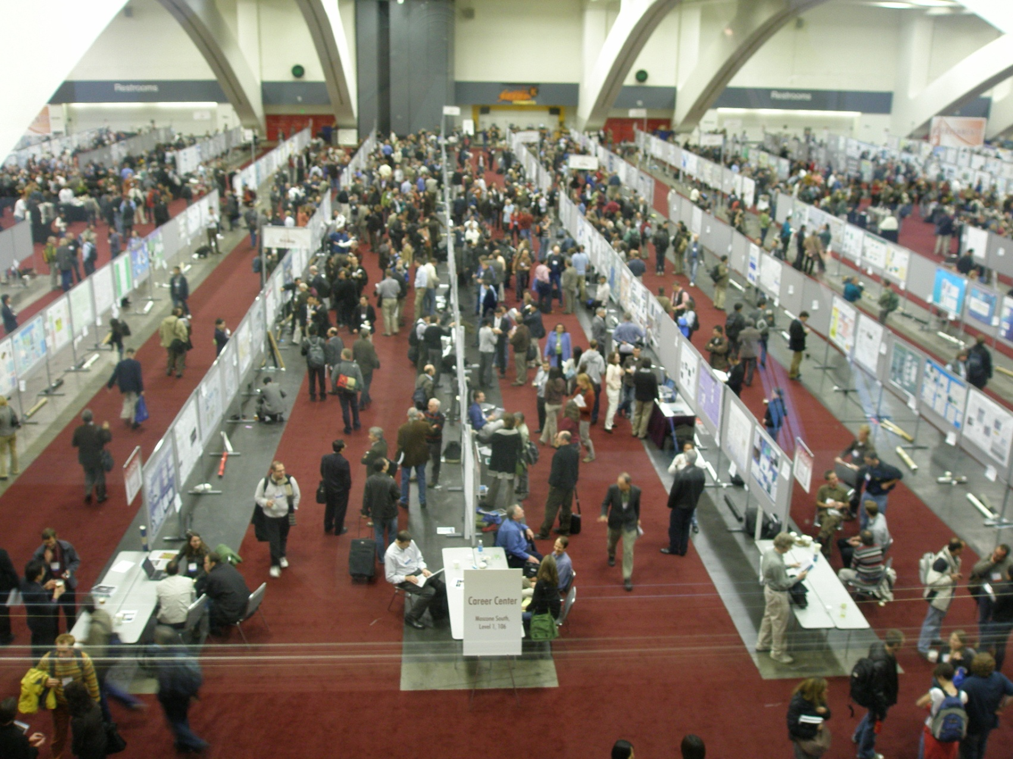
Scientists Present at large conferences:
American Geophysical Union Meeting

Slide 15
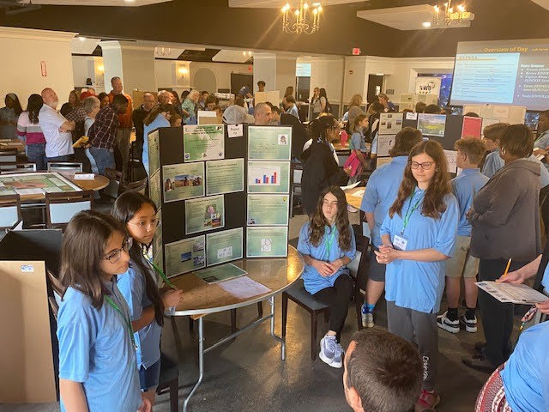
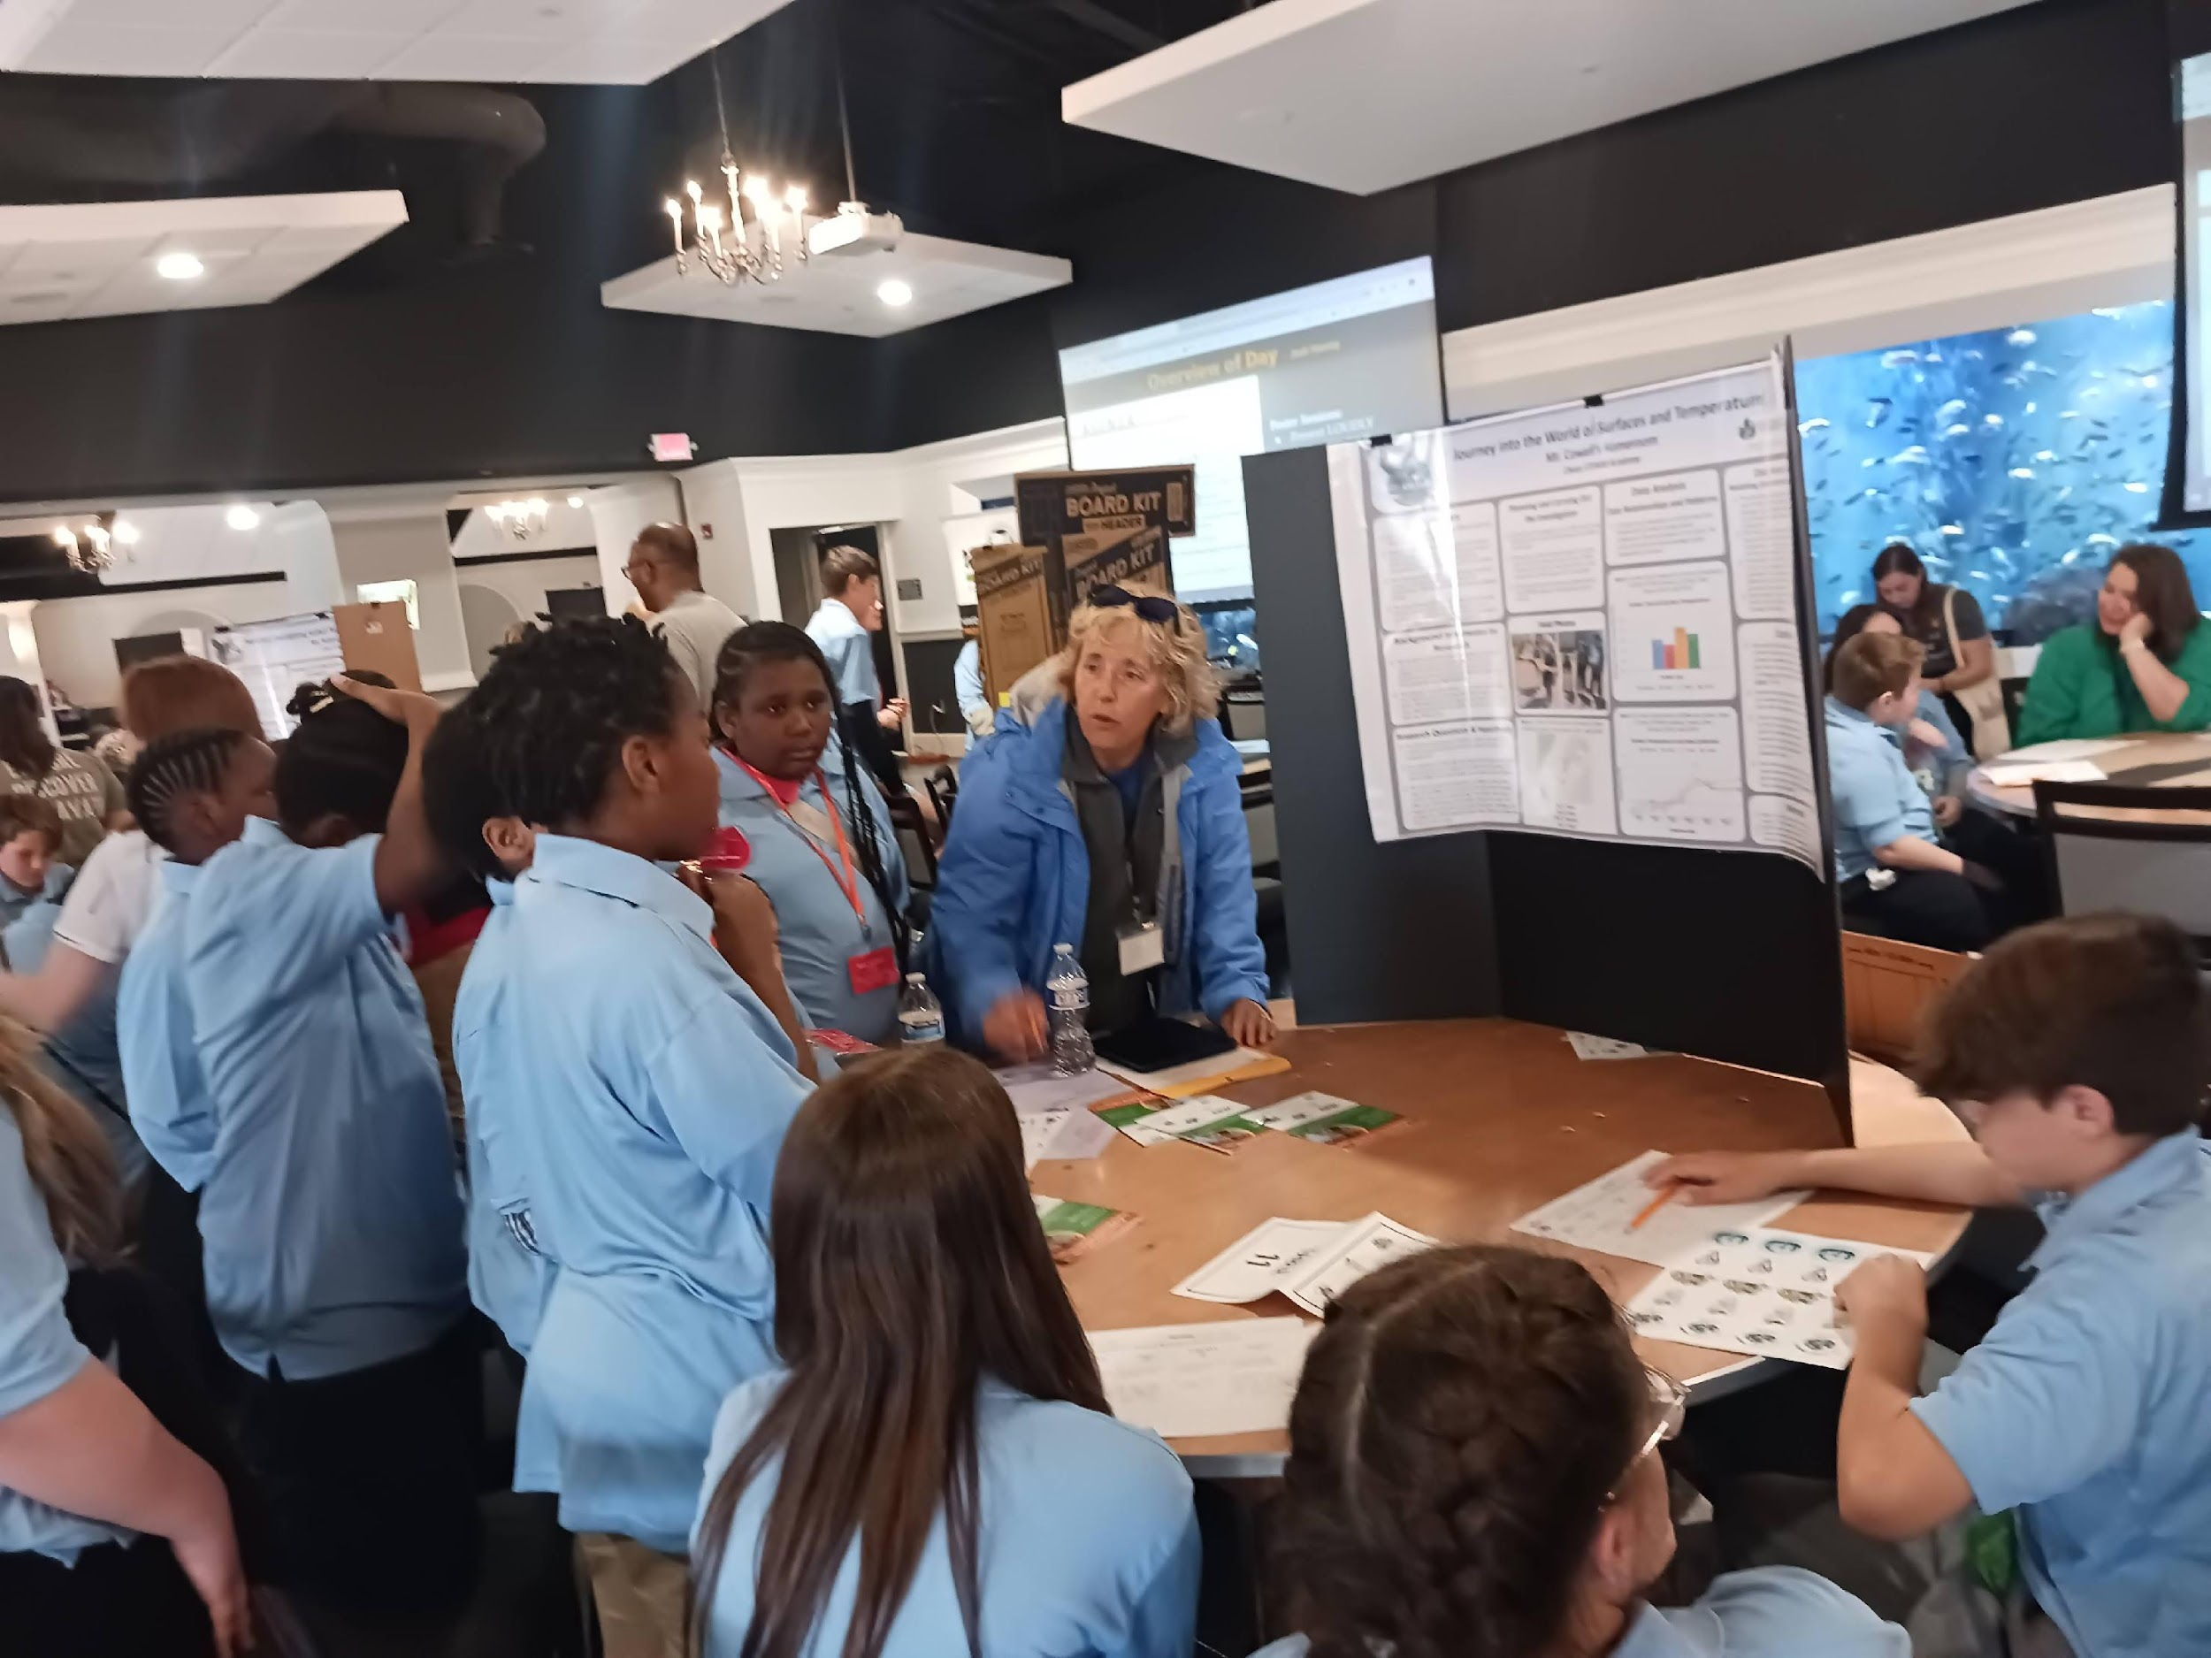
Supporting Students Presenting Their Research
Notes:
Learn protocols
Collect data
Do research
Present research
Receive recognition for their achievement

Slide 16
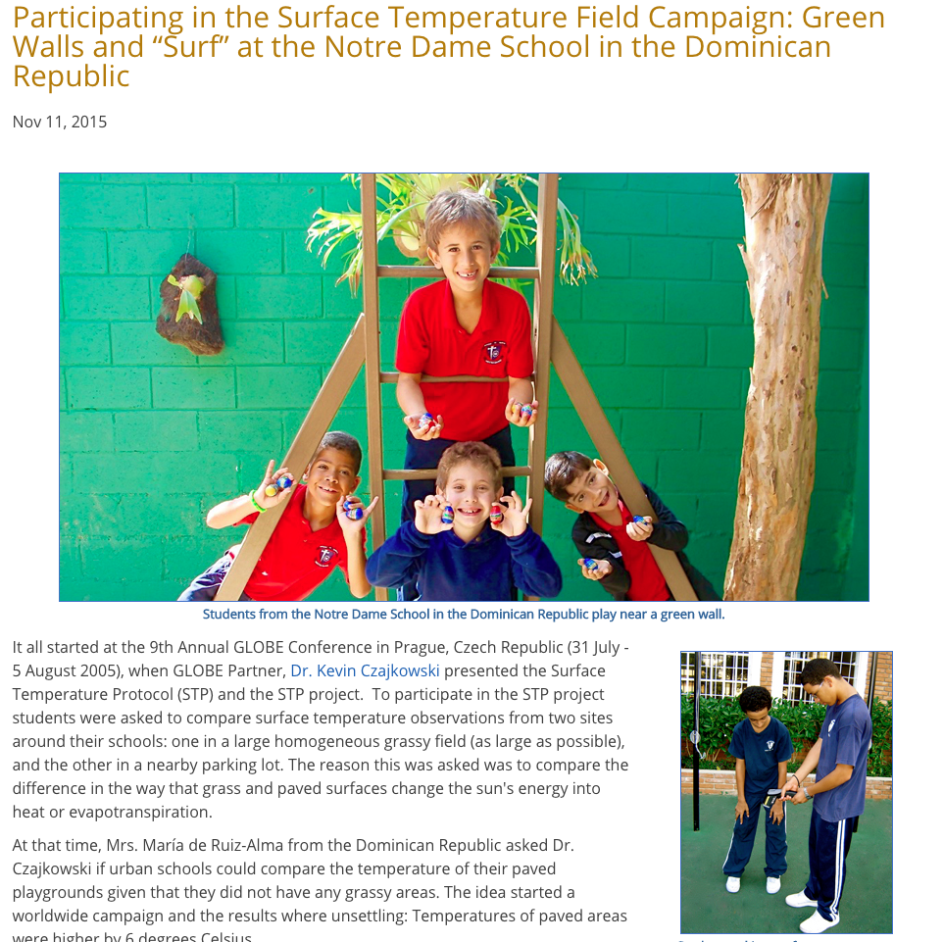
https://www.globe.gov/news-events/globe-news/-/newsdetail/globe/2015-surface-temperature-field-campain

Slide 17
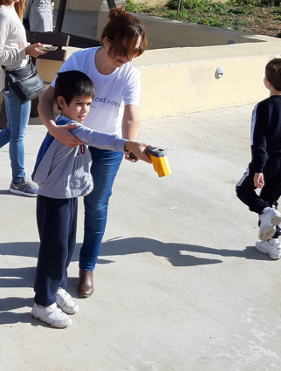
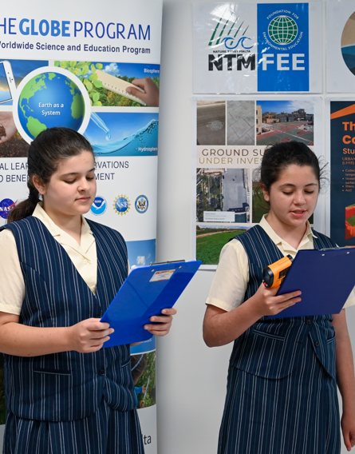
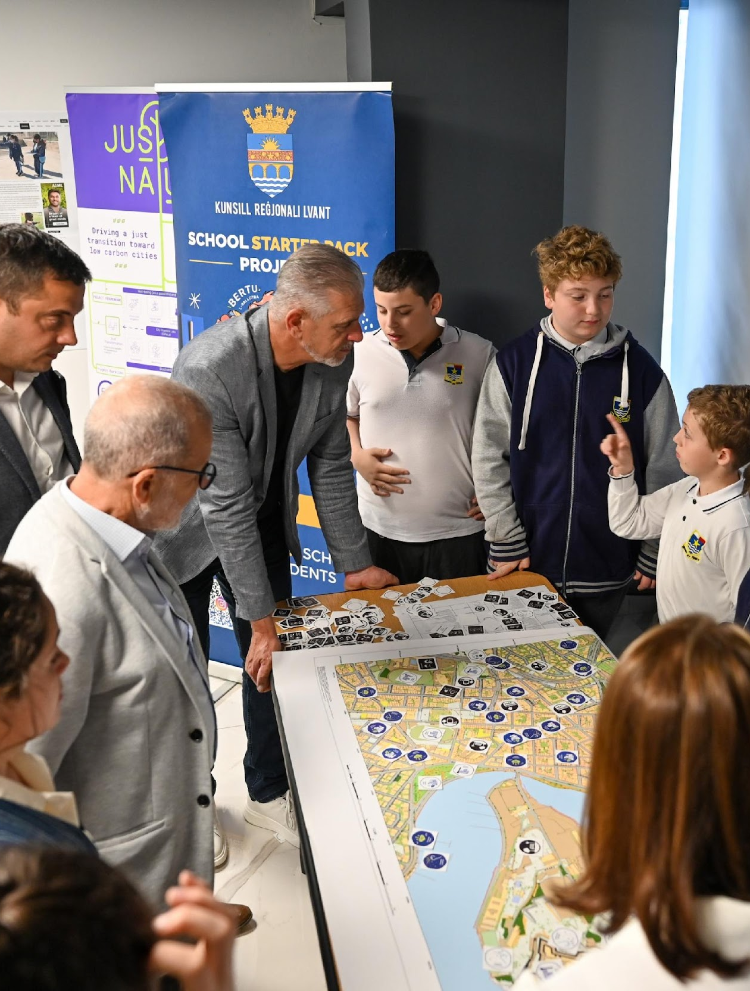
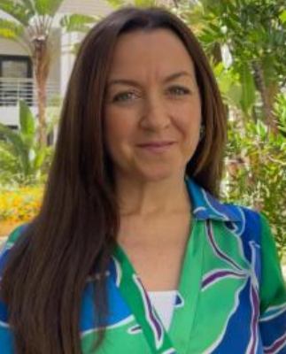
GLOBE Malta - Cooling Down Project Students meet mayors to explore solutions for ‘cooler’ localities
Ramona Mercieca, GLOBE Malta Deputy Coordinator
Notes:
Hello!! My name is Ramona Mercieca and I am the GLOBE deputy Coordinator for Malta.
GLOBE students across the Maltese Islands actively collect data from different areas within their school and locality. Following the success of the first edition of the GLOBE Cooling Down Students Investigation, the second edition allowed schools and local councils to establish a dialogue channel between them.
The students shared their research from the GLOBE Student Investigation while presenting projects related to tree inventories. Satellite photos and the students' data were contrasted to discuss Malta's urban heat island.
The students explored justice and injustice issues arising from the built environment and proposed related actions that can be implemented to bring about change within the schools and the local community, thus taking GLOBE investigations beyond data collection. The students, together with the mayors, delved deeper into the issue of urban heating and how cities and their communities can be more sustainable.

Slide 18
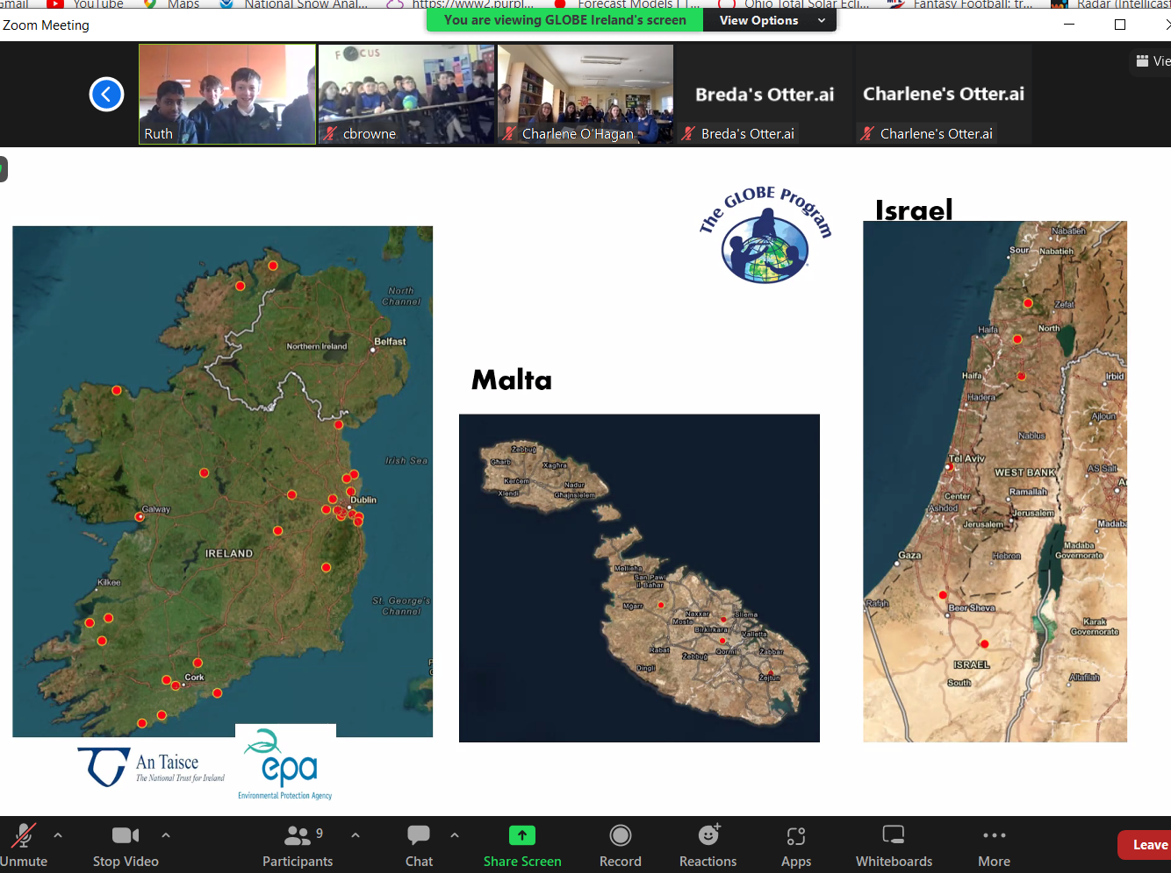

Slide 19
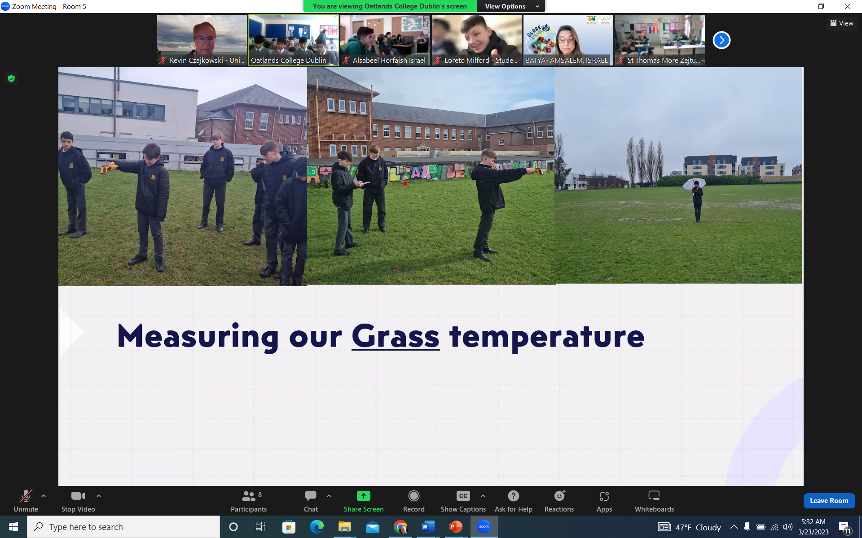
Surface Temperature Being Taken in Ireland

Slide 21
70 C

Slide 22
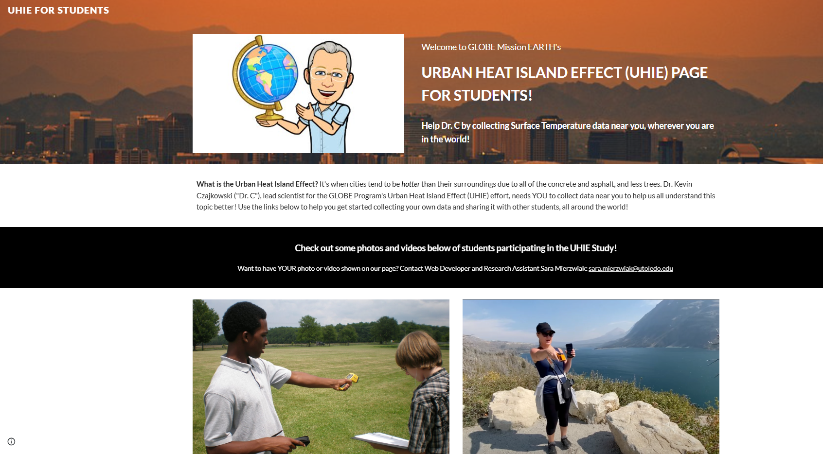
https://sites.google.com/view/uhieforstudents
Website to Help Students

Slide 23
What you need to collect data:
Instruments | Your eyes, GPS unit, Infrared Thermometer, Meter Stick
References | GLOBE cloud chart
When | Good: Any time Better: Within one hour of local solar noon Best: Within +/- 15 minutes of a satellite overpass
Where | A good observation site (See Documenting your atmosphere study site)
Form | Surface Temperature Data Sheet

Slide 24
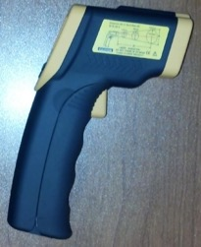
Infrared Thermometer Specifications
Accuracy: ±2 °C
Range: make sure that the instrument’s temperature range is large enough to capture the variations in your area.
Where do I get one?
Handheld infrared thermometers can be purchased from a number of stores and online retailers. Prices range from $25-$300 USD
Maintenance of instrument:
-proper cleaning of lenses is important since accumulated particles on the lens can reduce the accuracy
-do not use solvents to clean the lens

Slide 25
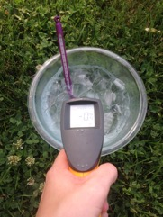
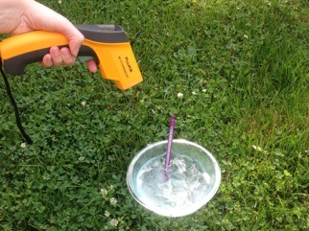
Calibrate your Infrared Thermometer
Calibrate once per year to ensure proper performance!
Calibrate with an ice water bath. Wait until the water reaches 0° C, then see if the infrared thermometer shows a similar reading.
If the temperature observed is more than +2° C or less than -2° C, try changing the battery. If the calibration still is off, the IRT needs to be replaced.
Photo credit: Sara Mierzwiak
Photo credit: Sara Mierzwiak
Notes:
Calibrate with bucket of ice water
-point IRT perpendicular to water surface about 5 cm away
-reading should be within –2° C to +2° C
The IRT sensor is susceptible to large differences in air temperature. If you enclose the IRT in the adapted oven mitt (thermal glove), this will ensure the IRT stays insulated and will provide accurate readings.
Some IRT units are equipped with a laser that will shine from the front of the thermometer along the approximate line of sight, causing a red dot to appear where the surface temperature is measured. Make sure students do not aim this laser beam directly at eyes or off surfaces that could reflect in someone’s eyes.
Wrap your IRT in the Thermal Glove when the air temperature at your study site varies more than 5 degrees Celsius from the air temperature of where the IRT has been stored. The IRT with the thermal glove has been tested to work for 30 minutes. The thermal glove is made from a standard oven mitt. The oven mitt used to make the thermal glove MUST be constructed of 100% terry cloth; inside and outside. An actual-size pattern of the thermal glove with hole designations for the IRT’s sensing eye and digital display screen is shown in the Surface Temperature Protocol section of the 2003 Teacher’s Guide.

Slide 26
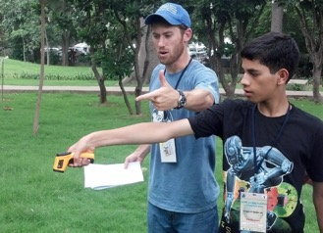
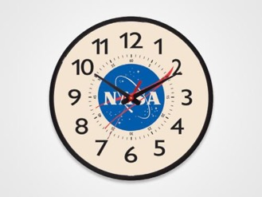
Collecting Data using an Infrared Thermometer
HOW?
Hold your arm at arms length and point the instrument at the ground. After you pull the trigger then read the value including the tenths of a degree Celsius.
WHEN?
Surface temperature measurements can be taken any time during the day.
Photo credit: Kevin Czajkowski
Notes:
Calibrate with bucket of ice water
-point IRT perpendicular to water surface about 5 cm away
-reading should be within –2° C to +2° C
The IRT sensor is susceptible to large differences in air temperature. If you enclose the IRT in the adapted oven mitt (thermal glove), this will ensure the IRT stays insulated and will provide accurate readings.
Some IRT units are equipped with a laser that will shine from the front of the thermometer along the approximate line of sight, causing a red dot to appear where the surface temperature is measured. Make sure students do not aim this laser beam directly at eyes or off surfaces that could reflect in someone’s eyes.
Wrap your IRT in the Thermal Glove when the air temperature at your study site varies more than 5 degrees Celsius from the air temperature of where the IRT has been stored. The IRT with the thermal glove has been tested to work for 30 minutes. The thermal glove is made from a standard oven mitt. The oven mitt used to make the thermal glove MUST be constructed of 100% terry cloth; inside and outside. An actual-size pattern of the thermal glove with hole designations for the IRT’s sensing eye and digital display screen is shown in the Surface Temperature Protocol section of the 2003 Teacher’s Guide.

Slide 27
Data Collection: Overview
Choose a site that is homogenous at least 30 meters square (if possible). Can be grass, asphalt, etc.
Collect GPS data for the center of the site (latitude, longitude and elevation).
Pick nine random observation spots in the study site:
Read and record surface temperature
Record the time
Measure and record snow depth (if present)
Use the Cloud Protocol to record cloud observations.
Record your data on the Surface Temperature Data sheet.
Log into the GLOBE website .
Create a Surface Temperature site.
Go back to Data Entry, select the new Surface Temperature site you just created, and enter your data.
Notes:
Calibrate with bucket of ice water
-point IRT perpendicular to water surface about 5 cm away
-reading should be within –2° C to +2° C
The IRT sensor is susceptible to large differences in air temperature. If you enclose the IRT in the adapted oven mitt (thermal glove), this will ensure the IRT stays insulated and will provide accurate readings.
Some IRT units are equipped with a laser that will shine from the front of the thermometer along the approximate line of sight, causing a red dot to appear where the surface temperature is measured. Make sure students do not aim this laser beam directly at eyes or off surfaces that could reflect in someone’s eyes.
Wrap your IRT in the Thermal Glove when the air temperature at your study site varies more than 5 degrees Celsius from the air temperature of where the IRT has been stored. The IRT with the thermal glove has been tested to work for 30 minutes. The thermal glove is made from a standard oven mitt. The oven mitt used to make the thermal glove MUST be constructed of 100% terry cloth; inside and outside. An actual-size pattern of the thermal glove with hole designations for the IRT’s sensing eye and digital display screen is shown in the Surface Temperature Protocol section of the 2003 Teacher’s Guide.

Slide 28
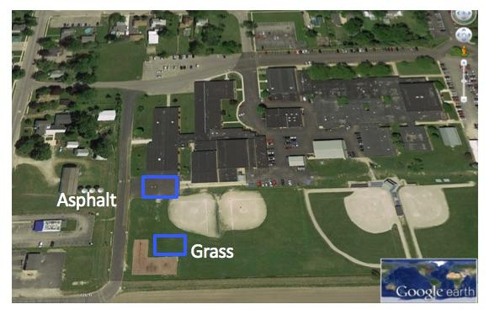
1. Choose homogenous study areas.
Choose study areas that are as large as possible and that have homogeneous cover. If the only area you have is smaller, take observations there and measure the size of the area. At this school, students took surface temperature observations on the asphalt and the nearby grassy outfield of a softball field.
Notes:
Calibrate with bucket of ice water
-point IRT perpendicular to water surface about 5 cm away
-reading should be within –2° C to +2° C
The IRT sensor is susceptible to large differences in air temperature. If you enclose the IRT in the adapted oven mitt (thermal glove), this will ensure the IRT stays insulated and will provide accurate readings.
Some IRT units are equipped with a laser that will shine from the front of the thermometer along the approximate line of sight, causing a red dot to appear where the surface temperature is measured. Make sure students do not aim this laser beam directly at eyes or off surfaces that could reflect in someone’s eyes.
Wrap your IRT in the Thermal Glove when the air temperature at your study site varies more than 5 degrees Celsius from the air temperature of where the IRT has been stored. The IRT with the thermal glove has been tested to work for 30 minutes. The thermal glove is made from a standard oven mitt. The oven mitt used to make the thermal glove MUST be constructed of 100% terry cloth; inside and outside. An actual-size pattern of the thermal glove with hole designations for the IRT’s sensing eye and digital display screen is shown in the Surface Temperature Protocol section of the 2003 Teacher’s Guide.

Slide 29
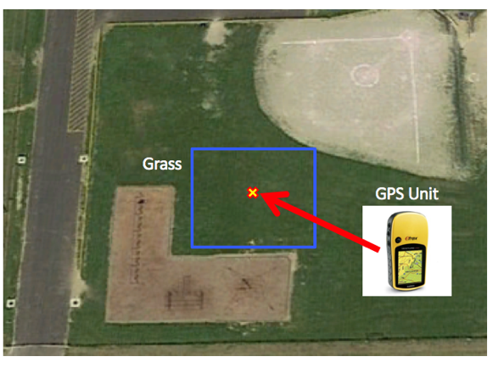
2. Collect GPS data of the center of each study area. If you are using the GLOBE Observer app on your phone, the latitude and longitude are automatically recorded.
Record latitude, longitude and elevation.
GPS Protocol
Notes:
Calibrate with bucket of ice water
-point IRT perpendicular to water surface about 5 cm away
-reading should be within –2° C to +2° C
The IRT sensor is susceptible to large differences in air temperature. If you enclose the IRT in the adapted oven mitt (thermal glove), this will ensure the IRT stays insulated and will provide accurate readings.
Some IRT units are equipped with a laser that will shine from the front of the thermometer along the approximate line of sight, causing a red dot to appear where the surface temperature is measured. Make sure students do not aim this laser beam directly at eyes or off surfaces that could reflect in someone’s eyes.
Wrap your IRT in the Thermal Glove when the air temperature at your study site varies more than 5 degrees Celsius from the air temperature of where the IRT has been stored. The IRT with the thermal glove has been tested to work for 30 minutes. The thermal glove is made from a standard oven mitt. The oven mitt used to make the thermal glove MUST be constructed of 100% terry cloth; inside and outside. An actual-size pattern of the thermal glove with hole designations for the IRT’s sensing eye and digital display screen is shown in the Surface Temperature Protocol section of the 2003 Teacher’s Guide.

Slide 30
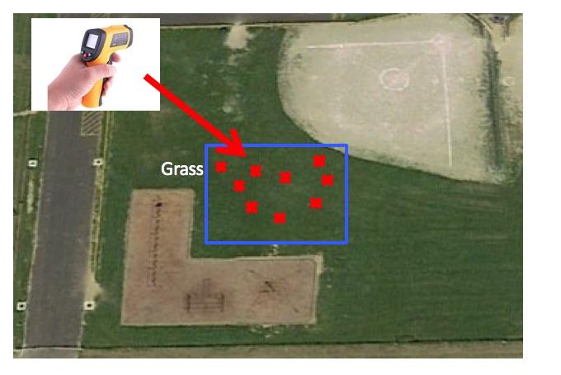
3. Take 9 random surface temperature readings
Take 9 random surface temperature readings within each study area. The 9 random observations ensure a good average for the site is observed.
Notes:
Calibrate with bucket of ice water
-point IRT perpendicular to water surface about 5 cm away
-reading should be within –2° C to +2° C
The IRT sensor is susceptible to large differences in air temperature. If you enclose the IRT in the adapted oven mitt (thermal glove), this will ensure the IRT stays insulated and will provide accurate readings.
Some IRT units are equipped with a laser that will shine from the front of the thermometer along the approximate line of sight, causing a red dot to appear where the surface temperature is measured. Make sure students do not aim this laser beam directly at eyes or off surfaces that could reflect in someone’s eyes.
Wrap your IRT in the Thermal Glove when the air temperature at your study site varies more than 5 degrees Celsius from the air temperature of where the IRT has been stored. The IRT with the thermal glove has been tested to work for 30 minutes. The thermal glove is made from a standard oven mitt. The oven mitt used to make the thermal glove MUST be constructed of 100% terry cloth; inside and outside. An actual-size pattern of the thermal glove with hole designations for the IRT’s sensing eye and digital display screen is shown in the Surface Temperature Protocol section of the 2003 Teacher’s Guide.

Slide 31
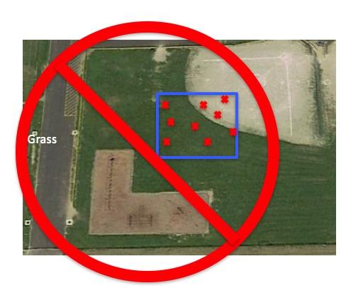
Caution!
Do not mix cover types in one study area.
In this case, the study area mistakenly has grass and bare ground.
.
Notes:
Calibrate with bucket of ice water
-point IRT perpendicular to water surface about 5 cm away
-reading should be within –2° C to +2° C
The IRT sensor is susceptible to large differences in air temperature. If you enclose the IRT in the adapted oven mitt (thermal glove), this will ensure the IRT stays insulated and will provide accurate readings.
Some IRT units are equipped with a laser that will shine from the front of the thermometer along the approximate line of sight, causing a red dot to appear where the surface temperature is measured. Make sure students do not aim this laser beam directly at eyes or off surfaces that could reflect in someone’s eyes.
Wrap your IRT in the Thermal Glove when the air temperature at your study site varies more than 5 degrees Celsius from the air temperature of where the IRT has been stored. The IRT with the thermal glove has been tested to work for 30 minutes. The thermal glove is made from a standard oven mitt. The oven mitt used to make the thermal glove MUST be constructed of 100% terry cloth; inside and outside. An actual-size pattern of the thermal glove with hole designations for the IRT’s sensing eye and digital display screen is shown in the Surface Temperature Protocol section of the 2003 Teacher’s Guide.

Slide 32
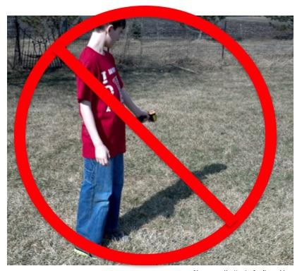
Caution! 1
Do not take the temperature of shadowed areas including the shadow that your body may cast.
Notes:
Calibrate with bucket of ice water
-point IRT perpendicular to water surface about 5 cm away
-reading should be within –2° C to +2° C
The IRT sensor is susceptible to large differences in air temperature. If you enclose the IRT in the adapted oven mitt (thermal glove), this will ensure the IRT stays insulated and will provide accurate readings.
Some IRT units are equipped with a laser that will shine from the front of the thermometer along the approximate line of sight, causing a red dot to appear where the surface temperature is measured. Make sure students do not aim this laser beam directly at eyes or off surfaces that could reflect in someone’s eyes.
Wrap your IRT in the Thermal Glove when the air temperature at your study site varies more than 5 degrees Celsius from the air temperature of where the IRT has been stored. The IRT with the thermal glove has been tested to work for 30 minutes. The thermal glove is made from a standard oven mitt. The oven mitt used to make the thermal glove MUST be constructed of 100% terry cloth; inside and outside. An actual-size pattern of the thermal glove with hole designations for the IRT’s sensing eye and digital display screen is shown in the Surface Temperature Protocol section of the 2003 Teacher’s Guide.

Slide 33
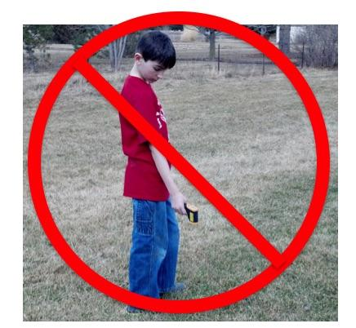
Caution! 2
Extend your arm in front of you to take the observations. You don’t want to measure the temperature of your feet.
.
Notes:
Calibrate with bucket of ice water
-point IRT perpendicular to water surface about 5 cm away
-reading should be within –2° C to +2° C
The IRT sensor is susceptible to large differences in air temperature. If you enclose the IRT in the adapted oven mitt (thermal glove), this will ensure the IRT stays insulated and will provide accurate readings.
Some IRT units are equipped with a laser that will shine from the front of the thermometer along the approximate line of sight, causing a red dot to appear where the surface temperature is measured. Make sure students do not aim this laser beam directly at eyes or off surfaces that could reflect in someone’s eyes.
Wrap your IRT in the Thermal Glove when the air temperature at your study site varies more than 5 degrees Celsius from the air temperature of where the IRT has been stored. The IRT with the thermal glove has been tested to work for 30 minutes. The thermal glove is made from a standard oven mitt. The oven mitt used to make the thermal glove MUST be constructed of 100% terry cloth; inside and outside. An actual-size pattern of the thermal glove with hole designations for the IRT’s sensing eye and digital display screen is shown in the Surface Temperature Protocol section of the 2003 Teacher’s Guide.

Slide 34
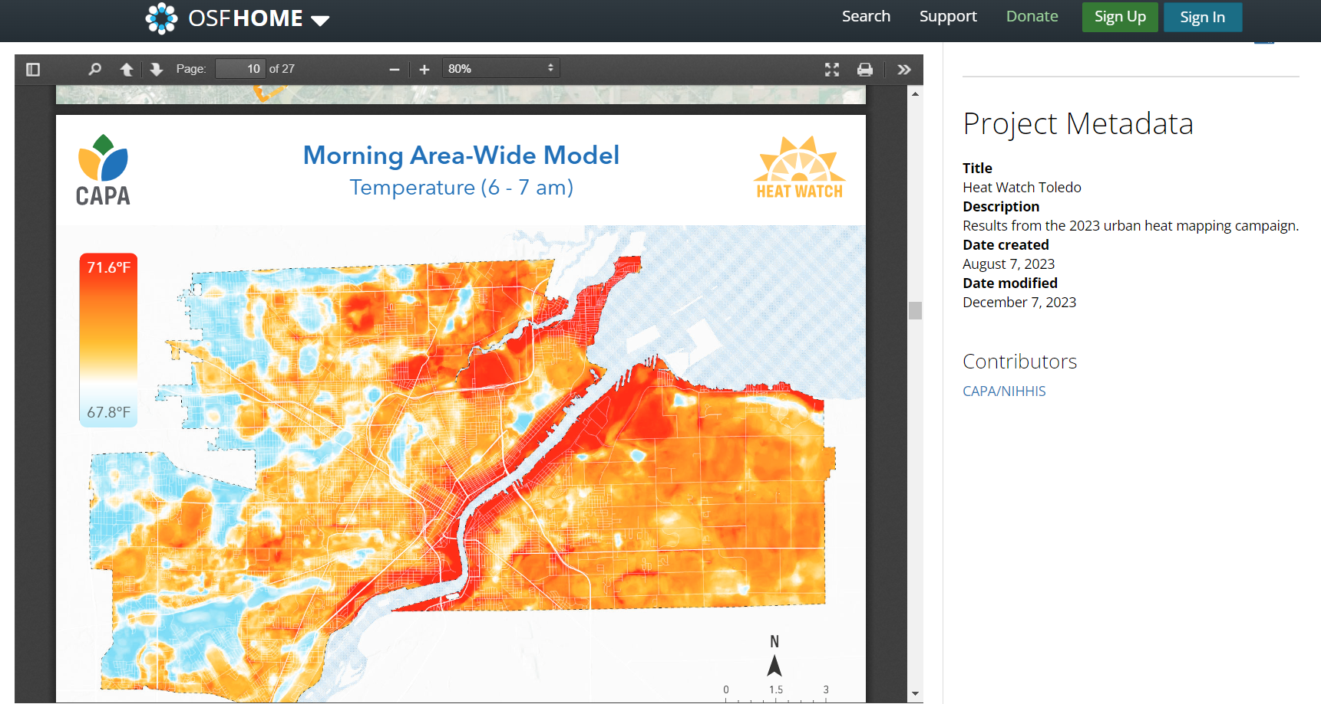
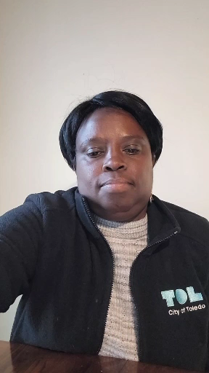
Urban Heat Island Mapping Toledo, OH Beatrice Miringu – Sustainability Coordinator, City of Toledo
Collaborating with the City of Toledo to organize citizen scientists to take urban heat island observations and map the effects

Slide 35
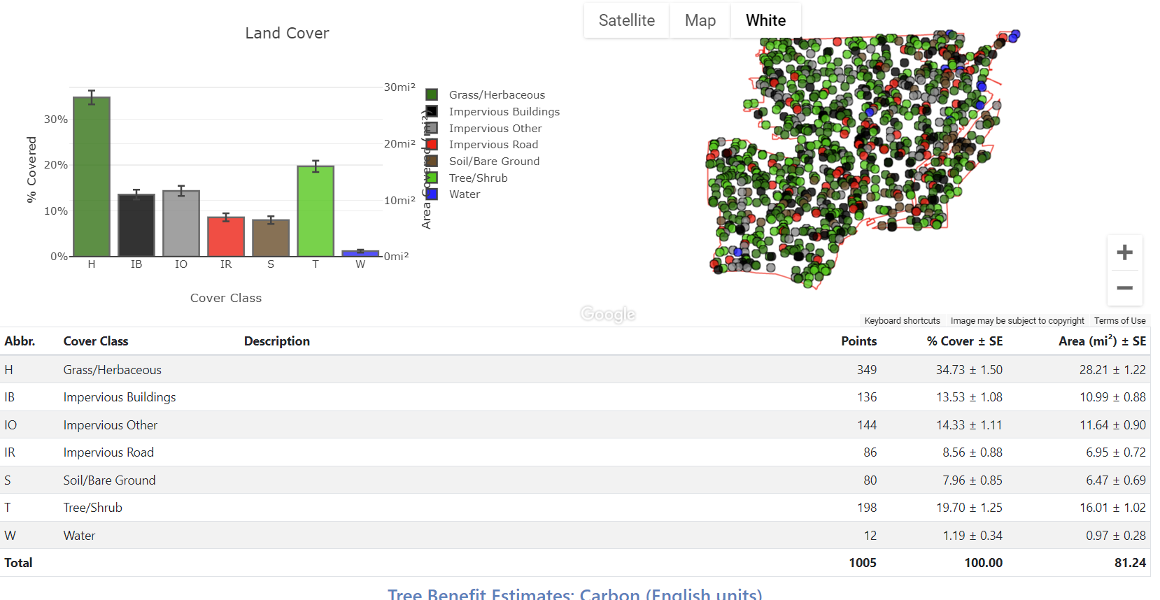
Dr. C’s iTree Analysis
Trees are 19.7% of land cover in Toledo

Slide 36
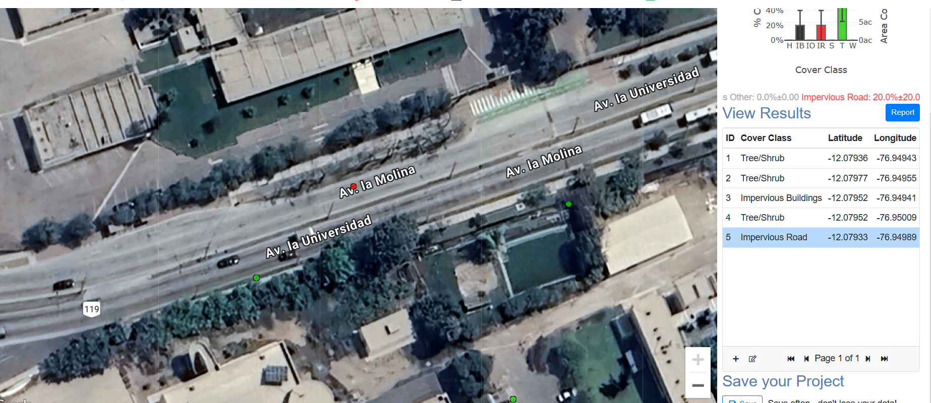
Application of iTree to National Agrarian University Lima, Peru
https://canopy.itreetools.org/

Slide 37
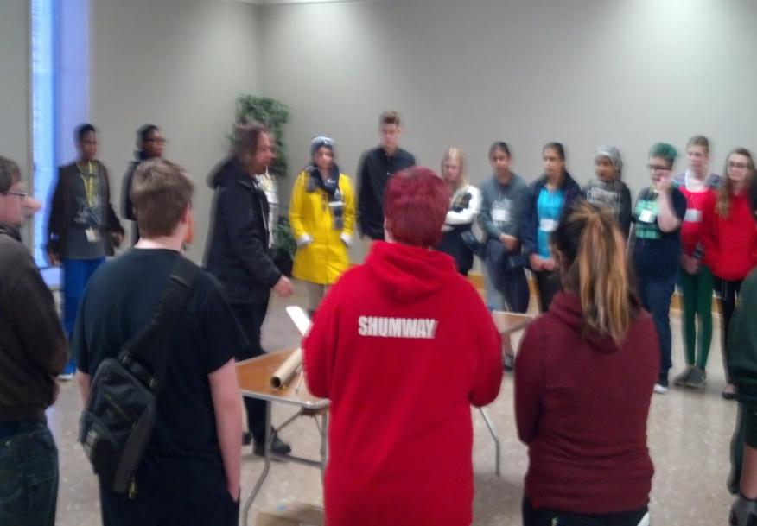
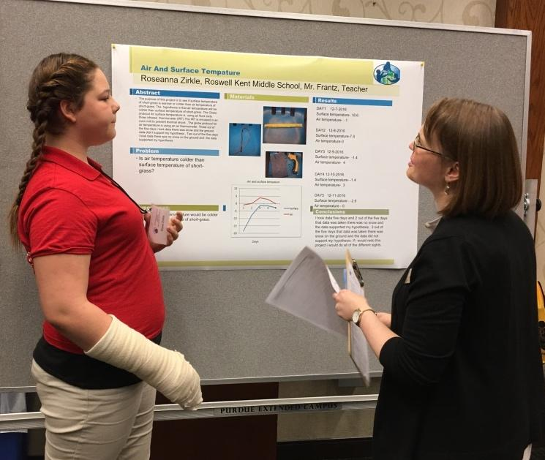
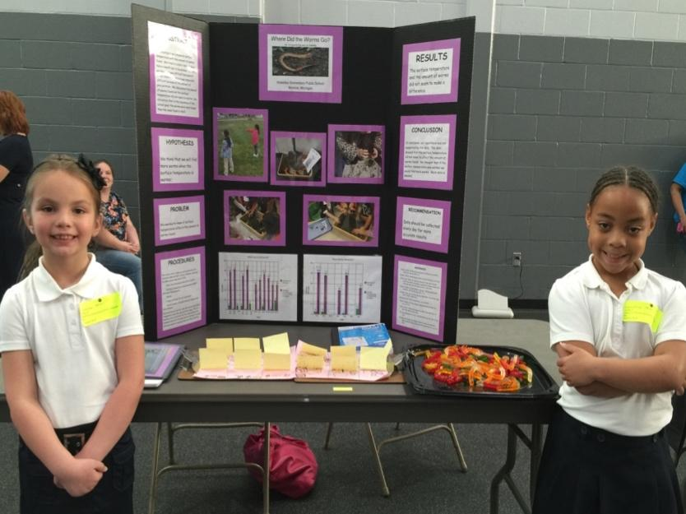
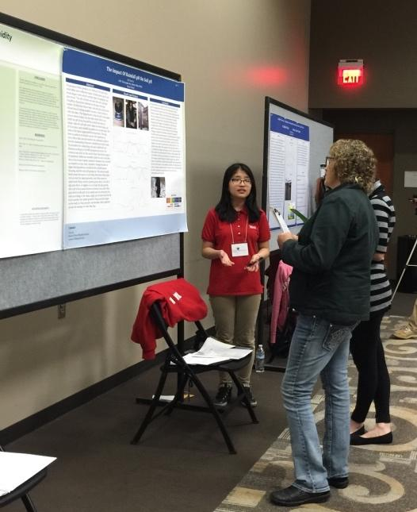
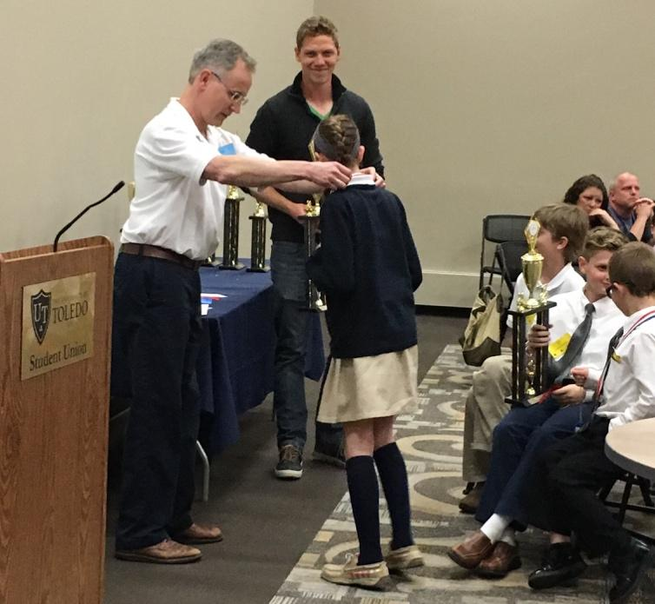
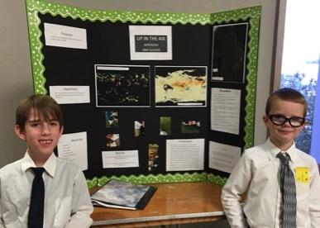
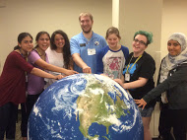
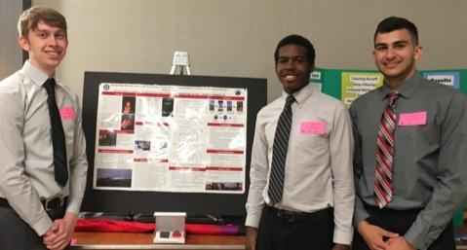
Support Students Presenting Research
GLOBE Student Research Conferences
Notes:
Learn protocols
Collect data
Do research
Present research
Receive recognition for their achievement

Slide 39
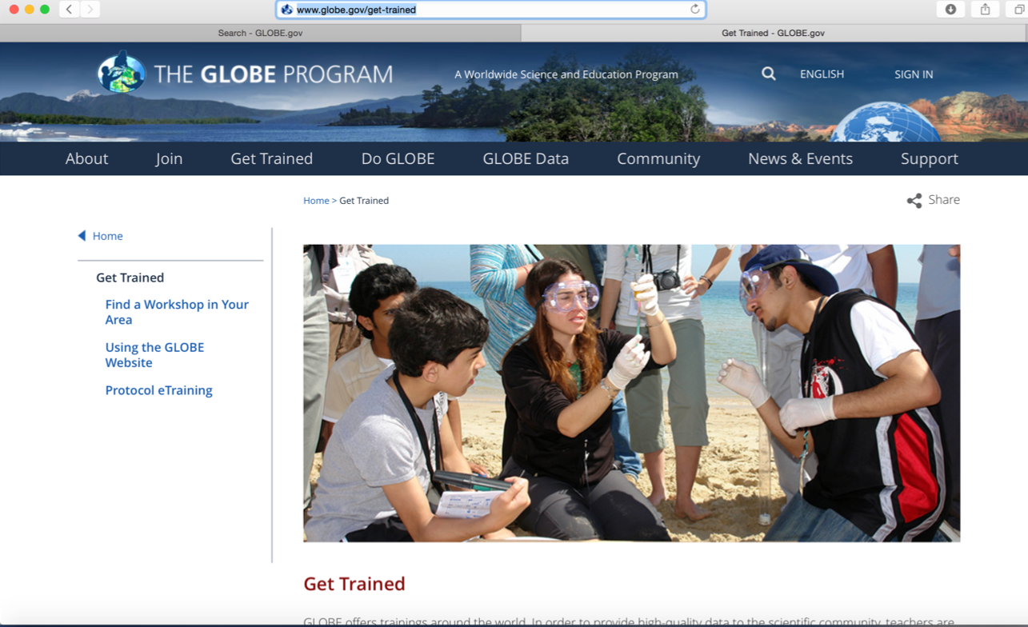
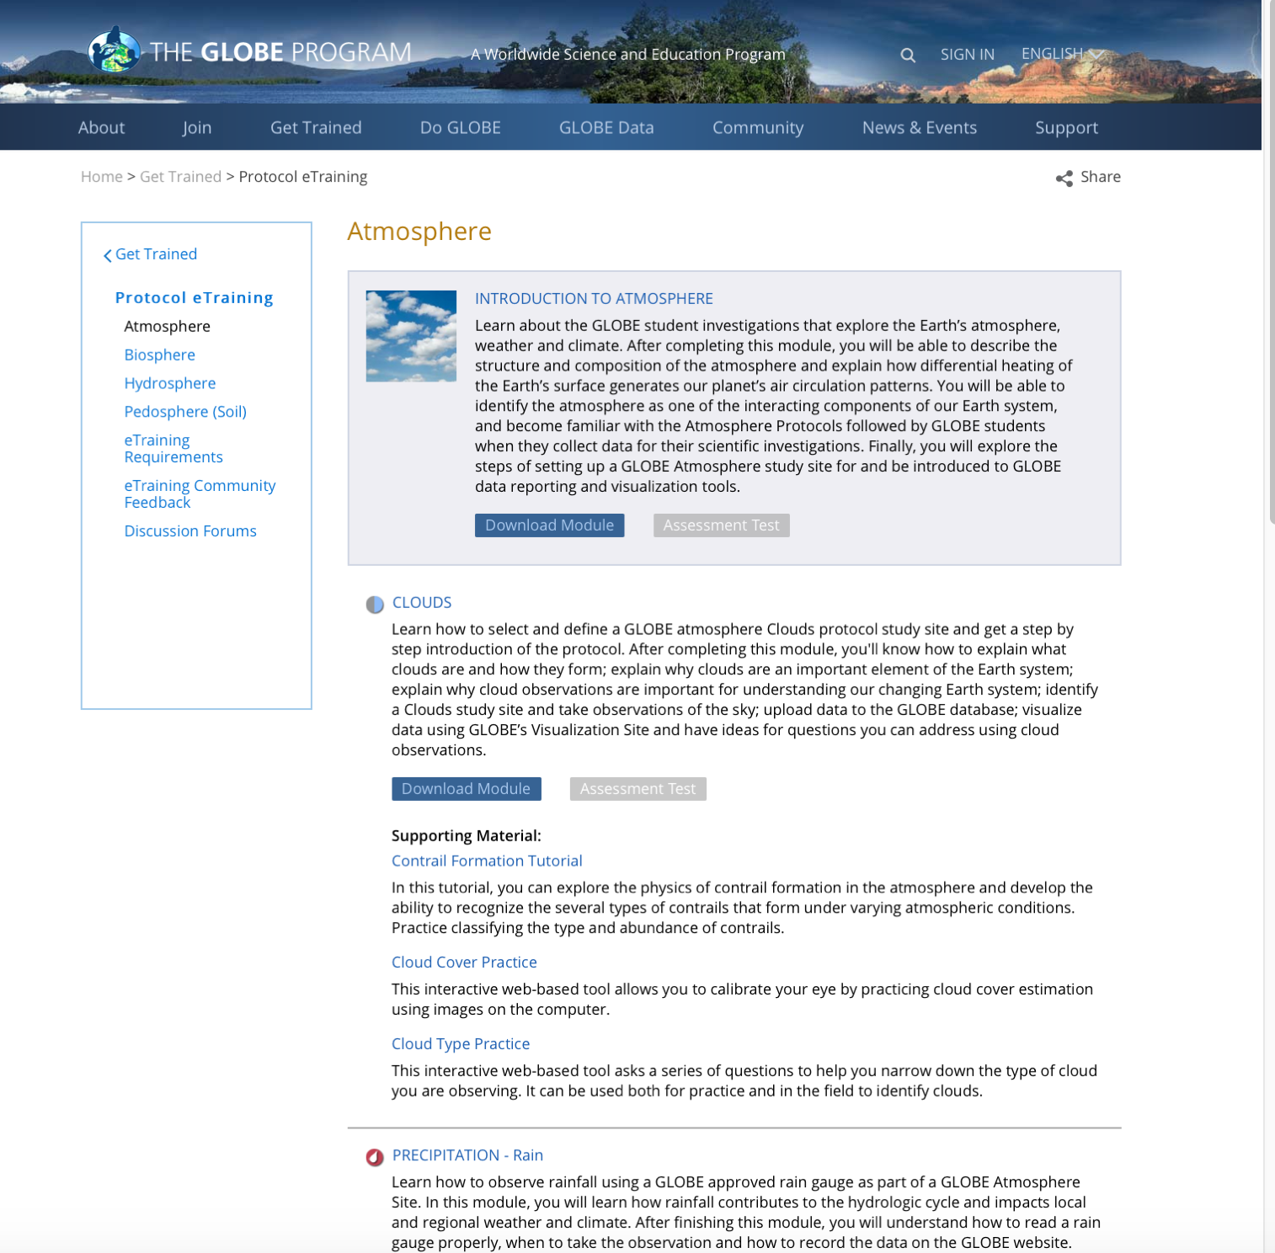
GLOBE e-Training/Atmosphere/ Surface Temperature https://www.globe.gov/get-trained/protocol-etraining/protocol-etraining-modules/etraining-modules//16867642/12267
http://www.globe.gov/get-trained
https://www.globe.gov/get-trained/protocol-etraining/etraining-modules/16867642/12267
Notes:
39

Slide 40
Urban Heat Island from Landsat Satellite
https://tahminehladi.users.earthengine.app/view/urban-heat-island2

Slide 41
Kevin Czajkowski
Kevin.czajkowski@utoledo.edu
Website: http://www.globe.gov/web/mission-earth
Email: http://globe.mission.earth@gmail.com
Twitter: @globemissionear
Facebook: https://www.facebook.com/globemissionearth/
YouTube channel: http:tinyurl.com/globemissionearth
The material in this document is based upon work supported by NASA under grant award No. NNX16AC54A. Any opinions, findings, and conclusions or recommendations expressed in this material are those of author(s) and do not necessarily reflect the views of the National Aeronautics and Space Administration.

