Slide 1
Nature connectedness
Notes:
This is an internationally recognised psychological construct: refers to a person's belief about the extent to which they are part of the natural environment, their emotional relationship with it and their experience within it (Schultz, 2002; Mayer and Frantz, 2004).
Measurable and malleable.

Slide 2
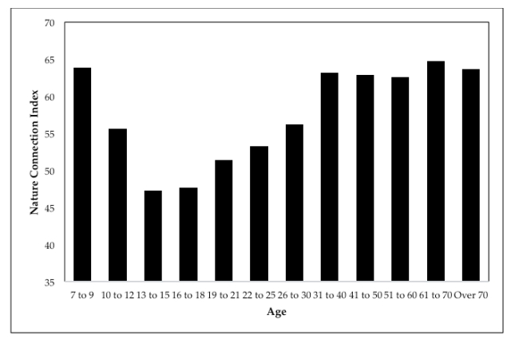
Source: Nature Connectedness: Pro-nature behaviours and the ‘Teenage Dip’ – 2019 population survey in the UK
Notes:
Comments from Factors associated with nature connectedness in school-aged children – ScienceDirect
Several studies have found that while levels of nature connectedness are high in young children, they decline by the middle of the teenage years, only recovering in adulthood (Chawla, 2020; Hughes et al., 2019; Richardson et al., 2019).
Pre-school: The crucial age at which the trajectory of nature connectedness reverses therefore seems to be at 5-7 years old, in other words, around the age that children start school.
Adolescents: this period where children develop an identity and form social relationships may conflict with a close connection with nature as priorities change (Richardson et al., 2019). Urban and commercial settings may be preferred as they offer places to meet and socialise easily, whereas natural settings may be less obviously desirable. Adolescents also seek time and space to be alone; in our study, most adolescents reported that their home was the place that they went to relax.
1) Source of graph: Nature Connectedness: Pro-nature behaviours and the ‘Teenage Dip’ – Results from a population survey | Finding Nature
2) Factors associated with nature connectedness in school-aged children – ScienceDirect

Slide 3
Research highlights from a 2019 study in Jersey
Nature connectedness is consistently higher in girls than in boys.
Nature connectedness declines with age into the early teens, then levels off.
Children in urban schools are less connected to nature than those in rural schools.
Daily screen time is negatively related to nature connectedness in adolescents.
Reducing the adolescent dip in nature connectedness could benefit wellbeing and behaviour change.
Source: Factors associated with nature connectedness in school-aged children – ScienceDirect

Slide 6
Notes:
What types of lasting relationships are based on facts and figures? Science says that a closer, healthier and sustainable relationship with nature comes through noticing, emotion, finding beauty, meaning (nature bringing meaning to our life) and compassion (caring and taking action for nature).
Teenagers: tying opportunities to interact with nature into social experiences, and promoting natural spaces as attractive places to both relax and to socialise, may help encourage adolescents to engage with the natural world more effectively. Socially focused, community based events that give young people a voice in decision-making may be more likely to engage them than individual activities that require little interaction (Chawla, 2009).
Other suggested activities based on what teenagers enjoy doing: (Outdoor) fitness, arts and craft, (nature noticing) apps.

Slide 7
Appendix

Slide 8
Notes:
Think about a positive experience in nature that you had (recently or as a younger person).

Slide 9
Notes:
Noticing things in nature every day.

Slide 10
Debriefing – together list activities that may foster nature connectedness
Using our senses for observation
Nature collection: beauty, meaning
Picnic under a tree: senses, emotions, meaning
Simple actions that you take that are life-positive: compassion
A tutor takes some notes on the flipchart.
Notes:
Integrate some NC into your outdoor learning.

Slide 11
Today’s harvest
A facilitator and a tutor taking some notes on the flipchart. We already have the harvest from the first activity:
Activities
Concepts
Skills
Links to the curriculum
Self: what inspired me? What do I need? My next outdoor lesson…

Slide 12
Activity – finding and choosing a tree
Place.
Equipment: enough scarves to cover the eyes.
Ensuring that everyone is OK doing this activity.
Resource: LiG to be printed.

