Slide 1
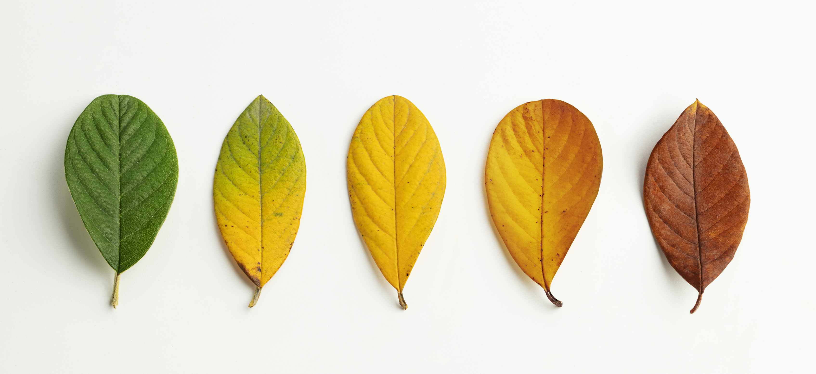
Teacher self-paced training
Autumn 2023

Slide 2
Upon completing this training, you will
Understand how ColourFall works.
Have access to resources and tools to implement it.
Understand the value of this project for your students, scientists and the wider community.
This training will take 60-75 minutes.
1
2
3

Slide 4
Who is participating?
Schools in the Northern Hemisphere across Eurasia and North America will join forces to collect autumn data.
You are 1 of 30 schools representing Ireland. Go team!
Who will record the first leaf fall off? Let's find out!

Slide 5
These link up well with the new Primary Curriculum Framework and the Junior Cycle.

Slide 6
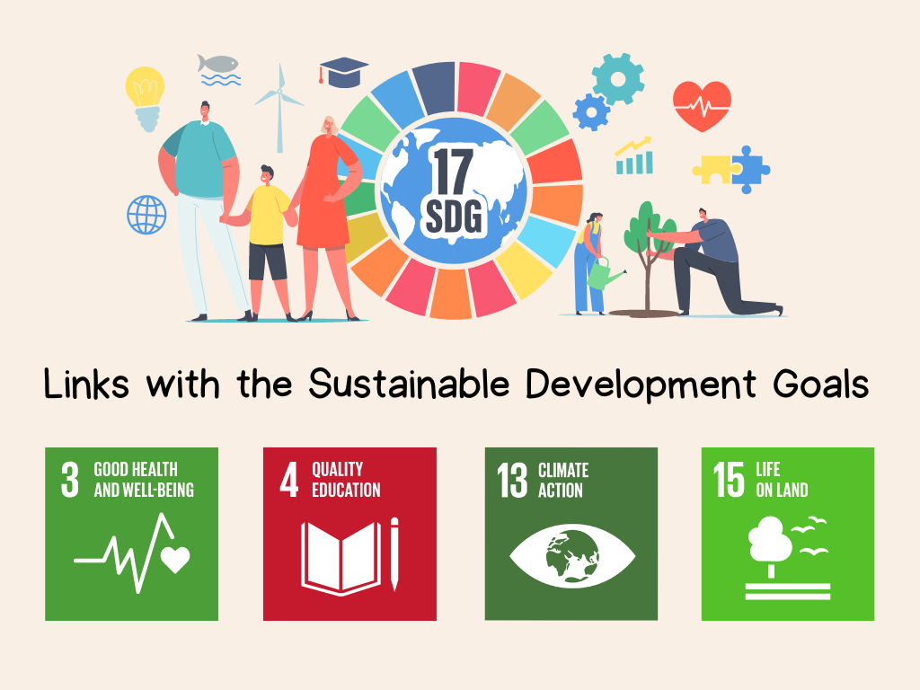

Slide 7
The Science underpinning this project
Phenology

Slide 8
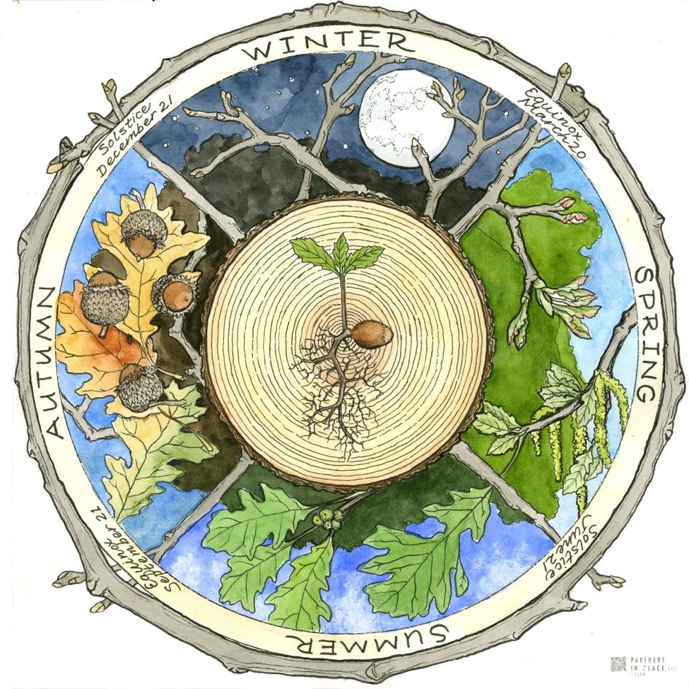
Phenology is the study of cycles in nature
Cyclical events have been observed for a very long time as they impact on our ability to gather wild foods, hunt or farm.
Think of the timing of animal migrations, blackberry season, the risk of frost…
Cyclical events in plants include flowering, leaf unfolding, seed set and dispersal, leaf colour change and fall.
Image source here

Slide 9
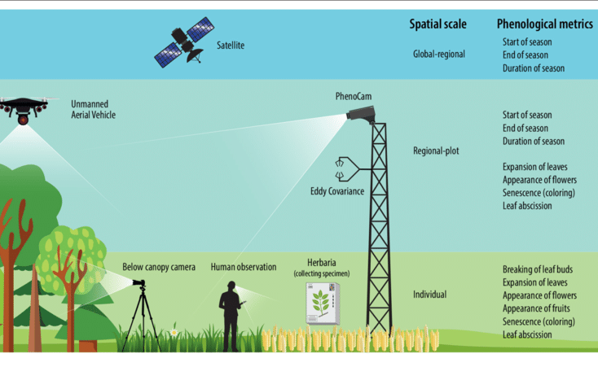
How are changes studied by scientists?

Slide 10
Green-Down observations from Space & the Ground
Scientists use data from a NASA sensor, the Moderate Resolution Imaging Spectrometer (MODIS), to monitor the seasonal dynamics of vegetation.
Image: NASA Earth Observatory
Ground observations are critical to improve the interpretation of satellite data. Green-up/green-down data gathered by GLOBE students, using consistent methods all over the world, offer a way to verify the accuracy of these satellite products.

Slide 11
Click one of the videos below to hear from a scientist who is studying the effects of a changing climate on the rhythms of plants/animals.
Some of the best indicators of climate change are how the plants and animals are responding. This is because organisms are sensitive to the world around them and depend on environmental cues to know when to migrate, eat, reproduce, etc.

Slide 12
Main Activity: Observe Green-Down

Slide 13
What is green-down?
Green-down marks the end of the growing season for many plants.
A colour change is generally associated with green-down of leaves. The colour will vary by species.
Plant green-down is also called senescence. It is initiated when environmental conditions change:
Fewer hours of sunlight and lower temperatures in temperate regions.
Drier and warmer temperatures in desert areas.
Notes:
Green-down starts dormancy (a state of suspended growth and metabolism).
For many places around the world, there is one green-up and green-down cycle, e.g., one warm and cold season.
There are places where multiple wet and dry seasons can occur in a single year, resulting in multiple green-up and green-down cycles.

Slide 14
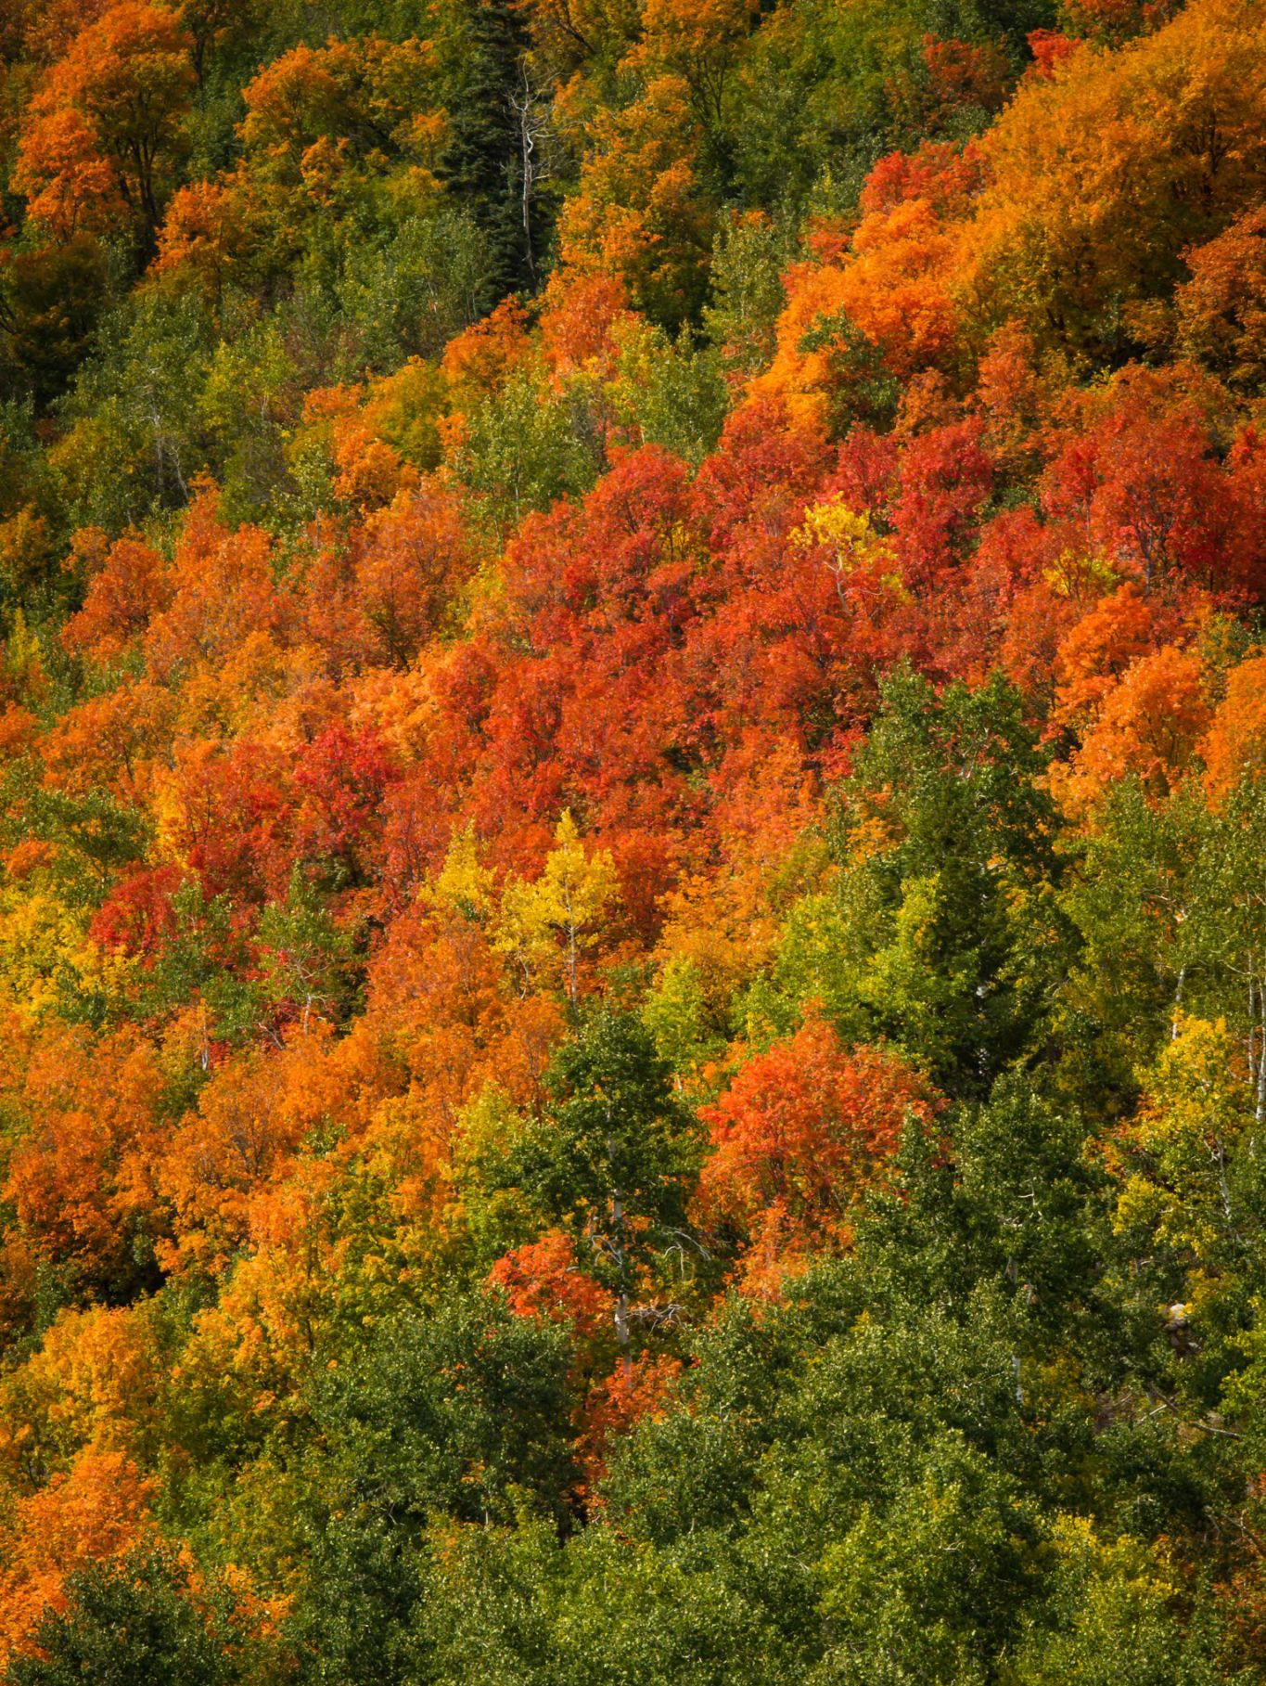
When to observe Green-Down?
In Ireland, we are starting the project on Tree day (October 5th) and ending it on November 17th.
These dates were based on when most tree species are expected to change colour.
However, you can start the project earlier if your local trees are starting to change colour.
Note that fruit and nut trees (e.g. cherry, plum and hazel), hawthorns and “autumn showy trees” (such as acers) may already be changing colour.
This Photo by Unknown author is licensed under CC BY-NC.
Notes:
The North America campaign is focused on monitoring and reporting plant green-down data to help validate the end of the plant growing season.

Slide 15
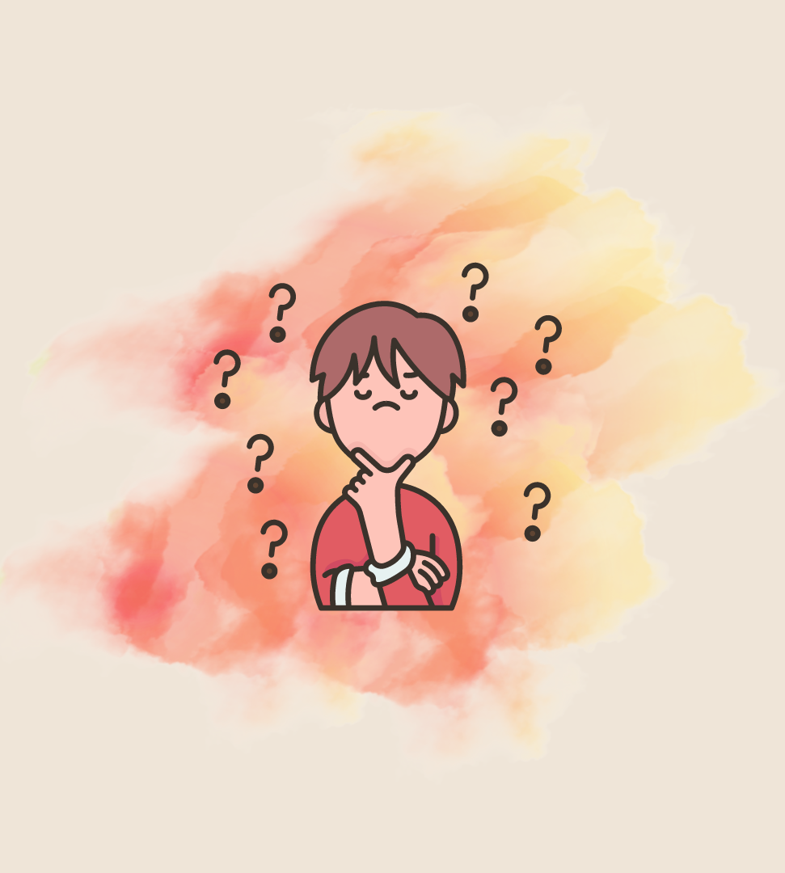
Start by getting your students curious about green-down!
From 10 years-old: an excellent lesson click here to develop your students’ inquiry skills in relation to leaf colour changes.
For younger children: go outside, tune in using all your senses (student activity sheet to take notes afterwards*).
*Tip: using our senses brings us to the present moment, making us observant and settled. You may develop a routine of “tuning in” before recording leaf colour. This is best done in silence as this part of the brain is non-verbal.

Slide 16
Why do leaves change colour?
Read Science of Fall Colors by the USDA Forest Service
Or watch:
Video by Michigan State University

Slide 17
How to choose trees to observe
These trees are the most observed by schools in Europe. Click on a tree name below to see its description:
Sour cherry
Lime
Hazel
Oak
Birch
Beech
You can choose to observe other deciduous* trees. Monitoring 2-3 trees will allow to make comparisons.
If possible, choose trees that are not shaded by a building and with at least one branch positioned low so that you can observe the leaves closely.
Technology can help identify a tree species and get its latin name. I use the PlantNet app and sometimes Google lens.
Notes:
*Deciduous: trees and shrubs that, unlike evergreens, lose their leaves and become dormant during the winter (source: dictionary.com).

Slide 18
3 steps to make your observations
1
2
3
Select 1-3 trees to monitor and mark the leaves you are going to observe.
Use the GLOBE Colour Guide(*) to determine the colour of each of the four leaves.
Measure twice a week until all four leaves have fallen down.
Upload your data to the GLOBE database with the GLOBE Observer app.
Step 1: student worksheet click here.
Step 2: student worksheet click here (or use the GLOBE Observer app in the field – see next video).
Optional: use the GROWApp to create timelapse videos of your trees (click here to find out more).
Notes:
All GLOBE students are following similar steps to ensure that their observations are consistent and comparable.

Slide 19
How to Measure Green-Down: Quick Guide
Adopt your leaves (step 1):
Locate the leaf at the end of the branch. Label it by marking one dot on the branch next to the leaf stem with a permanent felt tip marker.
Locate the three leaves on this branch closest to this terminal leaf. Label these leaves by marking two, three and four dots next to their stems on the branch.
Observe green-down (step 2):
Examine each of your leaves. Use the GLOBE Plant Colour Guide to estimate the dominant color of each leaf (or the GLOBE Observer app).
Record your observations with the GLOBE Observer app.

Slide 20
Steps before you can share your data with GLOBE
If you don’t have a teacher account, please create one now (link here).
Steps here.
Notes:
If you already have a GLOBE teacher account, skip to step 2.

Slide 21
What data will look like on the GLOBE platform: ColourFall graphs!
Lime
Sour cherry
Birch
Data collected by a school in Ukraine in 2022. Source: GLOBE database.
Students can compare leaf colour change for the same or different tree species at different locations. A resource will be shared with steps to visualize green-down data.

Slide 22
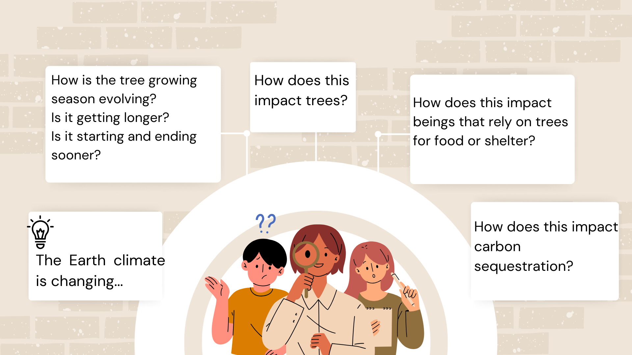
Some of the questions scientists are curious about…

Slide 23
Complementary student activities

Slide 24
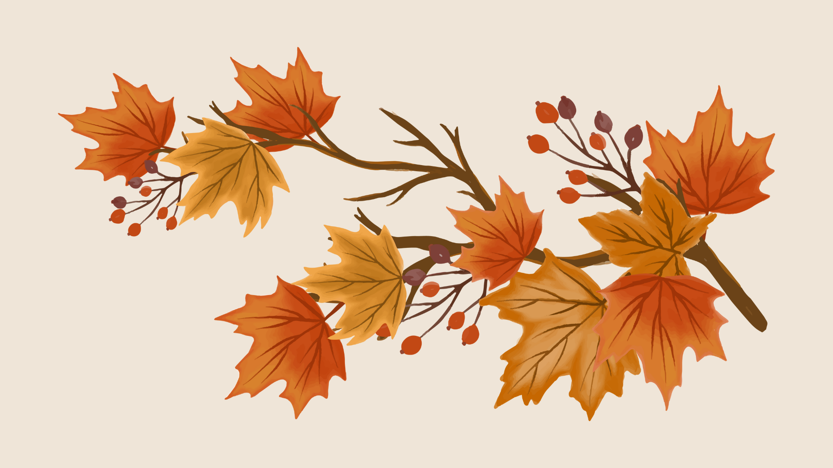
Go deeper by revealing “hidden” colours through a simple experiment
1
Teacher resource click here:
For markers, use water (p 2-3).
For leaves, use rubbing alcohol (p 4-5).
Grandma GLOBE reveals the colours in a black marker.

Slide 25
Gardening with nature
2

Slide 26
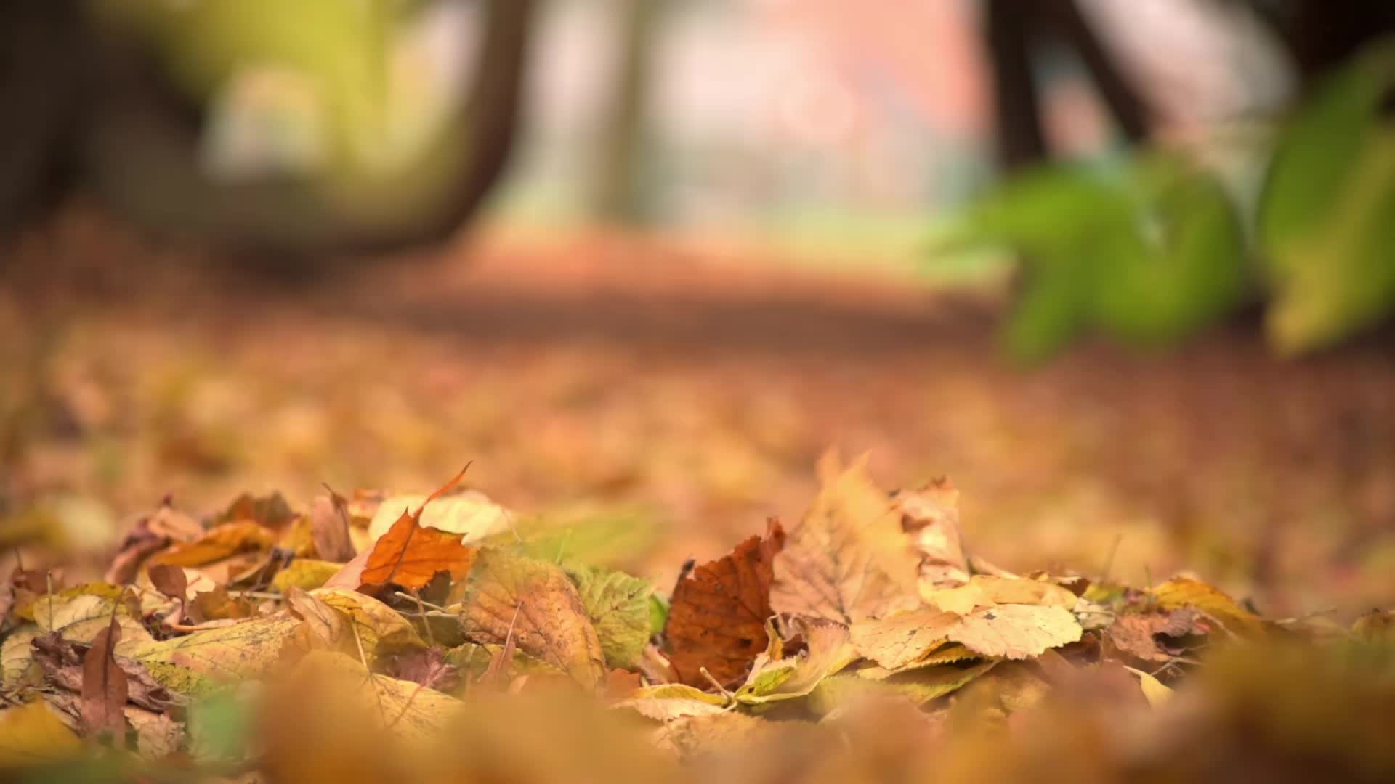
Leaf litter… or gold?
I used to rake the fallen leaves in my garden and dispose of them. One autumn, I changed my approach and only brushed them off the paths. All leaves which had fallen on natural ground had decomposed by the following spring. I was delighted by the more hands-off approach!
Of course, it’s important to sweep up leaves that have fallen onto pathways, patios and astroturf, as these areas may become slippery. In these instances, try to use a broom or a rake.
The main appeal of a leaf blower is efficiency. However, they suck up insects and other creatures along with the leaves, are noisy and require energy to run.

Slide 27
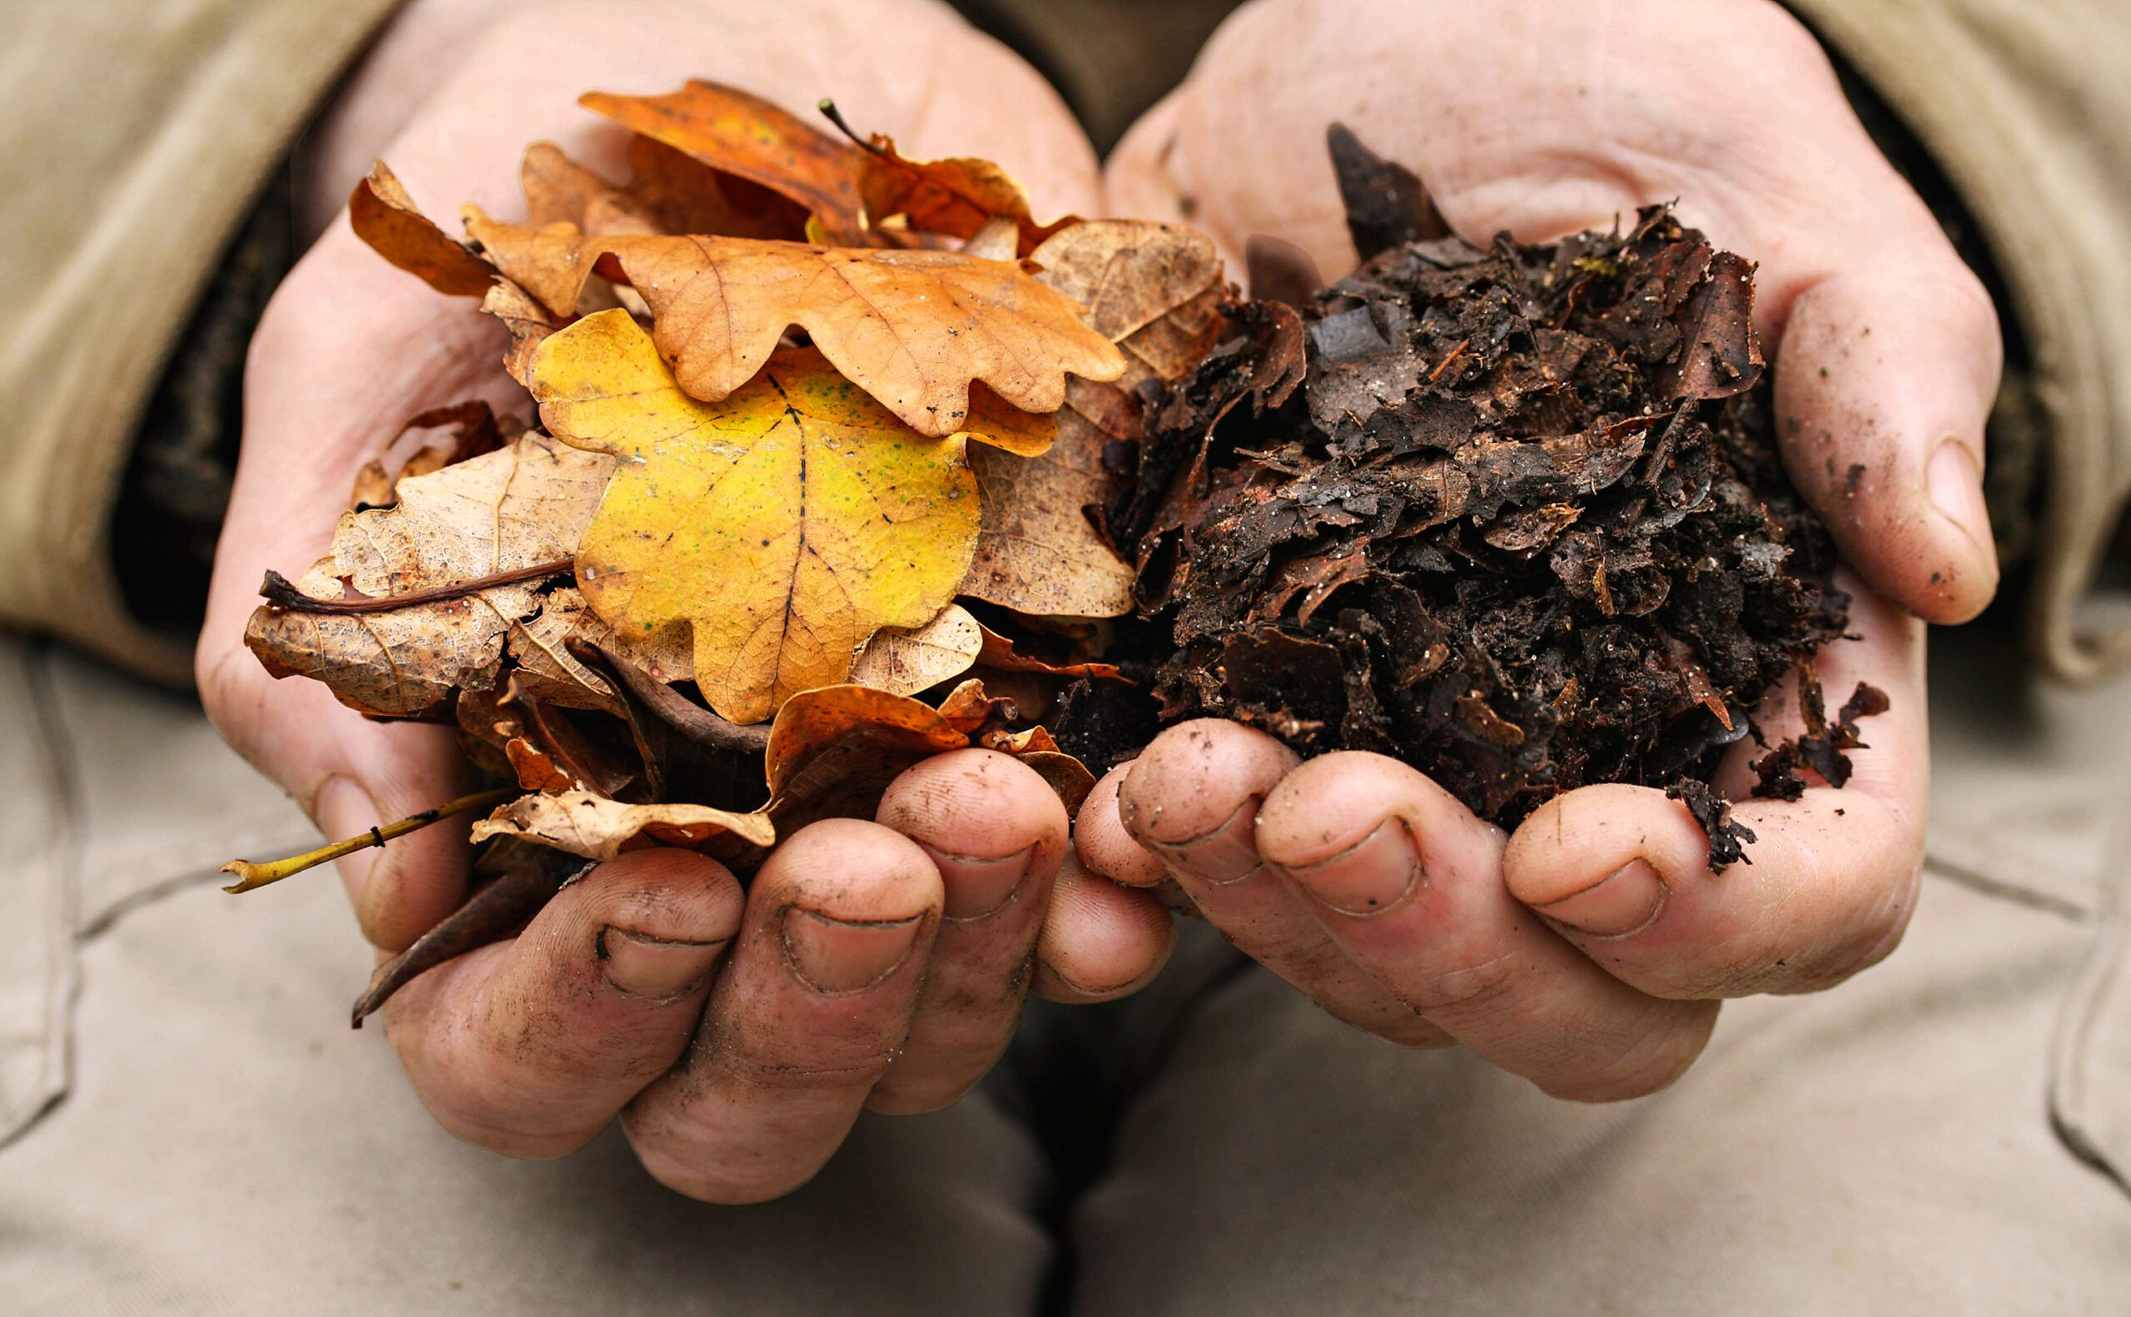
Gold!
Leaf mold is the end product of letting gathered up autumn leaves sit and decompose for 6-12 months to a dark brown crumbly texture with an earthy aroma.
Leaf mold is humus rich, an organic component that increases soils’ water-holding capacity. Leaf mold can retain over 300% of its weight in water.
Leaf mold is low in nutrients as they are absorbed back into the tree before its autumnal shedding. What is left behind is fiber — especially lignin. Lignin helps improve the soil’s holding capacity of nutrients and improves soil structure — all creating a better nutrient supply and a better root reach.
Leaf mold increases earthworm and bacteria populations and other beneficial aspects of the soil web.
Source for this slide and the two following ones: Irish examiner article here.

Slide 28
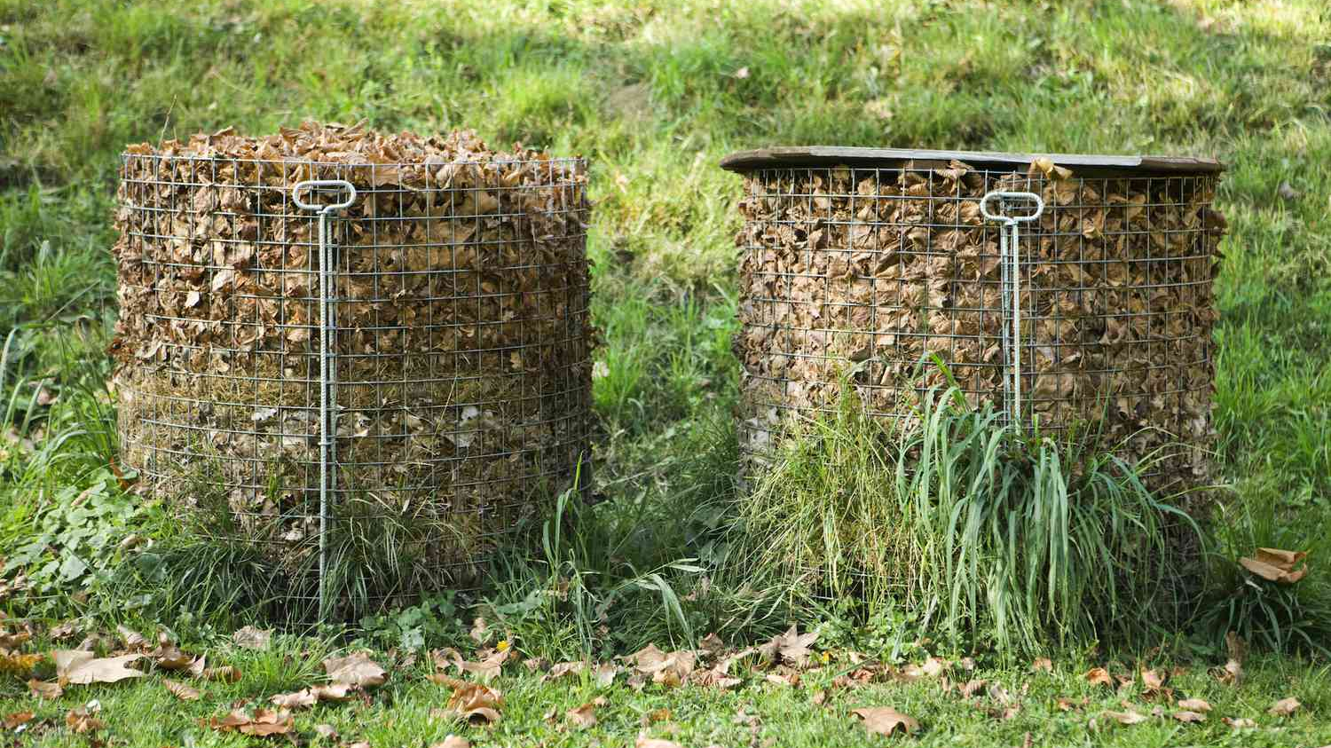
Leaf Mold: the Bin Method
Easy & plastic-free: 4 garden stakes and some chicken wire to make your leaf bin. A bit of tarp or ply over the top helps to manage moisture levels. What you want is moist - not sodden later with rain and sleet.
Hammer in the stakes, staple, nail or tie in the chicken wire walls and pile in your gathered leaves – a quick squirt of the hose and it is on to the waiting game. Now you can speed the process with a turn or two in autumn and again in winter (unless it’s just become a home to some overwintering hedgehogs).
Tip: thick leaves like sycamore, walnut, horse chestnut and sweet chestnut need to be shredded before adding to the leaf mold pile, as they are much slower to break down.

Slide 29
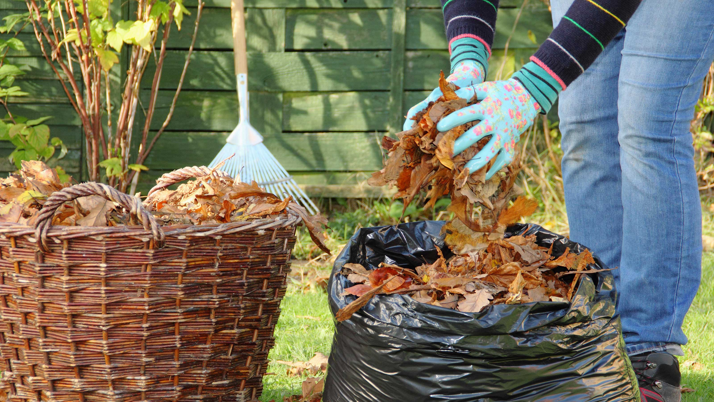
Leaf mold: The Bag Method
Rake up and bag the leaves from the side of the road/path — making sure to not include any people litter (cans, cigarette butts, food wrappers) — and tip the mowers’ collection bag into a bin liner. Add enough water to moisten the leaves (decomposition needs a moisture layer to really fire up the fungal activation).
Once moistened, tie the bag at the top. Place in a corner of the garden, puncture a few holes for airflow. Give it a shake or an invert every month – to get air in and keep breakdown potential going.

Slide 30
Talk to the caretaker at your school (and your family at home).
Explain what you’ve learned about leaf mold and what you would like to do.
Listen to their concerns and offer solutions.
Ask them for help. It is fun to work together, plus you want to bring them along!

Slide 31
3
Share what you have done
by Nov 17th
1
2
3
Upload your data to the GLOBE database!
Tell your story:
Display your work on your school board
Present at school assembly
Create a post for your school social media or school newsletter
Post on the GLOBE Europe Padlet here
Email your work to globe@eeu.antaisce.org by November 17th for a chance to represent Ireland at the GLOBE Europe student presentations (online event on November 29th)!
Get people’s attention with Song, Drama, Storytelling, Poetry, Video, A Halloween Costume or Science poster.
Include a Call-for-Action!

Slide 32
To finish: email globe@eeu.antaisce.org to confirm that you’ve completed this teacher training. We will unlock your ability to upload Green-Down data to the GLOBE database.

