Slide 1
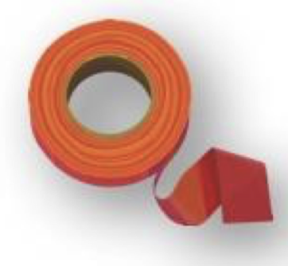
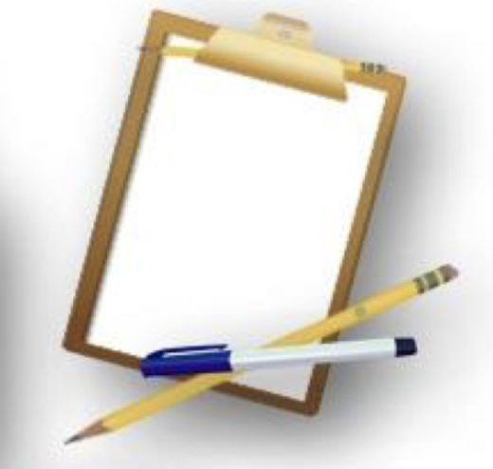
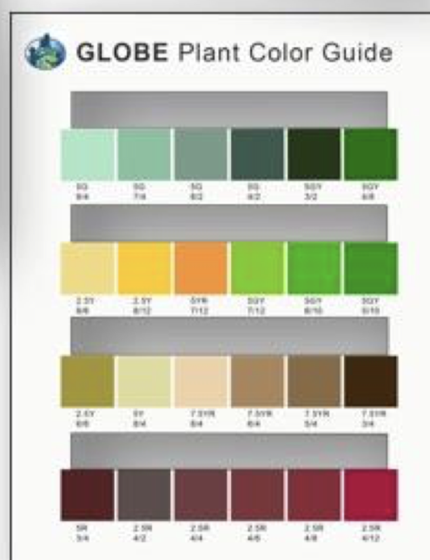
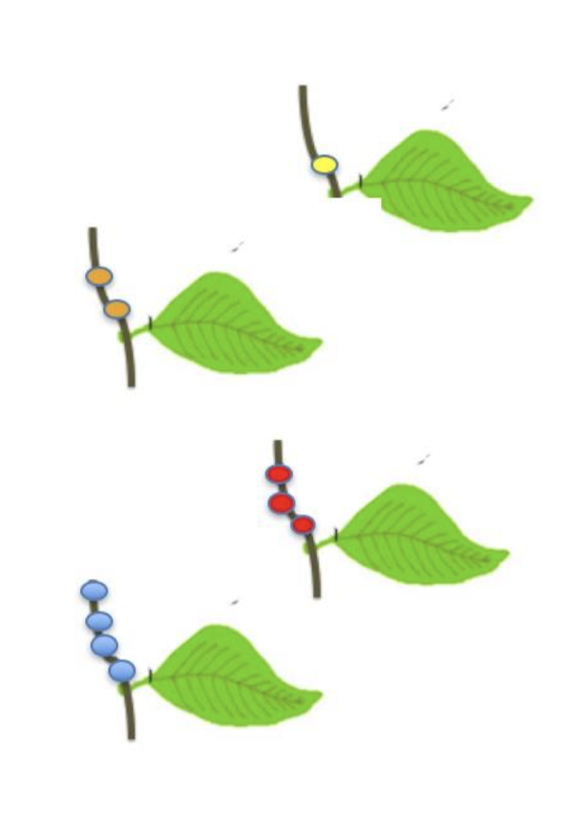
Date ______________________
Your name _____________________
Tree name ________________
Adopt your leaves
Instructions:
1. Gather your supplies:
A brightly coloured piece of ribbon or yarn
White out, puffy paint or a permanent marker
GLOBE Plant Colour Guide
GLOBE Green-down Data Sheet (see next activity)
Pencil
2. Choose 1-3 trees that you would like to observe.
3. For each tree, choose a branch that you can reach and tie a ribbon around the branch, four leaves up from the end.
4. Mark each leaf, starting at the tip of the branch. Use the whiteout, puffy paint or permanent marker to put one dot on the branch next to the first leaf. Put 2 dots on the branch next to the second leaf, 3 dots next to the third, and 4 dots next to the fourth leaf.
5. You have adopted your 4 leaves!
6. You will keep track of these leaves and see how they change.
Credit: GLOBE Grandma series for primary grades, Arctic and Earth SIGNs project. C. Villano

